Slide 1
Guidance for Clinicians Wondering Whether HRQOL of an Individual Patient has Changed
Ron D. Hays, Ph.D.
October 24, 2023 (9:00-10:00 am)
PROMIS Health Organization Annual Meeting
Banff, Canada

Slide 2
Basic Premises and Terminology
Statistically significant group mean difference may be trivial
  MCID: Minimal or minimally clinically important difference
    MID: Minimal or minimally important difference
    MIC: Minimal or minimally important change
  Meaningful change
    An obviously important difference
Individual change significant at p <.05 is always important
  Coefficient of repeatability
  Minimally detectable change
  Smallest real difference
  Smallest detectable change

Slide 3
Health-Related Quality of Life (HRQOL) Uses
Research: Randomized clinical trials and observational studies
Quality improvement
Public reporting (e.g., CDC)
Certification and recognition (NCQA)
Value-based purchasing

Slide 4
Health-Related Quality of Life (HRQOL) Uses
Research: Clinical trials and observational studies
Quality improvement
Public reporting
Certification and recognition
Value-based purchasing

Slide 5

Obstacles to Health Status Assessment in Ambulatory Settings
How to fit it into brief patient encounters?
When do I measure it?
What do I do with the information?
What difference does it make?
Wasson, Keller, Rubenstein et al. (1992), Medical Care

Slide 6
“Implementing patient-reported outcomes assessment in clinical practice: a review of the options and considerations”
  HRQOL
    is increasingly collected in a standardized fashion in routine clinical practice.
    improves patient-clinician communication
    may improve HRQOL
      Velikova et al. (2004, J Clin Oncol)
      Basch et al., (2017, JAMA)
Snyder, C.F., Aaronson, N. K., et al. (2012). Quality of Life Research, 21, 1305-1314.

Slide 7
Is Receiving Better Technical Quality of Care Bad for Health?
Change in SF-12 PCS regressed on process-of-care aggregate
Hypothesized positive effect, but regression coefficient was in the WRONG DIRECTION and not statistically significant:
unstandardized beta = -1.41, p =.188
Kahn et al. (2007), Health Services Research, Article of Year
Process
of care
SF-12 PCS

Slide 8
Individual Change in HRQOL
Research: Clinical trials and observational studies
  Supplement group mean differences
  But is rarely reported.

Slide 9
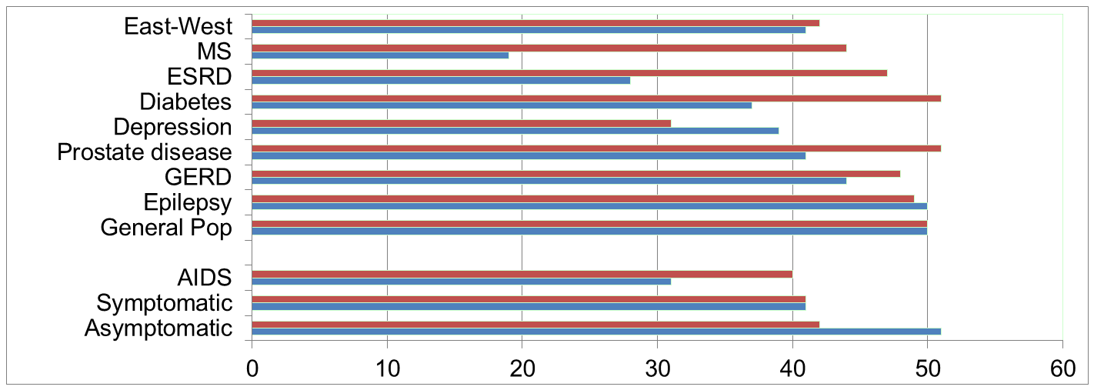
Physical Functioning (PF) and Emotional Well-Being (EWB) at Baseline for 54 Patients at UCLA-Center for East West Medicine
SF-36 EWB
SF-36 PF
MS = multiple sclerosis; ESRD = end-stage renal disease; GERD = gastroesophageal reflux disease.
Hays, R. D., Brodsky, M., Johnston, M. F., Spritzer, K. L., & Hui, K. (2005). Evaluating the statistical significance of health-related quality of life change in individual patients. Evaluation and the Health Professions, 28, 160-171.
9

Slide 10
Significant Mean improvement 6-weeks later in all but 1 SF-36 Scale
Change
t-test
prob.
PF-10
1.7
2.38
.0208
RP-4
4.1
3.81
.0004
BP-2
3.6
2.59
.0125
GH-5
2.4
2.86
.0061
EN-4
5.1
4.33
.0001
SF-2
4.7
3.51
.0009
RE-3
1.5
0.96
.3400
EWB-5
4.3
3.20
.0023
PCS
2.8
3.23
.0021
MCS
3.9
2.82
.0067
Change is in T-score metric.

Slide 11
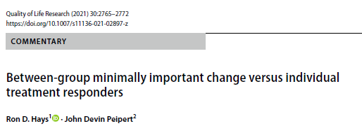
Minimally important change (MIC) should not be used to identify responders to treatment
Underestimates the amount of change needed to be significant at the individual level due to larger measurement errors for individual change scores.

Slide 12
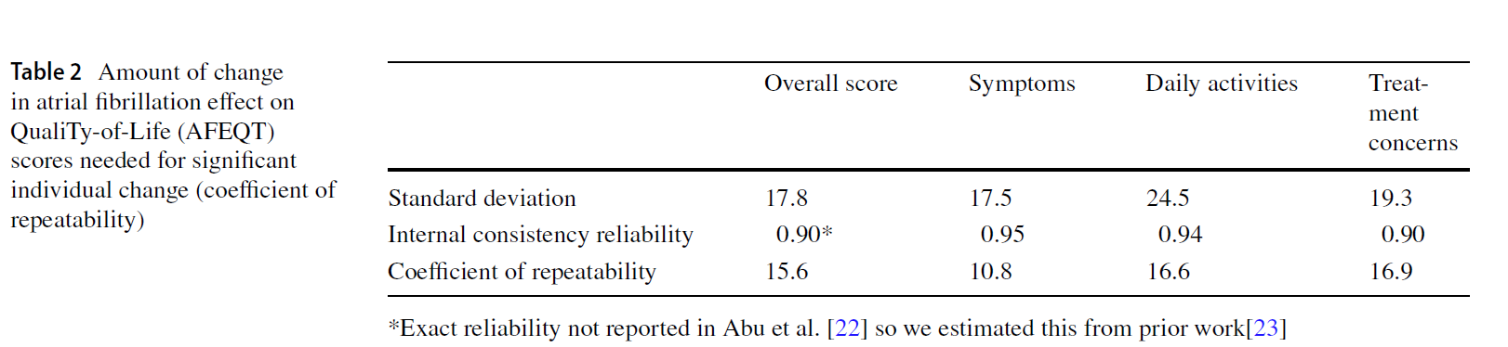

Abu et al. (2020) used MIC threshold of 5 as cutoff to identify if patients changed on the Atrial Fibrillation Effect QualiTy-of-Life (AFEQT) Questionnaire
Abu HO, Saczynski JS, Mehawej J, Tisminetzky M, Kiefe CI, et al. 2020. J Am Heart Assoc. 9(18):e016651

Slide 13
What are the Minimum Clinically Important Differences in SF-36 Scores in Patients with Orthopaedic Oncological Conditions?
310 orthopedic oncology patients underwent musculoskeletal surgery
  < 6 months (time 1) and 1-2 years (time 2) after surgery
Distribution-based MIC “estimates” for PCS and MCS
  Half SD (5 for both)
  Standard error of measurement (6 for PCS and 5 for MCS)
Anchor-based estimates for PCS and MCS
  Compared to when you last completed the questionnaire, is your musculoskeletal condition much better, somewhat better, about the same, somewhat worse, or much worse?
  4 for improvement (PCS and MCS)
Ogura et al. (2020). Clinical Orthopaedics and Related Research, 478: 2148-2158.

Slide 14

What are the MCIDs for PROMIS, NDI, and ODI instruments among patients with spinal conditions?
Median estimated MCID was 8 for PROMIS physical function
  Hung et al. (2018, Clin Orthop Relat Res) estimated minimum detectable change
Goldstein et al. (2015) also erroneously referred to significant individual change as the minimum clinically important change.

Slide 15
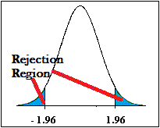
Identifying “Responders”: Reliable Change Index (RCI)
>= 1.96
SEM = standard error of measurement
SD_{bl} = standard deviation at baseline
r_{xx} = reliability

Slide 16
Amount of Change in Individual’s Score for Statistical Significance (p <.05)
= 2.77 *
SD
∗
1
−
r
= 2.77 * SEM
xx
“Coefficient of repeatability” (aka “minimally detectable change,” “smallest real difference,” and “smallest detectable change”).
Note: SD = standard deviation and r_{xx} = reliability

Slide 17
Individual T-Score Change Needed for p < .05 Significance at .90 and .95 Reliability
CR = Coefficient of Repeatability (minimally detectable change, smallest real difference, smallest detectable change)

Slide 18
Effect Sizes for Mean SF-36 Score Changes
Effect Size
_{ES = 0.20 Small}
_{ES = 0.50 Medium}
_{ES = 0.80 Large}
0.13
0.35
0.35
0.21
0.53
0.36
0.11
0.41
0.24
0.30
PFI = Physical Functioning; Role-P = Role-Physical; Pain = Bodily Pain; Gen H=General Health; Energy = Energy/Fatigue; Social = Social Functioning; Role-E = Role-Emotional; EWB = Emotional Well-being; PCS = Physical Component Summary; MCS =Mental Component Summary.

Slide 19
Effect Sizes for Mean SF-36 Score Changes
Effect Size
_{ES = 0.20 Small}
_{ES = 0.50 Medium}
_{ES = 0.80 Large}
0.13
0.35
0.35
0.21
0.53
0.36
0.11
0.41
0.24
0.30
.67 .72 1.01 1.13 1.33 1.07 0.71 1.26 .62 .73
PFI = Physical Functioning; Role-P = Role-Physical; Pain = Bodily Pain; Gen H=General Health; Energy = Energy/Fatigue; Social = Social Functioning; Role-E = Role-Emotional; EWB = Emotional Well-being; PCS = Physical Component Summary; MCS =Mental Component Summary.

Slide 20
7-31% of People in Sample Improved Significantly
% Improving
% Declining
Improving - Declining
PF-10
13%
2%
+ 11%
RP-4
31%
2%
+ 29%
BP-2
22%
7%
+ 15%
GH-5
7%
0%
+ 7%
EN-4
9%
2%
+ 7%
SF-2
17%
4%
+ 13%
RE-3
15%
15%
0%
EWB-5
19%
4%
+ 15%
PCS
24%
7%
+ 17%
MCS
22%
11%
+ 11%

Slide 21

IRT Reliable Change Index (IRT)
$$\frac{X_{2}−X_{1}}{SQRT(SEb2+SEf2) }$$
SE_{b}² = Variance at baseline, SE_{f}² = Variance at follow-up
Jabrayilov et al. (2016). Applied Psychological Measurement

Slide 22
Different Change Categories in Observational Study of Chronic Low Back and Neck Pain Patients Getting Chiropractic Care (Baseline to 3 Months Later)
PROMIS Scale | Worse | Same | Better
Physical Function | 3% | 91% | 6%
Significant according to IRT standard errors and two-tailed (p < .05) test.
Hays, Spritzer & Reise, (2023). Psychometrika

Slide 23



Slide 24



Slide 25

Individual Change in HRQOL
Quality improvement
  Individual patient monitoring

Slide 26

Use of HRQOL Measures in Clinical Practice
IDEAL
  Identify/elicit the problem
  Discuss/co-create planned actions
  Enact action(s)
  Action(s)
  Learn about the effects

Slide 27
Reliability Target for Individual Assessment
0.90 or above
    SE = SD (1- reliability)^{1/2}
    Reliability = 1 – (SE/10)²
Reliability = 0.90 when SE = 3.2
  95% CI = true score +/- 1.96 x SE
  (observed score = true score if = mean)

Slide 28
PROMIS CAT Report

Slide 29
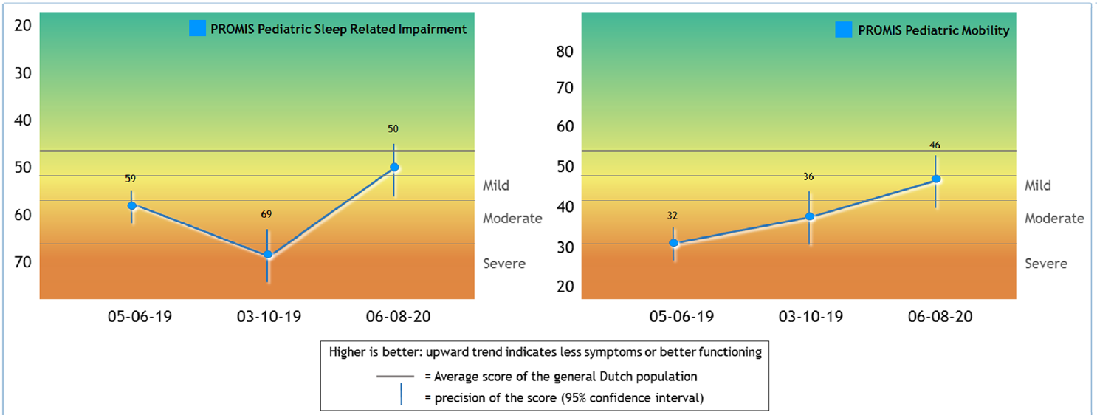
van Muilekom et al. (2021)

Slide 30

Likely Change
Donaldson, 2008, QLR
  Suggested relaxing .05 p-value because it misclassifies patients who feel they have changed.
Peipert et al. 2023, QLR
  .32 p-value corresponded more closely than .05 to mean change for those who were a little or lot better (worse).

Slide 31
T-Score Change Needed for Statistical Significance

Slide 32

Meaningful individual change
Patient-Reported Outcome Measures: Use in Medical Product Development to Support Labeling Claims (2009)
Incorporating Clinical Outcome Assessments into Endpoints for Regulatory Decision-Making (December 6, 2019, patient-focused drug development guidance public workshop)
Focuses on average change for patients who improved or got worse.
“Another anchor-based approach to defining responders makes use of patient ratings of change administered at different periods of time or upon exit from a clinical trial. These numerical ratings range from worse to the same and better. The difference in the PRO score for persons who rate their condition the same and better or worse can be used to define responders to treatment” (p. 25).

Slide 33
Meaningful Change on the ISS
Impact Stratification Score (ISS) assessed at baseline and 6 weeks
  750 active-duty U.S. military with low back pain treated with usual care alone or usual care plus chiropractic
ISS reliability = 0.92, SD = 8.5
  Coefficient of repeatability = 8 for p<.05
Compared to your first visit, your low back pain is:
  1: A little better, Moderately better, Much better, or Completely gone
  2: Moderately better, Much better, or Completely gone
Optimal cut-point = 6 (for #1 above) and 8 (for #2 above)
Hays & Peipert, 2021, Quality of Life Research

Slide 34
T-Score Change Needed for Statistical Significance

Slide 35
6-Week Change in Impact Stratification Score in 750 active-duty U.S. military with low back pain treated with usual care alone or usual care plus chiropractic
59% reported retrospectively that they were a little better, moderately better, much better, or their pain was completely gone post-baseline.
37% had a statistically significant (p <.05) improvement.
Improved statistically
No
No
Yes
Yes
Reported Being Better
Yes
No
Yes
No
Hays & Peipert (2021)

Slide 36

Another Consideration in Assessing Individual Change: Where One Ends Up
A primary care physician might be interested in whether a patient ends up within the normal blood pressure range following initiation of high blood pressure medicine.
A rehabilitation clinician might want to know if a patient with impaired physical functioning at the beginning of treatment ends up functioning as well as other people with a similar condition.

Slide 37
Person Fit
Person misfit may be suggestive of response carelessness or cognitive errors due to survey items being difficult to comprehend….
Person fit using the standardized Z(L) fit index.
Large negative Z(L) values indicate unlikely response patterns given the model.
On PROMIS physical functioning item bank someone reported
A little difficulty being out of bed most of the day.
&
Able to run 5 miles without any difficulty
Reise (1990); Hays, Calderón et al. (2018)

Slide 38

Multiple Observations Are Ideal
But the number recommended is large
  10+ per subject
    Borckardt et al. (2008), American Psychologist
  15 per subject
    Moinpour et al. (2017),Quality of Life Research
See critique of RCI
  “When (Not) to Rely on the Reliable Change Index”
    https://osf.io/3kthg

Slide 39

Recommendations for Your Patients
Evaluate the statistical significance of individual change at multiple p-values (.05, .10, .32).
Combine statistical significance with the patient’s perception of change
  Definitely improved statistically
    Patient felt they improved (retrospectively)
    Patient felt they did not improve
  Probably improved statistically
    Patient felt they improved
    Patient felt they did not improve
  Stayed the same statistically
    Patient felt they improved
    Patient felt they did not improve
    Patient felt they got worse
  Probably got worse
    Patient felt they got worse
    Patient felt they did not get worse
  Definitely got worse
    Patient felt they got worse
    Patient felt they did not get worse

Slide 40



