Slide 1

Patient Reports about their
Health Care and Health
Ron D. Hays, Ph.D
UCLA Center for East-West Medicine
May 14, 2018
10:00-12:00 noon (Geffen Hall 207)

Slide 2
Disclosures
Professor, UCLA Department of Medicine, Division of General Internal Medicine and Health Services Research (drhays@ucla.edu)
Research funding from
  Agency for Healthcare Research and Quality(AHRQ) for Consumer Assessment of Healthcare Providers and Systems (CAHPS®) project
  National Cancer Institute (NCI) for Patient-Centered Assessment Resource (PCAR)

Slide 3
Concerns About US
Health Care System
Access to care
  ~ 50 million people uninsured before Affordable Care Act
  ~ 32 million people uninsured after Affordable CareAct
Cost of care
  ~ $ 2.7 Trillion
Effectiveness (quality) of care
  Not all needed care is delivered
  Not all care delivered is beneficial

Slide 4

Quality of care measurement
Focus has been on expert consensus about clinical process
Variant of RAND Delphi Method

Slide 5
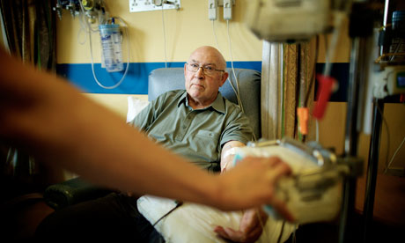
Quality of care measurement
But how patients perceive their care is also important
Patient reports about care are used to assess the patient’s experiences.
Focus has been on expert consensus about clinical process
Variant of RAND Delphi Method

Slide 6
Consumer Assessment of Healthcare Providers and Systems (CAHPS®) Approach
Focus on what patients want to know about AND can accurately report about
  Communication with health care provider
  Access to care
  Staff courtesy and respect

Slide 7
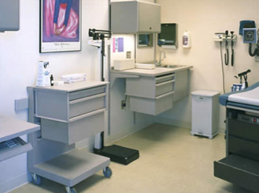
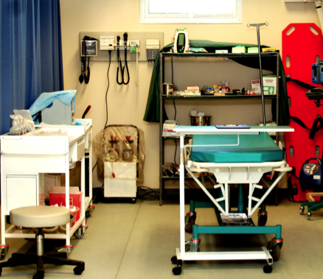
CAHPS has a family of surveys
Ambulatory Care
  Clinician & Group Survey
  Dental Plan Survey
  ECHO® Survey
  Health Plan Survey
  Home Health Care Survey
  Surgical Care Survey
Facility
  Hospital Survey
  Nursing Home Survey
  In-Center Hemodialysis Survey

Slide 8
CAHPS Medicare
Survey Composites
Communication
(4 items)
Getting needed care
(2 items)
Getting care quickly
(3 items)
Customer Service
(3 items)
In the last 6 months, how often did your personal doctor explain things in a way that was easy to understand? [Never; Sometimes; Usually; Always]
In the last 6 months, how often was it easy to get the care, tests or treatment you needed?
In the last 6 months, when you needed care right away, how often did you get care as soon as you needed? [Never; Sometimes; Usually; Always]
In the last 6 months, how often did your health plan’s customer service give you the information or help you needed? [Never; Sometimes; Usually; Always]
[Never; Sometimes; Usually; Always]

Slide 9
CAHPS Medicare Survey 2012
Care Coordination Items (n = 266,466)
Personal doctor:
  has medical records or other information about your care during visits
  talks about all medicines you are taking
  informed and up-to-date about care from specialists
  helps manage care from providers and services
  follows up on test results

Slide 10
Analyses
Categorical confirmatory factor analysis
  Patient-level and multi-level (patient and plan)
  Comparative Fit Index (CFI) > 0.95
  Root Mean Square Error of Approximation (RMSEA) < 0.06
Reliability >= 0.70
  Internal consistency (coefficient alpha)
  Plan-level reliability

Slide 11
Confirmatory Factor Analyses
Good fit for patient-level CFA
  CFI = 0.996
  RMSEA = 0.020
Good fit for multi-level CFA
  CFI = 0.997
  RMSEA = 0.014

Slide 12
Standardized Factor Loadings
 | Within-Level | Between-Level
Has medical records | 0.72 (0.73) | 0.86
Talks about medicines | 0.65 (0.64) | 0.58
Informed and up-to-date | 0.70 (0.68) | 0.49
Helps manage care | 0.71 (0.73) | 0.97
Follow-up on test results | 0.71 (0.70) | 0.72
Loadings from patient-level CFA shown within parentheses. Multi-level
CFA loadings are the other numbers.

Slide 13
Reliability
Internal consistency (alpha) = 0.70
Plan-level
  ICC = 0.022 at plan level
  Number of patients needed to obtain
    0.70 reliability = 102
    0.80 reliability = 170

Slide 14
Regress Global Rating on Composites
Using any number from 0 to 10, where 0 is the worst personal doctor possible, and 10 is the best personal doctor possible, what number would you use to rate your personal doctor?
□ 0 Worst personal doctor possible
□ 1
□ 2
□ 3
□ 4
□ 5
□ 6
□ 7
□ 8
□ 9
□ 10 Best personal doctor possible

Slide 15
Regression of Global Rating of Personal
Doctor on CAHPS Composites
Composite | Standardized Beta
Communication | 0.62
Care Coordination | 0.17
Getting Care Quickly | 0.03
Getting Needed Care | 0.01
Customer Service | -.002 (ns)
(R² = 0.56)

Slide 16
Implications
Because the care coordination composite has satisfactory reliability and is uniquely associated with the global rating of the personal doctor:
Center for Medicare & Medicaid Services now
  Reports care coordination to patients and health plans
  Uses it in Quality Bonus Payments to Managed Care Plans
Need to examine:
  How it is related to other ways of assessing care coordination such as work flow, scheduling and documentation rated by external observers.

Slide 17
CERC: ~1800 chiropractic patients with chronic low back or neck pain. C-G CAHPS: 137,416 respondents from 656 practice sites in the 2016 CAHPS database.
Notes:
Slide 41
Here we compare the 4 CAHPS communication items and the overall rating of provider item for the 1800 CERC patients vs. 137,416 respondents from 656 practice sites included in the 2016 CAHPS database. The CAHPS Clinician and Group Survey is administered using a 6-month reporting window whereas we used a 3-month reporting window in this study to cover the time between baseline and the 3-month follow-up. Responses to corresponding communication items are very similar but 6% more of the database sample than the chiropractic sample provided the most response to time spent with provider. In addition, 8% more of the database sample rated their provider a 10, the most positive score.

Slide 18
How Do We Know If Health
Care Is Effective?
Effective care maximizes probability of desired outcomes
Outcomes are markers of whether or not care is effective

Slide 19
Traditional Clinical Outcomes
Survival
Disease occurrence, complications, other adverse events
Clinical measures/biological indicators
    Blood pressure
    Blood hemoglobin level
    Symptoms (e.g. fever, night sweats)

Slide 20

Health-Related
Quality of Life (HRQOL)
What the person can DO (functioning)
Self-care
Role
Social
How the person FEELs (well-being)
Emotional well-being
Pain
Energy

Slide 21
Health-Related Quality of Life (HRQOL)
Quality of environment
Type of housing
Level of income
Social Support

Slide 22
In general, how would you rate your health?
Excellent
Very Good
Good
Fair
Poor

Slide 23
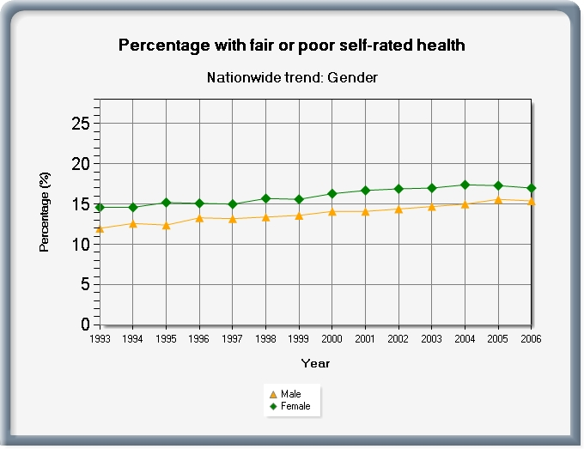
Greater % of fair or poor health reported
by females (17%) than males (15%)

Slide 24
Does your health now limit you in walking more than a mile?
(If so, how much?)
Yes, limited a lot
Yes, limited a little
No, not limited at all

Slide 25
How much of the time during the past 4 weeks have you been happy?
None of the time
A little of the time
Some of the time
Most of the time
All of the time

Slide 26
Physical Functioning and Emotional Well-Being at Baseline for 54 Patients at UCLA-Center for East West Medicine
Mental
Physical
MS = multiple sclerosis; ESRD = end-stage renal disease; GERD = gastroesophageal reflux disease.
26

Slide 27

Physical Functioning and Emotional Well-Being at Baseline for 54 Patients at UCLA-Center for East West Medicine
Mental
Physical
MS = multiple sclerosis; ESRD = end-stage renal disease; GERD = gastroesophageal reflux disease.
27

Slide 28
Significant Improvement in all but 1 of SF-36 Scales (Change is in T-score metric)
Change
t-test
prob.
PF-10
1.7
2.38
.0208
RP-4
4.1
3.81
.0004
BP-2
3.6
2.59
.0125
GH-5
2.4
2.86
.0061
EN-4
5.1
4.33
.0001
SF-2
4.7
3.51
.0009
RE-3
1.5
0.96
.3400
EWB-5
4.3
3.20
.0023
PCS
2.8
3.23
.0021
MCS
3.9
2.82
.0067

Slide 29
Effect Size
(Follow-up – Baseline)/ SD_{baseline}
_{Cohen’s Rule of Thumb:}
_{ES = 0.20 Small}
_{ES = 0.50 Medium}
_{ES = 0.80 Large}

Slide 30
Effect Sizes for Changes in SF-36 Scores
Effect Size
0.13
0.35
0.35
0.21
0.53
0.36
0.11
0.41
0.24
0.30
PFI = Physical Functioning; Role-P = Role-Physical; Pain = Bodily Pain; Gen H=General Health; Energy = Energy/Fatigue; Social = Social Functioning; Role-E = Role-Emotional; EWB = Emotional Well-being; PCS = Physical Component Summary; MCS =Mental Component Summary.
0.11 0.13 0.21 0.24 0.30 0.35 0.35 0.36 0.41 0.53

Slide 31
Defining a Responder: Reliable Change Index (RCI)
Note: SD_{bl} = standard deviation at baseline
r_{xx} = reliability

Slide 32
Significant Individual Change at p<0.05
> = 1.96

Slide 33
Amount of Change in Observed Score Needed To be Statistically Significant
2.77 * SD_{bl} * SQR (1- r_{xx})
“Coefficient of reproducibility”
Note: SD_{bl} = standard deviation at baseline and r_{xx} = reliability

Slide 34
How Reliability Relates to Amount of Individual Change Needed
Reliability | SQR (1- r_{xx}) | Change Needed
0.70 | 0.55 | 1.5 SD
0.80 | 0.44 | 1.2 SD
0.90 | 0.32 | 0.9 SD
0.95 | 0.22 | 0.6 SD
0.97 | 0.17 | 0.5 SD
2.77 * SQR (1- r_{xx}) * SD_{bl}

Slide 35
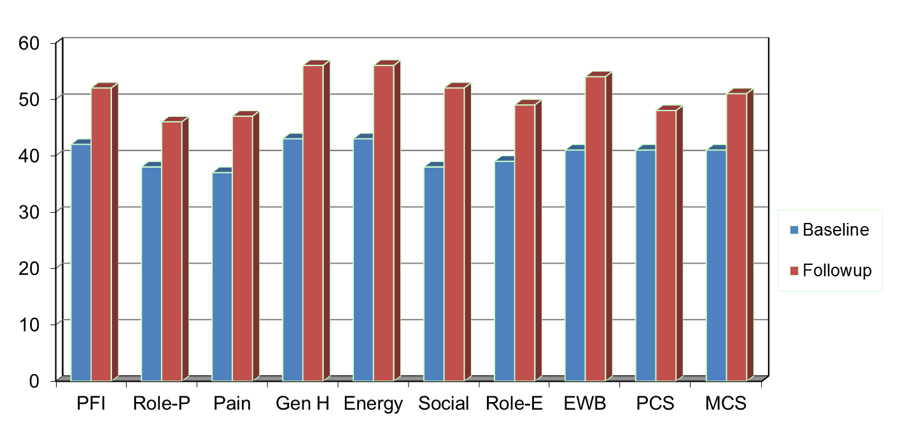
Amount of Change Needed for Significant Individual Change
Effect Size
0.67
0.72
1.01
1.13
1.33
1.07
0.71
1.26
0.62
0.73
PFI = Physical Functioning; Role-P = Role-Physical; Pain = Bodily Pain; Gen H=General Health; Energy = Energy/Fatigue; Social = Social Functioning;
Role-E = Role-Emotional; EWB = Emotional Well-being; PCS = Physical Component Summary; MCS =Mental Component Summary.

Slide 36
7-31% Improve Significantly
% Improving
% Declining
Difference
PF-10
13%
2%
+ 11%
RP-4
31%
2%
+ 29%
BP-2
22%
7%
+ 15%
GH-5
7%
0%
+ 7%
EN-4
9%
2%
+ 7%
SF-2
17%
4%
+ 13%
RE-3
15%
15%
0%
EWB-5
19%
4%
+ 15%
PCS
24%
7%
+ 17%
MCS
22%
11%
+ 11%

Slide 37

PROMIS
Self-report measures for adults and children in the general population and individuals with chronic conditions
T-score metric for U.S. general population (Mean = 50, SD = 10)
http://www.healthmeasures.net/explore-measurement-systems/promis/measure-development-research/promis-international

Slide 38
Observational Study of ~1800 Chiropractic Patients in Treatment for Chronic Low Back or Neck Pain
Notes:
Slide 45
The reliabilities of the PROMIS-29 v2.0 measures in this sample were 0.85 or higher.
Baseline means indicate that the sample of patients with chronic low back pain or neck pain are similar to the U.S. general population on emotional distress and better on social health. But they have worse physical functioning and more pain, fatigue, and sleep disturbance.

Slide 39
Notes:
Slide 46
From baseline to the end of the study 3 months later, we found no change in emotional distress but statistically significant and small improvements on all the other measures.
Note that improvements of about 3 points on the SF-36 summary scores over 3 months due to manipulation were found in the UK BEAM (back pain, exercise, and manipulation) randomized trial.

Slide 40
Notes:
Slide 47
13-30% of the sample got significantly better (“responders”) on the different health measures using the coefficient of reproducibility, which requires a change of at least 2.77 times the SEM, and is equivalent to the Reliable Change Index.

Slide 41
PROMIS Fatigue Across Five Clinical Conditions
Cancer
w/ benefit
(2 mos)
Cancer
Chemo
(B)
N = 310
N = 229
Back Pain
(3 mos)
Back Pain
(1 mo)
Back Pain
(B)
N = 114
Depression
(3 mos)
Depression
(1 mo)
Depression
(B)
N = 64
HF Post-transplant
HF Pre-transplant
Exacerbation to Stable
N = 125
COPD Stable (B)
COPD Exacerbation (B)
35
40
45
50
55
60
65
Average for General Population

Slide 42
Item Responses and
Trait Levels
Person 1
Person 2
Person 3
Trait
Continuum
Item 1
Item 2
Item 3

Slide 43
Computer Adaptive Test (CAT)
Question #1
high
physical
function
3
Question #2
Question #3
2
2
2
1
1
1
0
0
Questionnaire
with a high
precision -
AND a
wide range
- 1
- 2
low
physical
function
- 3
Notes:
Purpose of this slide is to walk the audience through the CAT process using an example …and thereby transmit the message of narrower measurement range and higher precision with each question …
I typically ese e.g. an example for depression, or any other topic I want to focus on … like first question “do you feel depressed”, answer “some of the time” … than we would like to know how depressed and the CAT might choose a question asking about self worth, and if the patient indicates that this is diminished also, a third question asking about thoughts of suicide might be appropriate … in this case the answer would be no, never …
And maybe compare it with another scenario like the participant would have answered the first question, no I am not at all depressed, asking about suicide would not make sense, instead the CAT might have chosen a question asking about happiness … bla bla
The conclusion is, we can make precise test over the entire range …

Slide 44




Who does CATs?

Slide 45
The PROMIS Metric
T Score
  Mean = 50
  SD = 10
  Referenced to US General Pop.
  T = 50 + (z * 10)
www.healthmeasures.net

Slide 46
Reliability Target for Use of
Measures with Individuals
Reliability ranges from 0-1
  0.90 or above is goal
  SE = SD (1- reliability)^{1/2}
  For T-scores
    Reliability = 1 – (SE/10)²
  Reliability = 0.90 when SE = 3.2
  95% CI = true score +/- 1.96 x SE
  (observed score = true score if = mean)
Notes:
T = z*10 + 50

Slide 47
In the past 7 days …
I was grouchy [1st question]
  Never [39]
  Rarely [48]
  Sometimes [56]
  Often [64]
  Always [72]
Estimated Anger = 56.1
SE = 5.7 (rel. = 0.68)

Slide 48
In the past 7 days …
I felt like I was ready to explode
[2nd question]
  Never
  Rarely
  Sometimes
  Often
  Always
Estimated Anger = 51.9
SE = 4.8 (rel. = 0.77)

Slide 49
In the past 7 days …
I felt angry [3rd question]
  Never
  Rarely
  Sometimes
  Often
  Always
Estimated Anger = 50.5
SE = 3.9 (rel. = 0.85)

Slide 50
In the past 7 days …
I felt angrier than I thought I should [4th question]
- Never
  Rarely
  Sometimes
  Often
  Always
Estimated Anger = 48.8
SE = 3.6 (rel. = 0.87)

Slide 51
In the past 7 days …
I felt annoyed [5th question]
  Never
  Rarely
  Sometimes
  Often
  Always
Estimated Anger = 50.1
SE = 3.2 (rel. = 0.90)

Slide 52
In the past 7 days …
I made myself angry about something just by thinking about it. [6th question]
  Never
  Rarely
  Sometimes
  Often
  Always
Estimated Anger = 50.2
SE = 2.8 (rel = 0.92)

Slide 53
PROMIS Preference-based Score
PROMIS-29 Profile v2.0 plus
2 Cognitive Function items
  PC6r: In the past 7 days, I have been able to concentrate. 1=Not at all, 2=A little bit, 3=Somewhat, 4=Quite a bit, 5=Very much
  PC27r: In the past 7 days, I have been able to remember to do things, like take medicine or buy something I needed. 1=Not at all, 2=A little bit, 3=Somewhat, 4=Quite a bit, 5=Very much
DeWitt, B., Feeny, D., Fischoff, B., Cella, D., Hays, R. D., Hess, R., Pilkonis, P., Revicki, D., Roberts, M., Tsevat, J., Lan, Y., & Hanmer, J. (in press). Estimation of a preference-based summary score for the Patient-Reported Outcomes Measurement Information System: The PROMIS®-Preference (PROPr) Scoring System. Medical Decision Making.

Slide 54


Questions?
drhays@ucla.edu (310-794-2294)

Slide 55
References
Brodsky, M., Spritzer, K., Hays, R. D., & Hui, K. (2016). Change in health-related quality of life at group and individual levers over time in patients treated for chronic myofascial neck pain. Journal of Evidence-Based Complementary and Alternative Medicine, 22(3): 365-368
Cella, D., Riley, W., Stone, A., Rothrock, N., Reeve, B., Young, S., Amtmann, D., Bode, R., Buysse, D., Choi, S., Cook, K., DeVellis, R., DeWalt, D., Fries, J. F., Gershon, R., Hahn, E. A., Pilkonis, P., Revicki, D., Rose, M., Weinfurt, K., Lai, J., & Hays, R. D. (2010). Initial item banks and first wave testing of the Patient-Reported Outcomes Measurement Information System (PROMIS) network: 2005-2008. Journal of Clinical Epidemiology, 63 (11), 1179-1194.
Hays, R. D., Brodsky, M., Johnston, M. F., Spritzer, K. L., & Hui, K. (2005). Evaluating the statistical significance of health-related quality of life change in individual patients. Evaluation and the Health Professions, 28, 160-171.
Hays, R. D., Martino, S., Brown, J., Cui, M., Cleary, P., Gaillot, S., & Elliott, M. (2014). Evaluation of a care coordination measure for the Consumer Assessment of Healthcare Providers and System (CAHPS®) Medicare Survey. Medical Care Research and Review, 71, 192-202.

