Slide 1
Health-Related Quality of Life as an Indicator of Quality of Care
Ron D. Hays, Ph.D. (hays@rand.org)
HS216—Quality Assessment: Making the Business Case for Quality
April 12, 2012, 9am-11:30am
RAND Room 1232
http://gim.med.ucla.edu/FacultyPages/Hays/

Slide 2
Students
Cantrock, Lisa
Cassell, Charisse
Danielson, Adam
Hochman, Michael
Jennings, Lee
Moin, Tannaz
Ray, Lhasa
Scales, Charles
Wilkes, Erin
Zimmerman, Ruth

Slide 3
Patient-Reported Measures
Demo-graphics
Technical
Reports
Quality of Care
Behavior
Health
Clinical
Reports

Slide 4
Health-Related Quality of Life is …
What you can do.
Functioning
  Self-care
  Role
  Social
How you feel about your life.
Well-being
  Emotional well-being
  Pain
  Energy

Slide 5
HRQOL Framework
Physical Health
Physical Functioning
Self-Reported Health
Mental Health
Depressive Symptoms
Social Health
Ability to Participate in Social Roles
Social Support
Patient Satisfaction

Slide 6
SF-36® Generic Profile Measure
Functioning
  Physical functioning (10 items)
  Role limitations/physical (4 items)
  Role limitations/emotional (3 items)
  Social functioning (2 items)
Well-Being
  Emotional well-being (5 items)
  Energy/fatigue (4 items)
  Pain (2 items)
  General health perceptions (5 items)

Slide 7
Scoring HRQOL Profile Scales
Average or sum all items in the same scale.
Transform average or sum to
  0 (worse) to 100 (best) possible range
  z-score (mean = 0, SD = 1)
  T-score (mean = 50, SD = 10)

Slide 8
Formula for Transforming Scores
X =
(original score - minimum) *100
(maximum - minimum)
Y
= target mean + (target SD * Zx)
(X - X)
Z_{X} =
SD_{X}

Slide 9
SF-36 online
  http://www.sf-36.org/demos/SF-36v2.html

Slide 10
Generic vs. Disease-Targeted
In general, would you say your health is:
Excellent/ Very good/ Good/ Fair/ Poor?
How much does kidney disease bother you in your ability to work around the house?
Not at all bothered/Somewhat bothered/
Moderately bothered/Very much bothered/ Extremely bothered

Slide 11
KDQOL-36 (24 targeted items)
Items 1-12: SF-12
Items 13-16: Burden of Kidney Disease (4)
Items 17-28: Symptoms/Problems (12)
Items 29-36: Effects of Kidney Disease (8)

Slide 12
Burden of Kidney Disease
My kidney disease interferes too much with my life.
Too much of my time is spent dealing with my kidney disease.
I feel frustrated with my kidney disease
I feel like a burden on my family.

Slide 13
Effects of Kidney Disease
How much does kidney disease bother you in …
Fluid restrictions?
Dietary restriction?
Your ability to work around the house?
Your ability to travel?
Being dependent on doctors and other medical staff?
Stress or worries caused by kidney disease?
Your sex life?
Your personal appearance?

Slide 14
Ultimate Use of HRQOL Measures-
Helping to Ensure Access to
Cost-Effective Care
Cost ↓
Effectiveness ↑

Slide 15
Is New Treatment (X) Better
Than Standard Care (O)?
X
0
X
0
Physical
Health
X > 0
Mental
Health
0 > X

Slide 16
Is Medicine Related to Worse HRQOL?
Medication
Person Use HRQOL (0-100)
1 No dead
2 No dead
3 No 50
4 No 75
5 No 100
6 Yes 0
7 Yes 25
8 Yes 50
9 Yes 75
10 Yes 100
  Group n HRQOL
  No Medicine 3 75
  Yes Medicine 5 50

Slide 17

Survival Analysis
Dead 0.0
Alive 1.0
- Marathoner - Person in coma

Slide 18
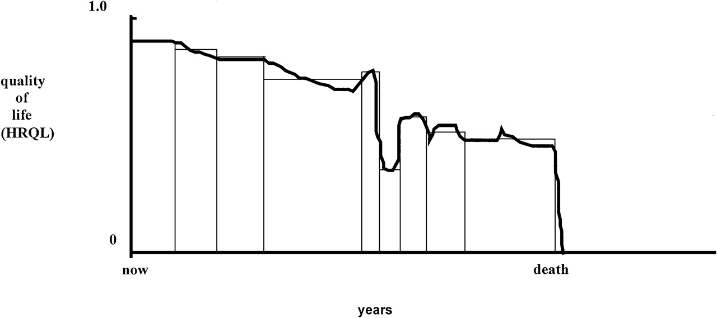
Quality of Life for Individual Over Time

Slide 19
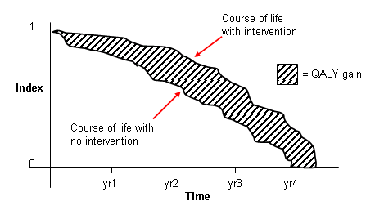
http://www.ukmi.nhs.uk/Research/pharma_res.asp

Slide 20
Direct Preference Measures
Underlying attributes unknown
  Rating Scale
  Standard gamble
  Time tradeoff

Slide 21
Rating Scale
Overall, how would you rate your current health?
(Circle One Number)
0 1 2 3 4 5 6 7 8 9 10
Worst possible
health (as bad or
worse than
being dead)
Half-way
between worst
and best
Best
possible
health

Slide 22
Preference Assessment
http://araw.mede.uic.edu/cgi-bin/utility.cgi

Slide 23
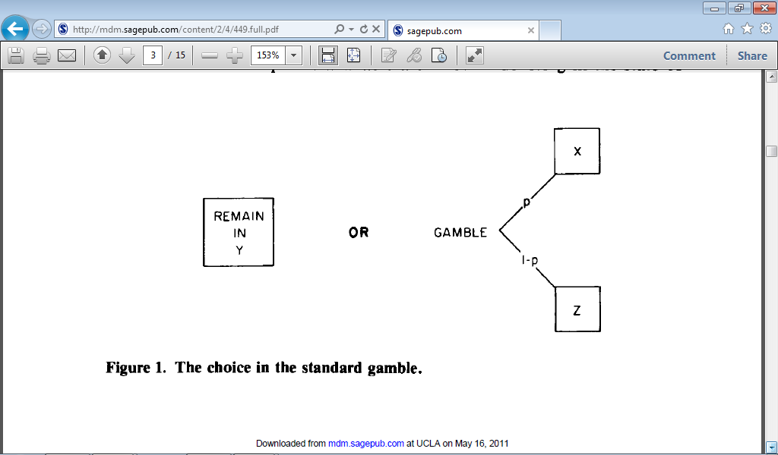
Alternative 1: Certainty of living in given health state y
Alternative 2: Probability of living in full health (x) or immediate death (z)

Slide 25
Indirect Preference Measures
Estimate single score based on knowing health state for person and societal preferences for that health state
  Quality of Well-Being (QWB) Scale
  EQ-5D
  HUI2 and HUI3
  SF-6D

Slide 26
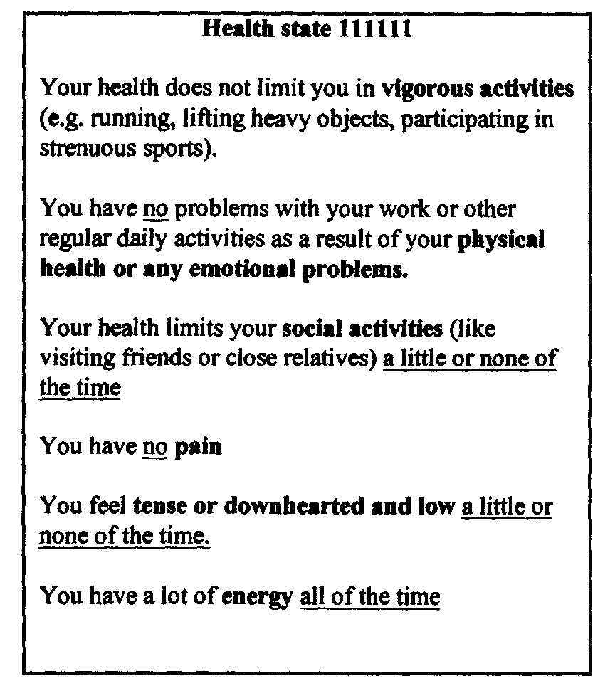
Health State 111111

Slide 27
Health state 424421 (0.59)
Your health limits you a lot in moderate activities (such as moving a table, pushing a vacuum cleaner, bowling or playing golf)
You are limited in the kind of work or other activities as a result of your physical health
Your health limits your social activities (like visiting friends, relatives etc.) most of the time.
You have pain that interferes with your normal work (both outside the home and housework) moderately
You feel tense or downhearted and low a little of the time.
You have a lot of energy all of the time

Slide 28
Correlations Among Indirect
Preference-Based Measures
 | EQ-5D | HUI2 | HUI3 | QWB-SA | SF-6D
EQ-5D | 1.00
HUI2 | 0.71 | 1.00
HUI3 | 0.68 | 0.89 | 1.00
QWB | 0.64 | 0.66 | 0.66 | 1.00
SF-6D | 0.70 | 0.71 | 0.69 | 0.65 | 1.00
Fryback, D. G. et al., (2007). US Norms for Six Generic Health-Related Quality-of-Life Indexes from the National Health Measurement Study. Medical Care, 45, 1162- 1170.

Slide 29
Latent Trait and Item Responses
P(X₁=1)
1
Item 1 Response
P(X₁=0)
0
P(X₂=1)
1
Latent Trait
Item 2 Response
P(X₂=0)
0
P(X₃=0)
0
Item 3 Response
P(X₃=1)
1
P(X₃=2)
2

Slide 30
Item Responses and Trait Levels
Person 1
Person 2
Person 3
Trait
Continuum
Item 1
Item 2
Item 3

Slide 31
PROMIS® http://www.nihpromis.org/
Patient-reported Outcomes Measurement Information System
Item banks measuring patient-reported outcomes
    Computer-adaptive testing (CAT)
    Short-forms
Reliability = 1 – SE² (z-score)
  SE = 0.32 for 0.90 reliability (z-score)
  SE = 3.2 for T-score (mean= 50 & SD = 10)
.

Slide 32
Anger CAT¹ (In the past 7 days )
I was grouchy
  Never
  Rarely
  Sometimes
  Often
  Always
Theta = 56.1 SE = 5.7 (rel. = 0.68)

Slide 33
²In the past 7 days …
I felt like I was ready to explode
  Never
  Rarely
  Sometimes
  Often
  Always
Theta = 51.9 SE = 4.8 (rel. = 0.77)

Slide 34
³In the past 7 days …
I felt angry
  Never
  Rarely
  Sometimes
  Often
  Always
Theta = 50.5 SE = 3.9 (rel. = 0.85)

Slide 35
⁴In the past 7 days …
I felt angrier than I thought I should
  Never
  Rarely
  Sometimes
  Often
  Always
Theta = 48.8 SE = 3.6 (rel. = 0.87)

Slide 36
⁵In the past 7 days …
I felt annoyed
  Never
  Rarely
  Sometimes
  Often
  Always
Theta = 50.1 SE = 3.2 (rel. = 0.90)

Slide 37
⁶In the past 7 days …
I made myself angry about something just by thinking about it.
  Never
  Rarely
  Sometimes
  Often
  Always
Theta = 50.2 SE = 2.8 (rel. = 0.92)

Slide 38
Theta and SE estimates
Item 1: 56 and 6
Item 2: 52 and 5
Item 3: 50 and 4
Item 4: 49 and 4
Item 5: 50 and 3
Item 6: 50 and <3

Slide 39
PROMIS Banks
Emotional Distress
  Depression (28)
  Anxiety (29)
  Anger (29)
Physical Function (124)
Pain
  Behavior (39)
  Impact (41)
Fatigue (95)
Satisfaction with Participation in Discretionary Social Activities (12)
Satisfaction with Participation in Social Roles (14)
Sleep Disturbance (27)
Wake Disturbance (16)

Slide 40
Item Response Theory (IRT)
IRT models the relationship between a person’s response Y_{i} to the question (i) and his or her level of the latent construct θ being measured by positing
b_{ik} estimates how difficult it is for the item (i) to have a score of k or more and the discrimination parameter a_{i} estimates the discriminatory power of the item.

Slide 41
IRT Features
Information/reliability
Category response curves
Differential item functioning
Person fit

Slide 42
Information/Reliability
For z-scores (mean = 0 and SD = 1):
  Reliability = 1 – SE² = 0.90 (when SE = 0.32)
  Information = 1/SE² = 10 (when SE = 0.32)
  Reliability = 1 – 1/information
Lowering the SE requires adding or replacing existing items with more informative items at the target range of the continuum.

Slide 43
Posttraumatic Growth Inventory
Indicate for each of the statements below the degree to which this change occurred in your life as a result of your crisis.
(Appreciating each day)
(0) I did not experience this change as result of my crisis
I experienced this change to a very small degree as a result of my crisis
I experienced this change to a small degree as a result of my crisis
I experienced this change to a moderate degree as a result of my crisis
I experienced this change to a great degree as a result of my crisis
I experienced this change to a very great degree as a result of my crisis

Slide 44
Category Response Curves
Appreciating each day.
No change
Very great change
Great change
Moderate change
Small change
Very small change
No Change
Great Change
θ

Slide 45
Category Response Curves (CRCs)
Figure shows that 2 of 6 response options are never most likely to be chosen
    did not, very small, small, moderate, great, very great degree
One or both of the response categories could be dropped or reworded to improve the response scale

Slide 46
Or have scoring implications
CAHPS global rating items
  0 = worst possible
  10 = best possible
11 response categories capture about 3 levels of information.
  10/9/8-0 or 10-9/8/7-0
Scale is administered as is and then collapsed in analysis

Slide 47
Differential Item Functioning (DIF)
Probability of choosing each response category should be the same for those who have the same estimated scale score, regardless of their other characteristics
Evaluation of DIF
  Different subgroups
  Mode differences

Slide 48
Differential Item Functioning
(2-Parameter Model)
AA
White
White
Slope DIF
Location DIF
AA
48
Location = uniform; Slope = non-uniform
Notes:
48

Slide 49
Person Fit
Large negative Z_{L} values indicate misfit.
Person responded to 14 items in physical functioning bank (Z_{L} = -3.13)
  For 13 items the person could do the activity (including running 5 miles) without any difficulty.
  However, this person reported a little difficulty being out of bed for most of the day.

Slide 50
Unique Associations with
Person Misfit
Misfit
Longer response time
Younger age
More chronic conditions
<HS
Non-white

Slide 51
Time to complete item
3-5 items per minute rule of thumb
  8 items per minute for dichotomous items
Polimetrix panel sample
  12-13 items per minute (automatic advance)
  8-9 items per minute (next button)
6 items per minute among UCLA Scleroderma patients

Slide 52
Language DIF Example
Ordinal logistic regression to evaluate differential item functioning
  Purified IRT trait score as matching criterion
  McFadden’s pseudo R² >= 0.02
Thetas estimated in Spanish data using
  English calibrations
  Linearly transformed Spanish calibrations (Stocking-Lord method of equating)

Slide 53
Lordif
http://CRAN.R-project.org/package=lordif
Model 1 : logit P(u_{i} >= k) = α_{k} + β₁ * ability
Model 2 : logit P(u_{i} >= k) = α_{k} + β₁ * ability + β₂ * group
Model 3 : logit P(u_{i} >= k) = α_{k} + β₁ * ability + β₂ * group + β₃ * ability * group
DIFF assessment (log likelihood values compared):
- Overall: Model 3 versus Model 1
Non-uniform: Model 3 versus Model 2
Uniform: Model 2 versus Model 1

Slide 54
Results
One-factor categorical model fit the data well (CFI=0.971, TLI=0.970, and RMSEA=0.052).
  Large residual correlation of 0.67 between “Are you able to run ten miles” and “Are you able to run five miles?”
50 of the 114 items had language DIF
  16 uniform
  34 non-uniform

Slide 55
Impact of DIF on Test
Characteristic Curves (TCCs)

Slide 56
Stocking-Lord Method
Spanish calibrations transformed so that their TCC most closely matches English TCC.
a* = a/A and b* = A * b + B
Optimal values of A (slope) and B (intercept) transformation constants found through multivariate search to minimize weighted sum of squared distances between TCCs of English and Spanish transformed parameters
  Stocking, M.L., & Lord, F.M. (1983). Developing a common metric in item response theory. Applied Psychological Measurement, 7, 201-210.

Slide 57
CAT-based Theta Estimates Using English
(x-axis) and Spanish (y-axis) Parameters for 114 Items in Spanish Sample
(n = 640, ICC = 0.89)

Slide 58
CAT-based Theta Estimates Using English
(x-axis) and Spanish (y-axis) Parameters for 64 non-DIF Items in Spanish Sample
(n = 640, ICC = 0.96)

Slide 59

Questions?
Notes:
59

