Slide 1

Primer on Evaluating Reliability and Validity of Multi-Item Scales
Questionnaire Design and Testing Workshop
October 25, 2013, 3:30-5:00pm
10940 Wilshire Blvd. Suite 710
Los Angeles, CA
Notes:
1

Slide 2

www.nihpromis.org
Patient Reported Outcomes Measurement Information System (PROMIS®)
Funded by the National Institutes of Health
One domain captured is “anger”
  Mood (irritability, frustration)
  Negative social cognitions (interpersonal sensitivity, envy, disagreeableness)
  Needing to control anger

Slide 3
Item Responses and Trait Levels
Person 1
Person 2
Person 3
Trait
Continuum
Item 1
Item 2
Item 3
www.nihpromis.org

Slide 4
Standard Error of
Measurement (SEM)
SEM = SD (1- reliability)^{1/2}
95% CI = true score +/- 1.96 x SEM
  If z-score = 0 and reliability = 0.90
  CI: -.62 to +.62 (width is 1.24 z-score units)
Notes:
4

Slide 5
Reliability (0-1)
0.70 or above for group comparisons
0.90 or above for individual assessment
z-scores (mean = 0 and SD = 1):
  Reliability = 1 – SE²
  So reliability = 0.90 when SE = 0.32
T-scores (mean = 50 and SD = 10):
  Reliability = 1 – (SE/10)²
  So reliability = 0.90 when SE = 3.2
T = 50 + (z * 10)
Notes:
T = z*10 + 50

Slide 6
In the past 7 days …
I was grouchy [1st question]
  Never [39]
  Rarely [48]
  Sometimes [56]
  Often [64]
  Always [72]
Theta = 56.1 SE = 5.7 (rel. = 0.68)
Notes:
Never: 39
Rarely: 48
Sometimes = 56
Often = 64
Always = 72

Slide 7
In the past 7 days …
I felt like I was ready to explode
[2nd question]
  Never
  Rarely
  Sometimes
  Often
  Always
Theta = 51.9 SE = 4.8 (rel. = 0.77)

Slide 8
In the past 7 days …
I felt angry [3rd question]
  Never
  Rarely
  Sometimes
  Often
  Always
Theta = 50.5 SE = 3.9 (rel. = 0.85)

Slide 9
In the past 7 days …
I felt angrier than I thought I should [4th question]
- Never
  Rarely
  Sometimes
  Often
  Always
Theta = 48.8 SE = 3.6 (rel. = 0.87)

Slide 10
In the past 7 days …
I felt annoyed [5th question]
  Never
  Rarely
  Sometimes
  Often
  Always
Theta = 50.1 SE = 3.2 (rel. = 0.90)

Slide 11
In the past 7 days …
I made myself angry about something just by thinking about it. [6th question]
  Never
  Rarely
  Sometimes
  Often
  Always
Theta = 50.2 SE = 2.8 (rel = 0.92)

Slide 12
Theta, SEM, and 95% CI
56 and 6 (reliability = .68) W = 22
52 and 5 (reliability = .77) W = 19
50 and 4 (reliability = .85) W = 15
49 and 4 (reliability = .87) W = 14
50 and 3 (reliability = .90) W = 12
50 and <3 (reliability = .92) W = 11

Slide 13
The following items are activities you might do during a typical day. Does your health limit you in these activities?
Vigorous activities, such as running, lifting heavy objects, participating in strenuous sports
Moderate activities, such as moving a table, pushing a vacuum cleaner, bowling, or playing golf
Lifting or carrying groceries
Climbing several flights of stairs
Climbing 1 flight of stairs
Bending, kneeling, or stooping
Walking more than a mile.
Walking several blocks.
Walking 1 block
Bathing or dressing yourself.
No, not limited at all
Yes, limited a little
Yes, limited a lot

Slide 14
11. In the past 4 weeks, to what extent did health problems limit you in your everyday physical activities (e.g., walking and climbing stairs)
  Not at all
  Slightly
  Moderately
  Quite a bit
  Extremely

Slide 15
12. How satisfied are you with your physical ability to do what you want to do?
  Completely satisfied
  Very satisfied
  Somewhat satisfied
  Somewhat dissatisfied
  Very dissatisfied
  Completely dissatisfied

Slide 16
13. When you travel around your community, does someone have to assist you because of your health?
  Yes, all of the time
  Yes, most of the time
  Yes, some of the time
  Yes, a little of the time
  No, none of the time

Slide 17
14. Are you in bed or in a chair most or all of the day because of your health?
  Yes, every day
  Yes, most days
  Yes, some days
  Yes, occasionally
  No, never

Slide 18
15. Are you able to use public transportation?
  No, because of my health
  No, for some other reason
  Yes, able to use public transportation

Slide 19
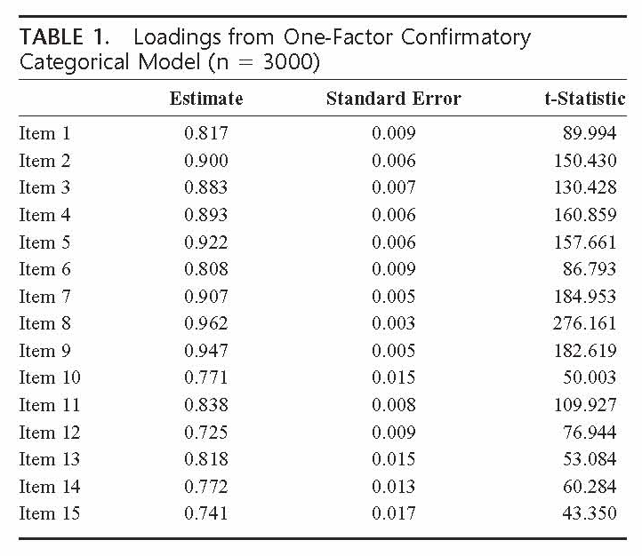
Comparative Fit Index = 0.95; Root Mean Square Error of Approximation = 0.12
(Cronbach’s coefficent alpha = 0.94)

Slide 20
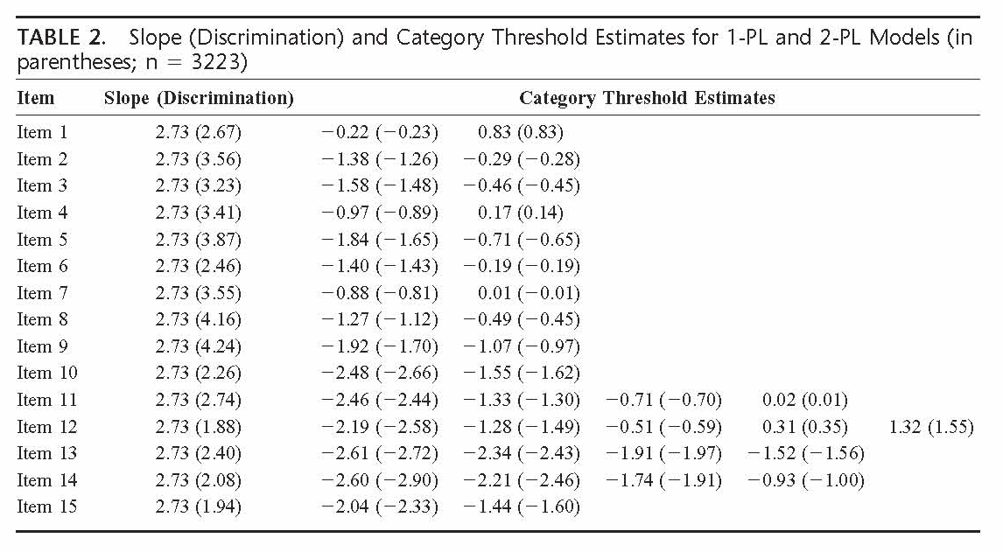

Slide 21
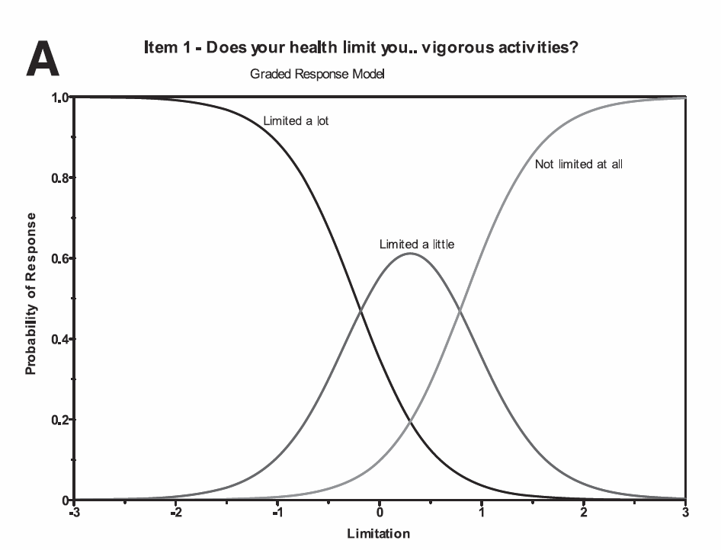

Slide 22
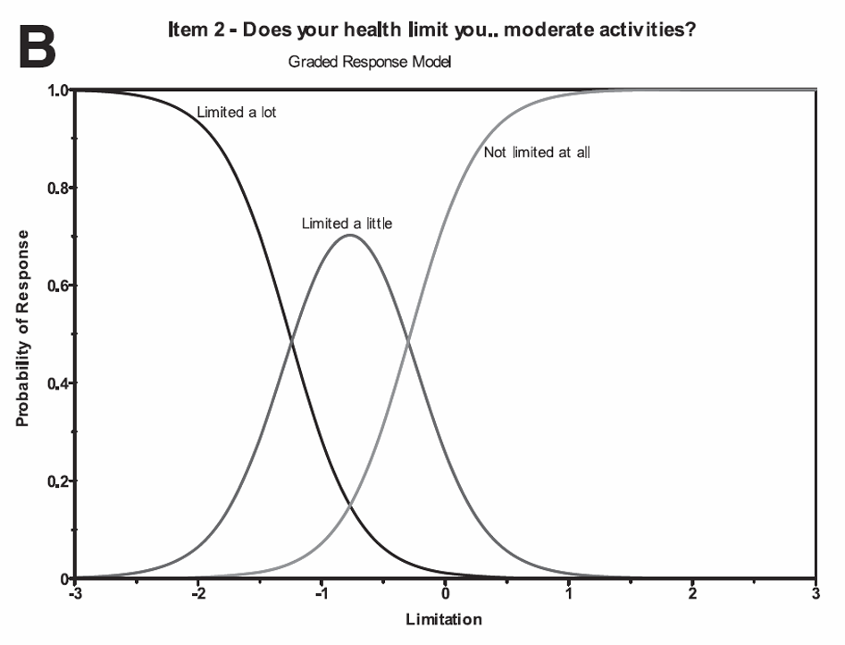

Slide 23
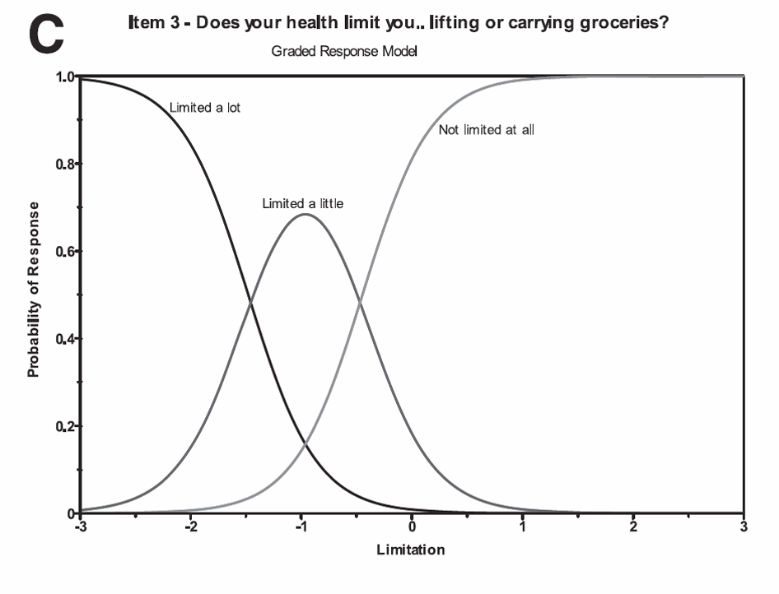

Slide 24
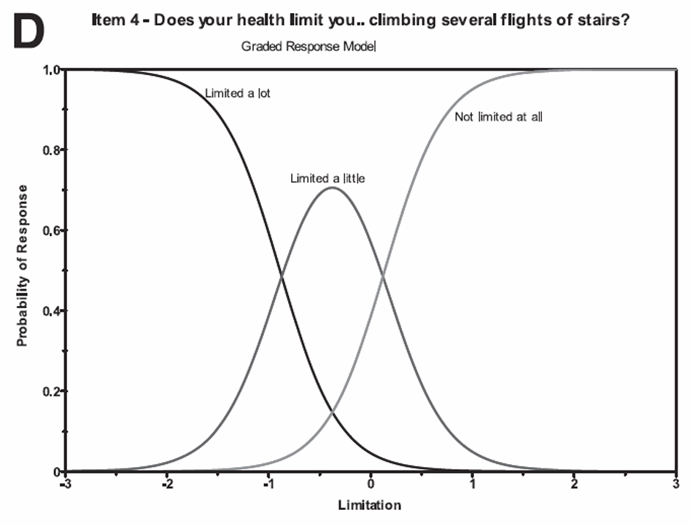

Slide 25
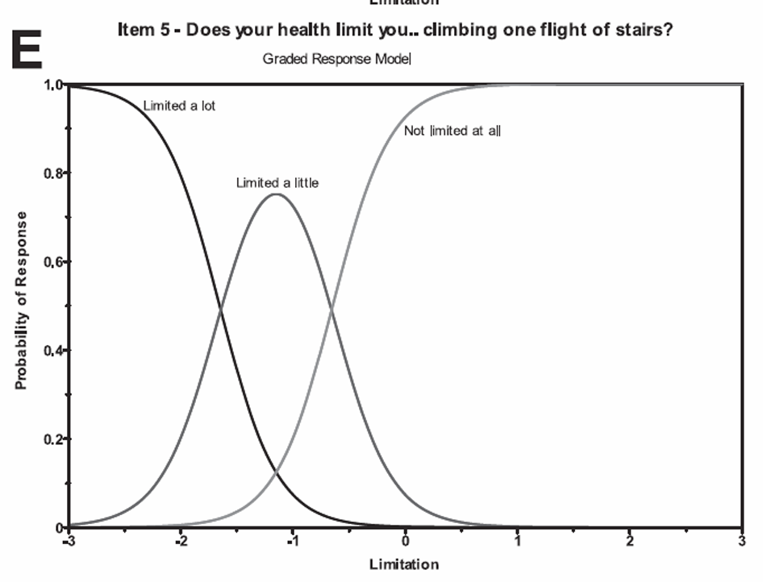

Slide 26
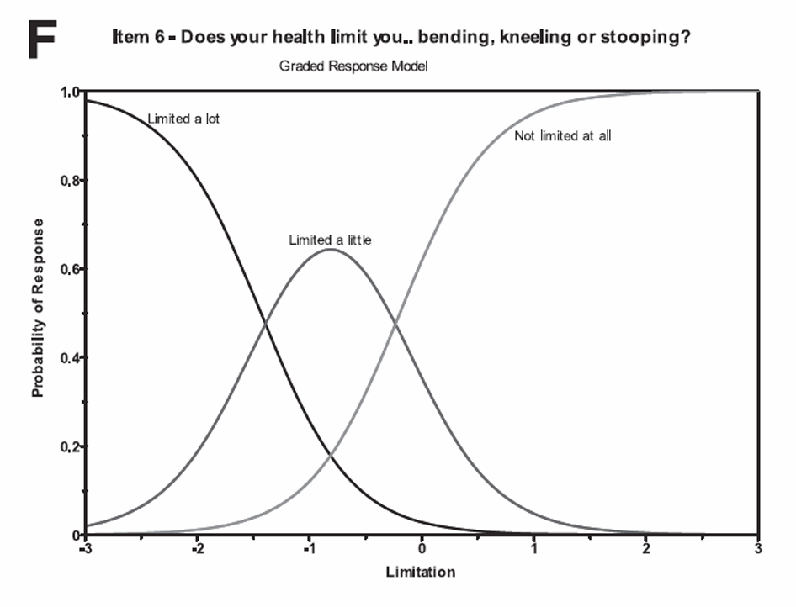

Slide 27
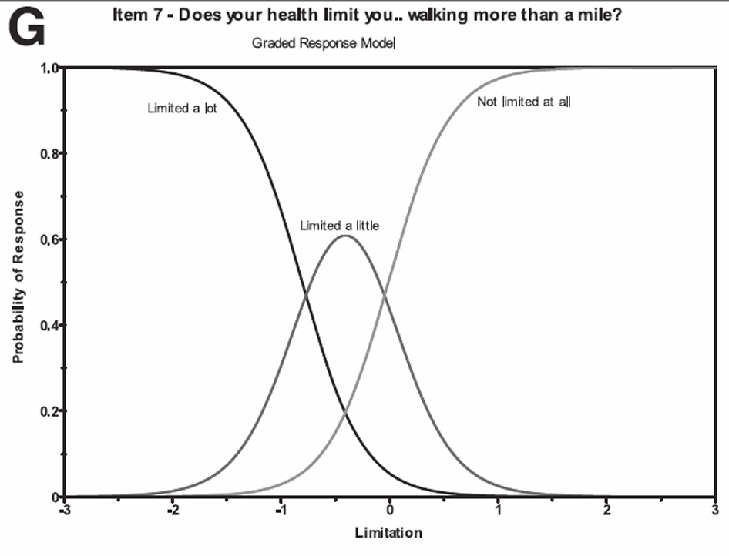

Slide 28
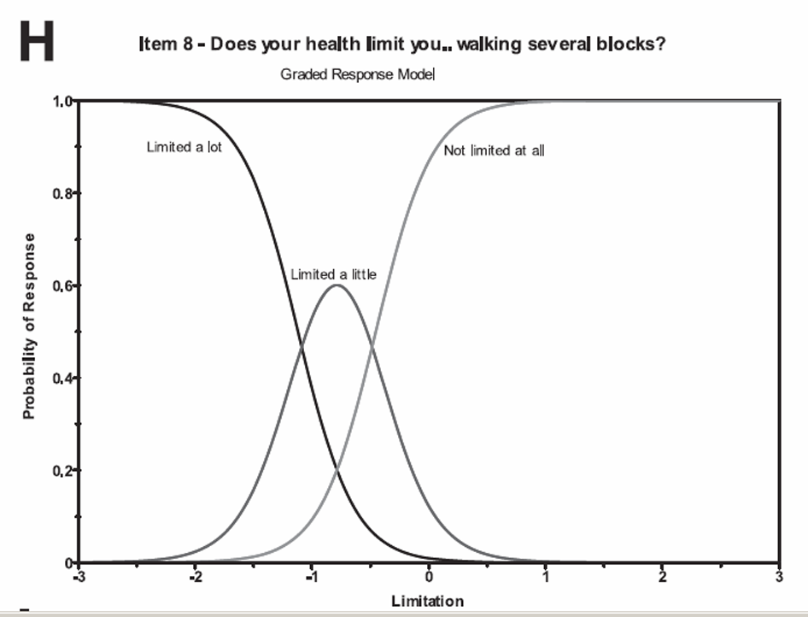

Slide 29
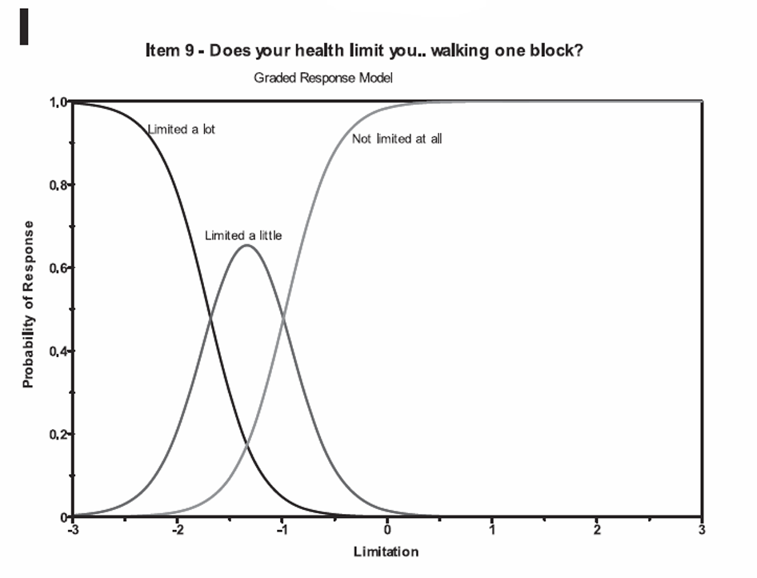

Slide 30
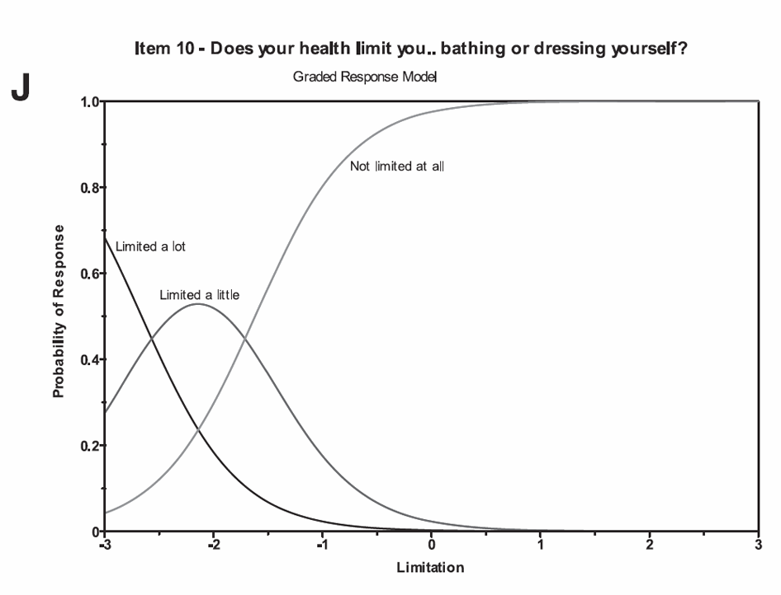

Slide 31
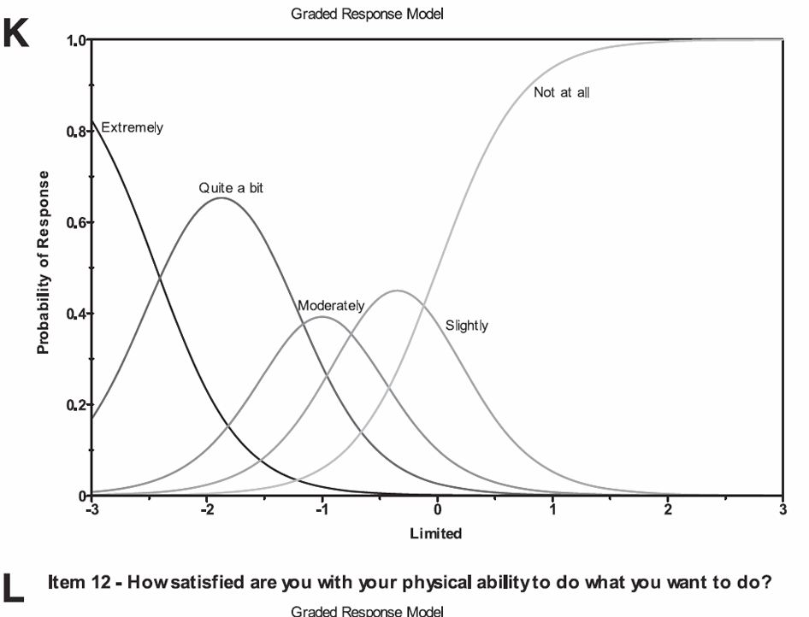
In the past 4 weeks, did health problems limit you in your everyday physical activities?

Slide 32
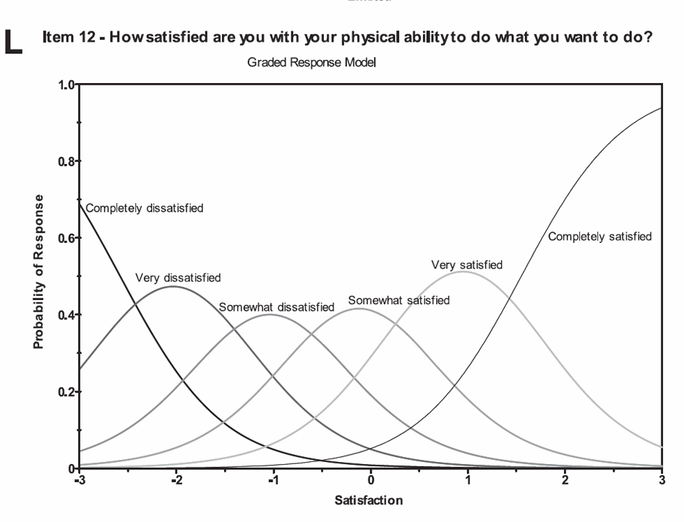

Slide 33
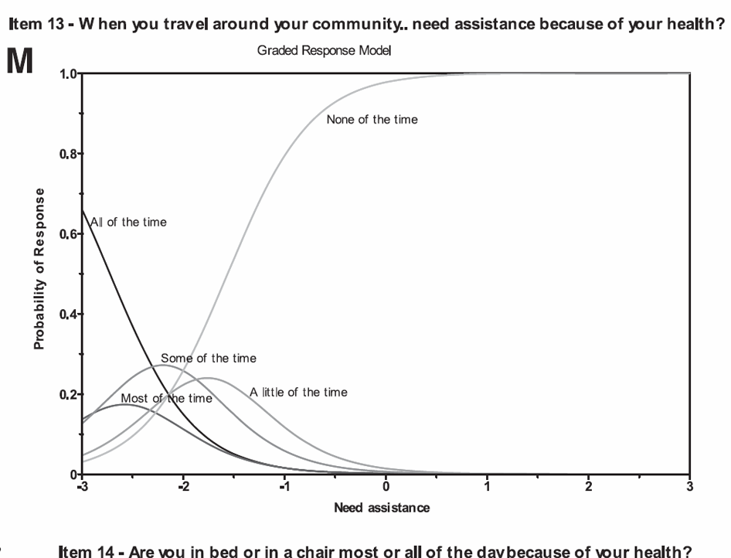

Slide 34
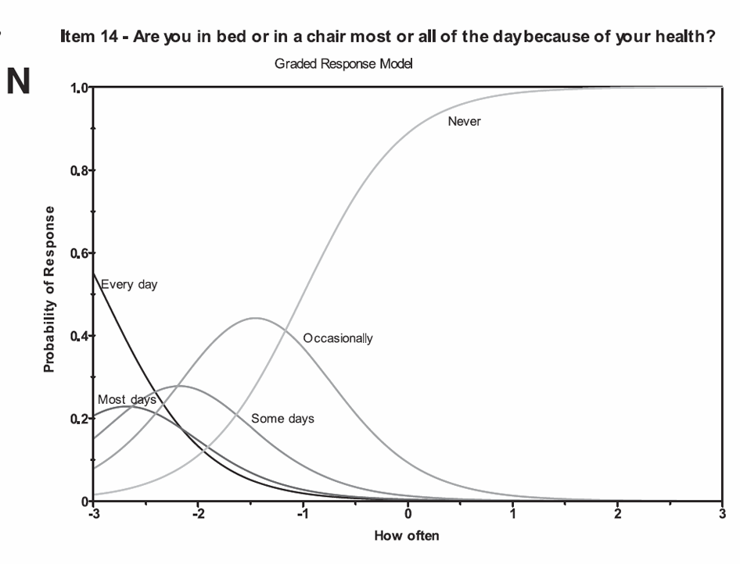

Slide 35
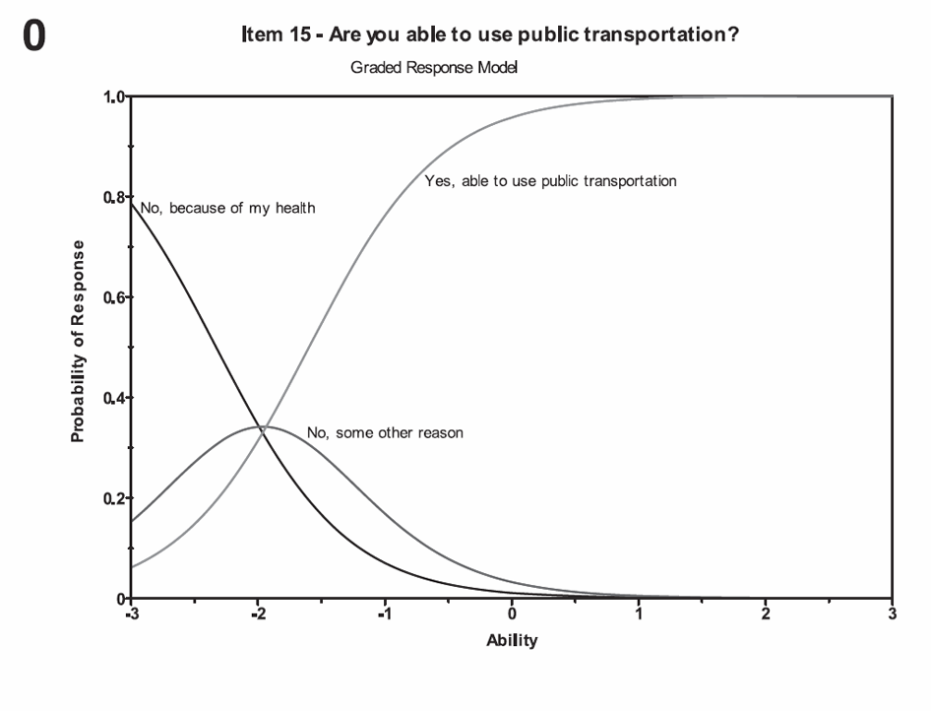

Slide 37

Item-scale correlation matrix
37
Notes:
37

Slide 38

Item-scale correlation matrix
38
Notes:
38

Slide 39
Evaluating Validity
Scale | Age | Obesity | ESRD | Nursing Home Resident
Physical Functioning | Medium (-) | Small (-) | Large (-) | Large (-)
Depressive Symptoms | ? | Small (+) | ? | Small (+)
Cohen effect size rules of thumb (d = 0.2, 0.5, and 0.8):
Small correlation = 0.100
Medium correlation = 0.243
Large correlation = 0.371
r = d / [(d² + 4)^{.5}] = 0.8 / [(0.8² + 4)^{.5}] = 0.8 / [(0.64 + 4)^{.5}] = 0.8 / [( 4.64)^{.5}]
= 0.8 / 2.154 = 0.371 .
Note: Often r’s of 0.10, 0.30 and 0.50 are cited as small, medium, and large.

Slide 40
Change on SF-36 Physical Functioning Scale by
Self-reported Retrospective Rating of Change
Interval | Lot Better (n = 21) | Little Better (n = 35) | Same (n = 252) | Little Worse (n = 113) | Lot Worse (n = 30)
12 months | 4.99ª | 0.32^{,b} | 0.46^{b} | -3.86^{c} | -4.74^{c}
6 months | 4.08ª | -0.58^{b,c} | 0.89^{b} | -2.34^{c} | -3.47^{c}
Note: Cell entries in the same row that share a letter do not differ significantly (p > 0.05) from one another (Duncan’s multiple range tests). SD of change was 7.74 for 12 months and 7.08 for 6 months.

Slide 41
Questions?
Powerpoint file posted at URL below (freely available for you to use, copy or burn):
http://gim.med.ucla.edu/FacultyPages/Hays/
Contact information:
drhays@ucla.edu 310-794-2294
For a good time call 867-5309 or go to: http://twitter.com/RonDHays

Slide 42
Appendix 1: For more information
Hays, R. D., Morales, L. S., & Reise, S. P. (2000). Item Response Theory and Health Outcomes Measurement in the 21st Century. Medical Care, 38 (Suppl.), II-28-II-42.
Hays, R. D., Liu, H., Spritzer, K., & Cella, D. (2007). Item response theory analyses of physical functioning items in the Medical Outcomes Study. Medical Care, 45, S32-38.
Cella, D., Riley, W., Stone, A., Rothrock, N., Reeve, B., Young, S., Amtmann, D., Bode, R., Buysse, D., Choi, S., Cook, K., DeVellis, R., DeWalt, D., Fries, J. F., Gershon, R., Hahn, E. A., Pilkonis, P., Revicki, D., Rose, M., Weinfurt, K., Lai, J., & Hays, R. D. (2010). Initial item banks and first wave testing of the Patient-Reported Outcomes Measurement Information System (PROMIS) network: 2005-2008. Journal of Clinical Epidemiology, 63 (11), 1179-1194.

Slide 43
Appendix 2:
Item Response Theory (IRT)
IRT models the relationship between a person’s response Y_{i} to the question (i) and his or her level of the latent construct θ being measured by positing
b_{ik} estimates how difficult it is for the item (i) to have a score of k or more and the discrimination parameter a_{i} estimates the discriminatory power of the item.

Slide 44
Appendix 3:
Intraclass Correlation and Reliability
Model
Reliability
Intraclass Correlation
One-way
Two-way fixed
Two-way random
BMS = Between Ratee Mean Square N = n of ratees
WMS = Within Mean Square k = n of items or raters
JMS = Item or Rater Mean Square
EMS = Ratee x Item (Rater) Mean Square
44
Notes:
44

Slide 45
Appendix 4: Confirmatory Factor Analysis Fit Indices
2
2
χ - χ
  Normed fit index:
  Non-normed fit index:
  Comparative fit index:
null
model
χ
2
2
2
χ χ
null
null
-
model
df df
null
model
2
χ
null
-
1
df
null
2
χ - df
1 -
model
model
2
χ -
df
null
null
RMSEA = SQRT (λ² – df)/SQRT (df (N – 1))
Notes:
45

