Slide 1
Responding to Arguments Against Use of PROs for Evaluating the Performance of Healthcare Providers
Ron D. Hays, Ph.D., UCLA
March 16, 2015 (2:05-2:40 ET)

Slide 2
New Podcast Discusses Common Concerns about CAHPS Surveys
Can patients really report on the quality of the care they receive?
Do patients’ expectations affect how they respond to CAHPS survey questions about their providers?
Is there a tradeoff between positive patient experiences and favorable clinical outcomes?
To help users of CAHPS surveys address these and other questions, the Agency for Healthcare Research and Quality (AHRQ) has released a new podcast: “CAHPS Surveys: Sorting Fact From Fiction,” featuring Rebecca Anhang Price, PhD.
Listen to this podcast: https://cahps.ahrq.gov/news-and-events/podcasts/cahps-surveys-podcast.html.

Slide 3
Patient surveys are subjective and do not provide valid information
PROs are “subjective” and providers have concerns about their scientific properties (Boyce et al., 2014, Implementation Science)
PROs are as reliable and valid as clinical measures: Hahn, E. A. et al., (2007). Precision of health-related quality of life data compared with other clinical measures. Mayo Clinic Proceedings, 82 (10), 1244-1254.
PROs are weakly related to clinical indicators.

Slide 4
PROs are not actionable
Patient surveys assess what is important to patients.
Patients want and need to know PRO information when choosing among providers.
PROs used in quality improvement
While link between use of PROs and subsequent health is tenuous, their use improves communication between patients and providers.

Slide 5
HRQOL data cannot be fairly compared across providers
My patients are different (e.g., sicker) than patients of other providers
PROs are determined by factors outside the control of the provider
Patient characteristics that are systematically related to PROs and not indicative of care quality are included in casemix adjustment.

Slide 6
Survey respondents are unrepresentative of my panel
Response rates are too low
Maximize participation rates.
Survey nonresponse does not necessarily lead to bias in comparisons.
Casemix adjustment can compensate for nonresponse bias.

Slide 7
Collecting PRO data is too burdensome and expensive
Patients are often more burdened by invasive medical tests than responding to surveys.
Survey data collection is not free but newer technologies can reduce costs.

Slide 8
Providers motivated to fulfill patient desires, regardless of appropriateness
Higher intensity care is not related to better outcomes
Good communication is important in addressing unreasonable expectations

Slide 9
Combat Strategies
Identifying opinion leaders
Researchers and clinicians
Collaborating with sponsors and providers
Journal articles and letters to editor
Conference presentations
Webinars
Social media
e.g., Blogs and twitter

Slide 10
CAHPS Articles
Price, R. A. et al. (2015). Should health care providers be accountable for patients’ care experiences? JGIM, 30, 253-256.
Price, R. A. et al. (2014). Examining the role of patient experience surveys in measuring health care quality. Medical Care Research and Review, 71, 522-554.
Xu, X. et al. (2014). Methodological considerations when studying the association between patient-reported care experiences and mortality. Health Services Res, 50, 1146-1161.

Slide 11
Use of and importance of patient experience surveys has grown…
CAHPS Hospital Survey (HCAHPS) data accounted for 30% of hospitals’ Total Performance Score in Value-Based Purchasing Program in FY2014
…so has misinformation about them

Slide 12
Some suggest that consumers lack expertise needed to evaluate care quality
Patients are the best source of information on communication, office staff courtesy and respect, access to care, and other issues covered by CAHPS surveys
CAHPS complements technical quality measures

Slide 13
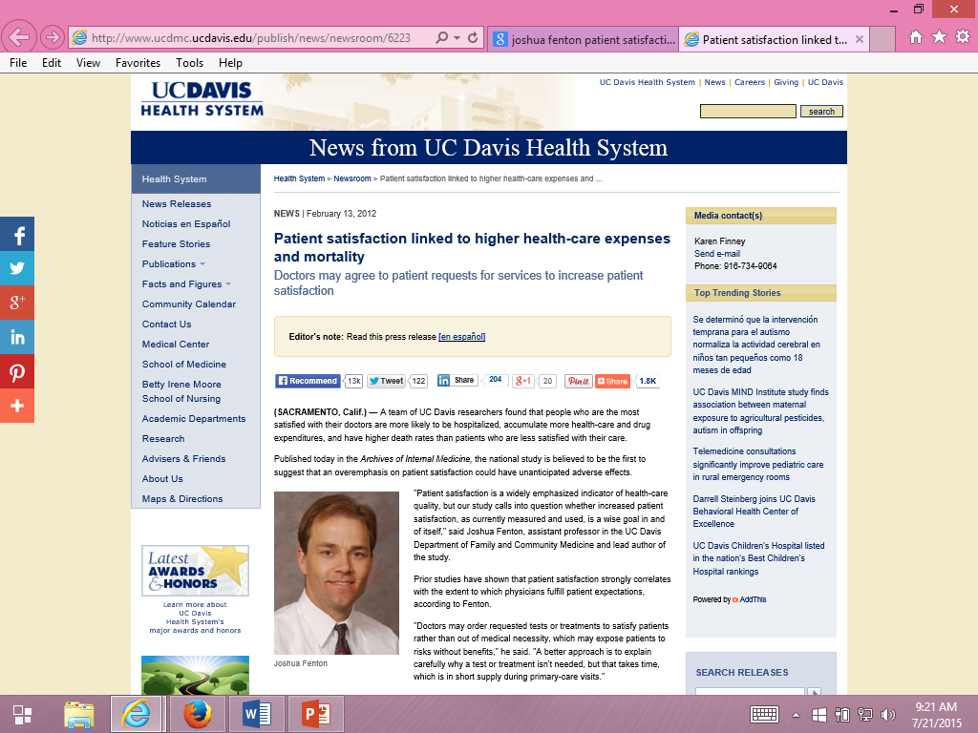
Some suggest patients can be “satisfied” to death.

Slide 14
Fenton et al. (2012) JAMA Internal Medicine
Medical Expenditure Panel Survey
Nationally representative survey of U.S. civilian non-institutionalized population. Panel followed over 2 calendar years with 5 rounds of interviews.
Five CAHPS item
4 items from communication scale
0-10 global rating of health care item
Results interpreted as indicating that acceding to patient demands results in expensive and dangerous treatment.

Slide 15
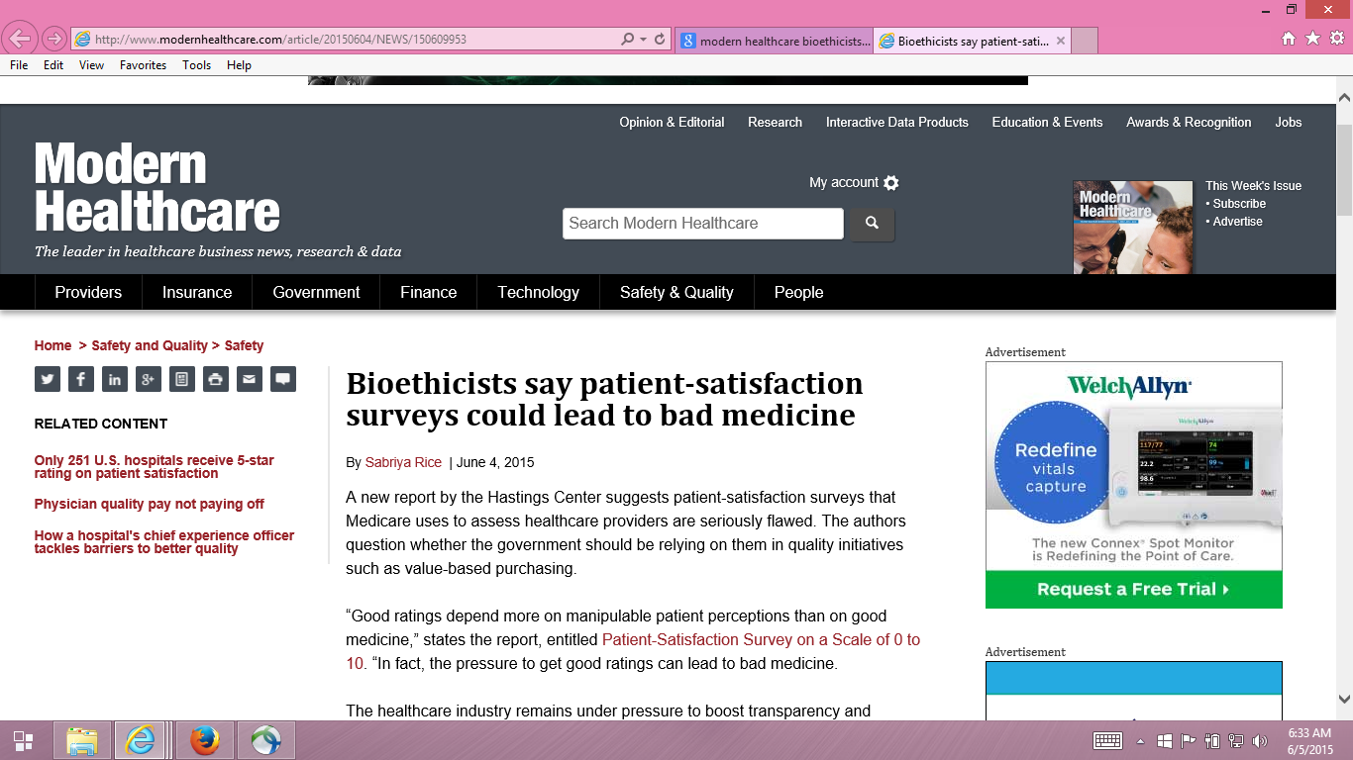

Slide 16
Hastings Center Report
Dr. Stuart Younger, Professor of Bioethics and Psychiatry at the Case Western Reserve University.
Pressure to get good ratings can lead to bad medicine.

Slide 17
Is Receiving Better Technical Quality of Care Bad for Health?
Change in SF-12 PCS regressed on process of care aggregate
Hypothesized positive effect, but regression coefficient was NOT SIGNIFICANT
unstandardized beta = -1.41, p =.188
Kahn et al. (2007), Health Services Research, Article of Year
Process
of care
SF-12 PCS

Slide 18
Five Concerns with Fenton et al.
Associations may be due to unmeasured variables (e.g., severity of illness).
Sicker patients may need more information
Clinicians may spend more time with them.
Estimated effect was implausibly large, suggesting good patient experience is more dangerous than having major chronic conditions.
Only amenable deaths can be prevented by health care.
Prognosis for those with end-stage pancreatic cancer is not modifiable
by the type of care they receive.
- Only 21% of the 1,287 deaths in the study were amenable to health care.

Slide 19
Five Concerns with Fenton et al.
Patient experiences with care vary over time.
Used CAHPS data at MEPS round 2 to predict mortality 3 months to 6 years later.
> half of deaths occurred more than 2 years after this.
Among those with best (quartile 4) experiences at baseline, > half had worse experiences 1 year later
Only looked at 5-item CAHPS aggregate

Slide 20
Reanalysis of Fenton et al. (Xu et al., 2014)
Same data used by Fenton et al.
2000-2005 Medical Expenditure Panel Survey data
National Health Interview Survey
National Death Index
Same statistical analysis
Cox proportional hazards models with mortality as the dependent variable and patient experience measures as independent variables
But, unlike Fenton et al.
Separated non-amenable and amenable deaths
Considered timing of patient experience and death
Looked at individual items to better understand the patient experience with mortality association

Slide 21
Patient Experiences and Mortality: Non-Amenable vs. Amenable Deaths
Patient Care Experience | Non-Amenable Mortality |  | Amenable Mortality
 | Hazard Ratio | p-value | Hazard Ratio | p-value
Quartile 1 (reference) | (1.00) |  | (1.00)
Quartile 2 | 1.07 | 0.56 | 1.27 | 0.25
Quartile 3 | 0.96 | 0.70 | 1.28 | 0.25
Quartile 4 (most positive) | 1.26 | 0.03 | 1.23 | 0.32
Overall p-value for patient care experience quartiles |  | 0.03 |  | 0.59
Adjusted for age, gender, race/ethnicity, education, income, metropolitan
statistical area, census region, access to usual source of care, insurance coverage,
smoking status, number of chronic conditions, self-rated overall health, SF-12
PCS/MCS, number of drug prescriptions, medical care expenditures, number of
office visits, any ER visits, any inpatient admissions, and survey panel.

Slide 22
Patient Experiences and Mortality: Consistency of Experiences Over Time
Patient Care Experience (baseline : 1 year later) | All-Cause Mortality
 | Hazard Ratio | p-value
Quartile 1 : Quartile 1 (reference) | (1.00)
Quartile 2 : Quartile 2 | 0.89 | 0.42
Quartile 3 : Quartile 3 | 1.13 | 0.57
Quartile 4 : Quartile 4 | 1.09 | 0.54
Different quartiles at baseline and 1 year later | 0.88 | 0.35

Slide 23
Patient Experiences and Mortality: Significant for Only One Item
Patient Care Experience Items | All-Cause Mortality
 | Hazard Ratio | p-value
Rating of healthcare 9-10 vs 0-8 | 1.10 | 0.15
Listen carefully to you † | 0.98 | 0.76
Show respect for what you had to say † | 1.05 | 0.44
Explain things in a way that is easy to understand † | 1.09 | 0.17
Spend enough time with you † | 1.17 | 0.03
† “Always" versus “Never”/“Sometimes”/“Usually”

Slide 24
Conclusions
Rather than patient demands producing expensive and dangerous treatment, the data are consistent with other studies that indicate more intensive care at the end-of-of life in the U.S. (Elliott et al., 2013, JAGS).
Patient experience surveys assess important dimensions of care for which patients are the best or only source of information.
Improving patient experience does not lead to inappropriate and inefficient care or result in trade-offs with high-quality clinical care.

Slide 25
Thank you.
drhays@g.ucla.edu
@RonDHays (twitter)
Powerpoint file at: http://gim.med.ucla.edu/FacultyPages/Hays/
Notes:
25

