Slide 1

Psychometric Evaluation of Survey Data
Questionnaire Design and Testing Workshop
October 24, 2014, 3:30-5:00pm
10940 Wilshire Blvd. Suite 710
Los Angeles, CA
Notes:
1

Slide 2
Class Roster
Priya Batra Reshma Gupta
Lillie Hudson Roya Ijadi-Maghsoodi Ippy Kalofonos Linda Kim (audit) Christine Lam Lucinda Leung
Yalda Rahimi Adam Schickedanz Megha Shah Jesus Ulloa

Slide 3
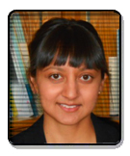
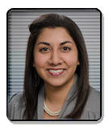

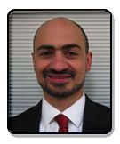

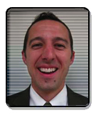


Slide 4
Patient-Reported Outcomes (PROs)
“Any report of the status of a patient’s health condition that comes directly from the patient, without interpretation of the patient’s response by a clinician or anyone else”
  Patient reports about their health
    What they can do and how they feel
  Patient evaluations of health care
Notes:
Read slide
The PRO assesses a concept which can be..symptom, etc. or any other information that can only come from the patient and not from another objective or semi-objective measures.
The PRO should be evaluated and have evidence to support its validity in assessing a given concept prior to enrollment in the pivotal trial. This is of particular importance since PRO development is often an iterative process requiring multiple modifications of the measurement tool.

Slide 5
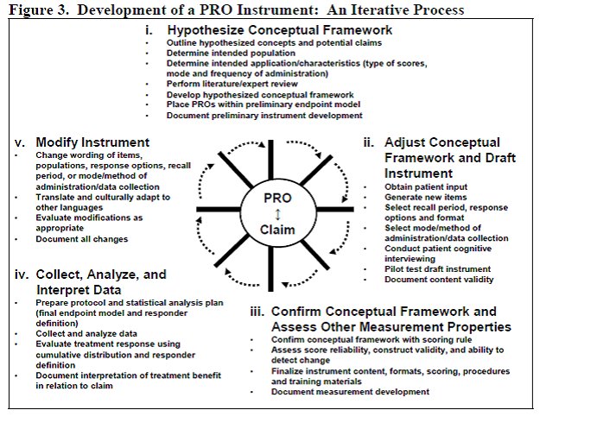
PRO Development Process
  http://www.fda.gov/downloads/Drugs/GuidanceComplianceRegulatoryInformation/Guidances/UCM205269.pdf

Slide 6
Identify Concepts and Hypothesize
Conceptual Framework
Literature, media, and citizen reports used to identify concepts of interest and potential confounders
  Functioning limitations
  Satisfaction with surgery
  Dry eye symptoms
  Expectations of surgery
  Coping
  Optimism/pessimism
  Depression/anxiety symptoms

Slide 7
PRO Development Process
  http://www.fda.gov/downloads/Drugs/GuidanceComplianceRegulatoryInformation/Guidances/UCM205269.pdf

Slide 8
Adjust Conceptual Framework and Draft Instrument
Evaluated published surveys of target concepts
Obtained permission to use copyrighted items
Wrote new items

Slide 9
Included Several Existing Measures in Draft Instrument
National Eye Institute Refractive Error Quality of Life (NEI-RQL-42)
National Eye Institute Visual Functioning Questionnaire (VFQ-25)
Ocular Surface Disease Index (OSDI)
Life Orientation Test Revised (LOT-R)
Brien Holden Vision Institute Multidimensional Quality of Life (BHVI QOL) Scale for Myopia
Work Productivity Activity and Impairment (WPAI)
Patient Health Questionnaire (PHQ-4)
Marlowe-Crowne Socially Desirable Response Set

Slide 10

Example of Visual Symptom Aberration Item
INSTRUCTIONS: The next few questions are about starbursts. By starbursts, we mean seeing rays of light coming out from lighted objects, such as in the car headlights in the images below. These images may not represent exactly what you see and your symptoms may be more or less severe than what is shown.
No starbursts
Severe starbursts
In the last 7 days, have you seen any starbursts?
Yes, but ONLY when NOT wearing glasses or contact lenses
Yes, but ONLY when wearing glasses or contact lenses
Yes, when wearing AND when not wearing glasses or contact lenses
No, not at all

Slide 11
Cognitive Interviews to Evaluate Draft Instrument
Objectives:
  To evaluate the content and ordering of the questionnaire, coverage of treatment-related issues pertinent to LASIK patients
  To evaluate the usability of the electronic format of the questionnaire

Slide 12
Cognitive Interviews
Conducted by RAND
Conducted in Los Angeles, CA and Washington, DC
Pre-operative patients (n=9)
  Adults very likely to have LASIK in the next 6 months
Post-operative patients (n=9)
  1 dissatisfied
  4 satisfied
  4 with visual symptoms
General Exclusions
  Eye care professionals, web site designers, and prior refractive surgery

Slide 13
Adjust Conceptual Framework: Based on Cognitive Interviews
Modified questionnaire with the following changes
  Ordering of items
  Clearer wording of some items
  Additional phrases to remind respondents of time frame
  Instructions were shortened and bulleted
  Formatting of web-based questionnaire to resemble other online surveys

Slide 14
Survey Measures
Existing Measures
  7 NEI-RQL-42 scales (23 of 42 items)
  NEI-VFQ-25 driving scale (3 items)
  2 of 3 Ocular Surface Disease Index scales (8 of 12 items)
  Lost work and productivity due to eye problems (3 items)
New Measures
  Visual aberrations (4 scales)
  Expectations of spectacle independence/vision clarity (6 items)
  Satisfaction with vision (1 item)
  Satisfaction with LASIK surgery (8 items)
Optimism (10 items)
Health Proneness (10 items)
Depression and Anxiety (4 items)

Slide 15
PRO Iterative Development Process
  http://www.fda.gov/downloads/Drugs/GuidanceComplianceRegulatoryInformation/Guidances/UCM205269.pdf

Slide 16
Assess Measurement
Properties: Reliability
Degree to which the same score is obtained when the target or thing being measured (person, plant or whatever) has not changed.
Internal consistency (items)
  Need 2 or more items
Test-retest (administrations) correlations
  Need 2 or more time points

Slide 17
Reliability
Model
Reliability
Intraclass Correlation
Two-way random
Two-way mixed
One-way
BMS = Between Ratee Mean Square N = n of ratees
WMS = Within Mean Square k = n of items or raters
JMS = Item or Rater Mean Square
EMS = Ratee x Item (Rater) Mean Square
Notes:
17

Slide 18
Reliability Formulas
Model
Reliability
Intraclass Correlation
Two-way random
Two-way mixed
One-way
BMS = Between Ratee Mean Square N = n of ratees
WMS = Within Mean Square k = n of items or raters
JMS = Item or Rater Mean Square
EMS = Ratee x Item (Rater) Mean Square
Notes:
18

Slide 19
Internal Consistency Reliability and Item-Scale Correlations for 23 Multi-Item Scales
PROWL-1
  Median alpha = 0.78 (range: 0.55-0.98)
PROWL-2
  Median alpha = 0.81 (range: 0.63-0.97)
Item-scale correlations (hypothesized scales vs other scales) support item discrimination across scales

Slide 20

Item-scale correlation matrix
20
Notes:
20

Slide 21

Item-scale correlation matrix
21
Notes:
21

Slide 22
PROWL-1 Item-Scale Correlations Example
Item Number | Ocular Surface Disease | NEI-RQL Clarity Vision
Q65 (eyes sensitive to light) | 0.38* | -.28
Q66 (eyes feel gritty) | 0.32* | -.20
Q67 (painful or sore eyes) | 0.32* | -.15
Q68 (blurred vision) | 0.46* | -.57
Q69 (poor vision) | 0.47* | -.53
Q70 (uncomfortable—wind) | 0.44* | -.15
Q71 (uncomfortable—humidity) | 0.45* | -.15
Q72 (uncomfortable—air cond.) | 0.31* | -.15
Q5 (how clear is your vision?) | -.21 | 0.12*
Q34a (distorted vision) | -.35 | 0.52*
Q35a (blurry vision) | -.45 | 0.65*
Q36a (trouble seeing) | -.48 | 0.62*

Slide 23
Assess Measurement
Properties: Validity
Content validity: Does measure “appear” to reflect what it is intended to (expert judges or patient judgments)?
  Do items operationalize concept?
  Do items cover all aspects of concept?
  Does scale name represent item content?
Construct validity
  Are the associations of the measure with other variables consistent with hypotheses?

Slide 24
Threats to Validity
Those with higher levels of expectations about surgery will be less satisfied with surgery
  The correlations between expectations and satisfaction with surgery were not statistically significant at the 1-month, 3-month, and 6-month follow-ups in PROWL-1.

Slide 25
Threats to Validity
Those with lower health proneness at baseline will be less satisfied with surgery
  Only the correlation of health proneness with 3-month satisfaction with surgery was statistically significant and it was a small correlation (r = 0.14, p = 0.0443) in PROWL-1.

Slide 26
Threats to Validity
Those with depressive/anxiety symptoms at baseline will be less satisfied with surgery
  Only the correlation of the PHQ-4 with 6-month satisfaction with surgery was statistically significant and it was a small correlation (r = -0.19, p = 0.0043), PROWL-1.

Slide 27
Support for Validity
Those with a greater degree of visual aberrations will be less satisfied with surgery
  Correlations statistically significant in hypothesized direction at 1-month, 3-month and 6-month follow-up in PROWL-1:
    Glare (r’s = 0.34, 0.36, 0.43)
    Starbursts (r’s = 0.27, 0.24, 0. 32)
    Haloes (r’s = 0.37, 0.34, 0.49)
    Double images (r’s = 0.43, 0.37, 0.39)

Slide 28
Usability Results
 | PROWL-1 | PROWL-2
Minutes to Complete (median) | 25 | 20
Length of Questionnaire About right A little too long | 46% 40% | 64% 33%
No problems using computer True False | 86% 10% | 90% 8%
Ease of taking questionnaire by computer vs paper Easier Harder | 54% 14% | 69% 5%

Slide 29
PRO Iterative Development Process
  http://www.fda.gov/downloads/Drugs/GuidanceComplianceRegulatoryInformation/Guidances/UCM205269.pdf

Slide 30
Item Response Theory (IRT)
IRT models the relationship between a person’s response Y_{i} to the question (i) and his or her level of the latent construct θ being measured by positing
b_{ik} estimates how difficult it is for the item (i) to have a score of k or more and the discrimination parameter a_{i} estimates the discriminatory power of the item.

Slide 31
Item Responses and Trait Levels
Person 1
Person 2
Person 3
Trait
Continuum
Item 1
Item 2
Item 3
www.nihpromis.org

Slide 32




Computer Adaptive Testing (CAT)
Notes:
Early research on CAT was funded by the U.S. military to enhance mental measurement.
NASD = National Association of Security Dealers. In 1978 they began developing CAT for regulatory exam to assess knowledge of securities and securities future products among licensed brokers.
The National Council of State Boards of Nursing starting using CAT in 1994.

Slide 33
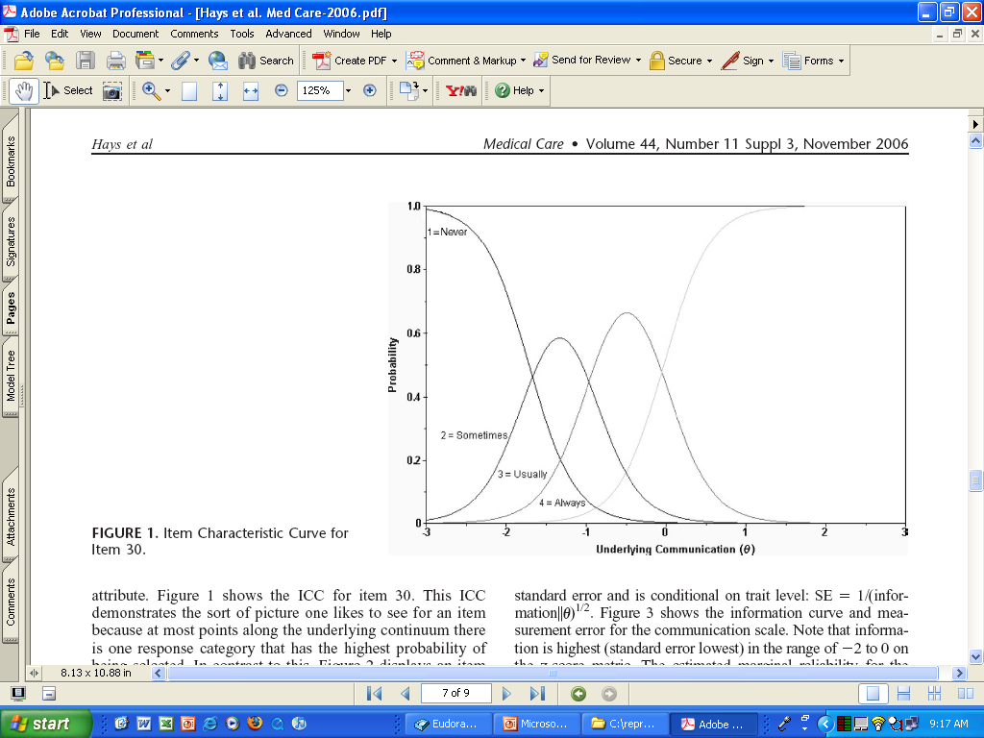
CATEGRORY RESPONSE CURVE

Slide 34
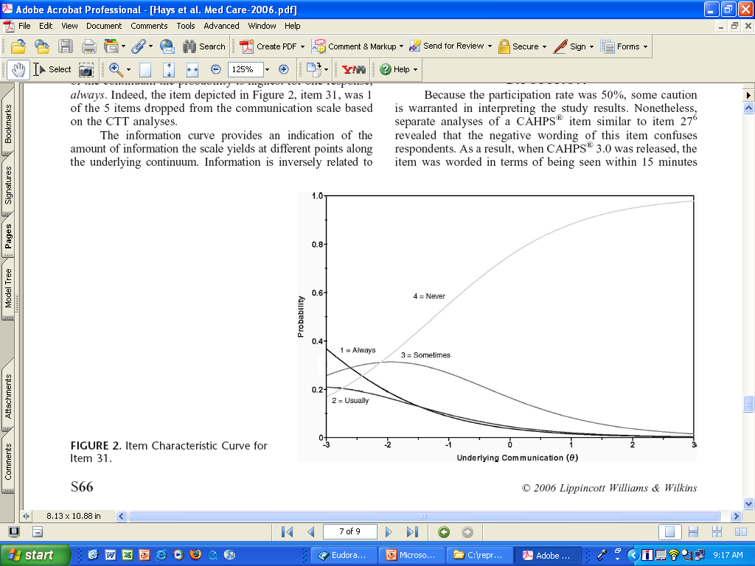

Slide 35
Differential Item Functioning (DIF)
Probability of choosing each response category should be the same for those who have the same estimated scale score, regardless of other characteristics
Evaluation of DIF by subgroups

Slide 36
DIF (2-parameter model)
Men
Women
White
Slope DIF
Location DIF
AA
I cry when upset
I get sad for no reason
Higher Score = More Depressive Symptoms
Notes:
36

Slide 37
PROMIS Physical Functioning vs. “Legacy” Measures
10 20 30 40 50 60 70

Slide 38

drhays@ucla.edu (310-794-2294). http://gim.med.ucla.edu/FacultyPages/Hays/
Notes:
38

