Slide 1
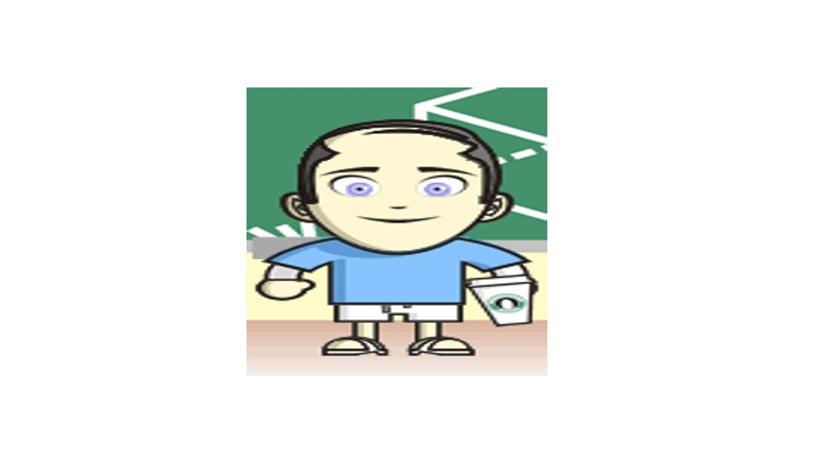
Evaluating Health-Related Quality of Life Measures
June 12, 2014 (1:00 – 2:00 PDT)
Kaiser Methods Webinar Series
Ron D.Hays, Ph.D.
drhays@ucla.edu

Slide 2
Burden of Kidney Disease Scale
How true or false is each of the following statements for you?
My kidney disease interferes too much with my life.
Too much of my time is spent dealing with kidney disease.
I feel frustrated dealing with my kidney disease.
I feel like a burden on my family.
- Definitely True = 100
- Mostly True = 75
- Don’t Know = 50
- Mostly false = 25
- Definitely false = 0

Slide 3
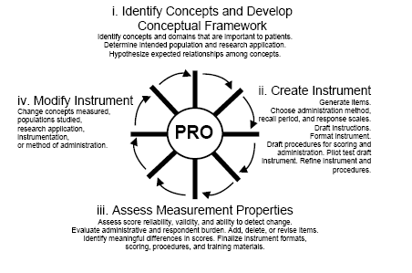
FDA PRO Process (released February 2006)

Slide 4
Aspects of Good Health-Related Quality of Life Measures
Aside from being practical..
Same people get same scores
Different people get different scores and differ in the way you expect
Measure is interpretable
Measure works the same way for different groups (age, gender, race/ethnicity)

Slide 5
Aspects of Good Health-Related Quality of Life Measures
Aside from being practical..
Same people get same scores
Different people get different scores and differ in the way you expect
Measure is interpretable
Measure works the same way for different groups (age, gender, race/ethnicity)

Slide 6
Aspects of Good Health-Related Quality of Life Measures
Aside from being practical..
Same people get same scores
Different people get different scores and differ in the way you expect
Measure is interpretable
Measure works the same way for different groups (age, gender, race/ethnicity)

Slide 7
Aspects of Good Health-Related Quality of Life Measures
Aside from being practical..
Same people get same scores
Different people get different scores and differ in the way you expect
Measure is interpretable
Measure works the same way for different groups (age, gender, race/ethnicity)

Slide 8
Aspects of Good Health-Related Quality of Life Measures
Aside from being practical..
Same people get same scores
Different people get different scores and differ in the way you expect
Measure is interpretable
Measure works the same way for different groups (age, gender, race/ethnicity)

Slide 9
Validity Does scale represent what it is supposed to be measuring?
Content validity: Does measure “appear” to reflect what it is intended to (expert judges or patient judgments)?
Do items operationalize concept?
Do items cover all aspects of concept?
Does scale name represent item content?
Construct validity
Are the associations of the measure with other variables consistent with hypotheses?

Slide 10
Relative Validity Example
Sensitivity of measure to important (clinical) difference
 | Severity of Kidney Disease
 | None | Mild | Severe | F-ratio | Relative Validity
Burden of Disease #1 | 87 | 90 | 91 | 2 | --
Burden of Disease #2 | 74 | 78 | 88 | 10 | 5
Burden of Disease #3 | 77 | 87 | 95 | 20 | 10

Slide 11
Evaluating Construct Validity
Scale | Age (years)
(Better) Physical Functioning | (-)

Slide 12
Evaluating Construct Validity
Scale | Age (years)
(Better) Physical Functioning | Medium (-)

Slide 13
Evaluating Construct Validity
Scale | Age (years)
(Better) Physical Functioning | Medium (-)
Effect size (ES) = D/SD
D = Score difference
SD = SD
Small (0.20), medium (0.50), large (0.80)

Slide 14
Evaluating Construct Validity
Scale | Age (years)
(Better) Physical Functioning | Medium (-) r ˜͂ 0.24
Cohen effect size rules of thumb (d = 0.20, 0.50, and 0.80):
Small r = 0.100; medium r = 0.243; large r = 0.371
r = d / [(d² + 4)^{.5}]
= 0.80 / [(0.80² + 4)^{.5}] = 0.80 / [(0.64 + 4)^{.5}] = 0.80 / [( 4.64)^{.5}] = 0.80 / 2.154
= 0.371

Slide 15
Evaluating Construct Validity
Scale | Age (years) | Obese yes = 1, no = 0 | Kidney Disease yes = 1, no = 0 | In Nursing home yes = 1, no = 0
(Better) Physical Functioning | Medium (-) | Small (-) | Large (-) | Large (-)
Cohen effect size rules of thumb (d = 0.20, 0.50, and 0.80):
Small r = 0.100; medium r = 0.243; large r = 0.371
r = d / [(d² + 4)^{.5}]
= 0.80 / [(0.80² + 4)^{.5}] = 0.80 / [(0.64 + 4)^{.5}] = 0.80 / [( 4.64)^{.5}] = 0.80 / 2.154
= 0.371

Slide 16
Evaluating Construct Validity
Scale | Age (years) | Obese yes = 1, no = 0 | Kidney Disease yes = 1, no = 0 | In Nursing home yes = 1, no = 0
(Better) Physical Functioning | Medium (-) | Small (-) | Large (-) | Large (-)
(More) Depressive Symptoms | ? | Small (+) | ? | Small (+)
Cohen effect size rules of thumb (d = 0.20, 0.50, and 0.80):
Small r = 0.100; medium r = 0.243; large r = 0.371
r = d / [(d² + 4)^{.5}]
= 0.80 / [(0.80² + 4)^{.5}] = 0.80 / [(0.64 + 4)^{.5}] = 0.80 / [( 4.64)^{.5}] = 0.80 / 2.154
= 0.371
(r’s of 0.10, 0.30 and 0.50 are often cited as small, medium, and large.)

Slide 17
Questions?

Slide 18
Responsiveness to Change
HRQOL measures should be responsive to interventions that change HRQOL
Need external indicators of change (Anchors)
Clinical measure
“improved” group = 100% reduction in seizure frequency
“unchanged” group = <50% change in seizure frequency
Retrospective self- or provider-report of change
Much better, A little better, Same, A little worse, Much worse
Anchor correlated with change on target measure at 0.371 or higher

Slide 19
Responsiveness Index
Effect size (ES) = D/SD
D = raw score change in “changed”
(improved) group
SD = baseline SD
Small: 0.20->0.49
Medium: 0.50->0.79
Large: 0.80 or above

Slide 20
Responsiveness Indices
Effect size (ES) = D/SD
(2) Standardized Response Mean (SRM) = D/SD†
(3) Guyatt responsiveness statistic (RS) = D/SD‡
D = raw score change in “changed” group;
SD = baseline SD;
SD† = SD of D;
SD‡ = SD of D among “unchanged”

Slide 21
Amount of Expected Change Varies
SF-36 physical function score mean = 87 (SD = 20)
Assume I have a score of 100 at baseline
Hit by Bike causes me to be
limited a lot in vigorous activities
limited a lot in climbing several flights of stairs
limited a little in moderate activities
SF-36 physical functioning score drops to 75 (-1.25 SD)
Hit by Rock causes me to be
limited a little in vigorous activities
SF-36 physical functioning score drops to 95 (- 0.25 SD)

Slide 22
Partition Change on Anchor
A lot better
A little better
No change
A little worse
A lot worse

Slide 23
Use Multiple Anchors
693 RA clinical trial participants evaluated at baseline and 6-weeks post-treatment.
Five anchors:
Self-report (global) by patient
Self-report (global) by physician
Self-report of pain
Joint swelling (clinical)
Joint tenderness (clinical)
Kosinski, M. et al. (2000). Determining minimally important changes in generic and disease-specific health-related quality of life questionnaires in clinical trials of rheumatoid arthritis. Arthritis and Rheumatism, 43, 1478-1487.

Slide 24
Patient and Physician Global Reports
How are you (is the patient) doing, considering all the ways that RA affects you (him/her)?
Very good (asymptomatic and no limitation of normal activities)
Good (mild symptoms and no limitation of normal activities)
Fair (moderate symptoms and limitation of normal activities)
Poor (severe symptoms and inability to carry out most normal activities)
Very poor (very severe symptoms that are intolerable and inability to carry out normal activities
--> Improvement of 1 level over time

Slide 25
Global Pain, Joint Swelling and Tenderness
0 = no pain, 10 = severe pain
Number of swollen and tender joints
-> 1-20% improvement over time

Slide 26
Effect Sizes for SF-36 PF Change Linked to Minimal Change in Anchors
Scale | Self-R | Clin.-R | Pain | Swell | Tender | Mean
Physical Function | .35 | .33 | .34 | .26 | .32 | .32

Slide 27
Effect Sizes for SF-36 Changes Linked to Minimal Change in Anchors
Scale | Self-R
PF | .35
Role-P | .56
Pain | .83
GH | .20
EWB | .39
Role-E | .41
SF | .43
EF | .50
PCS | .49
MCS | .42

Slide 28
Effect Sizes (mean = 0.34) for SF-36 Changes Linked to Minimal Change in Anchors
Scale | Self-R | Clin.-R | Pain | Swell | Tender | Mean
PF | .35 | .33 | .34 | .26 | .32 | .32
Role-P | .56 | .52 | .29 | .35 | .36 | .42
Pain | .83 | .70 | .47 | .69 | .42 | .62
GH | .20 | .12 | .09 | .12 | .04 | .12
EWB | .39 | .26 | .25 | .18 | .05 | .23
Role-E | .41 | .28 | .18 | .38 | .26 | .30
SF | .43 | .34 | .28 | .29 | .38 | .34
EF | .50 | .47 | .22 | .22 | .35 | .35
PCS | .49 | .48 | .34 | .29 | .36 | .39
MCS | .42 | .27 | .19 | .27 | .20 | .27

Slide 29
Reliability
Degree to which the same score is obtained when the target or thing being measured (person, plant or whatever) hasn’t changed.
Inter-rater (rater)
Need 2 or more raters of the thing being measured
Internal consistency (items)
Need 2 or more items
Test-retest (administrations)
Need 2 or more time points

Slide 30
Ratings of Performance of Six Kaiser Presentations by Two Raters
[1 = Poor; 2 = Fair; 3 = Good; 4 = Very good; 5 = Excellent]
1= Karen Kaiser (Good, Very Good)
2= Adam Ant (Very Good, Excellent)
3= Rick Dees (Good, Good)
4= Ron Hays (Fair, Poor)
5= John Adams (Excellent, Very Good)
6= Jane Error (Fair, Fair)
(Target = 6 presenters; assessed by 2 raters)

Slide 31
Reliability Formulas
Model
Reliability
Intraclass Correlation
Two-way random
Two-way mixed
One-way
BMS = Between Ratee Mean Square N = n of ratees
WMS = Within Mean Square k = n of items or raters
JMS = Item or Rater Mean Square
EMS = Ratee x Item (Rater) Mean Square
Notes:
31

Slide 32
01 13
01 24
02 14
02 25
03 13
03 23
04 12
04 21
05 15
05 24
06 12
06 22
Two-Way Random Effects
(Reliability of Ratings of Presentations)
Presenters (BMS) 5 15.67 3.13
Raters (JMS) 1 0.00 0.00
Pres. x Raters (EMS) 5 2.00 0.40
Total 11 17.67
Source
df
SS
MS
2-way R =
6 (3.13 - 0.40) = 0.89
6 (3.13) + 0.00 - 0.40
ICC = 0.80
Notes:
32

Slide 33
Responses of Presenters to Two Questions about Their Health
1= Karen Kaiser (Good, Very Good)
2= Adam Ant (Very Good, Excellent)
3= Rick Dees (Good, Good)
4= Ron Hays (Fair, Poor)
5= John Adams (Excellent, Very Good)
6= Jane Error (Fair, Fair)
(Target = 6 presenters; assessed by 2 items)

Slide 34
Two-Way Mixed Effects (Cronbach’s Alpha)
01 34
02 45
03 33
04 21
05 54
06 22
Presenters (BMS) 5 15.67 3.13
Items (JMS) 1 0.00 0.00
Pres. x Items (EMS) 5 2.00 0.40
Total 11 17.67
Source
df
SS
MS
Alpha =
3.13 - 0.40 = 2.93 = 0.87
ICC = 0.77
3.13
3.13
Notes:
34

Slide 35
Reliability Minimum Standards
0.70 or above (for group comparisons)
0.90 or higher (for individual assessment)
SEM = SD (1- reliability)^{1/2}
95% CI = true score +/- 1.96 x SEM
if z-score = 0, then CI: -.62 to +.62 when reliability = 0.90
Width of CI is 1.24 z-score units
Notes:
35

Slide 36
Guidelines for Interpreting Kappa
Conclusion | Kappa | Conclusion | Kappa
Poor | < .40 | Poor | < 0.0
Fair | .40 - .59 | Slight | .00 - .20
Good | .60 - .74 | Fair | .21 - .40
Excellent | > .74 | Moderate | .41 - .60
 |  | Substantial | .61 - .80
 |  | Almost perfect | .81 - 1.00
Fleiss (1981) |  | Landis and Koch (1977)

Slide 37

Questions?

Slide 38
Sufficient Unidimensionality
One-Factor Categorical Confirmatory Factor Analytic Model (e.g., using Mplus)
Polychoric correlations; weighted least squares with adjustments for mean and variance
Fit Indices
Comparative Fit Index, etc.

Slide 39
Local Independence
After controlling for dominant factor(s), item pairs should not be associated.
Look for residual correlations > 0.20
Local dependence often caused by asking the same question multiple times.
“I’m generally sad about my life.”
“My life is generally sad.”

Slide 40

Item-scale correlation matrix
Notes:
40

Slide 41

Item-scale correlation matrix
Notes:
41

Slide 42
Posttraumatic Growth Inventory
Indicate for each of the statements below the degree to which this change occurred in your life as a result of your crisis.
Appreciating each day
(0) I did not experience this change as result of my crisis
I experienced this change to a very small degree as a result of my crisis
I experienced this change to a small degree as a result of my crisis
I experienced this change to a moderate degree as a result of my crisis
I experienced this change to a great degree as a result of my crisis
I experienced this change to a very great degree as a result of my crisis

Slide 43
Category Response Curves
“Appreciating each day.”
No change
Very great change
Great change
Moderate change
Small change
Very small change
No Change
Great Change
θ

Slide 44
Differential Item Functioning (DIF)
Probability of choosing each response category should be the same for those who have the same estimated scale score, regardless of other characteristics
Evaluation of DIF
Different subgroups
Mode differences

Slide 45
DIF (2-parameter model)
Men
Women
White
Slope DIF
Location DIF
AA
I cry when upset
I get sad for no reason
Higher Score = More Depressive Symptoms
Notes:
45

Slide 46

drhays@ucla.edu (310-794-2294).
Powerpoint file available for downloading at: http://gim.med.ucla.edu/FacultyPages/Hays/
Notes:
46

