Slide 1
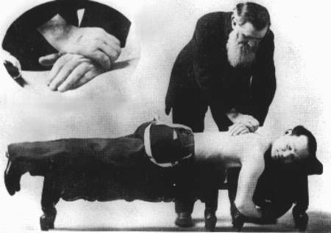
Assessing Health-Related Quality of Life at the Group- and Individual-Level
Ron D. Hays
Faculty Competency Training Program for Hubei University of Chinese Medicine
Geffen Hall 122, Los Angeles, CA, June 10, 2019

Slide 2
Disclosures
Professor, UCLA Department of Medicine, Division of General Internal Medicine and Health Services Research (drhays@ucla.edu)
Research funding from
  Agency for Healthcare Research and Quality(AHRQ)
  National Institutes of Aging (NIA)
  National Cancer Institute (NCI)

Slide 3

Concerns About US
Health Care System
Access to care
  ~ 49 million (16%) uninsured in 2010 B4 ACA
  ~ 28 million (9%) uninsured in 2017
  https://www.cnbc.com/2017/08/29/obamacare-kept-reducing-number-of-americans-without-health-insurance.html
Cost of care
  ~ $3.3 Trillion in 2016: https://en.wikipedia.org/wiki/Health_care_in_the_United_States
Effectiveness (quality) of care
  Some care delivered is inappropriate
  Not all needed care is delivered

Slide 4
Indicators of Effective Care
Quality of care
  Expert consensus about process
  Patient reports about care
    CAHPS® patient experience surveys
Health outcomes
  Clinical outcomes
    Survival, vital signs, adverse events, etc.
  Patient-reported outcomes
    Health-related quality of life

Slide 5

Health-Related
Quality of Life (HRQOL)
What the person can DO (functioning)
Physical (self-care)
Role
Social
How the person FEELs (well-being)
Emotional well-being
Pain
Energy

Slide 6
Health-Related Quality of Life (HRQOL)
Quality of environment
Type of housing
Level of income
Social Support
<- QOL, not HRQOL

Slide 7
In general, how would you rate your health?
Excellent
Very Good
Good
Fair
Poor
Hays, R. D., Spritzer, K. L., Thompson, W. W., & Cella, D. (2015). U.S. general population
estimate for “excellent” to “poor” self-rated health item. Journal of General Internal
Medicine. 30 (10), 1511-6.

Slide 8
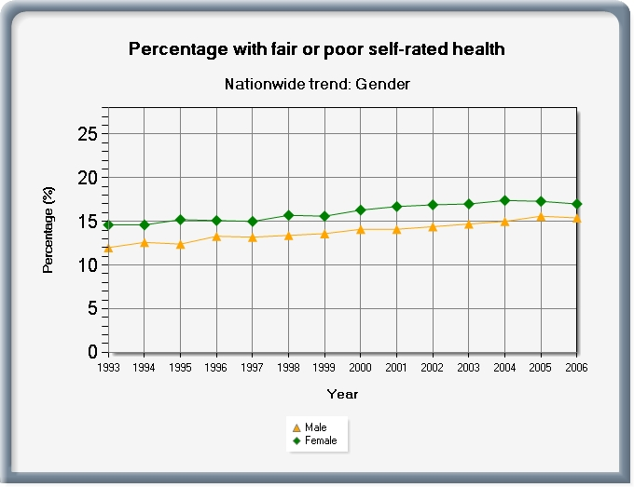
Greater % of fair or poor health reported
by females (17%) than males (15%)

Slide 9
Does your health now limit you in walking more than a mile?
(If so, how much?)
Yes, limited a lot
Yes, limited a little
No, not limited at all

Slide 10
How much of the time during the past 4 weeks have you been happy?
None of the time
A little of the time
Some of the time
Most of the time
All of the time

Slide 11
Profile HRQOL Measures
- Targeted
- Generic

Slide 12
Kidney-Disease Targeted Item
During the last 30 days, to what extent were you bothered by cramps during dialysis?
    Not at all bothered
    Somewhat bothered
    Moderately bothered
    Very much bothered
    Extremely bothered
Peipert, J. D., Nair, D., Klicko, K., Schatell, D., & Hays, R. D. (2019). Kidney Disease Quality of Life 36-item short form survey (KDQOL-36TM) normative values for the United States dialysis population and new single summary score. J Am Soc Nephrol., 30(4), 654-663.

Slide 13
SF-36 Generic Profile Measure
General health perceptions (5 items)
Physical functioning (10 items)
Role limitations/physical (4 items)
Pain (2 items)
Emotional well-being (5 items)
Role limitations/emotional (3 items)
Social functioning (2 items)
Energy/fatigue (4 items)

Slide 14
Scoring HRQOL Profile Scales
Two items with poor to excellent response scale
  1 = poor, 2 = fair, 3 = good, 4 = very good, 5 = excellent
  1 = poor, 2 = fair, 3 = good, 4 = very good, 5 = excellent
Average or sum all items in the same scale.
  Sum= 8 and average = 4
Transform to 0 (worse) to 100 (best) possible range
  100*(8 – 2)/(10-2) = 100*6/8 = 75

Slide 15
Transforming Scores to have
Target Mean and SD
Y
= target mean + (target SD * Zx)
(X - X)
Z_{X} =
SD_{X}
Z_{x} has mean = 0 and SD = 1

Slide 16
Emotional Well-Being (EWB) and Physical Functioning (PF) at Baseline: 54 Patients @ UCLA-Center for East West Medicine
EWB
PF
MS = multiple sclerosis; ESRD = end-stage renal disease; GERD = gastroesophageal reflux disease.
Higher score represents better health-related quality of life.
16

Slide 17

Emotional Well-Being (EWB) and Physical Functioning (PF) at Baseline: 54 Patients @ UCLA-Center for East West Medicine
EWB
PF
MS = multiple sclerosis; ESRD = end-stage renal disease; GERD = gastroesophageal reflux disease.
Higher score represents better health-related quality of life.
17

Slide 18
SF-36 PCS and MCS
PCS_z = (PF_Z * 0.42) + (RP_Z * 0.35) + (BP_Z * 0.32) + (GH_Z * 0.25) + (EF_Z * 0.03) + (SF_Z * -.01) + (RE_Z * -.19) + (EW_Z * -.22)
MCS_z = (EW_Z * 0.49) + (RE_Z * 0.43) +
(SF_Z * 0.27) + (EF_Z * 0.24) +
(GH_Z * -.02) + (BP_Z * -.10) +
(RP_Z * -.12) + (PF_Z * -.23)
PCS = (PCS_z*10) + 50
MCS = (MCS_z*10) + 50

Slide 19
Significant Improvement in all but 1 SF-36 Scales (T-scores)
Change
t-test
prob.
PF-10
1.7
2.38
.0208
RP-4
4.1
3.81
.0004
BP-2
3.6
2.59
.0125
GH-5
2.4
2.86
.0061
EN-4
5.1
4.33
.0001
SF-2
4.7
3.51
.0009
RE-3
1.5
0.96
.3400
EWB-5
4.3
3.20
.0023
PCS
2.8
3.23
.0021
MCS
3.9
2.82
.0067

Slide 20
Effect Size
(Follow-up – Baseline)/ SD_{baseline}
_{Cohen’s Rule of Thumb:}
_{ES = 0.20 Small}
_{ES = 0.50 Medium}
_{ES = 0.80 Large}

Slide 21
Effect Sizes for Changes in SF-36 Scores
Effect Size
0.13
0.35
0.35
0.21
0.53
0.36
0.11
0.41
0.24
0.30
PFI = Physical Functioning; Role-P = Role-Physical; Pain = Bodily Pain; Gen H=General Health; Energy = Energy/Fatigue; Social = Social Functioning; Role-E = Role-Emotional; EWB = Emotional Well-being; PCS = Physical Component Summary; MCS =Mental Component Summary.
0.11 0.13 0.21 0.24 0.30 0.35 0.35 0.36 0.41 0.53

Slide 22
Defining Responders to Treatment: Reliable Change Index (RCI)
SEM = standard error of measurement
SD_{bl} = standard deviation at baseline
r_{xx} = reliability
Notes:
Next, we were interested in how many people got better, stayed the same, and got worse over the 3 months of the study. We used the reliable change index to evaluate the significance of individual change.

Slide 23
Significant Individual Change at p<0.05
> = 1.96

Slide 24
Amount of Change in Observed Score Needed To be Statistically Significant
= 2.77 *
SD
∗
1
−
r
xx
“Coefficient of repeatability”
Note: SD = standard deviation and r_{xx} = reliability

Slide 25
How Reliability Relates to Amount of Individual Change Needed
Reliability | SQR (1- r_{xx}) | Change Needed
0.70 | 0.55 | 1.5 SD
0.80 | 0.45 | 1.2 SD
0.90 | 0.32 | 0.9 SD
0.95 | 0.22 | 0.6 SD
0.97 | 0.17 | 0.5 SD
2.77 *
SD
∗
1
−
r
xx

Slide 26
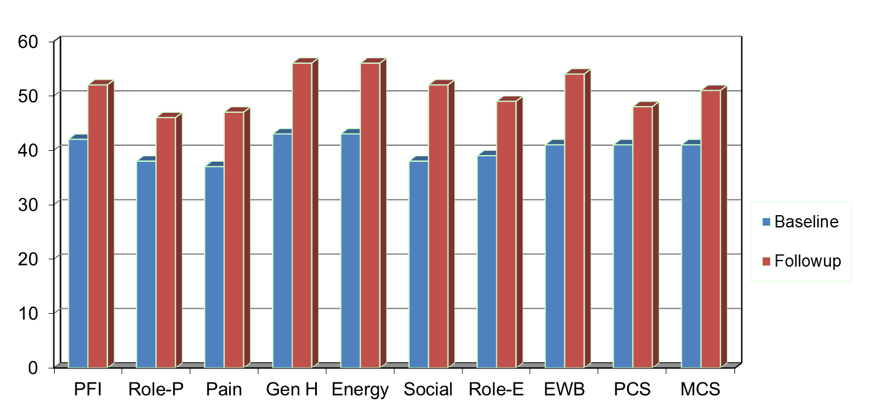
Amount of Change Needed for Significant Individual Change
Effect Size
0.67
0.72
1.01
1.13
1.33
1.07
0.71
1.26
0.62
0.73
PFI = Physical Functioning; Role-P = Role-Physical; Pain = Bodily Pain; Gen H=General Health; Energy = Energy/Fatigue; Social = Social Functioning;
Role-E = Role-Emotional; EWB = Emotional Well-being; PCS = Physical Component Summary; MCS =Mental Component Summary.

Slide 27
7-31% Improve Significantly
% Improving
% Declining
% Improving – % Declining
PF-10
13%
2%
+ 11%
RP-4
31%
2%
+ 29%
BP-2
22%
7%
+ 15%
GH-5
7%
0%
+ 7%
EN-4
9%
2%
+ 7%
SF-2
17%
4%
+ 13%
RE-3
15%
15%
0%
EWB-5
19%
4%
+ 15%
PCS
24%
7%
+ 17%
MCS
22%
11%
+ 11%

Slide 28

Patient-Reported Outcomes
Measurement Information System
Self-report measures for adults and children in the general population and individuals with chronic conditions
T-score metric for U.S. general population (Mean = 50, SD = 10)
http://www.healthmeasures.net/explore-measurement-systems/promis/measure-development-research/promis-international

Slide 29
PROMIS-29 V 2.0 Profile
  1. Physical functioning
  2. Pain (intensity and interference)
  3. Fatigue
  4. Sleep disturbance
  5. Social health (participation in roles and activities)
  6. Emotional distress (anxiety, depressive symptoms)
  7. Physical health summary score
  8. Mental health summary score
T-score metric (mean = 50, SD = 10)
  Cella, D., et al. (2019). PROMIS® Health Profiles: Efficient short-form measures of seven health domains. Value in Health, 22(5), 537-544.
  Hays, R. D., Spritzer, K. L., Schalet, B., & Cella, D. (2018). PROMIS®-29 v2.0 Profile Physical and Mental Health Summary Scores. Quality of Life Research, 27, 1885-1891.
Notes:
Slide 44
We measured patient-reported health with the Patient-reported Outcomes Measurement Information System (PROMIS) 29-item profile instrument that yields 6 multi-item scale scores and physical and mental health summary scores.
The PROMIS-29 scores are on a T-score metric with a mean of 50 and SD of 10 in the U.S. general population. For simplicity, I coded all scores so that a higher score represents better health.
[Typically, higher scores represent better physical functioning, social health, and physical and mental health summary scores. Higher scores are worse for the other 4 scales (pain, fatigue, sleep disturbance, and emotional distress).]

Slide 30
RAND Center for Excellence in Research on Complementary and Alternative Medicine )
National Center for Complementary and Integrative Health Grant No: 1U19AT007912 (PI: Ian Coulter)
Hays, R. D., Spritzer, K. L., Sherbourne, C. D., Ryan, G. W., & Coulter, I. D. (2019). Group and individual-level change on health-related quality of life in chiropractic patients with chronic low back or neck pain. Spine, 44(9), 647-651.
Notes:
This U19 examines chiropractic manipulation/mobilization for chronic low back and cervical pain using the RAND/UCLA expert panel process to assess treatment appropriateness. It also looks at patient preferences, treatment costs, and patient-reported outcomes.
Project 1: Clinician-Based Appropriateness
Project 2: Patient-Reported Outcomes
Project 3: Patient Experiences and Beliefs
Project 4: Resource Utilization.

Slide 31
Patient Inclusion/Exclusion
Inclusion
  21 and older current chiropractic patients
  Chronic low back pain and/or neck pain
    Pain for 3 months or more before seeing chiropractor
    Or self-reported as chronic
  Able to complete questionnaires in English
Exclusion
  Ongoing personal injury/workers’ compensation litigation

Slide 32
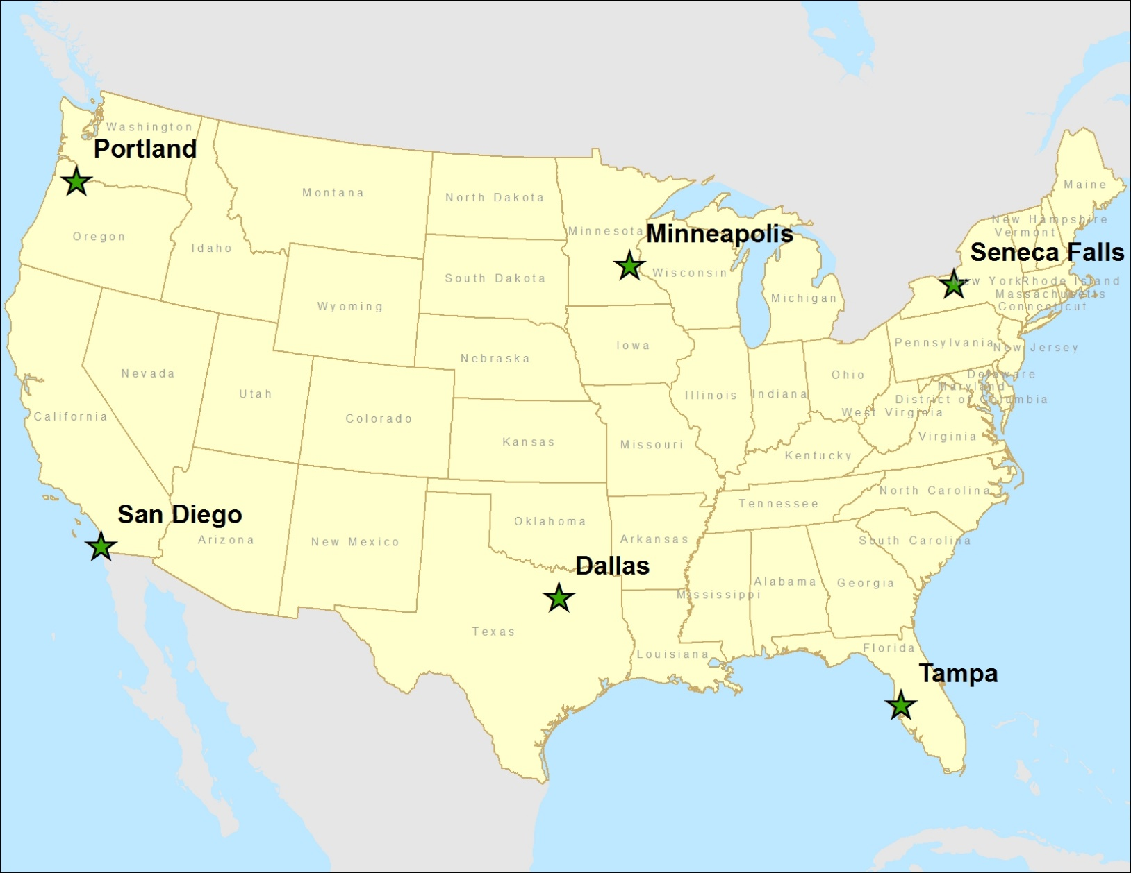
Portland, OR; San Diego, CA; Minneapolis, MN; Dallas, TX; Seneca Falls/Upstate NY, Tampa, FL for CERC National Study
125 clinics, 2024 (1834) patients
Notes:
n = 2024
72% of those eligible for the study (n = 2829) participated.
n = 1834 (65%) of the 2829; 91% of 2024.

Slide 33

n = 1834
Average age = 49 (range: 21-95)
74% female
56% college degree
88% non-Hispanic white
59% working full time; 32% income >=$100k
Mean number of years getting chiropractic care for pain = 11
Mean number of years seeing “this” chiropractor for pain = 5

Slide 34
Note: All scales scored here so that higher score is better health.
Reliability thresholds: 0.70 (group comparisons) and 0.90 (individual patients)
Notes:
The reliabilities of the PROMIS-29 v2.0 measures in this sample were 0.85 or higher.
Baseline means indicate that the sample of patients with chronic low back pain or neck pain are similar to the U.S. general population on emotional distress and better on social health. But they have worse physical functioning and more pain, fatigue, sleep disturbance, and physical and mental health summary scores.

Slide 36
Reliable Change Index (RCI)
SEM = standard error of measurement
SD_{bl} = standard deviation at baseline
r_{xx} = reliability
Notes:
Next, we were interested in how many people got better, stayed the same, and got worse over the 3 months of the study. We used the reliable change index to evaluate the significance of individual change.

Slide 37
Notes:
The percent of people that got significantly better ranged from 13% (physical functioning) to 30% (mental health summary score).

Slide 38
CR (two-tailed): 2.77*SEM
CR (one-tailed): 2.33*SEM
Notes:
Some have expressed dismay at the relatively small percentage of people classified as changed based on individual statistical significance.
One strategy for classifying change is to use a combination of one-tailed and two-tailed tests of significance and report five levels of change: definitely worse (two-tailed), probably worse (one-tailed), same (one-tailed), probably better (one-tailed), and definitely better (two-tailed). This table shows the number and percentage of people who fall into these 5 categories of change for physical function and emotional distress using IRT estimates.
Note that a very similar number of people are classified as worse versus better for emotional distress (a measure that did not change significantly at the group-level) while a greater number got better than got worse on physical function (a measure that improved significantly at the group-level).

Slide 39
Item Responses and
Trait Levels
Person 1
Person 2
Person 3
Trait
Continuum
Item 1
Item 2
Item 3

Slide 40
Computer Adaptive Test (CAT)
Question #1
high
physical
function
3
Question #2
Question #3
2
2
2
1
1
1
0
0
- 1
- 2
low
physical
function
- 3
Notes:
Purpose of this slide is to walk the audience through the CAT process using an example …and thereby transmit the message of narrower measurement range and higher precision with each question …
I typically ese e.g. an example for depression, or any other topic I want to focus on … like first question “do you feel depressed”, answer “some of the time” … than we would like to know how depressed and the CAT might choose a question asking about self worth, and if the patient indicates that this is diminished also, a third question asking about thoughts of suicide might be appropriate … in this case the answer would be no, never …
And maybe compare it with another scenario like the participant would have answered the first question, no I am not at all depressed, asking about suicide would not make sense, instead the CAT might have chosen a question asking about happiness … bla bla
The conclusion is, we can make precise test over the entire range …

Slide 41




Who does CATs?

Slide 42
The PROMIS Metric
T Score
  Mean = 50
  SD = 10
  Referenced to US General Pop.
  T = 50 + (z * 10)
www.healthmeasures.net

Slide 43
Reliability Target for Use of
Measures with Individuals
Reliability ranges from 0-1
  0.90 or above is goal
  SE = SD (1- reliability)^{1/2}
  For T-scores
    Reliability = 1 – (SE/10)²
  Reliability = 0.90 when SE = 3.2
  95% CI = true score +/- 1.96 x SE
  (observed score = true score if = mean)
Notes:
T = z*10 + 50

Slide 44
In the past 7 days …
I was grouchy [1st question]
  Never [39]
  Rarely [48]
  Sometimes [56]
  Often [64]
  Always [72]
Estimated Anger = 56.1
SE = 5.7 (rel. = 0.68)

Slide 45
In the past 7 days …
I felt like I was ready to explode
[2nd question]
  Never
  Rarely
  Sometimes
  Often
  Always
Estimated Anger = 51.9
SE = 4.8 (rel. = 0.77)

Slide 46
In the past 7 days …
I felt angry [3rd question]
  Never
  Rarely
  Sometimes
  Often
  Always
Estimated Anger = 50.5
SE = 3.9 (rel. = 0.85)

Slide 47
In the past 7 days …
I felt angrier than I thought I should [4th question]
- Never
  Rarely
  Sometimes
  Often
  Always
Estimated Anger = 48.8
SE = 3.6 (rel. = 0.87)

Slide 48
In the past 7 days …
I felt annoyed [5th question]
  Never
  Rarely
  Sometimes
  Often
  Always
Estimated Anger = 50.1
SE = 3.2 (rel. = 0.90)

Slide 49
In the past 7 days …
I made myself angry about something just by thinking about it. [6th question]
  Never
  Rarely
  Sometimes
  Often
  Always
Estimated Anger = 50.2
SE = 2.8 (rel = 0.92)

Slide 50
PROMIS Preference-based Score
Single summary score
  0 = “as bad as being dead”; 1 = “perfect health”
PROMIS-29 Profile v2.0 plus 2 Cognitive Function items
  PC6r: In the past 7 days, I have been able to concentrate. 1=Not at all, 2=A little bit, 3=Somewhat, 4=Quite a bit, 5=Very much
  PC27r: In the past 7 days, I have been able to remember to do things, like take medicine or buy something I needed. 1=Not at all, 2=A little bit, 3=Somewhat, 4=Quite a bit, 5=Very much
DeWitt, B., Feeny, D., Fischoff, B., Cella, D., Hays, R. D., Hess, R., Pilkonis, P., Revicki, D., Roberts, M. S., Tsevat, J., Lan, Y., & Hanmer, J. (2018). Estimation of a preference-based summary score for the Patient-Reported Outcomes Measurement Information System (PROPr) Scoring System. Medical Decision Making., 38(6), 683-698.

Slide 51


Questions?
drhays@ucla.edu (310-794-2294)

