Slide 1

Patient Experiences with Health Care in the United States
Ron D. Hays
Faculty Competency Training Program for Hubei University of Chinese Medicine
CHS 14-214 U, Los Angeles, CA, June 17, 2019

Slide 2
Disclosures
Professor, UCLA Department of Medicine, Division of General Internal Medicine and Health Services Research (drhays@ucla.edu)
Research funding from
  Agency for Healthcare Research and Quality(AHRQ) for Consumer Assessment of Healthcare Providers and Systems (CAHPS®) project
  National Institutes of Aging (NIA)
  National Cancer Institute (NCI)

Slide 3

Concerns About US
Health Care System
Access to care
  ~ 49 million (16%) uninsured in 2010 B4 ACA
  ~ 28 million (9%) uninsured in 2017
  https://www.cnbc.com/2017/08/29/obamacare-kept-reducing-number-of-americans-without-health-insurance.html
Cost of care
  ~ $ 3.3 Trillion in 2016: https://en.wikipedia.org/wiki/Health_care_in_the_United_States
Effectiveness (quality) of care
  Some care delivered is inappropriate
  Not all needed care is delivered

Slide 4
Indicators of Effective Care
Quality of care
  Expert consensus about process
  Patient reports about care (e.g., CAHPS®)
Health outcomes
  Clinical outcomes (e.g., BP)
  Patient-reported outcomes
    Health-related quality of life

Slide 5

Quality of care measurement
Focus has been on expert consensus about clinical process
Variant of RAND Delphi Method

Slide 6
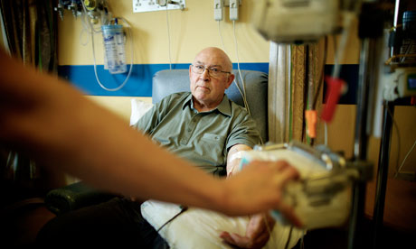
Quality of care measurement
But how patients perceive their care is also important
Patient reports about care are used to assess the patient’s experiences.
Focus has been on expert consensus about clinical process
Variant of RAND Delphi Method

Slide 7
Consumer Assessment of Healthcare Providers and Systems (CAHPS®) Approach
Focus on what patients want to know about AND can accurately report about
  Communication with health care provider
  Access to care
  Staff courtesy and respect

Slide 8
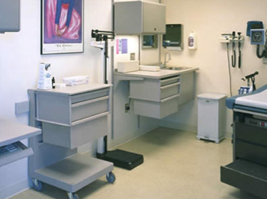

CAHPS has a family of surveys
Ambulatory Care
  Clinician & Group Survey
  Dental Plan Survey
  ECHO® Survey
  Health Plan Survey
  Home Health Care Survey
  Surgical Care Survey
Facility
  Hospital Survey
  Nursing Home Survey
  In-Center Hemodialysis Survey

Slide 9
RAND Center for Excellence in Research on Complementary and Alternative Medicine )
National Center for Complementary and Integrative Health Grant No: 1U19AT007912 (PI: Ian Coulter)
Hays, R. D., Sherbourne, C. D., Spritzer, K. L., Hilton, L. G., Ryan, G. W., Coulter, I. D., & Herman, P. M. (2019 epub). Experiences with chiropracticcare for patients with low back or neck pain. Journal of Patient Experience.
Notes:
This U19 examines chiropractic manipulation/mobilization for chronic low back and cervical pain using the RAND/UCLA expert panel process to assess treatment appropriateness. It also looks at patient preferences, treatment costs, and patient-reported outcomes.
Project 1: Clinician-Based Appropriateness
Project 2: Patient-Reported Outcomes
Project 3: Patient Experiences and Beliefs
Project 4: Resource Utilization.

Slide 10
Patient Inclusion/Exclusion
Inclusion
  21 and older current chiropractic patients
  Chronic low back pain and/or neck pain
    Pain for 3 months or more before seeing chiropractor
    Or self-reported as chronic
  Able to complete questionnaires in English
Exclusion
  Ongoing personal injury/workers’ compensation litigation

Slide 11
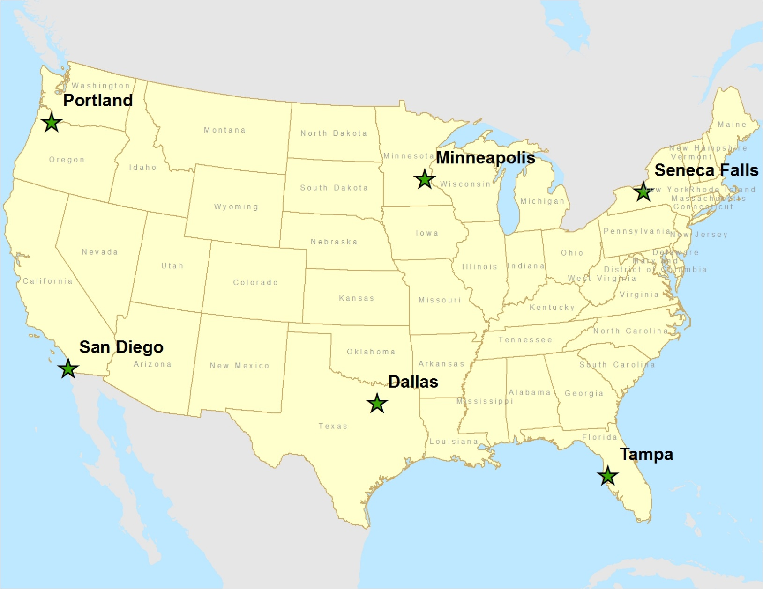
Portland, OR; San Diego, CA; Minneapolis, MN; Dallas, TX; Seneca Falls/Upstate NY, Tampa, FL for CERC National Study
125 clinics, 2024 (1834) patients
Notes:
n = 2024
72% of those eligible for the study (n = 2829) participated.
n = 1834 (65%) of the 2829; 91% of 2024.

Slide 12

n = 1834
Average age = 49 (range: 21-95)
74% female
56% college degree
88% non-Hispanic white
59% working full time; 32% income >=$100k
Mean number of years getting chiropractic care for pain = 11
Mean number of years seeing “this” chiropractor for pain = 5

Slide 13
Patient Experience Items
Literature review
Six focus groups
  2 in Los Angeles
  2 in Chicago
  2 in Boston
Selected items in the CAHPS Clinician and Group Survey relevant to chiropractic care
  Access to care (3 items)
  Communication (4 items)
  Global rating of provider (1 item)

Slide 14
CAHPS Clinician and Group Survey Items
Administered at 3-month follow-up
  Using 3-month recall interval
Responses compared with 2016 CAHPS National database
  137,416 adults from 656 practice sites
  Family practice, surgery, obstetrics/gynecology, ophthalmology, cardiology, orthopedics
  Used 6-month recall interval

Slide 17
Descriptive Statistics and Reliability of Scales
Measure (items) | Mean | SD | Alpha | Clinic-Level Intraclass Correlation
Access (5) | 87 | 18 | 0.71 | 0.066
Communication (9) | 86 | 17 | 0.86 | 0.067
Administrative assistant (4) | 95 | 12 | 0.60 | 0.101
Global ratings (2) | 89 | 14 | 0.71 | 0.033
Office appearance (1) | 90 | 13 | NA | 0.069
Perceived outcomes (3) | 82 | 17 | 0.74 | 0.012
Insurance met expectations (1) | 81 | 31 | NA | 0.020
125 clinics in chiropractic sample. Number of patients per clinic needed to obtain 0.70 reliability ranged from 21 to 197.

Slide 18
CAHPS Medicare
Survey Composites
Communication
(4 items)
Getting needed care
(2 items)
Getting care quickly
(3 items)
Customer Service
(3 items)
In the last 6 months, how often did your personal doctor explain things in a way that was easy to understand? [Never; Sometimes; Usually; Always]
In the last 6 months, how often was it easy to get the care, tests or treatment you needed?
In the last 6 months, when you needed care right away, how often did you get care as soon as you needed? [Never; Sometimes; Usually; Always]
In the last 6 months, how often did your health plan’s customer service give you the information or help you needed? [Never; Sometimes; Usually; Always]
[Never; Sometimes; Usually; Always]

Slide 19
CAHPS Medicare Survey 2012
Care Coordination Items (n = 266,466)
Personal doctor:
  has medical records or other information about your care during visits
  talks about all medicines you are taking
  informed and up-to-date about care from specialists
  helps manage care from providers and services
  follows up on test results

Slide 20
Analyses
Categorical confirmatory factor analysis
  Patient-level and multi-level (patient and plan)
  Comparative Fit Index (CFI) > 0.95
  Root Mean Square Error of Approximation (RMSEA) < 0.06
Reliability >= 0.70
  Internal consistency (coefficient alpha)
  Plan-level reliability

Slide 21
Confirmatory Factor Analyses
Good fit for patient-level CFA
  CFI = 0.996
  RMSEA = 0.020
Good fit for multi-level CFA
  CFI = 0.997
  RMSEA = 0.014

Slide 22
Standardized Factor Loadings
 | Within-Level | Between-Level
Has medical records | 0.72 (0.73) | 0.86
Talks about medicines | 0.65 (0.64) | 0.58
Informed and up-to-date | 0.70 (0.68) | 0.49
Helps manage care | 0.71 (0.73) | 0.97
Follow-up on test results | 0.71 (0.70) | 0.72
Loadings from patient-level CFA shown within parentheses. Multi-level CFA loadings are the other numbers.

Slide 23
Reliability
Internal consistency (alpha) = 0.70
Plan-level
  ICC = 0.022 at plan level
  Number of patients needed to obtain
    0.70 reliability = 102
    0.80 reliability = 170

Slide 24
Regress Global Rating on Composites
Using any number from 0 to 10, where 0 is the worst personal doctor possible, and 10 is the best personal doctor possible, what number would you use to rate your personal doctor?
□ 0 Worst personal doctor possible
□ 1
□ 2
□ 3
□ 4
□ 5
□ 6
□ 7
□ 8
□ 9
□ 10 Best personal doctor possible

Slide 25
Regression of Global Rating of Personal
Doctor on CAHPS Composites
Composite | Standardized Beta
Communication | 0.62
Care Coordination | 0.17
Getting Care Quickly | 0.03
Getting Needed Care | 0.01
Customer Service | -.002 (ns)
(R² = 0.56)
Communication and Care Coordination had a stronger association with positive ratings of the personal doctor among those with worse self-rated health.

Slide 26
Implications
Because the care coordination composite has satisfactory reliability and is uniquely associated with the global rating of the personal doctor:
Center for Medicare & Medicaid Services now
  Reports care coordination to patients and health plans
  Uses it in Quality Bonus Payments to Managed Care Plans
Need to examine:
  How it is related to other ways of assessing care coordination such as work flow, scheduling and documentation rated by external observers.
Hays, R. D., Martino, S., Brown, J., Cui, M., Cleary, P., Gaillot, S., & Elliott, M. (2014). Evaluation of a care coordination measure for the Consumer Assessment of Healthcare Providers and System (CAHPS®) Medicare Survey. Medical Care Research and Review, 71, 192-202.
Hays R. D., Mallett, J. S., Haas, A., Kahn, K., Martino, S., Gaillot, S., & Elliott, M. (2018). Associations of CAHPS composites with global ratings vary by Medicare beneficiaries’ health status. Medical Care, 56, 736-739

Slide 27


Questions?
drhays@ucla.edu (310-794-2294)

