Slide 1
Why Patient-Reported Outcomes Are Important: Growing Implications and Applications for Rheumatologists
Ron D. Hays, Ph.D.
UCLA Department of Medicine
RAND Health Program
ACR Annual Meeting, San Diego Convention Center October 30, 2013 (Room 6A)
Notes:
1

Slide 2
Disclosures
No financial relationships related to this presentation.

Slide 3
Evidence-based Medicine
Cella, D., et al. (2010). Initial item banks and first wave testing of the Patient-Reported Outcomes Measurement Information System (PROMIS) network: 2005-2008. Journal of Clinical Epidemiology, 63 (11), 1179-1194.
Hahn, E. A., et al. (2007). Precision of health-related quality-of-life data compared with other clinical measures. Mayo Clin Proceedings, 82 (10), 1244-1254.
Hays, R. D., Reeve, B. B., Smith, A. W., & Clauser, S. B. (2013, epub). Associations of cancer and other chronic medical conditions with SF-6D preference-based scores in Medicare beneficiaries. Quality of Life Research.
Khanna, D., Krishnan, E., Morgan DeWitt, E., Khanna, P. P., Spiegel, B., & Hays, R. D. (2011). The future of measuring patient reported outcomes in rheumatology. Arthritis Care and Research, 63, S486-490.

Slide 4

U.S. Health Care Issues
Access to care
  ~ 50 million people without health insurance
Costs of care
  Expenditures ~ $ 2.7 Trillion
Effectiveness (quality) of care

Slide 5
How Do We Know If Care Is Effective?
Effective care maximizes probability of desired health outcomes
  Health outcome measures indicate whether care is effective
Cost ↓
Effectiveness ↑

Slide 6
Health Outcomes Measures
Traditional clinical endpoints
  Survival
  Clinical/biological indicators
    Rheumatoid factor
    Blood pressure
    Hematocrit
Patient-Reported Outcomes

Slide 7
Patient-Reported Measures (PRMs)
Mediators
  Health behaviors (adherence)
Health Care Process
  Reports about care (e.g., communication)
Outcomes (PROs)
  Patient satisfaction with care
  Health-Related Quality of Life (HRQOL)

Slide 8
HRQOL in SEER-Medicare Health Outcomes Study (n = 126,366)
Controlling for age, gender, race/ethnicity, education, income, and marital status.
65

Slide 9
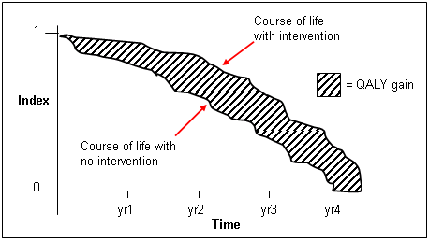
http://www.ukmi.nhs.uk/Research/pharma_res.asp

Slide 10

Health-Related Quality of Life (HRQOL)
How the person FEELs (well-being)
  Emotional well-being
  Pain
  Energy
What the person can DO (functioning)
  Self-care
  Role
  Social

Slide 11
Does your health now limit you in walking more than a mile?
(If so, how much?)
Yes, limited a lot
Yes, limited a little
No, not limited at all

Slide 12

HRQOL is Not
Quality of environment
Type of housing
Level of income
Social Support

Slide 13
HRQOL is Reliable and Predictive of (5-year) Mortality
%
Dead
(n=676)
(n=754)
(n=1181)
(n=609)
SF-36 Physical Health Component Score (PCS)—T score
Ware et al. (1994). SF-36 Physical and Mental Health Summary Scales: A User’s Manual.

Slide 14
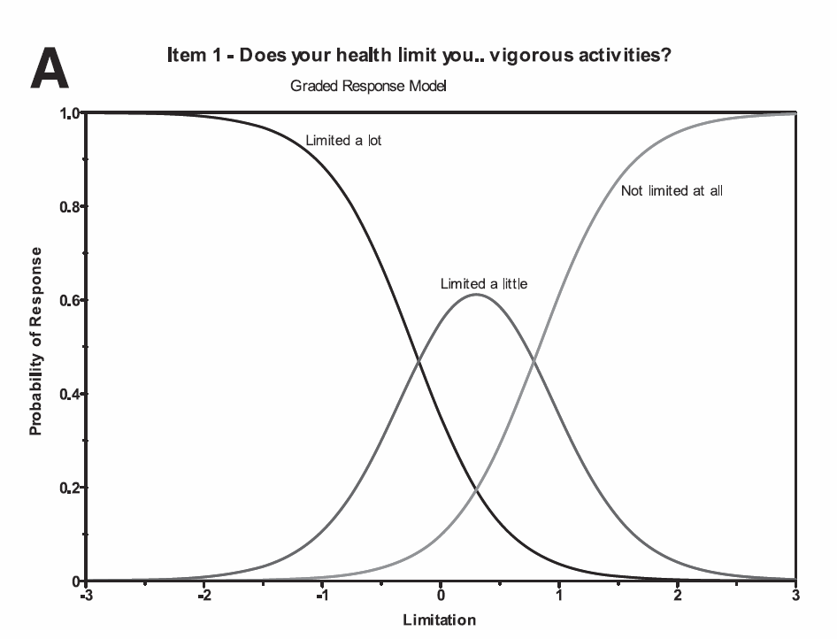
Does your health limit you in vigorous activities?
Less Limitation

Slide 15
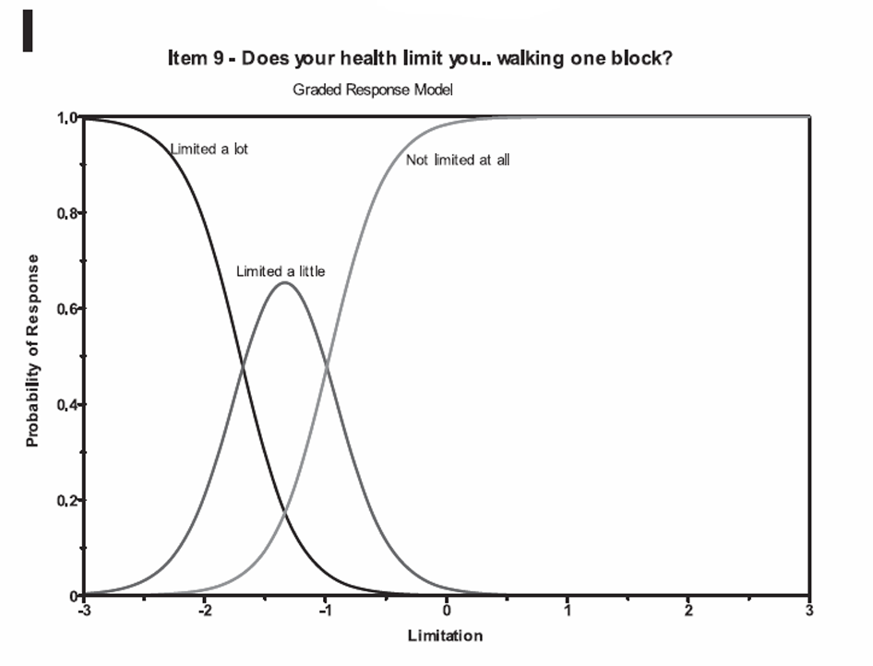
Does your health limit you in walking one block?
Less Limitation

Slide 16
Item Responses and Trait Levels
Person 1
Person 2
Person 3
Trait
Continuum
Item 1
Item 2
Item 3
www.nihpromis.org

Slide 17




Computer Adaptive Testing (CAT)
Notes:
Early research on CAT was funded by the U.S. military to enhance mental measurement.
NASD = National Association of Security Dealers. In 1978 they began developing CAT for regulatory exam to assess knowledge of securities and securities future products among licensed brokers.
The National Council of State Boards of Nursing starting using CAT in 1994.

Slide 18
Response Burden Reduced
Paper and pencil rules of thumb
  3-5 items per minute
PROMIS computer administration to general population
  8-12 items per minute
Scleroderma patients at UCLA
  6 items per minute

Slide 19
Reliability Target for Use of Measures with Individuals
Reliability ranges from 0-1
  0.90 or above is goal
Reliability = 0.90 when SE = 3.2
  T-scores (mean = 50, SD = 10)
  Reliability = 1 – (SE/10)²
T = 50 + (z * 10)
Notes:
T = z*10 + 50

Slide 20
PROMIS Physical Functioning vs. “Legacy” Measures
10 20 30 40 50 60 70

Slide 21
In the past 7 days …
I was grouchy [1st question]
  Never [39]
  Rarely [48]
  Sometimes [56]
  Often [64]
  Always [72]
Estimated Anger = 56.1
SE = 5.7 (rel. = 0.68)
Notes:
Never: 39
Rarely: 48
Sometimes = 56
Often = 64
Always = 72

Slide 22
In the past 7 days …
I felt like I was ready to explode
[2nd question]
  Never
  Rarely
  Sometimes
  Often
  Always
Estimated Anger = 51.9
SE = 4.8 (rel. = 0.77)

Slide 23
In the past 7 days …
I felt angry [3rd question]
  Never
  Rarely
  Sometimes
  Often
  Always
Estimated Anger = 50.5
SE = 3.9 (rel. = 0.85)

Slide 24
In the past 7 days …
I felt angrier than I thought I should [4th question]
- Never
  Rarely
  Sometimes
  Often
  Always
Estimated Anger = 48.8
SE = 3.6 (rel. = 0.87)

Slide 25
In the past 7 days …
I felt annoyed [5th question]
  Never
  Rarely
  Sometimes
  Often
  Always
Estimated Anger = 50.1
SE = 3.2 (rel. = 0.90)

Slide 26
In the past 7 days …
I made myself angry about something just by thinking about it. [6th question]
  Never
  Rarely
  Sometimes
  Often
  Always
Estimated Anger = 50.2
SE = 2.8 (rel = 0.92)

Slide 27
Defining a Responder: Reliable Change Index (RCI)
RCI >=1.96 is statistically significant individual change..

Slide 28

Thank you!
Contact Information:
drhays@ucla.edu (310-794-2294)
Powerpoint file available at: http://gim.med.ucla.edu/FacultyPages/Hays/

