Slide 1

Health-Related Quality of Life as an Indicator of Quality of Care
April 10, 2015 (8:30 – 11:30am)
HPM216: Quality Assessment/
Making the Business Case for Quality
10940 Wilshire Blvd. Suite 700
Los Angeles, CA
Ron D.Hays, Ph.D.

Slide 2

U.S. Health Care Issues
Access to care
  ~ 50 million people without health insurance
Costs of care
  Expenditures ~ $ 2.7 Trillion
Effectiveness (quality) of care

Slide 3
How Do We Know If Care Is Effective?
Effective care maximizes probability of desired health outcomes
  Health outcome measures indicate whether care is effective
Cost ↓
Effectiveness ↑

Slide 4
Determinants of Health
Quality
Of Care
Health
Characteristics
Behavior
Environment
Chronic
Conditions

Slide 5
Indicators of Health
Signs and Symptoms of Disease

Slide 6
Indicators of Health
Signs and Symptoms of Disease
Functioning
Well-Being

Slide 7
Functioning and Well-Being
Functioning (what you can do)
    Self-care
    Role
    Social
Well-being (how you feel)
  Pain
  Energy
  Depression
  Positive affect

Slide 8
Indicators of Health
Signs and Symptoms of Disease
Functioning
Well-Being

Slide 9
KDQOL Symptoms/Problems
During the past 4 weeks, to what extent were you bothered by each of the following?
Soreness in your muscles?
Chest pain?
Itchy skin?
Shortness of breath?
Faintness or dizziness?

Slide 10

Health-Related Quality of Life (HRQOL)
Quality of environment
Type of housing
Level of income
Social Support

Slide 11
HRQOL Measurement Options
Multiple Scores (Profile)
  Generic (SF-36)
    How much of the time during the past 4 weeks have you been happy? (None of the time → All of the time)
  Targeted (“Disease specific”)
    KDQOL-36
      My kidney disease interferes too much with my life.
Single Score
  Preference-based (EQ-5D, HUI, SF-6D)
Combinations of above

Slide 12
HRQOL Scoring Options
0-100 possible range
T-scores (mean = 50, SD = 10)
  (10 * z-score) + 50
    z-score = (score – mean)/SD
0 (dead) to 1 (perfect health)

Slide 13
HRQOL in HIV Compared to other
Chronic Illnesses and General Population
T-score metric
Hays et al. (2000), American Journal of Medicine

Slide 14
HRQOL in HIV Compared to other
Chronic Illnesses and General Population
T-score metric
Hays et al. (2000), American Journal of Medicine

Slide 15
HRQOL in HIV Compared to other
Chronic Illnesses and General Population
T-score metric
Hays et al. (2000), American Journal of Medicine

Slide 16
HRQOL in HIV Compared to other
Chronic Illnesses and General Population
T-score metric
Hays et al. (2000), American Journal of Medicine

Slide 17
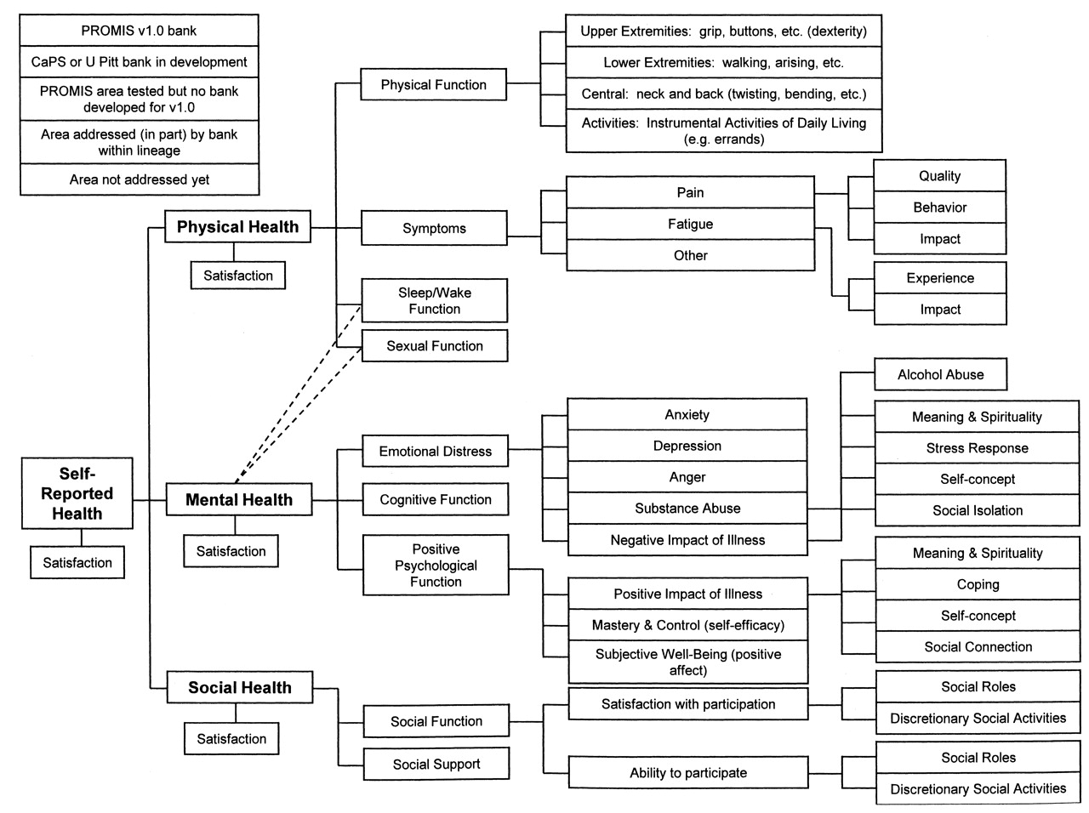

Slide 18
Item Responses and
Trait Levels
Person 1
Person 2
Person 3
Trait
Continuum
Item 1
Item 2
Item 3
www.nihpromis.org

Slide 19
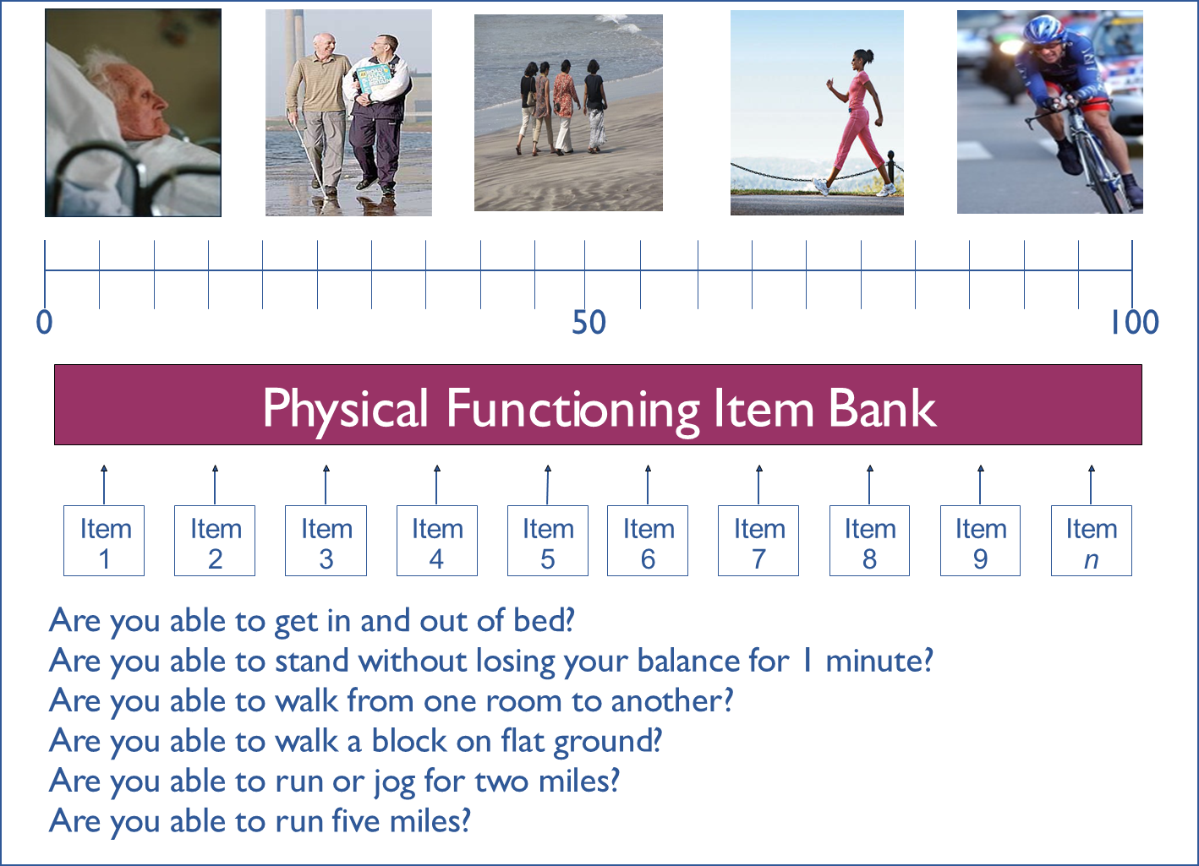

Slide 20
Reliability Target for Use of Measures with Individuals
Reliability ranges from 0-1
  0.90 or above is goal
  SE = SD (1- reliability)^{1/2}
  Reliability = 1 – (SE/10)²
  Reliability = 0.90 when SE = 3.2
  95% CI = true score +/- 1.96 x SE
Notes:
T = z*10 + 50

Slide 21
In the past 7 days …
I was grouchy [1st question]
  Never [39]
  Rarely [48]
  Sometimes [56]
  Often [64]
  Always [72]
Estimated Anger = 56.1
SE = 5.7 (rel. = 0.68)
Notes:
Never: 39
Rarely: 48
Sometimes = 56
Often = 64
Always = 72

Slide 22
In the past 7 days …
I felt like I was ready to explode
[2nd question]
  Never
  Rarely
  Sometimes
  Often
  Always
Estimated Anger = 51.9
SE = 4.8 (rel. = 0.77)

Slide 23
In the past 7 days …
I felt angry [3rd question]
  Never
  Rarely
  Sometimes
  Often
  Always
Estimated Anger = 50.5
SE = 3.9 (rel. = 0.85)

Slide 24
In the past 7 days …
I felt angrier than I thought I should [4th question]
- Never
  Rarely
  Sometimes
  Often
  Always
Estimated Anger = 48.8
SE = 3.6 (rel. = 0.87)

Slide 25
In the past 7 days …
I felt annoyed [5th question]
  Never
  Rarely
  Sometimes
  Often
  Always
Estimated Anger = 50.1
SE = 3.2 (rel. = 0.90)

Slide 26
In the past 7 days …
I made myself angry about something just by thinking about it. [6th question]
  Never
  Rarely
  Sometimes
  Often
  Always
Estimated Anger = 50.2
SE = 2.8 (rel = 0.92)

Slide 27
PROMIS Physical Functioning vs. “Legacy” Measures
10 20 30 40 50 60 70

Slide 28
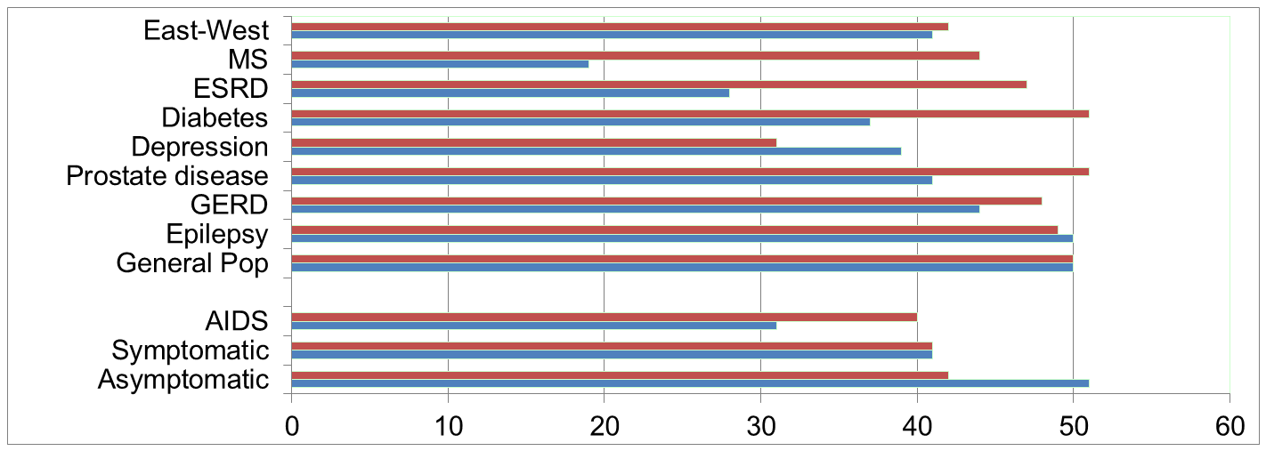
Physical Functioning and Emotional Well-Being at Baseline for 54 Patients at UCLA-Center for East West Medicine
EWB
Physical
MS = multiple sclerois; ESRD = end-stage renal disease; GERD = gastroesophageal reflux disease.
28

Slide 29
Significant Improvement in all but 1 of SF-36 Scales (Change is in T-score metric)
Change
t-test
prob.
PF-10
1.7
2.38
.0208
RP-4
4.1
3.81
.0004
BP-2
3.6
2.59
.0125
GH-5
2.4
2.86
.0061
EN-4
5.1
4.33
.0001
SF-2
4.7
3.51
.0009
RE-3
1.5
0.96
.3400
EWB-5
4.3
3.20
.0023
PCS
2.8
3.23
.0021
MCS
3.9
2.82
.0067

Slide 30
Effect Size
(Follow-up – Baseline)/ SD_{baseline}
_{Cohen’s Rule of Thumb:}
_{ES = 0.20 Small}
_{ES = 0.50 Medium}
_{ES = 0.80 Large}

Slide 31
Effect Sizes for Changes in SF-36 Scores
Effect Size
0.13
0.35
0.35
0.21
0.53
0.36
0.11
0.41
0.24
0.30
PFI = Physical Functioning; Role-P = Role-Physical; Pain = Bodily Pain; Gen H=General Health; Energy = Energy/Fatigue; Social = Social Functioning; Role-E = Role-Emotional; EWB = Emotional Well-being; PCS = Physical Component Summary; MCS =Mental Component Summary.

Slide 32
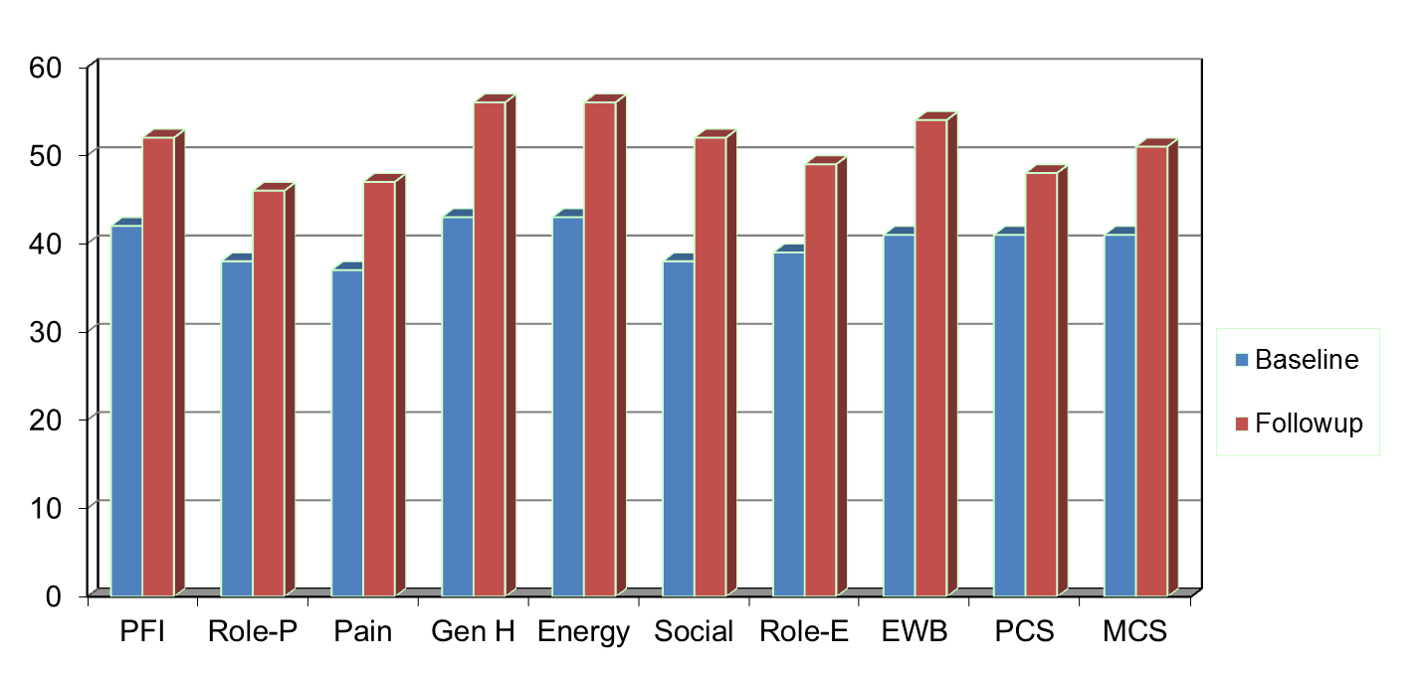
Amount of Change Needed for Significant Individual Change
Effect Size
0.67
0.72
1.01
1.13
1.33
1.07
0.71
1.26
0.62
0.73
PFI = Physical Functioning; Role-P = Role-Physical; Pain = Bodily Pain; Gen H=General Health; Energy = Energy/Fatigue; Social = Social Functioning;
Role-E = Role-Emotional; EWB = Emotional Well-being; PCS = Physical Component Summary; MCS =Mental Component Summary.

Slide 33
7-31% of People in Sample Improve Significantly
% Improving
% Declining
Difference
PF-10
13%
2%
+ 11%
RP-4
31%
2%
+ 29%
BP-2
22%
7%
+ 15%
GH-5
7%
0%
+ 7%
EN-4
9%
2%
+ 7%
SF-2
17%
4%
+ 13%
RE-3
15%
15%
0%
EWB-5
19%
4%
+ 15%
PCS
24%
7%
+ 17%
MCS
22%
11%
+ 11%

Slide 34
Defining a Responder: Reliable Change Index (RCI)
Note: SD_{bl} = standard deviation at baseline
r_{xx} = reliability

Slide 35
Amount of Change in Observed Score Needed To be Statistically Significant
Note: SD_{bl} = standard deviation at baseline and r_{xx} = reliability

Slide 36
PROMIS CAT Report

Slide 39
“Implementing patient-reported outcomes assessment in clinical practice: a review of the options and considerations”
Snyder, C.F., Aaronson, N. K., et al. Quality of Life Research, 21, 1305-1314, 2012.
  HRQOL has rarely been collected in a standardized fashion in routine clinical practice.
  Increased interest in using PROs for individual patient management.
  Research shows that use of PROs:
    Improves patient-clinician communication
    May improve outcomes

Slide 40
Is CAM Better than
Standard Care (SC)?
CAM
SC
CAM
SC
Physical
Health
CAM > SC
Mental
Health
SC > CAM

Slide 41
General Health Perceptions
In general, how would you rate your health?
Excellent
Very Good
Good
Fair
Poor

Slide 42
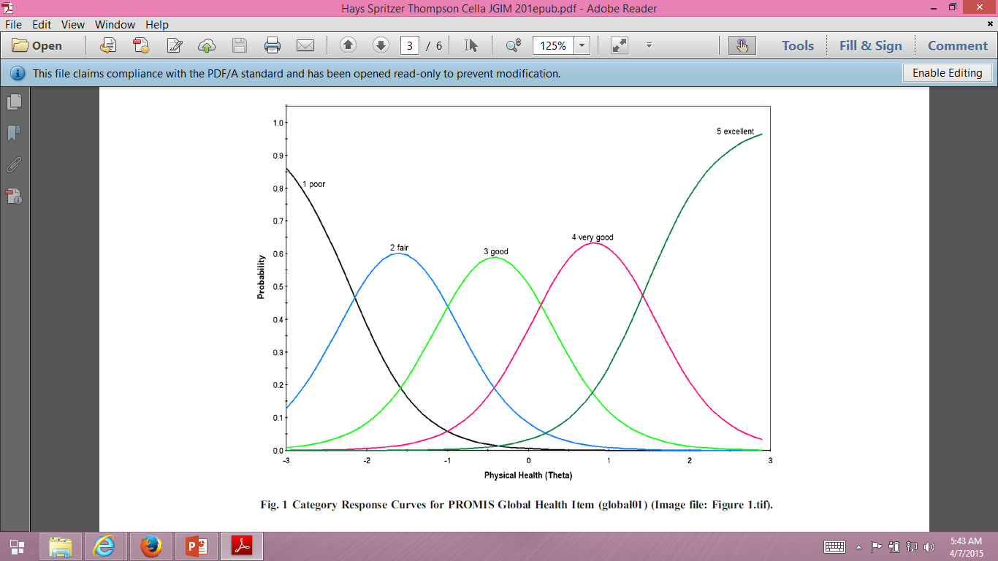

Slide 43
Is Acupuncture Related to Worse HRQOL?
Subject Acupuncture General Health
1 No dead
2 No dead
3 No 50
4 No 60
5 No 70
6 Yes 40
7 Yes 50
8 Yes 50
9 Yes 55 10 Yes 55
  Group n HRQOL
  No Acupuncture 3 60
  Yes Acupuncture 5 50

Slide 44
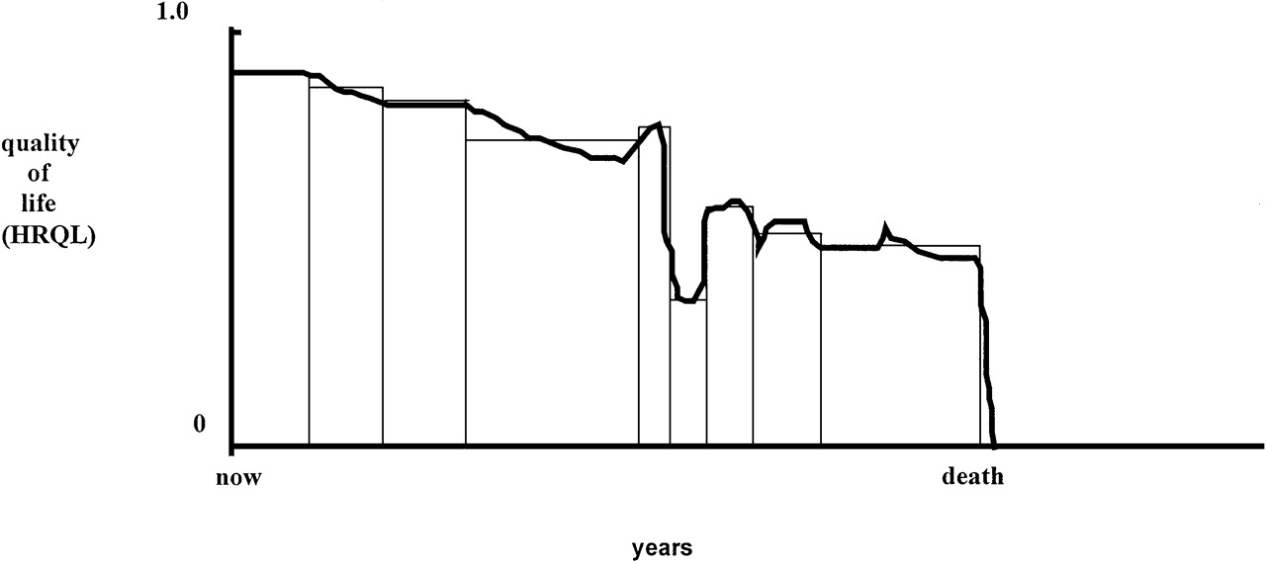
Quality of Life for Individual Over Time

Slide 45
Cost-Effective Care
Cost ↓
Effectiveness (“Utility”) ↑

Slide 46
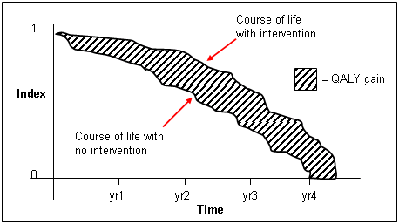
http://www.ukmi.nhs.uk/Research/pharma_res.asp

Slide 47
“QALYs: The Basics”
Milton Weinstein, George Torrance, Alistair McGuire
(Value in Health, 2009, vol. 12 Supplement 1)
What is value?
  Preference or desirability of health states
How are QALYs used?
  Societal resource allocation
  Personal decisions such as decision about whether to have a treatment
  Societal or program audit
    Evaluate programs in terms of health of the population.

Slide 48
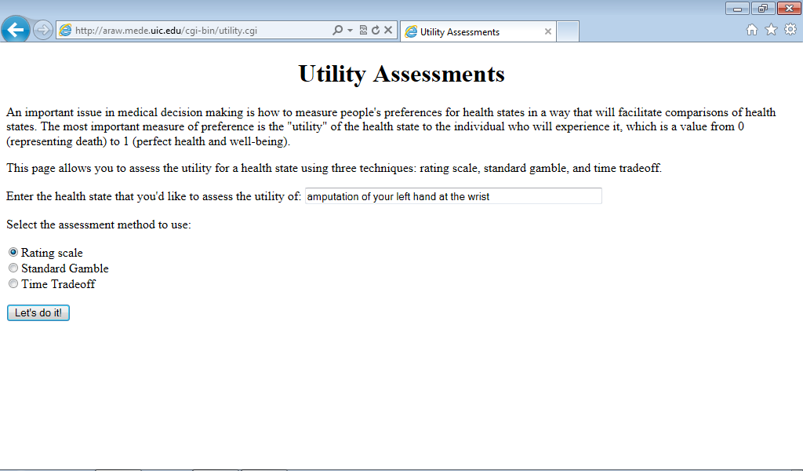
http://araw.mede.uic.edu/cgi-bin/utility.cgi
http://araw.mede.uic.edu/cgi-bin/utility.cgi

Slide 49
SG>TTO>RS
SG = TTOª
SG = RS^{b}
^{Where a and b are less than 1}

Slide 50
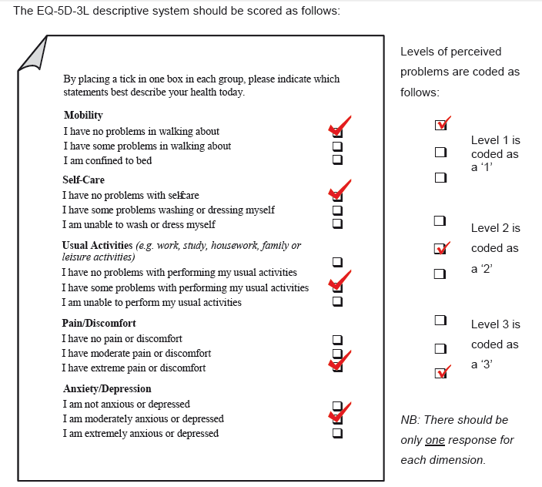
0.435

Slide 51
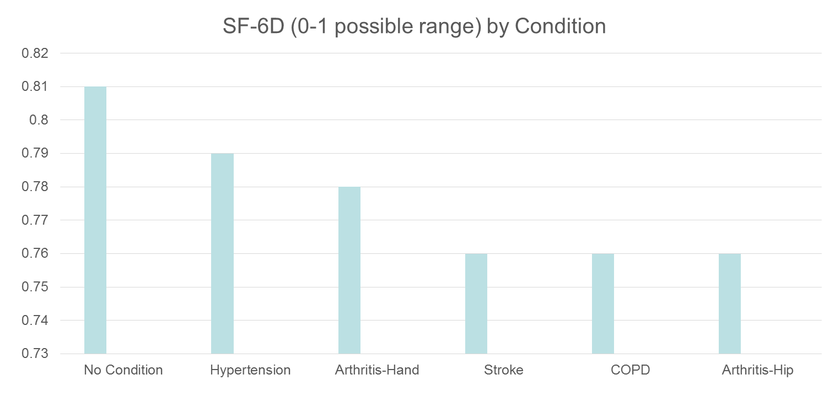
HRQOL in SEER-Medicare Health Outcomes Study (n = 126,366)
Controlling for age, gender, race/ethnicity, education, income, and marital status.

Slide 52
Distant stage of cancer associated with 0.05-0.10 lower SF-6D Score

Slide 53

Thank you.
drhays@g.ucla.edu
Powerpoint file at: http://gim.med.ucla.edu/FacultyPages/Hays/
Notes:
53

