Slide 1
15-minute Introduction to PROMIS
Ron D. Hays, Ph.D
UCLA Division of General Internal Medicine & Health Services Research
Roundtable Meeting on Measuring Burden of Illness
November 10, 2010 (1:50-2:05 pm)
RTI, Washington, DC

Slide 2
What is PROMIS?
A nine-year $70 million commitment of NIH to improve and standardize measurement of patient-reported outcomes (PROs)
  Self-reported health
An answer to the PRO “Tower of Babel”

Slide 3
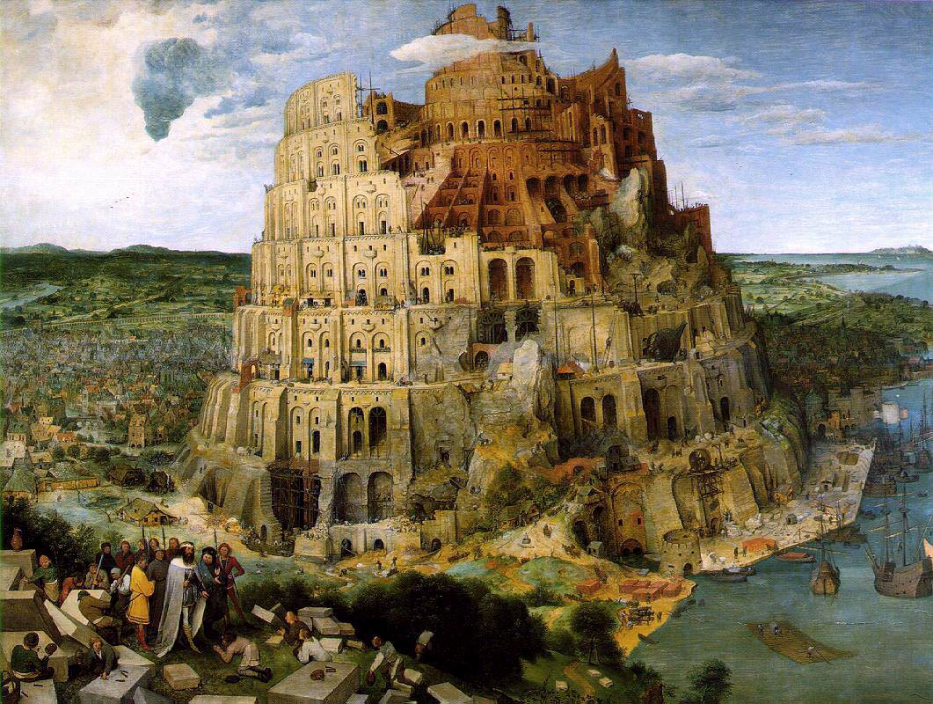
The Tower of Babel (Brueghel, 1563)

Slide 4
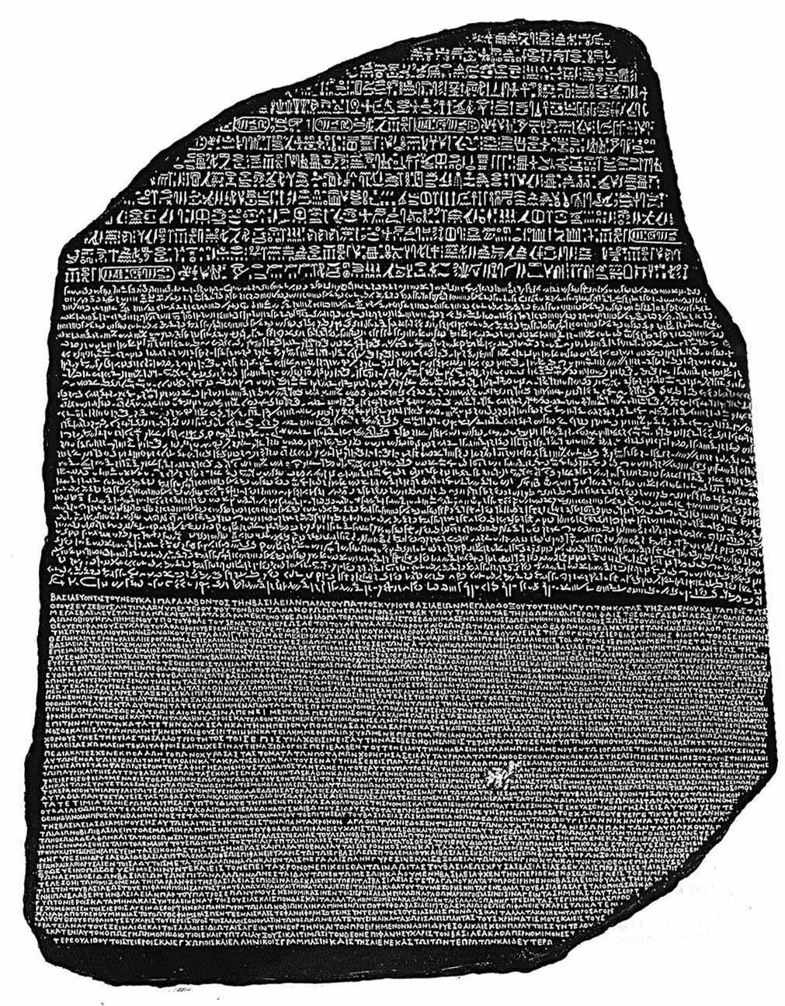
Rosetta Stone
The
Notes:
Egyptian hieroglyphs; Egyptian demotic script; Ancient Greek

Slide 5
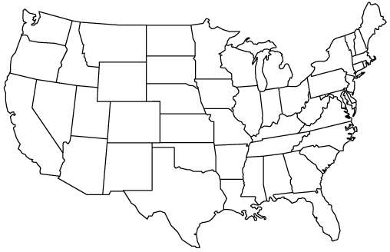
PROMIS-1 Network: 2004-2009
● University of Washington
●
StoneyBrook
Northwestern ♥
● University of Pittsburgh
● NIH
● Stanford
UNC –Chapel Hill ●
● Duke University*
♥Coordinating Center

Slide 6
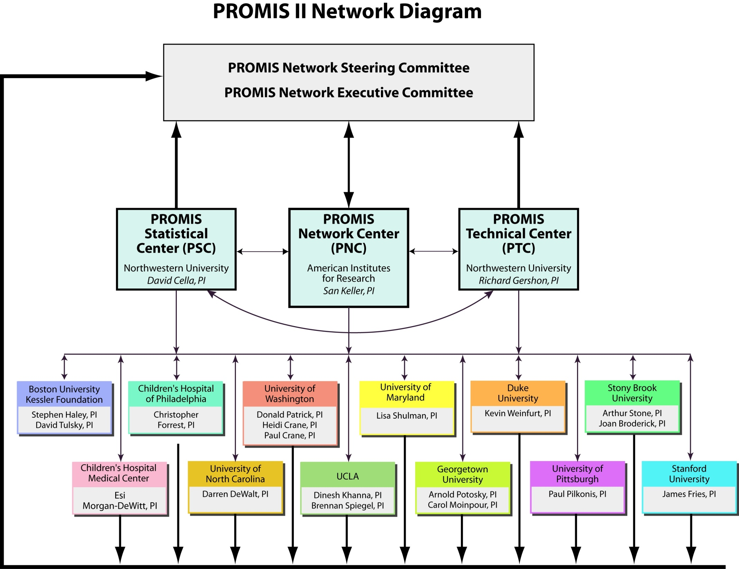

Slide 7
Literature
Review
Patient
Focus
Groups
Expert
Input and
Consensus
Existing
Items
Newly
Written
Items
Item Pool
Expert
Review
Translation
Cognitive
Testing
Secondary
Data Analysis





Questionnaire
administered to large
representative sample








Psycho-
metric
Testing
Item Bank
(IRT-calibrated items)
CAT
Short Form
Instruments

Slide 8
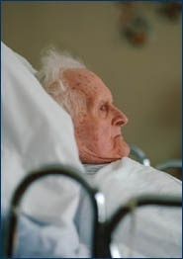
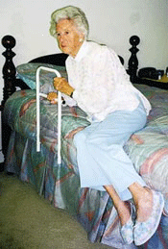
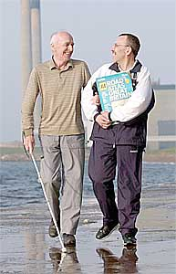
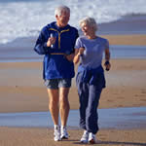
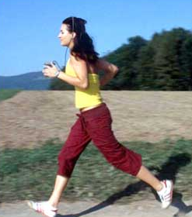
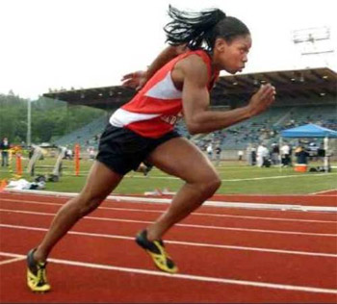











50
Physical Functioning Item Bank
Item
1
Item
2
Item
3
Item
4
Item
5
Item
6
Item
7
Item
8
Item
9
Item
n
Are you able to get in and out of bed?
Are you able to stand without losing your balance for 1 minute?
Are you able to walk from one room to another?
Are you able to walk a block on flat ground?
Are you able to run or jog for two miles?
Are you able to run five miles?

Slide 9
Interpretation
Person Fatigue Score


































Low






High















Q
Q Q Q
Q Q Q
Q Q Q
Q
Q Q Q
Q
Q
Q
Likely
“I get tired
when I run
a marathon”
Unlikely
“I get tired
when I get
out of a
chair”
Q Q Q
Q Q Q
Q Q Q
Q Q Q
Q
Q Q Q
Q Q Q
Q
Q Q Q
Q
Q Q Q
Q Q Q
Q
Q Q Q
Item Location
Notes:
Likely item: I get tired when I run a marathon (T)
Unlikely item: I get tired when I get out of bed (T)

Slide 10
Interpretation Aids
PRO Bank Person Score


































Low






High















30
40
50
60
70
M = 50, SD = 10
T = (z * 10) + 50

Slide 11
Example of high fatigue
Fatigue Score=60


































Low






High















30
40
50
60
70
This patient’s fatigue score is 60, significantly worse than average (50). People who score 60 on fatigue tend to answer questions as follows:
…”I have been too tired to climb one flight of stairs: VERY MUCH
…”I have had enough energy to go out with my family: A LITTLE BIT

Slide 12
Example of low fatigue
Fatigue Score=40


































Low






High















30
40
50
60
70
This patient’s fatigue score is 40, significantly better than average (50). People who
score 40 on fatigue tend to answer questions as follows:
…”I have been too tired to climb one flight of stairs: SOMEWHAT
…”I have had enough energy to go out with my family: VERY MUCH

Slide 13
Computerized Adaptive Testing (CAT)
Select questions based on a person’s response to previously administered questions.
Iteratively estimate a person’s standing on a domain (e.g., fatigue, depressive symptoms)
Administer most informative items
Desired level of precision can be obtained using the minimal possible number of questions.

Slide 14
Beginning of CAT
Best Item-I felt depressed
T-Score = 50
SE = 10

Slide 15
I felt depressed
  Never
  Rarely
  Sometimes
  Often
  Always
Next Best Item-I felt like a failure
T-Score = 52
SE = 4

Slide 16
I felt like a failure
  Never
  Rarely
  Sometimes
  Often
  Always
Next Best Item-I felt worthless
T-Score = 53
SE = 3

Slide 17
I felt worthless
  Never
  Rarely
  Sometimes
  Often
  Always
Next Best Item-I felt helpless
T-Score = 55
SE = 2

Slide 18
I felt helpless
  Never
  Rarely
  Sometimes
  Often
  Always
T-Score = 55
SE = 2

Slide 19
CAT assessments can achieve higher precision than fixed forms
measurement precision (standard error)
0.5
SF-12 items
0.4
SF-36 items
SE = 0.32
rel = 0.90
0.3
HAQ items
SE = 0.22
rel = 0.95
0.2
CAT 10 items
Full Item Bank
0.1
rheumatoid arthritis
patients
representative
sample
-4 -3 -2 -1 0 +1 +2
normed theta values
US-Representative Sample
Rose et al, J Clin Epidemiol 2007 (accepted)

Slide 20
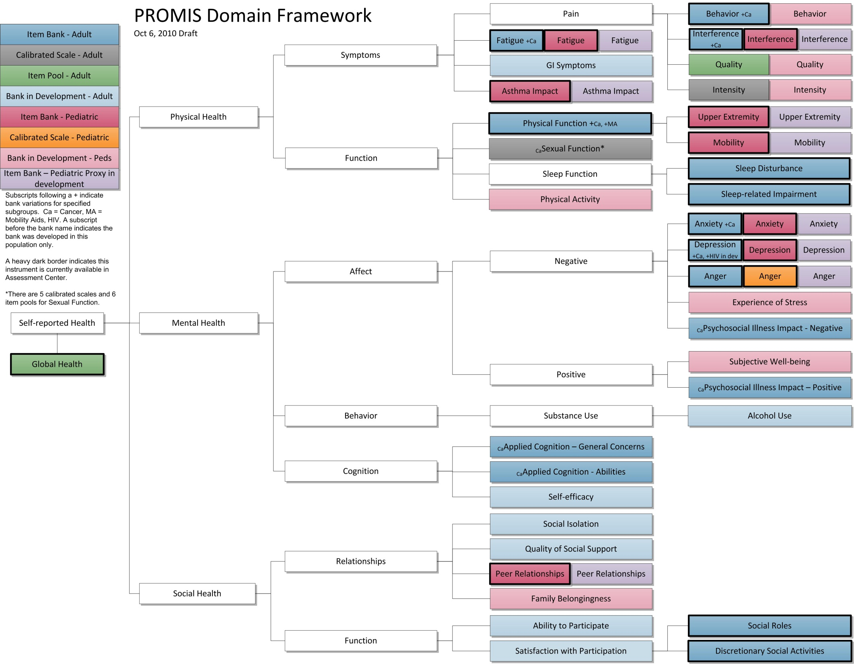

Slide 21
PROMIS Domains in AC, 2010
Domains | # Items Adult Bank | # Items Adult Short Forms | # Items Peds Bank | # Items Peds Short Form
Emotional Distress – Anger | 29 | 8 |  | 6
Emotional Distress – Anxiety | 29 | 4, 6, 7, 8 | 15 | 8
Emotional Distress – Depression | 28 | 4, 6, 8a, 8b | 14 | 8
Fatigue | 95 | 4, 6, 7, 8 | 23 | 10
Pain – Behavior | 39 | 7
Pain – Interference | 41 | 4, 6a, 6b, 8 | 13 | 8
Physical Function | 124 | 4, 6, 8, 10, 20
-- Mobility |  |  | 23 | 8
-- Upper Extremity |  |  | 29 | 8
Asthma Impact |  |  | 17 | 8

Slide 22
PROMIS Domains in AC, 2010
Domains | # Items Adult Bank | # Items Adult Short Forms | # Items Peds Bank | # Items Peds Short Forms
Satisfaction with Discretionary Social Activities | 12 | 7
Satisfaction with Social Roles | 14 | 4, 6, 7, 8
Peer Relationships |  |  | 15 | 8
Sleep Disturbance | 27 | 4, 6, 8a, 8b
Sleep-Related Impairment | 16 | 8
Global Health |  | 10

Slide 23
2010 PROMIS Profile Instruments
Domains | PROMIS-29 | PROMIS-43 | PROMIS-57
Emotional Distress – Anxiety | 4 | 6 | 8
Emotional Distress – Depression | 4 | 6 | 8
Fatigue | 4 | 6 | 8
Pain – Interference | 4 | 6 | 8
Pain – Intensity | 1 | 1 | 1
Satisfaction with Social Role | 4 | 6 | 8
Sleep Disturbance | 4 | 6 | 8
Physical Function | 4 | 6 | 8

Slide 24
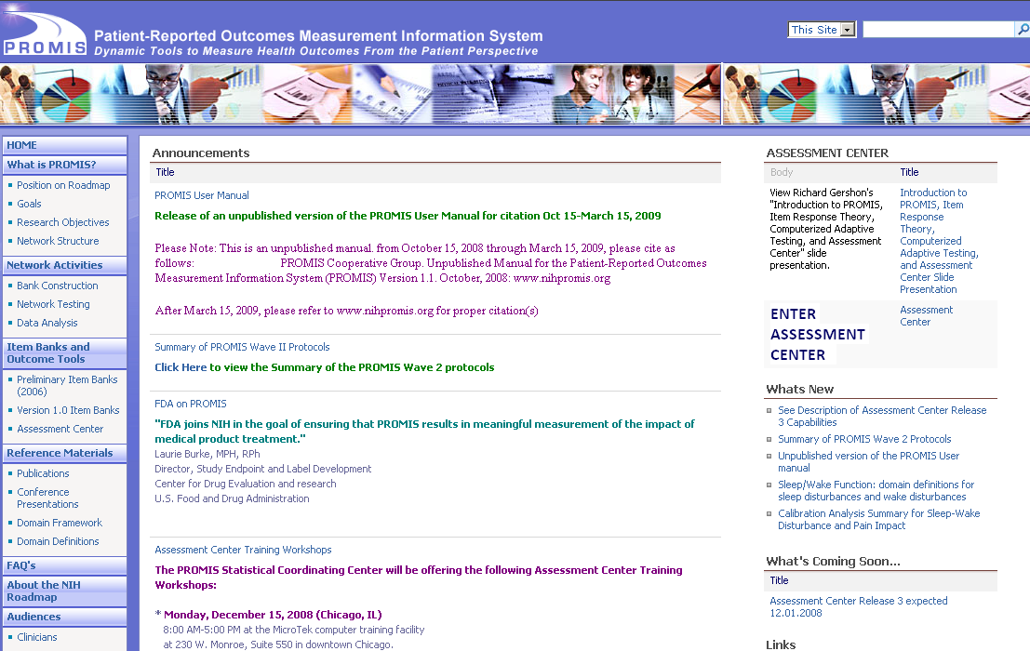
Thank you
www.nihpromis.org

