Slide 1
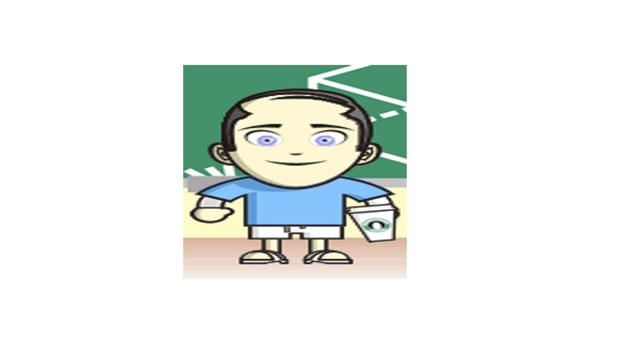
Patient-Centered Outcomes of Health Care
Comparative Effectiveness Research
February 3, 2015
9:00am – 12:00pm
16-145 CHS
Ron D.Hays, Ph.D.

Slide 2
Introduction to
Patient-Reported Outcomes
9:00-10:00am

Slide 3
Determinants of Health
Quality
Of Care
Health
Characteristics
Behavior
Environment
Chronic
Conditions

Slide 4
Indicators of Health
Signs and Symptoms of Disease
Functioning
Well-Being

Slide 5
Functioning and Well-Being
Functioning (what you can do)
    Self-care
    Role
    Social
Well-being (how you feel)
  Pain
  Energy
  Depression
  Positive affect

Slide 6
SF-36 Generic Profile Measure
Physical functioning (10 items)
Role limitations/physical (4 items)
Role limitations/emotional (3 items)
Social functioning (2 items)
Emotional well-being (5 items)
Energy/fatigue (4 items)
Pain (2 items)
General health perceptions (5 items)

Slide 7
Indicators of Health
Signs and Symptoms of Disease
Functioning
Well-Being

Slide 8

Health-Related Quality of Life (HRQOL)
Quality of environment
Type of housing
Level of income
Social Support

Slide 9
HRQOL Measurement Options
Multiple Scores (Profile)
  Generic (SF-36)
    How much of the time during the past 4 weeks have you been happy? (None of the time → All of the time)
  Targeted (“Disease specific”)
    KDQOL-36
      My kidney disease interferes too much with my life.
Single Score
  Preference-based (EQ-5D, HUI, SF-6D)
Combinations of above

Slide 10
HRQOL Scoring Options
0-100 possible range
T-scores (mean = 50, SD = 10)
  (10 * z-score) + 50
    z-score = (score – mean)/SD
0 (dead) to 1 (perfect health)

Slide 11
HRQOL in HIV Compared to other
Chronic Illnesses and General Population
T-score metric
Hays et al. (2000), American Journal of Medicine

Slide 12

Normal Distribution
Within 1 SD = 68.2%, 2 SDs =95.4%; 3 SDs = 99.6%

Slide 13
HRQOL in HIV Compared to other
Chronic Illnesses and General Population
T-score metric
Hays et al. (2000), American Journal of Medicine

Slide 14
HRQOL in HIV Compared to other
Chronic Illnesses and General Population
T-score metric
Hays et al. (2000), American Journal of Medicine

Slide 15
HRQOL in HIV Compared to other
Chronic Illnesses and General Population
T-score metric
Hays et al. (2000), American Journal of Medicine

Slide 16
Physical Functioning in Relation to Time
Spent Exercising 2-years Before
84
82
80
78
76
74
72
70
68
66
64
62
Hypertension
Diabetes
0-100 range
Current Depression
Low
High
Total Time Spent Exercising
Stewart, A.L., Hays, R.D., Wells, K.B., Rogers, W.H., Spritzer, K.L., & Greenfield, S. (1994). Long-term
functioning and well-being outcomes associated with physical activity and exercise in patients with
chronic conditions in the Medical Outcomes Study. Journal of Clinical Epidemiology, 47, 719-730.

Slide 17
Physical Health
Physical Health
Physical function
Role functionphysical
Pain
General Health

Slide 18
Mental Health
Mental Health
Emotional Well-Being
Role function-emotional
Energy
Social function

Slide 19
SF-36 PCS and MCS
PCS_z = (PF_Z * 0.42) + (RP_Z * 0.35) + (BP_Z * 0.32) + (GH_Z * 0.25) + (EF_Z * 0.03) + (SF_Z * -.01) + (RE_Z * -.19) + (EW_Z * -.22)
MCS_z = (PF_Z * -.23) + (RP_Z * -.12) + (BP_Z * -.10) + (GH_Z * -.02) + (EF_Z * 0.24) + (SF_Z * 0.27) + (RE_Z * 0.43) + (EW_Z * 0.49)
PCS = (PCS_z*10) + 50
MCS = (MCS_z*10) + 50

Slide 20
Is Complementary and Alternative Medicine
(CAM) Better than Standard Care (SC)?
CAM
SC
CAM
SC
Physical
Health
CAM > SC
Mental
Health
SC > CAM

Slide 21
Does Taking Medicine for HIV Lead to Worse HRQOL?
Subject Antiretroviral s HRQOL (0-100)
1 No dead
2 No dead
3 No 50
4 No 75
5 No 100
6 Yes 0
7 Yes 25
8 Yes 50
9 Yes 75
10 Yes 100
  Group n HRQOL
  No Antiretroviral 3 75
  Yes Antiretoviral 5 50

Slide 22
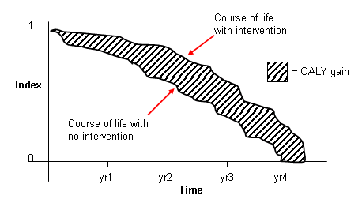
http://www.ukmi.nhs.uk/Research/pharma_res.asp

Slide 23
Cost-Effectiveness of Health Care
Cost ↓
Effectiveness (“Utility”) ↑

Slide 24
“QALYs: The Basics”
Value is …
  Preference or desirability of health states
Preferences can be used to
  Compare different interventions on a single common metric (societal resource allocation)
  Help make personal decisions about whether to have a treatment
  Milton Weinstein, George Torrance, Alistair McGuire, Value in Health, 2009, vol. 12 Supplement 1.

Slide 25
Preference Elicitation
Standard gamble (SG)
Time trade-off (TTO)
Rating scale (RS)
  http://araw.mede.uic.edu/cgi-bin/utility.cgi
SG > TTO > RS
SG = TTOª
SG = RS^{b} (Where a and b are less than 1)
Also discrete choice experiments

Slide 26
SF-6D health state (424421) = 0.59
Your health limits you a lot in moderate activities (such as moving a table, pushing a vacuum cleaner, bowling or playing golf)
You are limited in the kind of work or other activities as a result of your physical health
Your health limits your social activities (like visiting friends, relatives etc.) most of the time.
You have pain that interferes with your normal work (both outside the home and housework) moderately
You feel tense or downhearted and low a little of the time.
You have a lot of energy all of the time

Slide 27
HRQOL in SEER-Medicare Health Outcomes Study (n = 126,366)
Controlling for age, gender, race/ethnicity, education, income, marital status, and the other 22 conditions.

Slide 28
Distant stage of cancer associated with 0.05-0.10 lower SF-6D Score

Slide 29

Break #1

Slide 30
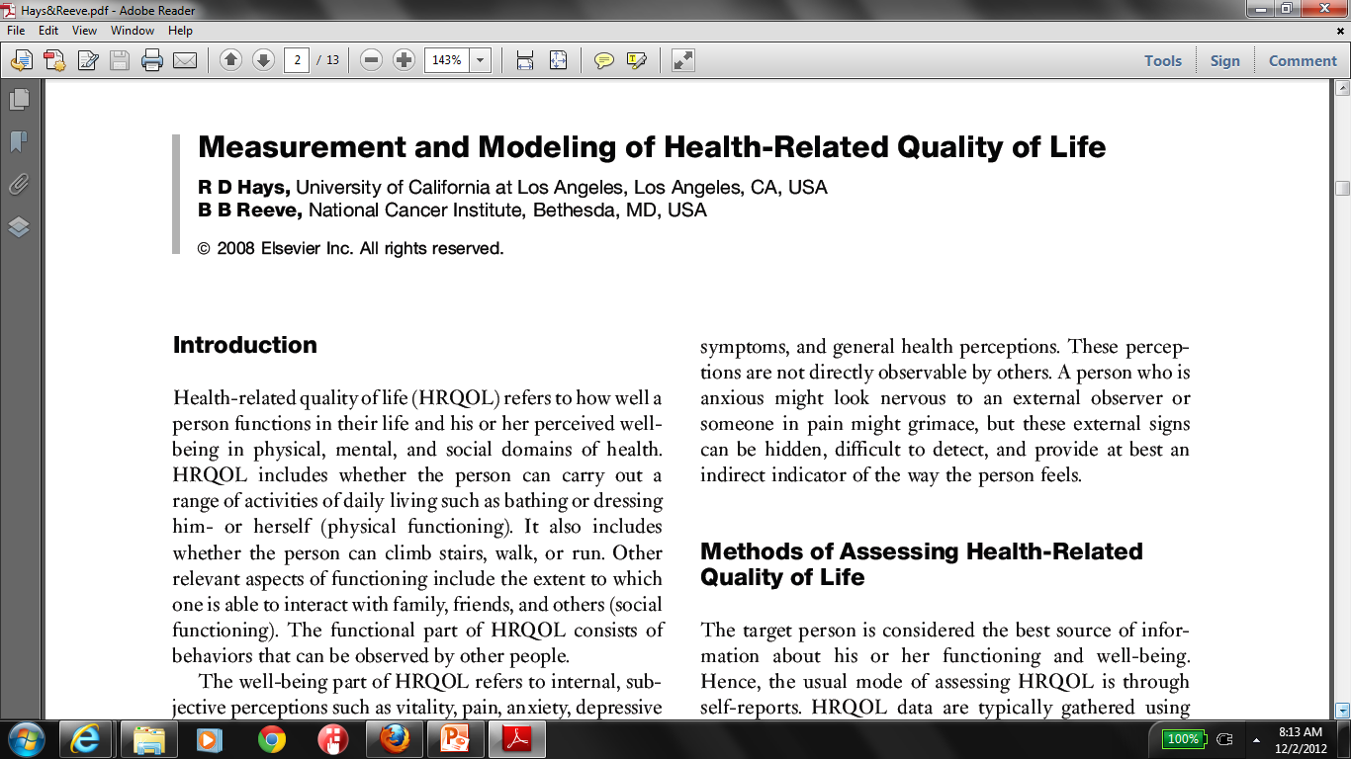
Evaluation of Patient-reported Outcome Measures
10:10-11:00am

Slide 31
Aspects of Good Health-Related Quality of Life Measures
Aside from being practical..
Same people get same scores
Different people get different scores and differ in the way you expect
Measure is interpretable
Measure works the same way for different groups (age, gender, race/ethnicity)

Slide 32
Aspects of Good Health-Related Quality of Life Measures
Aside from being practical..
Same people get same scores
Different people get different scores and differ in the way you expect
Measure is interpretable
Measure works the same way for different groups (age, gender, race/ethnicity)

Slide 33
Reliability
Degree to which the same score is obtained when the target or thing being measured (person, plant or whatever) hasn’t changed.
Inter-rater (rater)
  Need 2 or more raters of the thing being measured
Internal consistency (items)
  Need 2 or more items
Test-retest (administrations)
  Need 2 or more time points

Slide 34
Ratings of 6 CTSI Presentations by 2 Raters
[1 = Poor; 2 = Fair; 3 = Good; 4 = Very good; 5 = Excellent]
1= Jack Needleman (Good, Very Good)
2= Neil Wenger (Very Good, Excellent)
3= Ron Andersen (Good, Good)
4= Ron Hays (Fair, Poor)
5= Douglas Bell (Excellent, Very Good)
6= Martin Shapiro (Fair, Fair)
(Target = 6 presenters; assessed by 2 raters)

Slide 35
Reliability and Intraclass Correlation
Model
Reliability
Intraclass Correlation
Two-way random
Two-way mixed
One-way
BMS = Between Ratee Mean Square N = n of ratees
WMS = Within Mean Square k = n of items or raters
JMS = Item or Rater Mean Square
EMS = Ratee x Item (Rater) Mean Square
Notes:
35

Slide 36
01 13
01 24
02 14
02 25
03 13
03 23
04 12
04 21
05 15
05 24
06 12
06 22
Two-Way Random Effects
(Reliability of Ratings of Presentations)
Presenters (BMS) 5 15.67 3.13
Raters (JMS) 1 0.00 0.00
Pres. x Raters (EMS) 5 2.00 0.40
Total 11 17.67
Source
df
SS
MS
2-way R =
6 (3.13 - 0.40) = 0.89
6 (3.13) + 0.00 - 0.40
ICC = 0.80
Notes:
36

Slide 37
Responses of 6 CTSI Presenters to
2 Questions about Their Health
1= Jack Needleman (Good, Very Good)
2= Neil Wenger (Very Good, Excellent)
3= Ron Andersen (Good, Good)
4= Ron Hays (Fair, Poor)
5= Douglas Bell (Excellent, Very Good)
6= Martin Shapiro (Fair, Fair)
(Target = 6 presenters; assessed by 2 items)

Slide 38
Two-Way Mixed Effects (Cronbach’s Alpha)
01 34
02 45
03 33
04 21
05 54
06 22
Presenters (BMS) 5 15.67 3.13
Items (JMS) 1 0.00 0.00
Pres. x Items (EMS) 5 2.00 0.40
Total 11 17.67
Source
df
SS
MS
Alpha =
3.13 - 0.40 = 2.93 = 0.87
ICC = 0.77
3.13
3.13
Notes:
38

Slide 39
Reliability Minimum Standards
0.70 or above (for group comparisons)
0.90 or higher (for individual assessment)
  SEM = SD (1- reliability)^{1/2}
  95% CI = true score +/- 1.96 x SEM
    if z-score = 0, then CI: -.62 to +.62 when reliability = 0.90
      Width of CI is 1.24 z-score units
Notes:
39

Slide 40

Item-scale correlation matrix
Notes:
40

Slide 41

Item-scale correlation matrix
Notes:
41

Slide 42
Aspects of Good Health-Related Quality of Life Measures
Aside from being practical..
Same people get same scores
Different people get different scores and differ in the way you expect
Measure is interpretable
Measure works the same way for different groups (age, gender, race/ethnicity)

Slide 43
Validity
Does scale represent what it is supposed to be measuring?
Content validity: Does measure “appear” to reflect what it is intended to (expert judges or patient judgments)?
  Do items operationalize concept?
  Do items cover all aspects of concept?
  Does scale name represent item content?
Construct validity
  Are the associations of the measure with other variables consistent with hypotheses?

Slide 44
Relative Validity Example
Sensitivity of measure to important (clinical) difference
 | Severity of Kidney Disease
 | None | Mild | Severe | F-ratio | Relative Validity
Burden of Disease #1 | 87 | 90 | 91 | 2 | --
Burden of Disease #2 | 74 | 78 | 88 | 10 | 5
Burden of Disease #3 | 77 | 87 | 95 | 20 | 10

Slide 45
Evaluating Construct Validity
Scale | Age (years)
(Better) Physical Functioning | (-)

Slide 46
Evaluating Construct Validity
Scale | Age (years)
(Better) Physical Functioning | Medium (-)

Slide 47
Evaluating Construct Validity
Scale | Age (years)
(Better) Physical Functioning | Medium (-)
Effect size (ES) = D/SD
D = Score difference
SD = SD
Small (0.20), medium (0.50), large (0.80)

Slide 48
Evaluating Construct Validity
Scale | Age (years)
(Better) Physical Functioning | Medium (-) r ˜͂ 0.24
Cohen effect size rules of thumb (d = 0.20, 0.50, and 0.80):
Small r = 0.100; medium r = 0.243; large r = 0.371
r = d / [(d² + 4)^{.5}]
= 0.80 / [(0.80² + 4)^{.5}] = 0.80 / [(0.64 + 4)^{.5}] = 0.80 / [( 4.64)^{.5}] = 0.80 / 2.154
= 0.371

Slide 49
Evaluating Construct Validity
Scale | Age (years) | Obese yes = 1, no = 0 | Kidney Disease yes = 1, no = 0 | In Nursing home yes = 1, no = 0
(Better) Physical Functioning | Medium (-) | Small (-) | Large (-) | Large (-)
Cohen effect size rules of thumb (d = 0.20, 0.50, and 0.80):
Small r = 0.100; medium r = 0.243; large r = 0.371
r = d / [(d² + 4)^{.5}]
= 0.80 / [(0.80² + 4)^{.5}] = 0.80 / [(0.64 + 4)^{.5}] = 0.80 / [( 4.64)^{.5}] = 0.80 / 2.154
= 0.371

Slide 50
Evaluating Construct Validity
Scale | Age (years) | Obese yes = 1, no = 0 | Kidney Disease yes = 1, no = 0 | In Nursing home yes = 1, no = 0
(Better) Physical Functioning | Medium (-) | Small (-) | Large (-) | Large (-)
(More) Depressive Symptoms | ? | Small (+) | Small (+) | Small (+)
Cohen effect size rules of thumb (d = 0.20, 0.50, and 0.80):
Small r = 0.100; medium r = 0.243; large r = 0.371
r = d / [(d² + 4)^{.5}]
= 0.80 / [(0.80² + 4)^{.5}] = 0.80 / [(0.64 + 4)^{.5}] = 0.80 / [( 4.64)^{.5}] = 0.80 / 2.154
= 0.371
(r’s of 0.10, 0.30 and 0.50 are often cited as small, medium, and large.)

Slide 51
Responsiveness to Change
HRQOL measures should be responsive to interventions that change HRQOL
Need external indicator(s) of change (Anchors)
  “Improved” group = 100% reduction in seizure frequency
  Ambiguous group = 99%-50% reduction in seizure frequency
  “Unchanged” group = <50% change in seizure frequency
Anchor correlated with change on target measure at 0.371 or higher

Slide 52
Responsiveness Index
Effect size (ES) = D/SD
D = raw score change in “changed”
(improved) group
SD = baseline SD
Small: 0.20->0.49
Medium: 0.50->0.79
Large: 0.80 or above

Slide 53
Responsiveness Indices
Effect size (ES) = D/SD
(2) Standardized Response Mean (SRM) = D/SD†
(3) Guyatt responsiveness statistic (RS) = D/SD‡
D = raw score change in “changed” group;
SD = baseline SD;
SD† = SD of D;
SD‡ = SD of D among “unchanged”

Slide 54
Aspects of Good Health-Related Quality of Life Measures
Aside from being practical..
Same people get same scores
Different people get different scores and differ in the way you expect
Measure is interpretable
Measure works the same way for different groups (age, gender, race/ethnicity)

Slide 55
Amount of Expected Change Varies
SF-36 physical function score mean = 87 (SD = 20)
Assume I have a score of 100 at baseline
Hit by Bike causes me to be
  limited a lot in vigorous activities
  limited a lot in climbing several flights of stairs
  limited a little in moderate activities
SF-36 physical functioning score drops to 75 (-1.25 SD)
Hit by Rock causes me to be
  limited a little in vigorous activities
SF-36 physical functioning score drops to 95 (- 0.25 SD)

Slide 56
Partition Degree of Change on Anchor
A lot better
A little better <- MID
No change
A little worse <- MID
A lot worse

Slide 57
Aspects of Good Health-Related Quality of Life Measures
Aside from being practical..
Same people get same scores
Different people get different scores and differ in the way you expect
Measure is interpretable
Measure works the same way for different groups (age, gender, race/ethnicity)

Slide 58
Category Response Curves
“Appreciating each day.”
No change
Very great change
Great change
Moderate change
Small change
Very small change
No Change
Great Change
θ

Slide 59
Differential Item Functioning (DIF)
Probability of choosing each response category should be the same for those who have the same estimated scale score, regardless of other characteristics
Evaluation of DIF
  Different subgroups
  Mode differences

Slide 60
DIF (2-parameter model)
Men
Women
White
Slope DIF
Location DIF
AA
I cry when upset
I get sad for no reason
Higher Score = More Depressive Symptoms
Notes:
60

Slide 61
Questions?

Slide 62
Break #2

Slide 63

Use of Patient-Reported Outcome Measures in Clinical Practice
11:10-12:00 pm

Slide 64
Physical Functioning and Emotional Well-Being at Baseline for 54 Patients at UCLA-Center for East West Medicine
EWB
Physical
MS = multiple sclerosis; ESRD = end-stage renal disease; GERD = gastroesophageal reflux disease.
64

Slide 65
Significant Improvement in all but 1 of SF-36 Scales (Change is in T-score metric)
Change
t-test
prob.
PF-10
1.7
2.38
.0208
RP-4
4.1
3.81
.0004
BP-2
3.6
2.59
.0125
GH-5
2.4
2.86
.0061
EN-4
5.1
4.33
.0001
SF-2
4.7
3.51
.0009
RE-3
1.5
0.96
.3400
EWB-5
4.3
3.20
.0023
PCS
2.8
3.23
.0021
MCS
3.9
2.82
.0067

Slide 66
Effect Size
(Follow-up – Baseline)/ SD_{baseline}
_{Cohen’s Rule of Thumb:}
_{ES = 0.20 Small}
_{ES = 0.50 Medium}
_{ES = 0.80 Large}

Slide 67
Effect Sizes for Changes in SF-36 Scores
Effect Size
0.13
0.35
0.35
0.21
0.53
0.36
0.11
0.41
0.24
0.30
PFI = Physical Functioning; Role-P = Role-Physical; Pain = Bodily Pain; Gen H=General Health; Energy = Energy/Fatigue; Social = Social Functioning; Role-E = Role-Emotional; EWB = Emotional Well-being; PCS = Physical Component Summary; MCS =Mental Component Summary.
0.11 0.13 0.21 0.24 0.30 0.35 0.35 0.36 0.41 0.53

Slide 68
Defining a Responder: Reliable Change Index (RCI)
Note: SD_{bl} = standard deviation at baseline
r_{xx} = reliability

Slide 69
Significant Change
> = 1.96

Slide 70
Amount of Change in Observed Score Needed To be Statistically Significant
Note: SD_{bl} = standard deviation at baseline and r_{xx} = reliability

Slide 71
Amount of Change in Observed Score Needed To be Statistically Significant
If r_{xx} = 0.94 then
1.41421356237 x 0.24494897427 x 1.96 = 0.67

Slide 72
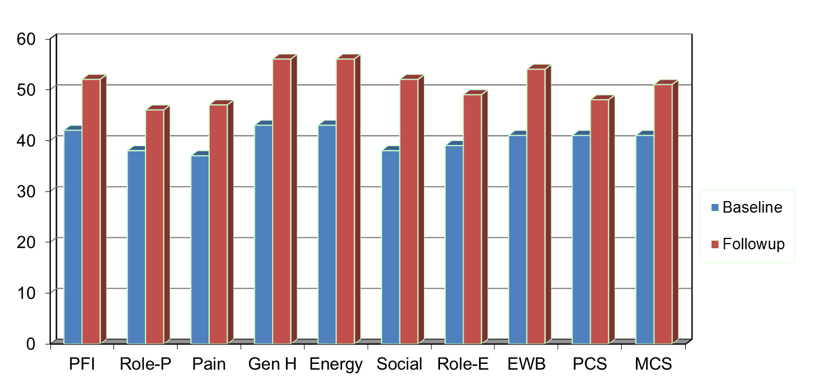
Amount of Change Needed for Significant Individual Change
Effect Size
0.67
0.72
1.01
1.13
1.33
1.07
0.71
1.26
0.62
0.73
PFI = Physical Functioning; Role-P = Role-Physical; Pain = Bodily Pain; Gen H=General Health; Energy = Energy/Fatigue; Social = Social Functioning;
Role-E = Role-Emotional; EWB = Emotional Well-being; PCS = Physical Component Summary; MCS =Mental Component Summary.

Slide 73
7-31% Improve Significantly
% Improving
% Declining
Difference
PF-10
13%
2%
+ 11%
RP-4
31%
2%
+ 29%
BP-2
22%
7%
+ 15%
GH-5
7%
0%
+ 7%
EN-4
9%
2%
+ 7%
SF-2
17%
4%
+ 13%
RE-3
15%
15%
0%
EWB-5
19%
4%
+ 15%
PCS
24%
7%
+ 17%
MCS
22%
11%
+ 11%

Slide 74
Item Responses and
Trait Levels
Person 1
Person 2
Person 3
Trait
Continuum
Item 1
Item 2
Item 3

Slide 75




Computer Adaptive Testing (CAT)

Slide 76
PROMIS Measures
Adult Health Measures
  More than 1,000 individual items (questions)
  51 distinct item banks or scales
  20 languages
Pediatric Health Measures
  More than 150 items (questions)
  18 distinct banks or scales
  8 languages
www.nihpromis.org

Slide 77
The PROMIS Metric
T Score
  Mean = 50
  SD = 10
  Referenced to US General Pop.
  T = 50 + (z * 10)
www.nihpromis.org

Slide 78
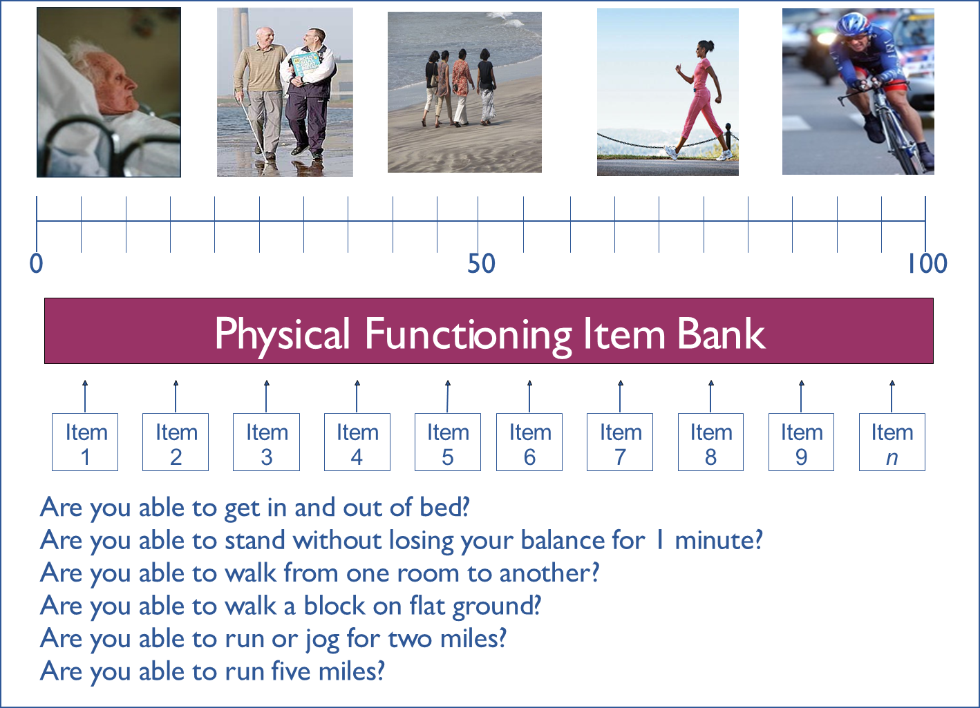

Slide 79
Reliability Target for Use of Measures with Individuals
Reliability ranges from 0-1
  0.90 or above is goal
  SE = SD (1- reliability)^{1/2}
  Reliability = 1 – (SE/10)²
  Reliability = 0.90 when SE = 3.2
  95% CI = true score +/- 1.96 x SE
Notes:
T = z*10 + 50

Slide 80
In the past 7 days …
I was grouchy [1st question]
  Never [39]
  Rarely [48]
  Sometimes [56]
  Often [64]
  Always [72]
Estimated Anger = 56.1
SE = 5.7 (rel. = 0.68)

Slide 81
In the past 7 days …
I felt like I was ready to explode
[2nd question]
  Never
  Rarely
  Sometimes
  Often
  Always
Estimated Anger = 51.9
SE = 4.8 (rel. = 0.77)

Slide 82
In the past 7 days …
I felt angry [3rd question]
  Never
  Rarely
  Sometimes
  Often
  Always
Estimated Anger = 50.5
SE = 3.9 (rel. = 0.85)

Slide 83
In the past 7 days …
I felt angrier than I thought I should [4th question]
- Never
  Rarely
  Sometimes
  Often
  Always
Estimated Anger = 48.8
SE = 3.6 (rel. = 0.87)

Slide 84
In the past 7 days …
I felt annoyed [5th question]
  Never
  Rarely
  Sometimes
  Often
  Always
Estimated Anger = 50.1
SE = 3.2 (rel. = 0.90)

Slide 85
In the past 7 days …
I made myself angry about something just by thinking about it. [6th question]
  Never
  Rarely
  Sometimes
  Often
  Always
Estimated Anger = 50.2
SE = 2.8 (rel = 0.92)

Slide 86
PROMIS Physical Functioning vs. “Legacy” Measures
10 20 30 40 50 60 70

Slide 87
Person Fit
Large negative Z_{L} values indicate misfit.
  one person who responded to 14 of the PROMIS physical functioning items had a Z_{L} = -3.13
  For 13 items the person could do the activity (including running 5 miles) without any difficulty.
    But this person reported a little difficulty being out of bed for most of the day.

Slide 88
Person Fit
Item misfit significantly related to:
  Longer response time
  More chronic conditions
  Younger age

Slide 90
PROMIS CAT Report

Slide 92
“Implementing patient-reported outcomes assessment in clinical practice: a review of the options and considerations”
Snyder, C.F., Aaronson, N. K., et al. Quality of Life Research, 21, 1305-1314, 2012.
  HRQOL has rarely been collected in a standardized fashion in routine clinical practice.
  Increased interest in using PROs for individual patient management.
  Research shows that use of PROs:
    Improves patient-clinician communication
    May improve outcomes

Slide 93
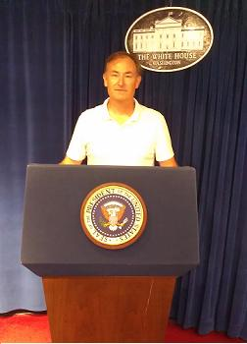
Thank you
drhays@ucla.edu (310-794-2294)
Powerpoint file available for downloading at: http://gim.med.ucla.edu/FacultyPages/Hays/
Notes:
93

