Slide 1
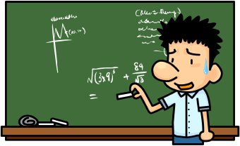
Psychometric evaluation of Measures
Ron D. Hays, Ph.D.
December 11, 2024 (2:30-4:00 pm)
Questionnaire Design and Testing Workshop
9th Floor Conference Room, 1100 Glendon Ave, Los Angeles, CA 90024

Slide 2
Impact Stratification Score (ISS)
ISS Parts
  PROMIS-29 physical function (4 items, 1-5)
  PROMIS-29 pain interference (4 items, 1-5)
  PROMIS-29 pain intensity (1 item, 0-10)
ISS Score
  A higher score is worse
  Possible range: 8-50
    Mild: 8-27
    Moderate: 28-34
    Severe: 35-50
Deyo, R. A., Dworkin, S. F., et al. (2014). Report of The NIH Task Force on research standards for
chronic low back pain. Spine, 39(14), 1128-1143.

Slide 4
Psychometrics
Item frequencies
Item-scale correlations
Factor analysis
Reliability
Scale means, medians, SD, % floor/ceiling
Associations with other measures
Item response theory

Slide 5
ACT: ClinicalTrials.gov (NCT01692275)
Objective. This study examines Patient-Reported Outcome Measurement Information System (PROMIS)-29 v1.0 outcomes of chiropractic care in a multi-site, pragmatic clinical trial and compares the PROMIS measures to: 1) worst pain intensity from a numerical pain rating 0–10 scale, 2) 24-item Roland-Morris Disability Questionnaire (RMDQ); and 3) global improvement (modified visual analog scale). Design. A pragmatic, prospective, multisite, parallel-group comparative effectiveness clinical trial comparing usual medical care (UMC) with UMC plus chiropractic care (UMC+CC).
Setting. Three military treatment facilities
Subjects. 750 active-duty military personnel with low back pain.
Methods. Linear mixed effects regression models estimated the treatment group differences. Coefficient of repeatability to estimate significant individual change. Results. We found statistically significant mean group differences favoring UMC+CC for all PROMIS
VR-29 scales and the RMDQ score. Area under the curve estimates for global improvement
for the PROMISVR -29 scales and the RMDQ, ranged from 0.79 to 0.83.
Conclusions. Findings from this preplanned secondary analysis demonstrate that chiropractic care impacts health-related quality of life beyond pain and pain-related disability. Further, comparable findings were found between the 24-item RMDQ and the PROMIS-29 v1.0 briefer scales.
Hays, R. D., Shannon, Z. K., Long, C. R., Spritzer, K. L, Vining, R. D., Coulter, I. D., Pohlman, K. A., Walter, J.A., & Goertz, C.M. (2022). Health-related quality of life among United States service members with low back pain receiving usual care plus chiropractic care vs usual care alone: Secondary outcomes of a pragmatic clinical trial. Pain Med, 23(9), 1550-1559.

Slide 6
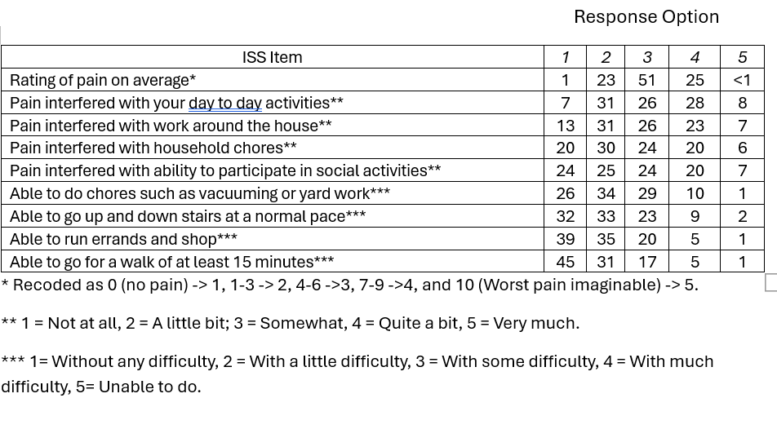











Baseline Item Frequencies in ACT Study (n= 749)
ACT: 749 active-duty military personnel with low back pain. Mean age = 31; 76% were male, and 67% were non-Hispanic White.

Slide 7
ISS Item-Scale Correlations
ACT

Slide 8
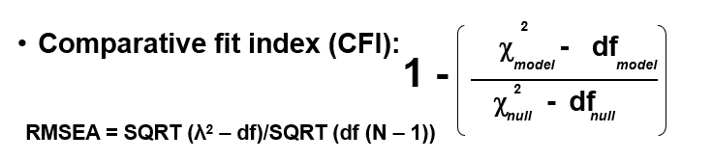
Categorical Confirmatory Factor Analysis of the ISS Items
Run errands
CFI = 0.80, RMSEA = 0.27
Rules of Thumb: CFI >=0.95, RMSEA <=0.06
Walk
Chores
Up & down stairs
Pain rating
Interfere chores
Interfere social
Interfere day2day
Root mean square error of approximation
Interfere housework

Slide 9
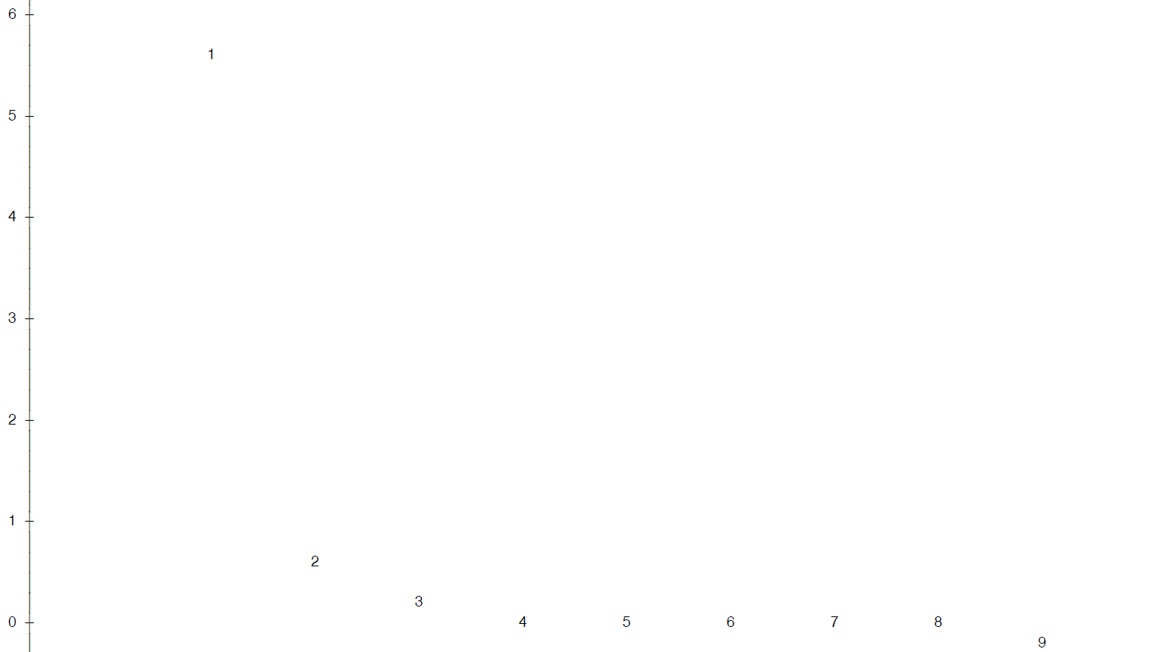


Exploratory Factor Analysis: Scree Plot
Principal component eigenvalues:
5.865, 1.001, 0.61182574, … (6.34, 0.94, 0.59 … polychoric correlations)
Parallel analysis (SMC): 2 factors
2-factor Tucker/Lewis reliability coefficient = 0.96
Tucker/Lewis reliability
Coefficient for 2 factors = 0.95
ACT

Slide 10
Promax Rotated Factor Loadings
Items | Physical function | Pain interference
Able to go for a walk of at least 15 minute | 0.82 | 0.02
Able to run errands and shop | 0.82 | 0.08
Able to go up and down stairs at a normal pace | 0.74 | 0.12
Able to do chores such as vacuuming or yard work | 0.62 | 0.21
Pain interfered with work around the house | 0.02 | 0.92
Pain interfered with day to day activities | 0.05 | 0.84
Pain interfered with household chores | 0.12 | 0.82
Pain interfered with ability to participate social act. | 0.12 | 0.75
Pain intensity | 0.19 | 0.47
Factor correlation of physical function with pain interference = 0.66
Note: Correlation between these simple-summated scales = 0.70
ACT

Slide 11
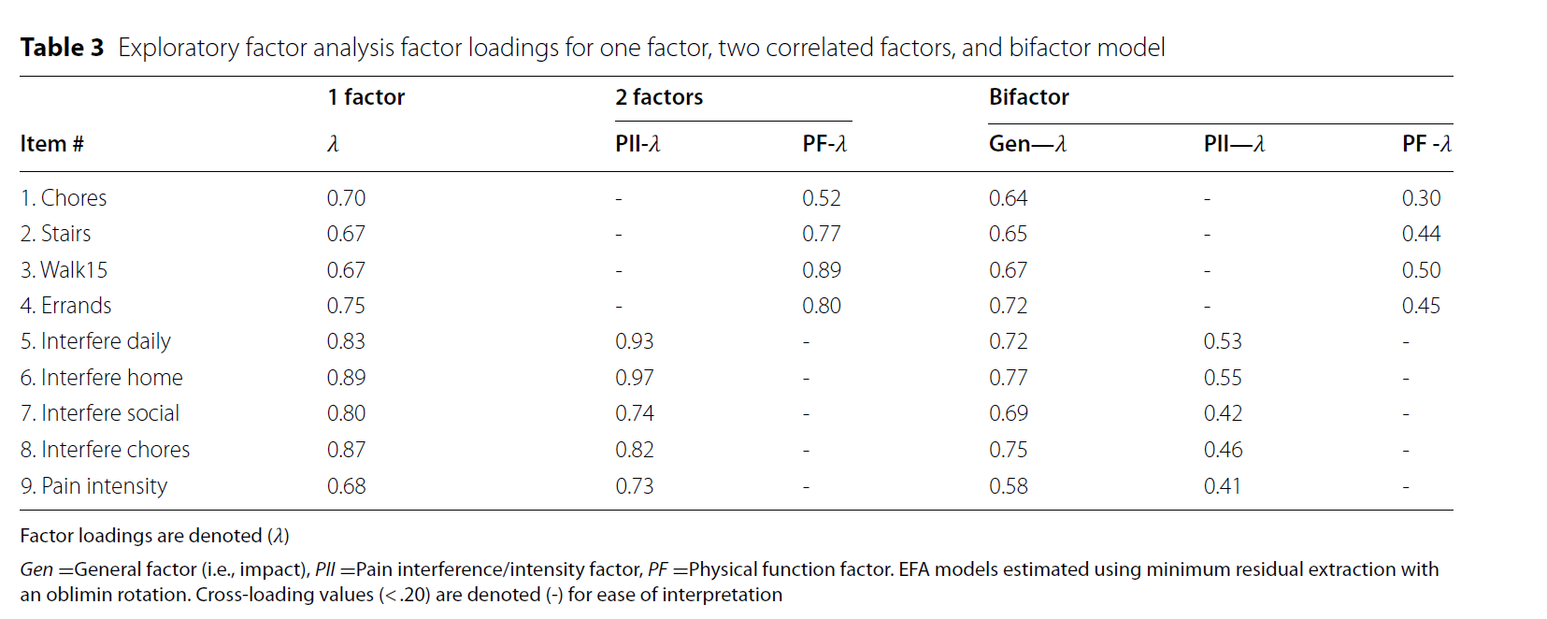









Rodriguez et al. (2022)
Notes:
1677 chiropractic patients being treated for CLBP and chronic neck pain

Slide 12
Types of Reliability
Inter-rater (rater)
Need 2 or more raters of the thing being measured
Test-retest (administrations)
Need 2 or more time points
Internal consistency (items)
Need 2 or more items

Slide 13
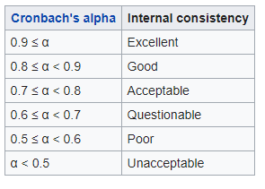

Test-retest Reliability of
MMPI 317-362 (r = 0.75)
MMPI 317
True
False
True
169
15 (14%)
184
MMPI 362
False
21 (11%)
95
116
190
110
I am more sensitive than most other people.
Hays, R. D., & Revetto, J. P. (1992). Old and new MMPI-derived scales and the Short-MAST as screening tools
for alcohol disorder. Alcohol and Alcoholism, 27, 685-695.
Notes:
Cronbach (1951).

Slide 14
ANOVA formulas to estimate reliability
Coefficient alpha = 0.92
in ACT Study at baseline.

Slide 15
Test-Retest Reliability Formulas

Slide 16
Six-WeekTest-Retest Reliability of ISS in ACT Study
Limited to those who reported the were the same at 6 weeks compared to baseline.
112.94-14.50
112.94+14.50
98.44/127.44 = 0.77
Note: 0.76 for
random effects.

Slide 17
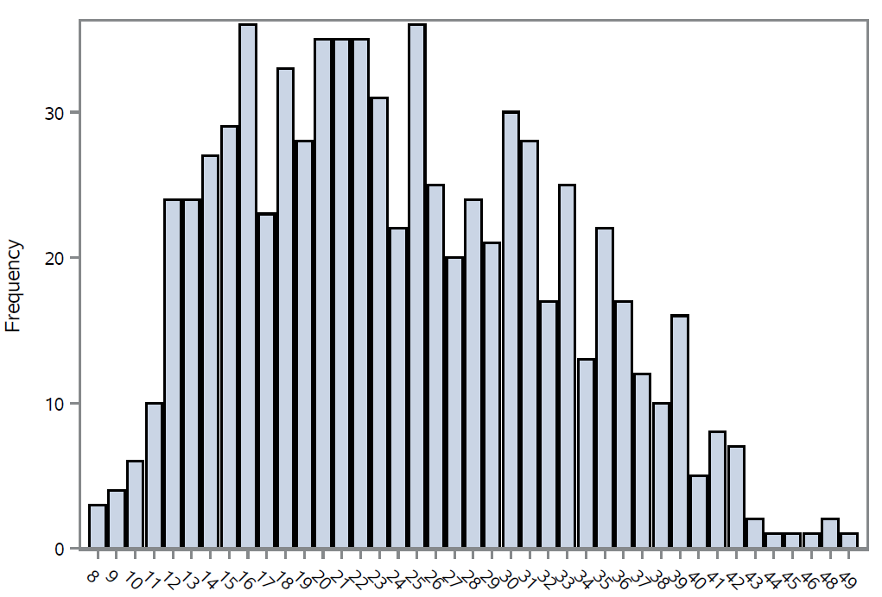
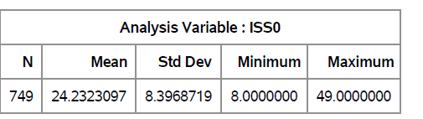
ISS Score Distribution in ACT Study
8-50 is the possible range.
Median = 22.5, Mode = 16 and 26
Floor: 0.4% and Ceiling: 0%

Slide 18
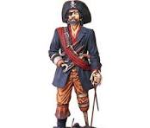
Pain Intensity, Interference With Enjoyment of Life, Interference With General Activity (PEG) Scale
What number best describes
  your pain on average in the past week?
  how, during the past week, pain has interfered with your enjoyment of life?
  how, during the past week, pain has interfered with your general activity?
0-10 Response scale (10 = most severe pain)
Mean scoring (0-10 possible range)

Slide 19

Standardized Factor Loadings for the ISS and 6 Other Pain Impact Measures Ranged from 0.78 (RMDQ) to 0.87 (ISS)
Impact Stratification Scale (ISS)
Graded Chronic Pain Scale (GCPS) disability score.
Oswestry Disability Index (ODI)
PEG (Pain intensity, interference with Enjoyment of life, interference with General activity)
Roland-Morris Disability Questionnaire (RMDQ)
Short form of the Orebro Musculoskeletal Pain Questionnaire (OMPQ)
Subgroups for Targeted Treatment (STarT) Back Tool
Hays, Herman et al. (2024)
Notes:
1,874 adults with back pain who were members of Amazon Mechanical Turk.

Slide 20
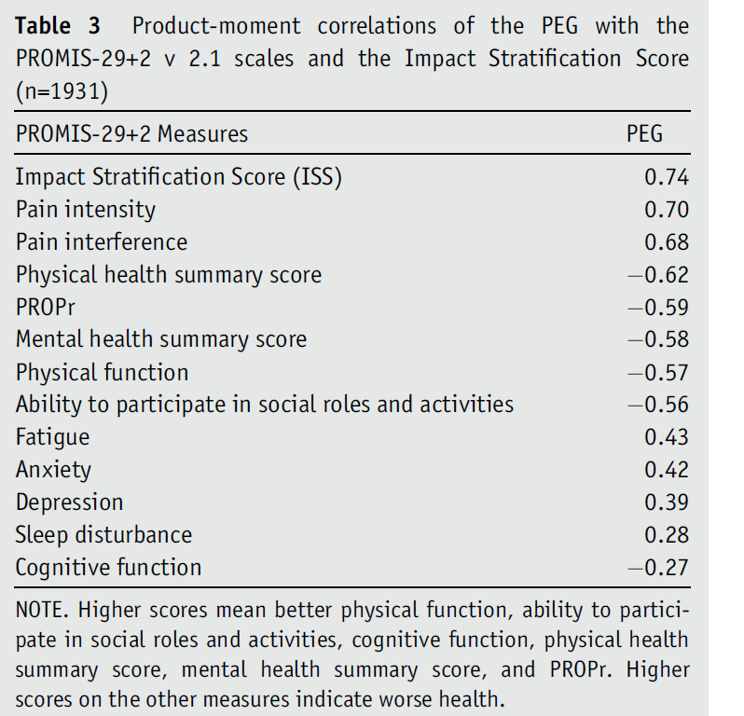
Hays, Qureshi et al., 2023
Notes:
Amazon’s Mechanical Turk (Mturk)

Slide 21



Hays, Rodriguez et al. (2024)
Notes:
N = 1256 adults from KnowledgePanel with back pain.

Slide 22
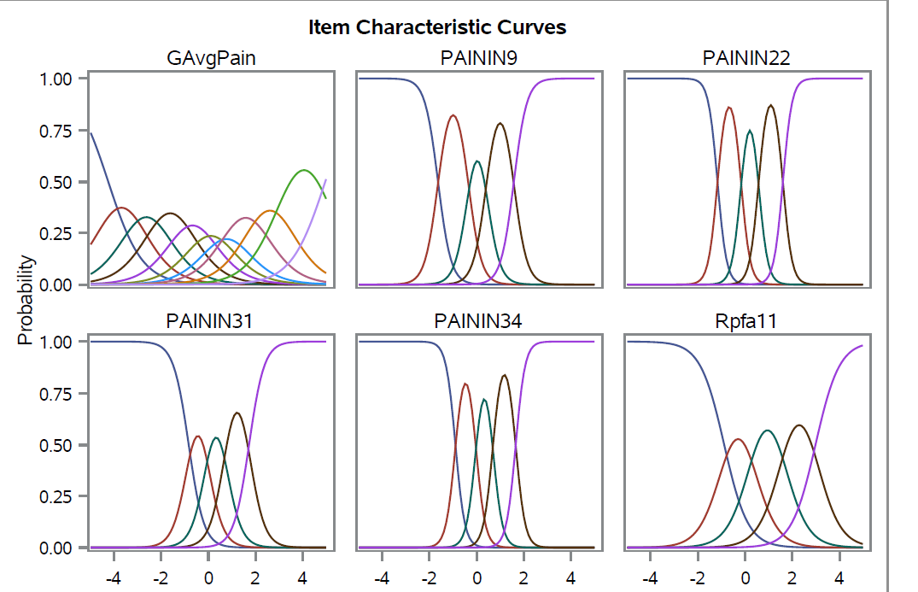
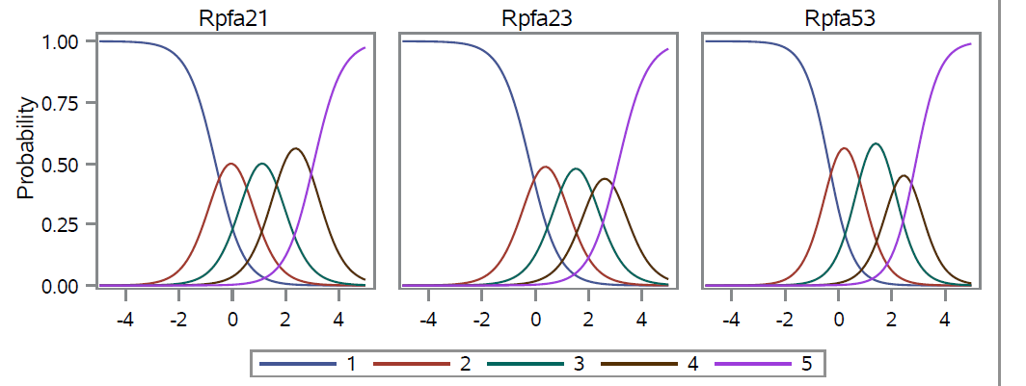
10
Not at
all
Very
much
0
Without any difficulty
Unable to do

Slide 23
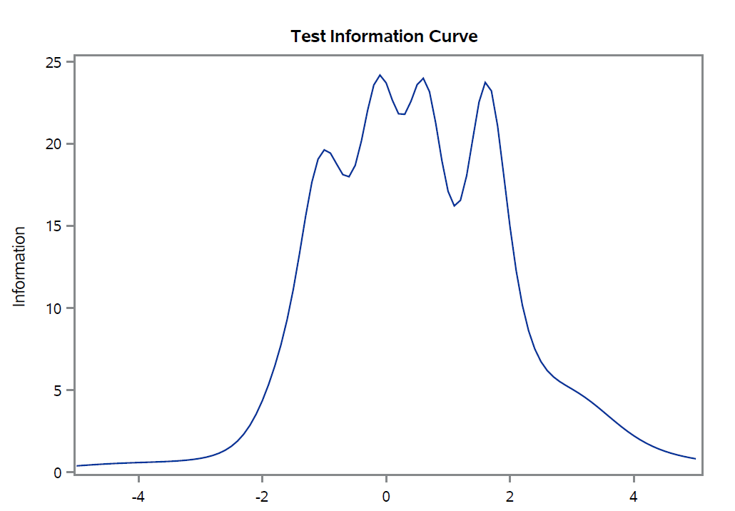
Rel = (INF-1)/INF
Reliability = 0.95
Reliability = 0.93
Reliability = 0.90
Reliability = 0.80
ISS (ACT Study)

Slide 24

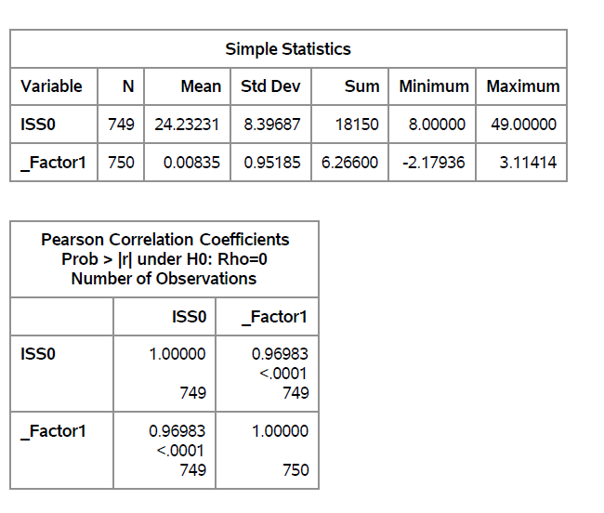
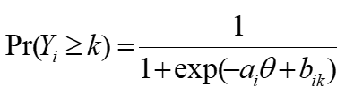

IRT graded response model estimates the relationship between a person’s response Y_{i} to the question (i) and his or her level on the latent construct (θ):
b_{ik} estimates how difficult it is to score k or more on item (i). a_{i} estimates item discrimination.

Slide 25

Email: drhays@ucla.edu
Resources: https://labs.dgsom.ucla.edu/hays/pages/

Slide 26
References
Edelen, M. O., Rodriguez, A., Qureshi, N., Herman P. M., & Hays, R. D. (2023). Evaluation of the Impact Stratification Score in a sample of older adult patients with multiple chronic conditions. J Geriatr Med Gerontol, 9:141. doi.org/10.23937
Hays, R. D., Edelen, M. O., Rodriguez, A., & Herman, P. (2021). Support for the reliability and validity of the National Institutes of Health Impact Stratification Score in a sample of active-duty U.S. military personnel with low back pain. Pain Medicine, 22(10), 2185-2190. doi: 10.1093/pm/pnab175.
Hays, R. D., Qureshi, N., Edelen, M., Rodriguez, M., Slaughter, M., & Herman, P. M. (2023). Crosswalking the National Institutes of Health Impact Stratification Score to the PEG. Arch Phys Med Rehabil, 104(3), 425-429. doi: 10.1016/j.apmr.2022.08.006
Hays, R. D., Rodriguez, A., Qureshi, N., Zeng, C., & Edelen, M. O. (2024). Support for a single underlying dimension of self-reported health in a sample of adults with low back pain in the United States. Applied Research in Quality of Life, 19(5): 2213-2226. doi:10.1007/s11482-024-10327-8.
Rodriguez, A., Edelen, M. O., Herman, P., & Hays, R. D. (2022). Unpacking the impact of chronic pain as measured by the Impact Stratification Score. BMC Musculoskelet Disord, 23: 884. https://doi.org/10.1186/s12891-022-05834-4
Rodriguez, A., Herman, P. M., Slaughter, M.E., Edelen, M. O., & Hays, R. D. (2023). Classifying patients with non-specific low back pain using the Impact Stratification Score in an online convenience sample. BMC Musculoskelet Disord, 24(1):719. doi: 10.1186/s12891-023-06848-2.

