Slide 1
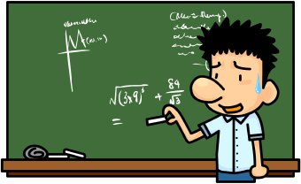
Psychometric evaluation of Measures
Ron D. Hays, Ph.D.
November 8, 2023 (2:30-4:00 pm)
Questionnaire Design and Testing Workshop
9th Floor Conference Room, 1100 Glendon Ave, Los Angeles, CA 90024

Slide 2
Medicare Health Outcomes Survey 2020 Cohort 23 Baseline File
8 Physical Functioning Activities of Daily Living (PFADL) items.
CMS scores items with 0-2 points each.
  Physical limitation or inability to perform an ADL = 0 points
  Some limitation or difficulty = 1 point
  No limitation or difficulty = 2 points.
The unadjusted PFADL scale score sum ranges from 0 to 16 and a higher score is better.
  Change from baseline to follow-up is scored on a 0-100 possible range, with 100 equivalent to retaining 100% of baseline function over two years and 0 corresponding to maximum decline.

Slide 3
Physical Functioning Activities of Daily Living items
2. The following items are about activities you might do during a typical day. Does your health now limit you in these activities? If so, how much?
a. Moderate activities, such as moving a table, pushing a vacuum cleaner, bowling, or playing golf (B23vrmact)
Yes, limited a lot
Yes, limited a little
No, not limited at all
b. Climbing several flights of stairs (B23vrstair)
Yes, limited a lot
Yes, limited a little
No, not limited at all

Slide 4




SF-36 Physical Function Items

Slide 5
Physical Functioning Activities of Daily Living items
10. Because of a health or physical problem, do you have any difficulty doing the following activities without special equipment or help from another person?
a. Bathing (B23adlbth)
No, I do not have difficulty
Yes, I have difficulty
I am unable to do this activity
b. Dressing (B23adldrs)
No, I do not have difficulty
Yes, I have difficulty
I am unable to do this activity
c. Eating (B23adleat)
No, I do not have difficulty
Yes, I have difficulty
I am unable to do this activity

Slide 6
Physical Functioning Activities of Daily Living items
10. Because of a health or physical problem, do you have any difficulty doing the following activities without special equipment or help from another person?
d. Getting in or out of chairs (B23adlchr)
No, I do not have difficulty
Yes, I have difficulty
I am unable to do this activity
e. Walking (B23adlwlk)
No, I do not have difficulty
Yes, I have difficulty
I am unable to do this activity
f. Using the toilet (B23adltlt)
No, I do not have difficulty
Yes, I have difficulty
I am unable to do this activity

Slide 7
Cohort 23 Dataset
287,476 observations (13,219 have missing data for > half the items).
“The 2020 Cohort 23 Baseline Medicare HOS included a random sample of 783,389 beneficiaries, including both the aged and disabled, from 510 managed care plans. Of the 783,389 individuals sampled, 287,476 (36.7%) completed the baseline survey and were included in the C23B_PUF.CSV data file. For the purposes of this data file, a completed survey was defined as a survey with at least one question item completed and a survey disposition code equal to M10, M11, M31, T10, T11, or T31 (please refer to Field 81 in the Survey Administration Table for a description of the codes)” (2020 Cohort 23 Baseline Public Use File Data Users Guide).
https://www.hosonline.org/en/data-dissemination/research-data-files/

Slide 8
Sample Characteristics
58% female
16% less than 65 years old, 50% 65-74, and 34% 75 or older
77% White, 14% Black, and 8% another race
19% less than high school education, 32% high school or GED, and 48% more than a high school education.
44% married
95% completed the survey in English and 5% in Spanish.

Slide 10
Psychometrics
Item frequencies
Inter-item correlations
Item-scale correlations and scale reliability
Scale means, medians, SD, % floor/ceiling
Factor analysis
Associations with other (similar and other) measures
Item response theory parameters

Slide 11
Item Frequencies
 | Most Limitation | Intermediate Limitation | No Limitation
Several flights of stairs | 32% limited a lot | 35% limited a little | 32% not limited at all
Moderate activities | 25% limited a lot | 35% limited a little | 40% not limited at all
Walking | 3% unable to do | 34% have difficulty | 62% do not have difficulty
Getting in or out of chairs | 2% unable to do | 24% have difficulty | 75% do not have difficulty
Bathing | 4% unable to do | 15% have difficulty | 81% do not have difficulty
Dressing | 2% unable to do | 23% have difficulty | 85% do not have difficulty
Using the toilet | 2% unable to do | 9% have difficulty | 89% do not have difficulty
Eating | 1% unable to do | 5% have difficulty | 94% do not have difficulty
Notes:
Yes, limited a lot; Yes, limited a little; No, not limited at all
I am unable to do this activity; Yes, I have difficulty; No, I do not have difficulty

Slide 13



Slide 14
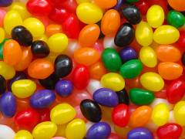
Types of Reliability
Inter-rater (rater)
  Need 2 or more raters of the thing being measured
Test-retest (administrations)
  Need 2 or more time points
Internal consistency (items)
  Need 2 or more items

Slide 15
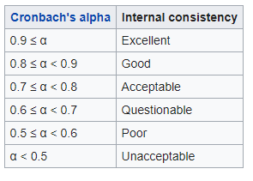

Test-retest Reliability of
MMPI 317-362 (r = 0.75)
MMPI 317
True
False
True
169
15 (14%)
184
MMPI 362
False
21 (11%)
95
116
190
110
I am more sensitive than most other people.
Hays, R. D., & Revetto, J. P. (1992). Old and new MMPI-derived scales and the Short-MAST as screening tools
for alcohol disorder. Alcohol and Alcoholism, 27, 685-695.
Notes:
Cronbach (1951).

Slide 16
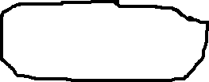

Reliability Formulas
Model
Reliability
Intraclass Correlation
Two-way random
Two-way mixed
One-way
BMS = Between Ratee Mean Square N = n of ratees
WMS = Within Mean Square k = n of items or raters
JMS = Item or Rater Mean Square
EMS = Ratee x Item (Rater) Mean Square
Notes:
16

Slide 17





Slide 18
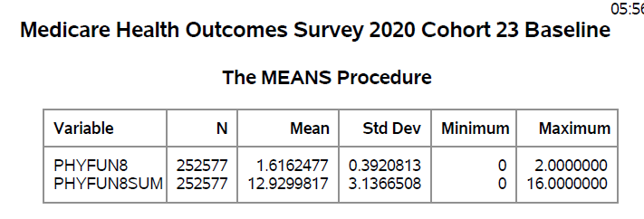
Physical Function
Scale Distribution
Median = 14
Mode = 16
Floor: 0.3%
Ceiling: 26%

Slide 19


Exploratory Factor Analysis
Note: 5.99 and 0.85 for
polychoric correlations.

Slide 20
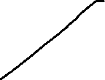
Scree Plot
Tucker/Lewis reliability
Coefficient for 2 factors = 0.95

Slide 21
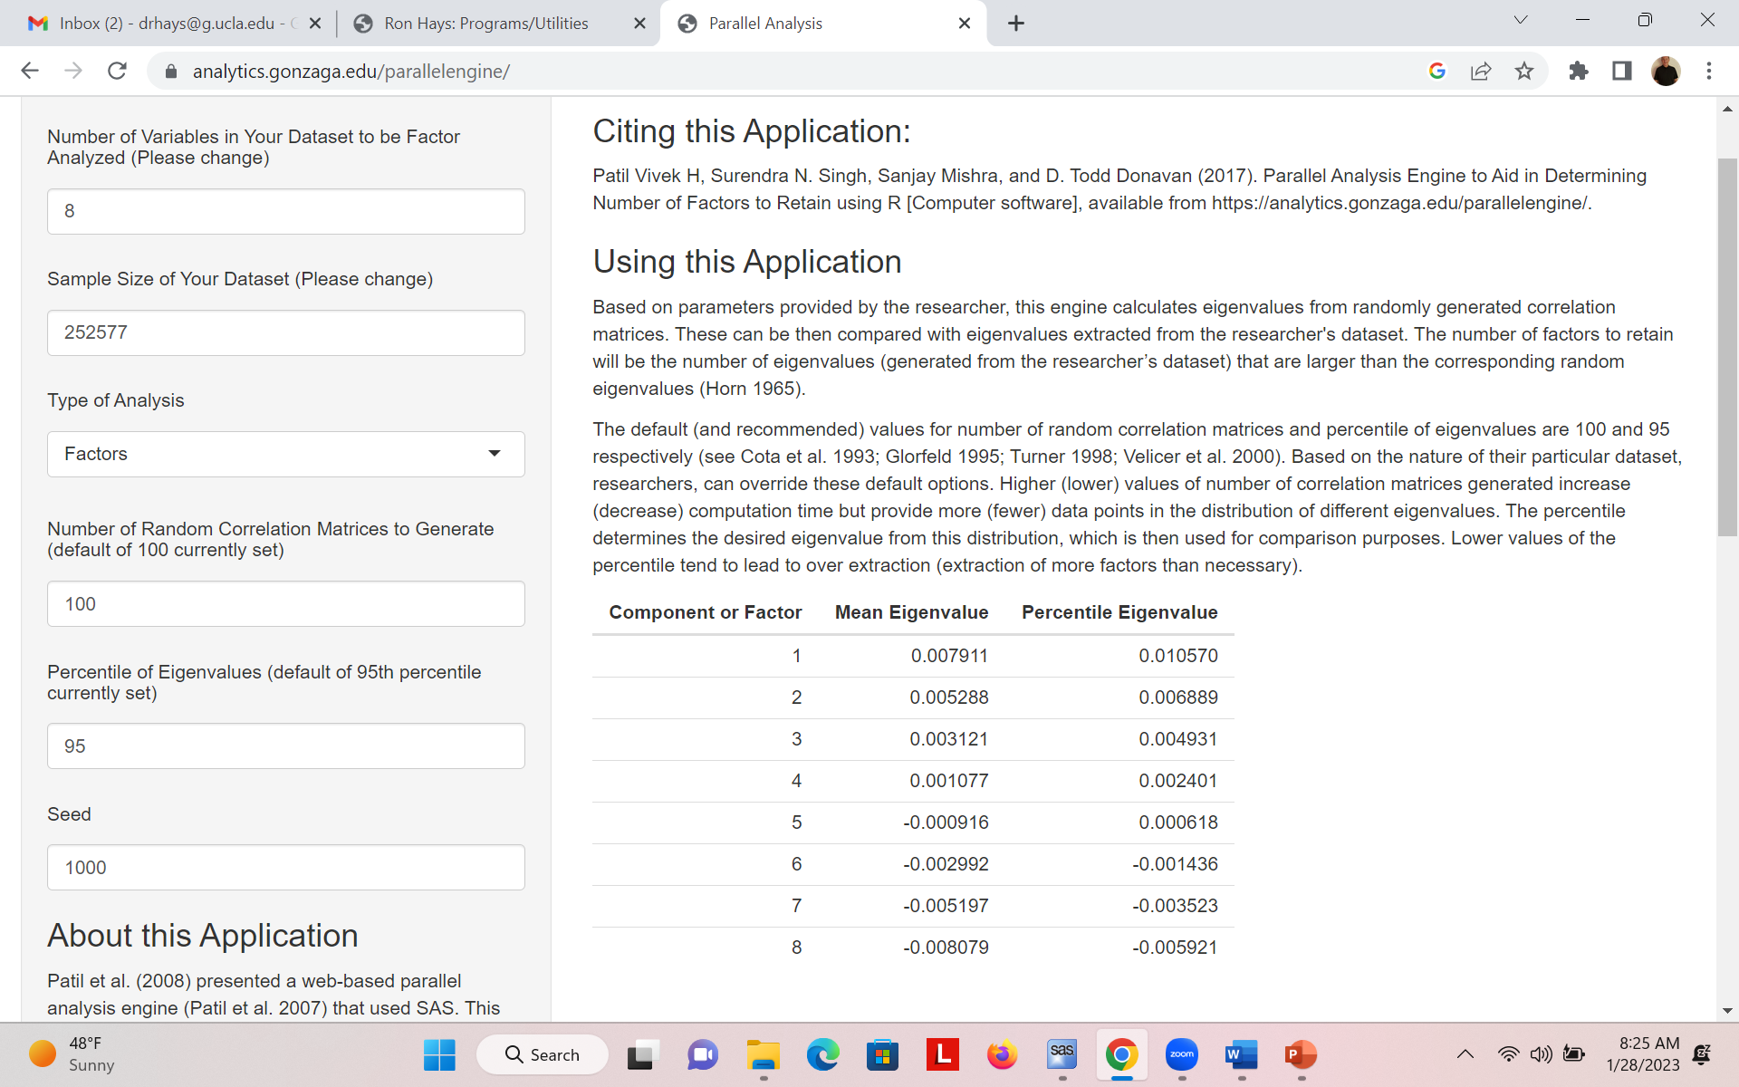

Slide 22
Factor Loadings for Rotated Factors
 | Factor 1: BADL | Factor 2: Advanced
Several flights of stairs | -.09 | 0.85
Moderate activities | -.02 | 0.82
Walking | 0.32 | 0.54
Getting in our out of chairs | 0.51 | 0.33
Bathing | 0.74 | 0.11
Dressing | 0.83 | 0.01
Using the toilet | 0.76 | -.01
Eating | 0.65 | -.09
Inter-factor correlations = 0.57

Slide 23
Multi-trait Scaling (n = 252,577; SE = 0.002)

Slide 24
Multi-trait Scaling (n = 252,577, SE = 0.002)
Inter-scale correlation = 0.55

Slide 25
Confirmatory Factor Analysis
Fit Indices
2
2
χ - χ
  Normed fit index:
  Non-normed fit index:
  Comparative fit index:
null
model
χ
2
2
2
χ χ
null
null
-
model
df df
null
model
2
χ
null
-
1
df
null
2
χ - df
1 -
model
model
2
χ -
df
null
null
RMSEA = SQRT (λ² – df)/SQRT (df (N – 1))
CFI >=0.95 and RMSEA <=0.06
Notes:
25

Slide 26
Correlations with Other Measures
 | Easier 2-PF (BADL) | Harder PF (Advanced)
Difficulty doing errands due to health condition | -.55 | -.45
Memory problems interference with daily activities | -.45 | -.38
Difficulty concentrating, remembering, decisions | -.39 | -.33
Blind or serious difficulty seeing even with glasses | -.24 | -.21
Depression | -.28 | -.29
Arthritis of hip or knee | -.25 | -.33
Arthritis of hand or wrist | -.21 | -.26
Emphysema, asthma, or COPD | -.16 | -.24
BMI | -.13 | -.21
Congestive heart failure | -.18 | -.20

Slide 27






IRT Parameters

Slide 28


IRT Parameters (Continued)

Slide 29
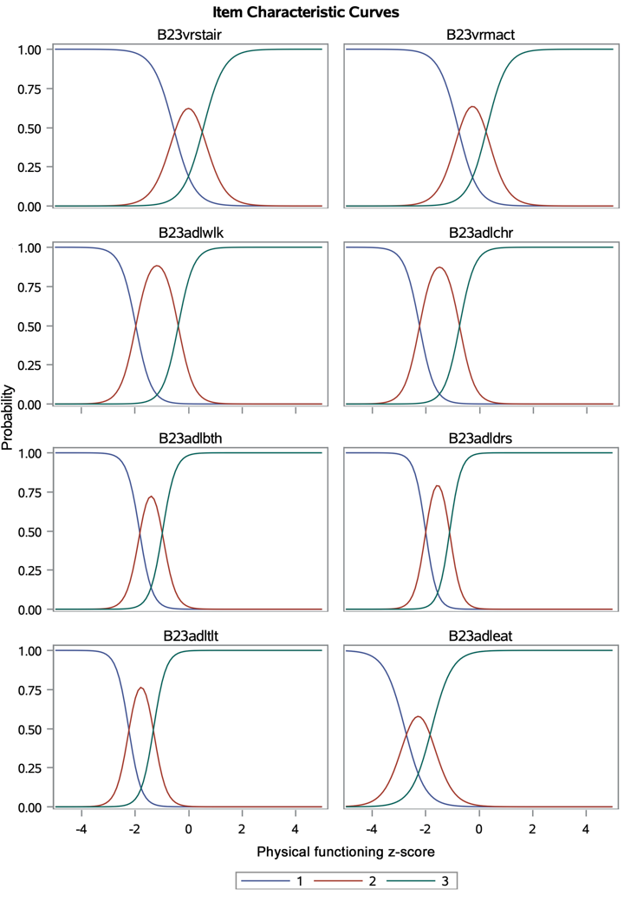

Slide 30
Rel = (INF-1)/INF

Slide 31

Email: drhays@ucla.edu
Resources
  https://labs.dgsom.ucla.edu/hays/pages/
  Hays, R. D., & Elliott, M. N. (submitted May 14, 2023; revised and resubmitted, September 6, 2023). Performance of the physical functioning activities of daily living scale in the 2020 Medicare Health Outcomes Survey. Arch Phys Med Rehabil.

