Slide 1
Change in health-related quality of life over 3 months in chiropractic patients with chronic low back or neck pain
Ron D. Hays
GIM & HSR Research Seminar: October 5, 2018
Opportunities for Health Services Research to Improve the Delivery of Health Care

Slide 2
RAND Center for Excellence in Research on Complementary and Alternative Medicine )
National Center for Complementary and Integrative Health Grant No: 1U19AT007912 (PI: Ian Coulter)
Hays, R. D., Spritzer, K. L., Sherbourne, C. D., Ryan, G. W., & Coulter, I. D. (in press). Group and individual-level change on health-related quality of life in chiropractic patients with chronic low back or neck pain. Spine.
Herman, P., Kommareddi, M. et al. (2018). Characteristics of chiropractic patients being treated for chronic low back and neck pain. J Manipulative and Physiological Therapeutics., 41, 445-455.
Notes:
This U19 examines chiropractic manipulation/mobilization for chronic low back and cervical pain using the RAND/UCLA expert panel process to assess treatment appropriateness. It also looks at patient preferences, treatment costs, and patient-reported outcomes.
Project 1: Clinician-Based Appropriateness
Project 2: Patient-Reported Outcomes
Project 3: Patient Experiences and Beliefs
Project 4: Resource Utilization.

Slide 3
Patient Inclusion/Exclusion
Inclusion
21 and older current chiropractic patients
Chronic low back pain and/or neck pain
Pain for 3 months or more before seeing chiropractor
Or self-reported as chronic
Able to complete questionnaires in English
Exclusion
Ongoing personal injury/workers’ compensation litigation

Slide 4
Portland, OR; San Diego, CA; Minneapolis, MN; Dallas, TX; Seneca Falls/Upstate NY, Tampa, FL for CERC National Study
125 clinics, 2024 (1834) patients
Notes:
n = 2024
72% of those eligible for the study (n = 2829) participated.
n = 1834 (65%) of the 2829; 91% of 2024.

Slide 5
n = 1834
Average age = 49 (range: 21-95)
74% female
56% college degree
88% non-Hispanic white
59% working full time; 32% income >=$100k
Mean number of years getting chiropractic care for pain = 11
Mean number of years seeing “this” chiropractor for pain = 5

Slide 6
PROMIS-29 V 2.0 Profile (Baseline and 3 Months Later)
1. Physical functioning
2. Pain (intensity and interference)
3. Fatigue
4. Sleep disturbance
5. Social health (participation in roles and activities)
6. Emotional distress (anxiety, depressive symptoms)
7. Physical health summary score
8. Mental health summary score
T-score metric (mean = 50, SD = 10)
Cella, D., et al. (submitted). PROMIS® Health Profiles: Efficient short-form measures of seven health domains.
Hays, R. D., Spritzer, K. L., Schalet, B., & Cella, D. (2018 epub). PROMIS®-29 v2.0 Profile Physical and Mental Health Summary Scores. Quality of Life Research.
Notes:
Slide 44
We measured patient-reported health with the Patient-reported Outcomes Measurement Information System (PROMIS) 29-item profile instrument that yields 6 multi-item scale scores and physical and mental health summary scores.
The PROMIS-29 scores are on a T-score metric with a mean of 50 and SD of 10 in the U.S. general population. For simplicity, I coded all scores so that a higher score represents better health.
[Typically, higher scores represent better physical functioning, social health, and physical and mental health summary scores. Higher scores are worse for the other 4 scales (pain, fatigue, sleep disturbance, and emotional distress).]

Slide 7
Reliability thresholds:
0.70 (group comparisons) and 0.90 (individual patients)
Notes:
The reliabilities of the PROMIS-29 v2.0 measures in this sample were 0.85 or higher.
Baseline means indicate that the sample of patients with chronic low back pain or neck pain are similar to the U.S. general population on emotional distress and better on social health. But they have worse physical functioning and more pain, fatigue, sleep disturbance, and physical and mental health summary scores.

Slide 9
Reliable Change Index (RCI)
SEM = standard error of measurement
SD_{bl} = standard deviation at baseline
r_{xx} = reliability
Notes:
Next, we were interested in how many people got better, stayed the same, and got worse over the 3 months of the study. We used the reliable change index to evaluate the significance of individual change.

Slide 10
Amount of Change in Observed Score Needed To be Statistically Significant
= 2.77 *
SD
∗
1
−
r
xx
“Coefficient of repeatability”
Note: SD = standard deviation and r_{xx} = reliability

Slide 11
How Reliability Relates to Amount of Individual Change Needed
Reliability | SQR (1- r_{xx}) | Change Needed
0.70 | 0.55 | 1.5 SD
0.80 | 0.45 | 1.2 SD
0.90 | 0.32 | 0.9 SD
0.95 | 0.22 | 0.6 SD
0.97 | 0.17 | 0.5 SD
2.77 *
SD
∗
1
−
r
xx

Slide 12
Notes:
The percent of people that got significantly better ranged from 13% (physical functioning) to 30% (mental health summary score).

Slide 13
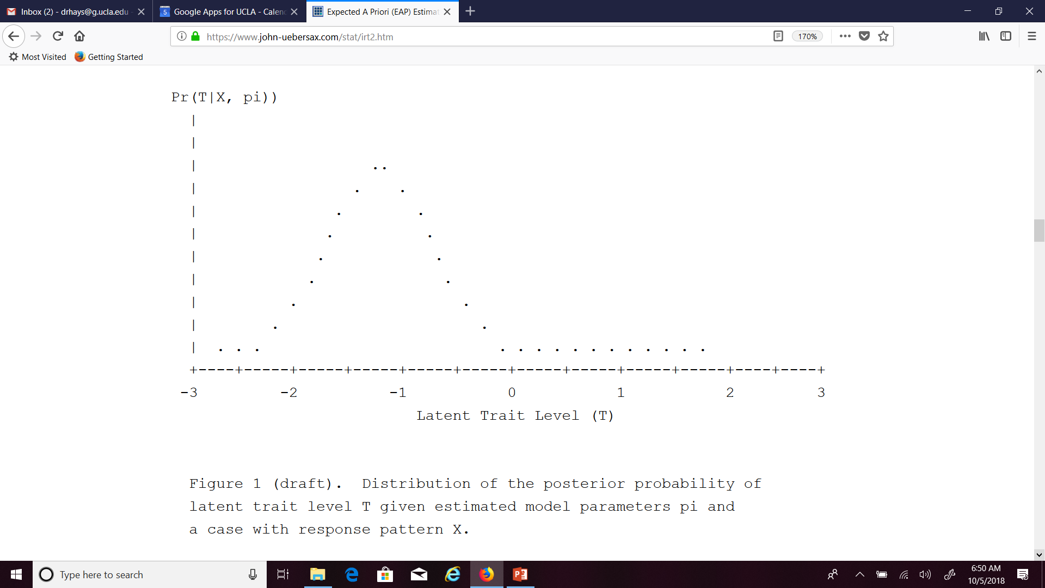

Slide 14
Notes:
CTT uses one standard error of measurement for everyone:
SEM = SD * SQRT (1-reliability)
With item response theory the standard error depends on the responses to the items in the scale and where the person is on the underlying concept. We used expected a-posterior SDs to estimate standard errors for comparison to the CTT results. (SD of the posterior distribution).
78% of the patients stayed the same according to the CTT estimates versus 91% based on IRT.
Of the 1425 that were classified as the same according to CTT, 99% were also classified as the same by IRT.
However, only 27% of the 173 people that were worse according to CTT were classified as such by IRT. Similarly, only 38% of the 236 people classified as better by CTT were also deemed better by IRT.
The Spearman rank—order correlation between CTT and IRT categories of change was 0.54 (p = 0.0228).

Slide 15
78%
91%
Notes:
CTT uses one standard error of measurement for everyone:
SEM = SD * SQRT (1-reliability)
With item response theory the standard error depends on the responses to the items in the scale and where the person is on the underlying concept. We used expected a-posterior SDs to estimate standard errors for comparison to the CTT results. (SD of the posterior distribution).
78% of the patients stayed the same according to the CTT estimates versus 91% based on IRT.
Of the 1425 that were classified as the same according to CTT, 99% were also classified as the same by IRT.
However, only 27% of the 173 people that were worse according to CTT were classified as such by IRT. Similarly, only 38% of the 236 people classified as better by CTT were also deemed better by IRT.
The Spearman rank—order correlation between CTT and IRT categories of change was 0.54 (p = 0.0228).

Slide 16
27%
99%
38%
Spearman rank-order correlation = 0.54
Notes:
CTT uses one standard error of measurement for everyone:
SEM = SD * SQRT (1-reliability)
With item response theory the standard error depends on the responses to the items in the scale and where the person is on the underlying concept. We used expected a-posterior SDs to estimate standard errors for comparison to the CTT results. (SD of the posterior distribution).
78% of the patients stayed the same according to the CTT estimates versus 91% based on IRT.
Of the 1425 that were classified as the same according to CTT, 99% were also classified as the same by IRT.
However, only 27% of the 173 people that were worse according to CTT were classified as such by IRT. Similarly, only 38% of the 236 people classified as better by CTT were also deemed better by IRT.
The Spearman rank—order correlation between CTT and IRT categories of change was 0.54 (p = 0.0228).

Slide 17
68%
90%
Notes:
68% of the patients stayed the same according to the CTT estimates versus 90% based on IRT.
All the 1255 that were classified as the same according to CTT were also classified as the same by IRT.
However, only 31% of the 290 people that were worse according to CTT were classified as such by IRT. Similarly, only 32% of the 289 people classified as better by CTT were also deemed better by IRT.
The Spearman rank—order correlation between CTT and IRT categories of change was 0.56 (p = 0.0172).

Slide 18
31%
100%
32%
Spearman rank-order correlation = 0.56
Notes:
68% of the patients stayed the same according to the CTT estimates versus 90% based on IRT.
All the 1255 that were classified as the same according to CTT were also classified as the same by IRT.
However, only 31% of the 290 people that were worse according to CTT were classified as such by IRT. Similarly, only 32% of the 289 people classified as better by CTT were also deemed better by IRT.
The Spearman rank—order correlation between CTT and IRT categories of change was 0.56 (p = 0.0172).

Slide 19
Notes:
This table provides mean change scores and standard deviation of change for the 7 cells with observations.
The average changes for the subgroups classified as the same by IRT but worse or better by CTT were substantial (about 10 T-score points but not as large as observed for those classified as worse or better (13 points) by both approaches.
The average change scores for the subgroups classified as the same by CTT but worse or better by IRT were noteworthy but not as large (about 7 points).

Slide 20
CR (two-tailed): 2.77*SEM
CR (one-tailed): 2.33*SEM
Notes:
Some have expressed dismay at the relatively small percentage of people classified as changed based on individual statistical significance.
One strategy for classifying change is to use a combination of one-tailed and two-tailed tests of significance and report five levels of change: definitely worse (two-tailed), probably worse (one-tailed), same (one-tailed), probably better (one-tailed), and definitely better (two-tailed). This table shows the number and percentage of people who fall into these 5 categories of change for physical function and emotional distress using IRT estimates.
Note that a very similar number of people are classified as worse versus better for emotional distress (a measure that did not change significantly at the group-level) while a greater number got better than got worse on physical function (a measure that improved significantly at the group-level).

Slide 21
Thank you.
Finkelman, M. D. et al. (2010). Item
selection and hypothesis testing for the
adaptive measurement of change. Applied Psychological Measurement, 34, 238-254.
Jabrayilov, R. et al. (2016). Comparison of classical test
theory and item response theory in individual change assessment. Applied Psychological Measurement, 40, 559-572.
Wang, C., & Weiss, D. J. (2018). Multivariate hypothesis
testing methods for evaluating significant individual change. Applied Psychological Measurement, 42, 221-239.
drhays@ucla.edu
Powerpoint file available for downloading at:
https://drhays.dgsom.ucla.edu/pages/presentations
Notes:
Jabrayilov et al. did a simulation and concluded that IRT is superior to to CTT in detection of individual change when a scale has 20 or more items, but CTT was superior for shorter scales.
The simulation used the Fisher information function to estimate IRT standard errors but we used expected a-posterior SDs here.
21

