Slide 1

Patient-Reported Outcomes of Health Care
Presentation to Visiting Scholars from
China Academy of Chinese Medical Sciences
April 16, 2014
9:00am – 11:00am
UCLA Center for East-West Medicine
1033 Gayley Ave, Suite 111
Los Angeles, CA 90024
Ron D.Hays, Ph.D. drhays@ucla.edu

Slide 2

U.S. Health Care Issues
Access to care
  ~ 50 million people without health insurance
Costs of care
  Expenditures ~ $ 2.7 Trillion
Effectiveness (quality) of care

Slide 3
How Do We Know If Care Is Effective?
Effective care maximizes probability of desired health outcomes
  Health outcome measures indicate whether care is effective
Cost ↓
Effectiveness ↑

Slide 4
Health Outcomes Measures
Traditional clinical endpoints
  Survival
  Clinical/biological indicators
    Rheumatoid factor
    Blood pressure
    Hematocrit
Patient-Reported Outcomes

Slide 5
Patient-Reported Measures (PRMs)
Mediators
  Health behaviors (adherence)
Health Care Process
  Reports about care (e.g., communication)
Outcomes (PROs)
  Patient satisfaction with care
  Health-Related Quality of Life (HRQOL)

Slide 6
Satisfaction
With Care
Patient Characteristics
Health
Behaviors
(Adherence)
Quality
of Care
HRQOL
Technical Quality
Patient Reports About Care

Slide 7

Health-Related Quality of Life (HRQOL)
How the person FEELs (well-being)
  Emotional well-being
  Pain
  Energy
What the person can DO (functioning)
  Self-care
  Role
  Social

Slide 8

HRQOL is Not
Quality of environment
Type of housing
Level of income
Social Support

Slide 9
Types of HRQOL Measures
- Targeted vs. Generic
- Profile vs. Preference-based

Slide 10
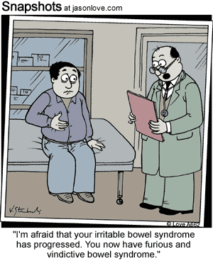
Targeted Item
During the last 4 weeks, how often were you angry about your irritable bowel syndrome?
None of the time
A little of the time
Some of the time
Most of the time
All of the time

Slide 11
Targeted Multi-Item Scale
Burden of Kidney Disease
My kidney disease interferes too much with my life.
Too much of my time is spent dealing with my kidney disease.
I feel frustrated with my kidney disease.
I feel like a burden on my family.

Slide 12
Generic Item
In general, how would you rate your health?
Excellent
Very Good
Good
Fair
Poor

Slide 13
Does your health now limit you in walking more than a mile?
(If so, how much?)
Yes, limited a lot
Yes, limited a little
No, not limited at all

Slide 14
How much of the time during the past 4 weeks have you been happy?
None of the time
A little of the time
Some of the time
Most of the time
All of the time

Slide 15
Generic Scales (SF-36)
Physical functioning (10 items)
Role limitations/physical (4 items)
Emotional well-being (5 items)
Role limitations/emotional (3 items)
Social functioning (2 items)
Pain (2 items)
Energy/fatigue (4 items)
General health perceptions (5 items)

Slide 16
Scoring HRQOL Scales
Average or sum all items in the same scale.
Transform average or sum to
  0 (worse) to 100 (best) possible range
  z-score (mean = 0, SD = 1)
  T-score (mean = 50, SD = 10)

Slide 17
Linear Transformations
X =
(original score - minimum) *100
(maximum - minimum)
Y
= target mean + (target SD * Zx)
(X - X)
Z_{X} =
SD_{X}

Slide 18
Example of Computing z-score and T-score
z-score = (score – mean)/SD
T-score = (10 * z-score) + 50
z-score = (100- 36)/31 = 2.06
T-score = 71

Slide 19
HRQOL in HIV Compared to other
Chronic Illnesses and General Population
T-score metric
Hays et al. (2000), American Journal of Medicine

Slide 20
Physical Health
Physical Health
Physical function
Role functionphysical
Pain
General Health

Slide 21
Mental Health
Mental Health
Emotional Well-Being
Role function-emotional
Energy
Social function

Slide 22
SF-36 PCS and MCS
PCS_z = (PF_Z * 0.42) + (RP_Z * 0.35) + (BP_Z * 0.32) + (GH_Z * 0.25) + (EF_Z * 0.03) + (SF_Z * -.01) + (RE_Z * -.19) + (EW_Z * -.22)
MCS_z = (PF_Z * -.23) + (RP_Z * -.12) + (BP_Z * -.10) + (GH_Z * -.02) + (EF_Z * 0.24) + (SF_Z * 0.27) + (RE_Z * 0.43) + (EW_Z * 0.49)
PCS = (PCS_z*10) + 50
MCS = (MCS_z*10) + 50

Slide 23
Is CAM Better than
Standard Care (SC)?
CAM
SC
CAM
SC
Physical
Health
CAM > SC
Mental
Health
SC > CAM

Slide 24
Is Acupuncture Related to Worse HRQOL?
Subject Acupuncture HRQOL (0-100)
1 No dead
2 No dead
3 No 50
4 No 75
5 No 100
6 Yes 0
7 Yes 25
8 Yes 50
9 Yes 75
10 Yes 100
  Group n HRQOL
  No Acupuncture 3 75
  Yes Acupuncture 5 50

Slide 25
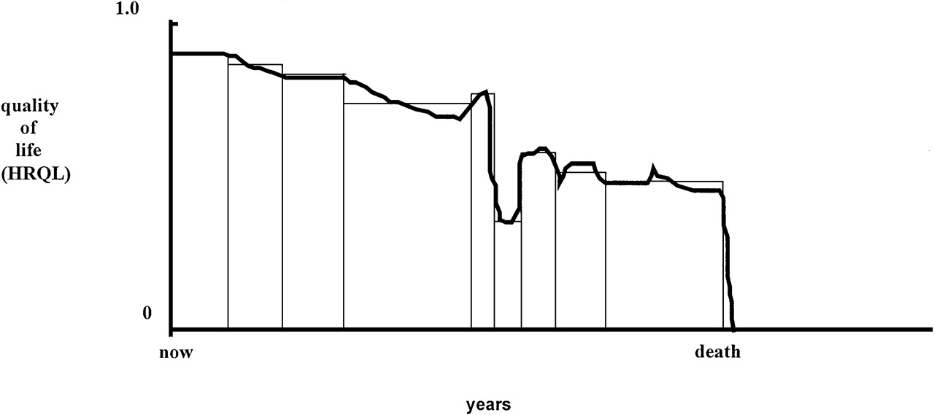
Quality of Life for Individual Over Time

Slide 26
Ultimate Use of HRQOL Measures--
Helping to Ensure Access to
Cost-Effective Care
Cost ↓
Effectiveness (“Utility”) ↑

Slide 27
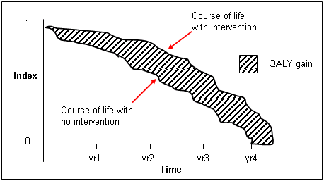
http://www.ukmi.nhs.uk/Research/pharma_res.asp

Slide 28
“QALYs: The Basics”
Milton Weinstein, George Torrance, Alistair McGuire
(Value in Health, 2009, vol. 12 Supplement 1)
What is value?
  Preference or desirability of health states
How are QALYs used?
  Societal resource allocation
  Personal decisions such as decision about whether to have a treatment
  Societal or program audit
    Evaluate programs in terms of health of the population.

Slide 29
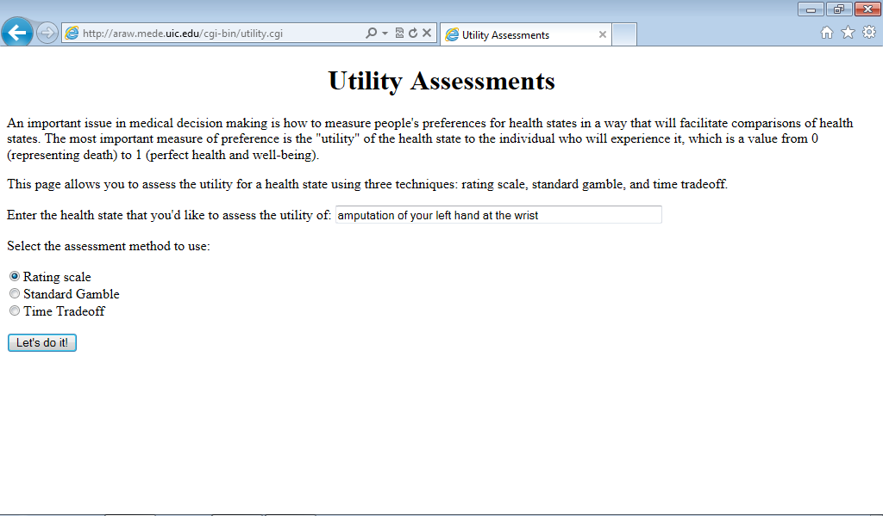
http://araw.mede.uic.edu/cgi-bin/utility.cgi
http://araw.mede.uic.edu/cgi-bin/utility.cgi

Slide 30
SG>TTO>RS
SG = TTOª
SG = RS^{b}
^{Where a and b are less than 1}

Slide 31
SF-6D health state (424421) = 0.59
Your health limits you a lot in moderate activities (such as moving a table, pushing a vacuum cleaner, bowling or playing golf)
You are limited in the kind of work or other activities as a result of your physical health
Your health limits your social activities (like visiting friends, relatives etc.) most of the time.
You have pain that interferes with your normal work (both outside the home and housework) moderately
You feel tense or downhearted and low a little of the time.
You have a lot of energy all of the time

Slide 32
Reliability Minimum Standards
0.70 or above (for group comparisons)
0.90 or higher (for individual assessment)
  SEM = SD (1- reliability)^{1/2}
  95% CI = true score +/- 1.96 x SEM
    if true z-score = 0, then CI: -.62 to +.62
      Width of CI is 1.24 z-score units
Notes:
32

Slide 33
Range of reliability estimates
0.80-0.90 for blood pressure
0.70-0.90 for multi-item self-report scales
Hahn, E. A., Cella, D., et al. (2007). Precision of health-related
quality-of-life data compared with other clinical measures.
Mayo Clin Proceedings, 82 (10), 1244-1254.

Slide 34
Self-Reports of Physical Health
Predict Five-Year Mortality
%
Dead
(n=676)
(n=754)
(n=1181)
(n=609)
SF-36 Physical Health Component Score (PCS)—T score
Ware et al. (1994). SF-36 Physical and Mental Health Summary Scales: A User’s Manual.

Slide 35
Mortality Prediction with a Single General Self-Rated Health Question
DeSalvo, K. B., Bloser, N., Reynolds, K., He, J., & Muntner, P. (2005). Mortality prediction with a single general self-rated health question: A meta-analysis. JGIM, 20, 267-275.

Slide 36
Course of Emotional Well-being Over
2-years for Patients in the MOS
General Medical Sector
Hypertension
Diabetes
0-100 range
Major Depression
Baseline
2-Years
Hays, R.D., Wells, K.B., Sherbourne, C.D., Rogers, W., & Spritzer, K. (1995). Functioning and well-being outcomes of patients with depression compared to chronic medical illnesses. Archives of General Psychiatry, 52, 11-19.

Slide 37
Physical Functioning in Relation to Time
Spent Exercising 2-years Before
84
82
80
78
76
74
72
70
68
66
64
62
Hypertension
Diabetes
0-100 range
Current Depression
Low
High
Total Time Spent Exercising
Stewart, A.L., Hays, R.D., Wells, K.B., Rogers, W.H., Spritzer, K.L., & Greenfield, S. (1994). Long-term
functioning and well-being outcomes associated with physical activity and exercise in patients with
chronic conditions in the Medical Outcomes Study. Journal of Clinical Epidemiology, 47, 719-730.

Slide 38
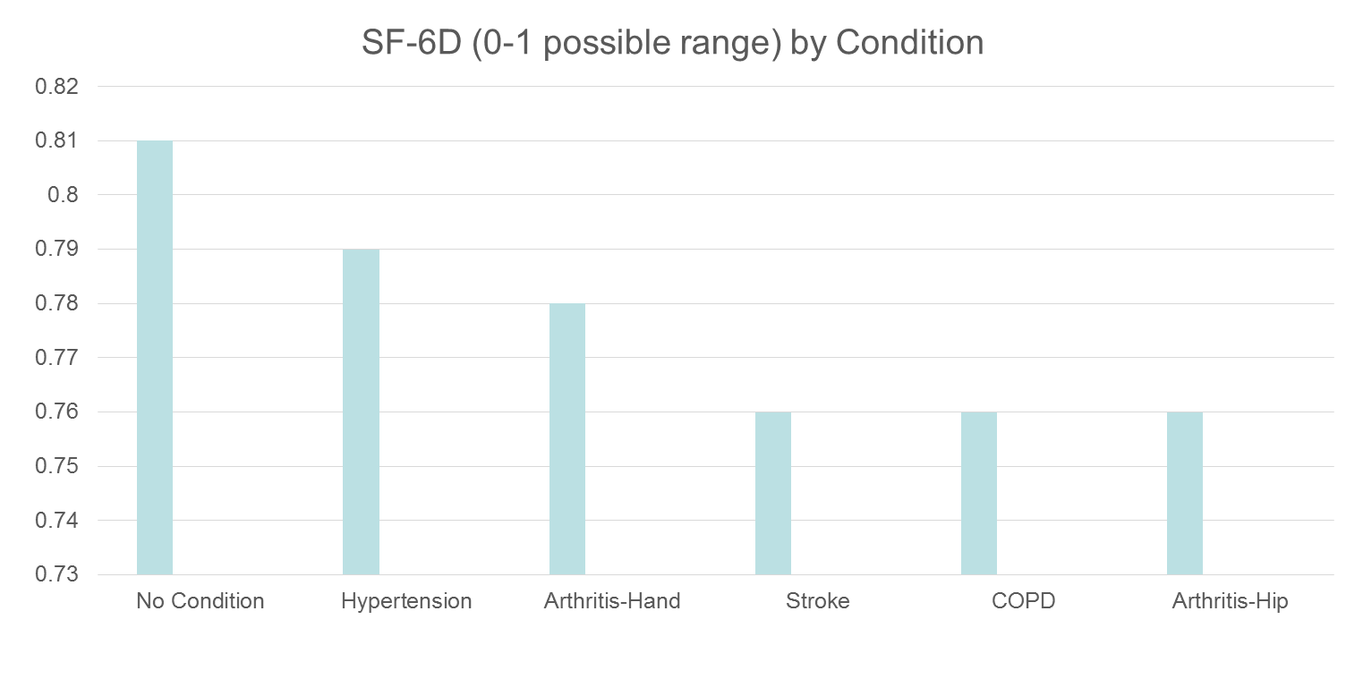
HRQOL in SEER-Medicare Health Outcomes Study (n = 126,366)
Controlling for age, gender, race/ethnicity, education, income, and marital status.

Slide 39
Distant stage of cancer associated with 0.05-0.10 lower SF-6D Score

Slide 40
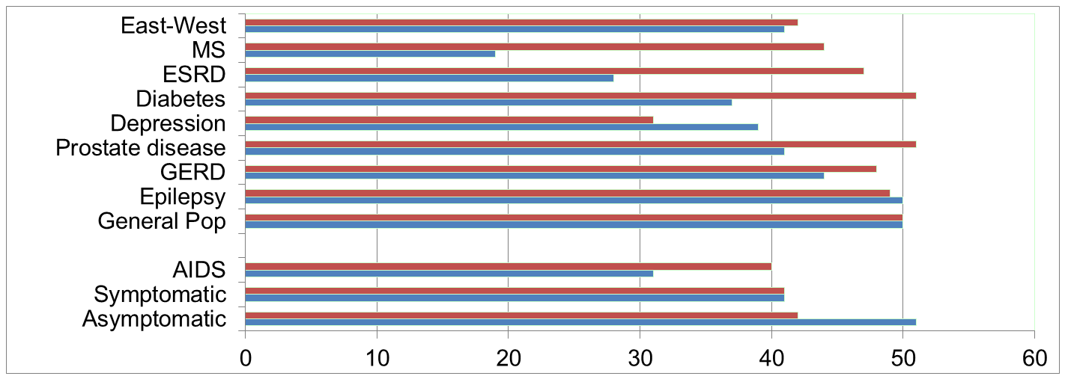
Physical Functioning and Emotional Well-Being at Baseline for 54 Patients at UCLA-Center for East West Medicine
EWB
Physical
MS = multiple sclerois; ESRD = end-stage renal disease; GERD = gastroesophageal reflux disease.
40

Slide 41
Significant Improvement in all but 1 of SF-36 Scales (Change is in T-score metric)
Change
t-test
prob.
PF-10
1.7
2.38
.0208
RP-4
4.1
3.81
.0004
BP-2
3.6
2.59
.0125
GH-5
2.4
2.86
.0061
EN-4
5.1
4.33
.0001
SF-2
4.7
3.51
.0009
RE-3
1.5
0.96
.3400
EWB-5
4.3
3.20
.0023
PCS
2.8
3.23
.0021
MCS
3.9
2.82
.0067

Slide 42
Effect Size
(Follow-up – Baseline)/ SD_{baseline}
_{Cohen’s Rule of Thumb:}
_{ES = 0.20 Small}
_{ES = 0.50 Medium}
_{ES = 0.80 Large}

Slide 43
Effect Sizes for Changes in SF-36 Scores
Effect Size
0.13
0.35
0.35
0.21
0.53
0.36
0.11
0.41
0.24
0.30
PFI = Physical Functioning; Role-P = Role-Physical; Pain = Bodily Pain; Gen H=General Health; Energy = Energy/Fatigue; Social = Social Functioning; Role-E = Role-Emotional; EWB = Emotional Well-being; PCS = Physical Component Summary; MCS =Mental Component Summary.

Slide 44
Defining a Responder: Reliable Change Index (RCI)
Note: SD_{bl} = standard deviation at baseline
r_{xx} = reliability

Slide 45
Amount of Change in Observed Score Needed To be Statistically Significant
Note: SD_{bl} = standard deviation at baseline and r_{xx} = reliability

Slide 46
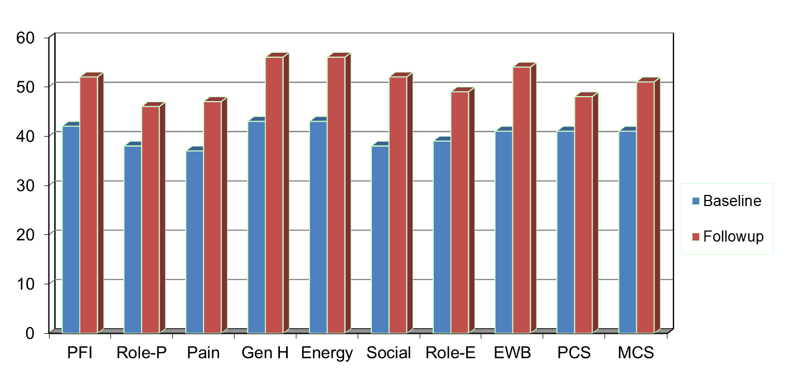
Amount of Change Needed for Significant Individual Change
Effect Size
0.67
0.72
1.01
1.13
1.33
1.07
0.71
1.26
0.62
0.73
PFI = Physical Functioning; Role-P = Role-Physical; Pain = Bodily Pain; Gen H=General Health; Energy = Energy/Fatigue; Social = Social Functioning;
Role-E = Role-Emotional; EWB = Emotional Well-being; PCS = Physical Component Summary; MCS =Mental Component Summary.

Slide 47
7-31% of People in Sample Improve Significantly
% Improving
% Declining
Difference
PF-10
13%
2%
+ 11%
RP-4
31%
2%
+ 29%
BP-2
22%
7%
+ 15%
GH-5
7%
0%
+ 7%
EN-4
9%
2%
+ 7%
SF-2
17%
4%
+ 13%
RE-3
15%
15%
0%
EWB-5
19%
4%
+ 15%
PCS
24%
7%
+ 17%
MCS
22%
11%
+ 11%

Slide 48
Item Responses and
Trait Levels
Person 1
Person 2
Person 3
Trait
Continuum
Item 1
Item 2
Item 3
www.nihpromis.org

Slide 49




Computer Adaptive Testing (CAT)
Notes:
Early research on CAT was funded by the U.S. military to enhance mental measurement.
NASD = National Association of Security Dealers. In 1978 they began developing CAT for regulatory exam to assess knowledge of securities and securities future products among licensed brokers.
The National Council of State Boards of Nursing starting using CAT in 1994.

Slide 50
Reliability Target for Use of Measures with Individuals
Reliability ranges from 0-1
  0.90 or above is goal
  SEM = SD (1- reliability)^{1/2}
  95% CI = true score +/- 1.96 x SEM
    if true z-score = 0, then CI: -.62 to +.62
      Width of CI is 1.24 z-score units
Reliability = 0.90 when SE = 3.2
  T-scores (mean = 50, SD = 10)
  Reliability = 1 – (SE/10)²
T = 50 + (z * 10)
Notes:
T = z*10 + 50

Slide 51
Reliability and SEM
For z-scores (mean = 0 and SD = 1):
  Reliability = 1 – SE²
  So reliability = 0.90 when SE = 0.32
For T-scores (mean = 50 and SD = 10):
  Reliability = 1 – (SE/10)²
  So reliability = 0.90 when SE = 3.2

Slide 52
In the past 7 days …
I was grouchy [1st question]
  Never [39]
  Rarely [48]
  Sometimes [56]
  Often [64]
  Always [72]
Estimated Anger = 56.1
SE = 5.7 (rel. = 0.68)
Notes:
Never: 39
Rarely: 48
Sometimes = 56
Often = 64
Always = 72

Slide 53
In the past 7 days …
I felt like I was ready to explode
[2nd question]
  Never
  Rarely
  Sometimes
  Often
  Always
Estimated Anger = 51.9
SE = 4.8 (rel. = 0.77)

Slide 54
In the past 7 days …
I felt angry [3rd question]
  Never
  Rarely
  Sometimes
  Often
  Always
Estimated Anger = 50.5
SE = 3.9 (rel. = 0.85)

Slide 55
In the past 7 days …
I felt angrier than I thought I should [4th question]
- Never
  Rarely
  Sometimes
  Often
  Always
Estimated Anger = 48.8
SE = 3.6 (rel. = 0.87)

Slide 56
In the past 7 days …
I felt annoyed [5th question]
  Never
  Rarely
  Sometimes
  Often
  Always
Estimated Anger = 50.1
SE = 3.2 (rel. = 0.90)

Slide 57
In the past 7 days …
I made myself angry about something just by thinking about it. [6th question]
  Never
  Rarely
  Sometimes
  Often
  Always
Estimated Anger = 50.2
SE = 2.8 (rel = 0.92)

Slide 58
PROMIS Physical Functioning vs. “Legacy” Measures
10 20 30 40 50 60 70

Slide 59
“Implementing patient-reported outcomes assessment in clinical practice: a review of the options and considerations”
Snyder, C.F., Aaronson, N. K., et al. Quality of Life Research, 21, 1305-1314, 2012.
  HRQOL has rarely been collected in a standardized fashion in routine clinical practice.
  Increased interest in using PROs for individual patient management.
  Research shows that use of PROs:
    Improves patient-clinician communication
    May improve outcomes

Slide 60

Thank you
drhays@ucla.edu (310-794-2294). Powerpoint file available for downloading at: http://gim.med.ucla.edu/FacultyPages/Hays/
Disclosures. This presentation was supported by NIA Grant P30-AG021684.
Notes:
60

