Slide 1

A Parsimonious Patient-Reported
Measure of Care Coordination
Ron D. Hays, Ph.D.
UCLA Department of Medicine
September 27, 2013
Los Angeles, CA 90024
2nd Floor Broxton Conference Room

Slide 2

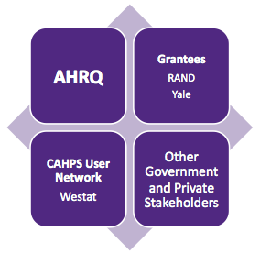
Consumer Assessment of Healthcare Providers and Systems (CAHPS®) Project
U18 HS016980
Consortium

Slide 3
Collaborators
RAND
  Steven Martino, Julie A. Brown, Mike Cui, Marc Elliott
Yale
  Paul Cleary
Center for Medicare & Medicaid Services (CMS)
  Sarah Gaillot
Supported by
  CMS contract HHSM-500-2005-000281

Slide 4



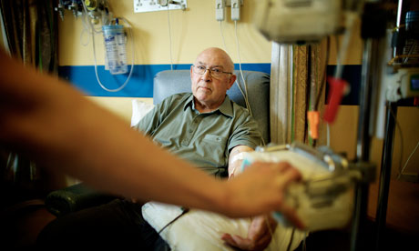
We Measure Quality of Care to Improve It
Find out how well they are doing
Providers
Government/
Private Insurers
Identify best/worst healthcare providers
Choose best health care for themselves
Patients

Slide 5
How Do We Measure Quality of Care?
Focus has been on expert consensus
Variant of RAND Delphi Method

Slide 6
How Do We Measure Quality of Care?
But how patients perceive their care also important
CAHPS project was tasked with measuring patient experiences.
Focus has been on expert consensus
Variant of RAND Delphi Method

Slide 7
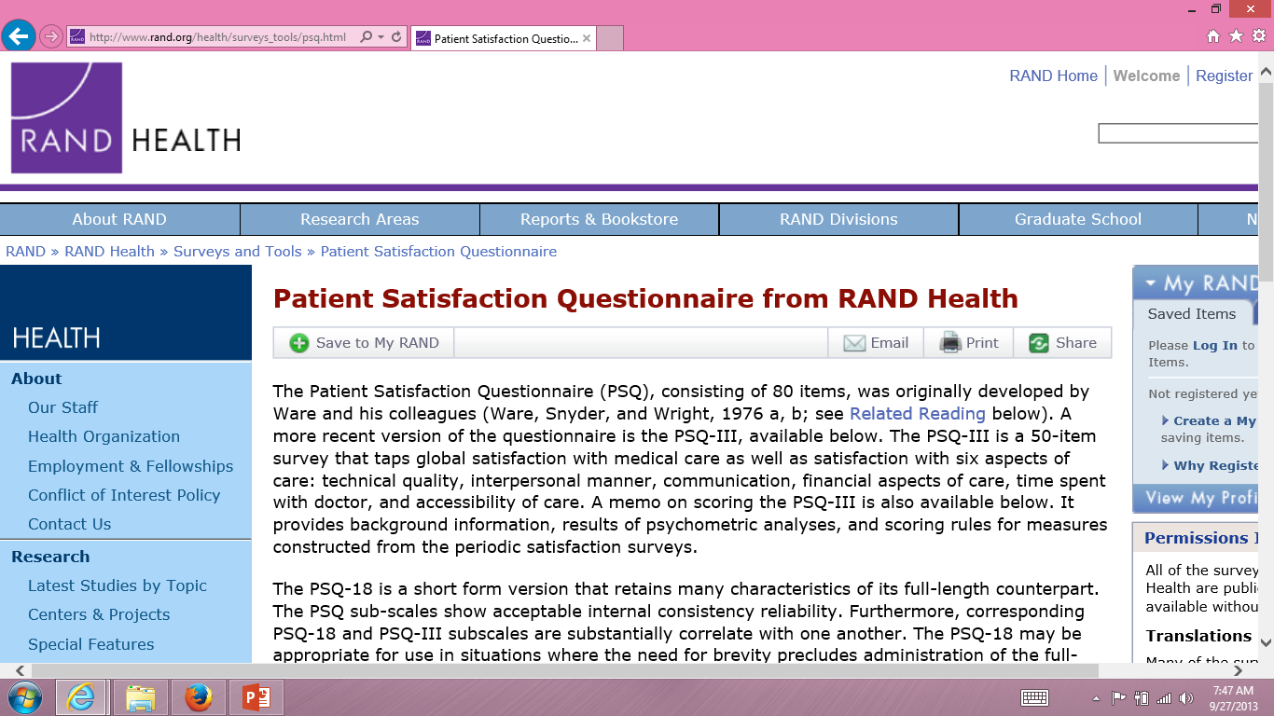

Slide 8
CAHPS Approach
Complements information from clinical process measures
  Correlates positively with clinical measures, but important in own right
Focus on what patients want to know about AND can accurately report about
  Communication with health care provider
  Access to care
  Office staff courtesy and respect
  Customer service

Slide 9
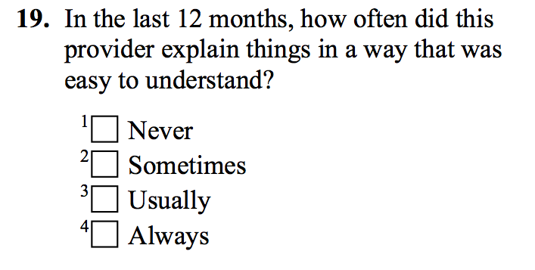
Rather than Assessing Patient Satisfaction, CAHPS Relies on Reports About Care

Slide 10
CAHPS Medicare Survey Composites
Communication (4 items)
Getting needed care (2 items)
Getting care quickly (3 items)
Customer Service (3 items)

Slide 11
CAHPS Has Evolved Over Time
1995
2013
CAHPS I (1995–2001)
CAHPS II (2002–2007)
CAHPS III (2007–2012)
CAHPS IV (2012–2017)
Develop surveys
Enhance reporting guidelines and advance science of reporting
Evaluating quality Improvement efforts
CAHPS I–IV represent $26 million in total funding

Slide 12
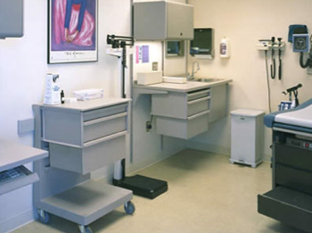
CAHPS Now Has a Family of Surveys
Ambulatory Care
  Health Plan Survey
  Clinician & Group Survey
  Home Health Care Survey
  Surgical Care Survey
  ECHO® Survey
  Dental Plan Survey
  American Indian Survey

Slide 13
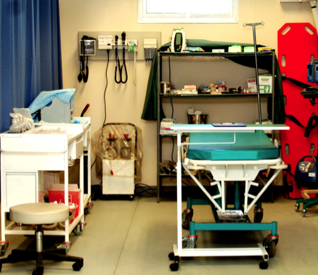
CAHPS Now Has a Family of Surveys
Ambulatory Care
  Health Plan Survey
  Clinician & Group Survey
  Home Health Care Survey
  Surgical Care Survey
  ECHO® Survey
  Dental Plan Survey
  American Indian Survey
Facility
  Hospital Survey
  In-Center Hemodialysis Survey
  Nursing Home Survey

Slide 14
CAHPS Now Has a Family of Surveys
Ambulatory Care
  Health Plan Survey
  Clinician & Group Survey
  Home Health Care Survey
  Surgical Care Survey
  ECHO® Survey
  Dental Plan Survey
  American Indian Survey
Facility
  Hospital Survey
  In-Center Hemodialysis Survey
  Nursing Home Surveys
CAHPS undisputed leader in measuring patient experience

Slide 15
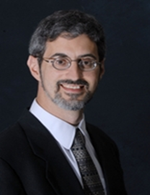
Care Coordination Measures
McDonald, K. M., et al. Care coordination measures atlas version 3. AHRQ, 2010.
David Meyers, AHRQ
CAHPS PCMH survey (Scholle et al., 2012)
  Availability of test results and records during appointments
  Information about prescription medicines
  Communication among providers

Slide 16
CAHPS Medicare Survey 2012
Care Coordination Items
Personal doctor:
  has medical records or other information about your care during visits
  talks about all medicines you are taking
  informed and up-to-date about care from specialists
  helps manage care from providers and services
  follows up on test results

Slide 17
Data Collection
Random sample of 2012 Medicare beneficiaries
  Data collected from February 21 to May 29, 2012
  46% response rate
266,466 in analytic sample
  98,014 fee-for service beneficiaries
  168,452 Medicare Advantage plan members

Slide 18
Analyses
Categorical confirmatory factor analysis (Mplus)
  Patient-level and multi-level (patient and MA plan)
  Comparative Fit Index (CFI) > 0.95
  Root Mean Square Error of Approximation (RMSEA) < 0.06
Reliability >= 0.70
  Internal consistency (coefficient alpha)
  Plan-level reliability

Slide 19
CAHPS Medicare Survey Composites
Communication (4 items)
Getting care quickly (3 items)
Getting needed care (2 items)
Customer Service (3 items)

Slide 20
Regress Global Rating on Composites
Using any number from 0 to 10, where 0 is the worst personal doctor possible, and 10 is the best personal doctor possible, what number would you use to rate your personal doctor?
□ 0 Worst personal doctor possible
□ 1
□ 2
□ 3
□ 4
□ 5
□ 6
□ 7
□ 8
□ 9
□ 10 Best personal doctor possible

Slide 21
Confirmatory Factor Analyses
Good fit for patient-level CFA
  CFI = 0.996
  RMSEA = 0.020
Good fit for multi-level CFA
  CFI = 0.997
  RMSEA = 0.014

Slide 22
Standardized Factor Loadings
 | Within-Level | Between-Level
Has medical records | 0.72 (0.71) | 0.86
Talks about medicines | 0.65 (0.64) | 0.58
Informed and up-to-date | 0.70 (0.69) | 0.49
Helps manage care | 0.71 (0.77) | 0.97
Follow-up on test results | 0.71 (0.70) | 0.72
Loadings from patient-level CFA shown within parentheses. Multi-level
CFA loadings are the other numbers.

Slide 23
Reliability
Internal consistency (alpha) = 0.70
Plan-level
  ICC = 0.022 at plan level
  Number of patients needed to obtain
    0.70 reliability = 102
    0.80 reliability = 170

Slide 24
Regression of Global Rating of Personal Doctor on CAHPS Composites
Composite | Standardized Beta
Communication | 0.62
Care Coordination | 0.17
Getting Care Quickly | 0.04
Getting Needed Care | 0.01
Customer Service | -.002 (ns)
(R² = 0.56)

Slide 25
Conclusions
Care coordination composite
  Unidimensional
  Has satisfactory reliability
  Uniquely associated with global rating of personal doctor
Implications for CMS
  Report to patients
  Report to plans
  Use in Quality Bonus Payments to Managed Care Plans
    http://www.cms.gov/Medicare/Prescription-Drug-Coverage/PrescriptionDrugCovGenIn/PerformanceData.html
    Outcomes (55%), CAHPS (27%), Process (18%)
Future
  Examine how it is related to other ways of assessing care coordination such as work flow, scheduling and documentation rated by external observers.

Slide 26
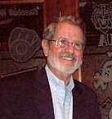

Thank you.
Medical Care Research & Review, in press
drhays@ucla.edu
Chuck Darby, Emeritus CAHPS Project Officer

