Slide 1
Health-Related Quality of Life as an indicator of Quality of Care
Ron D. Hays, Ph.D.
UCLA Department of Medicine
HPM216: Quality Assessment/Making the
Business Case for Quality
https://labs.dgsom.ucla.edu/hays/pages/presentations
April 19, 2019, 8:30-11:30am
1100 Glendon Avenue, Suite 900
Notes:
1

Slide 2

Concerns About US
Health Care System
Access to care
  ~ 49 million (16%) uninsured in 2010 B4 ACA
  ~ 28 million (9%) uninsured in 2017
  https://www.cnbc.com/2017/08/29/obamacare-kept-reducing-number-of-americans-without-health-insurance.html
Cost of care
  ~ $ 3.3 Trillion in 2016: https://en.wikipedia.org/wiki/Health_care_in_the_United_States
Effectiveness (quality) of care
  Some care delivered is inappropriate
  Not all needed care is delivered

Slide 3
Indicators of Effective Care
Quality of care
  Expert consensus about process
  Patient reports about care (e.g., CAHPS®)
Health outcomes
  Clinical outcomes (e.g., BP)
  Patient-reported outcomes
    Health-related quality of life

Slide 4
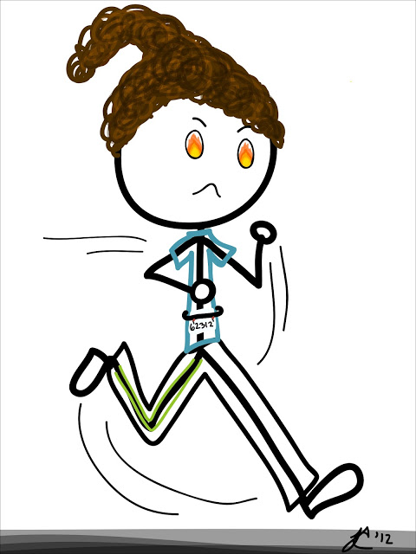

Limitation of Survival Analysis
Dead 0.0
Alive 1.0
Marathoner 1.0
Person in coma 1.0

Slide 5
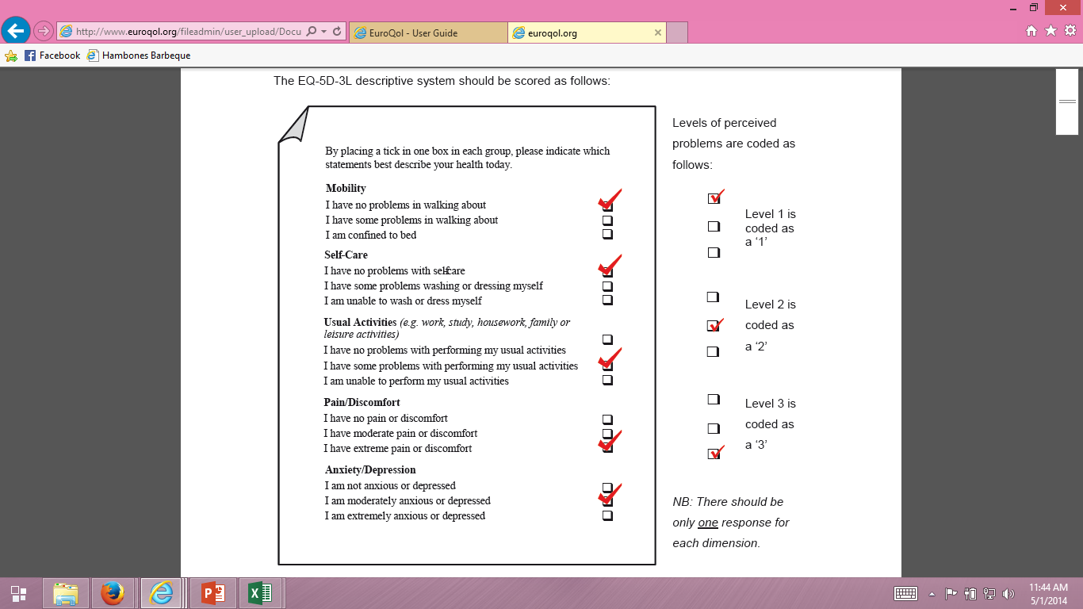
EQ-5D-3L Quality-Adjusted Life Years (0 = dead, 1 = perfect health) = 0.435

Slide 6
Phillips & Thompson
http://www.vhpharmsci.com/decisionmaking/Therapeutic_Decision_Making/Advanced_files/What%20is%20a%20QALY.pdf

Slide 7
Cost-Effective Care
Cost ↓
Effectiveness (“Utility”) ↑
Cost/QALY

Slide 8
Whittington, M. D. et al. (2019)
Long-term survival and cost-effectiveness associated with axicabtagene ciloleucel vs chemotherapy for treatment of B-cell lymphoma. JAMA Netw Open. 2019;2(2):e190035
Modeled ZUMA-1 cohort^{Neelapu et al. 2017, NEJM} of 111 adults patients with refractory aggressive non-Hodgkin-lymphoma (B-cell lymphoma) that were evaluated for safety and efficacy of axicabtagene ciloleucel (AC) vs chemotherapy (C).
Lymphoma: blood cancer
AC: Yescarta “is a treatment for large B-cell lymphoma that has failed conventional treatment. T cells are removed from a person with lymphoma and genetically engineered to produce a specific T-cell receptor.”
C: “type of cancer treatment that uses one or more anti-cancer drugs.”

Slide 9
Costs and Survival Estimates
Total costs of AC (~ $521k) and C (~ $118k) treatment groups and survival curves in the ZUMA-1 trial (24 month followup) extrapolated to lifetime horizon:
Five different survival models:
Standard parametric
Flexible parametric
2 mixture cure models
Flexible parametric mixture model

Slide 10
Incremental: AC vs C
Life years: 1.89-5.82
Quality-adjusted life years (QALYs): 1.52-4.90
(0 = dead and 1 = perfect health)
Cost per QALY: $82,400-$230,900
“Under certain long-term survival assumptions, treatment with axicabtagene ciloleucel also appears to be cost-effective.”

Slide 11
Cost-Utility Thresholds
WHO: Gross Domestic Product (GDP)/capita
  Cost-effective
    < GDP per capita (50k in 2011 in U.S.)
  Economically unattractive
    >= 3 times GDP per capita (>150k in 2011 in U.S.)
American College of Cardiology/American Heart Association
  Highly cost-effective: < 10k
  Cost-effective: 10-49k
  Somewhat cost-effective: 50-150K
  Insufficient evidence: >150k

Slide 12
QALYs Estimation

Slide 13
Chen et al. (2018)
Exploring the potential cost-effectiveness of precision medicine treatment strategies for diffuse large B-cell lymphoma, Leukemia & Lymphoma, 2018, 59(7), 1700-1709.
“Survival was adjusted by health-related quality of life using published utility estimates from the literature. We used a utility of 0.83 for progression-free state and 0.39 for relapsed state with progressive disease, following the utility estimates used in previous economic evaluation studies for DLBCL patients receiving RCHOP [28].”

Slide 14
Best et al. (2005)
Cost-effectiveness analysis of rituximab combined with CHOP for treatment of diffuse large b-cell lymphoma. Value in Health, 2005, 8(4), 462-470.
“We weighted the 3-month utility scores from Doorduijn et al.’s study [28] by the proportion of patients in the GELA study who had a CR and no CR/progression to obtain a utility score of 0.83 for DFS and 0.39 for progression.”
Doorduijn, J. et al. Quality of life (QOL) in elderly patients with aggressive non-Hodgkin’s lymphoma (NHL) treated with CHOP (Abstract). Blood, 2001, 98, 1803.
CR = complete response, DFS = disease-free survival

Slide 15
QALY Estimation (2)

Slide 16
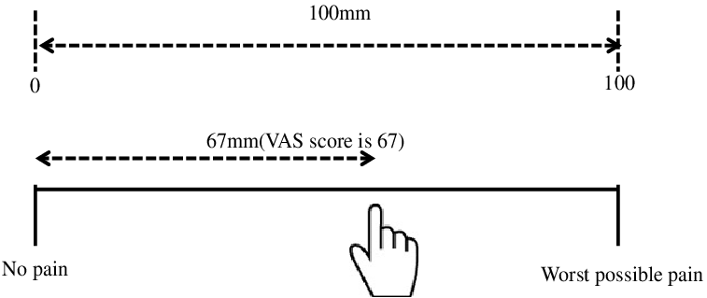
Sung et al.
Treatment options for patients with acute myeloid leukemia with a matched sibling donor: A decision analysis. Cancer, 2003, 97, 592-600.
“Physicians were asked to estimate QOL on a 10-cm VAS for each of our health states. The short-term dysutilities associated with BMT and CT were also obtained…These VAS values were then converted to standard gamble utilities using the following formula: utility = 1-(1- VAS score)^{2.29}
1- (0.1^{2.29})= 1-0.005 = 0.995
1- (0.5^{2.29})= 1-0.204 = 0.796

Slide 17
Standard Gamble and Time Tradeoff
Indifferent to current health and gamble of:
Perfect health = 100% and death = 0% → QALY = 1.00
Perfect health = 50% and death = 50% → QALY = 0.50
Perfect health = 25% and death = 75% → QALY = 0.25
Perfect health = 0% and death = 100% → QALY = 0.00
10 years perfect health vs current health → QALY = 1.00
5 years perfect health vs current health → QALY = 0.50
2.5 years perfect health vs current health→ QALY = 0.25
0 years perfect health vs current health → QALY = 0.00

Slide 18
Preference Elicitation
Standard gamble (SG)
Time trade-off (TTO)
Rating scale (RS) or visual analog scale (VAS)
SG > TTO > RS
SG = TTOª
SG = RS^{b} (Where 0 <a and b < 1)
  e.g., SG= 0.796 = 0.5^{0.33}
  1- (0.5^{2.29})= 1-0.204 = 0.796 = SG

Slide 19

HRQOL Profile Measures
  Targeted
    KDQOL-36
    Intraocular lens
  Generic
    SF-36
    PROMIS®

Slide 20
Kidney-Disease Targeted Items
During the last 30 days, to what extent were you bothered by cramps during dialysis?
    Not at all bothered
    Somewhat bothered
    Moderately bothered
    Very much bothered
    Extremely bothered

Slide 21
Intraocular Lens

Slide 22

Health-Related Quality of Life (HRQOL)
How the person FEELs (well-being)
  Emotional well-being
  Pain
  Energy
What the person can DO (functioning)
  Self-care
  Role
  Social

Slide 23
Health-Related Quality of Life (HRQOL)
Quality of environment
Type of housing
Level of income
Social Support

Slide 24
PROMIS-29 v2.0 Profile
  1. Physical functioning
  2. Pain (intensity and interference)
  3. Fatigue
  4. Sleep disturbance
  5. Social health (participation in roles and activities)
  6. Emotional distress (anxiety, depressive symptoms)
  7. Physical health summary score
  8. Mental health summary score
T-score metric (mean = 50, SD = 10)
  Cella, D., et al. (in press). PROMIS® Health Profiles: Efficient short-form measures of seven health domains. Value in Health.
  Hays, R. D., Spritzer, K. L., Schalet, B., & Cella, D. (2018). PROMIS®-29 v2.0 Profile Physical and Mental Health Summary Scores. Quality of Life Research, 27, 1885-1891.
Notes:
Slide 44
We measured patient-reported health with the Patient-reported Outcomes Measurement Information System (PROMIS) 29-item profile instrument that yields 6 multi-item scale scores and physical and mental health summary scores.
The PROMIS-29 scores are on a T-score metric with a mean of 50 and SD of 10 in the U.S. general population. For simplicity, I coded all scores so that a higher score represents better health.
[Typically, higher scores represent better physical functioning, social health, and physical and mental health summary scores. Higher scores are worse for the other 4 scales (pain, fatigue, sleep disturbance, and emotional distress).]

Slide 25
SF-36 Generic Profile Measure
Physical functioning (10 items)
Role limitations/physical (4 items)
Role limitations/emotional (3 items)
Social functioning (2 items)
Emotional well-being (5 items)
Energy/fatigue (4 items)
Pain (2 items)
General health perceptions (5 items)

Slide 26
Profile Scoring Options
0-100 possible range
  (raw – min. possible)/(maximum – min. possible)
T-scores (mean = 50, SD = 10)
  (10 * z-score) + 50
    z-score = (score – mean)/SD

Slide 27
HRQOL in HIV Compared to other
Chronic Illnesses and General Population
T-score metric
Hays et al. (2000), American Journal of Medicine

Slide 28
HRQOL in HIV Compared to other
Chronic Illnesses and General Population
T-score metric
Hays et al. (2000), American Journal of Medicine

Slide 29
HRQOL in HIV Compared to other
Chronic Illnesses and General Population
T-score metric
Hays et al. (2000), American Journal of Medicine

Slide 30
HRQOL in HIV Compared to other
Chronic Illnesses and General Population
T-score metric
Hays et al. (2000), American Journal of Medicine

Slide 31
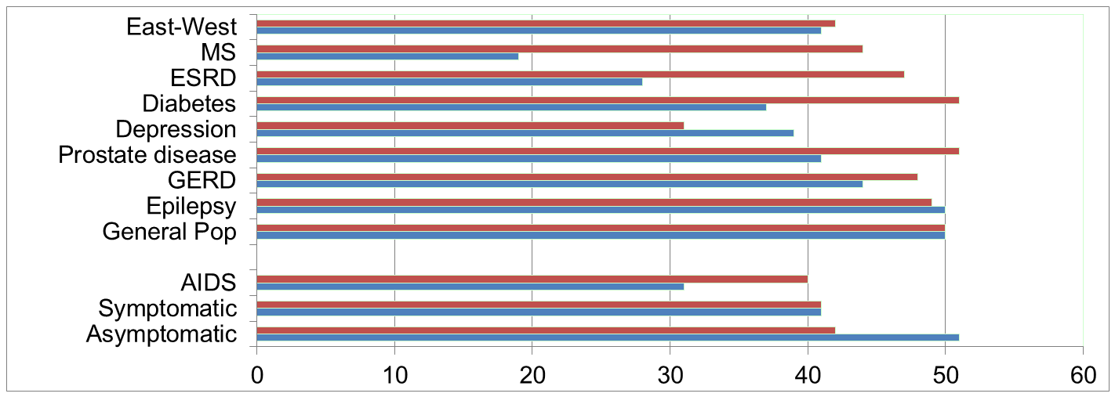
Physical Functioning and Emotional Well-Being at Baseline for 54 Patients at UCLA-Center for East West Medicine
EWB
Physical
MS = multiple sclerois; ESRD = end-stage renal disease; GERD = gastroesophageal reflux disease.
31

Slide 32
Significant Improvement in all but 1 of SF-36 Scales (Change is in T-score metric)
Change
t-test
prob.
PF-10
1.7
2.38
.0208
RP-4
4.1
3.81
.0004
BP-2
3.6
2.59
.0125
GH-5
2.4
2.86
.0061
EN-4
5.1
4.33
.0001
SF-2
4.7
3.51
.0009
RE-3
1.5
0.96
.3400
EWB-5
4.3
3.20
.0023
PCS
2.8
3.23
.0021
MCS
3.9
2.82
.0067

Slide 33
Effect Sizes for Changes in SF-36 Scores
Effect Size
0.13
0.35
0.35
0.21
0.53
0.36
0.11
0.41
0.24
0.30
PFI = Physical Functioning; Role-P = Role-Physical; Pain = Bodily Pain; Gen H=General Health; Energy = Energy/Fatigue; Social = Social Functioning; Role-E = Role-Emotional; EWB = Emotional Well-being; PCS = Physical Component Summary; MCS =Mental Component Summary.
Effect size = 0.20 is small, 0.50 = medium, and 0.80 = large.

Slide 34
Reliable Change Index
(Identifying Responders)
Note: SD_{bl} = standard deviation at baseline
r_{xx} = reliability

Slide 35
Coefficient of Repeatibility
Amount of Change in Observed Score Needed To be Statistically Significant
= 2.77 * SEM
Note: SD_{bl} = standard deviation at baseline and r_{xx} = reliability

Slide 36
7-31% of People in Sample Improved Significantly
% Improving
% Declining
Difference
PF-10
13%
2%
+ 11%
RP-4
31%
2%
+ 29%
BP-2
22%
7%
+ 15%
GH-5
7%
0%
+ 7%
EN-4
9%
2%
+ 7%
SF-2
17%
4%
+ 13%
RE-3
15%
15%
0%
EWB-5
19%
4%
+ 15%
PCS
24%
7%
+ 17%
MCS
22%
11%
+ 11%

Slide 37
Item Response Theory Puts
People and Items on Same Scale
Person 1
Person 2
Person 3
Trait
Continuum
Item 1
Item 2
Item 3

Slide 38
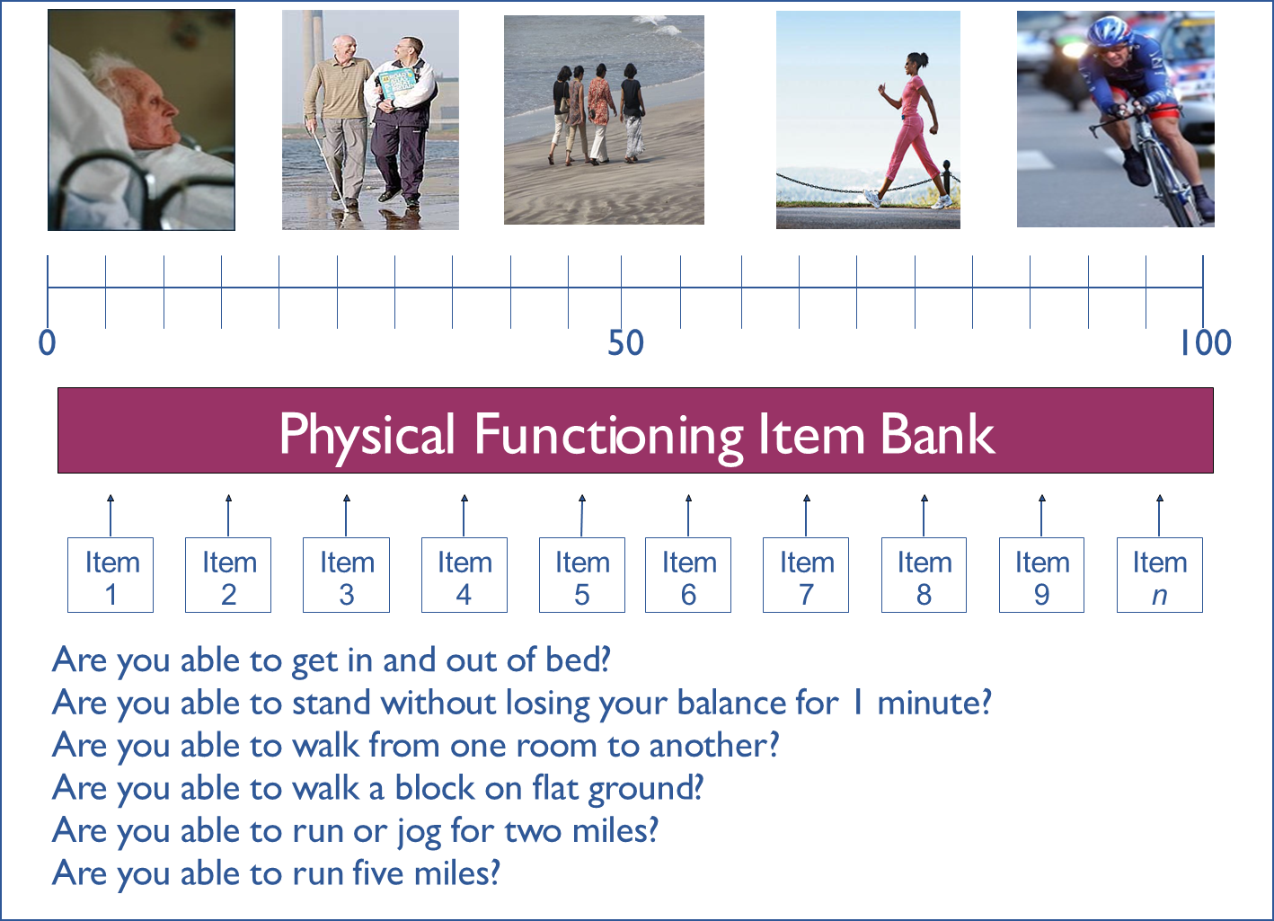
20 30 40
60 70 80

Slide 39
Item Response Theory (IRT)
IRT graded response model estimates relationship between a person’s response Y_{i} to the question (i) and his or her level on the latent construct (θ):
b_{ik} estimates how difficult it is to have a score of k or more on item (i).
a_{i} estimates item discrimination.

Slide 40
Reliability Target for Use of Measures with Individuals
Reliability ranges from 0-1
  0.90 or above is goal
  SE = SD (1- reliability)^{1/2}
  Reliability = 1 – (SE/10)^{2 (T-score metric)}
  Reliability = 0.90 when SE = 3.2
  95% CI = true score +/- 1.96 x SE
Notes:
T = z*10 + 50

Slide 41
In the past 7 days …
I was grouchy [1st question]
  Never [39]
  Rarely [48]
  Sometimes [56]
  Often [64]
  Always [72]
Estimated Anger = 56.1
SE = 5.7 (rel. = 0.68)
Notes:
Never: 39
Rarely: 48
Sometimes = 56
Often = 64
Always = 72

Slide 42
In the past 7 days …
I felt like I was ready to explode
[2nd question]
  Never
  Rarely
  Sometimes
  Often
  Always
Estimated Anger = 51.9
SE = 4.8 (rel. = 0.77)

Slide 43
In the past 7 days …
I felt angry [3rd question]
  Never
  Rarely
  Sometimes
  Often
  Always
Estimated Anger = 50.5
SE = 3.9 (rel. = 0.85)

Slide 44
In the past 7 days …
I felt angrier than I thought I should [4th question]
- Never
  Rarely
  Sometimes
  Often
  Always
Estimated Anger = 48.8
SE = 3.6 (rel. = 0.87)

Slide 45
In the past 7 days …
I felt annoyed [5th question]
  Never
  Rarely
  Sometimes
  Often
  Always
Estimated Anger = 50.1
SE = 3.2 (rel. = 0.90)

Slide 46
In the past 7 days …
I made myself angry about something just by thinking about it. [6th question]
  Never
  Rarely
  Sometimes
  Often
  Always
Estimated Anger = 50.2
SE = 2.8 (rel = 0.92) (95% CI: 44.7-55.7)

Slide 47
Person Fit
Large negative Z_{L} values (Drasgow et al., 1985) indicate misfit.
  one person who responded to 14 of the PROMIS physical functioning items had a Z_{L} = -3.13
  For 13 items the person could do the activity (including running 5 miles) without any difficulty.
    But this person reported a little difficulty being out of bed for most of the day.

Slide 48
Item Characteristic Curves

Slide 49
Reliability = (Info – 1) / Info
Reliability = 0.90

Slide 50
DIF (2-parameter model)
Men
Women
White
Slope DIF
Location DIF
AA
I cry when upset
I get sad for no reason
Higher Score = More Depressive Symptoms
Notes:
50

Slide 51


Thank you.
https://twitter.com/RonDHays
drhays@ucla.edu
Notes:
51

Slide 52

October 24-25, 2019
PROMIS® Health Organization Conference
https://www.regonline.com/builder/site/Default.aspx?EventID=2558944

