Slide 1

Health-Related Quality of Life
November 14, 2011: 9-10:30am
Ron D. Hays, Ph.D. (drhays@ucla.edu)
- UCLA Department of Medicine: Division of General Internal Medicine and Health Services Research
- UCLA School of Public Health: Department of Health Services
- RAND, Santa Monica

Slide 2
Health-Related Quality of Life is …
What you can do.
Functioning
  Self-care
  Role
  Social
How you feel about your life.
Well-being
  Emotional well-being
  Pain
  Energy

Slide 3
HRQOL Framework
Physical Health
Physical Functioning
Self-Reported Health
Mental Health
Depressive Symptoms
Social Health
Ability to Participate in Social Roles

Slide 4
SF-36®
Functioning
  Physical functioning (10 items)
  Role limitations/physical (4 items)
  Role limitations/emotional (3 items)
  Social functioning (2 items)
Well-Being
  Emotional well-being (5 items)
  Energy/fatigue (4 items)
  Pain (2 items)
  General health perceptions (5 items)

Slide 5
An item bank is a large collection of items measuring a single domain.
Any and all items can be used to provide a score for that domain.
Notes:
[CLICK] Definition
[CLICK] Any and all . . .
Let’s look at an item bank for the domain of Physical Functioning. [NEXT]

Slide 6
Item Development Cycle
Qualitative
Research
and Item
Writing
Testing
General Population
Clinical Samples
Item Bank
Analysis
Interpretation
Refining
Notes:
Item bank is not fixed. Don’t make and put on shelf.
We can continually work to evaluate and improve it.
Perhaps adding items to help measure the extremes of the domain.

Slide 8
Computerized Adaptive Testing (CAT)
Select questions based on responses to previously administered questions.
  Pick most “informative” items
Iteratively estimate “location” on the domain (e.g., anger)
Stop administering items when desired level of precision is reached.

Slide 9
Computerized Adaptive Tests
Question #1
high
physical
function
3
Question #2
Question #3
2
2
2
1
1
1
0
0
Questionnaire
with a high
precision -
AND a
wide range
- 1
- 2
low
physical
function
- 3
Notes:
Purpose of this slide is to walk the audience through the CAT process using an example …and thereby transmit the message of narrower measurement range and higher precision with each question …
I typically ese e.g. an example for depression, or any other topic I want to focus on … like first question “do you feel depressed”, answer “some of the time” … than we would like to know how depressed and the CAT might choose a question asking about self worth, and if the patient indicates that this is diminished also, a third question asking about thoughts of suicide might be appropriate … in this case the answer would be no, never …
And maybe compare it with another scenario like the participant would have answered the first question, no I am not at all depressed, asking about suicide would not make sense, instead the CAT might have chosen a question asking about happiness … bla bla
The conclusion is, we can make precise test over the entire range …

Slide 10
Reliability and SEM
z-score (mean = 0 and SD = 1)
  Reliability = 1 – SEM² (for z-scores)
  = 0.91 (when SEM = 0.30)
  = 0.90 (when SEM = 0.32)
With 0.90 reliability
  95% Confidence Interval for score at mean
    z-score: - 0.62 → 0.62
T-score = (z-score * 10) + 50
    T-score: 44 → 56

Slide 11
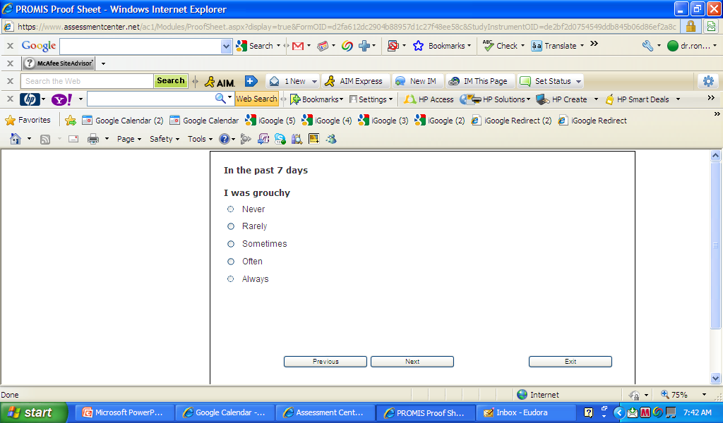
Notes:
Sometimes

Slide 12
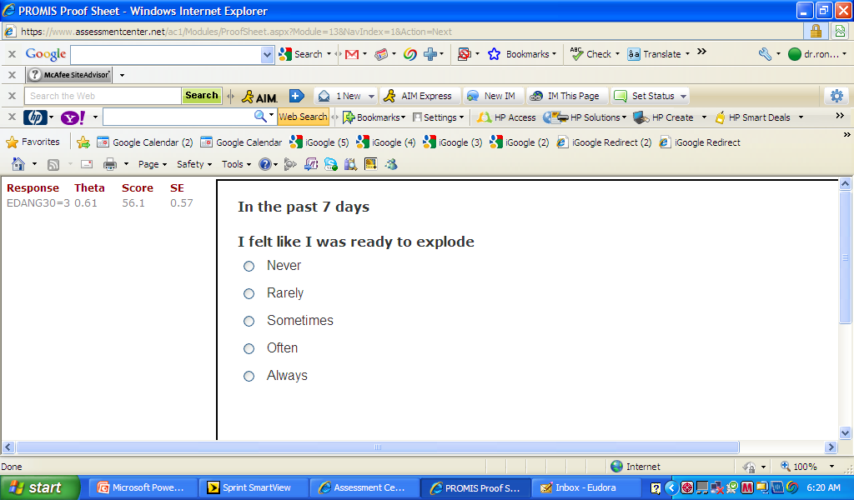
Notes:
Never

Slide 13
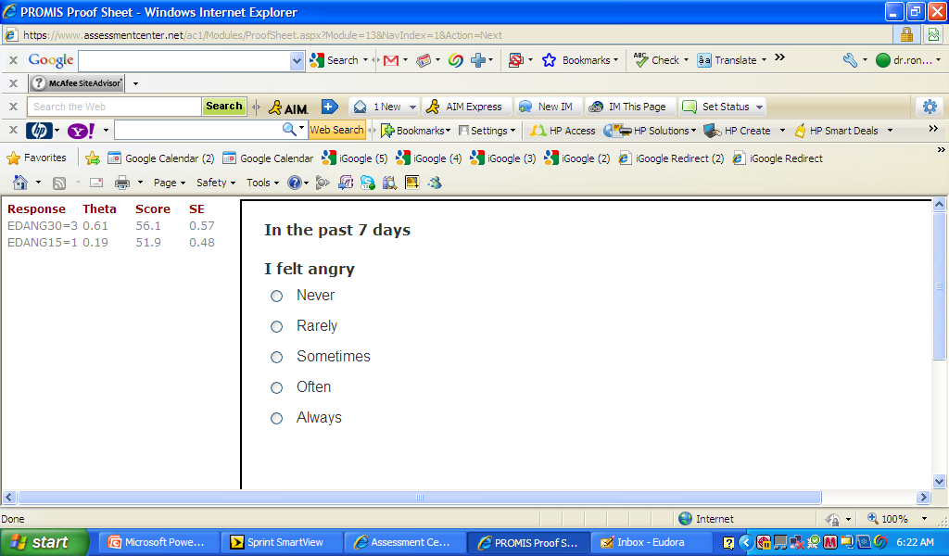
Notes:
Rarely

Slide 14
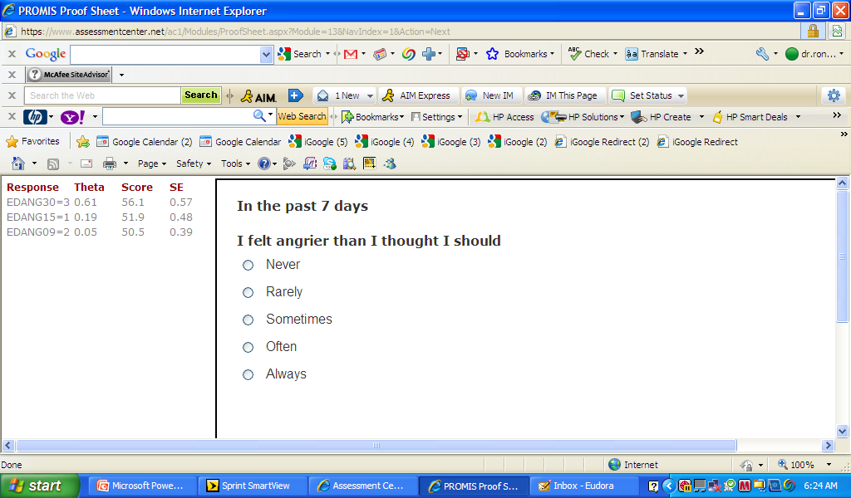
Notes:
Never

Slide 15
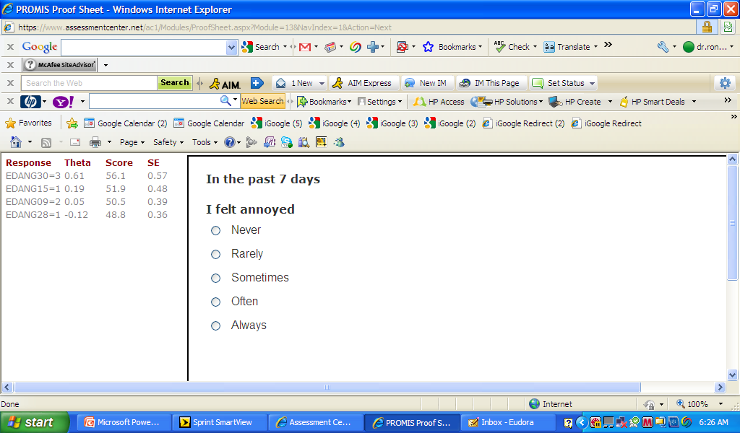
Notes:
Sometimes

Slide 16
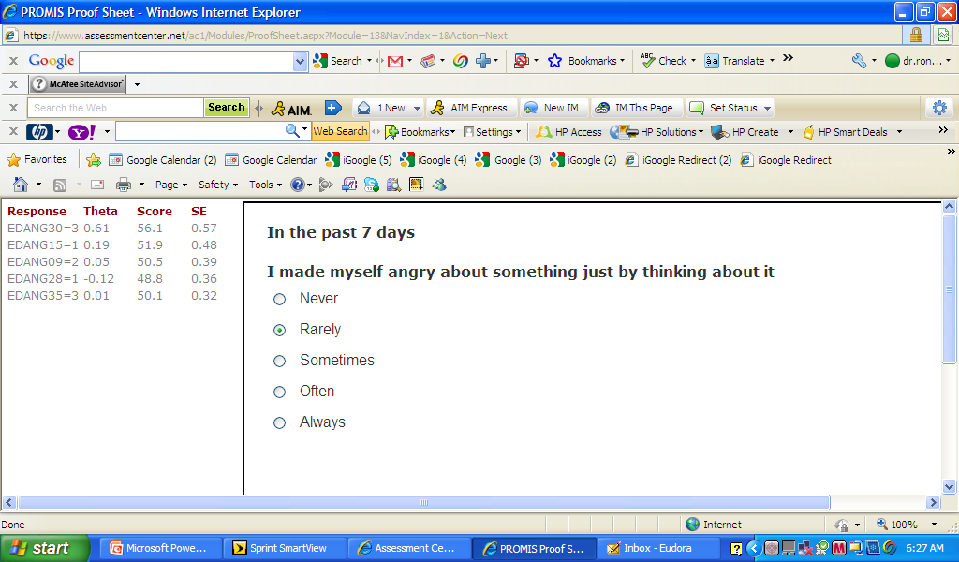
Notes:
Rarely

Slide 17
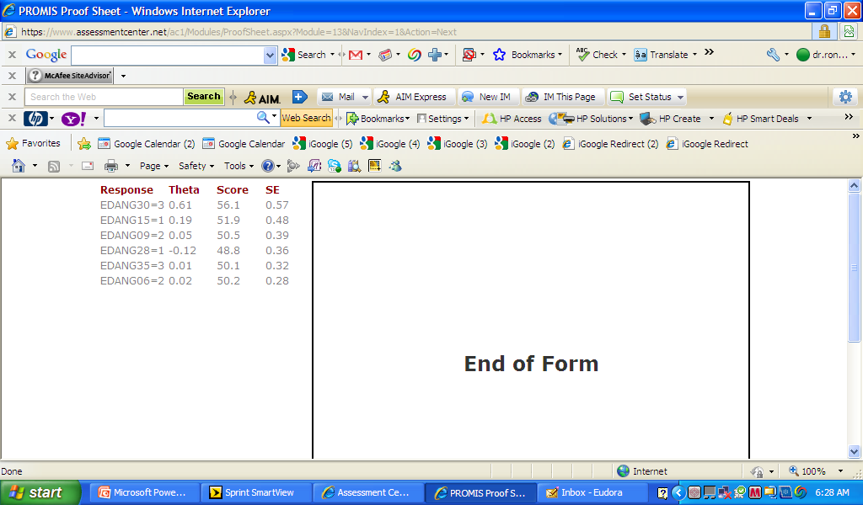

Slide 18
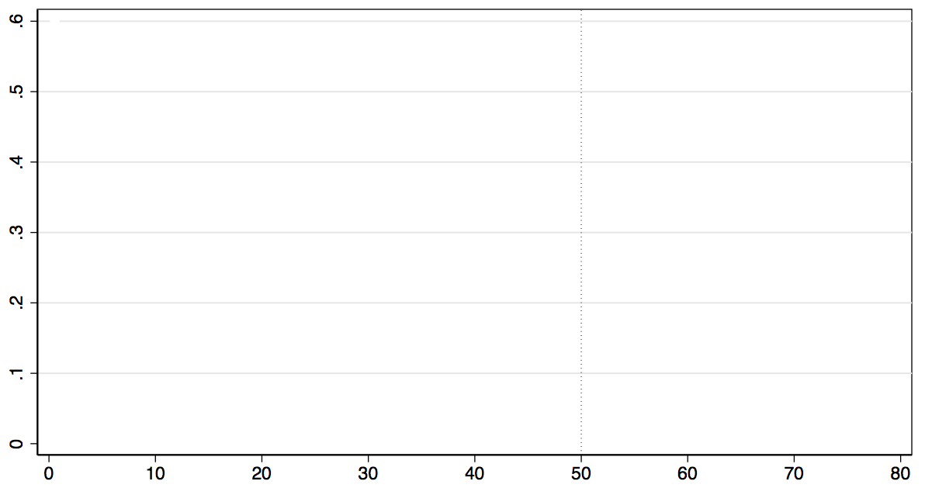
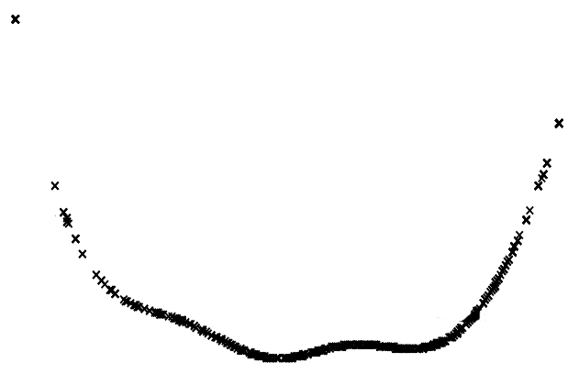
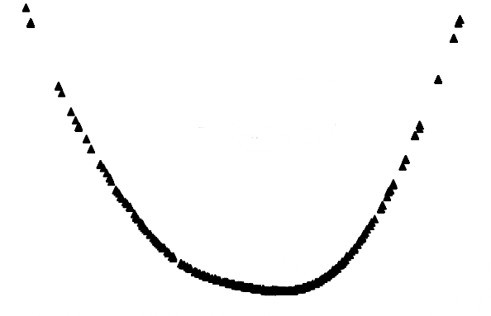
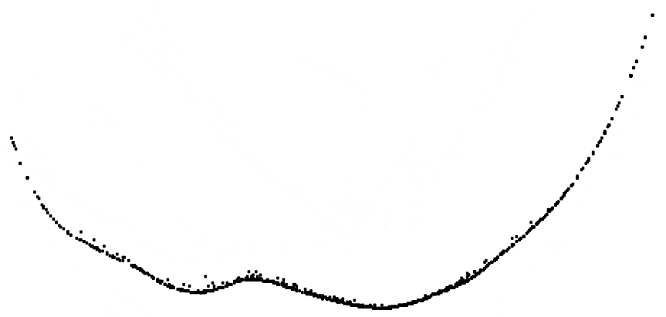
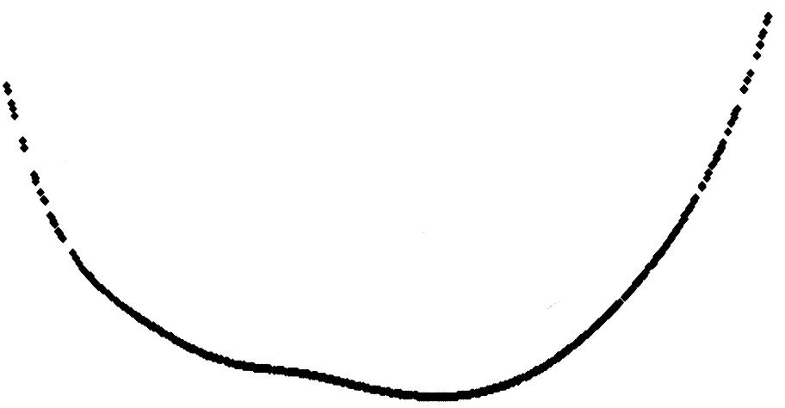
Relative Precision of Measures
High
Error
SF-36
(10 items)
HAQ
(20 items)
HAQ
(20 items)
CAT
(10 items)
Full Item Bank
(126 items)
Rheumatoid
Arthritis Patients
Low
Representative Sample
Worse
Physical Functioning
(T-Score; Mean=50, SD=10)
Better

Slide 19

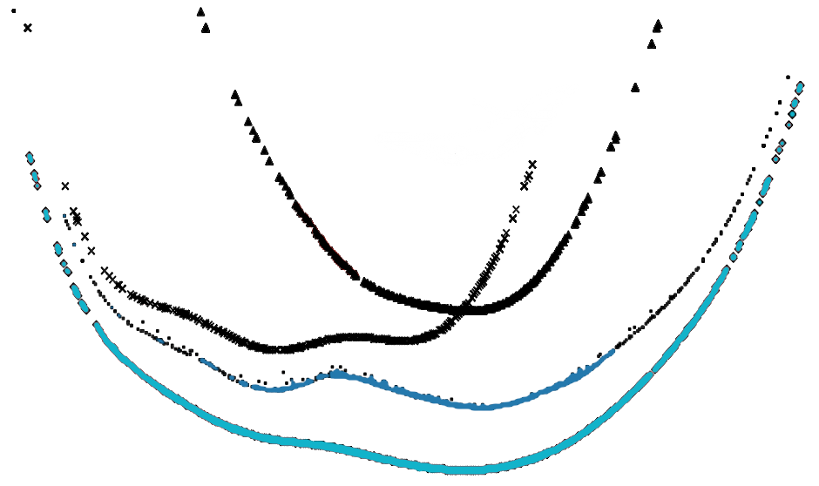
Relative Precision of Measures
High
Error
CAT
Full Item Bank
Low
Rheumatoid
Arthritis Patients
Representative Sample
Worse
Physical Functioning
(T-Score; Mean=50, SD=10)
Better

Slide 20
PROMIS Fatigue in Five Clinical Conditions
Cancer
w/ benefit
(2 mos)
Cancer
Chemo
(B)
N = 310
N = 229
Back Pain
(3 mos)
Back Pain
(1 mo)
Back Pain
(B)
N = 114
Depression
(3 mos)
Depression
(1 mo)
Depression
(B)
N = 64
HF Post-transplant
HF Pre-transplant
Exacerbation to Stable
N = 125
COPD Stable (B)
COPD Exacerbation (B)
35
40
45
50
55
60
65
Average for General Population

Slide 21
Multi-Domain Results from Heart Transplant Trial
PROMIS T Score

Slide 22

Assessment Center
www.nihpromis.org
PROMIS surveys
- CAT software
Study-specific URL
Non-PROMIS items
eConsent
NIH inclusion enrollment
report

Slide 23


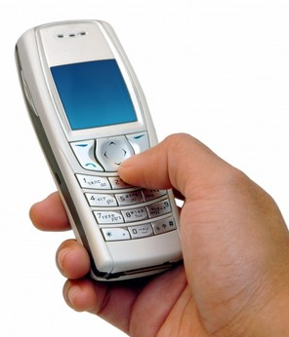

Assessment Center supports different modes of administration
Notes:
Prior literature suggests that how tests are administered may affect how people respond, which limits applicability of scales across diverse populations and study designs.
We designed and conducted the largest study do date to test whether mode of administration makes a difference.

Slide 24


Slide 25
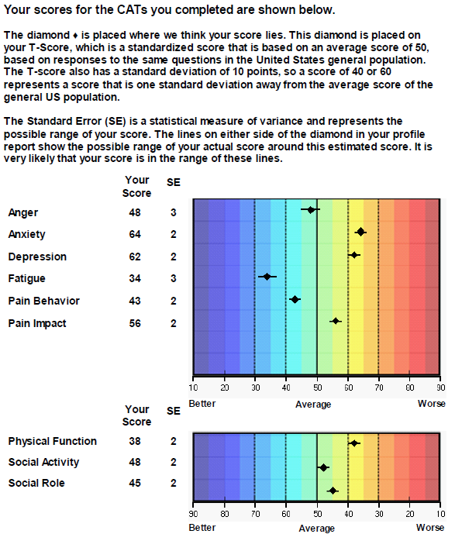
CAT Graph

Slide 26
Significant Improvement in all but 1 of SF-36 Scales (Change is in T-score metric)
Change
t-test
prob.
PF-10
1.7
2.38
.0208
RP-4
4.1
3.81
.0004
BP-2
3.6
2.59
.0125
GH-5
2.4
2.86
.0061
EN-4
5.1
4.33
.0001
SF-2
4.7
3.51
.0009
RE-3
1.5
0.96
.3400
EWB-5
4.3
3.20
.0023
PCS
2.8
3.23
.0021
MCS
3.9
2.82
.0067
26

Slide 27
Defining a Responder: Reliable Change Index (RCI)
Note: SD_{bl} = standard deviation at baseline
r_{xx} = reliability
27

Slide 28
Amount of Change in Observed Score
Needed for Significant Individual Change
Scale
Change
Effect size
Reliability
PF-10
8
0.7
0.94
RP-4
8
0.7
0.93
BP-2
10
1.0
0.87
GH-5
13
1.1
0.83
EN-4
13
1.3
0.77
SF-2
14
1.1
0.85
RE-3
10
0.7
0.94
EWB-5
13
1.3
0.79
PCS
7
0.6
0.94
MCS
10
0.7
0.93
28

Slide 29
7-31% of People in Sample Improve Significantly
% Improving
% Declining
Difference
PF-10
13%
2%
+ 11%
RP-4
31%
2%
+ 29%
BP-2
22%
7%
+ 15%
GH-5
7%
0%
+ 7%
EN-4
9%
2%
+ 7%
SF-2
17%
4%
+ 13%
RE-3
15%
15%
0%
EWB-5
19%
4%
+ 15%
PCS
24%
7%
+ 17%
MCS
22%
11%
+ 11%
29

Slide 30
Ultimate Use of HRQOL Measures--
Helping to Ensure Access to
Cost-Effective Care
Cost ↓
Effectiveness ↑

Slide 31
Is New Treatment (X) Better
Than Standard Care (O)?
X
0
X
0
Physical
Health
X > 0
Mental
Health
0 > X

Slide 32
Is Medicine Related to Worse HRQOL?
Medication
Person Use HRQOL (0-100)
1 No dead
2 No dead
3 No 50
4 No 75
5 No 100
6 Yes 0
7 Yes 25
8 Yes 50
9 Yes 75
10 Yes 100
  Group n HRQOL
  No Medicine 3 75
  Yes Medicine 5 50

Slide 33
Indirect Preference Measures
Attributes know and used to estimate societal preferences
  Quality of Well-Being (QWB) Scale
  EQ-5D
  HUI2 and HUI3
  SF-6D

Slide 34
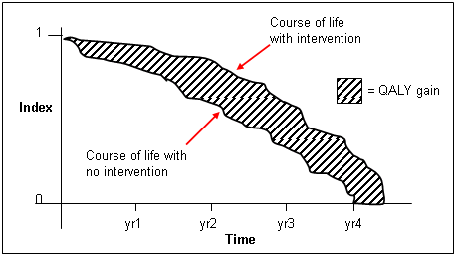
QALY with and without Intervention

Slide 35

Use of PROMIS
44 NIH grants
  R01; R21; P01; P60; U01; K; SBIR
111 studies collecting data on AC
20 NIH-sponsored clinical trials
- ECOG; GOG; RTOG; SWOG; NCCTG; COG
8 Industry-sponsored clinical trials
12 Foundation-sponsored registries
- Surgery; cardiology; oncology; nephrology; pediatrics

Slide 36








PROMIS International Users’ Group
. . .and more

Slide 37
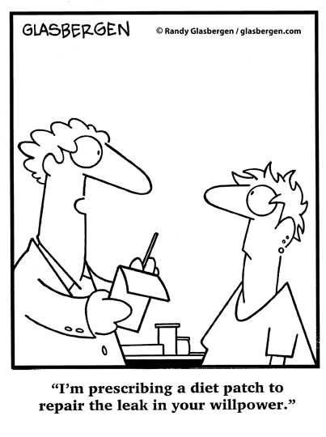
Questions?
http://gim.med.ucla.edu/FacultyPages/Hays/
http://twitter.com/RonDHays
www.nihpromis.org

