Slide 1

Listening to the Patient: Measuring Patients’ Perceptions of Health Care
Ron D. Hays
UCLA Department of Medicine
May 11, 2022 (Noon – 1 pm PT)
Conflicts of interest: None
Acknowledgement:
Agency for Healthcare Research and Policy
U18HS025920

Slide 2

Quality of care measurement
Focus has been on expert consensus about clinical process
Variant of RAND Delphi Method

Slide 3
Quality of care measurement
If diabetic, bare feet should be examined at least once every 15 months.
  American Diabetes Association (1998)
Focus has been on expert consensus about clinical process
Variant of RAND Delphi Method

Slide 4
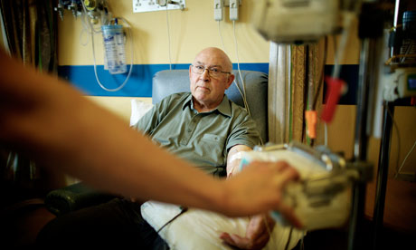
Quality of care measurement
But how patients perceive their health care is also important
Patient reports about care are used to assess the patient experiences.
Focus has been on expert consensus about clinical process
Variant of RAND Delphi Method

Slide 5
Consumer Assessment of Healthcare Providers and Systems (CAHPS®) Approach
Focus on what patients want to know about AND can accurately report about
  Communication with health care provider
  Access to care
  Staff courtesy and respect
Funded by AHRQ
Notes:
The CAHPS program began over a quarter century ago. CAHPS surveys are standardized measures of patient experience with healthcare. It is worth noting that the Agency for Healthcare Research and Quality funds the creation of surveys but does not mandate their use.
The surveys focus on aspects of care for which the patient is the best or only source of information. Patients are not asked to assess technical quality of care, for example. The surveys consist primarily of reports about different aspects of care, but they also include a few global rating questions. The development of these surveys is done using a rigorous process that includes patient and clinician input, and extension empirical evaluation.

Slide 6
CAHPS Survey Development Process
Literature Review/ Environmental Scan
What can be learned from prior studies and surveys?
Stakeholder Input
Which topic areas are most important to stakeholders (e.g., clinicians, provider groups)? What do survey experts recommend?
Technical Expert Panel
Focus Groups & Interviews
What matters most to patients and their families?
Cognitive Interviews
Are draft survey questions interpreted correctly and consistently across respondents?
Field Test
Which survey items and administration procedures result in the most accurate and comparable data?
Notes:
The survey development process begins with a review of prior work. This and input from providers and survey experts and focus groups with patients are used to identify what is most important to measure in each context. Next, items are drafted, cognitively tested, and revised as needed. Then one or more field tests are conducted to assess the psychometric properties of the survey and evaluate survey administration procedures.

Slide 7
CAHPS Core Surveys
Patient Experience with Providers
► Clinician & Group
► Hospice
► Home Health Care
► Surgical Care
► American Indian
Patient Experience with Condition- Specific Care
► Cancer Care
► Mental Health Care
Patient Experience with Facility- Based Care
► Hospital
► In-Center Hemodialysis
► Nursing Home
► Outpatient and Ambulatory Surgery
Enrollee Experience with Health Plans
► Health Plan
► Dental Plan
► Home and Community-Based Services
Notes:
There are a lot of CAHPS surveys. Some focus on care from providers, while others assess facility-based care, condition-specific care, and care provided by health plans. .

Slide 8
CAHPS relies on reports about care
In the last 6 months, how often did this provider explain things in a way that was easy to understand?
꙱ Never
꙱ Sometimes
꙱ Usually
꙱ Always
Notes:
Most CAHPS survey items ask patients to report about care using a frequency of occurrence response scale.

Slide 9
CAHPS Clinician and Group Survey 3.0
Multi-item composites
  Doctor communication (4 items)
  Care coordination (3 items)
  Access to care (3 items)
  Office staff (2 items)
Single item
  Global rating of doctor (1 item)
Notes:
The Clinician and Group Survey is one of the CAHPS surveys. The 3.0 version of this survey has been available for 7 years. It assesses doctor communication, care coordination, access to care, and office staff using multiple questions each. It also includes a global rating of the doctor.

Slide 10
Patient Experience Content
Doctor communication
  Explained, listened, showed respect, spent enough time
Care coordination
  Knew about medical history, followed up on test results, talked about medications
Access
  Got urgent care appointment, non-urgent care appointment, answer to medical question same day contacted office
Office staff (helpful, courteous and respectful)
0 (worse possible)–10 (best possible) rating of doctor
Notes:
The doctor communication scale assesses doctor explanations, listening, showing respect, and spending enough time with the patient.
The care coordination scale asks whether the doctor seemed to know the patient’s medical history, followed up on test results, and talked about medications.
The access scale assesses getting appointments and getting answers to medical questions when contacting the doctor’s office.
The helpfulness, courtesy and respect of office staff is also assessed.
The doctor rating item is administered using a 0-10 response scale, with 0 the worse possible and 10 the best possible rating.

Slide 11
CAHPS Race and Ethnicity Questions
Are you of Hispanic or Latino origin or descent?
- Yes, Hispanic or Latino
- No, not Hispanic or Latino
What is your race? Mark one or more.
- White
- Black or African American
- Asian
- Native Hawaiian or Other Pacific Islander
- American Indian or Alaska Native
- Other
Notes:
At the end of CAHPS surveys is an “about you” section that asks about age, gender, education, race, ethnicity, and general health perceptions. Here are the questions about ethnicity and race. Next, I will briefly summarize three prior studies that have looked at race/ethnic differences in CAHPS survey scores.

Slide 12
#1: Race/Ethnic Differences in Patient Experience
Reports of care are less positive for
  Asians (especially non-English preferring)
  Spanish-language preferring Hispanics
  African Americans (sometimes)
Ahmedov et al. (2021)
Notes:
Shown here are results from the CAHPS database that includes 266,327 CAHPS 1.0 visit surveys completed for 769 providers. The overall response rate was 35%. Three CAHPS multi-item composites, a global rating item and a would you recommend the provider item are shown . All 5 CAHPS measures are presented on a 0-100 possible range with a larger number representing a more positive care experience. The means are adjusted for age, gender, education and self-rated heath. These results indicate less positive experience among Asians than other race/ethnic subgroups for access to care, perceptions of office staff, and overall rating of the provider. Asians and those who reported “other” as their race were less likely to recommend their provider to others.

Slide 13
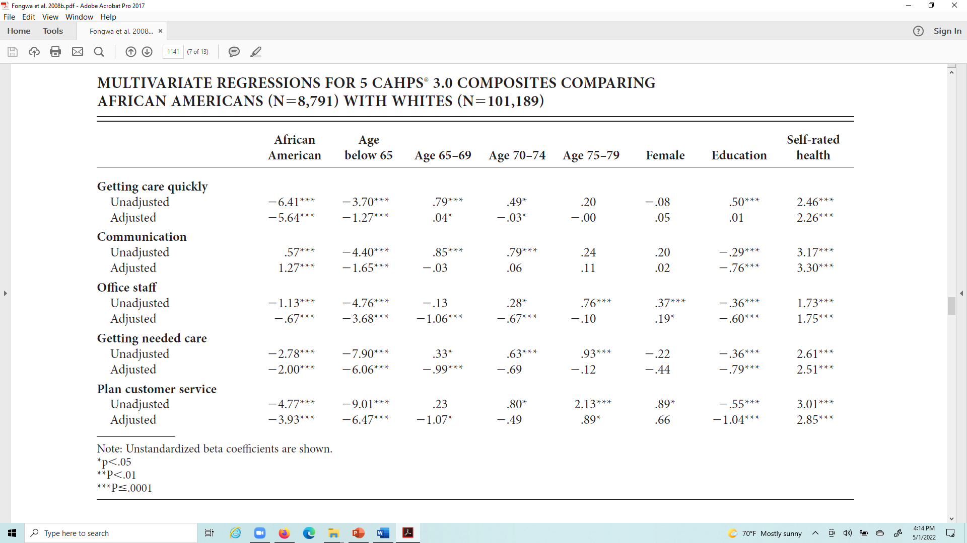
#2: Fongwa et al. (2008)
Notes:
Summarized here are mean differences in a second study that included 153,172 respondents to the CAHPS health plan survey 3.0 receiving care from 321 Medicare managed care plans. The analysis was limited to 101,189 Whites and 8,791 African Americans (n = 109,980). Regression models were run adjusting for age, gender, education, and self-rated health.
Black enrollees reported significantly worse experiences than White enrollees with getting care quickly, office staff helpfulness, getting needed care, health plan customer service, rating of specialist care, and rating of the health plan.
But they reported better provider communication and rated their personal doctors/nurses and health care more positively.

Slide 14
#3: Distribution of Race and Ethnicity in 58,500 adult patients at a large integrated health system
Race and ethnicity | Percentage of Respondents
Hispanic | 12%
White | 55%
Asian | 6%
Black | 5%
Pac. Islander/A. Indian/Alaskan Native | 1%
Other | 5%
Missing race | 16%
Notes:
In this third study, most of the sample was female (59%), 55 or older (65%), and non-Hispanic White (66%). In addition to what is shown here, the sample was highly educated with 64% having a 4-year college degree or higher.

Slide 15
Patient Experience by Race and Ethnicity
Race and ethnicity | Access | Communication | Coordination | Office Staff | Doctor Rating
Hispanic | 85 | 95 | 86 | 94 | 94
White | 85 | 95 | 86 | 94 | 93
Black | 86 | 95 | 86 | 94 | 93
Asian | 83 | 94 | 85 | 91 | 93
Pac./Ind/Al N | 84 | 94 | 86 | 93 | 93
Other | 82 | 93 | 83 | 91 | 91
Missing | 81 | 93 | 83 | 91 | 92
Notes:
Asians reported worse experiences than other race/ethnic subgroups on access to care and office staff courtesy and respect. Note, however, that the most consistently worse perceptions of care were seen for those with “other” race or missing race.

Slide 16
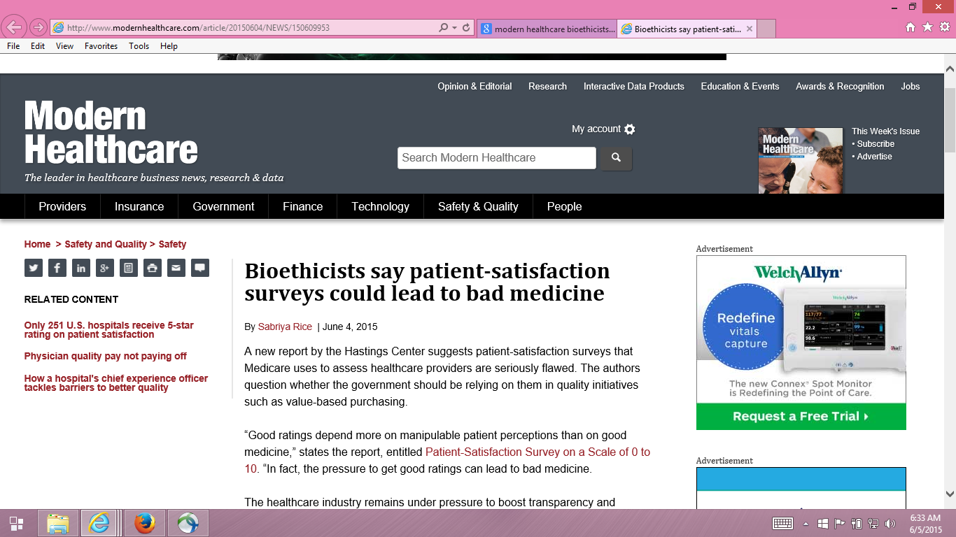
Backlash to Patient Experience Surveys
Notes:
There has been backlash to use of CAHPS surveys for provider payment. This 2015 article in a trade publication is one example where it was claimed that bad care would result because doctors are pressured to satisfy patients and give them what they want instead of what they should get.

Slide 17
Providers motivated to fulfill patient desires, regardless of appropriateness
  Dr. Stuart Younger
  Professor of Bioethics and Psychiatry at the Case Western Reserve University
    Hastings Center Report, “Patient-Satisfaction survey on a scale of 0 to 10: Improving health care, or leading it astray?”
      Alexandra Junewicz and Stuart J. Youngner
      https://pubmed.ncbi.nlm.nih.gov/25753653/
“Good ratings depend more on manipulable patient perceptions than on good medicine… Pressure to get good ratings can lead to bad medicine.”
Notes:
In the Hastings Center report cited in the trade magazine, Dr. Younger was quoted as saying that patient-satisfaction surveys that Medicare uses to assess healthcare providers are seriously Flawed and should not be relied upon in quality initiatives such as value-based purchasing. According to him, “good ratings depend more on manipulable patient perceptions than on good medicine.” Dr. Younger’s father was a virologist who worked with Jonas Salk on the polio vaccine.

Slide 18

October 7, 2018
Notes:
A little less than 4 years ago, I was watching 60 minutes and noticed a similar sentiment was expressed in one of the letters shown at the end of the program.

Slide 19
Do providers fulfill patient desires, regardless of appropriateness?
Good communication is important in addressing unreasonable expectations
“Patient satisfaction can be maintained in the absence of request fulfillment if physicians address patient concerns in a patient-centered way.” (Fenton et al. 2012)
* Low-value care not associated with positive health care experiences (Sanghavi et al., 2021, JAMA Intern Med).

Slide 20
HCAHPS Survey, Pain Management, and Opioid Misuse: The CMS Perspective
Clarifying Facts, Myths, and Approaches
CMS believes that effective communication with patients about pain and treatment, including options other than prescription medicine when appropriate, is the preferred way to improve patient experience of care.
In the process of developing the HCAHPS Survey, we did not find that experience with pain dominated patients’ overall assessment of the hospital experience.
Once was posted at (URL link broken now):
http://www.qualityreportingcenter.com/wp-content/uploads/2016/02/IQR_20160126_QATranscript_vFINAL508.pdf
Notes:
The Hospital CAHPS survey included questions assessing pain. CMS received criticisms of assessing pain management and removed the questions. The American Society of Anesthesiologists was pleased that CMS did this, saying this was an important step toward addressing how these questions impact opioid prescribing practices.

Slide 21
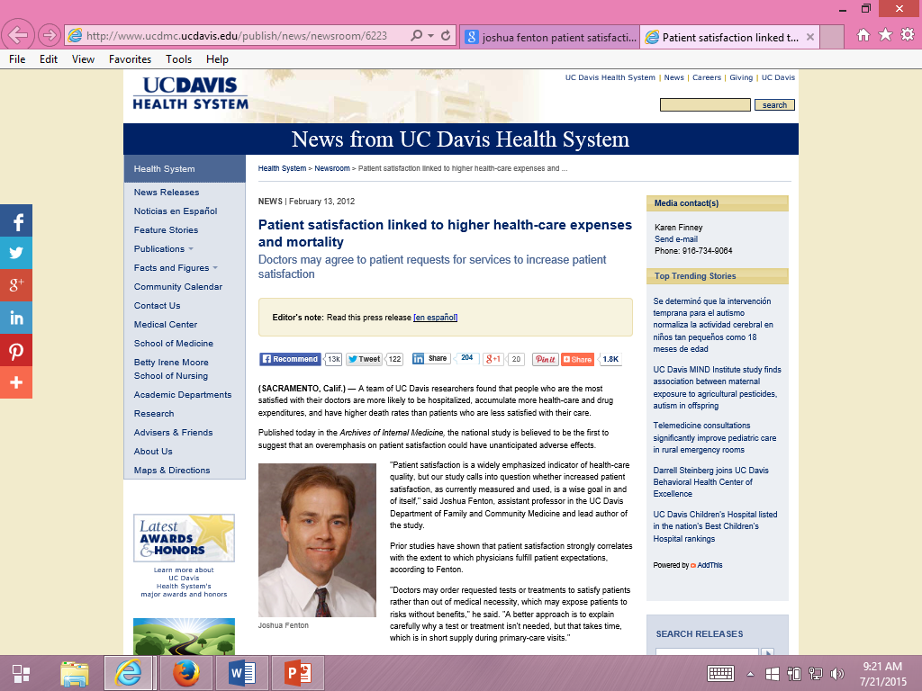
Fenton suggested patients can be “satisfied” to death.
Notes:
Published 10 years ago in Archives of Internal Medicine.

Slide 22
Fenton et al. (2012)
Archives of Internal Medicine
2000-2005 Medical Expenditure Panel Survey cohorts
  Nationally representative survey of U.S. civilian non-institutionalized population. Panels followed over 2 calendar years with 5 rounds of interviews (baseline, 6 months, 12 months, 18 months, 24 months).
  n = 34,180
Four CAHPS communication (last 12 months) and 0-10 rating of health care item from round 2 (round 4 not used)
  Quartile from average of standardized scores for 5 items
Results interpreted as indicating that acceding to patient demands results in dangerous treatment.

Slide 23
Five Concerns with Fenton et al.
Unmeasured variables. Adjusted for age, gender, race/ethnicity, education, income, metropolitan statistical area, census region, access to usual source of care, insurance coverage, smoking, number of chronic conditions, self-rated general health, SF-12 PCS and MCS, number of prescription meds, medical care expenditures, number of office visits, any ER visits, any inpatient admissions, and MEPS cohort … but associations still may be due to unmeasured variables (e.g., severity of illness).
  Sicker patients may need more information and clinicians may spend more time with them.
Estimated effect was implausibly large, suggesting good patient experience is more dangerous than having major chronic conditions.

Slide 24
Five Concerns with Fenton et al.
3. Only amenable deaths can be prevented by health care.
  Prognosis for those with end-stage pancreatic cancer is not modifiable
  by the type of care they receive.
  Only 21% of the 1,287 deaths in the study were amenable to health care.
    Nolte, E. and C. M. McKee. 2008. Measuring the health of nations: updating an earlier analysis. Health Aff (Millwood) 27(1): 58-71.
Patient experiences with care vary over time.
  Used CAHPS data at MEPS round 2 to predict mortality 3 months to 6 years later.
  > half of deaths occurred more than 2 years later.
  Among those with best (quartile 4) experiences at round 2, > half had worse experiences 1 year later
Only looked at 5-item CAHPS aggregate

Slide 25
Reanalysis of Fenton et al.
(Xu et al., 2014)
Same data used by Fenton et al. (Note: Fenton would not share his computer code with us.)
  2000-2005 Medical Expenditure Panel Survey data
  National Health Interview Survey and National Death Index
Same statistical analysis
  Cox proportional hazards models with mortality as the dependent variable and patient experience measures as independent variables
But, unlike Fenton et al.
  Separated non-amenable and amenable deaths
  Considered consistency of patient experience and death
  Looked at individual items to better understand the patient experience with mortality association

Slide 26
Patient Experiences and Mortality:
Significant for Only One Item
Patient Care Experience Items | All-Cause Mortality
 | Hazard Ratio | p-value
Rating of healthcare 9-10 vs 0-8 | 1.10 | 0.15
Listen carefully to you † | 0.98 | 0.76
Show respect for what you had to say † | 1.05 | 0.44
Explain things in a way that is easy to understand † | 1.09 | 0.17
Spend enough time with you † | 1.17 | 0.03
† “Always" versus “Never”/“Sometimes”/“Usually”
Xu, X., Buta, E., et al. (2014). Methodological considerations when studying the association between patient-reported care experiences and mortality. Health Services Research. 50(4), 1146-61.

Slide 27
Patient Experiences and Mortality:
Non-Amenable vs. Amenable Deaths
Patient Care Experience | Non-Amenable Mortality |  | Amenable Mortality
 | Hazard Ratio | p-value | Hazard Ratio | p-value
Quartile 1 (reference) | (1.00) |  | (1.00)
Quartile 2 | 1.07 | 0.56 | 1.27 | 0.25
Quartile 3 | 0.96 | 0.70 | 1.28 | 0.25
Quartile 4 (most positive) | 1.26 | 0.03 | 1.23 | 0.32
Overall p-value for patient care experience quartiles |  | 0.03 |  | 0.59

Slide 28
Patient Experiences and Mortality:
Consistency of Experiences Over Time
Patient Care Experience (baseline : 1 year later) | All-Cause Mortality
 | Hazard Ratio | p-value
Quartile 1 : Quartile 1 (reference) | (1.00)
Quartile 2 : Quartile 2 | 0.89 | 0.42
Quartile 3 : Quartile 3 | 1.13 | 0.57
Quartile 4 : Quartile 4 | 1.09 | 0.54
Different quartiles at baseline and 1 year later | 0.88 | 0.35

Slide 29

Patient Reports are Weakly Related to Clinical Indicators
Systematic review (55 studies)
Wide range of disease areas, setting, designs, and outcome measures
Weak Positive Associations
  Patient experience
  Patient safety
  Clinical effectiveness
Kemp, K. A., Santana, M. J., Southern, D. A., McCormack, B., & Quan, H. (2016).
Association of inpatient hospital experience with patient safety
indicators: A cross-sectional Canadian study. BMJ Open, 2016;6: e011242

Slide 30

Patient-reported data cannot be fairly compared across providers
My patients are different (e.g., sicker) than patients of other providers
Patient reports are determined by factors outside the control of the provider
  -> Patient characteristics that are not indicative of care quality, systematically related to patient reports, and vary across provider units are included in casemix adjustment.
  e.g., older age, lower education, better self-rated health

Slide 31
Collecting patient experience data is too burdensome and expensive
Patients are burdened by invasive medical tests as much or more than responding to surveys.
Survey data collection is not free, but neither are diagnostic tests.

Slide 32
Patient surveys are subjective and do not provide valid information
Patient reports are “subjective” and providers have concerns about their scientific properties (Boyce et al., 2014, Implementation Science)
Patient reports are as reliable (and valid) as clinical measures
  Hahn, E. A. et al., (2007). Precision of health-related quality of life data compared with other clinical measures. Mayo Clinic Proceedings, 82 (10), 1244-1254.

Slide 33
CAHPS has evolved to include system-level changes in telemedicine
CAHPS Clinician & Group Survey 3.1
As you answer these questions, please think of the in-person, phone, and video visits you had with that person in the last 6 months.
C-G CAHPS 3.1 survey created in response to increased use of telehealth associated with COVID-19 pandemic
Assess impact on patient experience with care associated with changes in healthcare delivery
Notes:
Last year the CAHPS team produced a 3.1 version of the CAHPS Clinician and Group Survey that has changes in instructions and item wording to prompt respondents to include telehealth as well as office visits.

Slide 34
CAHPS Health Plan Survey 5.1
These questions ask about your own health care from a clinic, emergency room, or doctor’s office. This includes care you got in person, by phone, or by video. Do not include care you got when you stayed overnight in a hospital. Do not include the times you went for dental care visits.
Notes:
Similarly tweaks were done in creating the 5.1 version of the health plan survey. In addition, the CAHPS team created a 4.0 survey focused on the most recent visit that assesses all visit types.

Slide 35
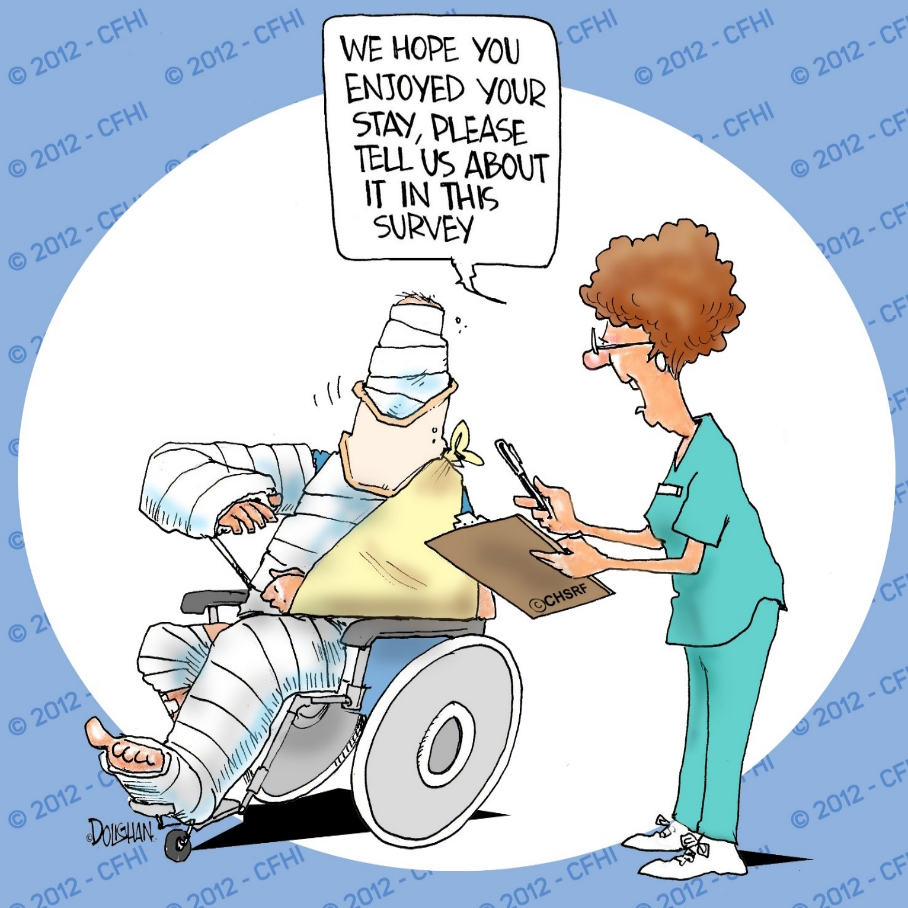

Questions?

Slide 36
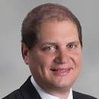
Physician Wellness
Steve Asch to insert

