Slide 1
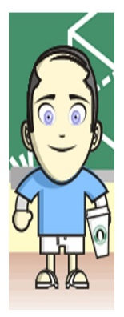
Social And Behavioral Determinants of Health
Ron D. Hays, Ph.D. (UCLA)
February 6, 2014 (8:40-9:35 am session)
Institute of Medicine Committee on Recommended Social and Behavioral Domains and Measures for Electronic Health Records
Beckman Center of the National Academies Of Sciences
100 Academy Drive, Irvine, CA 92617

Slide 2
Phase II Questions
What specific measures under each domain specified in Phase 1 should be included in EHRs?
What are the obstacles to adding these measures to the EHR and how can these obstacles be overcome?
What are the possibilities for linking EHRs to public health departments, social service agencies, or other relevant non-healthcare organizations?
2

Slide 3
My Charge
What specific measures under each domain specified in Phase 1 should be included in EHRs?
  “Characteristics of measures that make them effective in an EHR” (Karen Helsing email)
3

Slide 4
Eastabrooks et al. (2013)
J Am Med Inform Assoc.
Expert panel subject matter working groups
  Examined available tools using standard criteria
    Including extent to which item/measure potentially enhances patient engagement.
  Recommended up to 4 candidate measures for inclusion in EHR (http://www.gem-beta.org)
Reviewed by 93 health professionals
  Primary care, patients, professional societies, scientists, regulators, federal entities
Finalized in town hall meeting with stakeholders
4

Slide 5
Nine Domains
Behavioral characteristics
  Eating patterns (3 items)
  Physical activity (2 items)
  Risky drinking (1 item)
  Sleep quality (2 items)
  Smoking/tobacco use (2 items)
  Substance use (1 item)
Psychosocial characteristics
  Anxiety and depression (4 items)
  Stress (1 item)
Patient characteristics
  Demographics (9 items)
5

Slide 6
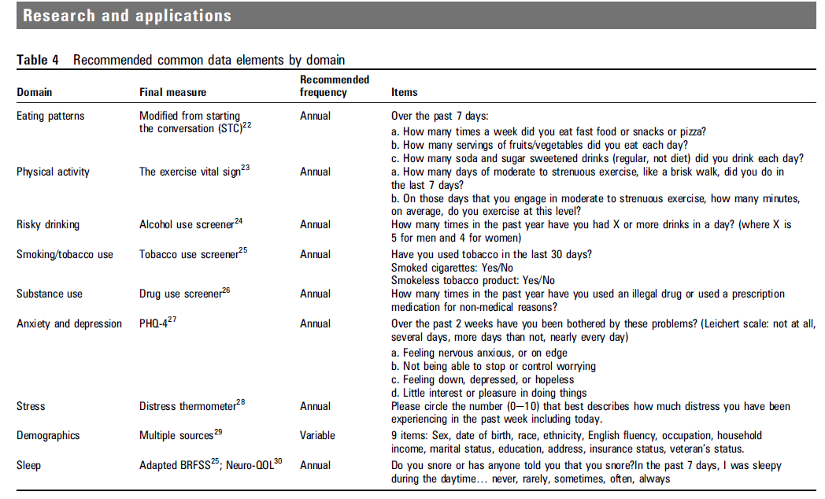
6

Slide 7
Example Data Elements
How many times a week did you eat fast food or snacks or pizza?
  Snacks could be healthy snacks
How many times in the past year have you used an illegal drug or used a prescription medication for non-medical reasons?
  Is marijuana an “illegal” drug?
7

Slide 8
Important Aspects of Measures
Same people get same scores
Different people get different scores and differ in hypothesized ways
Measurement equivalence for different subgroups (e.g., age, gender, race/ethnicity)
Measure is practical
Standardized metric facilitating comparisons
8

Slide 9

Comparability of Scores
(Two-sided tape measure)
http://www.ahrq.gov/news/events/conference/2009/ware/index.html
9

Slide 10
How Much is Lost in Using Single Items?
“IRT is grounded in knowing that any subset from a pool of unidimensional items can be used to represent the underlying concept.”
  Identify best subset of items for estimating score based on large pool of items
    Those with the highest discrimination with thresholds closest to where people are on the underlying continuum (i.e., most informative).
  Hays, Reise, & Calderon, 2013, JGIM
10

Slide 11
Reliability Target for Use of Measures with Individuals
Reliability ranges from 0-1
  0.90 or above is goal
  SEM = SD (1- reliability)^{1/2}
  95% CI = true score +/- 1.96 x SEM
    if true z-score = 0, then CI: -.62 to +.62
      Width of CI is 1.24 z-score units
Reliability = 0.90 when SE = 3.2
  T-scores (mean = 50, SD = 10)
  Reliability = 1 – (SE/10)²
T = 50 + (z * 10)
11
Notes:
T = z*10 + 50

Slide 12
PROMIS Physical Functioning vs. “Legacy” Measures
10 20 30 40 50 60 70
12

Slide 13
Potential Targets
PROMIS Physical activity bank
PROMIS alcohol use bank
PROMIS Sleep-related impairment bank
Maria Edelen smoking banks
PROMIS emotional distress bank
13

Slide 14
Conversion of PHQ-9 to
PROMIS Depression
PHQ-9
14

Slide 15
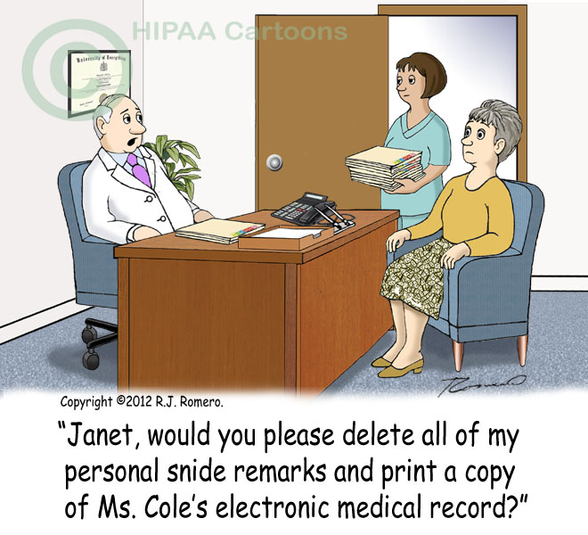
Thank you.
15

