Slide 1
Are Positive Experiences with Health Care Bad for Health?
June 14, 2015 (AcademyHealth)
Minneapolis Convention Center
1301 S. 2nd Avenue, Minneapolis, MN
Acknowledgements:
- Paul Cleary and Marc Elliott
Ron D.Hays, Ph.D.
@RonDHays

Slide 2
Is Receiving Better Technical Quality of Care Bad for Health?
Change in SF-12 PCS regressed on process of care aggregate
Hypothesized positive effect, but regression coefficient was NOT SIGNIFICANT
unstandardized beta = -1.41, p =.188
Kahn et al. (2007), Health Services Research, Article of Year
Process
of care
PCS
Notes:
Although one should always be alert to the possibility of spurious associations, special vigilance is called for when results are implausible.

Slide 3
Use of and Importance of Patient Experience Surveys has Grown…
CAHPS Hospital Survey (HCAHPS) data accounted for 30% of hospitals’ Total Performance Score in Value-Based Purchasing Program in FY2014
…so has misinformation about them

Slide 4
Some Suggest that Consumers Lack Expertise Needed to Evaluate Care Quality
Patients are the only source of some process of care measures (e.g., were things explained in a way you could understand?)
Patients are the best source of information on communication, office staff courtesy and respect, access to care, and other issues covered by CAHPS surveys
CAHPS reports of care are reliable and valid.
CAHPS complements technical quality measures

Slide 5
Some suggest patients can be “satisfied” to death.
Fenton et al. 2012 JAMA Internal Medicine
Medical Expenditure Panel Survey
4 items from CAHPS communication composite
0-10 global rating of health care
More positive assessment of care associated with higher mortality
Results interpreted by some as indicating that acceding to patient demands results in expensive and dangerous treatment.

Slide 6
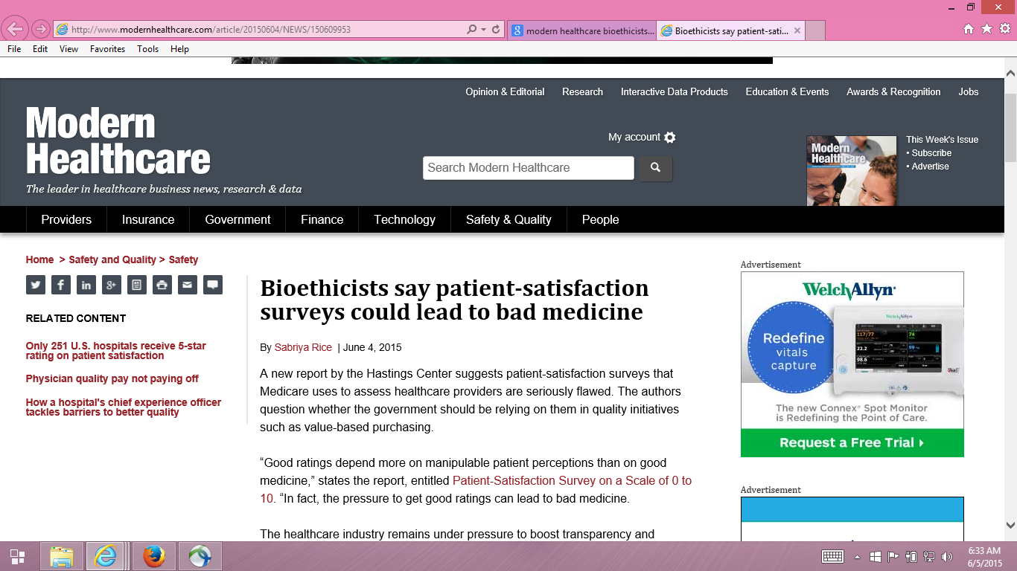
Notes:
Hastings Center report by Dr. Stuart Younger, professor of bioethics and psychiatry at the Case Western Reserve University suggested that pressure to get good ratings can lead to bad medicine.
Patient feedback about their experiences helps providers to appropriately address patients requests.
There are effective strategies to promote positive experience when patients requests require discussion.
Patient assessments of care are more strongly associated with provider communication than receipt of desired treatments.

Slide 7
Five Concerns with Fenton et al.
Associations may be due to unmeasured variables (e.g., severity of illness).
Estimated effect was implausibly large, suggesting good patient experience is more dangerous than having major chronic conditions.
Only amenable deaths can be prevented by health care.
Patient experiences with care vary over time.
Used CAHPS data at MEPS round 2 to predict mortality 3 months to 6 years later.
> half of deaths occurred more than 2 years after this.
Among those with best (quartile 4) experiences at baseline, > half had worse experiences 1 year later
Only looked at 5-item aggregate of CAHPS items.
Notes:
Sicker patients may need more information and clinicians may spend more time with them.
Although one should always be alert to the possibility of spurious association, special vigilance is called for when results are implausible.
Not all deaths can be prevented or delayed by health care. For example, the prognosis of patients with end-stage pancreatic cancer is not modifiable by the type of care they receive.

Slide 8
Reanalysis of Fenton et al. by Xu et al. (2014)
Same data used by Fenton et al.
2000-2005 Medical Expenditure Panel Survey data
National Health Interview Survey
National Death Index
Same statistical analysis
Cox proportional hazards models with mortality as the dependent variable and patient experience measures as independent variables
But, unlike Fenton et al.
Separated non-amenable and amenable deaths
Considered timing of patient experience and death
Looked at individual items to better understand the patient experience with mortality association
Notes:
MEPS is a nationally representative survey of U.S. civilian noninstitutionalized population. The panel is followed over 2 calendar years with 5 rounds of interviews.
Of the 1,287 deaths in the study, only 21% were amenable to health care.

Slide 9
Patient Experiences and Mortality: Non-Amenable vs. Amenable Deaths
Patient Care Experience | Non-Amenable Mortality |  | Amenable Mortality
 | Hazard Ratio | p-value | Hazard Ratio | p-value
Quartile 1 (reference) | (1.00) |  | (1.00)
Quartile 2 | 1.07 | 0.56 | 1.27 | 0.25
Quartile 3 | 0.96 | 0.70 | 1.28 | 0.25
Quartile 4 (most positive) | 1.26 | 0.03 | 1.23 | 0.32
Overall p-value for patient care experience quartiles |  | 0.03 |  | 0.59
Notes:
Adjusted for age, gender, race/ethnicity, education, income, metropolitan statistical area, census region, access to usual source of care, insurance coverage, smoking status, number of chronic conditions, self-rated overall health, SF-12 PCS/MCS, number of drug prescriptions, medical care expenditures, number of office visits, any ER visits, any inpatient admiissions, and survey panel.

Slide 10
Patient Experiences and Mortality: Consistency of Experiences Over Time
Patient Care Experience (baseline : 1 year later) | All-Cause Mortality
 | Hazard Ratio | p-value
Quartile 1 : Quartile 1 (reference) | (1.00)
Quartile 2 : Quartile 2 | 0.89 | 0.42
Quartile 3 : Quartile 3 | 1.13 | 0.57
Quartile 4 : Quartile 4 | 1.09 | 0.54
Different quartiles at baseline and 1 year later | 0.88 | 0.35

Slide 11
Patient Experiences and Mortality: Significant for Only One Measure
Patient Care Experience Items | All-Cause Mortality
 | Hazard Ratio | p-value
Rating of healthcare 9-10 vs 0-8 | 1.10 | 0.15
Listen carefully to you † | 0.98 | 0.76
Show respect for what you had to say † | 1.05 | 0.44
Explain things in a way that is easy to understand † | 1.09 | 0.17
Spend enough time with you † | 1.17 | 0.03
† “Always" versus “Never”/“Sometimes”/“Usually”

Slide 12
Concluding Statements
Rather than patient demands producing expensive and dangerous treatment, the data are consistent with other studies that indicate more intensive care at the end-of-of life in the U.S. (Elliott et al., 2013, JAGS).
Patient experience surveys assess important dimensions of care for which patients are the best or only source of information
Improving patient experience does not lead to inappropriate and inefficient care or result in trade-offs with high-quality clinical care

Slide 13
Relevant Readings
Price, R. A. Elliott, M.N., et al. (2015). Should health care providers be accountable for patients’ care experiences? JGIM, 30, 253-256.
Price, R. A., Elliott, M. N., et al. (2014). Examining the role of patient experience surveys in measuring health care quality. Medical Care Research and Review, 71, 522-554.
Xu, X., Buta, E. et al. (2014 epub). Methodological considerations when studying the association between patient-reported care experiences and mortality. Health Services Res.

Slide 14
Thank you.
drhays@g.ucla.edu
@RonDHays (twitter)
Powerpoint file at: http://gim.med.ucla.edu/FacultyPages/Hays/
Notes:
14

