Slide 1
Assessing Patient-Reported Outcomes of Hemodialysis
Ron D Hays, Ph.D.
UCLA Division of General Internal Medicine & Health Services Research
drhays@ucla.edu
December 12, 2017
Amgen, Thousand Oaks, CA
Lunch and Learn

Slide 2

References
Hays, R. D., Kallich, J. D., Mapes, D. L., Coons, S. J., & Carter, W. B. (1994). Development of the Kidney Disease Quality of Life (KDQOL) Instrument. Quality of Life Research, 3, 329-338.
Edgell, E. T., Coons, S. J., Carter, W. B., Kallich, J. D., Mapes, D., Damush, T. M., & Hays, R. D. (1996). A review of health-related quality of life assessment in end-stage renal disease. Clinical Therapeutics, 18 (5), 887-938.
Rao, S., Carter, W. B., Mapes, D. L., Kallich, J. D., Kamberg, C. J., Spritzer, K. L., & Hays, R. D. (2000). Development of subscales from the symptom/problems and effects of kidney-disease items in the Kidney Disease Quality of Life (KDQOLTM) instrument. Clinical Therapeutics, 22, 1099-1111.
Peipert, J. D., & Hays, R. D. (2017). Using patient reported measures in dialysis clinics. Clinical Journal of the American Society of Nephrology., 12, 1889-1891.
Peipert, J. D., & Hays, R. D. (2017). Methodological considerations in
using patient reported measures in dialysis clinics. JPRO.
Peipert, J. D., Bentler, P. M., Klicko, K., & Hays, R. D. (2017).
Psychometric properties of the Kidney Disease Quality of Life
36-item short-form survey (KDQOLTM-36) in the United States.
American Journal of Kidney Disease.

Slide 3

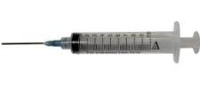

How do we learn about the health of patients?
Traditional Clinical Measures
Vital Signs
Hemoglobin level
Calcium
Phosphorus
Patient-Reported Measures
Behaviors
Care experiences
Health perceptions

Slide 4
Patient-Reported Outcomes (PROs)
PRO is “any report coming from patients about a health condition and its treatment, without interpretation of the patient’s response by a clinician or anyone else’’ (FDA)
Note: PROs are one type of patient-reported measure (PRM).
FDA. 2009.

Slide 5
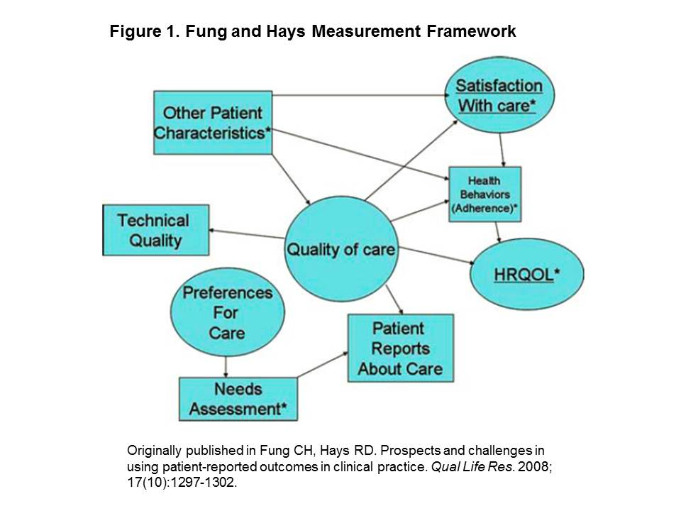
PRM framework
Notes:
Major concepts in this framework include preferences for care, HRQOL, quality of care, and satisfaction with care. The direct indicators include patient characteristics, technical quality of care, needs assessment, patient reports about care, and health behaviors. Of the many relationships between these constructs and indicators, it is important to note that HRQOL is exclusively an outcome and itself does not influence the other depicted constructs or indicators. On the other hand, HRQOL is influenced by other concepts and indicators, including health behaviors and quality of care, which do not count as outcomes, and therefore are not PROs.

Slide 6
PRMs can be assessed along the entire continuum of Provider-Patient encounter
Health issue elicited
Course of treatment discussed
Treatment plan created
During treatment
Treatment concluded

Slide 7
Impact of Providing PRO Information to Health Care Providers
Systematic review of 28 studies published between 1978 and 2007 evaluated impact of administering PROs in clinical practice:
  65% (15/23) found evidence of PROs improving processes of care
  47% (8/17) found evidence of PROs improving outcomes of care
Valderas, et al. Qual Life Res. 2008

Slide 8
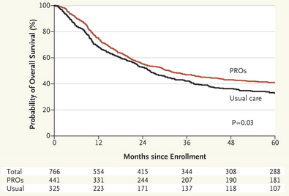
PRO Assessment Reduces ED visits and improves survical
Basch. N Eng J Med. 2017.

Slide 9
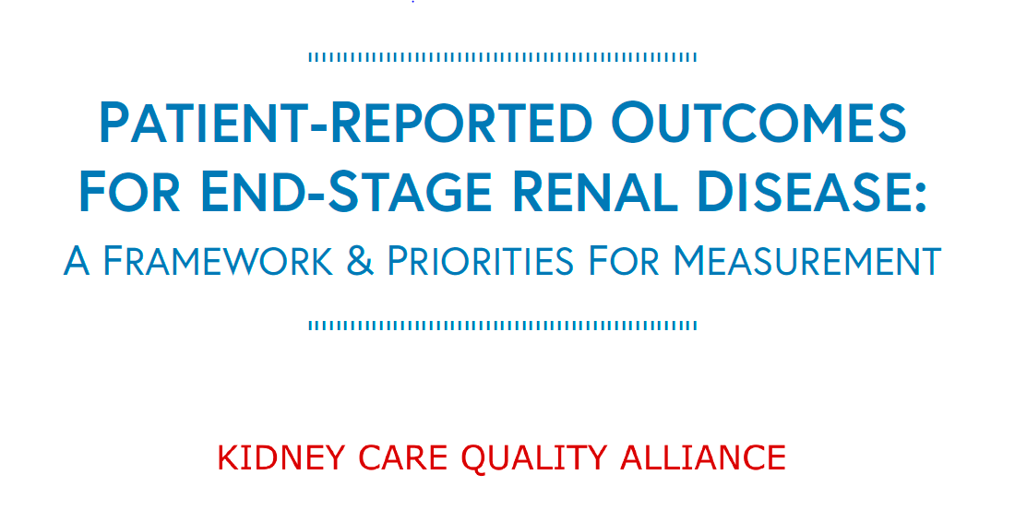
Kidney Care Quality Alliance Commissioned
Report on PRMs
Kidney Care Quality Alliance. Patient-Reported Outcomes for End-Stage Renal Disease: A
Framework and Priorities for Measurement. http://kidneycarepartners.com/kidney-care-quality-alliance-kcqa/.
Washington, DC: 2017.

Slide 10
KCQA Steering Committee
Allen R. Nissenson, MD, Co-Chair – DaVita HealthCare Partners
Paul Palevsky, MD, Co-Chair – Renal Physicians Association
Jason Spangler, MD – Amgen
Gail Wick, MHSA, RN – American Kidney Fund
Donna Bednarski, RN, MSN – American Nephrology Nurses Association
Raymond Hakim, MD, PhD – American Society of Nephrology
Sarah J. Swartz, MD – American Society of Pediatric Nephrology
Chris Lovell, RN, MSN – Dialysis Clinics, Inc.
Mike Guffey – Dialysis Patient Citizens
Lorien Dalrymple, MD, MPH – Fresenius Medical Care North America
Thomas Manley, RN, BSN – National Kidney Foundation
Jesse Roach, MD – Center for Medicare and Medicaid Services (CMS Liaison Member)

Slide 11
CMS Mandates for PRMs in Dialysis
CMS Conditions for Coverage (42 CFR §494.90)
  Each U.S. dialysis patient’s physical and mental health be monitored.
  Kidney Disease Quality of Life 36-item measure (KDQOL-36) most commonly used.
Performance measure
  In-Center Hemodialysis – Consumer Assessment of Healthcare Providers and Systems (ICH-CAHPS®) survey used in CMS Quality Incentive Program (QIP).
    https://www.cms.gov/Research-Statistics-Data-and-Systems/Research/CAHPS/ichcahps.html

Slide 12
Kidney Targeted HRQOL: KDQOL-36
Developed with patient input
  Focus groups with patients and dialysis center staf
  Field test with patients from 9 different outpatient dialysis centers from California, the Northwest and Midwest.
  Subsequent administration in Dialysis Outcomes and Practice Patterns Study
Contains generic (universal) and targeted items
Evidence of reliability and validity
Administered with 1000’s of dialysis patients; norms available for comparison
ªHays, et al. Qual Life Res. 1994

Slide 13
KDQOL-36 Scales
Composite | n items | Sample Item
Burden of Kidney Disease | 4 | “My kidney disease interferes too much with my life”
Symptoms/ Problems with Kidney Disease | 12 | “To what extent are you bothered by chest pain?”
Effects of Kidney Disease | 8 | “How much does fluid restriction from kidney disease bother you?”
+SF-12 as generic (universal) core:
Physical Component Score (PCS)
Mental Component Score (MCS)

Slide 14

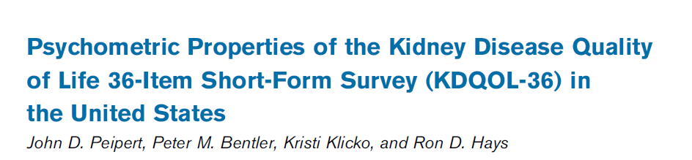

Slide 15
Sample
70,786 dialysis patients from 1,381 US dialysis facilities
Assessed KDQOL-36 between 06/01/2015 and 05/31/2016 as part of routine clinical assessment
Medical Education Institute (MEI) data

Slide 16
KDQOL-36 Scale Distributions
 | KDQOL Burdens | KDQOL Symptoms/ Problems | KDQOL Effects
Sample size | 70,022 | 70,004 | 69,938
Mean | 52 | 79 | 74
Standard Deviation | 30 | 16 | 22
% at Floor | 5% | 0.03% | 0.3%
% at Ceiling | 9% | 4% | 10%
Note: KDQOL scales above scored on 0-100 possible range, with 100 representing better
Health.

Slide 17
Evaluation of KDQOL-36 Factor Structure
Confirmatory factor analysis (CFA)
  3 correlated factors model
  Robust maximum likelihood
  Polychoric correlations to account for categorical items
Model Fit
  Comparative fit index (CFI) >0.95
  Tucker-Lewis Index (TLI) >0.95
  Root mean square error of approximation (RMSEA) <0.06

Slide 18

CFA Model Results
All items loaded on expected scale at >0.40
Model Fit
  TLI: 0.97 (meets criteria of > 0.95)
  CFI: 0.98 (meets criteria of > 0.95)
  RMSEA: 0.05 (meets criteria of < 0.06)
Conclusion
KDQOL factor structure provides
good fit to the observed data.

Slide 19
Evaluation of Reliability and Validity
Reliability
Internal consistency estimated with Cronbach’s alpha (α)
Dialysis facility-level reliability estimated with 1-way analysis of variance (ANOVA)
Construct Validity
Known groups analyses

Slide 20
Reliability
>0.70 acceptable
>0.80 good
>0.90 excellent
Sample sizes required for 0.70 facility-level reliability are 40, 38 and 24.

Slide 21
Construct Validity
 | KDQOL Burden | p-value | KDQOL Symptoms | p-value | KDQOL Effects | p-value
Dialysis Type
Peritoneal Dialysis | 56 | ref | 80 | ref | 76 | ref
In-Center Hemodialysis | 52 | <0.001 | 79 | <0.001 | 73 | <0.001
Conventional Home Hemodialysis | 52 | <0.001 | 80 | 0.03 | 75 | <0.001
Other | 52 | <0.001 | 80 | 0.48 | 74 | 0.008
Diabetes
Yes | 51 | Ref | 78 | Ref | 73 | Ref
No | 54 | <0.001 | 80 | <0.001 | 75 | <0.001

Slide 22

Content area experts, methodological experts, clinicians from academia, and NIH project officers
Can be assessed as static “short forms” or through computer adaptive testing (CAT)
Normed T-scores
  Mean of 50, SD of 10, referenced to the U.S. general population

Slide 23
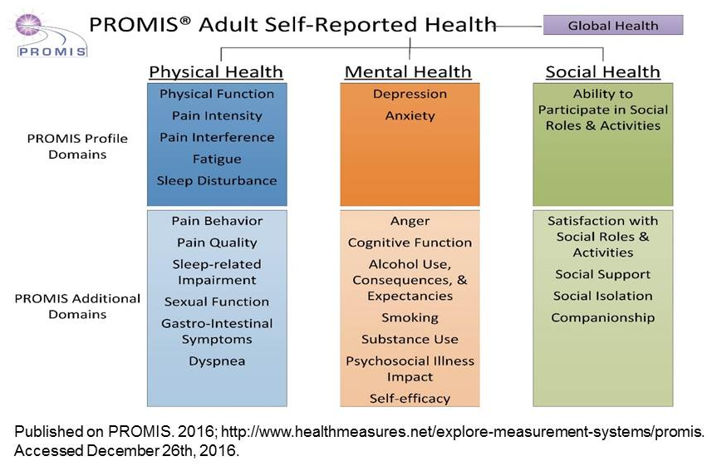
Universal Health-Related Quality of Life
Notes:
PROMIS measures are the state of the science in generic HRQOL measurement. In the PROMIS framework for HRQOL, general domains include Physical Health, Mental Health, and Social Health.

Slide 24
Peipert and Hays 1st Recommendation
We recommend the continued use of the KDQOL-36 instrument with dialysis patients for the purposes of dialysis centers’ internal quality improvement
Improve KDQOL-36 by replacing
SF-12 with PROMIS items

Slide 25
KCQA Recommendations
Rec. 1
“KDQOL is not an appropriate starting point for a facility-level, HRQOL-related PROM”
Rec. 2
“PROMIS should be considered […] for any new, targeted HRQOL-related PROM/PRO-PM development.”

Slide 26


“KDQOL is not an appropriate starting point for a facility-level, HRQOL-related PROM”
  1. Developed more than 20 years ago
    No compelling case made that dialysis patients HRQOL would be fundamentally different than it was in 1994
    Are the Burdens of KD, Symptoms of KD, and Effects of KD different than in 1994?

Slide 27

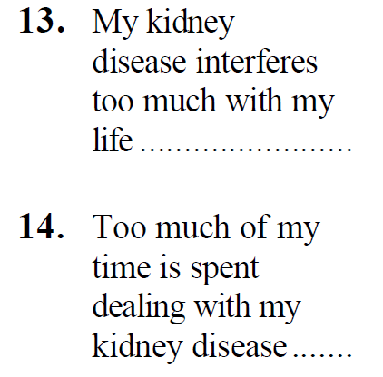
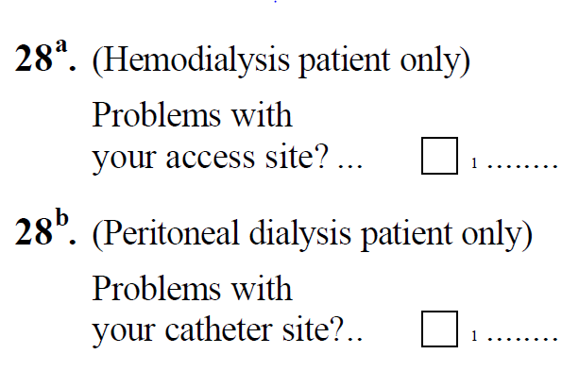
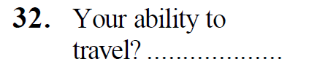
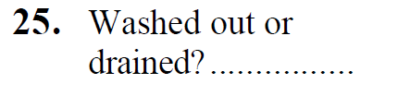
What do stakeholders care about today?
KDQOL-36™ Survey
Vascular Access Problems
Death/Mortality
Cardiovascular Disease
Dialysis Adequacy
Fatigue/Energy
Ability to Travel
Dialysis-Free Time
Evangelidis, et al., Am J Kidney Dis. 2017.

Slide 28
KDQOL Symptoms/Problems Still Relevant
Amro, et al., Pain Symptom Manage. 2016
Notes:
Fig. 2. Proportions of patients with different symptoms in the transition from dialysis ( first bars) to renal transplantation (second bars). Patients were categorized as very much to extremely bothered (black), somewhat to moderately bothered ( gray), or not bothered at all (white). The McNemar-Bowker test was used for comparison between the categories; *P < 0.05 and **P < 0.001.

Slide 29
2. The KDQOL is an Individual-Level Measure, Not Facility-Level
    Most PRO-based performance measures for providers, facilities, or health-care plans are derived from individual measures
      E.g., Veterans RAND 36-Item Health Survey (VR-36)
    KDQOL-36 has demonstrated ability to distinguish between facilities already (center-level reliabilities)
    KDQOL-36 has great potential for facility-level assessment.

Slide 30
“PROMIS should be considered […] for any new, targeted HRQOL-related PROM/PRO-PM development.”
PROMIS measures do represent the state of the science in generic/universal HRQOL measurement
No kidney/dialysis-targeted measures or questions
  Targeted measures are more responsive/sensitive
  Targeted measures address condition-specific concerns/symptoms
A combination of universal/targeted measures is recommended
Cella, et al., Patient-Reported Outcomes in
Performance Measurement. 2015

Slide 31
Experience with Care
“The range of interactions that patients have with the health care system, including their care from health plans, and from doctors, nurses, and staff in hospitals, physician practices, and other health care facilities” (AHRQ)
https://www.ahrq.gov/cahps/index.html

Slide 32
ICH-CAHPS Properties
Developed with patient input
Evidence of reliability and validity
Administered with 1000’s of dialysis patients; norms available for comparison

Slide 33
In-Center Hemodialysis Consumer Assessment of Healthcare Providers and Systems (ICH-CAHPS®)
Composite | n of Items | Sample Item
Nephrologists Communication and Caring | 6 | “In the last 3 months, how often did your kidney doctors explain things in a way that was easy for you to understand?”
Providing Information to Patients | 9 | “Did dialysis center staff at this center ever review your rights as a patient with you?”
Quality of Dialysis Center Care & Operations | 17 | “In the last 3 months, how often did the dialysis center staff show respect for what you had to say?"
+3 global items

Slide 34
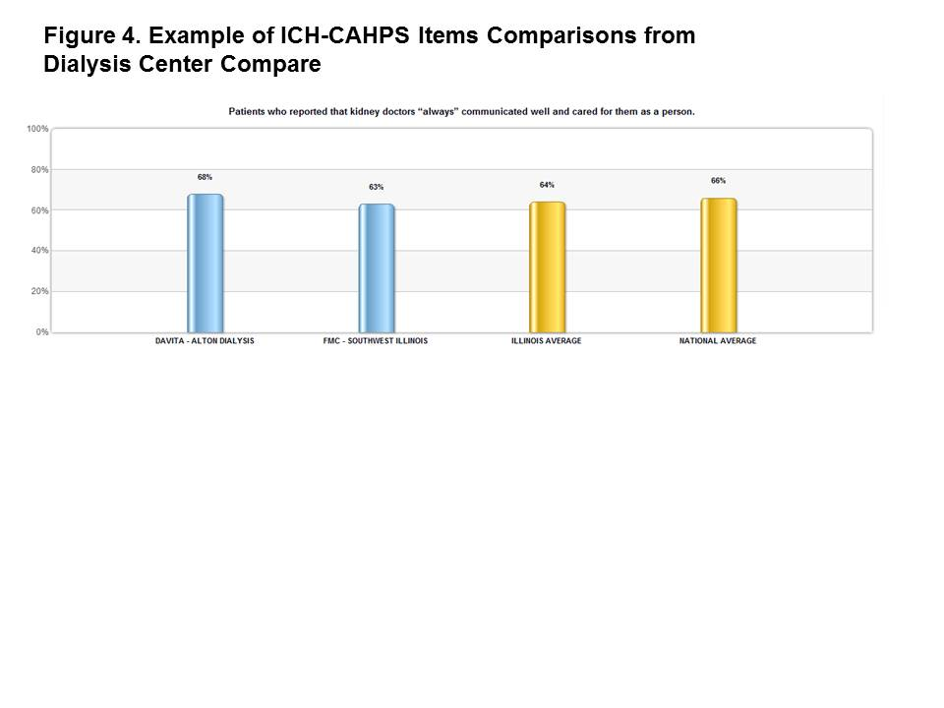
Inclusion in Dialysis Facility Compare

Slide 35
ICH-CAHPS Reliability
>0.70 acceptable
>0.80 good
>0.90 excellent
Composite | Alpha | Center-Level
Nephrologists Communication and Caring | 0.89 | 0.77
Providing Information to Patients | 0.93 | 0.84
Quality of Dialysis Center Care & Operations | 0.75 | 0.79
Weidmer, et al., Am J Kid Dis. 2014

Slide 36
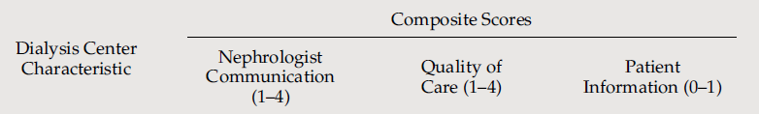
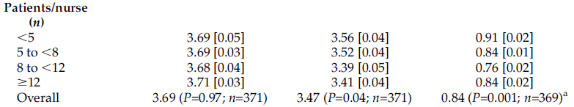
ICH-CAHPS Mean Differences
Wood, et al., Clin J Am Soc Neph. 2014

Slide 37
Peipert and Hays 2nd Recommendation
We recommend the continued use of the ICH-CAHPS for CMS’s dialysis center performance monitoring
Improve parsimony by reducing
number of items in scales.

Slide 38
Conclusions
Many opportunities to improve current measures
  Additional work is needed before KDQOL-based quality measure is ready for use
Best chances to develop well-performing quality measures is to start with KDQOL-36 and ICH-CAHPS
  Matches patients’ concerns
  Best measurement properties
  Available norms for comparison

Slide 39

Thank you.
drhays@ucla.edu
Phone: 1-310-794-2294
http://gim.med.ucla.edu/FacultyPages/Hays/present/
Notes:
39

