Slide 1

Review of Patient Safety Culture Survey Measures Completed by Healthcare Providers
Ron D. Hays, Ph.D.
October 21, 2014 (12:00 – 1:00)
44th Presentation of the UCLA Center for Maximizing
Outcomes and Research on Effectiveness (C-MORE)
Live Webinar at: https://uclahs.webex.com/
Meeting Number: 809 345 589
Meeting Password: uclacmore

Slide 2
CMORE http://cmore.med.ucla.edu/index.htm
05/11/2010 Robert Kaplan, PhD
How Do We Interpret Unexpected Findings From Large Clinical Trials?
06/08/2010 Brian Mittman, PhD
Achieving the Promise of CER: The Role of Implementation Science
07/13/2010 Benjamin Craig, PhD
Comparing Health Outcomes in Comparative Effectiveness (CHOICE) Research: Do preferences matter?

Slide 3
Motivation for Today’s Topics
Agency for Healthcare Research and Quality (AHRQ) Safety Culture Conference funded by R13 to:
  Jason Etchegaray, Ph.D.
  University of Texas-Houston Medical School
Held October 2, 2014

Slide 4


Putting Safety in Context*
Advances in medicine have led to positive outcomes:
  Most childhood cancers are curable
  AIDS is now a chronic disease
  Life expectancy has increased 10 years since the 1950s
However, sponges are still found inside patients’ bodies after operations.
*Note: Slide from Comprehensive Unit-based Safety Program (CUSP) http://www.ahrq.gov/professionals/education/curriculum-tools/cusptoolkit/index.html

Slide 5
Health Care Defects in U.S.*
  7% of patients suffer a medication error²
  On average, every patient admitted to an intensive care unit suffers an adverse event^{3,4}
  44k—99k die in hospitals/year as the result of medical errors⁵
  > half a million develop catheter-associated urinary tract infections, resulting in 13,000 deaths/ year⁶
  Nearly 100k die from health care-associated infections (HAIs)/year and the cost of HAIs is $28 to $33 billion/year⁷
  30k—62k deaths from central line-associated blood stream infections/year⁸

Slide 6
Patient Safety Culture Measures
AHRQ Hospital Survey on Patient Safety Culture (HSOPSC or SOPS)
  http://www.ahrq.gov/legacy/qual/patientsafetyculture/hospsurvindex.htm
Safety Attitudes Questionnaire (SAQ)
  https://med.uth.edu/chqs/surveys/safety-attitudes-and-safety-climate-questionnaire/
Patient Safety Climate in Healthcare Organizations (PSCHO) Survey
  http://www.midss.org/content/patient-safety-climate-healthcare-organizations-pscho

Slide 7
AHRQ Hospital Survey on Patient Safety Culture (HSOPSC or SOPS)
42 items measuring 12 domains
  Supervisor/manager expectations (k = 4)
  Organizational learning/Cont. improve (k = 3)
  Teamwork within units (k = 4)
  Teamwork across units (k = 4)
  Communication openness (k = 3)
  Feedback/comm. about error (k = 3)
  Non-punitive response to error (k = 3)
  Staffing (k = 4)
  Management support for safety (k = 3)
  Handoffs/transitions (k = 4)
  Frequency of events reports (k = 3)
  Overall perceptions of patient safety (k = 4)

Slide 8
2012 Comparative Database
1,128 hospitals
  66% non-teaching
  80% non-government
567,703 hospital staff respondents
  Mean of 503 surveys/hospital
  53% response rate
Respondents
  35% registered nurse, or licensed vocational nurse/licensed practical nurse
  11% technician (e.g., EKG, lab, radiology)
  8% administration/management
  6% attending, resident, physician assistant, or nurse practitioner

Slide 10
Areas in need of Improvement
Non-punitive response to error (44% positive)
  Staff feel that their mistakes and event reports are not held against them and that mistakes are not kept in their personal file.
Handoffs and tradeoffs (45% positive)
  Important patient care information is transferred across hospital units and during shift changes
Staffing (56% positive)
  Enough staff to handle the workload and work hours are appropriate to provide best care.

Slide 11
Safety Attitudes Questionnaire (SAQ)
30 items measuring 6 domains
  Safety climate (k = 7)
  Teamwork climate (k = 6)
  Perceptions of management (k = 4)
  Job satisfaction (k = 5)
  Working conditions (k = 4)
  Stress recognition (k = 4)

Slide 12
Patient Safety Climate in Healthcare Organizations (PSCHO) Survey
31 items measuring 7 domains
  Senior managers’ engagement (k = 7)
  Organizational resources (k = 3)
  Overall emphasis on patient safety (k = 3)
  Unit safety norms (k = 7)
  Unit support/recognition for safety effort (k = 4)
  Fear of blame (k = 2)
  Fear of shame (k = 5)

Slide 13
Qualitative Observations (HSOPSC)
Response options

Slide 14
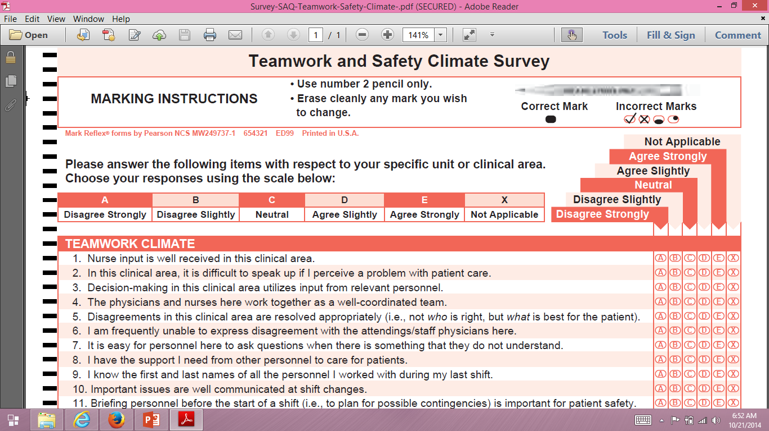
Qualitative Observations (SAQ)

Slide 15
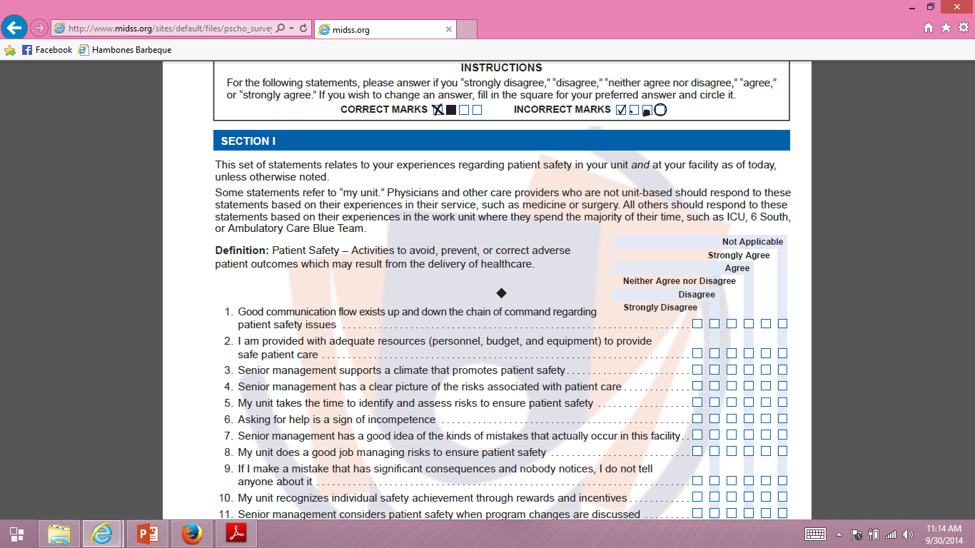
Qualitative Observations (PSCHO)

Slide 16
Reliability
Model
Reliability
Intraclass Correlation
Two-way random
Two-way mixed
One-way
BMS = Between Ratee Mean Square N = n of ratees
WMS = Within Mean Square k = n of items or raters
JMS = Item or Rater Mean Square
EMS = Ratee x Item (Rater) Mean Square
Notes:
16

Slide 17
Reliability Formulas
Model
Reliability
Intraclass Correlation
Two-way random
Two-way mixed
One-way
BMS = Between Ratee Mean Square N = n of ratees
WMS = Within Mean Square k = n of items or raters
JMS = Item or Rater Mean Square
EMS = Ratee x Item (Rater) Mean Square
Notes:
17

Slide 18
Reliability Formulas
Model
Reliability
Intraclass Correlation
Two-way random
Two-way mixed
One-way
BMS = Between Ratee Mean Square N = n of ratees
WMS = Within Mean Square k = n of items or raters
JMS = Item or Rater Mean Square
EMS = Ratee x Item (Rater) Mean Square
Notes:
18

Slide 19
r_{wg} (i)
1 – (Sx_{j}² / sigma_{EU}²)
  Within-group interrater reliability for Xj (Proportion of non-error variance)
  Sx_{j}² = observed variance on X_{j}
  Sigma_{EU}² = variance on X_{j} if all judgements were due to random measurement error
    Expected error variance based on uniform distribution.
    (NCAT² – 1)/12
James et al. (1984, J App Psych)

Slide 20

Item-scale correlation matrix
20
Notes:
20

Slide 21

Item-scale correlation matrix
21
Notes:
21

Slide 22
Confirmatory Factor Analysis
22
Notes:
22

Slide 23
Validity
Does scale represent what it is supposed to be measuring?
Singer et al. (2009)
  Hospitals (91 hospitals, 18,223 respondents) with better safety climate overall had lower relative incidence of patient safety indicators
    PSIs recommended by AHRQ Quality Indicators Support Team (see Appendix for list)
    2004 MEDPAR data
  Frontline personnel’s (not senior manager’s) perceptions of better safety climate were associated with lower incidence of patient safety indicators

Slide 24
New Directions
Standardized General Population Metric
Category Response Curves
Computer Adaptive Testing
Differential Item Functioning
Linking of Different Measures

Slide 25
T-score Metric
T Score referenced to US Hospitals
  Mean = 50
  SD = 10
  T = 50 + (z * 10)

Slide 26
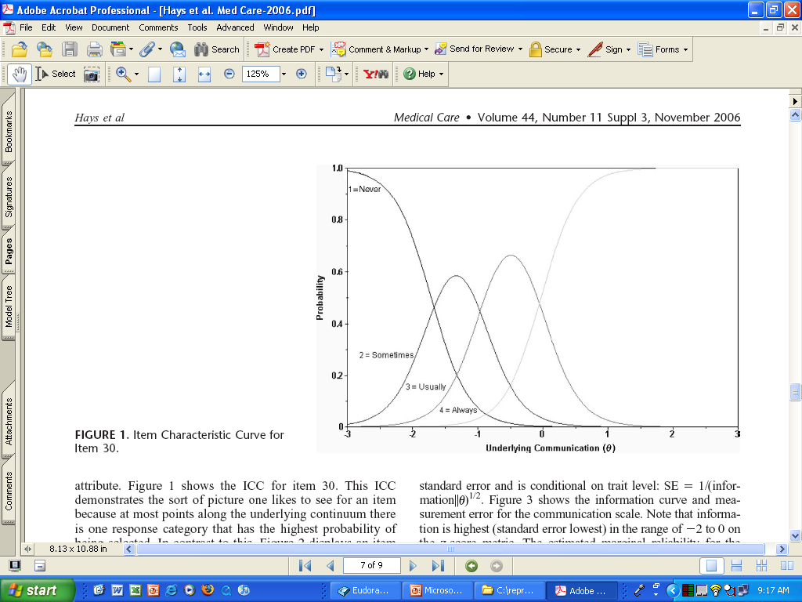
CATEGRORY RESPONSE CURVE

Slide 27
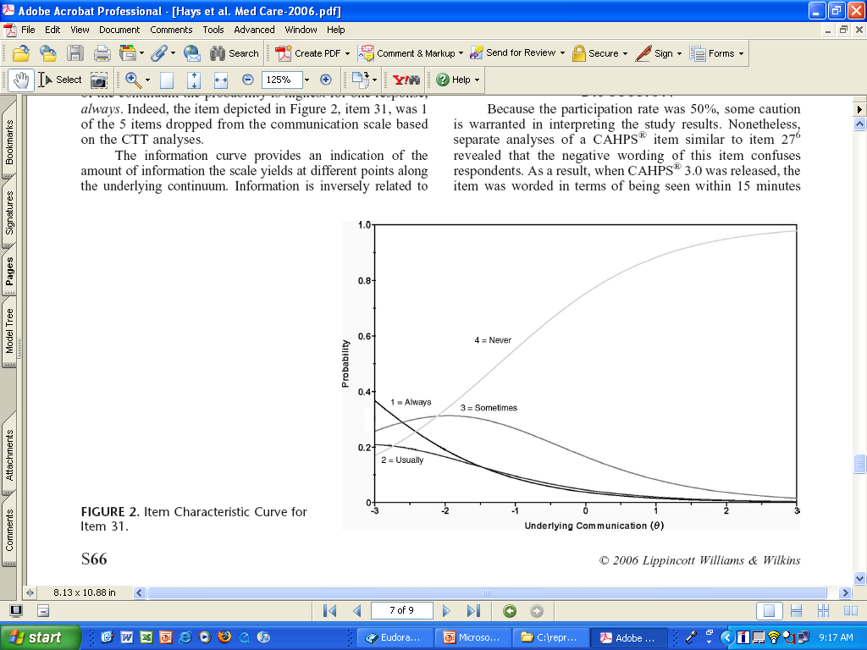

Slide 28
Item Responses and Trait Levels
Person 1
Person 2
Person 3
Trait
Continuum
Item 1
Item 2
Item 3
www.nihpromis.org

Slide 29




Computer Adaptive Testing (CAT)
Notes:
Early research on CAT was funded by the U.S. military to enhance mental measurement.
NASD = National Association of Security Dealers. In 1978 they began developing CAT for regulatory exam to assess knowledge of securities and securities future products among licensed brokers.
The National Council of State Boards of Nursing starting using CAT in 1994.

Slide 30
PROMIS Physical Functioning vs. “Legacy” Measures
10 20 30 40 50 60 70

Slide 31
Differential Item Functioning (DIF)
Probability of choosing each response category should be the same for those who have the same estimated scale score, regardless of other characteristics
Evaluation of DIF by subgroups

Slide 32
DIF (2-parameter model)
Men
Women
White
Slope DIF
Location DIF
AA
I cry when upset
I get sad for no reason
Higher Score = More Depressive Symptoms
Notes:
32

Slide 33
Linking of Difference Patient
Safety Culture Measures
Equipercentile linking of scores
  Scores associated with equivalent %
  X scores and Y scores correspond to same number of SDs above or below the mean
  Matches two cumulative distribute functions to each other either via smooth functions or non-parametrically
IRT linking
  Map onto logistic scales

Slide 34
Linking Assumptions
Instruments are measuring essentially the same thing (unidimensional)
Scores from the two instruments are highly correlated (> 0.80); compare actual with estimated scores
Subgroup invariance (standardized root mean square deviation)

Slide 35
Etchegaray & Thomas (2012)
R-squared for SAQ teamwork = 54%
0.83 + 0.34* HSOPSteamwork + 0.51* HSOPScommun.
R-squared for SAQ safety = 42%
1.63 + 0.65* HSOPorganizational learning
Correlations among SAQ and HSOPS
  Etchegaray & Thomas (2012) Table 4
  Predominantly unidimensional
    8.2, 1.28 and 0.96 are 1st 3 principal components
  If two factors rotated 2nd factor shows common variance among 5 HSOPS scales
    Teamwork within, non-punitive, number of events reported, expectations, and staffing

Slide 36
Bibliography
DiCuccio, M. H. (2014). The relationship between patient safety culture and patient outcomes: A systematic review. J Patient Saf, epub.
Etchegary, J. M., & Thomas, E. J. (2012). Comparing two safety culture surveys: Safety Attitudes Questionnaire and Hospital Survey on Patient Safety. BMJ Qual Sat, 21, 490-498.
Morello, R. T. et al. (2013). Strategies for improving patient safety culture in hospitals: A systematic review. BMJ Qual Saf, 22, 11-18.
Sammer, C. E., Lykens, K., Singh, K. P., Mains, D. A., & Lackan, N. A. (2010). What is patient safety culture? A review of the literature. Journal of Nursing Scholarship, 42, 156-165.
Sexton, J. B. et al. (2011). Assessing and improving safety climate in a large cohort of intensive care units. Crit Care Med, 39, 934-939.
Sexton, J. B. et al. (2006). The Safety Attitudes Questionnaire: Psychometric properties, benchmarking data, and emerging research. BMC Health Services Research, 6, 44.
Singer, S. et al. (2009). Relationship of safety climate and safety performance in hospitals. Health Services Research, 44, 399-421.
Singer, S. et al. (2007). Workforce perceptions of hospital safety culture: Development and validation of the Patient Safety Climate in Healthcare Organizations Survey. Health Services Research, 42, 1999-2021
Sorra, J. S., & Dyer, N. (2010). Multilevel psychometric properties of the AHRQ hospital survey on patient safety culture. BMC Health Services Research, 10, 199.

Slide 37

drhays@ucla.edu (310-794-2294). http://gim.med.ucla.edu/FacultyPages/Hays/
Notes:
37

Slide 38
Appendix: 12 PSIs in Singer et al. (2009)
Complications of anesthesia
Decubitus ulcer
Inatrogenic pneumothorax
Infection due to medical care
Postoperative hip fracture
Postop hemorrhage or hematoma
Postop physio metabol derangmnt
Postop respiratory failure
Postop PE or DVT
Postop sepsis
Postop wound dehiscence
Accidental puncture/lacertaion

Slide 39
Previous CMORE Talks http://cmore.med.ucla.edu/index.htm
05/11/2010 Robert Kaplan, PhD
How Do We Interpret Unexpected Findings From Large Clinical Trials?
06/08/2010 Brian Mittman, PhD
Achieving the Promise of CER: The Role of Implementation Science
07/13/2010 Benjamin Craig, PhD
Comparing Health Outcomes in Comparative Effectiveness (CHOICE) Research: Do preferences matter?

Slide 40
CMORE
08/10/2010 Robert Brook, MD, ScD
Can We Establish a Business Case for Comparative Effectiveness Research?
09/14/2010 Brennan Spiegel, MD MSHS, FACG
Introduction to Cost-Effectiveness Analysis: How to Figure out if the Juice is Worth the Squeeze.
10/12/2010 Michael Ong, MD, PhD
Comparative Effectiveness Research on Reducing Heart Failure Readmissions.

Slide 41
CMORE
11/09/2010 Teryl Nuckols, MD
Utilization of care as a criteria for comparative effectiveness research.
12/14/2010 Francesco Chiappelli, PhD
Toward Clinically Relevant Complex Systematic Reviews (CRCSR's), and beyond: Recent Milestones and Remaining Challenges.
01/11/2011 Ken Wells, MD, MPH
Community-partnered comparative effectiveness research in mental health.

Slide 42
CMORE
02/08/2011 John Adams, PhD
Physician Cost Profiling.
03/08/2011 Mark Litwin, MD MPH
Caring for the Uninsured in California with Prostate Cancer.
04/12/2011 Katherine Kahn, MD, PhD
Approach to the Evaluation of the Effectiveness of Decision Support Systems for Advanced Imaging Procedures.

Slide 43
CMORE
05/10/2011 Patricia Ganz, MD
Comparative Effectiveness and Studies of Breast Cancer Outcomes and Quality.
07/12/2011 Lisa Rubenstein, MD
Quality Improvement and Implementation Science in the Era of Comparative Effectiveness.
08/16/2011 Sarah Starks
Cost and Effectiveness of Full Service Partnerships: Assertive Community Treatment of Severe Mental Illness

Slide 44
CMORE
09/13/2011 John Romley, PhD
Hospital Spending and Inpatient Mortality: Evidence from California.
10/18/2011 Emmett Keeler, PhD
Cost effectiveness of lung cancer screening in the NLST.
11/08/2011 Ian Coulter, PhD
Overview and Critique of Comparative Effectiveness Research.

Slide 45
CMORE
12/20/2011 Pamela Davidson, PhD
Improving Safety through Intervention, Innovation, Policy Analysis, and Workforce Development.
01/17/2012 Cheryl Damberg, PhD
Potential Unintended Consequences in Pay for Performance Programs.
02/21/2012 Ron Anderson, PhD
The State of Comparative Effectiveness Research at the National Level

Slide 46
CMORE
03/20/2012 Roger Lewis, MD, PhD
Adaptive Clinical Trials
04/17/2012 Dominick Frosch, PhD
Communicating Comparative Effectiveness Research Results to Patients
05/15/2012 Kevin Grumbach, MD
The Translational Research Challenge: Improving the Health of the Community.

Slide 47
CMORE
06/19/2012 Robin Clarke, MD
Incorporating Stakeholders: Examining the Medical Home Through an Adaptation of the Modified Delphi Process.
07/17/2012 David Reuben, MD
UCLA Alzheimer's and Dementia Care: Comprehensive, coordinated, patient-centered.
08/21/2012 Brian Mittman, PhD
"Methods Matter": Goals and Content for the First PCORI Methodology Report and Standards.

Slide 48
CMORE
09/18/2012 PCORI Discussion Panel on Patient-Engagement (Tim Carey and Paul G. Shekelle)
How can we meet or surpass the bar raised by PCORI on stakeholder engagement in our research - from study design to dissemination.
10/16/2012 Christopher Saigal, MD MPH
Improving Decision Making at the Point of Care: Opportunities and Challenges.

Slide 49
CMORE
12/4/12 Douglas Bell, MD PhD
Value of Information: A Brief Summary.
Lenore Arab, Phd, MS
PCORI Update: Board of Governors Recap
01/15/2013 Wendy Slusser, MD
How to Build Stakeholder Engagement into Studies
02/19/2013 Lenore Arab, PhD MS
What PCORI Wants: An Open Discussion of PCORI Reviews, PCORI Reviewers, and PCORI Successes.

Slide 50
CMORE
03/19/2013 Mellissa Withers, PhD, MHS
Qualitative Research.
04/16/2013 Bruce Dobkin, MD
UCLA Wireless Health Institute can Help Investigators.
05/21/2013
Alison Hamilton, PhD, Brian Mittman, PhD, and Gail Wyatt, PhD
Studying Effectiveness and Implementation of Evidence-Based, Research-Developed Programs in Routine Care Settings: Tradeoffs and Challenges in Study Designs and Methods.

Slide 51
CMORE
11/5/2013 Matthew Press, MD MSc
Collaboration Between Clinicians: Assessing its Quality and Impact
12/17/2013 José Calderón, MD
Improving diabetes health literacy by animation.
2/18/2014 Amy D. Waterman, PhD
Expanding Living Donor Transplantation Through Improved Education.

Slide 52
CMORE
3/18/2014 Rich Baker, MD
The 30% solution? Challenging an underlying assumption of the ACA and its implication for successful health reform.
4/15/2014 Loren Miller, MD MPH
Recurrent urinary tract infections among women: comparative effectiveness of 5 prevention and management strategies using a Markov chain Monte Carlo model.
5/20/2014 Adam Richards, MD
Health Equity Metrics to Ameliorate Health Disparities Inequity: A User's Guide.

Slide 53
CMORE
6/17/2014 Ka-kit Hui, MD
The Potential Value of the Integrative Health Paradigm in Health Outcomes Research.
9/16/2014 John Adams, PhD
Using Item Response Theory to Summarize Health Care Quality Measures.

