Slide 1


Psychometric Analysis of Survey Data
Ron D. Hays, Ph.D.
RCMAR Methods Seminar
February 26, 2024
(3:15-4:15 pm)

Slide 2

Acknowledgements
José L. Calderón: “Mitigating Cognitive Demand for Completion of CAHPS® Surveys by Aging Latinos: CAHPS® Visual Display and Cognitive Design Revision.” RCMAR Pilot (2015-16 Cohort)
  National Institute on Aging (Grant Number P30-AG021684)
Agency for Healthcare and Research Quality (Contract number U18HS029321)
https://drjoe.life/obituary/ (November 16, 2023)

Slide 3
AHRQ’s CAHPS® Program
Agency for Healthcare Research and Quality
  Research and development agency in the U.S. Department of Health and Human Services
  Since 1995, AHRQ’s CAHPS Program has advanced the science of patient experience:
    Surveys that can be used for high-stakes purposes
    Quality improvement tools to improve patient experience
    Research to advance the science of patient experience, including best methods to administer CAHPS surveys and report CAHPS survey findings

Slide 4
The Patient’s Voice
CAHPS Surveys reflect the patient’s voice.
All CAHPS survey development begins with asking patients/consumers about what’s important to measure and report. The resulting survey reflects their input.

Slide 5

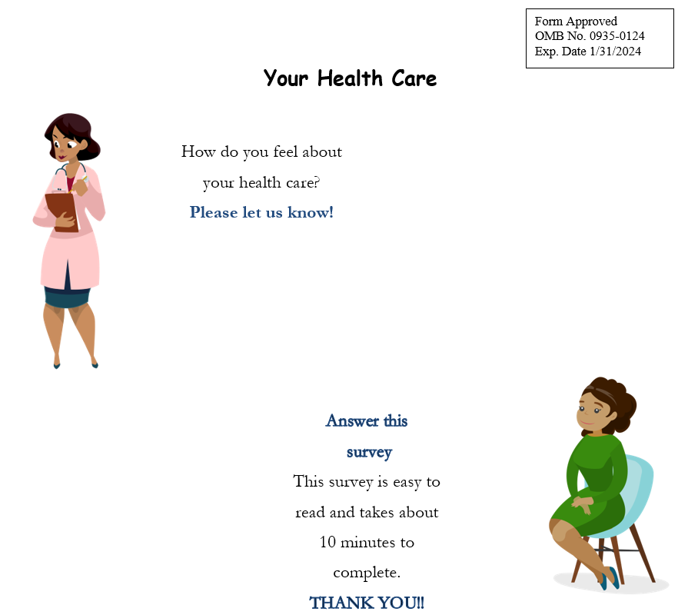
CAHPS CG 3.1 Survey
EZ Survey

Slide 6
CAHPS Versus “Easy” (EZ) Item
CG-CAHPS 3.1 Item
Passive lead before query ->
In the last 6 months, when you contacted this provider’s office to get an appointment for care you needed right away, how often did you get an appointment as soon as you needed?
← Random Truncation of Item Lines
Flesh-Kincaid Readability Score: 14th Grade Level
Difficult to Read
EZ Item
How often do you get care
as soon as you needed?
← Stanzaic Versification of Item Lines
Flesh-Kincaid Readability Score: 3rd Grade Level
Very Easy to Read
Notes:
We created a variant of the CG-CAHPS 3.1 mail survey that simplifies the wording of questions and presents one complete thought on each line.
Shown here is an example of how one of the CAHPS clinician and group 3.1 item stems was modified to produce an easier-to-read question. The CAHPS item has several words, written in the passive tense, and line length determines wrapping to the next line. The EZ item is short and presents a single thought on each line. As a result, the reading level was reduced from college to 3rd grade.

Slide 7
CAHPS Clinician and Group 3.1 Survey
31 questions
  9 “About You” questions.
  1 global rating question: Using any number from 0 to 10, where 0 is the worst provider possible, what number would you use to rate this provider?
Four multi-item scales (12 reports about care items)
Timely Care
6. In the last 6 months, when you contacted this provider’s office to get an appointment for care you needed right away, how often did you get an appointment as soon as you needed?
8. In the last 6 months, when you made an appointment for a check-up or routine care with this provider, how often did you get an appointment as soon as you needed?
10. In the last 6 months, when you contacted this provider’s office during regular office hours, how often did you get an answer to your medical question that same day?

Slide 8
CAHPS Clinician and Group 3.1 Survey
Communication
11. In the last 6 months, how often did this provider explain things in a way that was easy to understand?
12. In the last 6 months, how often did this provider listen carefully to you?
14. In the last 6 months, how often did this provider show respect for what you had to say?
15. In the last 6 months, how often did this provider spend enough time with you?
Coordination of Care
13. In the last 6 months, how often did this provider seem to know the important information about your medical history?
17. In the last 6 months, when this provider ordered a blood test, x-ray, or other test for you, how often did someone from this provider’s office follow up to give you those results?
20. In the last 6 months, how often did you and someone from this provider’s office talk about all the prescription medicines you were taking?
Office Staff
21. In the last 6 months, how often were clerks and receptionists at this provider’s office as helpful as you thought they should be?
22. In the last 6 months, how often did clerks and receptionists at this provider’s office treat you with courtesy and respect?

Slide 9
EZ Survey
31 questions
  9 “About You” questions.
  1 global rating question: Rate the care this doctor gave you in the last 6 months. Pick a number from 0 to 10. The Worst doctor is 0. The Best doctor is 10
  Four multi-item scales (12 reports about care items)
Timely Care
6. How often did you get care as soon as you needed?
8. How often did you get an appointment as soon as you needed?
10. How often did you get answers to your medical questions the same day?

Slide 10
EZ Survey
Communication
13. How often did this doctor explain things in a way you understood?
14. How often did this doctor listen to you carefully?
16. How often did this doctor show respect for what you had to say?
17. How often did this doctor spend enough time with you?
Coordination of Care
15. How often did this doctor seem to know what is important to you about your health?
19. How often did this doctor explain the test results to you?
21. How often did this doctor talk about all the medicine you took?
Office Staff
11. How often were clerks and receptionists as helpful as they should be in the last 6 months?
12. How often did clerks and receptionists treat you with respect in the last 6 months?

Slide 11
Data Collection
Safety net healthcare provider in Los Angeles
CAHPS C-G 3.1 and EZ Paper Surveys
  Pre-notification letter in advance of survey
  Personalized letters and survey packets
  Used first-class postage
  Sent a second survey to non-respondents
  English and Spanish surveys
August 1, 2023, through December 31, 2023.
n = 264 surveys returned (16 providers)
  7 doctors, 5 NPs, 4 PAs

Slide 12
Analysis Plan
Response rate
Failure to follow skip patterns
Missing data
Item frequencies
Multi-item scale means (SDs)
Internal consistency reliability
Patient-level correlations among measures
Provider-level reliability
Multi-trait scaling
Factor analyses (exploratory and confirmatory)

Slide 13
Survey response rate
18% overall (n =264)
20% for CG 3.1 Survey (n = 147)
16% for EZ Survey (n = 117)
Response rate did not differ significantly by the amount of incentive ($2 vs $5)
Analytic sample (n = 232)
  n = 133 (CG 3.1) and 99 (EZ) surveys where respondents reported care from sampled provider

Slide 14
Sample Characteristics
Variable | Percentage
Female | 64%
Hispanic | 66%
Black | 14%
White | 14%
Asian | 7%
Spanish language survey | 44%
High school education or less | 33%
Modal age category | 55-64 (40%)
Excellent physical health | 15%
Very good physical health | 15%
Good physical health | 40%
Excellent mental health | 24%
Very good mental health | 18%
Good mental health | 36%

Slide 15
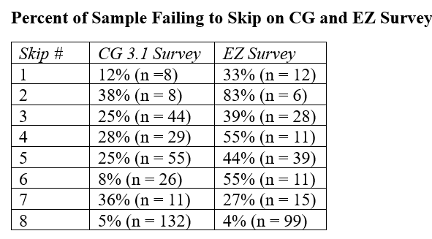

Slide 16
Item missing data was rare
24 items asked of everyone
Mean missing
  0.53 for CG 3.1 survey
  1.04 for EZ survey
t =1.78, p =0.0769

Slide 17
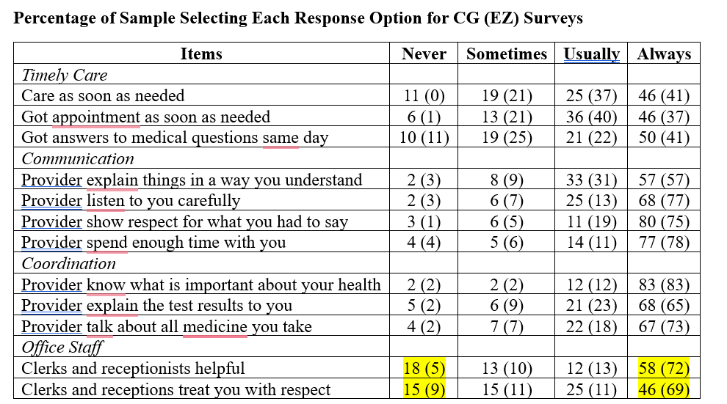

Slide 18
Patient-Level Means, SDs, Alphas
---------CG----------
-----------EZ----------
 | Mean | SD | Alpha* | Mean | SD | Alpha*
Timely | 3.09 | 0.91 | 0.90 | 3.06 | 0.83 | 0.81
Communication | 3.65 | 0.65 | 0.92 | 3.65 | 0.62 | 0.83
Coordination | 3.22 | 0.80 | 0.65 | 3.52 | 0.75 | 0.80
Office Staff | 3.52 | 0.65 | 0.83 | 3.53 | 0.73 | 0.88
*(MS_{BMS}-MS_{EMS})/MS_{BMS} MS_{EMS} = Patient x Item interaction

Slide 19
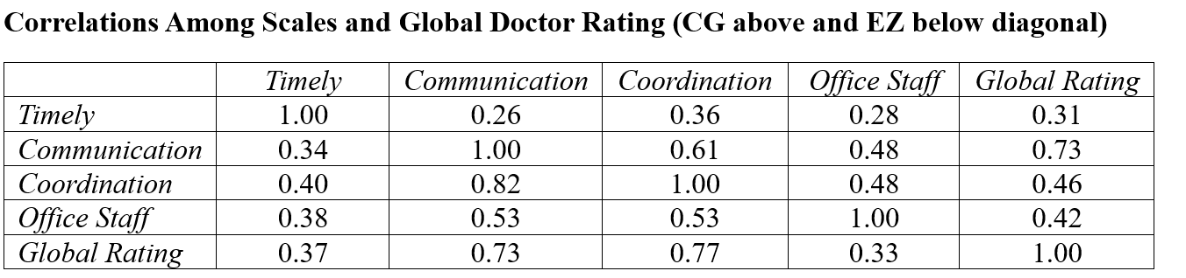






Slide 20
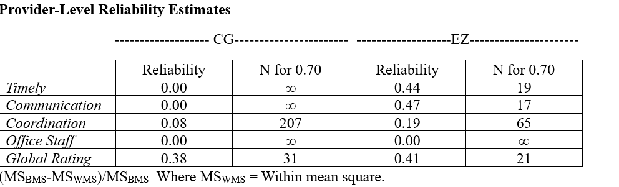

Slide 21
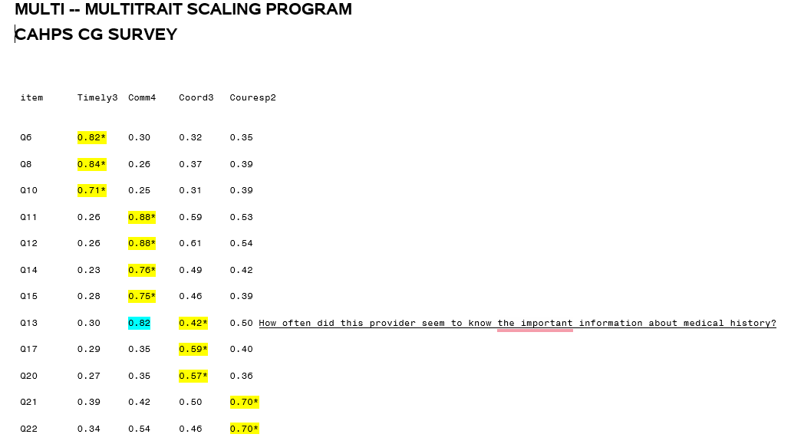

Slide 22
Primary Care First Patient Experience of Care Survey: https://pcfpecs.org/General-Information/About-PCF-PECS

Slide 23
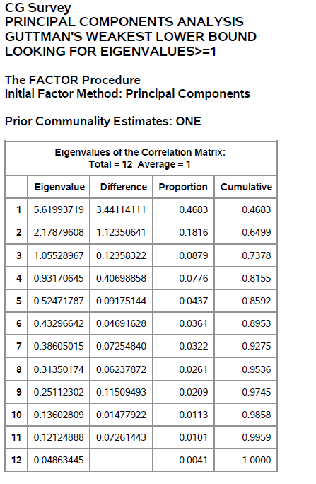





Exploratory Factor Analysis
7.31, 1.97, and 0.98 eigenvalues for polychoric correlations

Slide 24
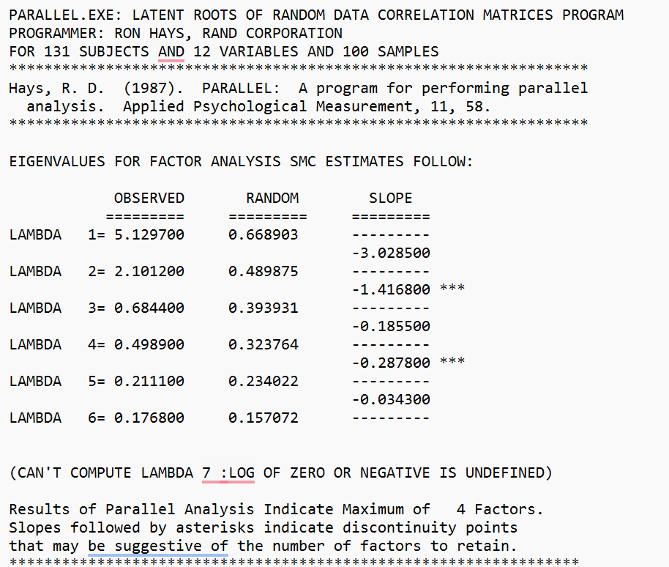


Slide 25
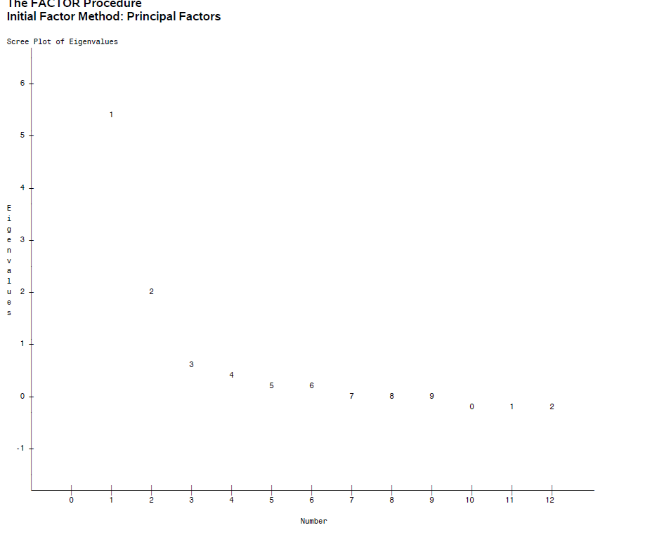
Scree Plot
Tucker/Lewis reliability
Coefficient for 3 factors = 0.80
and 4 factors = 0.82

Slide 26
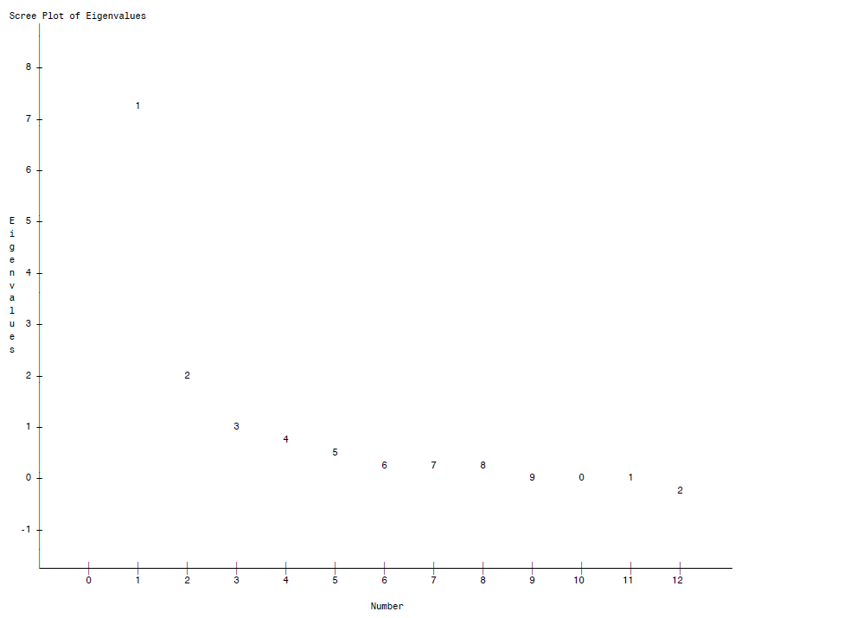


Polychoric Correlations

Slide 27
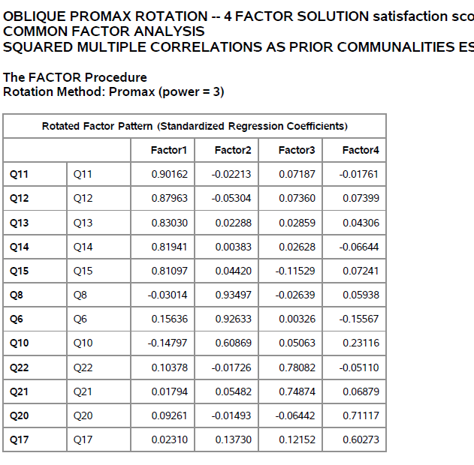
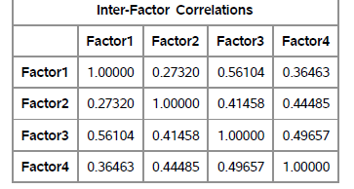













Slide 28
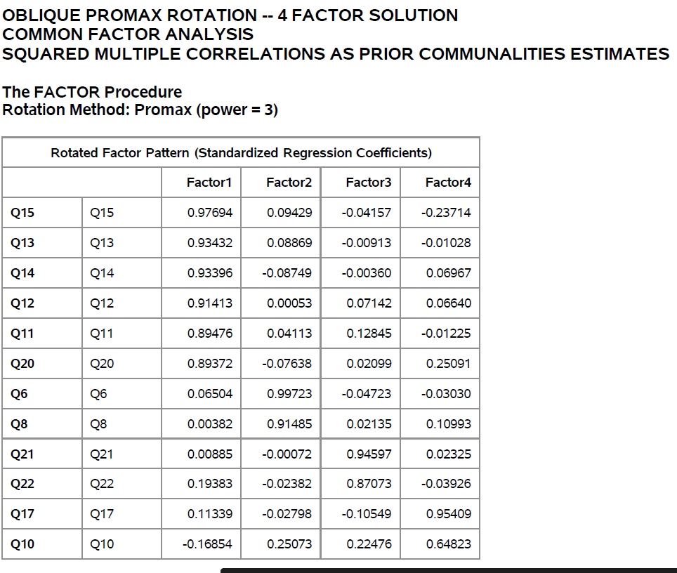












Slide 29
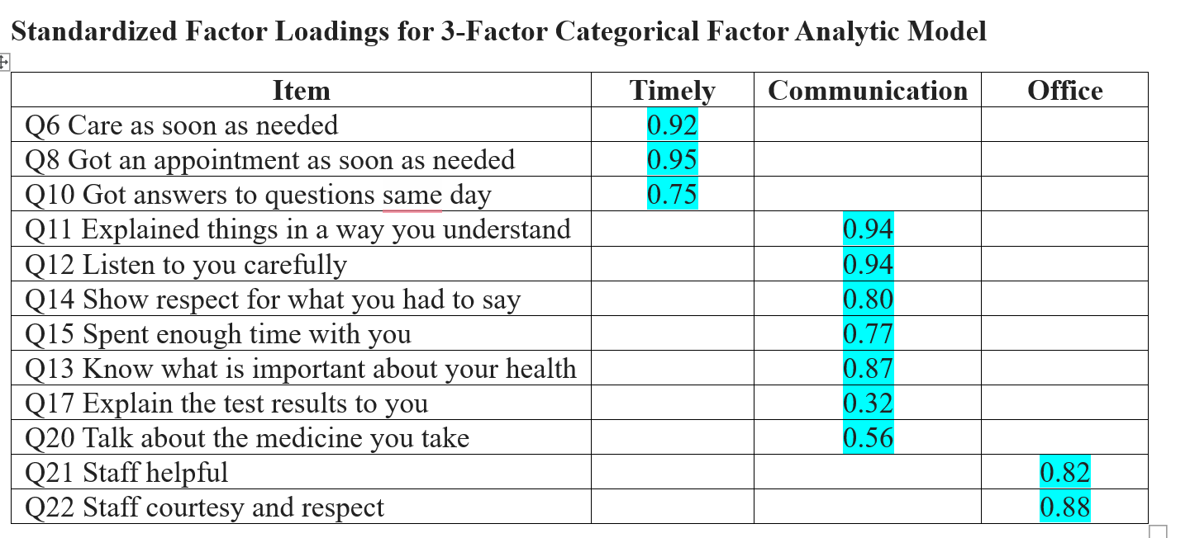
Comparative fit index = 0.95; RMSEA = 0.09

Slide 30
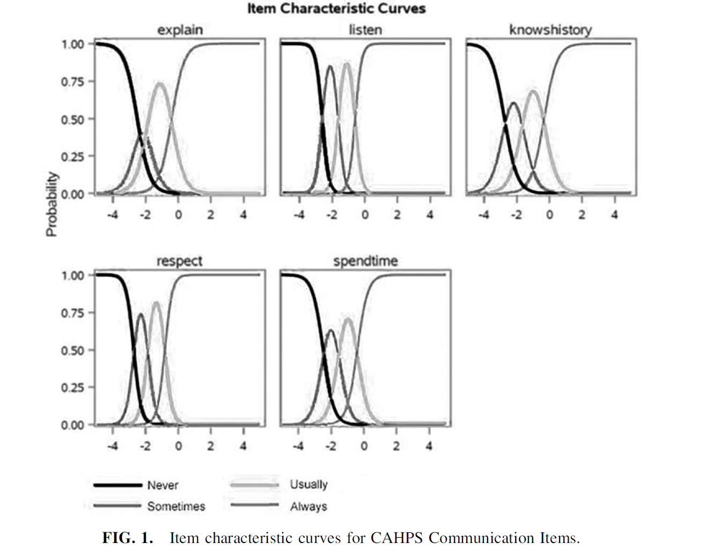
Hays, Walling et al. (2023)

Slide 31

Email: drhays@ucla.edu
https://labs.dgsom.ucla.edu/hays/pages/
We thank Charleen Mikail for her immense assistance with the study.
For further reading see:
Cappelleri, J. C., Lundy, J.J., & Hays, R. D. (2014). Overview of classical test theory and item response theory for quantitative assessment of items in developing patient-reported outcome measures. Clinical Therapeutics., 36 (5), 648-662.
Hays, R. D., Walling, A. M., Sudore, R. L., Chau, A., & Wenger, N. S. (2023). Support for the use of Consumer Assessment of Healthcare Providers and Systems communication items among seriously ill patients. J Palliat Med, 26(9), 1234-1239.

