Slide 1
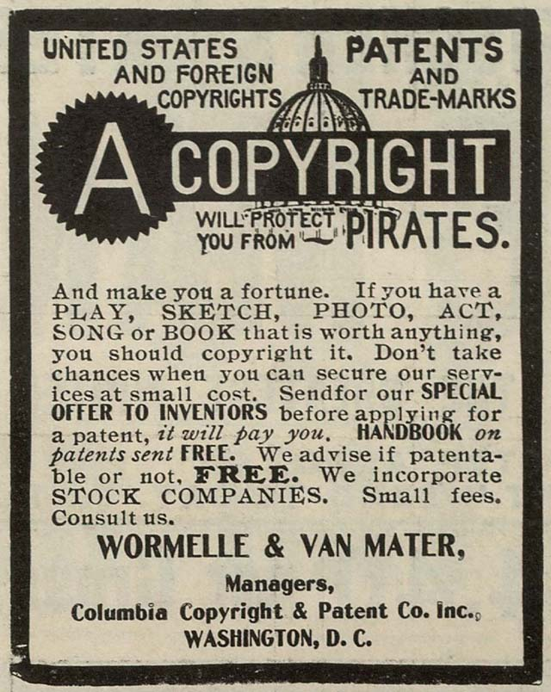
Copyright Restrictions
Versus Open Access to Survey Instruments
Ron D. Hays
January 12, 2018 (12-1pm) http://gim.med.ucla.edu/FacultyPages/Hays/present/

Slide 2
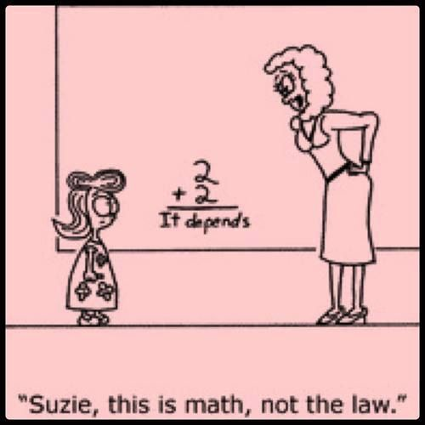
Disclaimer
I am not a lawyer.
Anything I say today does not represent sound legal knowledge.

Slide 3
Citation
Hays, R. D., Weech-Maldonado, R., Teresi, J. A., Wallace, S. P., & Stewart, A. L. (2017 epub). Commentary: Copyright restrictions versus open access to survey instruments. Medical Care.
Supported in part through the National Institute on Aging’s Resource Centers on Minority Aging Research (RCMAR) (P30-AG021684, P30-AG031054, and P30-AG15272).
We benefited from discussions with Arie Kapteyn (USC), Dan Mungas (UC Davis), Steve Schwartz (U Wash), and Tom Templin (Wayne State).

Slide 4

“original works of authorship including literary, dramatic, musical, and artistic works, such as poetry, novels, movies, songs, computer software, and architecture.”
https://www.copyright.gov/help/faq/faq-protect.html
“Any new intellectual work is under copyright protection automatically from the moment it is fixed in a tangible medium of expression.”
- Newman & Feldman (2011, NEJM, p. 2448)

Slide 5
Copyright Infringement
“is the use of works protected by copyright law without permission, infringing certain exclusive rights granted to the copyright holder.”
https://en.wikipedia.org/wiki/Copyright_infringement

Slide 6
There is Tension Between Different
Levels of Restriction
Incremental advance of science requires building on past studies.
Ability to use and modify existing measures is essential.
  Health disparities research often required modification of existing measures to ensure it is useful for subgroups of the population or in a different culture.

Slide 7
Use of a Survey Instrument Can be Unrestricted
https://www.rand.org/health/surveys_tools.html
All of the surveys from RAND Health are public documents, available without charge. Please provide an appropriate citation when using these products….
There are no further permissions necessary.

Slide 8
Samples of Permissions and Citations
This survey was reprinted with permission from the RAND Corporation. Copyright © the RAND Corporation. RAND's permission to reproduce the survey is not an endorsement of the products, services, or other uses in which the survey appears or is applied.
2. [Survey name] is reproduced here (in part or in its entirety) with permission from the RAND Corporation. Copyright © the RAND Corporation. RAND's permission to reproduce the survey is not an endorsement of the products, services, or other uses in which the survey appears or is applied.
3. This translation is based on [survey name], developed and owned by the RAND Corporation, copyright © RAND. Although permission to translate the survey was granted by RAND, the translation itself has not been approved or reviewed by RAND. RAND's permission to reproduce the survey is not an endorsement of the products, services, or other uses in which the survey appears or is applied.
4. Hays, RD (1994). The Medical Outcomes Study (MOS) Measures of Patient Adherence. Retrieved April 19, 2004, from the RAND Corporation web site: http://www.rand.org/health/surveys/MOS.adherence.measures.pdf.

Slide 9
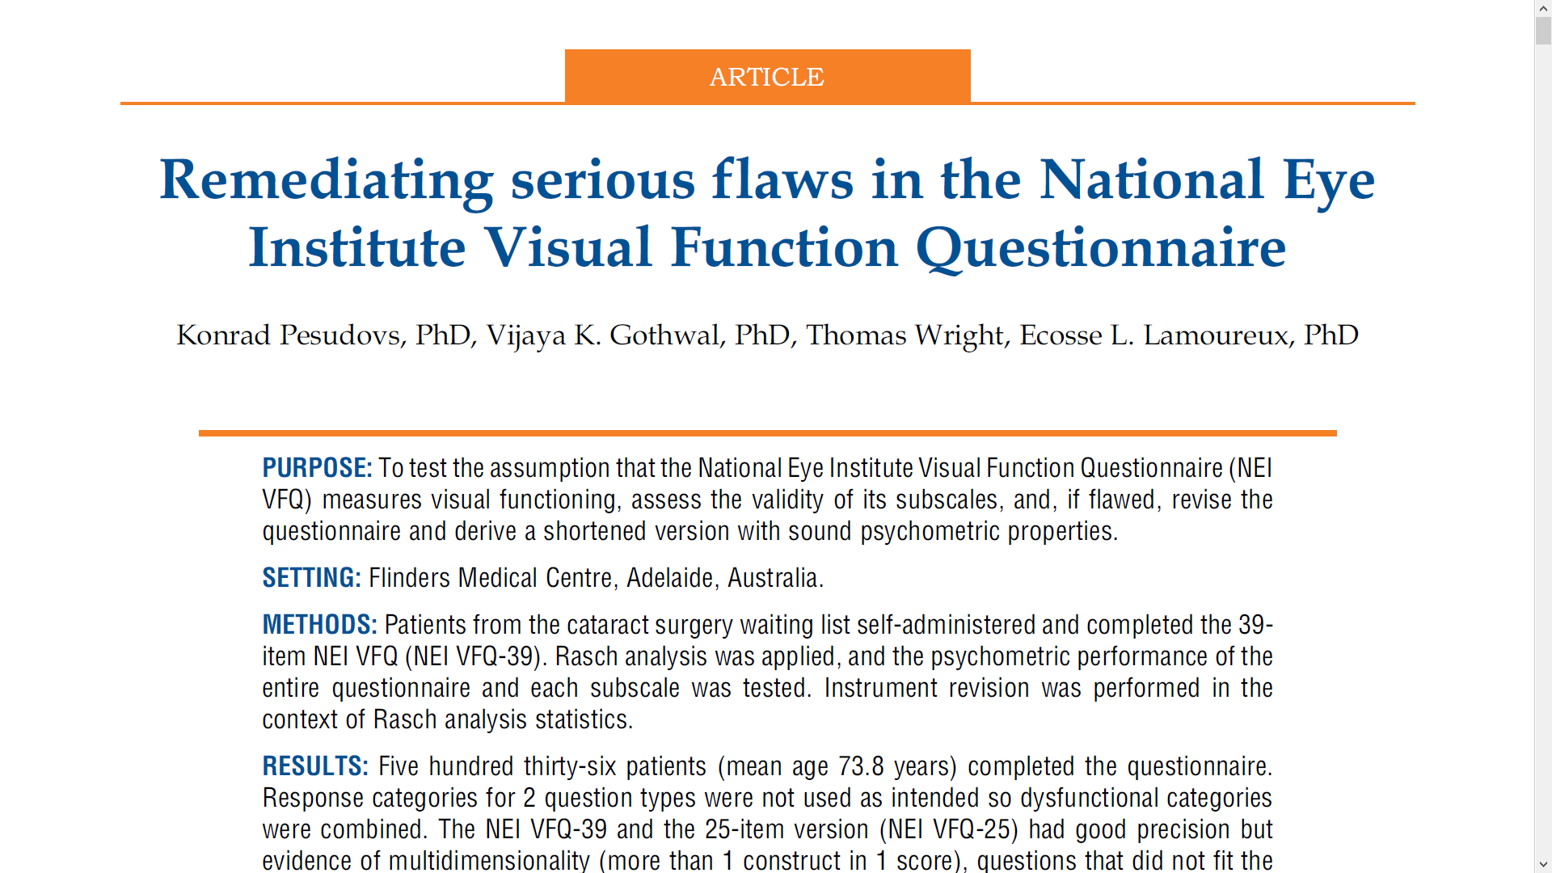

Slide 10
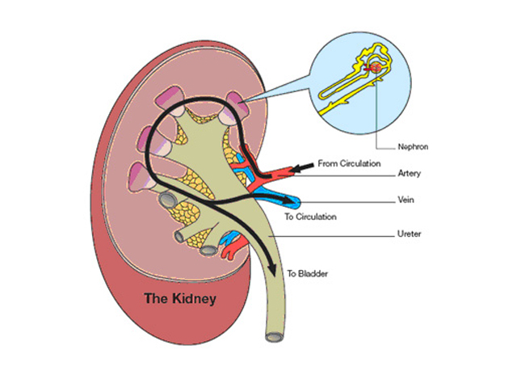
Registration Required to Use
Kidney Disease Quality of Life Instrument
http://gim.med.ucla.edu/kdqol/kdqol_register.php

Slide 11
Permission Required to Modify
“One should never change a precision questionnaire in any way without the developer’s permission. Even very small changes can destroy validity.” (Juniper, 2009, Chest, p. 951)
“User agrees not to adapt, alter, amend, abridge, modify, condense, make derivative works, or translate HealthMeasures instruments without prior written permission from the (Department of Medical Social Sciences). In cases where permission is granted, user will be expected to evaluate the impact of approved modifications.”

Slide 12

Restrictions on Showing Survey
A doctoral student who complied with all the survey licensing requirements was not allowed to share her instrument with her dissertation committee or provide survey item examples in her dissertation.

Slide 13
Fees: Licensing and/or Scoring
Health Utilities Index (HUI)
  http://www.healthutilities.com/fees.htm
Mini Mental Status Exam
  Exclusive rights transferred to Psychological Assessment Resources in 2001
  $1.48/administration
Patient Activation Measure (PAM)

Slide 14
In an effort to continually improve our collective knowledge about activation, Insignia Health offers a special research license to healthcare researchers for PAM or a related activation survey (Parent-PAM, Caregiver PAM or CS-PAM*). To qualify for one these licenses, the researcher and the study must meet certain minimum requirements:
The study is sufficiently funded, but not by a pharmaceutical company, health plan or other entity intending to develop or validate another measurement of activation, engagement or self-management.
The study will have at least 75 unique participants.
The researcher or institution intends to publish the study results in an academic journal or professional publication.
The principal researcher(s) or the sponsoring institution will share the entire de-identified data set and any related materials with Insignia Health at the conclusion of the study, whether or not the results are published.
The study will not use PAM or related survey to validate another measurement of activation, engagement, self-management or similar construct, or to validate another commercial/proprietary health intervention.
If your study meets these parameters, please proceed to our Research License service center for more information and to apply for a PAM-only research license. A $75 non-refundable application fee is required, payable by credit card only.
https://www.insigniahealth.com/research/research-licenses

Slide 15


One Doesn’t Need to Look far to See Consequences of
Copyright Infringement
Morisky Medication Adherence Scale

Slide 16
Dear Ron,
… because of what has happened before, I am very concerned about dealing with anyone from the UCLA.
What I can say here is, as a second year (full-time) PhD student, I was very scared and depressed due to that issue and had to withdraw my first research paper, making substantial changes in my project after more than one year of collecting data.
After all that, they still insisted >$5000 needed to be paid and the agreement (retroactive license) be signed or legal action would be taken against us.

Slide 17
Pay up or retract? Survey creator’s demands for money rile some health researchers
“Last June, a health care researcher in the United States was clearing out her email when she came across a message that looked like spam....
The message concerned an abstract that the researcher and two colleagues had published in a journal just days before. It asked whether the researchers had obtained a license for a copyrighted questionnaire … that they’d used in the study….
The researcher, then a graduate student, says she had contacted the scale’s author …for permission to use the tool. She never heard back. Now … demanding $6500 for its use….she couldn’t afford that, but offered $200….Unfortunately, we can’t reduce the fees. … We will turn this case over to our lawyer.”

Slide 18

Recommendations for Researchers
Determine if explicit permission and/or fees are required for use of a survey measure.
Obtain permission and know conditions of use.
If unsuccessful in reaching the copyright holder, use of measure is at your own risk.
Note: Some journals (e.g., Medical Care) now require proof that permission was obtained for use of measures.

Slide 19
SF-36
Stewart, A. L., Sherbourne, C. D., Hays, R. D., Wells, K. B., Nelson, E. C., Kamberg, C. J., Rogers, W. H., Berry, S. D., & Ware, J. E. (1992). Summary and discussion of MOS measures. Measuring functioning and well-being: The Medical Outcomes Study approach. Duke University Press.
“The MOS options for those requiring extremely brief surveys are reported here. A 36-item short form (SF-36) has also been constructed” (p. 349).
---------------
Ware and Sherbourne (1992): “A 36-item short-form (SF-36) was constructed to survey health status in the Medical Outcomes Study.”

Slide 20

Who owns the Copyright?
RAND
QualityMetric/Optum.com
Paul Elwood’s group
Medical Outcomes Trust
Health Outcomes Institute
Psychological Corporation

Slide 21
Suggestions for Researchers
Use instruments without undue restrictions whenever possible.
Use instruments for which there are no fees or at least reasonable fees.
Pay fees only if the cost is worth it (e.g., alternative measures have deficiencies).
Demand and market value with decrease for costly measures.

Slide 22

Recommendation to Funders
NIH (and potentially other) funding agencies should require that measures developed with their funding be:
  Made available to the research community without fees.
  Posted on a publicly available website.

Slide 23

Authors can document conditions of use via:
  https://creativecommons.org/share-your-work/
“free, easy-to-use copyright licenses to make a simple and standardized way to give the public permission to share and use your creative work–on conditions of your choice.”
“Copyleft” encourages innovation and access while protecting authors’ rights.

Slide 25

Thank you.
http://retractionwatch.com/2017/01/26/use-research-tool-without-permission-youll-hear/
http://www.sciencemag.org/news/2017/09/pay-or-retract-survey-creators-demands-money-rile-some-health-researchers

