Slide 1
Ron D. Hays, Ph.D.
UCLA GIM & HSR
November 22, 2023 (12-1 pm)
drhays@ucla.edu
^
Self-Rated
https://labs.dgsom.ucla.edu/hays/pages/presentations
Notes:
This PowerPoint file is available at the link shown at the bottom. Throughout the presentation, I refer to authors of published work. If their full citation is not shown on the slide, it appears in the bibliography at the end of the file.

Slide 2
Disclosures
Ron D. Hays declares no conflicts of interest..
Funding supporting the work described included:
Unrestricted research grant from The Medical Quality Commission.
National Institute of Aging (AG20679-01).
PROMIS Cooperative Agreement (U01AR52177)
Resource Center for Minority Aging Research (P30AG021684)
National Center for Complementary and Integrative Health (R01AT010402)

Slide 3
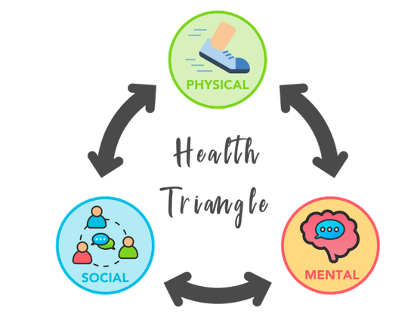
Patient-reported Outcome Measures
Patient reports about
Functioning and well-being in physical, mental, and social health domains
Health-related quality of life

Slide 4
Confirmatory Factor Analysis of Patient-Reported Outcomes Measurement Information System (PROMIS®)
.46
.84
.86
.68
.68
.81
.93
.47
.83
.90
0.57
0.68
0.67
Carle et al. (2015)
Notes:
n = 6988 from the field test data to create the state-of-the-science HRQOL measures (PROMIS). A CFA of 9 PROMIS scales representing physical, mental and social health showed that the model fit the data: RMSEA = 0.08 and CFI = 0.97. Fatigue was found to load on both physical and mental health factors. The social health factor correlated equally with physical and mental health.

Slide 5
Physical and Mental Health Dimensions
Correlations of 0.60 and larger between physical and mental health factors have been consistently found.
Physical
Health
Mental
Health
Hays & Stewart (1990); Essink-Bot et al. (1997); Hays et al. (2018)
Notes:
However, a separate social health factor has rarely been found. Several studies have only found support for positively correlated physical and mental health factors.

Slide 6
SF-36
“Physical Health” scales
Physical function
Role-Physical
Bodily pain
General health perceptions
“Mental Health” scales
Mental health (emotional well-being)
Role-Emotional
Energy
Social function
Notes:
The SF-36 HRQOL measure was produced from the RAND Medical Outcomes Study in the 1980s. Although the PROMIS instruments are overtaking it, the SF-36 was the most widely used measure of HRQOL until recently. It consists of 8 multi-item scales. Four of the scales represent physical health more than mental health, and the other four scales represent mental health more than physical health.

Slide 7
Even though physical and mental health are positively correlated
Notes:
PCS = physical component summary score, and MCS = mental component summary score. To fit the model that forced physical and mental health to be uncorrelated, better mental health scale scores reduce the physical component summary score, but better physical health scale scores drive down the mental component summary score.

Slide 8
536 Primary Care Patients
Initiating Antidepressant Treatment
3-month improvements in “Physical Health” measures
Physical functioning, role—physical, pain, general health perceptions)
of 0.28 to 0.49 SDs.
SF-36 Physical Component Summary Score (PCS) did not improve because worse scores for “Mental Health” measures
Mental health, role—emotional, energy, social function.
Simon et al. (1998)
Notes:
Because of the way scale scores are weighted, the physical and mental health summary scores do not accurately represent—and can be inconsistent with--the scale scores.

Slide 9
194 adults with Multiple Sclerosis
Lower scores than the general population on “Mental health” measures:
Mental health (↓ 0.3 SD, small effect size)
Role—emotional (↓ 0.7 SD, medium effect size)
Energy (↓1.0 SD, large effect size)
Social functioning (↓1.0 SD, large effect size)
SF-36 Mental Component Summary Score (MCS) was only 0.2 SD lower because scores were even worse for “Physical health” measures
physical functioning, role—physical, pain, general health perceptions.
Nortvedt et al. (2000)

Slide 10
Farivar et al.(2007) weights
(Correlated Factor Model)
PCS_z = (PF_z * .20) + (RP_z * .31) + (BP_z * .23) +
(GH_z * .20) + (EF_z * .13) + (SF_z * .11) +
(RE_z * .03) + (EW_z * -.03)
MCS_z = (PF_z * -.02) + (RP_z * .03) + (BP_z * .04) +
(GH_z * .10) + (EF_z * .29) + (SF_z * .14) +
(RE_z * .20) + (EW_z * .35)
Notes:
7,093 patients (59% response rate) who received medical care in the mid 1990’s from an independent association of 48 physician groups, the Unified Medical Group Association (UMGA) located in the western United States.

Slide 11
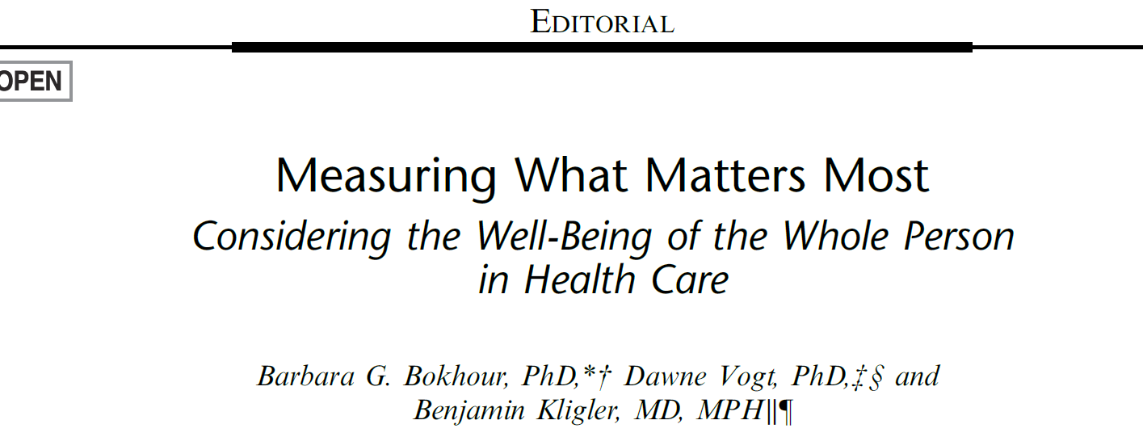
Med Care, December 2024 vol. 62 (12) Supplement
Notes:
A Medical Care supplement was just published on Whole-Person outcomes and measurement and how healthcare systems can improve care delivery and patient health by addressing not only disease but also what matters most to patients.

Slide 12
Whole Person Health Definitions
Moving from what’s the matter with you to what matters to you and embracing the notion that engaging with the whole person, not just the physical body but the emotional, mental, and spiritual aspects is critical to healing.
Veteran’s Health Administration

Slide 13
Whole Person Health Definitions
supporting the health and well-being of each person across multiple domains—biological, behavioral, social, and environmental.
National Center for Complementary and Integrative Health (NCCIH)

Slide 14
Whole Person Health Definitions
Whole health is physical, behavioral, spiritual, and socioeconomic wellbeing as defined by individuals, families, and communities.
National Academies’ Committee on Transforming Health Care

Slide 15
Self-Rated Health = Functioning and Well-Being
1992
Wells, K. B., Stewart, A. L., Hays, R. D., Burnam, M. A., Rogers, W., Daniels, M., Berry, S., Greenfield, S., & Ware, J. E. (1989). The functioning and well-being of depressed patients: Results from the Medical Outcomes Study. Journal of the American Medical Association, 262, 914-919
Stewart, A. L., Greenfield, S., Hays, R. D., Wells, K., Rogers, W. H., Berry, S. D., McGlynn, E. A. & Ware, J. E. (1989). Functional status and well-being of patients with chronic conditions: Results from the Medical Outcomes Study. Journal of the American Medical Association, 262, 907-913
Stewart, A. L., Sherbourne, C. D., Wells, K. B., Burnam, M. A., Rogers, W. H., Hays, R. D., & Ware, J. E. (1993). Do depressed patients in different treatment settings have different levels of well-being and functioning? Journal of Consulting and Clinical Psychology, 61, 849-857.
Stewart, A. L., Hays, R. D., Wells, K. B., Rogers, W. H., Spritzer, K. L., & Greenfield, S. (1994). Long-term functioning and well-being outcomes associated with physical activity and exercise in patients with chronic conditions in the Medical Outcomes Study. Journal of Clinical Epidemiology, 47, 719-730.
Hays, R. D., Wells, K.B., Sherbourne, C. B., Rogers, W. H., & Spritzer, K. (1995). Functioning and well-being outcomes of patients with depression compared to chronic general medical illness. Archives of General Psychiatry, 52, 11-19.
Notes:
The MOS where the SF-36 was created was about measuring functional and well-being. These words appear in the MOS book and in several publications in the 1980s and 1990s.

Slide 16
Hedonic or Experienced
Emotional states or mood over a short time.
“Did you experience anger during a lot of the day yesterday?”
Eudemonic
Perceived purpose and fulfillment
“Is your life worthwhile?”
Evaluative
- Overall appraisal of one’s life
- “How satisfied are you with your life?”
- “How would you rate your quality of life?”
Notes:
The International Society for Quality-of-Life Studies is an organization that focuses on measuring well-being. It is divided into three groups, summarized here. Note that they seem to have much less interest in physical health. I presented a paper at their annual meeting in October 2015 on physical functioning among Medicare beneficiaries in Phoenix.

Slide 17
L.D. Bjørndal, R.B. Nes, N. Czajkowski, E. Røysamb. The structure of well-being: a single underlying factor with genetic and environmental influences. Qual Life Res 32, 2805-2816.
Notes:
The article of the year for 2023 in Quality of Life Research journal found support for a single underlying higher-order well-being factor based on several measures of well-being.

Slide 18
Wilson and Cleary (1995)
Notes:
A major article published in JAMA 30 years ago and cited 8k times presented a conceptual model linking clinical variables with health-related quality of life.

Slide 19
Wilson and Cleary (1995)
Evaluative well-being

Slide 20
Spiro and Bossé (2000)
“For decades, social scientists have observed significant relations between self-reported health status and subjective wellbeing.…well-being and health-related quality of life overlap (p. 299).
Relations between health-related quality of life and well-being: The gerontologist’s new clothes? International Journal of Aging and Human Development, 50, 297-318.

Slide 21
Vickrey et al. (1995) Multiple Sclerosis Quality of Life Measure
Notes:
A study by Barbara Vickrey of 179 adults with a diagnosis of definite multiple sclerosis (MS) showed that evaluative well-being loading substantially on a mental health factor and significantly on a physical health factor.
[Confirmed by experts in MS based on an evaluation at UCLA over the preceding 2-year period.]

Slide 22
Overall Rating of Quality of Life Regressed on PROMIS global health and EQ-5D-3L items in PROMIS Sample 1 (Adjusted R² = 0.69)
 | Standardized Beta | t-statistic | p-value | Zero order correlation*
Satisfaction with social activities and relationships | 0.27 | 36.34 | <0.0001 | 0.68
Physical health | 0.20 | 16.98 | <0.0001 | 0.70
General health | 0.18 | 15.07 | <0.0001 | 0.69
Mental health | 0.17 | 20.34 | <0.0001 | 0.64
Perform social activities and roles | 0.12 | 14.50 | <0.0001 | 0.67
Usual activities (EQ-5D-3L) | 0.04 | 5.36 | <0.0001 | 0.50
Physical functioning | 0.03 | 3.19 | 0.0014 | 0.50
Pain | 0.02 | 2.69 | 0.0072 | 0.44
Self-care (EQ-5D-3L) | 0.01 | 2.67 | 0.0077 | 0.29
Emotional problems | 0.01 | 0.90 | 0.3701 | 0.48
Mobility (EQ-5D-3L) | 0.01 | 0.84 | 0.6807 | 0.40
Pain/discomfort (EQ-5D-3L) | 0.00 | 0.48 | 0.6298 | 0.42
Anxiety/depression (EQ-5D-3L) | 0.00 | 0.19 | 0.8507 | 0.46
Fatigue | -0.01 | -1.76 | 0.0789 | 0.50
Palimaru & Hays (2017)
Notes:
One of Alina Palimaru’s dissertation papers analyzed data from n = 21,133 adults from clinical sites and YouGovPolimetrix’s internet panel used in the initial evaluation of Patient Reported Outcomes Measurement Information System (PROMIS) measures. She regressed an evaluative well-being item on PROMIS global health items and the 5 items in the EQ-5D-3L, another HRQOL measure.

Slide 23
Overall Rating of Quality of Life regressed on PROMIS global health items and HUI3 utility score in PROMIS Sample 2 (Adjusted R² = 0.75)
 | Standardized Beta | t-statistic | p-value | Zero order correlation*
Physical health | 0.39 | 22.04 | <.0001 | 0.82
General health | 0.27 | 16.45 | <.0001 | 0.79
Mental health | 0.11 | 7.94 | <.0001 | 0.66
Satisfaction with social activities and relationships | 0.09 | 6.01 | <.0001 | 0.64
Perform social activities and roles | 0.06 | 4.37 | <.0001 | 0.62
Physical functioning | 0.03 | 2.58 | 0.0101 | 0.56
HUI-3 | 0.03 | 2.19 | 0.0287 | 0.48
Pain | 0.01 | 0.64 | 0.5235 | 0.36
Fatigue | 0.01 | 0.93 | 0.3504 | 0.48
Emotional problems | 0.00 | -0.33 | 0.7437 | 0.39
* All p’s < 0.0001
Notes:
In the same paper she analyzed data from a sample of 2996 Op4G internet panel members that regressed the evaluative well-being item on the PROMIS global health items and the health utilities index single score.

Slide 24
Self-reported Health Scoring Options
Multiple Scores (Profile)
Physical and Mental Health Summary Scores
Single Score
Preference-based score
HUI-3, EQ-5D-5L,SF-6D, PROPr
SF-36 total score (Lins & Carvalho, 2016)
(0 = dead, 1 = “perfect health”

Slide 25
Single summary self-reported health score
CDC Behavioral Risk Factor Surveillance System items
Would you say that in general your health is excellent, very good, good, fair, or poor?
During the past 30 days, for about how many days did poor physical or mental health keep you from doing your usual activities, such as self-care, work, or recreation?
Now thinking about your physical health, which includes physical illness and injury, for how many days during the past 30 days was your physical health not good?
Now thinking about your mental health, which includes stress, depression, and problems with emotions, for how many days during the past 30 days was your mental health not good?
Yin, S., Njai, R., Barker, L., Siegel, P. Z., & Liao, Y. (2016)

Slide 26
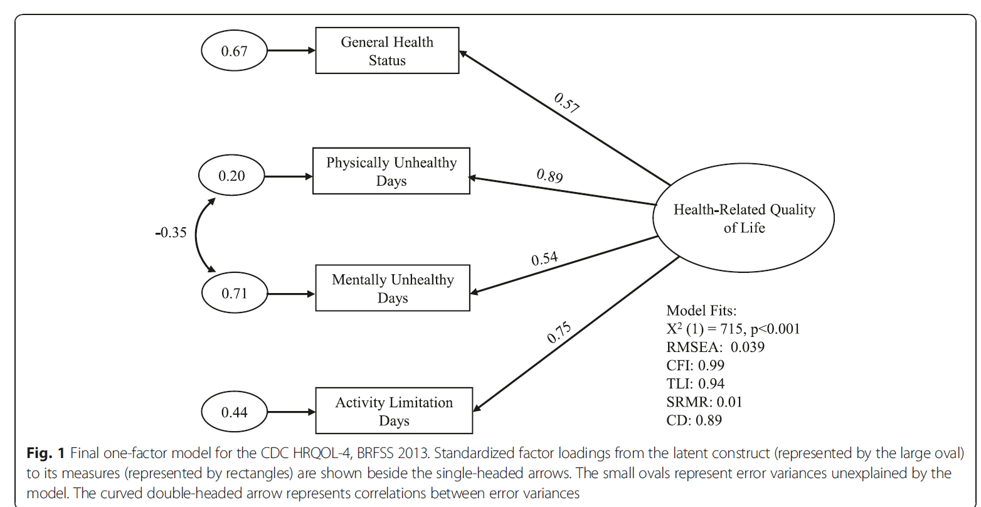
Notes:
They found support for a single underlying factor and recommended using this score to monitor population trends. However, whether a single factor would be supported for more comprehensive self-reported health measures was unclear.

Slide 27
Measures (50 items)
PROMIS®-29+2
Physical function (4 items)
Pain interference (4 items)
Pain intensity (1 item)
Fatigue (4 items)
Depressive symptoms (4 items)
Anxiety (4 items)
Sleep disturbance (4 items)
Ability to participate in social roles and activities (4 items)
Cognitive function (2 items)
PROMIS social isolation (4 items)
Personal well-being index (10 items)
EQ-5D-5L (5 items)
Hays, Rodriguez et al (2024)
Notes:
We extended the work of Yin et al (2016).

Slide 28
Personal Well-Being Index
How satisfied are you with:
1) Your standard of living?
2) Your health?
3) What you are achieving in life?
4) Your personal relationships?
5) How safe you feel?
6) Feeling part of your community?
7) Your future security?
8) Your spirituality or religion?
9) Overall, how satisfied are you with your life as a whole these days?”
0= Not satisfied at all, 10 = Completely satisfied
10) Overall, to what extent do you feel the things you do in your life are worthwhile?”
0 = Not at all worthwhile, 10 = Completely worthwhile
International Wellbeing Group. (2013). Personal wellbeing index (5th ed.). Australian Centre on Quality of Life, Deakin University.

Slide 29
EQ-5D-5L (5⁵= 3,125 states, -0.573 to 1.00)
Mobility
Self-care
Usual activities
Pain/discomfort
Anxiety/depression
e.g., No problems; slight problems; moderate problems; severe problems; unable

Slide 30
KnowledgePanel® Sample (1256 adults with back pain)
Notes:
Probability-based internet panel: KnowledgePanel

Slide 31
7-item PWB index mean = 67 in the sample vs. 75 in the Australian gen. population.

Slide 32
Impact Stratification Score (ISS)
ISS Parts
PROMIS-29 physical function (4 items, 1-5)
PROMIS-29 pain interference (4 items, 1-5)
PROMIS-29 pain intensity (1 item, 0-10)
ISS Score
Higher is worse
Possible range: 8-50
Mild: 8-27
Moderate: 28-34
Severe: 35-50
Deyo, R. A., Dworkin, S. F., et al. (2014). Report of The NIH Task Force on research standards for
chronic low back pain. Spine, 39(14), 1128-1143.

Slide 34
ISS and 6 Other Pain Impact Measures
Standardized factor loadings on pain latent variable
0.782 (RMDQ) to 0.870 (ISS)
Graded Chronic Pain Scale (GCPS) disability score.
Oswestry Disability Index (ODI)
PEG (Pain intensity, interference with Enjoyment of life, interference with General activity)
Roland-Morris Disability Questionnaire (RMDQ)
Short form of the Orebro Musculoskeletal Pain Questionnaire (OMPQ)
Subgroups for Targeted Treatment (STarT) Back Tool
Hays, Herman et al. (2024)
Notes:
1,874 adults with back pain who were members of Amazon Mechanical Turk.

Slide 36
Measurement of Whole Person Health
Separate the “means” from the “ends”
Use whole person health (WPH) to represent the end goal or outcome—i.e., the thing (concept, construct) we want to improve and/or maintain: the whole person’s health.
Use whole person health determinants (WPHD) to represent what can be intervened upon to maximize WPH—i.e., the means.
Includes physical and mental health diagnoses and social determinants of health
Herman, P. M., Rodriquez, A., et al. (2024).

Slide 37
2025 NHIS Whole-Person Index
Would you say your health in general is excellent, very good, good, fair, or poor?
How would you rate your quality of life, focusing on what matters most to you?
How would you rate your social and family connections?
How would you rate your sleep?
How would you rate your ability to find meaning and purpose in your daily life?

Slide 38
2025 NHIS Whole-Person Index
Would you say your health in general is excellent, very good, good, fair, or poor?
How would you rate your quality of life, focusing on what matters most to you?
How would you rate your social and family connections?
How would you rate your sleep?
How would you rate your ability to find meaning and purpose in your daily life?
In general, how healthy is your overall diet?
How would you rate your physical activity, compared with people in your age group?
How would you rate your ability to manage stress?
How would you rate your ability to manage your health, focusing on aspects of your health that matter most to you?

Slide 39
Stephen Blumberg, Ph.D. Director, Div. Health Interview Statistics
“I don’t think it is so easy to separate WPH from WPH determinants. e.g., poor health can lead to sleep disturbances, but choices about sleep schedules and duration can lead to poor health. And I am not yet convinced that an index for WPH needs to be supported by evidence of a single underlying dimension.
CFA would hypothesize that one’s underlying health drives responses to the individual items on an index…. But if we were looking at physiological organ-systems functioning, and we measured the health of the heart, the lungs, the nerves, the bones, and the kidneys separately, they would be correlated, but what would the underlying factor be?
It would be more informative, perhaps, to know that one or more of the measures were diminished …, and to have an index score that reflects that.
Maybe a WPH index should look at the whole of all of the components in an integrative way, not just the pieces of those components that are related to an underlying global health factor.”
Notes:
Stephen Blumberg: “I don’t think it is so easy to separate WPH from WPH determinants. e.g., poor health can lead to sleep disturbances, but choices about sleep schedules and duration can lead to poor health. And I am not yet convinced that an index for WPH needs to be supported by evidence of a single underlying dimension. CFA would hypothesize that one’s underlying health drives responses to the individual items on an index, and that is the reason the individual items are correlated. But if we were looking at physiological organ-systems functioning, and we measured the health of the heart, the lungs, the nerves, the bones, and the kidneys separately, they would be correlated, but what would the underlying factor be? It would be more informative, perhaps, to know that one or more of the measures were diminished (out of balance, if you will, in Helene’s diagram of whole person physiological network changes), and to have an index score that reflects that. Maybe a WPH index should look at the whole of all of the components in an integrative way, not just the pieces of those components that are related to an underlying global health factor.

Slide 40
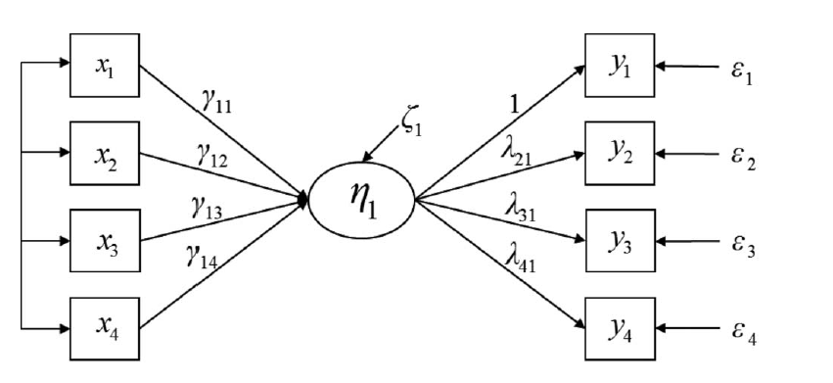
Formative (“causal”) versus Reflective (“effect”) indicators
Diet
PhActivity
Stress
Health
Health
Formative Indicators
Reflective Indicators
Bollen KA, & Diamantopoulos A. (2017). In defense of causal-formative indicators: A minority report. Psychol Methods,22(3):581-596.
Notes:
Causal-formative indicators have conceptual unity, and thus “it is sensible to view the indicator as
matching the idea embodied by the concept.” Composite–formative indicators do not have conceptual unity. They are used not to measure a scientific concept but to summarize the effects of several variables. Measurement is the process by which a concept is linked to one or more latent variables, and these are linked to observed variables.

Slide 41
Notes:
Whole person conceptual map will be built by a team of content experts using existing knowledge of healthy human physiology, linking all physiological systems into a whole. Once built, the whole person conceptual map will be used as a foundational tool to anchor and support the creation of data-driven whole person models.
Trans-NIH Program including 19 NIH Institutes, Center and Offices, the Center for Disease Control
and the US Department of Veterans Affairs

Slide 43
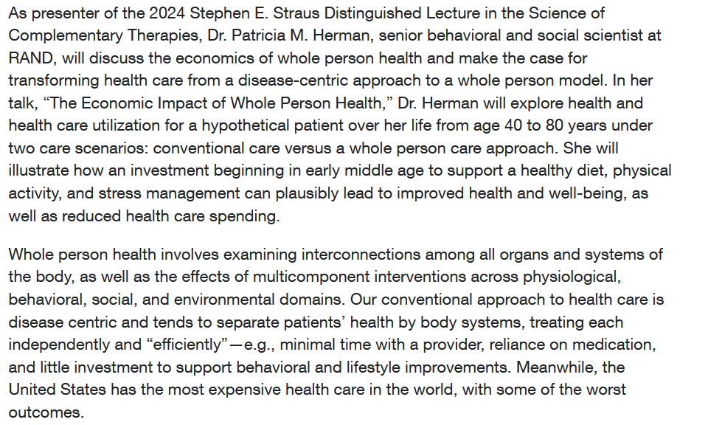
NCCIH December 2 2024 Event

Slide 44
Bibliography
Carle, A. C., Riley, W., Hays, R. D., & Cella, D. (2015). Confirmatory factor analysis of the patient reported outcomes measurement information system (PROMIS) adult domain framework using item response theory scores. Medical Care, 53, 894-900.
Essink-Bot, M. L., Krabbe, P. F., Bonsel, G. J., & Aaronson, N. K. (1997). An empirical comparison of four generic health status measures. The Nottingham health profile, the medical outcomes study 36-item short-form health survey, the COOP/WONCA charts, and the EuroQol instrument. Medical Care, 35(5), 522–537.
Farivar, S. S., Cunningham, W. E., & Hays, R. D. (2007). Correlated physical and mental health summary scores for the SF-36 and SF-12 health survey, V. 1. Health and Quality of Life Outcomes, 5: 54.
Hays, R.D., Herman, P.M., Qureshi, N., Rodriquez, A., & Edelen, M. O. (2024). How well do seven self-report measures represent underlying back pain impact? Pain Manag Nurs., 25(1): e1-e7.
Hays, R. D., Rodriguez, A., Qureshi, N., Zeng, C., & Edelen, M. O. (2024). Support for a single underlying dimension of self-reported health in a sample of adults with low back pain in the United States. Applied Research in Quality of Life., 19(5): 2213-2226. doi:10.1007/s11482-024-10327-8.
Hays, R. D., Spritzer, K. L., Schalet, B. D., & Cella, D. (2018). PROMS®-29 v2.0 profile physical and mental health summary scores. Quality of Life Research, 27 (7), 1885-1891
Hays, R. D., & Stewart, A. L. (1990). The structure of self-reported health in chronic disease patients. Psychological Assessment, 2(1), 22–30.
Herman, P. M., Rodriquez, A., Edelen, M. O., DiGuiseppi, G., Zeng, C., Coulter, I. D., & Hays, R. D. (2024). A perspective on the measurement of whole person health. Med Care., 62(12), S24-26.
Lins, L, & Carvalho FM. (2016). SF-36 total score as a single measure of health-related quality of life: Scoping review. SAGE Open Med.. 4:2050312116671725. .
Nortvedt M, Riise T, Myhr K, Nyland H. Performance of the SF-36, SF-12 and RAND-36 summary scales in a multiple sclerosis population. Med Care 2000; 38: 1022–8.
Palimaru, A., & Hays, R. D. (2017). Associations of health-related quality of life with overall quality of life in the Patient-Reported Outcomes Measurement Information System (PROMIS®) Project. Applied Research in Quality of Life, 12, 241-250.
Simon, G. E., Revicki, D. A., Grothaus, L., & Vonkorff, M. (1998). SF-36 summary scores: Are physical and mental health truly distinct? Med Care 36(4): 567-572.
Vickrey, B. G., Hays, R. D., Harooni, R., Myers, L. W., & Ellison, G. W. (1995). A health-related quality of life measure for multiple sclerosis. Quality of Life Research, 4, 187-206.
Ware, JE, Kosinski M, Keller SD. (1994). SF-36 Physical and mental health summary scales: A user’s manual. Boston, MA: The Health Institute: New England Medical Center.
Wilson IB, Cleary PD. (1995). Linking clinical variables with health-related quality of life. A conceptual model of patient outcomes. JAMA, 273(1):59-65.
Yin, S., Njai, R., Barker, L., Siegel, P. Z., & Liao, Y. (2016). Summarizing health-related quality of life (HRQOL): Development and testing of a one-factor model. Population Health Metrics, 14, 22.

Slide 45
Thank you..
Notes:
45

