Slide 1

Psychometric Methods:
Reliability and Validity
Ron D. Hays, Ph.D.
UC END DISPARITIES: Cardiometabolic disparities research
January 30, 2024 (1:00-2:00 pm)
https://uclahs.zoom.us/j/2707654943

Slide 2
Acknowledgements
Peipert, J. D., Bentler, P. M., Klicko, K., & Hays, R. D. (2018). Psychometric properties of the Kidney Disease Quality of Life 36-item short-form survey (KDQOLTM-36) in the United States. American Journal of Kidney Disease, 71 (4), 461-468.
Peipert, J. D., Bentler, P., Klicko, K., & Hays, R. D. (2018) Neglible impact of differential item functioning between black and white dialysis patients on the Kidney Disease Quality of Life 36-item short-form survey (KDQOLTM-36). Quality of Life Research, 27(10), 2699-2707.
Peipert, J. D., Nair, D., Klicko, K., Schatell, D., & Hays, R. D. (2019). Kidney Disease Quality of Life 36-item short form survey (KDQOL-36TM) normative values for the United States dialysis population and new single summary score. J Am Soc Nephrol., 30(4), 654-663.

Slide 3

KDQOL-36™ Survey
- Items 1-12: SF-12 (PCS and MCS)
- Items 13-16: Burden of kidney disease (k=4)
- Items 17-28: Symptoms/problems (k=12)
- Items 29-36: Effects of kidney disease (k=8)

Slide 4
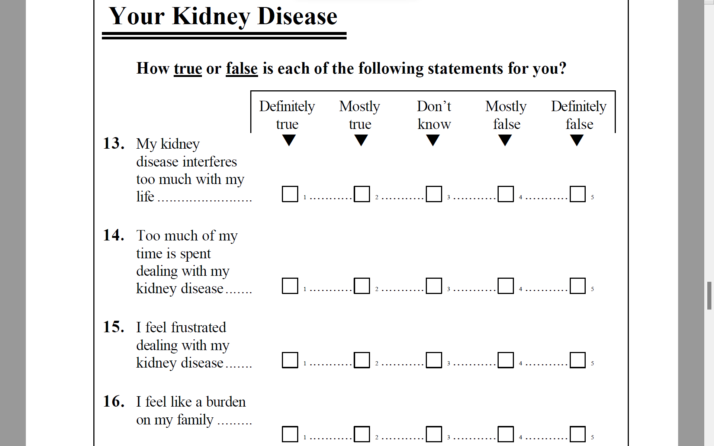

Slide 5
Data
KDQOL-36 administered by paper
June 1, 2015, through May 31, 2016.
n = 70,786 patients; 1,381 dialysis facilities
  Average of 51 patients per clinic
Medical Education Institute
  https://meiresearch.org/

Slide 6
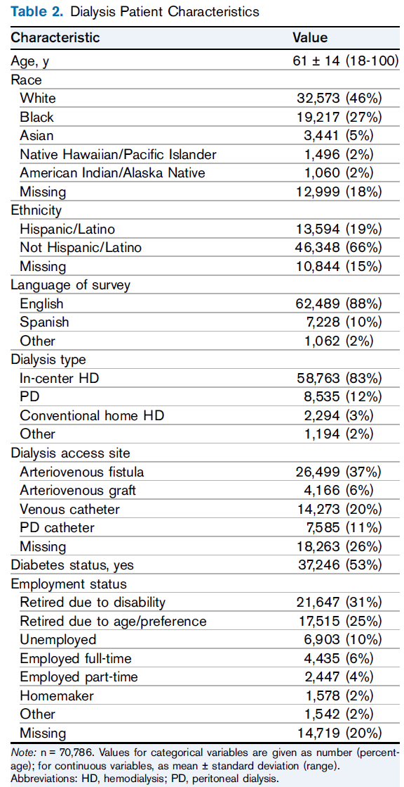






Slide 7
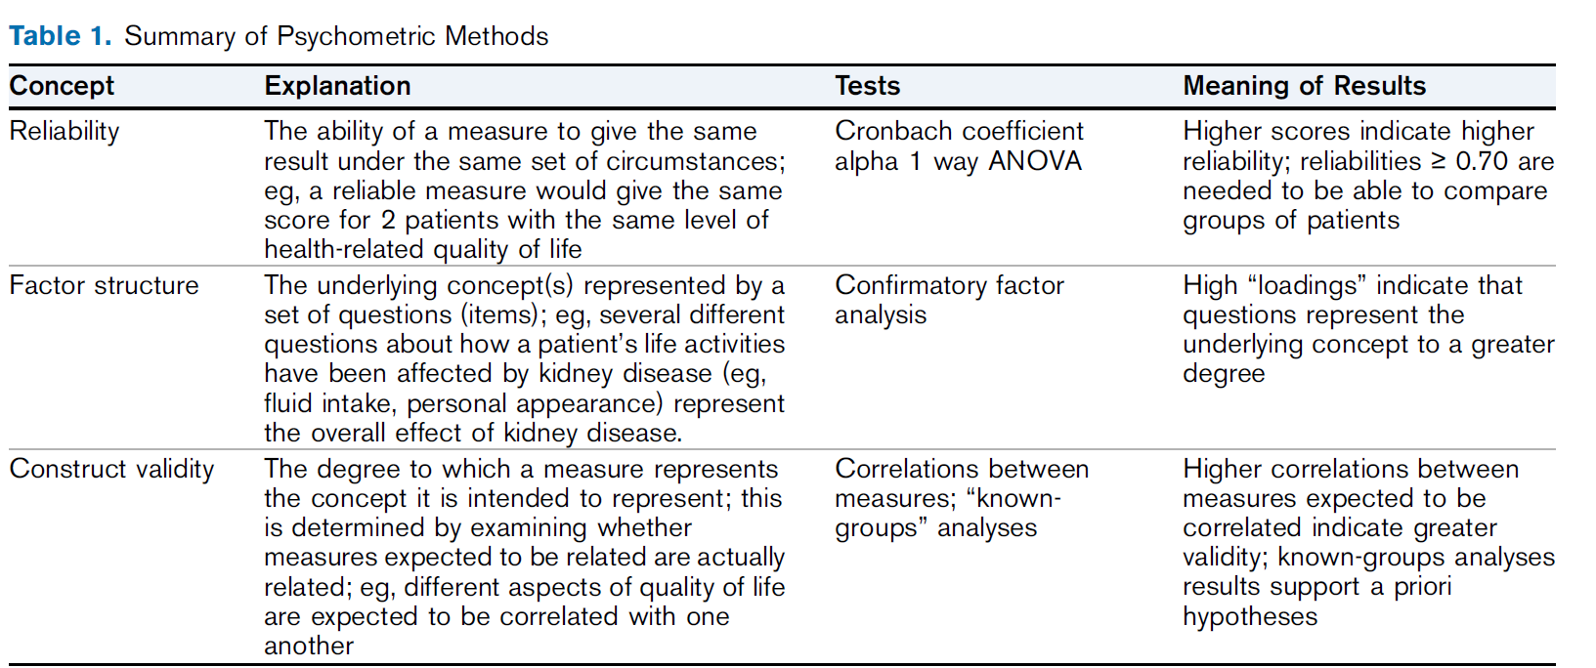

Slide 8


Reliability Formulas
Model
Reliability
Intraclass Correlation
Two-way random
Two-way mixed
One-way
BMS = Between Ratee Mean Square N = n of ratees
WMS = Within Mean Square k = n of items or raters
JMS = Item or Rater Mean Square
EMS = Ratee x Item (Rater) Mean Square
Notes:
8

Slide 9
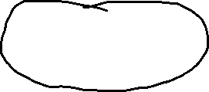
Center-Level Reliability
Model
Reliability
Intraclass Correlation
Two-way random
Two-way mixed
One-way
BMS = Between Ratee Mean Square N = n of ratees
WMS = Within Mean Square k = n of items or raters
JMS = Item or Rater Mean Square
EMS = Ratee x Item (Rater) Mean Square
Notes:
9

Slide 10
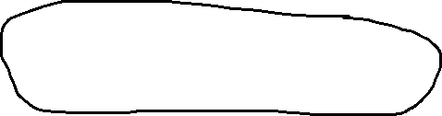
Test-Retest Reliability (n = 121, 1-21 days)
Model
Reliability
Intraclass Correlation
Two-way random
Two-way mixed
One-way
BMS = Between Ratee Mean Square N = n of ratees
WMS = Within Mean Square k = n of items or raters
JMS = Item or Rater Mean Square
EMS = Ratee x Item (Rater) Mean Square
Wave/Time point
Notes:
10

Slide 11
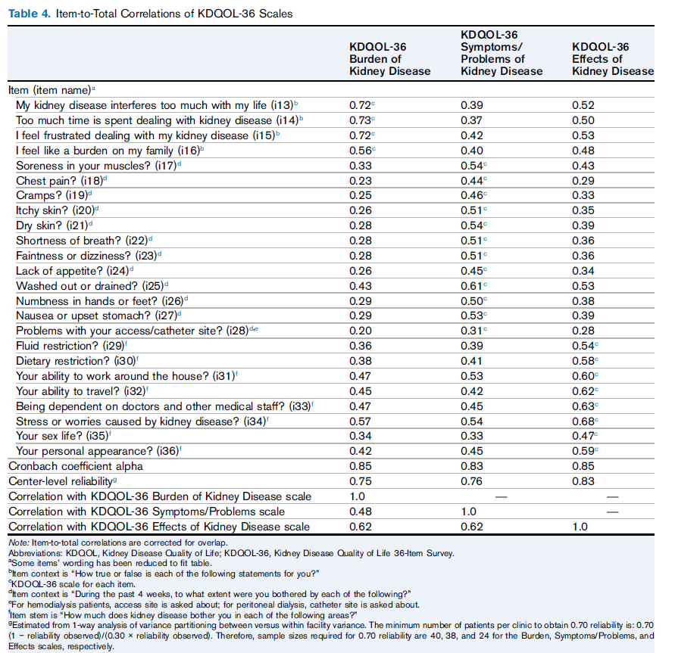
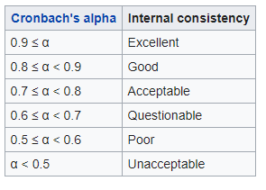












Slide 12












Slide 13
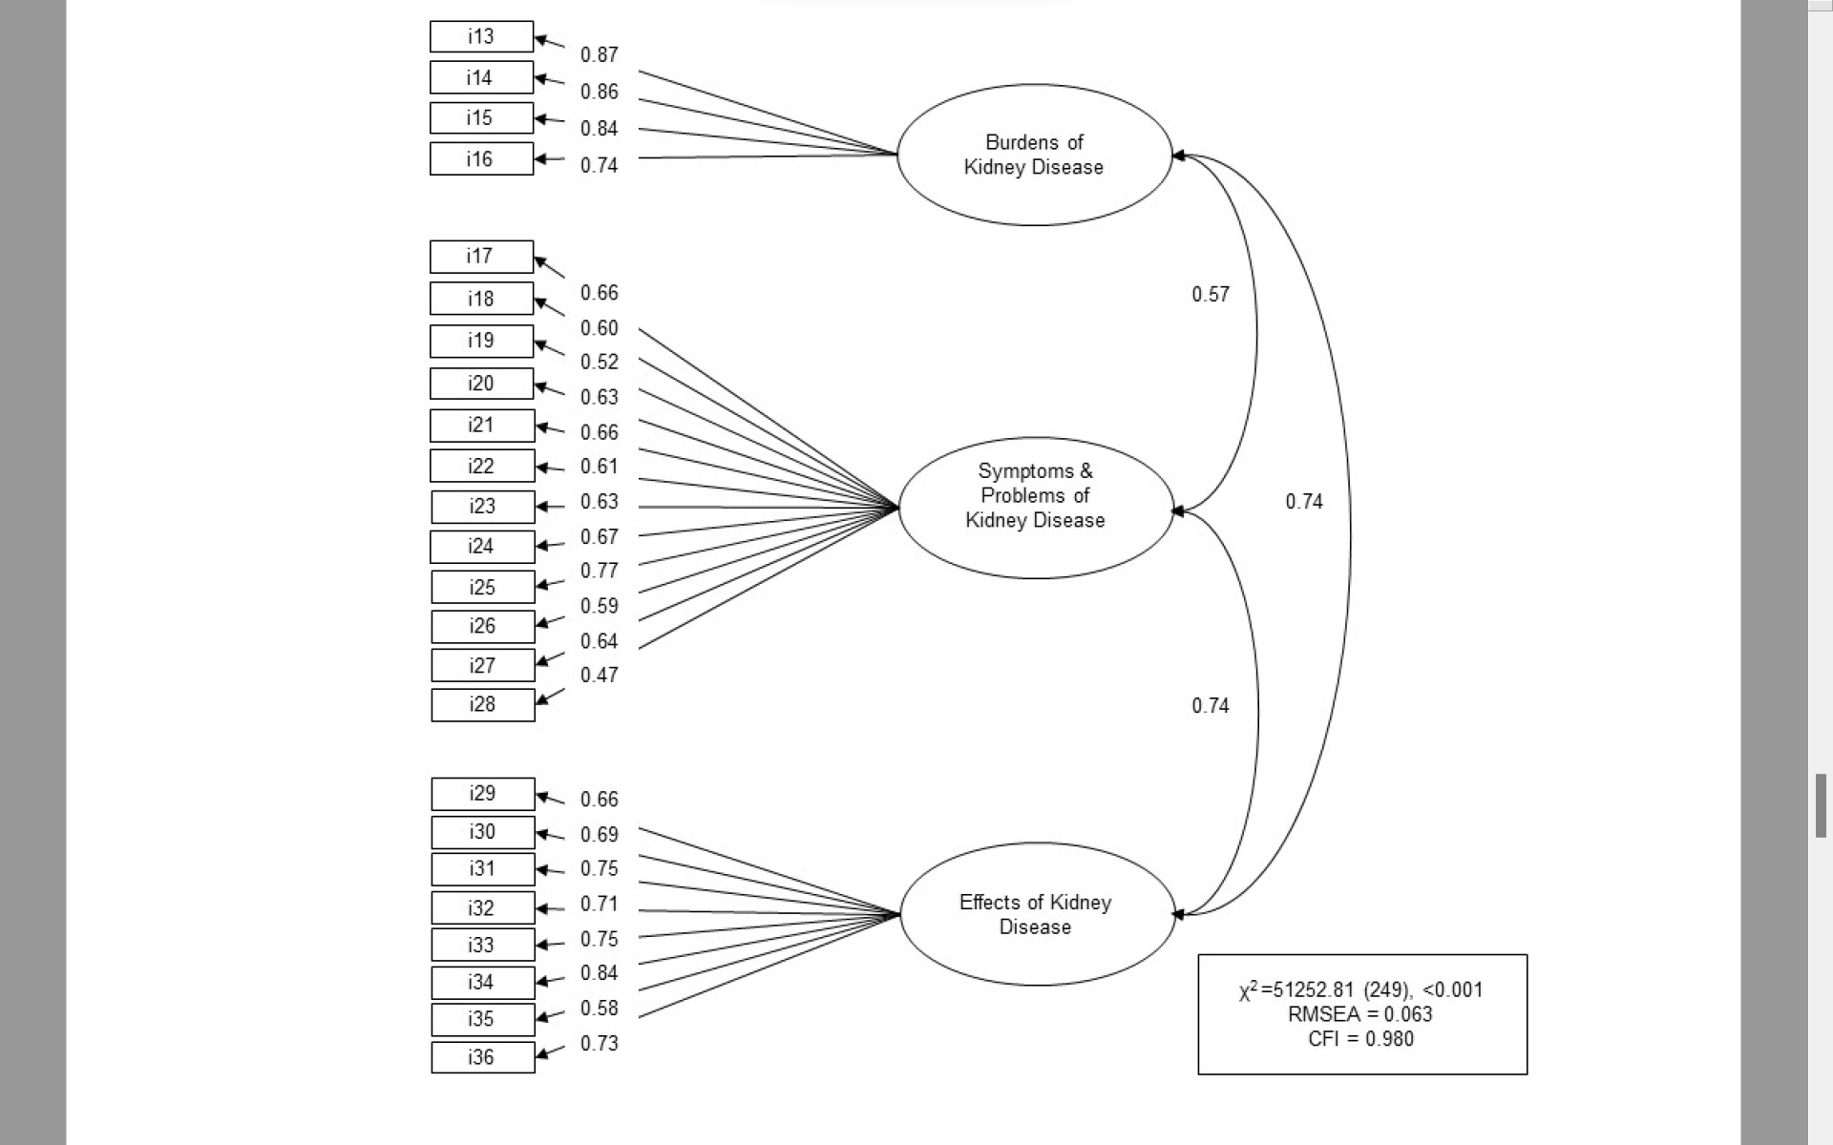

Slide 14
Confirmatory Factor Analysis
Fit Indices
2
2
χ - χ
  Normed fit index:
  Non-normed fit index:
  Comparative fit index:
null
model
χ
2
2
2
χ χ
null
null
-
model
df df
null
model
2
χ
null
-
1
df
null
2
χ - df
1 -
model
model
2
χ -
df
null
null
RMSEA = SQRT (λ² – df)/SQRT (df (N – 1))
CFI >=0.95 and RMSEA <=0.06
Notes:
14

Slide 15
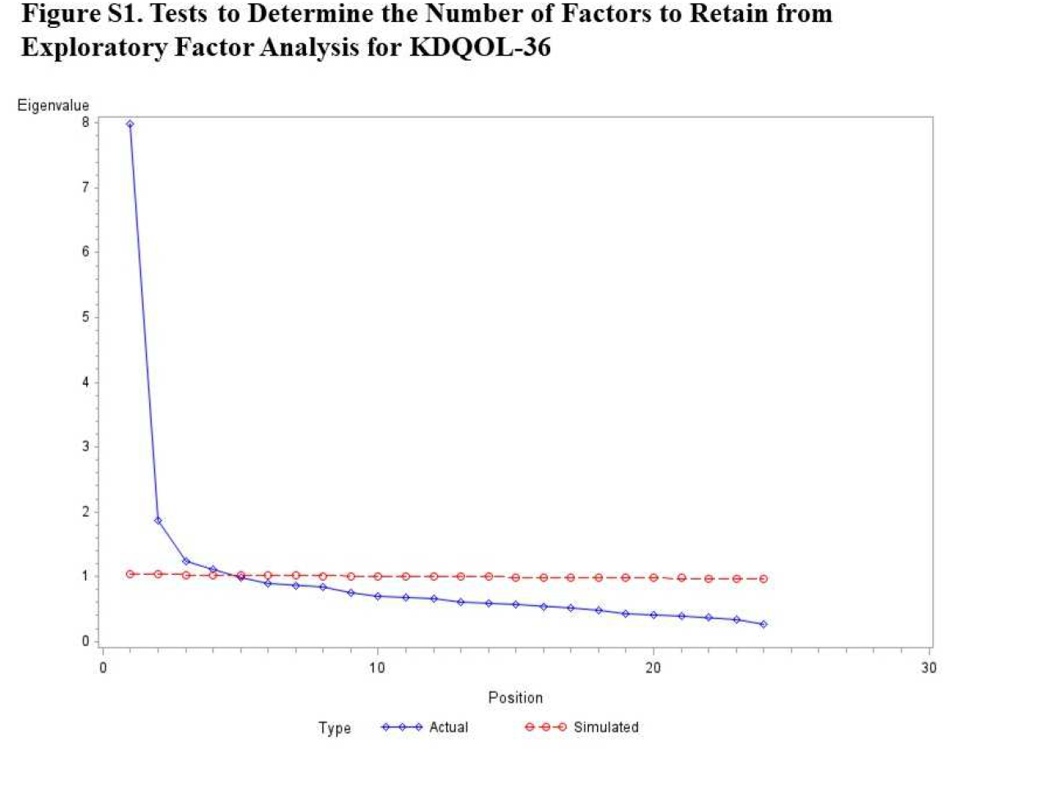

Slide 16
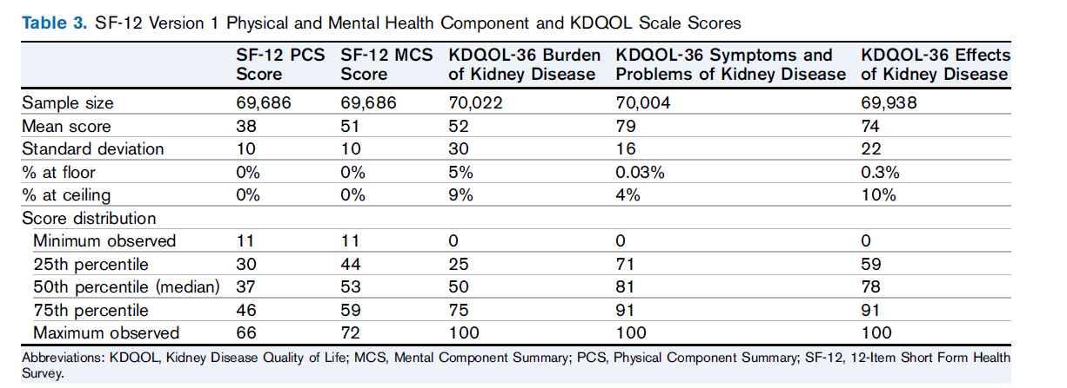




Slide 17
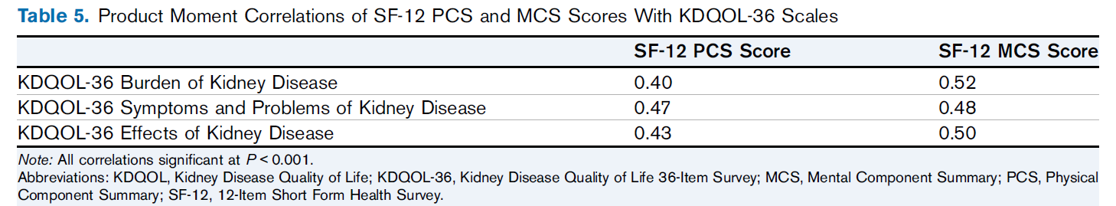

Slide 18
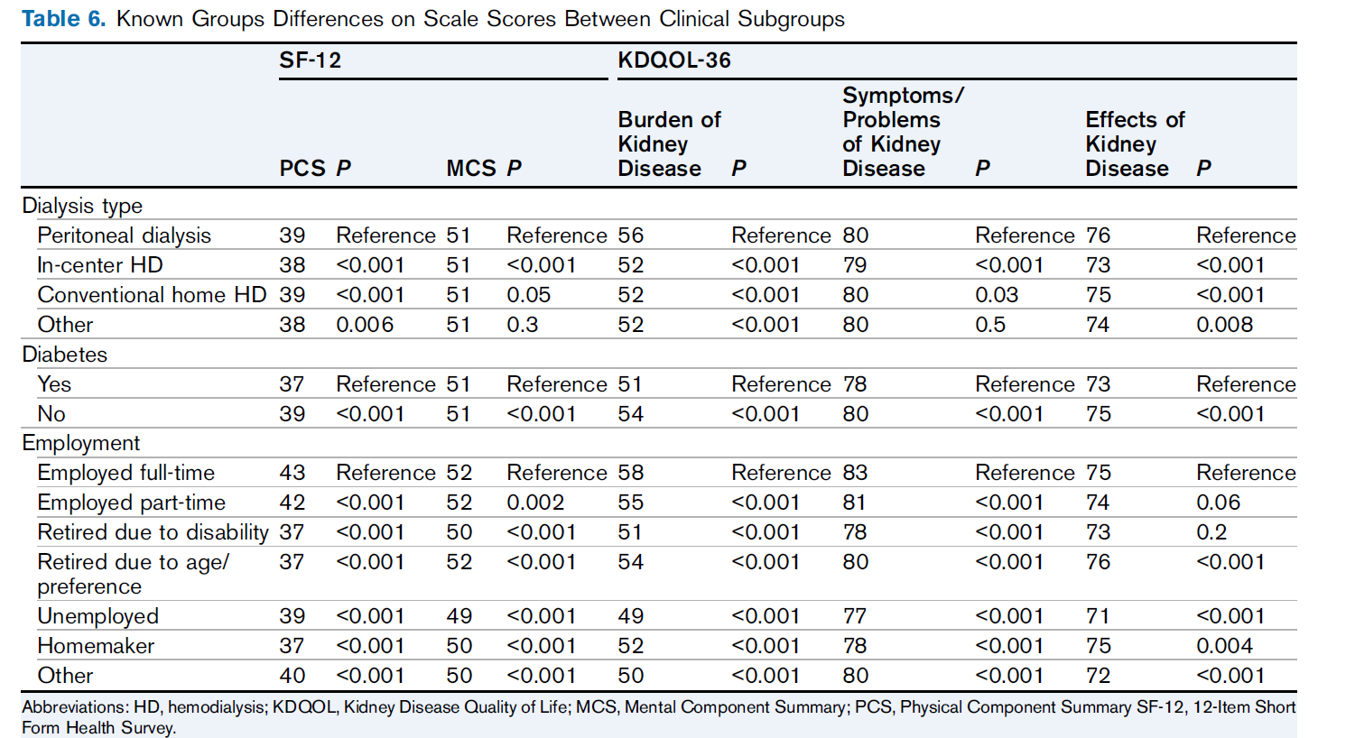

Slide 19
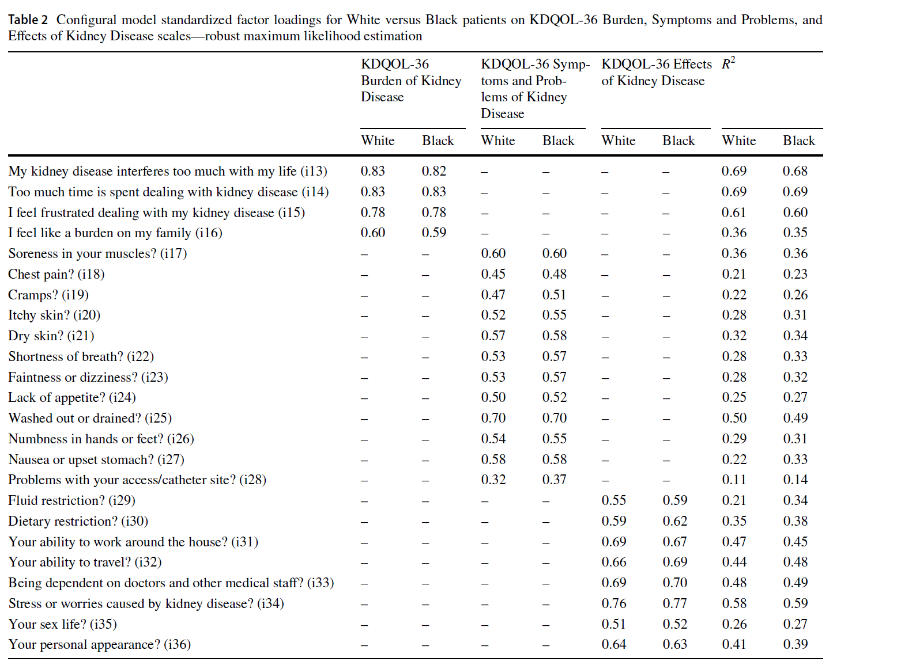

Slide 20
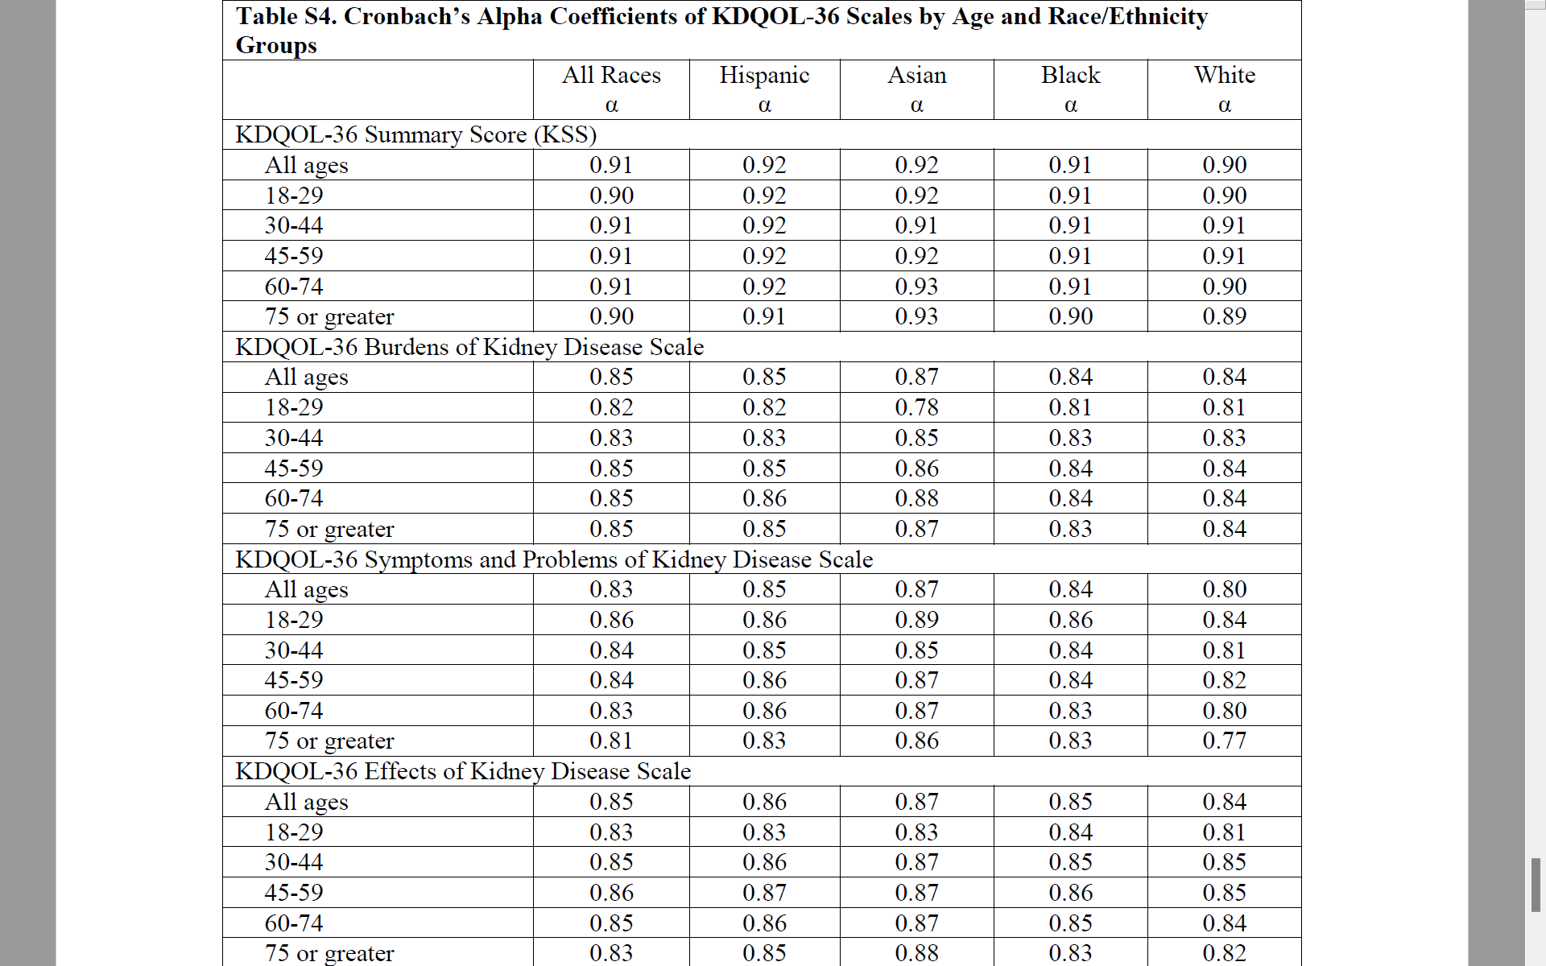

Slide 21
Mean KDQOL T-Scores by Race/Ethnicity
 | Black | White | Hispanic | Asian
SF-12 PCS | 39 | 36 | 39 | 38
SF-12 MCS | 51 | 51 | 49 | 50
Burden of Kidney Disease | 52 | 50 | 49 | 47
Symptom/Problems | 50 | 50 | 50 | 49
Effects of Kidney Disease | 51 | 50 | 49 | 48
SF-12 scores normed to U.S. general population. KDQOL-36
targeted scales normed to MEI “population.”
Weighted to match joint distribution to U.S. general population (USRDS) on
Age, sex, race/ethnicity, dialysis type, and etiology of ESRD.

Slide 22
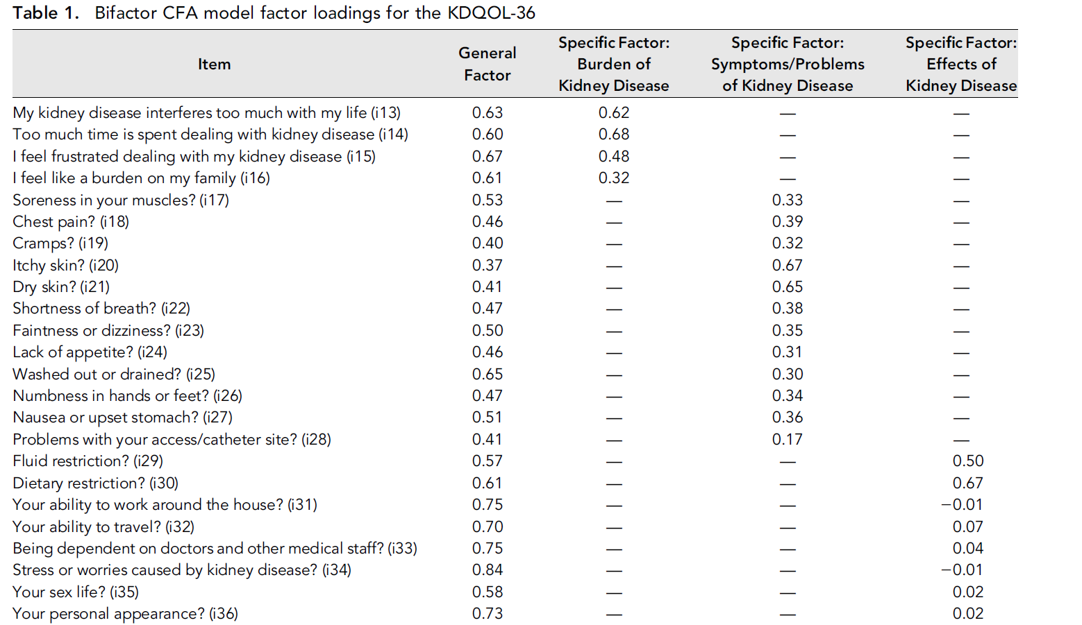

Slide 23

Email: drhays@ucla.edu
https://labs.dgsom.ucla.edu/hays/pages/

