Slide 1

SAS PROC IRT
July 20, 2015
RCMAR/EXPORT Methods Seminar
3-4pm
http://chime.med.ucla.edu/seminars/
Acknowledgements:
- Karen L. Spritzer
- NCI (1U2-CCA186878-01)
Ron D.Hays, Ph.D.

Slide 2
Patient-Reported Outcomes Measurement Information System (PROMIS®)
Reduce response burden.
Improve measurement precision.
Compare or combine results from multiple studies.
Use computer-based administration, scoring, and reporting.

Slide 3
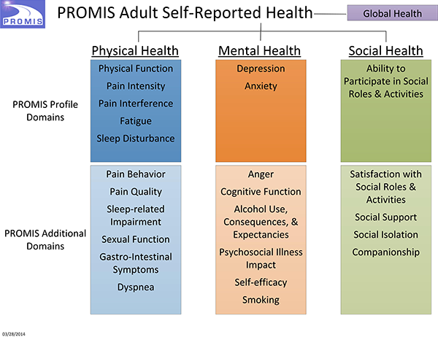

Slide 4
The PROMIS Global Health item pool/scale assesses health in general (i.e. overall health). The global health items include global ratings of the five primary PROMIS domains (physical function, fatigue, pain, emotional distress, social health) as well as perceptions of general health that cut across domains. Global items allow respondents to weigh together different aspects of health to arrive at a “bottom-line” indicator of their health. Similar global health items have been found predictive of future health care utilization and mortality. The PROMIS Global Health items include the most widely used single self-rated health item (“In general, would you say your health is . . .”). Previous research has shown that this item taps physical and mental health about equally but reflects physical health more than mental health among respondents at lower income levels. PROMIS Global Health items include specific ratings of physical health and mental health, as well as a rating of overall quality of life. The remaining items provide global ratings of physical function, fatigue, pain, emotional distress, and social health. The PROMIS Global Health items can be administered as individual items or combined to produce separate physical and mental health summary scores (see Hays, Bjorner, Revicki, Spritzer, & Cella, 2009).

Slide 5
PROMIS Global Physical Health (alpha = 0.81)
In general, how would you rate your physical health? (Global03)
To what extent are you able to carry out your everyday physical activities such as walking, climbing stairs, carrying groceries, or moving a chair? (Global06)
How would you rate your pain on average? (Global07)
How would you rate your fatigue on average? (Global08)

Slide 6
Graded Response Model
Item “difficulty” and “discrimination” parameters
Probability of item responses modeled as:
  e ^{D*a (theta – b)} 1/(e^{-D*a (theta – b)})
  ⁻⁻⁻⁻⁻⁻⁻⁻⁻⁻⁻⁻⁻⁻⁻⁻⁻⁻⁻⁻⁻⁻⁻
  1 + e ^{D*a (theta – b)}
e = 2.718
D = scaling constant, 1.7 = normal
ogive
a = discrimination
b = difficulty

Slide 7
Global Physical Health Item Parameters
Item | A | B1 | B2 | B3 | B4
Global03 | 2.31 | -2.11 | -0.89 | 0.29 | 1.54
Global06 | 2.99 | -2.80 | -1.78 | -1.04 | -0.40
Global07 | 1.74 | -3.87 | -1.81 | -0.67 | 1.00
Global08 | 1.90 | -3.24 | -1.88 | -0.36 | 1.17
3. In general, how would you rate your physical health?
6. To what extent are you able to carry out your everyday physical activities such as walking, climbing
stairs, carrying groceries or moving a chair?
How would you rate your pain on average?
How would you rate your fatigue on average?
3: Poor; Fair: Good; Very Good: Excellent
6: Not at all,; A Little; Moderately; Mostly; Completely
7: Worse pain imaginable (10) - No pain (0)
8: Very Severe; Severe; Moderate; Mild; None

Slide 8
IRT Software
IRTPRO 2.1 for Windows
  Li Cai, David Thissen & Stephen du Toit
  http://www.ssicentral.com/irt/
  MULTILOG was predecessor
WINSTEPS
  http://www.winsteps.com/index.htm
  http://www.ati-online.com/pdfs/researchK12/RaschVsBirnbaum.pdf
STATA 14
  http://www.stata.com/stata14/irt/
SAS Version 9.4 (TS1M2)

Slide 9
PROC IRT
Polychoric correlations between ordinal variables (Underlying normally distributed continuous latent variables)
Eigenvalues and scree plots
IRT model fit statistics
IRT model parameter estimates
Item characteristic and information curves
Test (scale) information curve
An, X., & Yung, Y-F. (2014). Item response theory: What it is and how you can use the IRT procedure to apply it. Paper SAS364-2014.
http://support.sas.com/resources/papers/proceedings14/SAS364-2014.pdf

Slide 10
PROC IRT Code
DATA PROMIS;
INFILE "C:\PCAR\gh_orig_all.dat";
INPUT CASEID GLOBAL03 GLOBAL06 R_GLOBAL07 R_GLOBAL08;
RUN;
******************************************;
TITLE "PROC IRT EXAMPLE USING PROMIS GLOBAL PHYSICAL HEALTH SCALE";
PROC IRT DATA=PROMIS POLYCHORIC PLOTS=(ALL);
VAR GLOBAL03 GLOBAL06 R_GLOBAL07 R_GLOBAL08;
RUN;

Slide 11
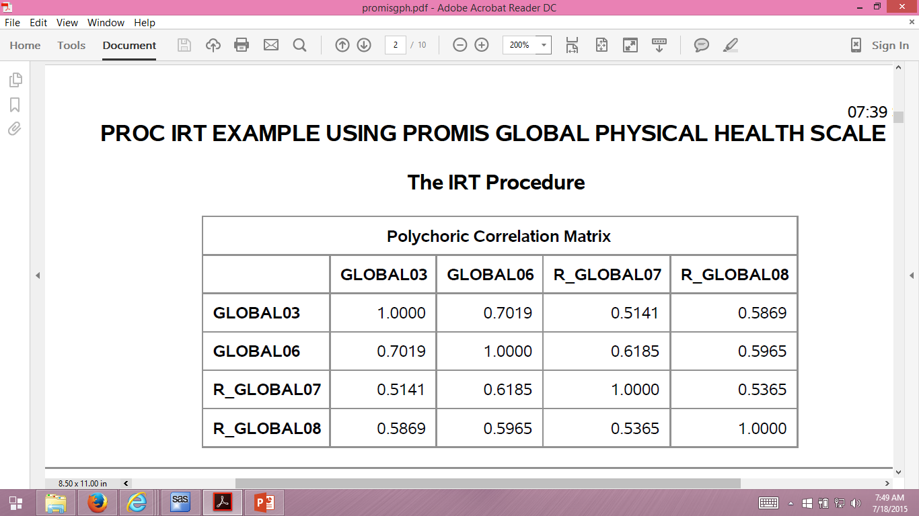

Slide 12
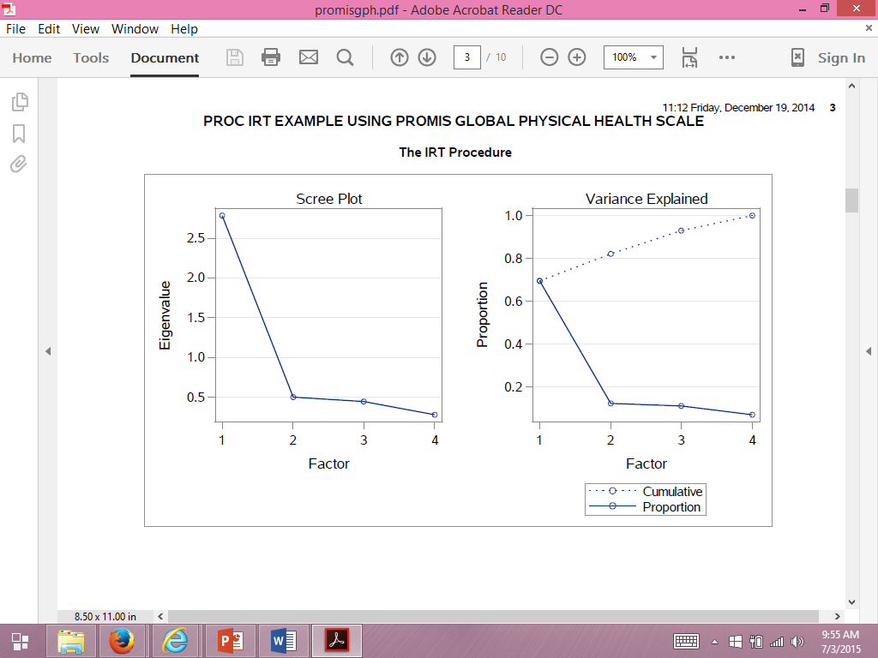
PROC IRT Output

Slide 13
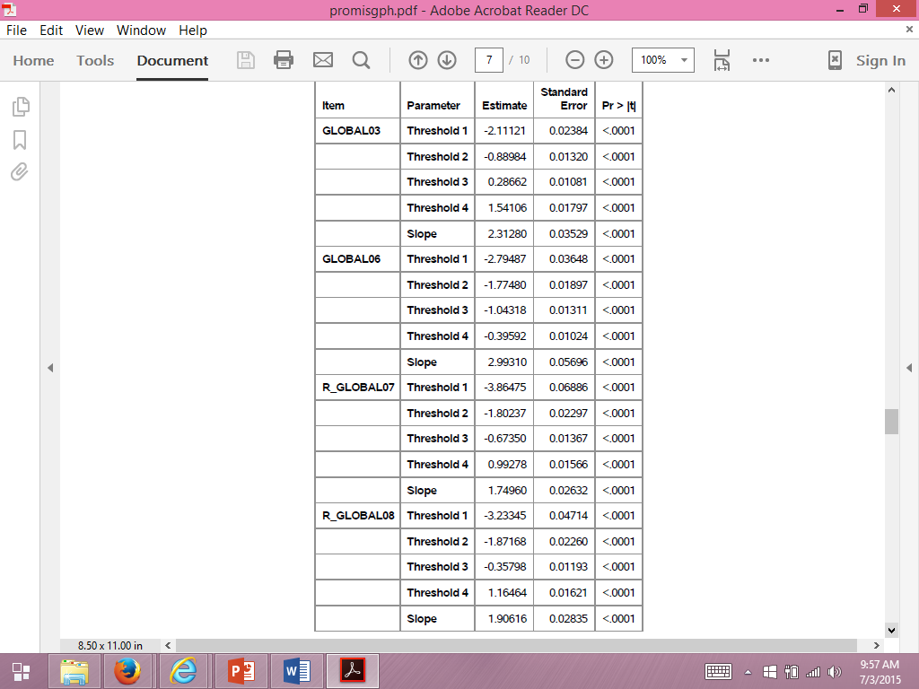

Slide 14
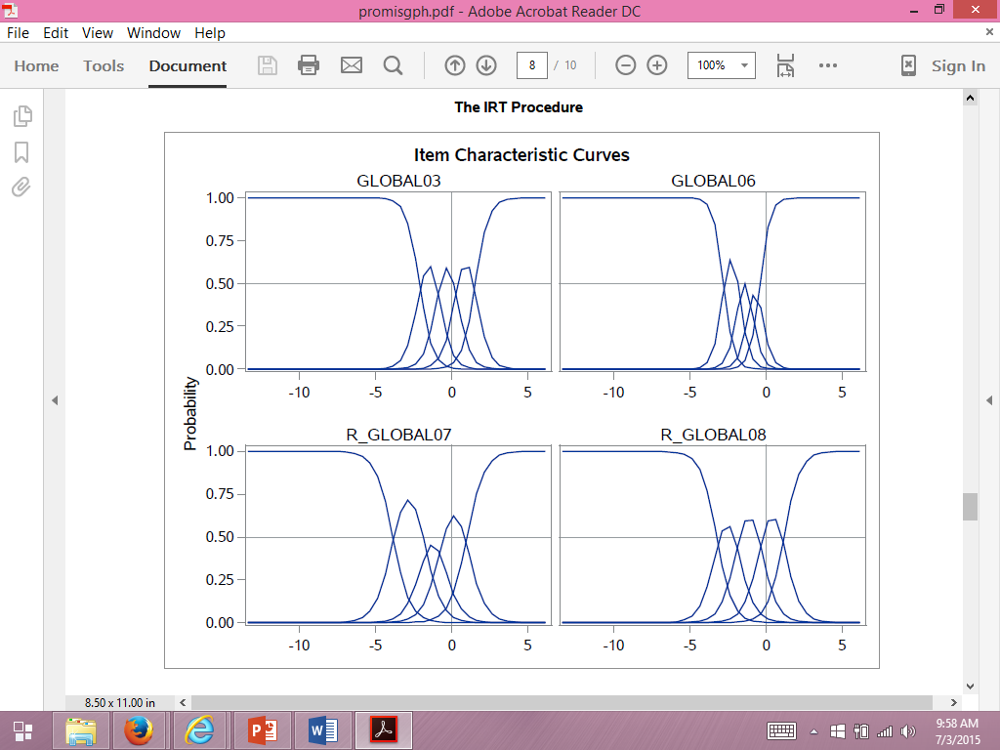
Poor
Excellent
Good
Very
Good
Fair

Slide 15
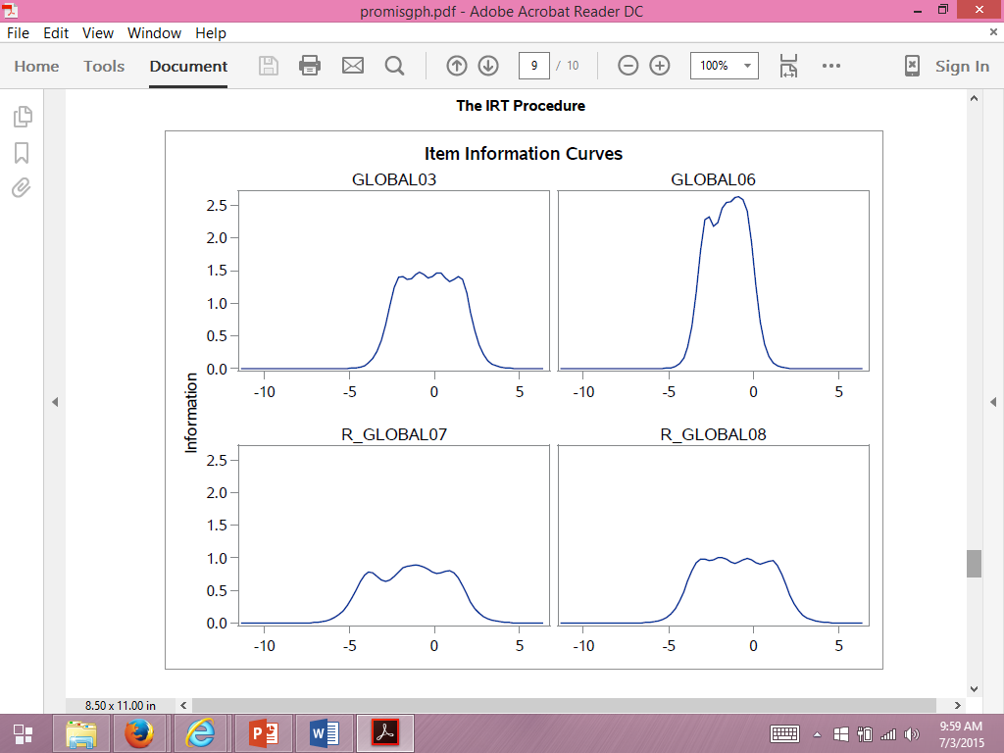

Slide 16
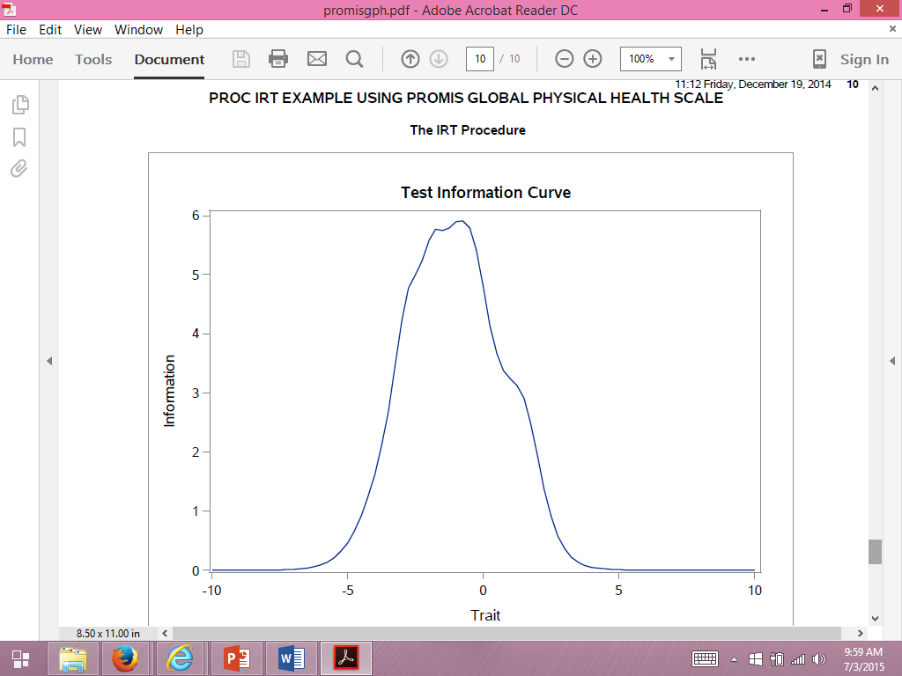
Rel = (Info – 1) / Info

Slide 17
Some PROC IRT Options
RESFUNC = RASCH
EQUALITY GLOBAL03 GLOBAL06 R_GLOBAL07 R_GLOBAL08/parm=[slopes];
LINK = PROBIT
  LOGISTIC / 1.7
  Camilli, G. (1994). Origin of the scaling constant d = 1.7 in item response theory. Journal of Educational and Behavioral Statistics, 19, 293-295.

Slide 18
Global Physical Health
Five items
  RMSEA = 0.220
r = 0.29 between two items:
  In general, how would you rate your health (1)
  In general, how would you rate your physical health? (3)
  RMSEA = 0.081
Dropped general health item (1)

Slide 19
Local Independence Assumption
Items | a | a*
Global03 | 2.31 | 7.65
Global06 | 2.99 | 1.86
Global07 | 1.74 | 1.13
Global08 | 1.90 | 1.35
Global03: In general, how would you rate your physical health?
* Item discrimination parameters when also including “In general, would you say your health is:” item.

Slide 20
In general, how would you rate your health?
Excellent
Very Good
Good
Fair
Poor

Slide 21
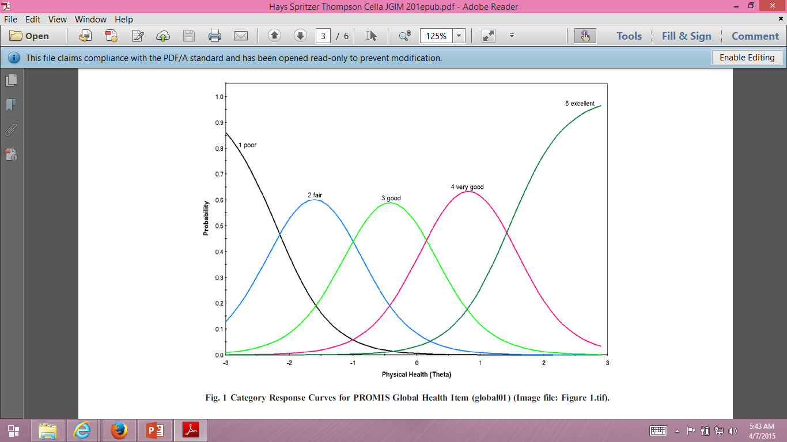

Slide 22
In general, how would you rate your health?
62 = Excellent
54 = Very Good
47 = Good
38 = Fair
29 = Poor
Reliability = 0.52 (compared to 0.81 for 4-item scale).

Slide 23
Suggested Readings
Hays, R. D., Bjorner, J., Revicki, D. A., Spritzer, K., & Cella, D. (2009). Development of physical and mental health summary scores from the Patient-Reported Outcomes Measurement Information System (PROMIS) global items. Quality of Life Research, 18, 873-80.
Hays, R. D., Morales, L. S., & Reise, S. P. (2000). Item Response Theory and Health Outcomes Measurement in the 21st Century. Medical Care, 38 (Suppl.), II-28-II-42.
Hays, R. D., Spritzer, K. L., Thompson, W. W., & Cella, D. (2015 epub). U.S. general population estimate for “excellent” to “poor” self-rated health item. Journal of General Internal Medicine.

Slide 24

Thank you.
drhays@g.ucla.edu
@RonDHays (twitter)
Powerpoint file at: http://gim.med.ucla.edu/FacultyPages/Hays/
Notes:
24

