Slide 1
Can patients be satisfied to death? What was Joshua J. Fenton thinking?
Ron D. Hays, Ph.D.
July 21, 2015
UCLA Center for Maximizing Outcomes
and Research on Effectiveness (C-MORE)
http://cmore.med.ucla.edu/seminar/

Slide 2
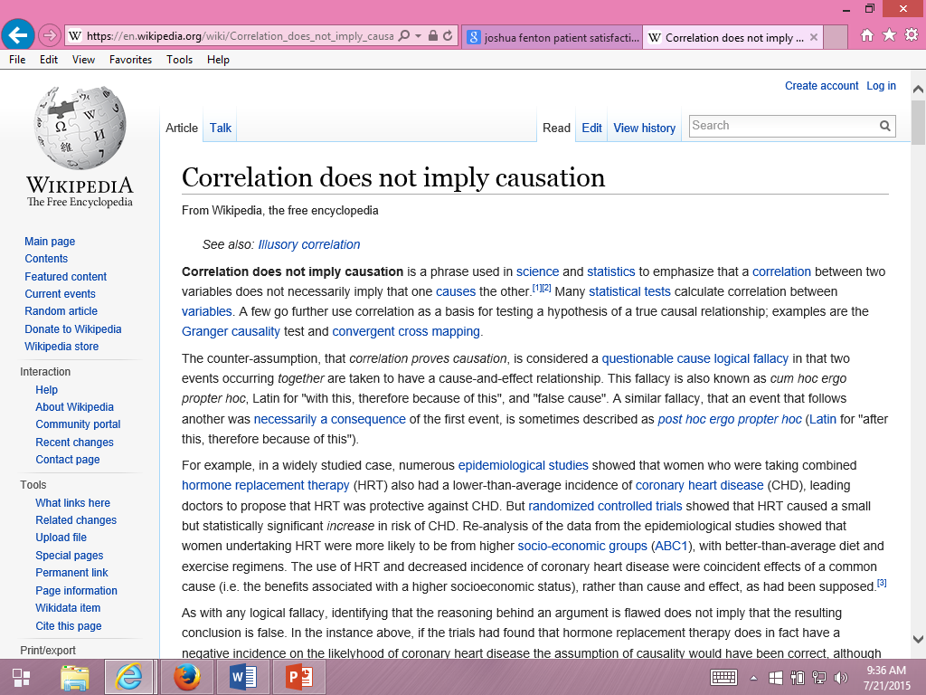
One should always be alert to the possibility of spurious associations, especially when results are implausible.

Slide 3
Is Receiving Better Technical Quality of Care Bad for Health?
Change in SF-12 PCS regressed on process of care aggregate
Hypothesized positive effect, but regression coefficient was NOT SIGNIFICANT
unstandardized beta = -1.41, p =.188
Kahn et al. (2007), Health Services Research, Article of Year
Process
of care
PCS

Slide 4
Use of and Importance of Patient Experience Surveys has Grown…
CAHPS Hospital Survey (HCAHPS) data accounted for 30% of hospitals’ Total Performance Score in Value-Based Purchasing Program in FY2014
…so has misinformation about them

Slide 5
Some Suggest that Consumers Lack Expertise Needed to Evaluate Care Quality
Patients are the best source of information on communication, office staff courtesy and respect, access to care, and other issues covered by CAHPS surveys
CAHPS complements technical quality measures

Slide 6
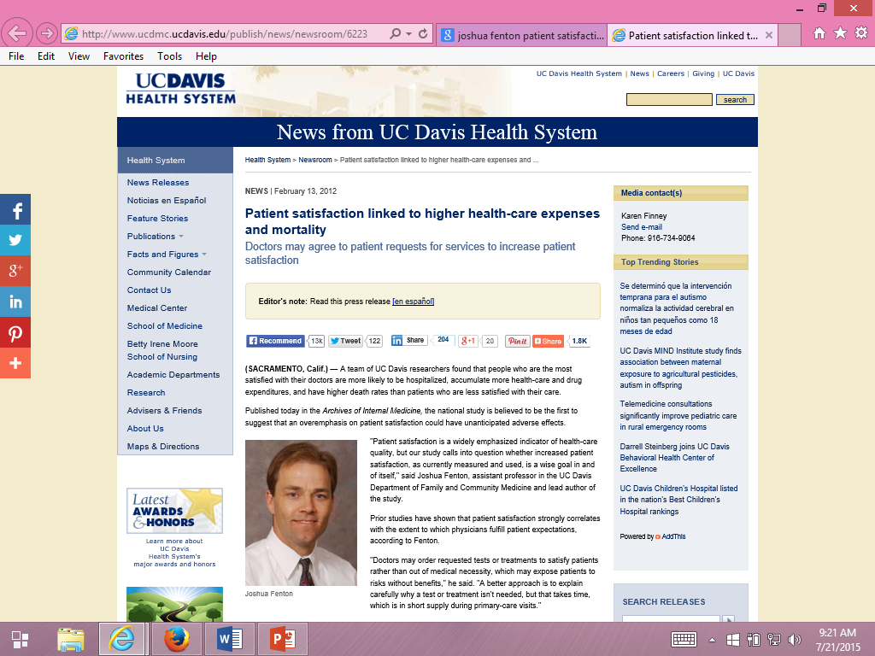
Some suggest patients can be “satisfied” to death.

Slide 7
Fenton et al. (2012) JAMA Internal Medicine
Medical Expenditure Panel Survey
Nationally representative survey of U.S. civilian non-institutionalized population. Panel followed over 2 calendar years with 5 rounds of interviews.
CAHPS survey
4 communication scale items
0-10 global rating of health care
Results interpreted as indicating that acceding to patient demands results in expensive and dangerous treatment.

Slide 8
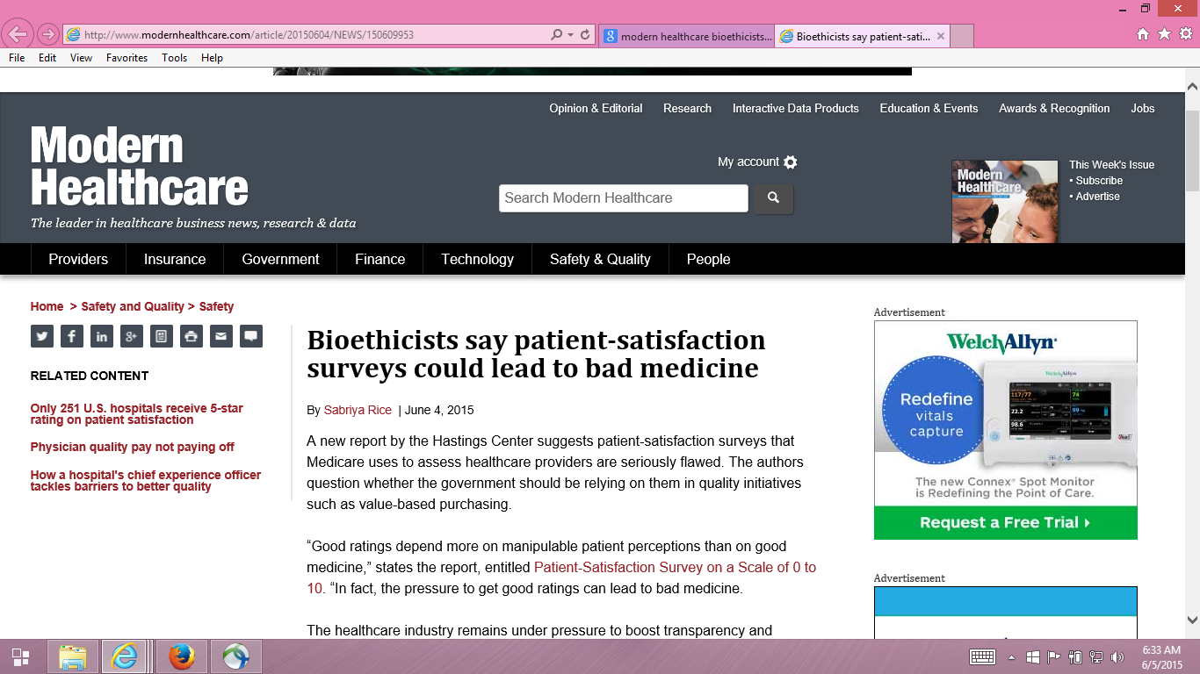

Slide 9
Hastings Center Report
Dr. Stuart Younger, Professor of Bioethics and Psychiatry at the Case Western Reserve University.
Pressure to get good ratings can lead to bad medicine.

Slide 10
Five Concerns with Fenton et al.
Associations may be due to unmeasured variables (e.g., severity of illness).
Sicker patients may need more information
Clinicians may spend more time with them.
Estimated effect was implausibly large, suggesting good patient experience is more dangerous than having major chronic conditions.
Only amenable deaths can be prevented by health care.
Prognosis for those with end-stage pancreatic cancer is not modifiable
by the type of care they receive.
- Only 21% of the 1,287 deaths in the study were amenable to health care.

Slide 11
Five Concerns with Fenton et al.
Patient experiences with care vary over time.
Used CAHPS data at MEPS round 2 to predict mortality 3 months to 6 years later.
> half of deaths occurred more than 2 years after this.
Among those with best (quartile 4) experiences at baseline, > half had worse experiences 1 year later
Only looked at 5-item CAHPS aggregate

Slide 12
Reanalysis of Fenton et al. by Xu et al. (2014)
Same data used by Fenton et al.
2000-2005 Medical Expenditure Panel Survey data
National Health Interview Survey
National Death Index
Same statistical analysis
Cox proportional hazards models with mortality as the dependent variable and patient experience measures as independent variables
But, unlike Fenton et al.
Separated non-amenable and amenable deaths
Considered timing of patient experience and death
Looked at individual items to better understand the patient experience with mortality association

Slide 13
Patient Experiences and Mortality: Non-Amenable vs. Amenable Deaths
Patient Care Experience | Non-Amenable Mortality |  | Amenable Mortality
 | Hazard Ratio | p-value | Hazard Ratio | p-value
Quartile 1 (reference) | (1.00) |  | (1.00)
Quartile 2 | 1.07 | 0.56 | 1.27 | 0.25
Quartile 3 | 0.96 | 0.70 | 1.28 | 0.25
Quartile 4 (most positive) | 1.26 | 0.03 | 1.23 | 0.32
Overall p-value for patient care experience quartiles |  | 0.03 |  | 0.59
Adjusted for age, gender, race/ethnicity, education, income, metropolitan
statistical area, census region, access to usual source of care, insurance coverage,
smoking status, number of chronic conditions, self-rated overall health, SF-12
PCS/MCS, number of drug prescriptions, medical care expenditures, number of
office visits, any ER visits, any inpatient admissions, and survey panel.

Slide 14
Patient Experiences and Mortality: Consistency of Experiences Over Time
Patient Care Experience (baseline : 1 year later) | All-Cause Mortality
 | Hazard Ratio | p-value
Quartile 1 : Quartile 1 (reference) | (1.00)
Quartile 2 : Quartile 2 | 0.89 | 0.42
Quartile 3 : Quartile 3 | 1.13 | 0.57
Quartile 4 : Quartile 4 | 1.09 | 0.54
Different quartiles at baseline and 1 year later | 0.88 | 0.35

Slide 15
Patient Experiences and Mortality: Significant for Only One Measure
Patient Care Experience Items | All-Cause Mortality
 | Hazard Ratio | p-value
Rating of healthcare 9-10 vs 0-8 | 1.10 | 0.15
Listen carefully to you † | 0.98 | 0.76
Show respect for what you had to say † | 1.05 | 0.44
Explain things in a way that is easy to understand † | 1.09 | 0.17
Spend enough time with you † | 1.17 | 0.03
† “Always" versus “Never”/“Sometimes”/“Usually”

Slide 16
Conclusions
Rather than patient demands producing expensive and dangerous treatment, the data are consistent with other studies that indicate more intensive care at the end-of-of life in the U.S. (Elliott et al., 2013, JAGS).
Patient experience surveys assess important dimensions of care for which patients are the best or only source of information
Improving patient experience does not lead to inappropriate and inefficient care or result in trade-offs with high-quality clinical care

Slide 17
Relevant Readings
Price, R. A. Elliott, M.N., et al. (2015). Should health care providers be accountable for patients’ care experiences? JGIM, 30, 253-256.
Price, R. A., Elliott, M. N., et al. (2014). Examining the role of patient experience surveys in measuring health care quality. Medical Care Research and Review, 71, 522-554.
Xu, X., Buta, E. et al. (2014 epub). Methodological considerations when studying the association between patient-reported care experiences and mortality. Health Services Res.

Slide 18
Thank you.
drhays@g.ucla.edu
@RonDHays (twitter)
Powerpoint file at: http://gim.med.ucla.edu/FacultyPages/Hays/
Notes:
18

