Slide 1

Patient-Reported Outcomes (PROs) as Quality of Care Measures
Ron D. Hays, Ph.D., UCLA
June 2, 2016 (2:45-4:15 CT)
Hyatt Rosemont, Rosemont, Illinois

Slide 2



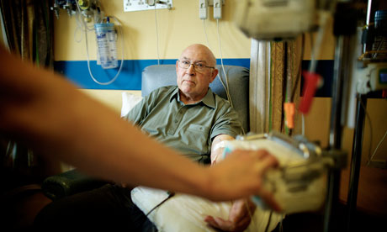
We Measure Quality of Care to Improve It
Find out how well they are doing
Providers
Government/
Private Insurers
Identify best/worst healthcare providers
Choose best health care for themselves
Patients

Slide 3
How Do We Measure Quality of Care?
Focus has been on expert consensus
Variant of RAND Delphi Method

Slide 4
How Do We Measure Quality of Care?
But how patients perceive their care also important
CAHPS® project measures patient experiences.
Focus has been on expert consensus about clinical process
Variant of RAND Delphi Method

Slide 5
Consumer Assessment of Healthcare Providers and Systems (CAHPS®) Approach
Complements information from clinical process measures
Focus on what patients want to know about AND can accurately report about
  Communication with health care provider
  Access to care
  Office staff courtesy and respect
  Customer service

Slide 6
Quality of Care Indicators
Process of care
  Clinical indicators (expert consensus)
  Patient reports (CAHPS®, 1995)
Health
    Care maximizing probability of desired health outcomes.
  Clinical indicators
  Patient reports (PROMIS®, 2004)

Slide 7
Multiple Factors Impact Health
Quality
Of Care
Health
Socio-
demographics
Behavior
Environment
Chronic
Conditions

Slide 8
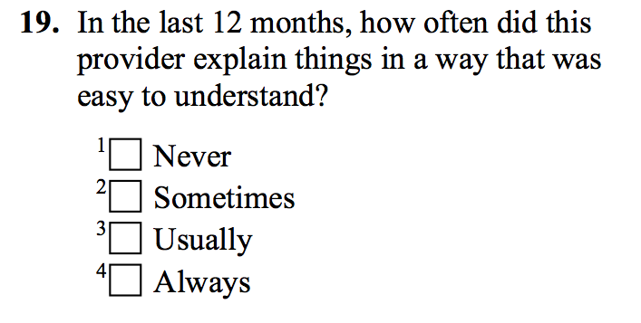
Rather than Assessing Patient Satisfaction, CAHPS Relies on Reports About Care

Slide 9







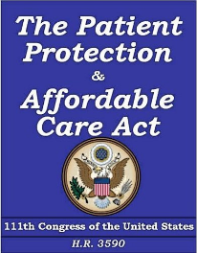
CAHPS Tipping Point was its
Widespread Adoption
. . . and its link to payment through ACA

Slide 10

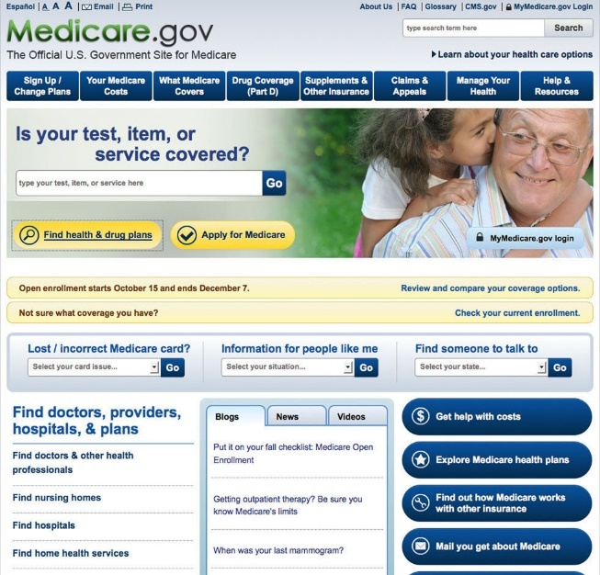
CAHPS Survey Implementation
Develop surveys
  Stakeholder input
Train and oversee survey vendors
Analyze and report plan-level data
  Casemix adjustment
Report to plans/providers for quality improvement

Slide 11
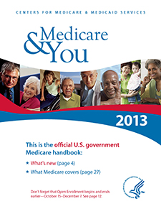

Public reporting of CAHPS Data
CMS reports MCAHPS data by plan
and state
  Mails booklets
  Online tool
Helps beneficiaries choose coverage
Makes plan performance transparent

Slide 12
Use of and importance of patient experience surveys has grown…
CAHPS Hospital Survey (HCAHPS) data accounted for 30% of hospitals’ Total Performance Score in Value-Based Purchasing Program in FY2014

Slide 13
Use of and importance of patient experience surveys has grown…
CAHPS Hospital Survey (HCAHPS) data accounted for 30% of hospitals’ Total Performance Score in Value-Based Purchasing Program in FY2014
…greater scrutiny

Slide 14

Use of and importance of patient experience surveys has grown…
CAHPS Hospital Survey (HCAHPS) data accounted for 30% of hospitals’ Total Performance Score in Value-Based Purchasing Program in FY2014
…greater scrutiny
..and more misinformation

Slide 15
Patient surveys are subjective and do not provide valid information
PROs are “subjective” and providers have concerns about their scientific properties (Boyce et al., 2014, Implementation Science)
PROs are as reliable and valid as clinical measures
  Hahn, E. A. et al., (2007). Precision of health-related quality of life data compared with other clinical measures. Mayo Clinic Proceedings, 82 (10), 1244-1254.

Slide 16
PROs are Weakly Related to Clinical Indicators

Slide 17

PROs are Weakly Related to Clinical Indicators
Systematic review (55 studies)
Wide range of disease areas, setting, designs, and outcome measures
Consistent Positive Associations
  Patient experience
  Patient safety
  Clinical effectiveness

Slide 18
PROs are not actionable
Patient surveys assess what is important to patients.
  Patients want and need to know PRO information when choosing among providers.
PROs used in quality improvement
  While link between use of PROs and subsequent health is tenuous, their use improves communication between patients and providers.

Slide 19

PRO data cannot be fairly compared across providers
My patients are different (e.g., sicker) than patients of other providers
PROs are determined by factors outside the control of the provider
  -> Patient characteristics that are systematically related to PROs and not indicative of care quality included in casemix adjustment.

Slide 20
Because of low response rates, survey respondents are unrepresentative
Maximize participation rates.
Survey nonresponse does not necessarily lead to bias in comparisons.
Casemix adjustment can compensate for nonresponse bias.

Slide 21
Collecting PRO data is too burdensome and expensive

Slide 22
Collecting PRO data is too burdensome and expensive
Patients are often more burdened by invasive medical tests than responding to surveys.
Survey data collection is not free but newer technologies can reduce costs.

Slide 23
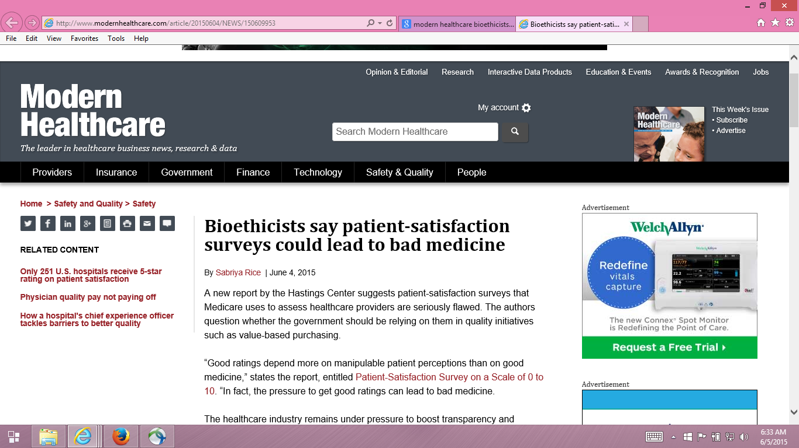

Slide 24
Providers motivated to fulfill patient desires, regardless of appropriateness
“Pressure to get good ratings can lead to bad medicine.”
  Dr. Stuart Younger, Professor of Bioethics and Psychiatry at the Case Western Reserve University (Hastings Center Report)

Slide 25
Providers motivated to fulfill patient desires, regardless of appropriateness?
Higher intensity care is not related to better outcomes
Good communication is important in addressing unreasonable expectations

Slide 26
Fenton et al. (2012)
“Patient satisfaction can be maintained in the absence of request fulfillment if physicians address patient concerns in a patient-centered way.”

Slide 27
Fenton et al. (2012)
“ In the ideal vision of patient-centered care, physicians deliver evidence-based care in accord with the preferences of informed patients, thereby improving satisfaction and health outcomes, while using health resources efficiently.”

Slide 28
Fenton et al. (2012)
“However, patient-centered communication requires longer visits and may be challenging for many physicians to implement.”

Slide 29

Strategies to Address Resistance to PROs as Quality of Care Indicators
Stakeholder involvement
  Sponsor and provider feedback
  Clinician opinion leaders
Communication
  Conference presentations
  Webinars
  Social media
    e.g., Blogs and twitter
  Letters to editor
  Journal articles

Slide 30
Podcast Addressing Concerns
about CAHPS Surveys
Can patients really report on the quality of the care they receive?
Do patients’ expectations affect how they respond to CAHPS survey questions about their providers?
Is there a tradeoff between positive patient experiences and favorable clinical outcomes?
To help users of CAHPS surveys address these and other questions, the Agency for Healthcare Research and Quality (AHRQ) released a podcast: “CAHPS Surveys: Sorting Fact From Fiction,” featuring Rebecca Anhang Price, PhD.
Listen to this podcast: https://cahps.ahrq.gov/news-and-events/podcasts/cahps-surveys-podcast.html

Slide 31
HCAHPS Survey, Pain Management, and Opioid Misuse: The CMS Perspective
Clarifying Facts, Myths, and Approaches
CMS believes that effective communication with patients about pain and treatment, including options other than prescription medicine when appropriate, is the preferred way to improve patient experience of care. In the process of developing the HCAHPS Survey, we did not find that experience with pain dominated patients’ overall assessment of the hospital experience.
http://www.qualityreportingcenter.com/wp-content/uploads/2016/02/IQR_20160126_QATranscript_vFINAL508.pdf

Slide 32
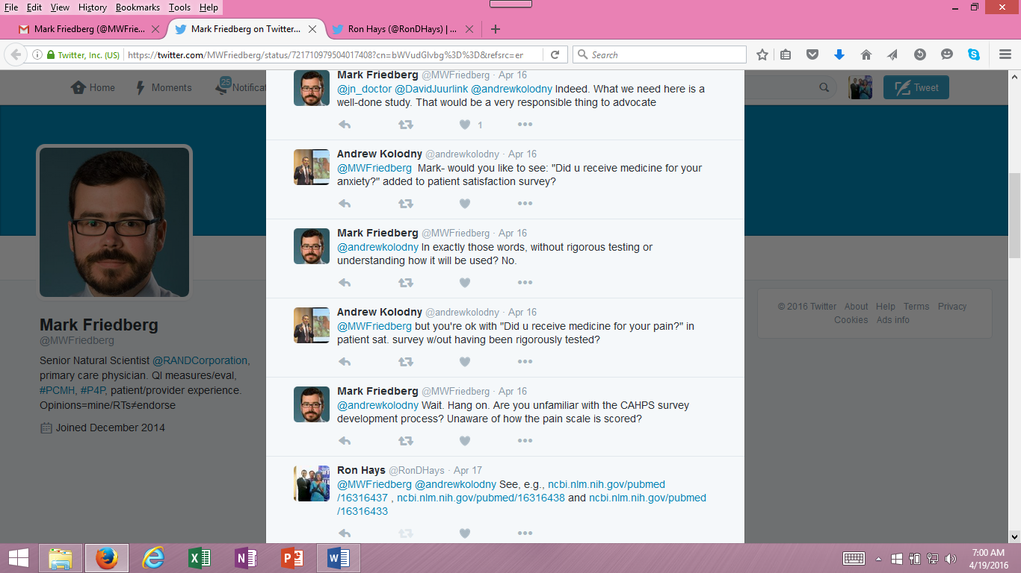



Slide 33
CAHPS Articles
Price, R. A. et al. (2015). Should health care providers be accountable for patients’ care experiences? JGIM, 30, 253-256.
Price, R. A. et al. (2014). Examining the role of patient experience surveys in measuring health care quality. Medical Care Research and Review, 71, 522-554.
Xu, X. et al. (2014). Methodological considerations when studying the association between patient-reported care experiences and mortality. Health Services Res, 50, 1146-1161.

Slide 34
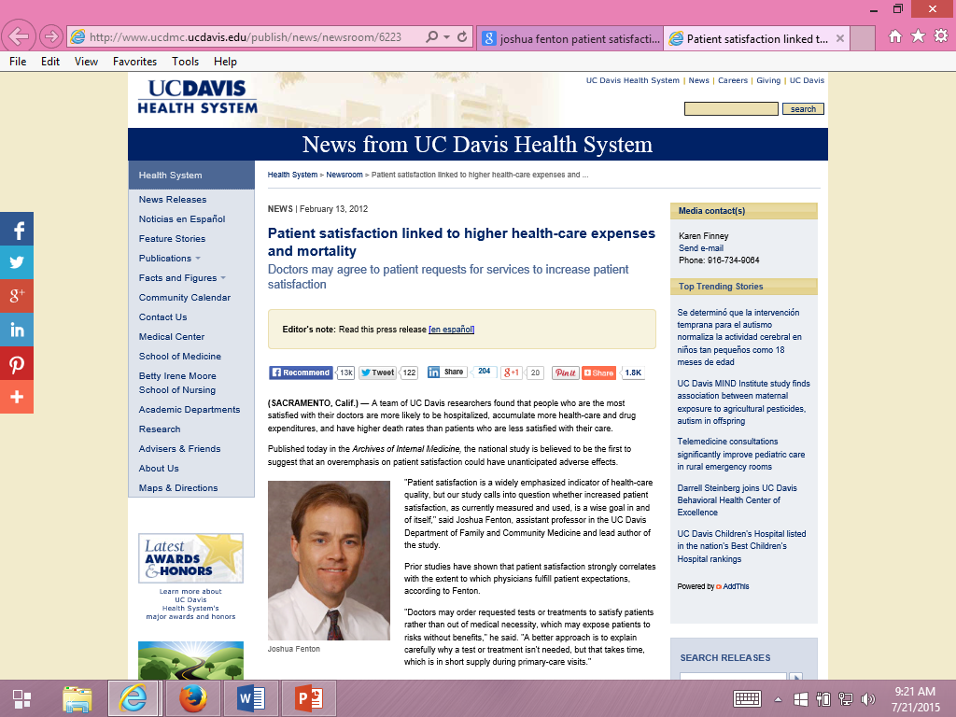
Some suggest patients can be “satisfied” to death.

Slide 35
Fenton et al. (2012)
Archives of Internal Medicine
Medical Expenditure Panel Survey
  Nationally representative survey of U.S. civilian non-institutionalized population. Panel followed over 2 calendar years with 5 rounds of interviews.
Five CAHPS item
  4 items from communication scale
  0-10 global rating of health care item
Results interpreted as indicating that acceding to patient demands results in expensive and dangerous treatment.

Slide 36
Five Concerns with Fenton et al.
Associations may be due to unmeasured variables (e.g., severity of illness).
  Sicker patients may need more information
  Clinicians may spend more time with them.
Estimated effect was implausibly large, suggesting good patient experience is more dangerous than having major chronic conditions.
Only amenable deaths can be prevented by health care.
  Prognosis for those with end-stage pancreatic cancer is not modifiable
  by the type of care they receive.
  - Only 21% of the 1,287 deaths in the study were amenable to health care.

Slide 37
Five Concerns with Fenton et al.
Patient experiences with care vary over time.
  Used CAHPS data at MEPS round 2 to predict mortality 3 months to 6 years later.
  > half of deaths occurred more than 2 years later.
  Among those with best (quartile 4) experiences at round 2, > half had worse experiences 1 year later
Only looked at 5-item CAHPS aggregate

Slide 38
Reanalysis of Fenton et al.
(Xu et al., 2014)
Same data used by Fenton et al.
  2000-2005 Medical Expenditure Panel Survey data
  National Health Interview Survey
  National Death Index
Same statistical analysis
  Cox proportional hazards models with mortality as the dependent variable and patient experience measures as independent variables
But, unlike Fenton et al.
  Separated non-amenable and amenable deaths
  Considered consistency of patient experience and death
  Looked at individual items to better understand the patient experience with mortality association

Slide 39
Patient Experiences and Mortality:
Non-Amenable vs. Amenable Deaths
Patient Care Experience | Non-Amenable Mortality |  | Amenable Mortality
 | Hazard Ratio | p-value | Hazard Ratio | p-value
Quartile 1 (reference) | (1.00) |  | (1.00)
Quartile 2 | 1.07 | 0.56 | 1.27 | 0.25
Quartile 3 | 0.96 | 0.70 | 1.28 | 0.25
Quartile 4 (most positive) | 1.26 | 0.03 | 1.23 | 0.32
Overall p-value for patient care experience quartiles |  | 0.03 |  | 0.59
Adjusted for age, gender, race/ethnicity, education, income, metropolitan
statistical area, census region, access to usual source of care, insurance coverage,
smoking status, number of chronic conditions, self-rated overall health, SF-12
PCS/MCS, number of drug prescriptions, medical care expenditures, number of
office visits, any ER visits, any inpatient admissions, and survey panel.

Slide 40
Patient Experiences and Mortality:
Consistency of Experiences Over Time
Patient Care Experience (baseline : 1 year later) | All-Cause Mortality
 | Hazard Ratio | p-value
Quartile 1 : Quartile 1 (reference) | (1.00)
Quartile 2 : Quartile 2 | 0.89 | 0.42
Quartile 3 : Quartile 3 | 1.13 | 0.57
Quartile 4 : Quartile 4 | 1.09 | 0.54
Different quartiles at baseline and 1 year later | 0.88 | 0.35

Slide 41
Patient Experiences and Mortality:
Significant for Only One Item
Patient Care Experience Items | All-Cause Mortality
 | Hazard Ratio | p-value
Rating of healthcare 9-10 vs 0-8 | 1.10 | 0.15
Listen carefully to you † | 0.98 | 0.76
Show respect for what you had to say † | 1.05 | 0.44
Explain things in a way that is easy to understand † | 1.09 | 0.17
Spend enough time with you † | 1.17 | 0.03
† “Always" versus “Never”/“Sometimes”/“Usually”

Slide 42

Thank you.
drhays@g.ucla.edu
@RonDHays (twitter)
Powerpoint file at: http://gim.med.ucla.edu/FacultyPages/Hays/
Notes:
42

Slide 43
Is Receiving Better Technical Quality of Care Bad for Health?
Change in SF-12 PCS regressed on process of care aggregate
Hypothesized positive effect, but regression coefficient was NOT SIGNIFICANT
unstandardized beta = -1.41, p =.188
Kahn et al. (2007), Health Services Research, Article of Year
Process
of care
SF-12 PCS

