Slide 1

Depressive symptoms are “associated” with Health-Related Quality of Life
Ron D. Hays
March 19, 2021 (12:00-1:00 pm)
UCLA GIM Noon Research Seminar
Los Angeles, CA

Slide 2



Slide 3
Health-Related Quality of Life (HRQOL) refers to
What you can do (functioning) and how you feel (well-being):
  Physical (Health)
    Physical functioning
  Mental (Health)
    Symptoms (anxiety, depression, positive affect)
  Social (Health)
    Getting along with others
Note: HRQOL ends at the skin of the individual.

Slide 4
SF-36 HRQOL Instrument
Physical functioning (10 items)
Role limitations/physical (4 items)
Role limitations/emotional (3 items)
Social functioning (2 items)
Emotional well-being (5 items)
Energy/fatigue (4 items)
Pain (2 items)
General health perceptions (5 items)

Slide 5
SF-6D Preference-Based Score (0 = dead, 1 = perfect health):
Health state 424421 (0.59)
Your health limits you a lot in moderate activities (such as moving a table, pushing a vacuum cleaner, bowling or playing golf)
You are limited in the kind of work or other activities as a result of your physical health
Your health limits your social activities (like visiting friends, relatives etc.) most of the time.
You have pain that interferes with your normal work (both outside the home and housework) moderately
You feel tense or downhearted and low a little of the time.
You have a lot of energy all of the time

Slide 6
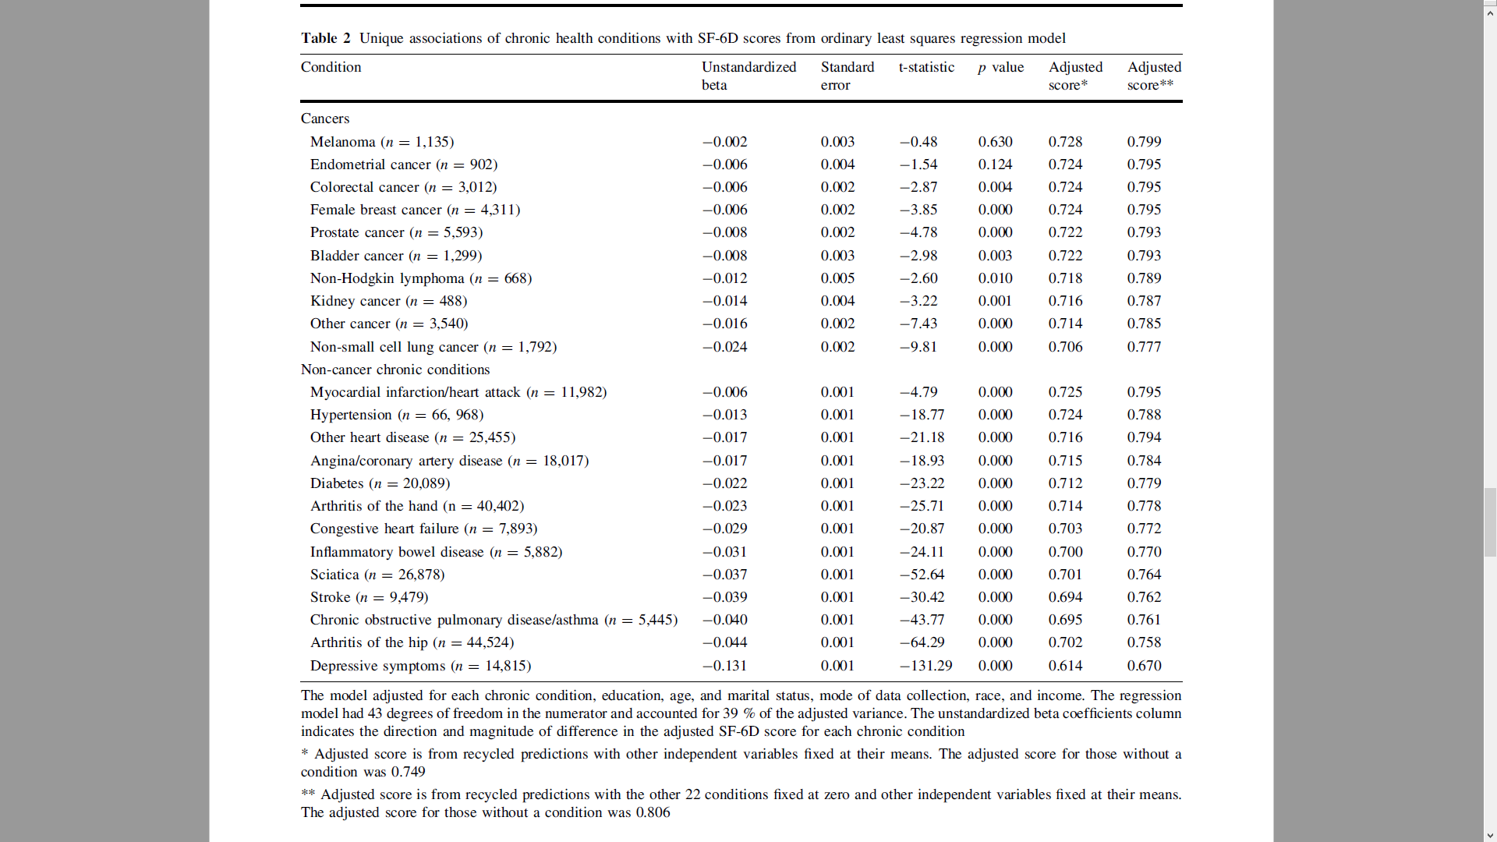


January 6, 2012
(10 cancer and 13 other conditions)

Slide 7
Hays et al. (Quality of Life Research, 2014)
The strongest association with the SF-6D preference-based score was observed for depressive symptoms (-0.131)…a strong negative association of depression with the SF-6D was expected because the measure includes mental health items. Thus, depressive symptoms are represented to some extent on both sides of the equation.
Dropping depressive symptoms from the model had no impact on the interpretation of the associations for the other 20 comorbid conditions that had significant unique associations with the SF-6D score.

Slide 8
#1. Olson et al. (Quality of Life Research, 2019)
Found that depressive symptoms
  Geriatric Depression Scale (GDS)
  accounted for 31% of the variance in overall health-related quality of life.
  Functional Assessment of Human Immunodeficiency Virus Infection (FAHI) Quality of Life Instrument
Concluded that results show the “important role of mental health, specifically depressive symptoms” in HRQOL.
Suggested that “mental health treatment may reduce overall costs of health care services.”
“Depressive symptoms, physical symptoms, and health-related quality of life among older adults with HIV,”

Slide 9
Example items in Geriatric Depression Scale (GDS) and Functional Assessment of Human Immunodeficiency Virus Infection (FAHI) Quality of Life Instrument
Column A
I have a lack of energy.
Do you feel happy most of the time?
Do you often get restless and fidgety?
I am concerned for what
the future holds for me.
Is your mind as clear as it used to be?
Column B
Do you feel full of energy?
I feel sad.
I feel nervous.
Are you hopeful about the future?
My thinking is clear.

Slide 10
#2. Evans et al. (Quality of Life Research, 2007)
Some adults in the UK with no mental disorder and some with mental disorder (n = 2062 overall).
Significant associations of a depressive item from the General Health Questionnaire with Lancashire Quality of Life measures:
  Mental health
  Overall quality of life
“Results pertaining to the association between depressive symptoms and QOL need to be treated with caution because of the crudeness of the depression indicators used; nevertheless, the use of single-item measures was justifiable as they agree closely with validated depression scales.”
and the results reported here are similar to those of
other studies.

Slide 11
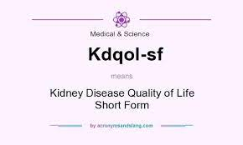
#3. Lopes et al. (Nephron Clin Pract, 2010)
Kidney Disease Quality of Life Instrument (KDQOL-SF 1.3: includes SF-36) scores were worse for those with depressive symptoms (CES-D).

Slide 12
#4. Wang et al. (Health and Quality of Life Outcomes, 2020)
Concluded depression symptoms mediated association between social support and quality of life in a sample of 420 elderly in rural China.

Slide 13
#5. He et al. (Health and Quality of Life Outcomes, 2021)
Cross-sectional study of 150 hospitalized patients in China with Parkinson’s disease.

Slide 14
#6. Mougianis et al. (J Pediatric Psychology, 2020)
Concluded that greater perceived racism affected depression symptoms (PROMIS pediatric depression scale), which in turn lead to poorer HRQOL (PedsQL) in sample of 75 adolescents with SCD.

Slide 15
#7. Jia and Lubetkin (Health and Quality of Life Outcomes, 2017)
- Monotonic association between depression symptom severity (PHQ-9) and EQ-5D-3L (0 = dead, 1= perfect health).
- This study showed an “incremental decrease in QALYs with an increasing severity of depressive symptoms.”

Slide 16


Slide 17
#8. Baert et al. (European Journal of Preventive Cardiology, 2018)
“Through a systematic literature search, factors associated with HRQoL among congestive hear failure patients were investigated…the presence of depressive symptoms was most consistently related to a worse HRQoL.”

Slide 18
#8. Baert et al. (European Journal of Preventive Cardiology, 2018)
“Through a systematic literature search, factors associated with HRQoL among congestive hear failure patients were investigated…the presence of depressive symptoms was most consistently related to a worse HRQoL.”
“Since HRQOL comprises a mental as well as a physical component, the association with depression … is not unexpected, making depression or depressive symptoms … rather redundant as a predictor for HRQOL” (p. 478 in discussion section).

Slide 19
#9. de Alencar et al. (Quality of Life Research, 2020)
Predicted mortality (Cox proportional hazards models) in hemodialysis patients from:
  Depression (Mini-International Neuropsychiatric Interview)
  Control, Autonomy, Self-realization, and Pleasure Questionnaire (CASP-16) quality of life measure
Both significantly predicted mortality separately.
In multivariable model, quality of life significantly predicted mortality, but depression did not.
  Authors concluded that quality of life is more important than depression

Slide 20
Summary
Failure to recognize overlap between stand-alone depressive symptom measures and HRQOL instruments leads authors to:
  Suggest depression has an “impact” on HRQOL (tautological).
  Make questionable conclusions about the prognostic value of depression and HRQOL for mortality and other outcomes.
Researchers and journal editors need awareness of the overlap of depressive symptoms and HRQOL.

Slide 21

https://hqlo.biomedcentral.com/articles/10.1186/s12955-021-01740-w
Okunrintemi V, Valero-Elizondo Micos ED, Salami JA, et al. Association of depression risk with patient experience, healthcare experience, and
health resource utilization among adults with atherosclerotic cardiovascular disease. J Gen Intern Med. 2019; 34:2427–34.
Olson B, Vincent W, Meyer JP, Kershaw T, Sikkema KJ, Heckman TG, et al. Depressive symptoms, physical symptoms, and health-related quality of life among older adults with HIV. Qual Life Res. 2019;28:3313-3322.
de Alencar SBV, Dias LdA, Dias VDA, de Lima FM, Montarroyos UR, del Petribo KCL. Quality of life may be a more valuable prognostic factor than depression in older hemodialysis patients. Qual Life Res. 2020;29:1829-1838.
de Alencar SBV, de Lima FM, Dias LdA, Dias VdA, Lessa AC, Bezerra JM, et al. Depression and quality of life in older adults on hemodialysis. Braz J Psychiatry. 2020;42:195-200.
Wang J, Xue J , Jiang Y, Zhu T, Chen, S. Mediating effects of depressive symptoms on social support and quality of life among rural older Chinese. Health and Quality of Life Outcomes. 2020;18:242.
Evans S, Banerjee S, Leese M, Huxley P. (2007). The impact of mental illness on quality of life: A comparison of severe mental illness, common mental disorder and healthy population samples. Qual Life Res. 2007;16:17-29.
Lopes GB, Matos CM, Leite EB, Martins MTS, Martins MS, Silva LF, et al. Depression as a potential explanation for gender differences in health-related quality of life among patients on maintenance hemodialysis. Nephron Clin Pract. 2010;115:c35-c40.
Engell L, Chen G, Richardson J, Mihalopoulos C. The impact of depression on health-related quality of life and wellbeing identifying important dimensions and assessing their inclusion in multi-attribute utility instruments. Qual Life Res. 2018;27:2873-2884.
Gaynes BN, Burns BJ, Tweed DL, Erickson P. Depression and health-related quality of life. The Journal of Nervous and Mental Disease. 2002;190:799-806.
Jia H, Lubetkin EI. Incremental decreases in quality-adjusted life years (QALY) associated with higher levels of depressive symptoms for U.S. adults aged 65 years and older. Health and Quality of Life Outcomes. 2017;15:9.
Berghöfer A, Martin L, Hense S, Weinmann S, Roll S. Quality of life in patients with several mental illness: A cross-sectional survey in an integrated outpatient health care model. Qual Life Res. 2020;29:2073-2087.
Behall M, Legall G, Kahn K. Quality of life among patients with cardiac disease: The impact of comorbid depression. Health and Quality of Life Outcomes. 2020;18: 189.
Bian W, Wan J, Tan M, Su J, Yuan Y, Wang Z, Li S. Predictors of health-related quality of life in Chinese patients receiving treatment for neovascular age-related macular degeneration: A prospective longitudinal study. BMC Ophthalmology. 2020;20:291.
Doi T, Nakamoto H, Nakajima K, Hirai S, Sato Y, Kato S, et al. Effect of depression and anxiety on health-related quality of life outcomes and patient satisfaction after surgery for cervical compressive myelopathy. J Neurosurg Spine. 2019;31: 816-823.
Gu W, Xu YM, Zhu J-H, Zhong B-L. Depression and its impact on health-related quality of life among Chinese inpatients with lung cancer. Oncotaret. 2017;8:104806-104812.

Slide 22
Appendix
Predictors of Gross Domestic Product
A model for the U.S. Gross Domestic Product (GDP) was developed using data on government spending and unemployment from 1947 to 1997
  R-squared = 0.9994.
GDP = (121*Spending) – (3.5*Spending²) + (136*Time) – (61*Unemployment) – 566
http://www.house.gov/jec/growth/govtsize/govtsize.htm
https://statswithcats.net/2011/04/24/regression-fantasies-part-ii/

Slide 23
How spending was defined
GDP = (121*Spending) – (3.5*Spending²) + (136*Time) – (61*Unemployment) – 566
Spending = proportion of government outlays per the GDP:
GDP = (121*Outlays/GDP) – (3.5* (Outlays/GDP)²) +
(136*Time) – (61*Unemployment) – 566

