Slide 1


Consumer Assessment of Healthcare Providers and Systems (CAHPS®) Approach to Assessing Patient Experiences with Care in the U.S.
What Matters to You: Measuring Patient Experiences (Symposium 5)
October 27, 2018 (2:00-3:15pm)
Dublin, Ireland

Slide 2
Disclosures
Professor, UCLA Department of Medicine, Division of General Internal Medicine and Health Services Research (drhays@ucla.edu)
Affiliated Adjunct Researcher, RAND Health Program
Presentation funded by:
  Agency for Healthcare Research and Quality(AHRQ) for Consumer Assessment of Healthcare Providers and Systems (CAHPS®) project

Slide 3

Quality of care measurement
Focus has been on expert consensus about clinical process
Variant of RAND Delphi Method

Slide 4
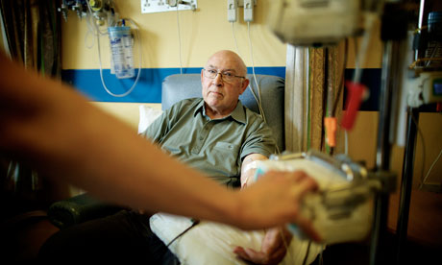
Quality of care measurement
But how patients perceive their care is also important
Patient reports about care are used to assess the patient’s experiences.
Focus has been on expert consensus about clinical process
Variant of RAND Delphi Method

Slide 5
Consumer Assessment of Healthcare Providers and Systems (CAHPS®) Approach
Focus on what patients want to know about AND can accurately report about
  Communication with health care provider
  Access to care
  Staff courtesy and respect

Slide 6
CAHPS relies on reports about care
How often did your personal doctor explain things in a way that was easy to understand?
[ ] Never
[ ] Sometimes
[ ] Usually
[ ] Always

Slide 7
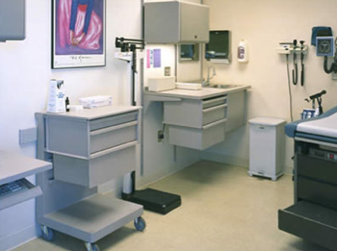
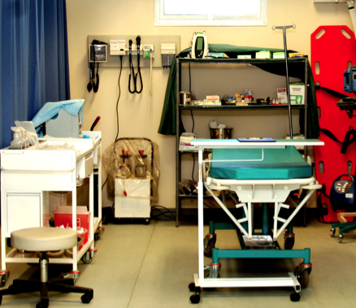
CAHPS has a family of surveys
Ambulatory Care
  Clinician & Group Survey
  Dental Plan Survey
  ECHO® Survey
  Health Plan Survey
  Home Health Care Survey
  Surgical Care Survey
Facility
  Hospital Survey
  Nursing Home Survey
  In-Center Hemodialysis Survey

Slide 8








CAHPS Tipping Point was its
Widespread Adoption
. . . and its link to payment through ACA

Slide 9
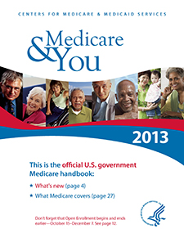
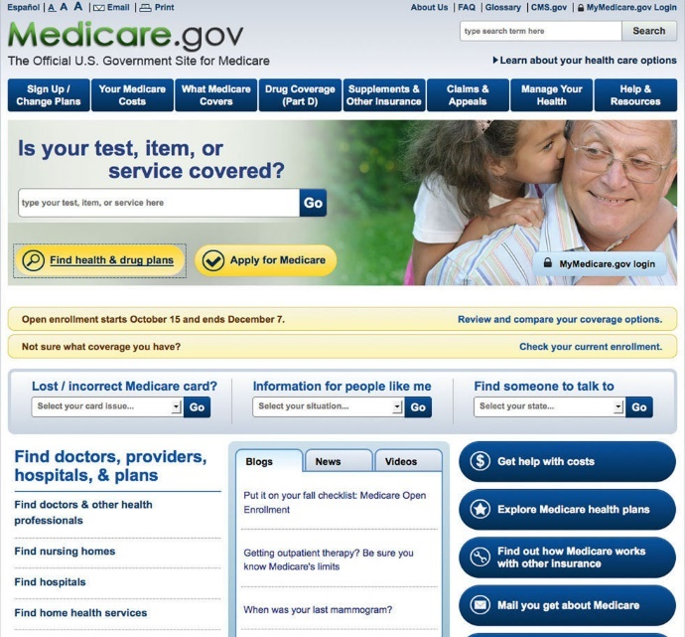
Public reporting of CAHPS Data
Centers for Medicare & Medicaid Services (CMS) reports MCAHPS data by plan and state
  Mails booklets
  Online tool
Helps beneficiaries choose coverage
Makes plan performance transparent

Slide 10
Use of and importance of patient experience surveys has grown…
CAHPS Hospital Survey (HCAHPS) data accounted for 30% of hospitals’ Total Performance Score in Value-Based Purchasing Program in FY2014
…greater scrutiny

Slide 11

Use of and importance of patient experience surveys has grown…
CAHPS Hospital Survey (HCAHPS) data accounted for 30% of hospitals’ Total Performance Score in Value-Based Purchasing Program in FY2014
…greater scrutiny
..and more misinformation

Slide 12
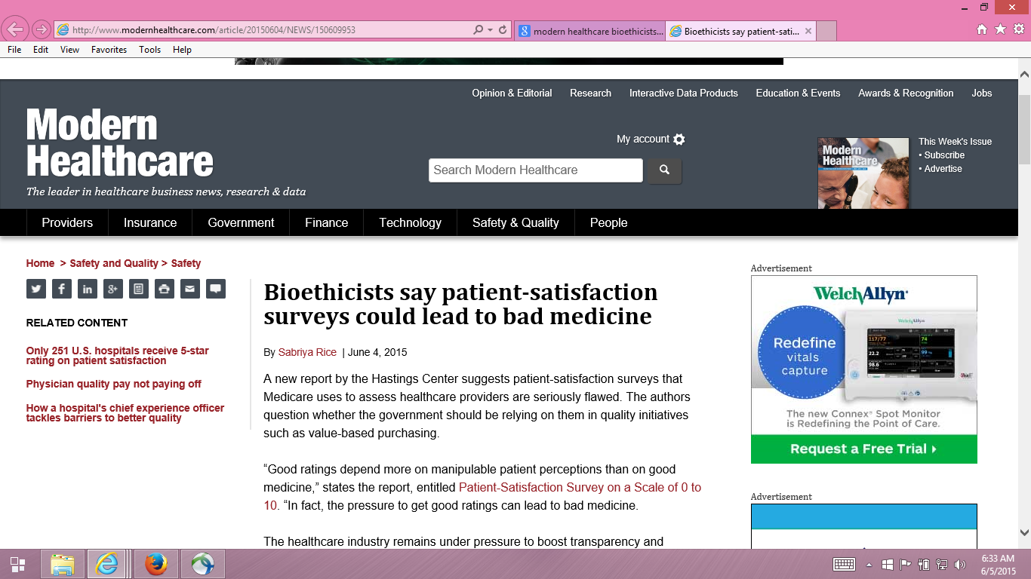

Slide 13
Providers motivated to fulfill patient desires, regardless of appropriateness
“Pressure to get good ratings can lead to bad medicine.”
  Dr. Stuart Younger, Professor of Bioethics and Psychiatry at the Case Western Reserve University (Hastings Center Report)

Slide 14

October 7, 2018

Slide 15
Providers motivated to fulfill patient desires, regardless of appropriateness?
Higher intensity care is not related to better outcomes
Good communication is important in addressing unreasonable expectations
“Patient satisfaction can be maintained in the absence of request fulfillment if physicians address patient concerns in a patient-centered way.” (Fenton et al. 2012)

Slide 16
HCAHPS Survey, Pain Management, and Opioid Misuse: The CMS Perspective
Clarifying Facts, Myths, and Approaches
CMS believes that effective communication with patients about pain and treatment, including options other than prescription medicine when appropriate, is the preferred way to improve patient experience of care.
In the process of developing the HCAHPS Survey, we did not find that experience with pain dominated patients’ overall assessment of the hospital experience.
http://www.qualityreportingcenter.com/wp-content/uploads/2016/02/IQR_20160126_QATranscript_vFINAL508.pdf

Slide 17
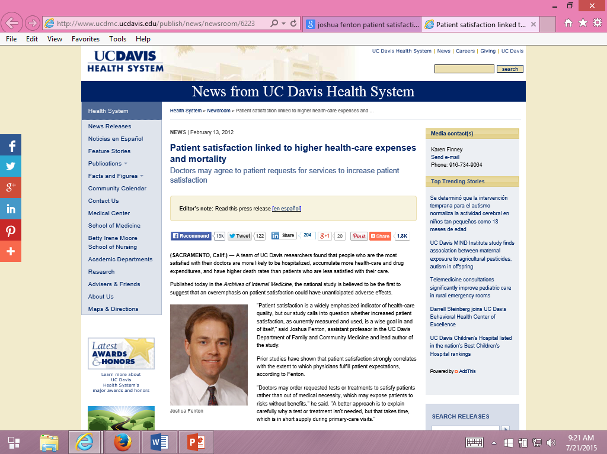
Fenton suggested patients can be “satisfied” to death.

Slide 18
Patient Experiences and Mortality:
Significant for Only One Item
Patient Care Experience Items | All-Cause Mortality
 | Hazard Ratio | p-value
Rating of healthcare 9-10 vs 0-8 | 1.10 | 0.15
Listen carefully to you † | 0.98 | 0.76
Show respect for what you had to say † | 1.05 | 0.44
Explain things in a way that is easy to understand † | 1.09 | 0.17
Spend enough time with you † | 1.17 | 0.03
† “Always" versus “Never”/“Sometimes”/“Usually”

Slide 19
Is Receiving Better Technical Quality of Care Bad for Health?
Change in SF-12 PCS regressed on process of care aggregate
Hypothesized positive effect, but regression coefficient was
NOT SIGNIFICANT
Unstandardized beta = -1.41, p =.188
Kahn et al. (2007), Health Services Research, Article of Year
Process
of care
SF-12 PCS

Slide 20
Patient Reports are Weakly Related to Clinical Indicators

Slide 21

Patient Reports are Weakly Related to Clinical Indicators
Systematic review (55 studies)
Wide range of disease areas, setting, designs, and outcome measures
Consistent Positive Associations
  Patient experience
  Patient safety
  Clinical effectiveness
Kemp, K. A., Santana, M. J., Southern, D. A., McCormack, B., & Quan, H. (2016).
Association of inpatient hospital experience with patient safety
indicators: A cross-sectional Canadian study. BMJ Open, 2016;6: e011242

Slide 22

Patient-reported data cannot be fairly compared across providers
My patients are different (e.g., sicker) than patients of other providers
Patient reports are determined by factors outside the control of the provider
  -> Patient characteristics that are systematically related to patient reports and not indicative of care quality included in casemix adjustment.
  e.g., older age, lower education, better self-rated health

Slide 23
Collecting patient experience data is too burdensome and expensive
Patients are more burdened by invasive medical tests than responding to surveys.
Survey data collection is not free but newer technologies can reduce costs.

Slide 24
Patient surveys are subjective and do not provide valid information
Patient reports are “subjective” and providers have concerns about their scientific properties (Boyce et al., 2014, Implementation Science)
Patient reports are as reliable (and valid) as clinical measures
  Hahn, E. A. et al., (2007). Precision of health-related quality of life data compared with other clinical measures. Mayo Clinic Proceedings, 82 (10), 1244-1254.

Slide 25
Example of CAHPS Team Responses
Cefalu M.S., Elliott, M. N., Setodji, C. M. Cleary, P. M., & Hays, R. D. (2018 epub). The role of multidimensionality in hospital quality reporting. Health Services Research.
Price, R. A. et al. (2014). Examining the role of patient experience surveys in measuring health care quality. Medical Care Research and Review, 71, 522-554.
Price, R. A. et al. (2015). Should health care providers be accountable for patients’ care experiences? JGIM, 30, 253-256.
Xu, X., et al. (2014). Methodological considerations when studying the association between patient-reported care experiences and mortality. Health Services Research. 50(4), 1146-61.

Slide 26
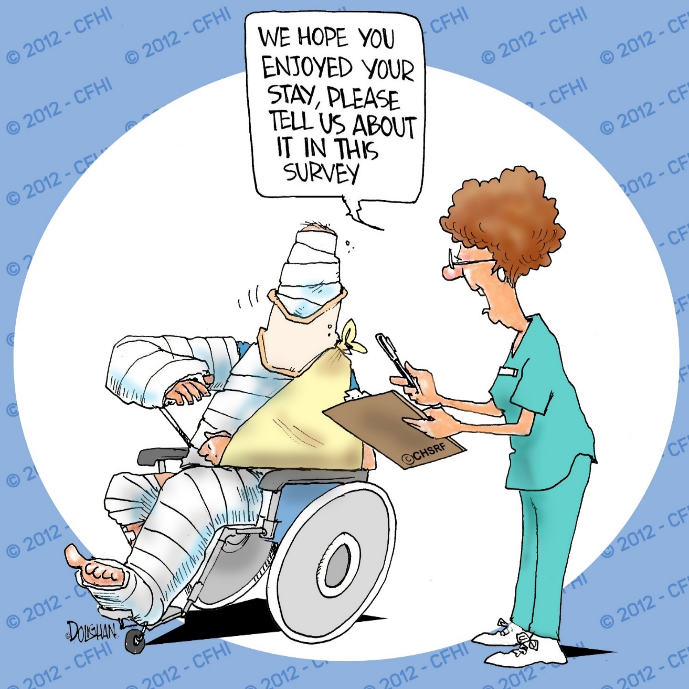
Questions?

Slide 27

This is a master header/text slide
Calibri 28 font
SAVE THE DATE
HealthMeasures User Conference
June 4 – 6, 2019 Chicago, Illinois
For researchers, clinicians, and others using PROMIS®, Neuro-QoL, ASCQ-Me®, and NIH Toolbox®
Case studies, expert training, peer-to-peer learning, and opportunities for networking and collaboration
Call for Proposals now available at www.HealthMeasures.net/2019UserConference

