Slide 1
The Current State of Patient-Reported Outcome Measures for Eye and Vision Conditions
.
Ron D. Hays
Workshop on Patient-Reported Outcomes (PROs) and
Vision-Related Quality of Life (QoL) Questionnaires
https://labs.dgsom.ucla.edu/hays/pages/presentations
September 29, 2023 ~ 10:40-11:05 ET
I have no financial interests or relationships to disclose.

Slide 2
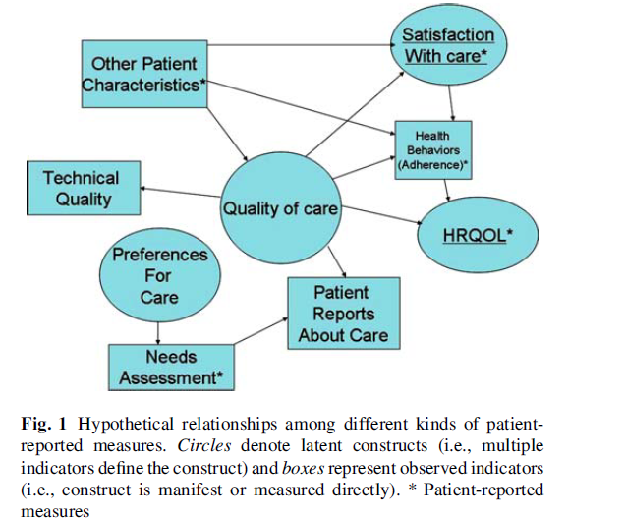
Environment
Fung & Hays, 2008

Slide 3

Health-Related Quality of Life (HRQOL)
How the person FEELs (well-being)
  Emotional well-being
  Pain
  Energy
What the person can DO (functioning)
  Self-care
  Role
  Social

Slide 4

Types of HRQOL Measures
Generic
  SF-36, EQ-5D-5L, PROMIS-29
Targeted
  Gender-targeted (Women’s Health Questionnaire)
  Age-targeted (Geriatric Depression Scale)
  Single ocular condition
    Cataracts (Cat-PROM5)
  Multiple conditions/vision-targeted
    NEI-VFQ

Slide 5
Assessment of HRQOL 27 years ago
“Except for a small number of studies designed to assess outcome after cataract extraction, measurement of visual functioning and health-related quality of life has rarely been incorporated into ophthalmologic research” (Mangione, Lee et al., 1996, p. 1045).

Slide 6
NEI VFQ Focus Groups
26 focus groups with 246 adults
  Primary open-angle glaucoma (n = 82)
  Diabetic retinopathy (n = 58)
  Cataract (n = 42)
  Age-related macular degeneration (n = 35)
  CMV retinitis (n = 17)
  Low vision (n = 12)
  Mangione, Berry et al. (1998)

Slide 7
51-item NEI VFQ Pilot (n = 262) and Field (n=597) Tests
  Cataracts, macular degeneration, diabetic retinopathy, glaucoma, cytomegalovirus retinitis, low vision
    1:Color vision (1 item, 1 item)
    2:Distance vision (7 items, 3 items)
    3:Driving (4 items, 3 items)
    4: General health (2 items, 1 item)
    5: General vision (2 items, 1 item)
    6: Near vision (7 items, 3 items)
    7: Ocular pain (2 items, 2 items)
    8: Peripheral vision (1 item, 1 item)
    Vision-specific:
      9: Dependency (5 items, 3 items), 10: Expectations for future vision (2 items, 0 items), 11: Mental health (8 items, 4 items), 12: Role difficulties (5 items, 2 items), 13: Social function (4 items, 2 items)
  Mangione, Lee et al. (1998); Mangione, Lee et al. (2001)

Slide 8
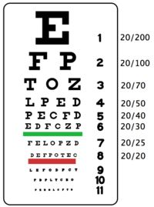
Los Angeles Latino Eye Study (LALES)
Population-based prevalence study of 6,357 Latino adults 40 or older (82% of eligible) living in Los Angeles (La Puente), California:
Baseline: 02/2000—04/2003
Follow-up: 01/2004---05/2008
5,213 for baseline analyses (15% less due to missing data)
Mean age = 55 (40-98 range)
61% female; 49% employed
66% less than high school education
75% responded in Spanish
McKean, Varma et al. (2007, 2010); Varma, Wu et al. (2006)

Slide 9
Change in Best Corrected VA Over Four Years
Two-line loss associated with small decreases in:
  ES=0.33: General vision
  ES= 0.41: Vision-related dependency
  ES=0.42: Driving difficulty
  ES=0.43: Vision-related mental health
Two-line gain associated with small to large improvements in:
  ES=0.30: Ocular pain
  ES=0.39: Color vision
  ES=0.46: Near vision
  ES=0.80: Driving difficulty

Slide 10
Cost-Effectiveness of Health Care
Cost ↓
Effectiveness (“Utility”) ↑

Slide 11
Six-Item Visual Function Questionnaire Utility Index (VFQ-UI)
6. How much difficulty do you have doing work or hobbies that require you to see well up close, such as cooking, sewing, fixing things around the house, or using hand tools? (near vision)
14. Because of your eyesight, how much difficulty do you have going out to see movies, plays, or sports events? (distance vision)
18. Are you limited in how long you can work or do other activities because of your vision? (role function)
25. I worry about doing things that will embarrass myself or others, because of my eyesight. (mental health)
20. I stay home most of the time because of my eyesight. (dependency)
11. Because of your eyesight, how much difficulty do you have seeing how people react to things you say? (social function)
Kowalski, Rentz et al. (2012); Rentz, Kowalski et al. (2014)

Slide 12
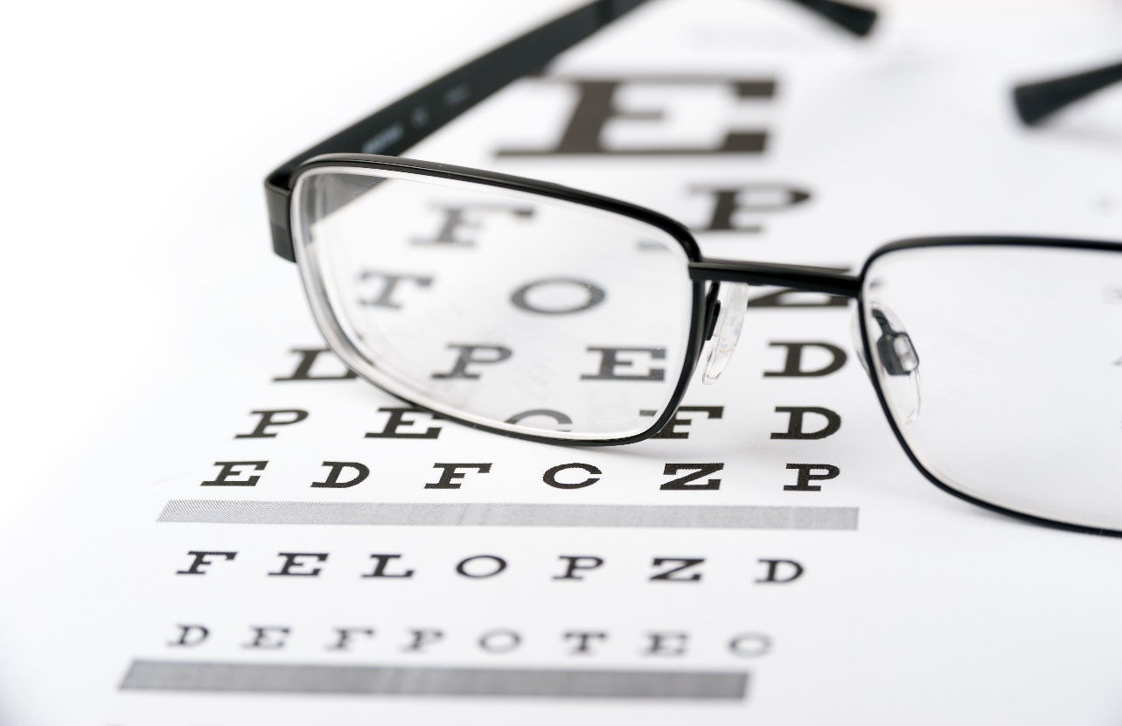
VFQ-UI
Sample of 607 adults (Australia, Canada, U.K., U.S.)
Time trade-off preference elicitation for 8 health states
  Indifference: t = 10 years in the health state vs x years full health
    x/t = preference for health state
  0.34 (pits) to 0.96 (best health state)
Estimated 15,625 possible states
  Kowalski et al. (2012) and Rentz et al. (2014)

Slide 13

A Plethora of Measures Have Been Developed
Ocular Surface Disease Index (OSDI)
Impact of Dry Eye in Everyday Life (IDEEL)
Symptom Assessment iN Dry Eye (SANDE)
University of North Carolina Dry Eye Management Scale (UNC DEMS)
BLepharItIS Symptom (BLISS) measure
Dry Eye-Related Quality-of-Life Score (DEQS) questionnaire
Meibomian gland dysfunction (MGD)-specific questionnaire
National Eye Institute Visual Function Questionnaire 25-Item (NEI-VFQ-25)
Ocular Comfort Index (OCI) questionnaire
Standard Patient Evaluation of Eye Dryness (SPEED) questionnaire
Vision core Measure1 (VCM1)
Recchioni A, Aiyegbusi OL, Cruz-Rivera S, Rauz S, Slade A. A systematic review assessing the quality of patient
reported outcomes measures in dry eye diseases. PLoS One. 2021 Aug 9;16(8):e0253857.

Slide 14
A Plethora of Measures Have Been Developed
Ocular Surface Disease Index (OSDI)
Impact of Dry Eye in Everyday Life (IDEEL)
Symptom Assessment iN Dry Eye (SANDE)
University of North Carolina Dry Eye Management Scale (UNC DEMS)
BLepharItIS Symptom (BLISS) measure
Dry Eye-Related Quality-of-Life Score (DEQS) questionnaire
Meibomian gland dysfunction (MGD)-specific questionnaire
National Eye Institute Visual Function Questionnaire 25-Item (NEI-VFQ-25)
Ocular Comfort Index (OCI) questionnaire
Standard Patient Evaluation of Eye Dryness (SPEED) questionnaire
Vision core Measure1 (VCM1)
Recchioni A, Aiyegbusi OL, Cruz-Rivera S, Rauz S, Slade A. A systematic review assessing the quality of patient
reported outcomes measures in dry eye diseases. PLoS One. 2021 Aug 9;16(8):e0253857.
“The majority of the studies evaluating PROMs included in this review did not meet the recommended COSMIN criteria
and the quality of the PROMs evaluated is not assured.”

Slide 15
Top 10 (out of 41) Glaucoma Measures
SF-36
NEI-VFQ-25
Glaucoma Quality of Life-36
Glaucoma Quality of Life-15
Glaucoma Activity Limitation
Aberdeen Glaucoma Questionnaire
Viswanathan Questionnaire
Symptom Impact Glaucoma (SIG)
Comparison of Ophthalmic Medications for Tolerability (COMTof)
Treatment Satisfaction Survey for Intraocular Pressure
Gazzard G, Kolko M, Iester M, Crabb DP; Educational Club of Ocular Surface and Glaucoma (ECOS-G) Members. A Scoping Review of Quality of Life Questionnaires in Glaucoma Patients. J Glaucoma. 2021 Aug 1;30(8):732-743.

Slide 16
Top 10 (out of 41) Glaucoma Measures
SF-36
NEI-VFQ-25
Glaucoma Quality of Life-36
Glaucoma Quality of Life-15
Glaucoma Activity Limitation
Aberdeen Glaucoma Questionnaire
Viswanathan Questionnaire
Symptom Impact Glaucoma (SIG)
Comparison of Ophthalmic Medications for Tolerability (COMTof)
Treatment Satisfaction Survey for Intraocular Pressure
Gazzard G, Kolko M, Iester M, Crabb DP; Educational Club of Ocular Surface and Glaucoma (ECOS-G) Members. A Scoping Review of Quality of Life Questionnaires in Glaucoma Patients. J Glaucoma. 2021 Aug 1;30(8):732-743.
“Development of a new questionnaire that could better distinguish between treatments in terms of vision and treatment-related QoL would be useful that includes the patient perspective of treatment effects as well as meeting requirements of regulatory and health authorities.”

Slide 17

Lazy eye and crossed eyes
71 PROMs including the NEI-VFQ-25 used to study the impact of strabismus and/or amblyopia.
Kumaran SE, Khadka J, Baker R, Pesudovs K. Patient-reported outcome measures in amblyopia and strabismus: a systematic
review. Clin Exp Optom. 2018 Jul;101(4):460-484. doi: 10.1111/cxo.12553.

Slide 18
Lazy eye and crossed eyes
71 PROMs including the NEI-VFQ-25 used to study the impact of strabismus and/or amblyopia.
Kumaran SE, Khadka J, Baker R, Pesudovs K. Patient-reported outcome measures in amblyopia and strabismus: a systematic
review. Clin Exp Optom. 2018 Jul;101(4):460-484. doi: 10.1111/cxo.12553.
“Only four questionnaires …have been subjected to modern psychometric tests and the
AS-20 was found to have better psychometric properties than others; however, none of
these instruments offer comprehensive measurement of QoL.”

Slide 19
NEI Refractive Error Quality of Life Instrument
No differences between groups on the SF-36.
Emmetropes scored a little better than hyperopes on the NEI VFQ-25, and myopes did not differ from emmetropes.
  Emmetropes scored significantly better than hyperopes and myopes on NEI-RQL

Slide 20

Other Patient-Reported Outcome Measures
Psychosocial Impact of Assistive Devices
Refractive Status Vision Profile
Quality of Life Impact of Refractive Correction
Quality of Vision (QOV) Questionnaire

Slide 21

-connected Patient-Reported Outcome Measures
Patient-Reported Outcomes with LASIK Symptoms and Satisfaction (PROWL-SS); 2011-2014
Assessment of IntraOcular Lens Implant Symptoms (AIOLIS) instrument; 2019-2022
Glaucoma Outcomes Survey (GOS); 2021-2023

Slide 22

Future Directions
Should we build upon the NEI-VFQ?
Definitions and pictures to assess ocular symptoms?
Readability assessment?
Analytic issues
  “Modern” methods and assessing individuals

Slide 23

Should We Build Upon the NEI-VFQ?
NIH and other funding agencies should require that measures developed with their support be:
  Made available to the research community without fees.
  Posted on a publicly available website.
  Hays, Weech-Maldonado et al. (2018)

Slide 24
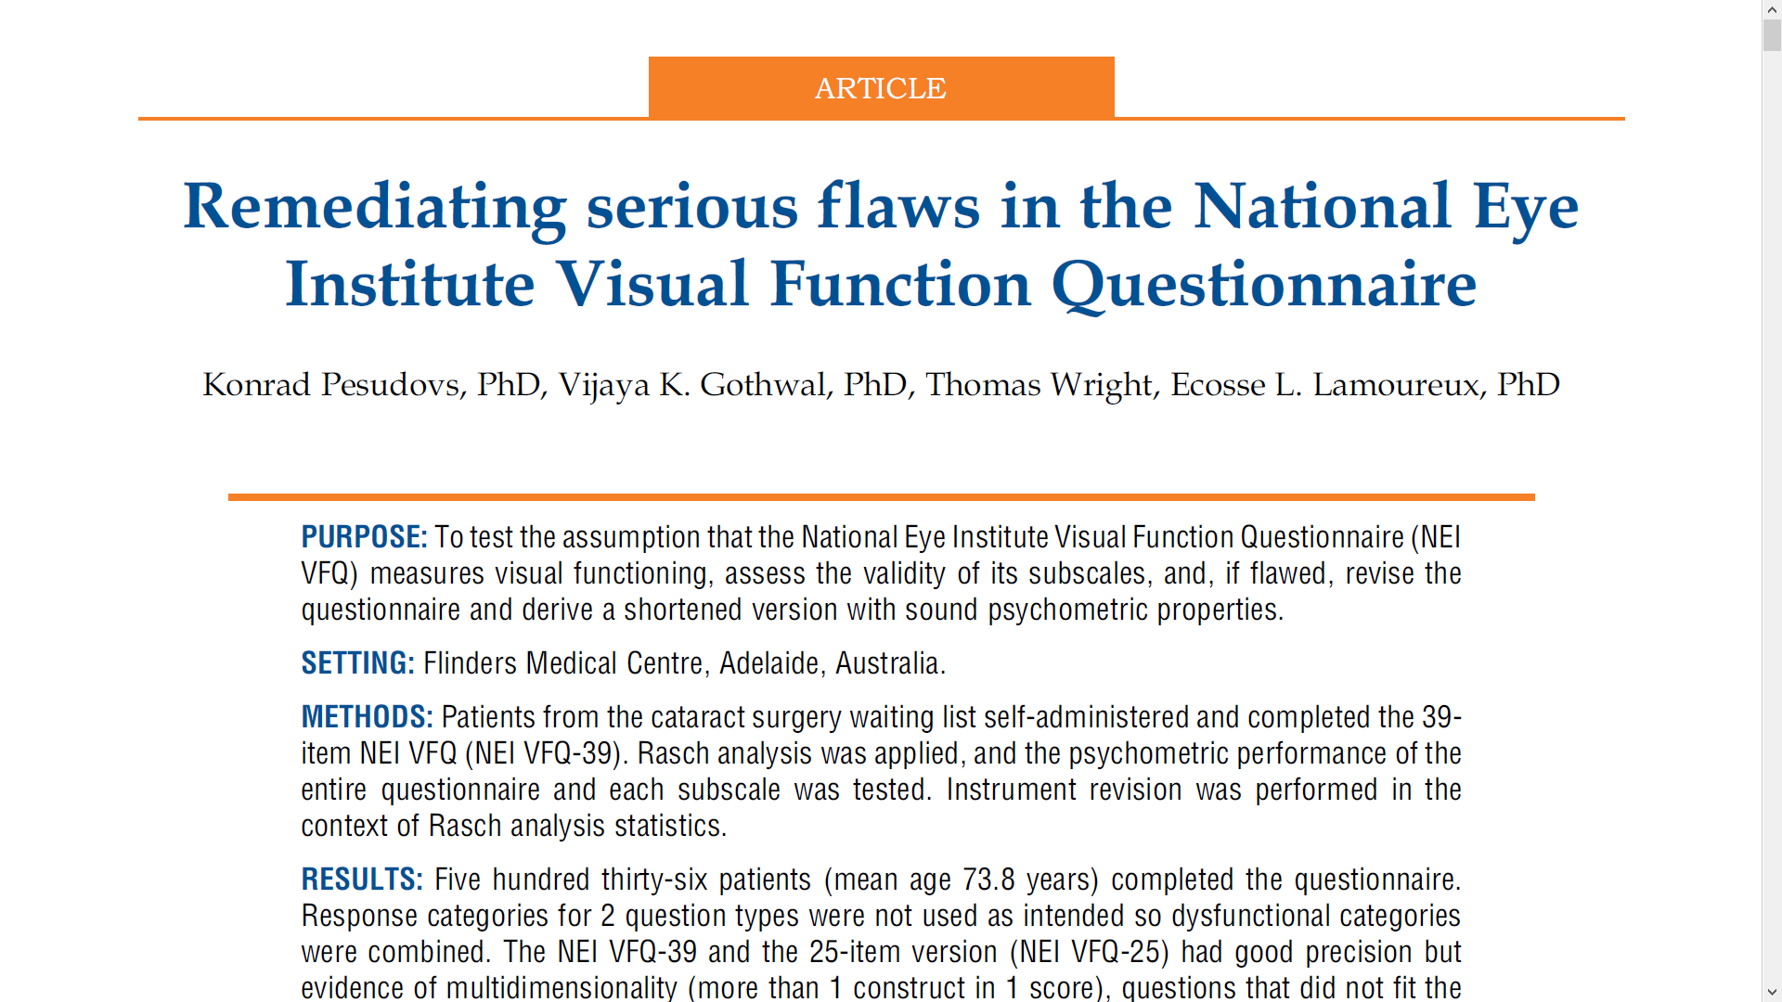


Slide 25

The NEI-VFQ-25 items are not unidimensional
Mangione et al. (1998, p. 1502)
  “Interscale correlations suggest that the 12 descriptive scales represent multiple dimensions of vision-targeted HRQOL.”
NEI-VFQ-25 User Manual
  https://www.rand.org/content/dam/rand/www/external/health/surveys_tools/vfq/vfq25_manual.pdf
  “Average the vision-targeted subscale scores, excluding the general health rating question.”
Using the Rasch model to evaluate a 25-item scale is inappropriate.

Slide 26
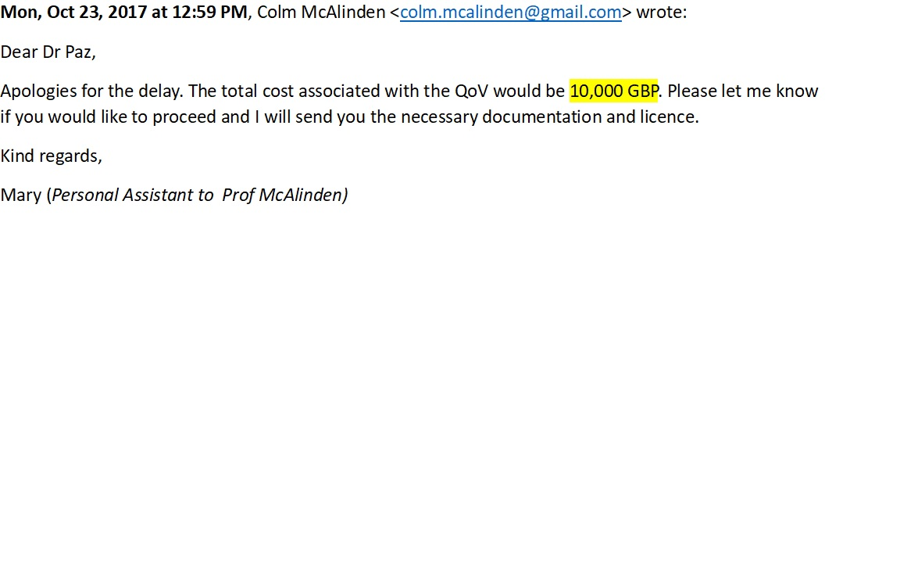
$12,600 to use the
Quality of Vision (QoV) Questionnaire
* 10,000 GBP = 12,600 U.S. dollars

Slide 27


All questionnaire
are flawed but
some are useful.

Slide 28

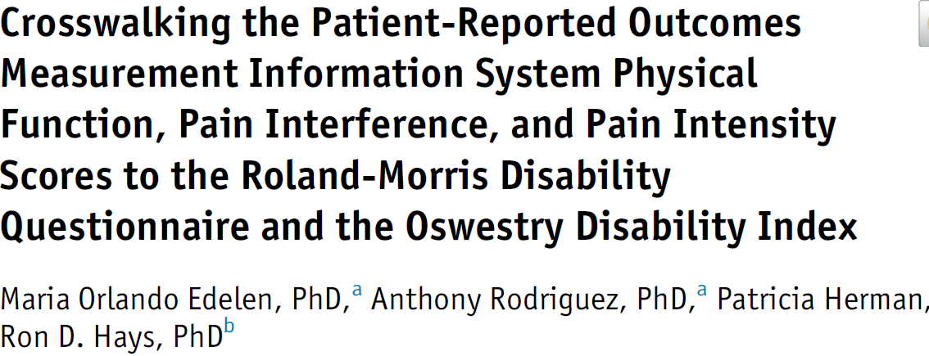
Linking/crosswalking to NEI-VFQ
Item response theory
  https://www.prosettastone.org/
Regression

Slide 29
NIH Toolbox Vision-targeted HRQOL Measure
Literature review
Drafting, winnowing and revising items
Cognitive interviews
Field test
  Factor analysis
  Classical test theory and item response theory analyses
Item response theory graded response theory item parameters
  https://labs.dgsom.ucla.edu/hays/pages/surveys

Slide 30
Literature Review
NEI-VFQ-25
Graves Ophthalmopathy Quality of Life Questionnaire
Impact of Visual Impairment
Low Vision Quality of Life Questionnaire
NEI Refraction Error Quality of Life Questionnaire
Quality of Life and Vision Function Questionnaire
Refractive Status and Vision Profile
Visual Function-14
Impact of Dry Eye on Everyday Living
Activities of Daily Vision Scale
Visual Activities Questionnaire
Low Luminance Questionnaire

Slide 31
NIH Toolbox Vision-targeted HRQOL Domains
Color vision (3 items)
Distance vision (16 items)
Near vision (13 items)
Ocular symptoms (7 items)
Psychosocial (9 items)
Role performance (5 items)
Paz et al. (2013)

Slide 32
Hays, Tarver et al. (2017)

Slide 33
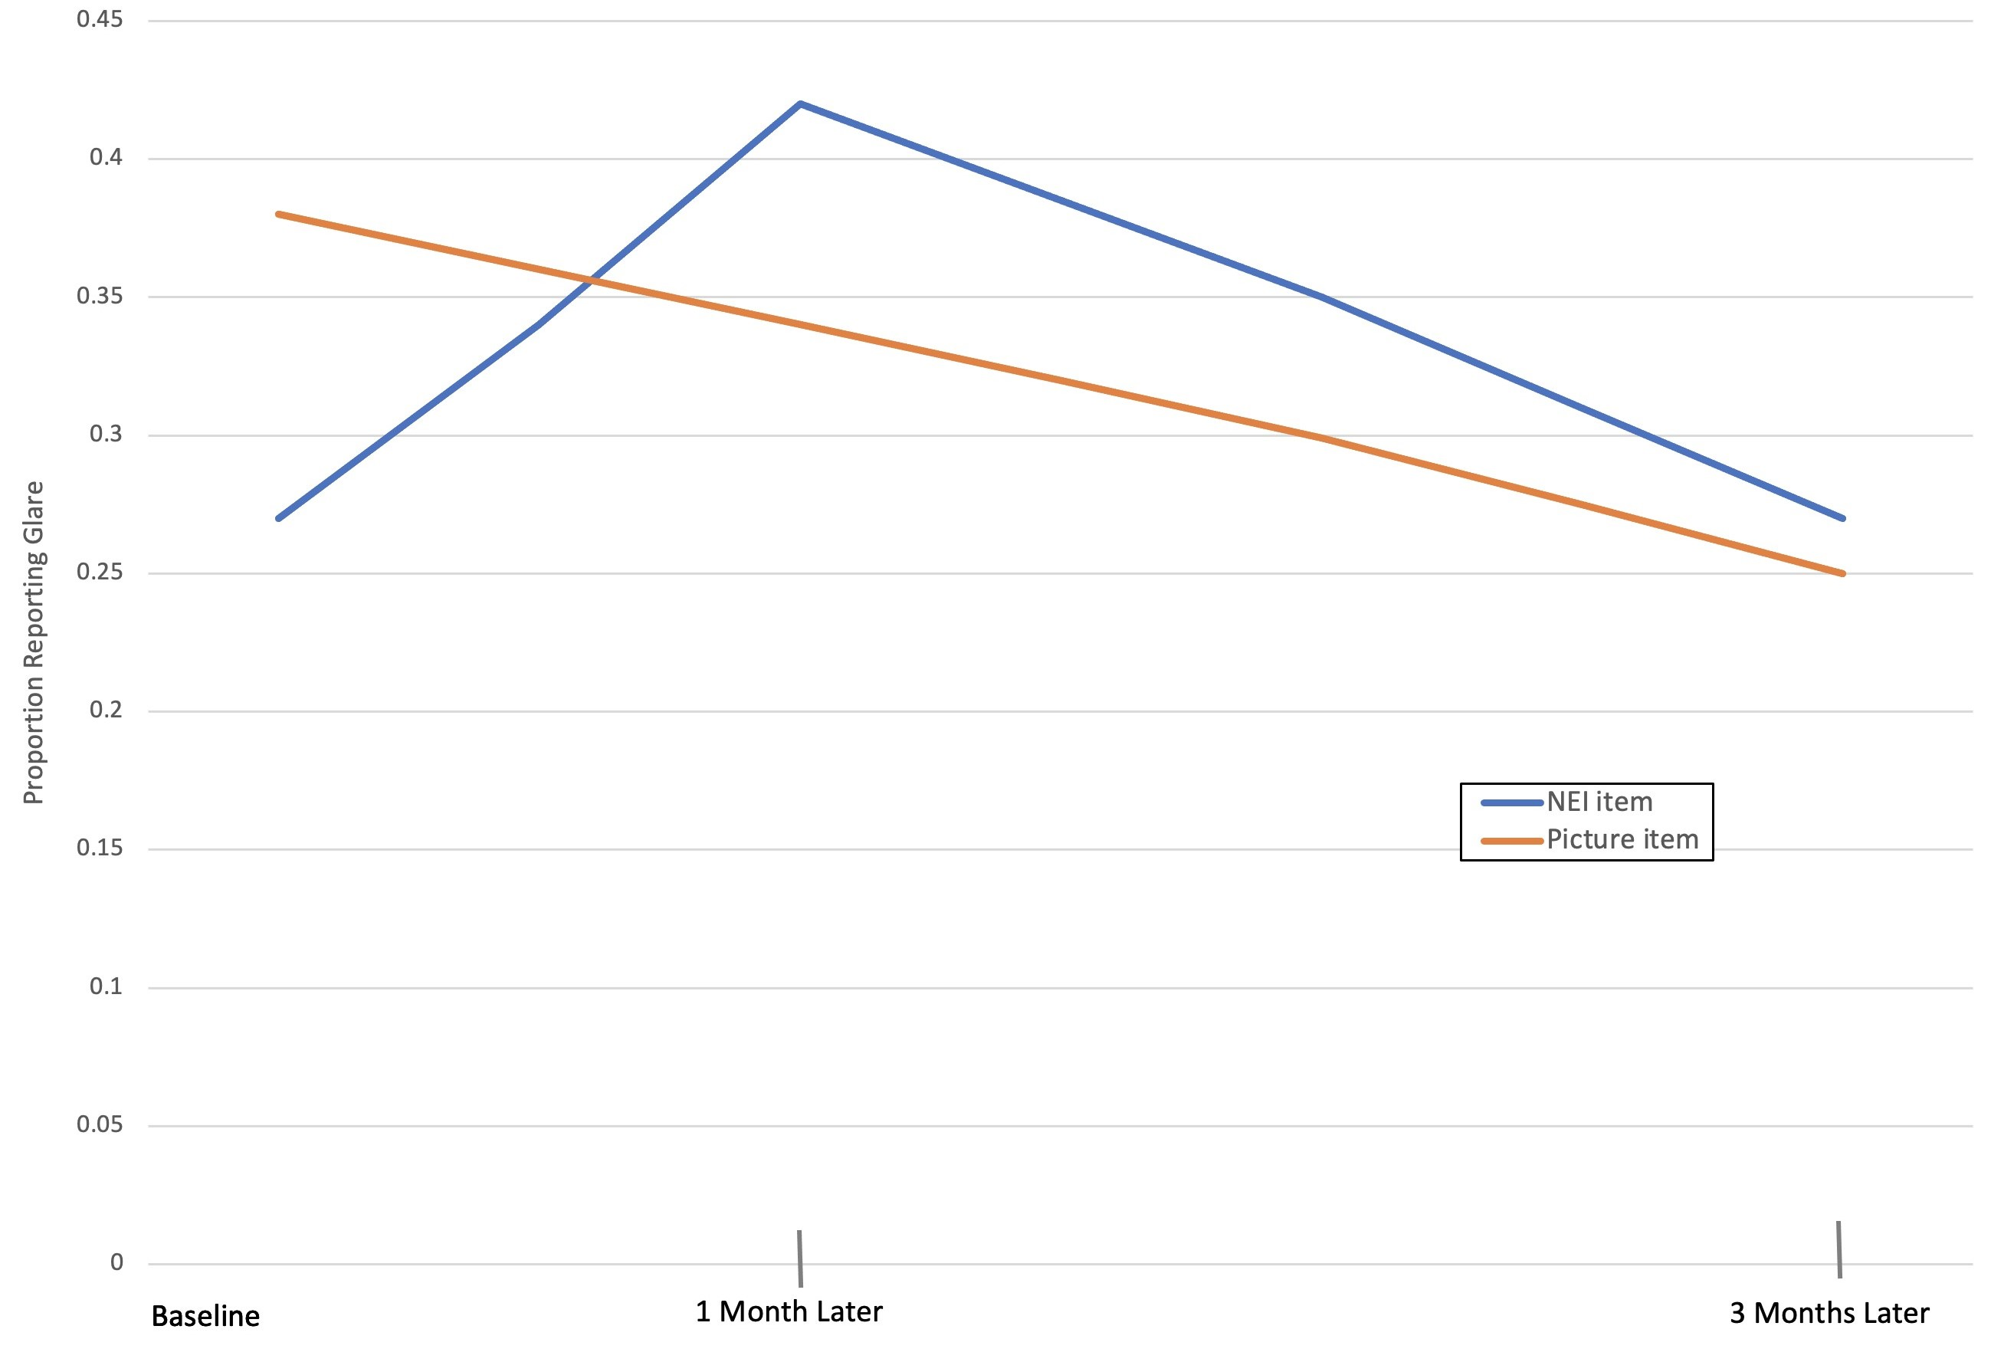
495 patients in the Patient-Reported Outcomes With LASIK (PROWL) Study
42%
Johnston et al., in press
38%
34%
27%
27%
25%
NEI: Have you experienced glare in the last 7 days?
Picture: In the last 7 days, have you noticed any glare?

Slide 34
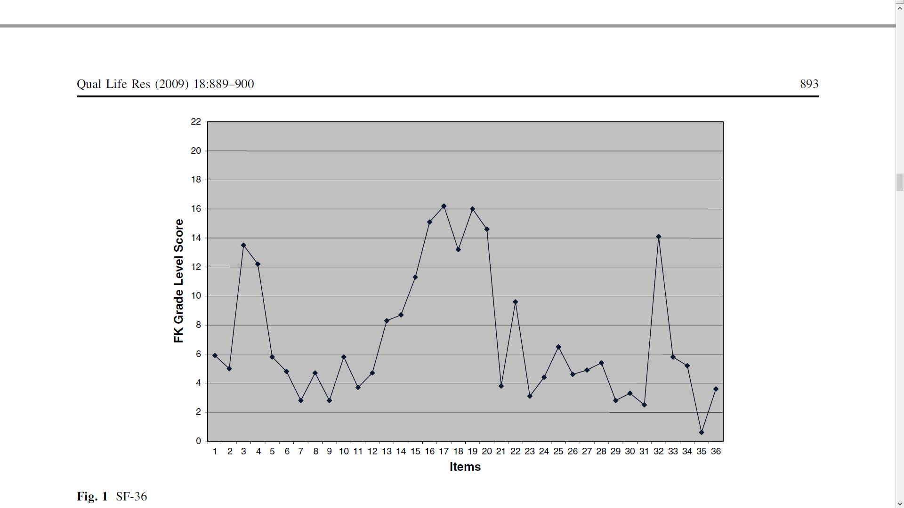


FK = 0.39 * (n of words/n of sentences) + 11.8 * (n of syllables/n of words) – 15.59
Readability of the SF-36 Items
Mean = 7th grade
Paz et al. (2009)

Slide 35
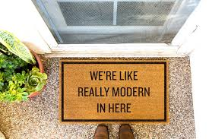
Caution about So-Called “Modern” Methods
Rasch and IRT are not "modern" or new.
  70-90 years old
"Most say it made it to the mainstream … with the publication of Lord and Novick's (1968) Statistical Theories of Mental Test Scores, which makes the last 4 to 5 decades the second half of IRT's history….
Seminal articles by Thurstone (1925) and Symonds (1929), or with Lawley's (1943) description of the use of maximum likelihood for the computation of scores” (Thissen, 2016, J Educ & Beh Statistics, p. 81).

Slide 36
Simple sum and IRT scores are highly correlated
Average correlation between simple sum and IRT scores
  Math ability (r = 0.98) and reading ability (r = 0.98)
    Fan (1998)
Correlations of simple sum and Rasch scores
  0.95 before surgery and 0.97 post-surgery: 5-item general vision scale
    Hays, MacRae et al. (2023)
  0.97 or higher for Five Facet Mindfulness Questionnaire
    Shallcross et al. (2020)

Slide 37
Individual Assessment: Person Misfit
Person misfit may be suggestive of response carelessness or cognitive errors due to survey items being difficult to comprehend….
Person fit using the standardized Z(L) fit index. Large negative Z(L) values indicate response patterns that are unlikely given the model.
On PROMIS physical functioning item bank someone reported
a little difficulty being out of bed most of the day.
but
able to run 5 miles without any difficulty
Reise (1990); Hays, Calderón et al. (2018)

Slide 38
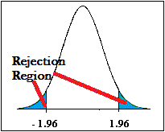
Identifying “Responders”: Reliable Change Index (RCI)
>= 1.96
SEM = standard error of measurement
SD_{bl} = standard deviation at baseline
r_{xx} = reliability

Slide 39
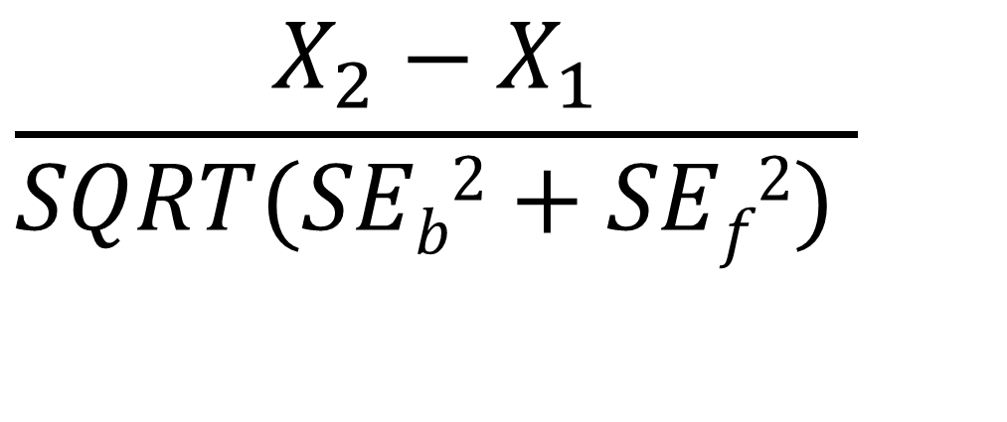
IRT Reliable Change Index (IRT)
$$\frac{X_{2}−X_{1}}{SQRT(SEb2+SEf2) }$$
SE_{b}² = Variance at baseline, SE_{f}² = Variance at follow-up
Jabrayilov et al. (2016). Hays, Spritzer & Reise (2021)

Slide 40
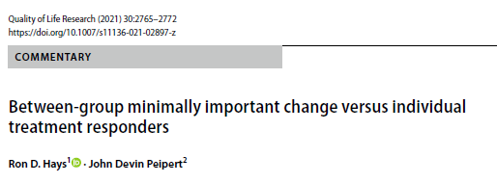
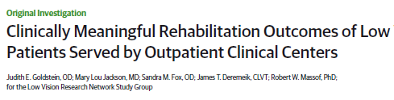
Note: Some Authors Have Erroneously
Used minimally important difference (MID) estimates to identify responders
  As detailed by Hays & Peipert (2021)
Referred to significant individual change as MID/MCID
  Goldstein et al. (2015, 2022)

Slide 41

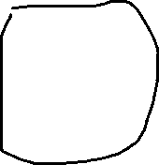
Hays & Peipert (2021)

Slide 42
Change over 6 Weeks Among 750 active-duty U.S. military with low back pain
59% reported retrospectively that they were a little better, moderately better, much better, or their pain was completely gone post-baseline.
37% statistically significant improvement (using RCI).
Most desirable: 33% improved significantly and reported being better
Intermediate:
  4% improved significantly but reported not being better
  26% did not improve significantly but reported being better
Least desirable: 37% did not improve significantly or report being better
Hays & Peipert (2021)

Slide 43


drhays@ucla.edu
https://labs.dgsom.ucla.edu/hays/pages/presentations

