Slide 1

Patient Experience of Care is an Indicator of Quality of Care
Ron D. Hays, Ph.D., UCLA
September 26, 2016 (12:00-1:30pm)
University of New Mexico
Department of Internal Medicine
Division of Nephrology

Slide 2



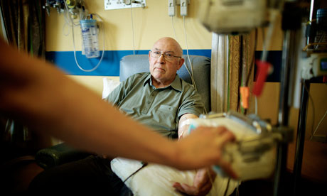
We Measure Quality of Care to Improve It
Find out how well they are doing
Providers
Government/
Private Insurers
Identify best/worst healthcare providers
Choose best health care for themselves
Patients

Slide 3
How Do We Measure Quality of Care?
If diabetic, bare feet should be examined at least once every 15 months.
  American Diabetes Association (1998)
Focus has been on expert consensus about clinical process.
Variant of RAND Delphi Method

Slide 4
How Do We Measure Quality of Care?
But how patients perceive their care also important
CAHPS® project measures patient experiences.
Focus has been on expert consensus about clinical process; variant of RAND Delphi Method
  e.g., If diabetic, bare feet should be examined at least once every 15-months
Cavanaugh, 2016, Patient experience assessment is a requisite for quality evaluation: A discussion of the In-Center Hemodialysis CAHPS survey. Seminars in Dialysis.

Slide 5
Consumer Assessment of Healthcare Providers and Systems (CAHPS®) Approach
Complements information from clinical process measures
Focus on what patients want to know about AND can accurately report about
  Communication with health care provider
  Access to care
  Office staff courtesy and respect
  Customer service

Slide 6
Quality of Care Indicators
Process of care
  Clinical indicators (expert consensus)
  Patient reports (CAHPS®, 1995)
Health
  Clinical indicators
  Patient reports (PROMIS®, 2004)

Slide 7
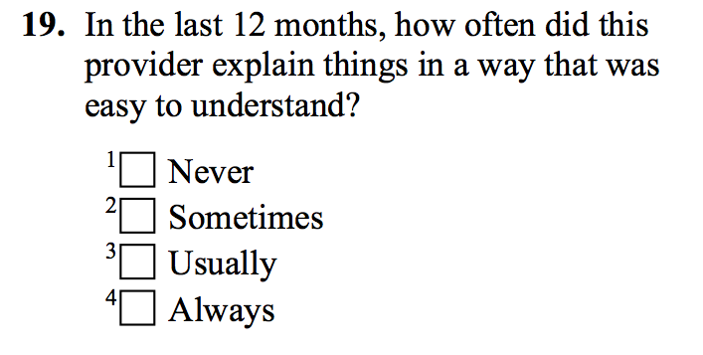
Rather than Assessing Patient Satisfaction, CAHPS Relies on Reports About Care

Slide 9
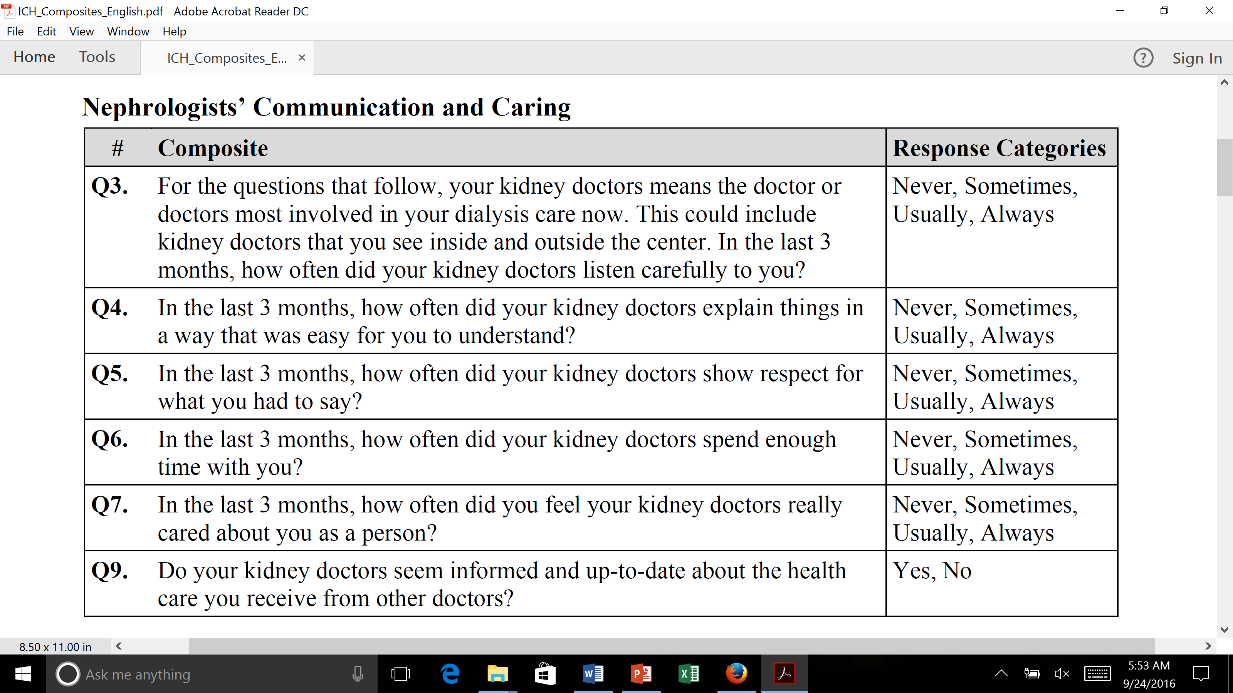
In-Center Hemodialysis Items

Slide 10

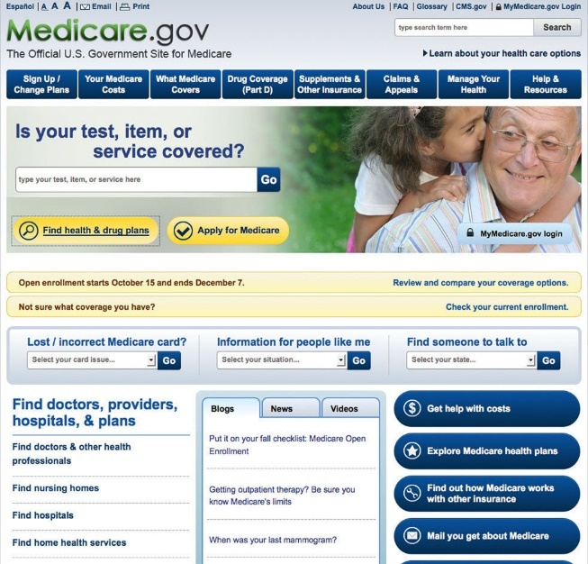
CAHPS Survey Implementation
Develop surveys
  Stakeholder input
Train and oversee survey vendors
Analyze and report plan-level data
  Casemix adjustment
Report to plans/providers for quality improvement

Slide 11
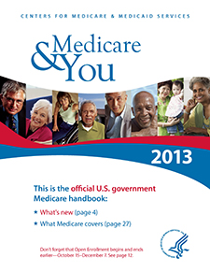

Public reporting of CAHPS Data
Centers for Medicare & Medicaid Services (CMS) reports MCAHPS data by plan and state
  Mails booklets
  Online tool
Helps beneficiaries choose coverage
Makes plan performance transparent

Slide 12








CAHPS Tipping Point was its
Widespread Adoption
. . . and its link to payment through ACA

Slide 13
Use of and importance of patient experience surveys has grown…
CAHPS Hospital Survey (HCAHPS) data accounted for 30% of hospitals’ Total Performance Score in Value-Based Purchasing Program in FY2014
…greater scrutiny

Slide 14

Use of and importance of patient experience surveys has grown…
CAHPS Hospital Survey (HCAHPS) data accounted for 30% of hospitals’ Total Performance Score in Value-Based Purchasing Program in FY2014
…greater scrutiny
..and more misinformation

Slide 15
Requiring CAHPS Team Response
Price, R. A. et al. (2014). Examining the role of patient experience surveys in measuring health care quality. Medical Care Research and Review, 71, 522-554.
Price, R. A. et al. (2015). Should health care providers be accountable for patients’ care experiences? JGIM, 30, 253-256.
Xu, X., et al. (2014). Methodological considerations when studying the association between patient-reported care experiences and mortality. Health Services Research. 50(4), 1146-61.

Slide 16
Patient surveys are subjective and do not provide valid information
Patient reports are “subjective” and providers have concerns about their scientific properties (Boyce et al., 2014, Implementation Science)
Patient reports are as reliable (and valid) as clinical measures
  Hahn, E. A. et al., (2007). Precision of health-related quality of life data compared with other clinical measures. Mayo Clinic Proceedings, 82 (10), 1244-1254.

Slide 17
Patient Reports are Weakly Related to Clinical Indicators

Slide 18

Patient Reports are Weakly Related to Clinical Indicators
Systematic review (55 studies)
Wide range of disease areas, setting, designs, and outcome measures
Consistent Positive Associations
  Patient experience
  Patient safety
  Clinical effectiveness

Slide 19
Patient Reports are Weakly Related to Clinical Indicators
Systematic review (55 studies)
Wide range of disease areas, setting, designs, and outcome measures
Consistent Positive Associations
  Patient experience
  Patient safety
  Clinical effectiveness
Kemp, K. A., Santana, M. J., Southern, D. A., McCormack, B., & Quan, H. (2016).
Association of inpatient hospital experience with patient safety
indicators: A cross-sectional Canadian study. BMJ Open, 2016;6: e011242

Slide 20
Patient Reports are not actionable
Patient surveys assess what is important to patients.
  Patients want and need to know this information when choosing among providers.
Patient reports used in quality improvement
  Improves communication between patients and providers.

Slide 21

Patient-reported data cannot be fairly compared across providers
My patients are different (e.g., sicker) than patients of other providers
Patient reports are determined by factors outside the control of the provider
  -> Patient characteristics that are systematically related to patient reports and not indicative of care quality included in casemix adjustment.
  e.g., older age, lower education, better self-rated health

Slide 22
Because of low response rates, survey respondents are unrepresentative
Maximize participation rates.
Survey nonresponse does not necessarily lead to bias in comparisons.
Casemix adjustment can compensate for nonresponse bias.

Slide 23
Collecting patient experience data is too burdensome and expensive
Connie Anderson from Northwest Kidney Centers spoke in opposition to KDQOL-36 due to burden, saying I-CAHPS was more important on NQF renal committee call Friday.
Patients are more burdened by invasive medical tests than responding to surveys.
Survey data collection is not free but newer technologies can reduce costs.

Slide 24
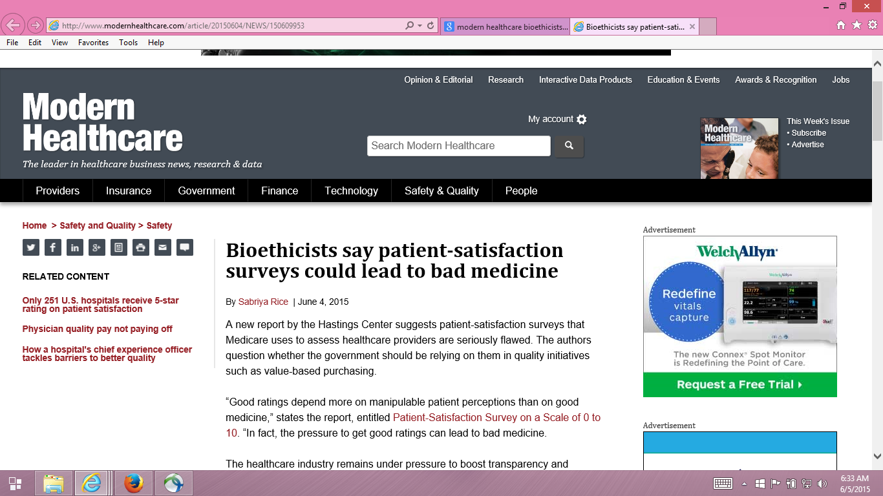

Slide 25
Providers motivated to fulfill patient desires, regardless of appropriateness
“Pressure to get good ratings can lead to bad medicine.”
  Dr. Stuart Younger, Professor of Bioethics and Psychiatry at the Case Western Reserve University (Hastings Center Report)

Slide 26
Providers motivated to fulfill patient desires, regardless of appropriateness?
Higher intensity care is not related to better outcomes
Good communication is important in addressing unreasonable expectations
“Patient satisfaction can be maintained in the absence of request fulfillment if physicians address patient concerns in a patient-centered way.” (Fenton et al. 2012)

Slide 27
Podcast Addressing Concerns
about CAHPS Surveys
Can patients really report on the quality of the care they receive?
Do patients’ expectations affect how they respond to CAHPS survey questions about their providers?
Is there a tradeoff between positive patient experiences and favorable clinical outcomes?
To help users of CAHPS surveys address these and other questions, the Agency for Healthcare Research and Quality (AHRQ) released a podcast: “CAHPS Surveys: Sorting Fact From Fiction,” featuring Rebecca Anhang Price, PhD.
Listen to this podcast: https://cahps.ahrq.gov/news-and-events/podcasts/cahps-surveys-podcast.html

Slide 28
HCAHPS Survey, Pain Management, and Opioid Misuse: The CMS Perspective
Clarifying Facts, Myths, and Approaches
CMS believes that effective communication with patients about pain and treatment, including options other than prescription medicine when appropriate, is the preferred way to improve patient experience of care.
In the process of developing the HCAHPS Survey, we did not find that experience with pain dominated patients’ overall assessment of the hospital experience.
http://www.qualityreportingcenter.com/wp-content/uploads/2016/02/IQR_20160126_QATranscript_vFINAL508.pdf

Slide 29




Slide 30
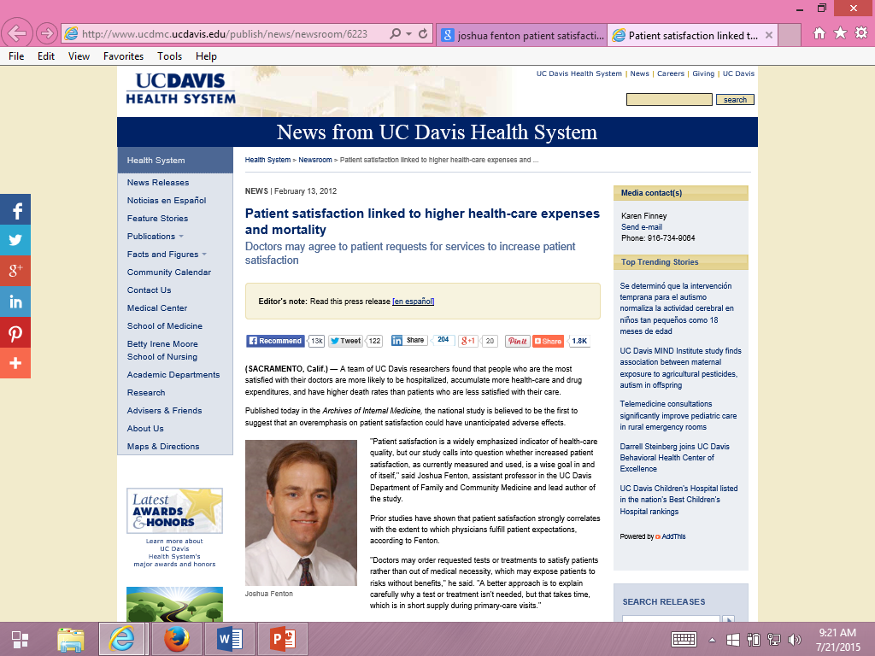
Some suggest patients can be “satisfied” to death.

Slide 31
Fenton et al. (2012)
Archives of Internal Medicine
2000-2005 Medical Expenditure Panel Survey cohorts
  Nationally representative survey of U.S. civilian non-institutionalized population. Panels followed over 2 calendar years with 5 rounds of interviews (baseline, 6 months, 12 months, 18 months, 24 months).
  n = 34,180
Four CAHPS communication (last 12 months) and 0-10 rating of health care item from round 2 (round 4 not used)
  Quartile from average of standardized scores for 5 items
Results interpreted as indicating that acceding to patient demands results in expensive and dangerous treatment.

Slide 32
Five Concerns with Fenton et al.
Unmeasured variables. Adjusted for age, gender, race/ethnicity, education, income, metropolitan statistical area, census region, access to usual source of care, insurance coverage, smoking, number of chronic conditions, self-rated general health, SF-12 PCS and MCS, number of prescription meds, medical care expenditures, number of office visits, any ER visits, any inpatient admissions, and MEPS cohort … but associations still may be due to unmeasured variables (e.g., severity of illness).
  Sicker patients may need more information and clinicians may spend more time with them.
Estimated effect was implausibly large, suggesting good patient experience is more dangerous than having major chronic conditions.

Slide 33
Is Receiving Better Technical Quality of Care Bad for Health?
Change in SF-12 PCS regressed on process of care aggregate
Hypothesized positive effect, but regression coefficient was NOT SIGNIFICANT
unstandardized beta = -1.41, p =.188
Kahn et al. (2007), Health Services Research, Article of Year
Process
of care
SF-12 PCS

Slide 34
Five Concerns with Fenton et al.
3. Only amenable deaths can be prevented by health care.
  Prognosis for those with end-stage pancreatic cancer is not modifiable
  by the type of care they receive.
  Only 21% of the 1,287 deaths in the study were amenable to health care.
    Nolte, E. and C. M. McKee. 2008. Measuring the health of nations: updating an earlier analysis. Health Aff (Millwood) 27(1): 58-71.
Patient experiences with care vary over time.
  Used CAHPS data at MEPS round 2 to predict mortality 3 months to 6 years later.
  > half of deaths occurred more than 2 years later.
  Among those with best (quartile 4) experiences at round 2, > half had worse experiences 1 year later
Only looked at 5-item CAHPS aggregate

Slide 35
Reanalysis of Fenton et al.
(Xu et al., 2014)
Same data used by Fenton et al. (Note: Fenton would not share his computer code with us.)
  2000-2005 Medical Expenditure Panel Survey data
  National Health Interview Survey and National Death Index
Same statistical analysis
  Cox proportional hazards models with mortality as the dependent variable and patient experience measures as independent variables
But, unlike Fenton et al.
  Separated non-amenable and amenable deaths
  Considered consistency of patient experience and death
  Looked at individual items to better understand the patient experience with mortality association

Slide 36
Patient Experiences and Mortality:
Non-Amenable vs. Amenable Deaths
Patient Care Experience | Non-Amenable Mortality |  | Amenable Mortality
 | Hazard Ratio | p-value | Hazard Ratio | p-value
Quartile 1 (reference) | (1.00) |  | (1.00)
Quartile 2 | 1.07 | 0.56 | 1.27 | 0.25
Quartile 3 | 0.96 | 0.70 | 1.28 | 0.25
Quartile 4 (most positive) | 1.26 | 0.03 | 1.23 | 0.32
Overall p-value for patient care experience quartiles |  | 0.03 |  | 0.59
Adjusted for age, gender, race/ethnicity, education, income, metropolitan
statistical area, census region, access to usual source of care, insurance coverage,
smoking status, number of chronic conditions, self-rated overall health, SF-12
PCS/MCS, number of drug prescriptions, medical care expenditures, number of
office visits, any ER visits, any inpatient admissions, and MEPS cohort.

Slide 37
Patient Experiences and Mortality:
Consistency of Experiences Over Time
Patient Care Experience (baseline : 1 year later) | All-Cause Mortality
 | Hazard Ratio | p-value
Quartile 1 : Quartile 1 (reference) | (1.00)
Quartile 2 : Quartile 2 | 0.89 | 0.42
Quartile 3 : Quartile 3 | 1.13 | 0.57
Quartile 4 : Quartile 4 | 1.09 | 0.54
Different quartiles at baseline and 1 year later | 0.88 | 0.35

Slide 38
Patient Experiences and Mortality:
Significant for Only One Item
Patient Care Experience Items | All-Cause Mortality
 | Hazard Ratio | p-value
Rating of healthcare 9-10 vs 0-8 | 1.10 | 0.15
Listen carefully to you † | 0.98 | 0.76
Show respect for what you had to say † | 1.05 | 0.44
Explain things in a way that is easy to understand † | 1.09 | 0.17
Spend enough time with you † | 1.17 | 0.03
† “Always" versus “Never”/“Sometimes”/“Usually”

Slide 39

Fenton et al. (2012)
“Patient-centered communication requires longer visits and may be challenging for many physicians to implement.”

Slide 40
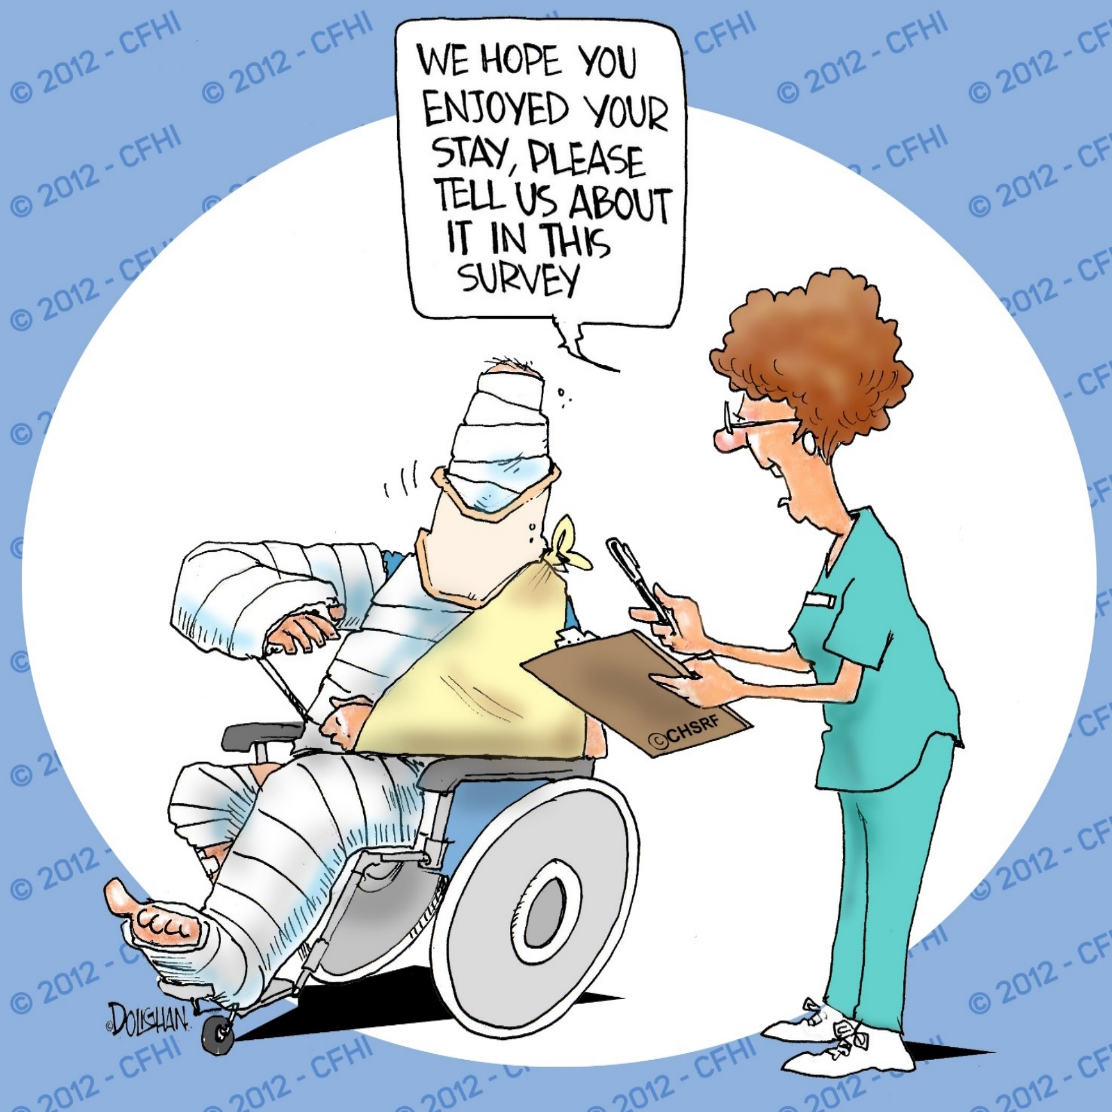
drhays@ucla.edu @RonDHays (twitter)
Powerpoint file at: http://gim.med.ucla.edu/FacultyPages/Hays/
Notes:
40

