Slide 1
Online Panels for Data Collection
Ron D. Hays and Honghu Liu (UCLA)
Arie Kapteyn (USC)
RCMAR/EXPORT
Methodological Seminar Series https://uclahs.webex.com (meeting # 806 592 178)
December 15, 2014 (3-4pm)

Slide 2
CTSI Competencies
1) Assess the strengths and weaknesses of possible study designs for a given clinical or translational research question.
2) Design a research data analysis plan.
3) Assess threats to internal validity in any planned or completed clinical or translational study, including selection bias, misclassification, and confounding.

Slide 3

http://www.surveypolice.com/opinion-miles-club

Slide 4
https://www.opinionmilesclub.com/
Bait and switch repeatedly. Plus, they collect information for 20 or more minutes, then say "not a match" or conveniently develop a technical glitch so that you can't complete the survey.
The help desk is beyond frustrating, work off of a script and seem incapable of addressing any problem. The only thing they "help" with is to issue the same stock response and refuse to put one in touch with a supervisor.
This is, by far, one of the absolute worst survey sites ever!

Slide 5

Non-Probability (Convenience) Internet Panels
NIH Toolbox
  Multidimensional set of brief measures assessing cognitive, emotional, motor and sensory function from ages 3 to 85.
Delve, Inc databases assembled using online self-enrollment, enrollment through events hosted by the company, and telephone calls from market research representatives

Slide 6
Convenience Internet Panels
PROs
  Relatively inexpensive and faster
  Able to get to low incidence subgroups
CONs
  Data integrity
    False answers
    Answering too fast
    Same answer repeatedly
    Duplicate surveys from same person
  Respondents may differ from intended target on measured (more educated) and on unmeasured characteristics

Slide 7
Convenience Internet Panels differ from Underlying Population
2002 Health and Retirement Study (HRS) sample of 11,279 of 55 and older population
30% reported internet access
Predicted internet access from
  Race/ethnicity, gender, education, age, marital status, income, owns house, and self-rated health
Schonlau, M. A. et al. (2009). Selection bias in web surveys and the use of propensity scores. Sociological Methods and Research, 37, 291-318.

Slide 8
Internet Sample vs. Full Sample
Variable | Internet sample | Weighted internet sample | Full sample
High blood pressure | 44% | 52% | 55%
Depressed | 11% | 15% | 19%
Difficulty dressing | 4% | 7% | 9%
Difficulty walking several blocks | 15% | 27% | 31%

Slide 9
Probability Panels
Selection probabilities known.
  Need sampling frame (denominator)
Get internet access for those without it.

Slide 10
Telepanel (1980’s)
Started by Willem Saris, Professor of sociology at the University of Amsterdam
  Recruited a sample of 1000 Dutch and gave them computers and modems.
  Panel asked to download a survey every weekend, answer and upload it to the central modem pool.
Sold panel to a market research agency.
http://en.wikipedia.org/wiki/Willem_Saris

Slide 11
CentERpanel (1990s)
Saris started another (larger) panel
  Panel size = 3k
Sold to Tilburg Univ. Center for Economic Research
CentERpanel still exists and is the oldest internet probability panel in the world.
Notes:
For the sake of full disclosure: I was the director of CentER and bought the panel and named it the CentERpanel.

Slide 12
Subsequent probability panels
1999: Knowledge Networks (now GFK), U.S.
  Address-based sampling
  Approximate recruiting response rate = 15%
  Panel size = 55k
2006: Longitudinal Internet Studies for the Social Sciences, Netherlands
  Population registry-based sampling
  Recruited face-to-face and telephone
  Approximate recruiting response rate = 45%
  Panel size = 7.5k

Slide 13


Subsequent probability panels (2)
2006: American Life Panel, U.S.
  Recruited by RDD, face-to-face, and address-based
  Approximate recruiting response rate = 15%
  Panel size = 6k
2014: Understanding America Study, U.S.
  Address-based sampling
  Approximate recruiting response rate = 20%
  Panel size = 2k

Slide 14
Patient-Reported Outcomes Measurement Information System (PROMIS®)
Polimetrix (now YouGov)
Non-probability based recruitment of panel
> 1 million members who regularly participate in online surveys
Liu et al. (2010). Representativeness of the Patient-Reported Outcomes Measurement Information System internet panel. J Clinical Epidemiology, 63, 1169-1178.

Slide 15
Sample-Matching Methodology
Target subset with selected characteristics
  n = 11,796 overall
  Subgroups with lower response rates oversampled
PROMIS targets (“Quota sampling”)
  50% female
  20% 18-29, 30-44, 45-59, 60-74 and 75+
  12.5% black, 12.5% Hispanic
  10% < high school graduate

Slide 16
PROMIS Internet Sample versus Census
 | PROMIS Sample | 2000 Census
% Female | 55% | 52%
% Hispanic | 13% | 11%
% Black | 10% | 11%
% < High school | 3% | 20%
% High school/GED | 19% | 29%
% > High school | 78% | 51%
Mean age | 50 | 45

Slide 17
Analytic Weights
(Post-Stratification Adjustment)
Compensate for nonresponse and non-coverage
Weight sample to have same distribution on demographic variables
    Gender, age, race/ethnicity, education, marital status, and income
Iterative proportional fitting or raking

Slide 18
Raking
Matches cell counts to the marginal distributions of the variables
Performs cell-by-cell adjustments
Repeated iteratively until convergence between the weighted sample and U.S. Census distributions

Slide 19
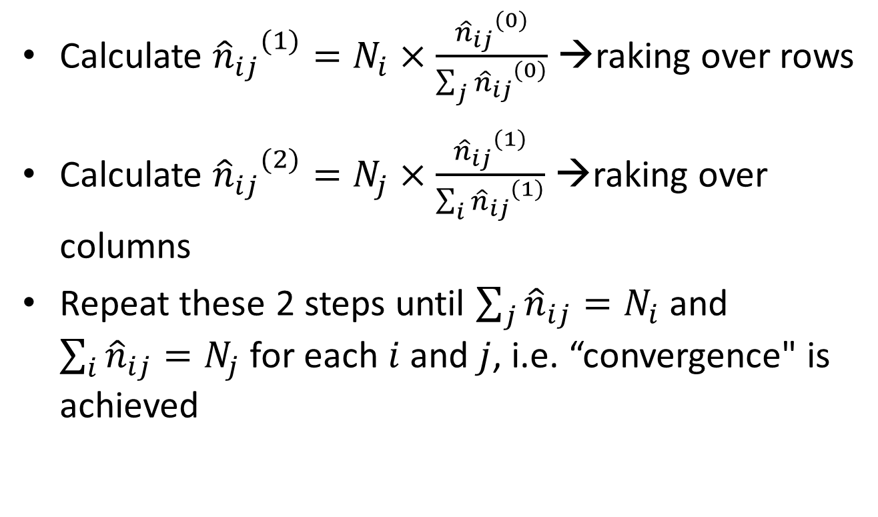
Raking Algorithm
Calculate ${{\hat{n}}_{ij}}^{(1)}=N_{i}×\frac{{{\hat{n}}_{ij}}^{(0)}}{\sum_{j}{{{\hat{n}}_{ij}}^{(0)}}}$ →raking over rows
Calculate ${{\hat{n}}_{ij}}^{(2)}=N_{j}×\frac{{{\hat{n}}_{ij}}^{(1)}}{\sum_{i}{{{\hat{n}}_{ij}}^{(1)}}}$ →raking over columns
Repeat these 2 steps until $\sum_{j}{{\hat{n}}_{ij}=N_{i}}$ and $\sum_{i}{{\hat{n}}_{ij}=N_{j}}$ for each $i$ and $j$, i.e. “convergence" is achieved
Notes:
Superscript 0=initial frequency
Superscript 1,2…. iterations
n_ij hat=cell frequency for sample row i, column j
N_i=population frequency for row i
Sum_j(n_ij_hat)=row i total for sample
N_j=population frequency for column j
Sum_i(n_ij_hat)=column j total for sample
Sum_j(n_ij hat)=summation of cell frequency across j columns for sample row i
Sum_i(n_ij hat)=summation of cell cell frequency across i rows for sample column j

Slide 20
Raking Example
Grouping by Gender & Race
Sample | Black | White | Asian | Native American | Other | Sum of Weights | Pop. Sum
Female | 300 | 1200 | 60 | 25 | 30 | 1615 | 6500
Male | 150 | 1080 | 93 | 30 | 32 | 1385 | 5725
Sum of Weights | 450 | 2280 | 150 | 60 | 60 | 3000
Pop. Sum | 2000 | 9000 | 700 | 250 | 275 |  | 12225
Notes:
Suppose that the true population counts for the marginal totals are: …

Slide 21

Raking Example (-con’t)
Adjust rows first. Multiply each row by $\frac{\text{true} \text{row} \text{pop}}{\text{estimated} \text{row} \text{pop}}=\frac{6500}{1615}$ for female row, $\frac{5725}{1385}$ for male row
Now row margins are right, but column margins aren't. So, we rake over columns
Repeat, until convergence
 | Black | White | Asian | Native American | Other | Sample Sum | Pop. Sum
Female | 1207 | 4830 | 241 | 101 | 121 | 6500 | 6500
Male | 620 | 4464 | 384 | 124 | 132 | 5725 | 5725
Sample Sum | 1827 | 9294 | 626 | 225 | 253 | 12225
Pop. Sum | 2000 | 9000 | 700 | 250 | 275 |  | 12225

Slide 22
Raking--Summary
Response probabilities depend only on the row and column and not on the specific cell
Allow to include more variables
Converge to Cell weighting if the auxiliary variables are independent
Convergence can be slow, and occasionally impossible

Slide 23
PROMIS Weighted Sample
A raking benchmarking to variables (gender, age, race/ethnicity, education, marital status and income) common to both the PROMIS and the 2000 Census.
The weights assigned to individual respondents
Marginal distributions on auxiliary variables were equivalent between the PROMIS and 2000 Census.
Notes:
A raking method was used for population weighting adjustment, benchmarking to 4 variables (age, sex, region, and education, and race/ethnicity) common to both common to both the PROMIS and the 2000 Census
The sample was weighted to have the same distribution of demographic variables (gender × age × race/ethnicity, education, marital status and income) as the U.S. Census.
Raking used an iterative proportional fitting procedure to ensure that the weights assigned to individual respondents lead to marginal distributions on auxiliary variables that were equivalent in the PROMIS and Census.

Slide 24
PROMIS Internet Sample (Weighted) versus Census
 | PROMIS Sample | 2000 Census
% Female | 52% | 52%
% Hispanic | 11% | 11%
% Black | 11% | 11%
% < High school | 20% | 20%
% High school/GED | 29% | 29%
% > High school | 51% | 51%
Mean age | 45 | 45

Slide 25
PROMIS General Population Sub-sample
A subset of the PROMIS internet sample
Sub-sample approximated the joint distributions of key demographic variables in the 2000 U.S. Census:
  Age
  Gender
  Race/ethnicity

Slide 26
Algorithm to Obtain PROMIS General Sub-sample
Obtain the marginal distribution of gender, age, and race/ethnicity of the PROMIS Internet general population
Create grids of cells: 2 (gender: Male, Female) × 5 (age: 18 to 29, 30 to 44, 45 to 59, 60 to 74, 75+) × 4 (race/ethnicity: African American, White, Hispanic, Other race) = 40 cells
Calculate the frequency of responses for each cell for the PROMIS sample: with i = 1,2; j = 1,2,3,4,5; k = 1,2,3,4.
Calculate the corresponding percentage for each cell based on census data (SF4): with i = 1,2; j = 1,2,3,4,5; k = 1,2,3,4 with general U.S. population.
Compute the sample size for each cell for the sub-sample:
Within each cell, draw random sample from general population.
Notes:
In the formula, the minimum is over i, j and k.

Slide 27
GENERAL HEALTH
In general, how would you rate your health? (5 = excellent; 4 = very good; 3 = good; 2 = fair; 1 = poor)
Sample | Mean (1-5 possible score)
PROMIS general population sub-sample | 3.53
PROMIS (Weighted) | 3.42
2004 Medical Expenditure Panel Survey (MEPS) | 3.56
2001-2002 National Health and Nutrition Examination Survey (NHANES) | 3.50
2005 Behavioral Risk Factor Surveillance System (BRFSS) | 3.52

Slide 28
Tests of Equivalence
The non-significance of the traditional differences testing between groups does not allow us to conclude equivalence
  The observed p-value can only be used as a measure of evidence against H0, not for proving H0
  Having a small sample would allow us to retain the null hypothesis
  Need Equivalence Test
Notes:
The typical method of looking for differences between groups does not technically allow us to conclude equivalence just because we do not reject null hypothesis
The observed p-value can only be used as a measure of evidence against the null hypothesis, not for proving it
Having a small sample would allow us to the retain the null hypothesis
When to use equ test?
When we are trying to prove that sample and population are essentially equivalent, that any difference is of no practical consequence, scientifically or clinically.
Reference:
http://www.graphpad.com/library/biostatsspecial/article_182.htm
Testing for equivalence is not just the opposite of testing for significant differences.
In most experimental situations, your goal is to show that one treatment is better than another. But in some situations, your goal is just the opposite -- to prove that a one treatment is indistinguishable from another. You are not trying to prove that one treatment makes a statistically significant difference in the outcome. Rather, you are trying to prove that two treatments are essentially equivalent, that any difference is of no practical consequence.
If your traditional difference test reaches the conclusion of “no statistically significant difference”, that simply means that the current evidence is not strong enough to persuade you that the two treatments lead to different outcomes. That is not the same as saying that the two outcomes are the same. If your test reaches the conclusion that the difference is “statistically significant”, you have strong evidence that the difference is not zero. You don’t know, from that result alone, whether the difference is large enough to rule out the conclusion that the two treatments are functionally equivalent
You must decide how large a difference has to be to scientifically or clinically relevant.
In any experiment, there will always be some difference in outcome when you apply two treatments. You expect that by chance. So the question is not whether the two treatments lead to different outcomes. The question is whether the outcomes differ enough to be clinically or scientifically relevant. How big a difference is that? There is no way to answer that question generally. The answer depends on the scientific or clinical context of your experiment.
To ask questions about equivalence, you first have to define a range of treatment effects that you consider to be scientifically or clinically trivial. This is an important decision that must be made totally on scientific or clinical grounds. Statisticians can’t help.

Slide 29
Two One-Sided Tests (TOST)
To test the joint null hypothesis
  H_{0a}: μ₁ - μ₂ > δ OR
  H_{0b}¹: μ₁ - μ₂ < -δ
By rejecting both of these hypotheses, we can conclude that | μ₁ - μ₂| < δ, or that our difference falls within the range specified
The null hypothesis is usually tested by performing two tests at the α level:

Slide 30
Confidence Interval Approach (CI)
Specify a range of values that would constitute equivalence among groups
  - δ to δ
Determine the appropriate confidence interval for the mean difference between the groups
See if the CI for the difference between means falls entirely within the range of equivalence
  If lower/upper end falls out of [- δ to δ] range, do not claim equivalent
This is equivalent to the TOST

Slide 31
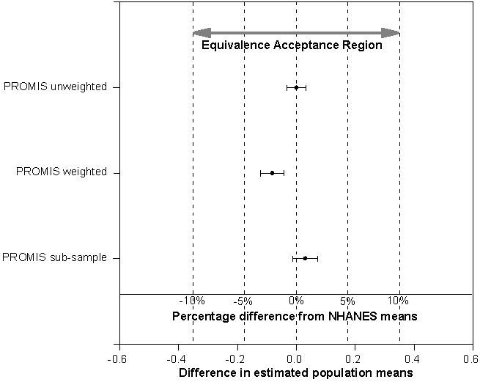
General Health Comparisons
PROMIS vs NHANES

Slide 32
Indeterminancy
Judgment must be suspended as there is no evidence for or against the hypothesis
One may not be able to come to a solid conclusion
May help to avoid the trend of interpretation of ‘marginally significant’ findings

Slide 33
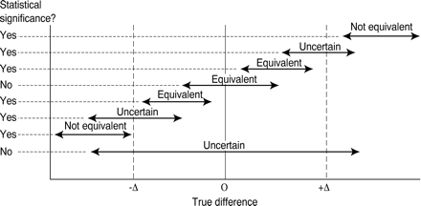
Figure from Jones et al (BMJ 1996) showing relationship
between equivalence and confidence intervals.

Slide 34

Thank you and

Slide 35
Appendix: Are probability internet panels with low response rates superior to convenience panels?
Coverage of non-internet population
Selectivity of respondents who sign up for convenience panels.
  30% of online surveys completed by 0.25% of the U.S. population (Miller, 2006)
  15-25% of vendor samples from a common pool of respondents (Craig et al., 2013)
  Panel participants belong to 7 online panels (Tourangeau, Conrad, and Couper, 2013)

Slide 36
Appendix: Comparing probability and convenience panels
Same questionnaire (on politics) administered to a probability-based telephone (OSU center for survey research), probability-based internet sample (Knowledge Networks) and to a convenience internet sample (Harris Interactive).
“The probability samples were more representative of the nation than the nonprobability sample in terms of demographics … even after weighting.”
Chang, L. and J.A. Krosnick (2009), National surveys via RDD telephone interviewing versus the Internet: Comparing sample representativeness and response quality, Public Opinion Quarterly, 73, 641-678.

Slide 37
Appendix: Average errors for Harris Interactive and Knowledge Networks Versus 2000 Current Population Survey
 | Harris Interactive | Knowledge Networks
Education | 5% | 4%
Income | 2% | 6%
Age | 2% | 2%
Race | 2% | 2%
Gender | 2% | 3%
Comparison is for weighted panel estimates.

