Slide 1
Patient Experience of
Care Surveys
Ron D. Hays, Ph.D.
UCLA Division of General Internal Medicine & Health Services Research
February 15, 2017 (Grand Rounds)
Ronald Reagan Medical Center, ~7:30-8am
Room B-130, RRMC Auditorium

Slide 2

Quality of care measurement
Focus has been on expert consensus
Variant of RAND Delphi Method

Slide 3
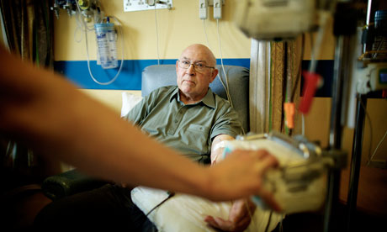
Quality of care measurement
But how patients perceive their care is also important
Patient reports about care are used to assess the patient’s experiences measures patient experiences.
Focus has been on expert consensus about clinical process
Variant of RAND Delphi Method

Slide 4
Consumer Assessment of Healthcare Providers and Systems (CAHPS®) Approach
Focus on what patients want to know about AND can accurately report about
  Communication with health care provider
  Access to care
  Staff courtesy and respect

Slide 5

Patient Experience is Weakly Related to Clinical Indicators
Systematic review (55 studies)
Wide range of disease areas, setting, designs, and outcome measures
Consistent Positive Associations
  Patient experience
  Clinical process
  Patient safety

Slide 6
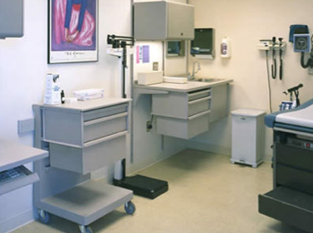
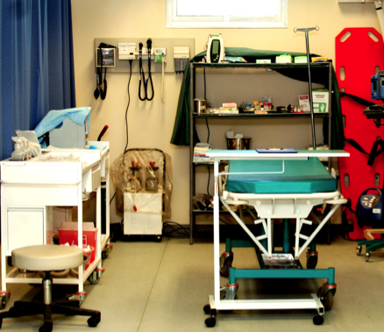
CAHPS has a family of surveys
Ambulatory Care
  Clinician & Group Survey
  Dental Plan Survey
  ECHO® Survey
  Health Plan Survey
  Home Health Care Survey
  Surgical Care Survey
Facility
  Hospital Survey
  Nursing Home Survey
  In-Center Hemodialysis Survey

Slide 7
CAHPS relies on reports about care
Did your doctor or anyone from the facility explain the process of giving anesthesia in a way that was easy to understand?
[ ] Yes, definitely
[ ] Yes, somewhat
[ ] No

Slide 8
Press-Ganey items added to
HCAHPS Survey
OPERATING/RECOVERY ROOM
Explanation by Anesthesiology Team
Your rating of the Operating/Recovery room staff
Response scale:
Very poor/Poor/Fair/Good/Very Good

Slide 9
Press-Ganey surgery center/procedure unit survey
BEFORE YOUR SURGERY OR PROCEDURE
Instructions you were given by our staff about how to prepare for your surgery or procedure.
Anesthesiologist’s explanation.
Response scale:
Very poor/Poor/Fair/Good/Very Good

Slide 10
OAS CAHPS® Survey
Mandatory effective January 2018 for:
  Hospital-based outpatient surgical department (HOPDs) and ambulatory surgical centers (ASCs)
37 questions
  Facilities and Staff
  Communication About Procedure
  Preparation for Discharge and Recovery
  Overall Rating of Facility
  Recommendation of Facility
Facilities can add up to 15 supplemental questions

Slide 11
CAHPS Outpatient and Ambulatory Surgery Survey (OAS CAHPS®)
10. Anesthesia is something that would make you feel sleepy or go to sleep during your procedure. Were you given anesthesia?
[ ] Yes
[ ] No
11. Did your doctor or anyone from the facility explain the process of giving anesthesia in a way that was easy to understand?
[ ] Yes, definitely
[ ] Yes, somewhat
[ ] No
12. Did your doctor or anyone from the facility explain the possible side effects of the anesthesia in a way that was easy to understand?
[ ] Yes, definitely
[ ] Yes, somewhat Note: This replaced PG Surgery Center/Procedure Unit
[ ] No Survey, July 2016 (Kyulo Namgyal)
[ ] No

Slide 12
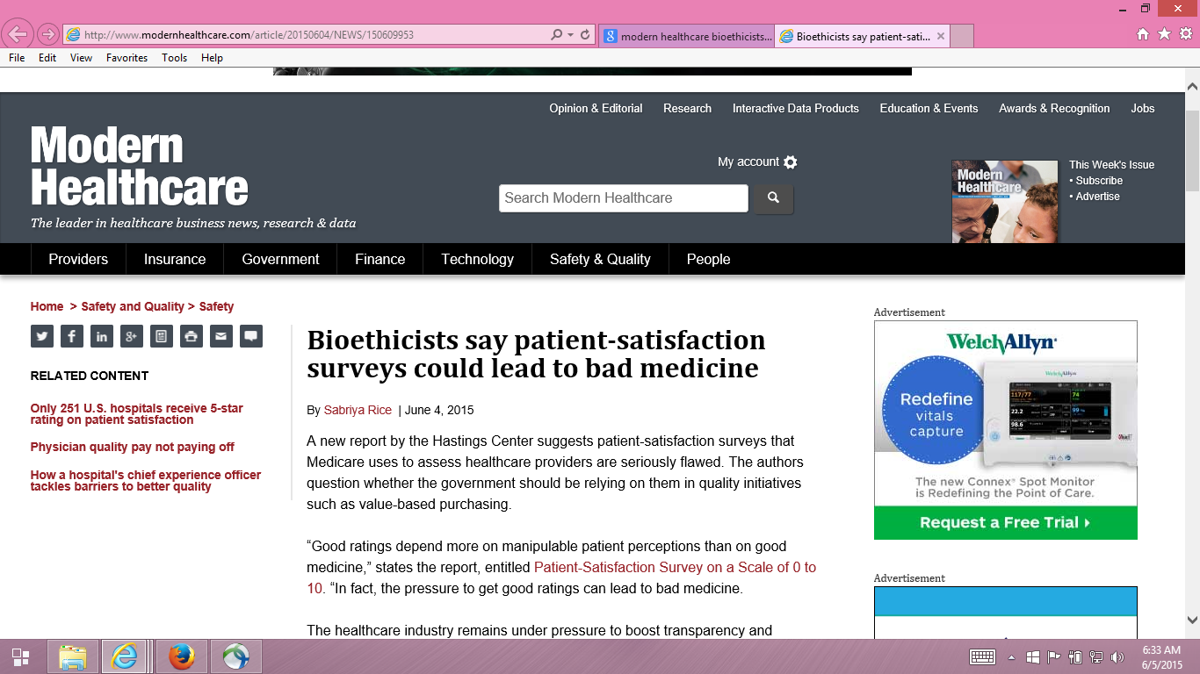

Slide 13
Providers motivated to fulfill patient desires regardless of appropriateness?
“Pressure to get good ratings can lead to bad medicine.”
  Dr. Stuart Younger, Professor of Bioethics and Psychiatry at the Case Western Reserve University (Hastings Center Report)
Good communication is important in addressing unreasonable expectations

Slide 14
Fenton et al. (2012)
“Patient satisfaction can be maintained in the absence of request fulfillment if physicians address patient concerns in a patient-centered way.”
“ In the ideal vision of patient-centered care, physicians deliver evidence-based care in accord with the preferences of informed patients, thereby improving satisfaction and health outcomes, while using health resources efficiently.”
“However, patient-centered communication requires longer visits and may be challenging for many physicians to implement.”

Slide 15
HCAHPS Survey, Pain Management, and Opioid Misuse: The CMS Perspective
Clarifying Facts, Myths, and Approaches
CMS believes that effective communication with patients about pain and treatment, including options other than prescription medicine when appropriate, is the preferred way to improve patient experience of care. In the process of developing the HCAHPS Survey, we did not find that experience with pain dominated patients’ overall assessment of the hospital experience.
http://www.qualityreportingcenter.com/wp-content/uploads/2016/02/IQR_20160126_QATranscript_vFINAL508.pdf

Slide 16
Are patient surveys actionable?
Surveys assess what is important to patients
Patient narratives (including complaints) and focus groups can indicate common problems
Communication skill training
Tools to help patients communicate their preferences

Slide 17

Questions?

