Slide 1

Studying the Doctor-Patient Relationship
May 3, 2012 (HS265 Broxton 2nd Floor Conference Room)
Ron D. Hays, Ph.D. (drhays@ucla.edu)
- UCLA Department of Medicine: Division of General Internal Medicine and Health Services Research
- UCLA School of Public Health: Department of Health Services
- RAND, Santa Monica
http://gim.med.ucla.edu/FacultyPages/Hays/

Slide 2
Patient-Reported Measures
Demo-graphics
Technical
Reports
Quality of Care
Behavior
Health
Clinical
Reports

Slide 3
Fullam et al. (2009) Medical Care
612 physicians studied from large academic medical center in midwest from 1998-2006
11% named in lawsuits brought against the hospital and/or physicians of the hospital
Press Ganey hospital satisfaction survey
  Time doctor spent with you, concern for your questions & worries, how well kept you informed, friendliness/courtesy, skill

Slide 4
Risk of Malpractice Suit
(Surgical Specialist)
7% if “very good”
8% if “good”
10% if “fair”
12% if “poor”
14% if “very poor”

Slide 5
Some issues
Purpose
Spheres and domains
Periodic or visit-specific?
Items
  Number of response options
  Global ratings versus reports
Mode of administration
Sample size
Response rate
Casemix adjustment

Slide 6


Founding Father of CAHPS

Slide 7
CAHPS®
Public domain surveys, reports, and QI tools focused on quality of care from the patient’s perspective
Information patients want and need to help select plans, groups, and providers
Core items applicable to everyone, supplemented by items targeted to specific groups
https://www.cahps.ahrq.gov/

Slide 8
CAHPS is the Standard
Consumer Assessment of Healthcare Providers and Systems
NCQA, CMS, State Medicaid, etc.
Many spheres
  Plan, clinician/group, dialysis, hospital, nursing home, home health
  American Indian, chiropractic, dental, behavioral health, PWMI, health information technology, medical home, pharmacy, health literacy/cultural competency
  https://www.cahps.ahrq.gov/content/products/PDF/PocketGuide.pdf

Slide 9
Consumer Assessment of Healthcare Providers and Systems
(CAHPS®) Surveys
Ambulatory Care Surveys
  CAHPS Health Plan Survey
  CAHPS Clinician & Group Survey
  CAHPS Surgical Care Survey
  ECHO® Survey
  CAHPS Dental Plan Survey
  CAHPS American Indian Survey
  CAHPS Home Health Care Survey
Facility Surveys
  CAHPS Hospital Survey
  CAHPS Nursing Home Survey
  CAHPS In-Center Hemodialysis Survey

Slide 10
Emphasis on consumers/patients
CAHPS surveys ask about aspects of care for which:
  Patients are the best or only source of information
  Patients and purchasers have identified as being important

Slide 11
Reports of experiences
CAHPS surveys are NOT satisfaction surveys
  They do include ratings
Focus is on experiences and behaviors
  More actionable, understandable, specific, and objective than general ratings

Slide 12
Standardization
Instrument
  Everyone administers items in same way
Protocol
  Sampling, communicating with potential respondents, and data collection procedures are standardized
Analysis
  Standardized programs and procedures
Reporting
  Standard reporting measures and presentation guidelines
Benchmarks
  CAHPS Database

Slide 13
Multiple versions for diverse populations
Designed for all types of users
  Medicaid, Medicare, commercial users, all delivery systems
Spanish language versions
  Cognitive testing
  Cultural comparability research

Slide 14
Extensive testing with consumers
Cognitive testing
  Several rounds
  Testing in Spanish as well as English
Field testing
  Effectiveness and feasibility of survey administration procedures and guidelines

Slide 15
Report meaningful information
Report information that patients and purchasers say is important
Cognitive testing of report formats and language
  Maximize usability and comprehensibility

Slide 16
Public Resource
Free!
  Products
    Survey and Reporting Kits (www.cahps.ahrq.gov)
  CAHPS Technical assistance
    Help Line (1.800.492.9261)
    E-mail Help (cahps1@ahrq.gov)

Slide 17
Literature Review – the first step
Review of the relevant literature
Identification of:
  The key issues
  Previous research
  Gaps in the literature

Slide 18
Other early input
Environmental scan for measures
Federal Register Notices
Technical Expert Panels

Slide 19
Draft Items and Test
Cognitive Interviews with members of the target population
  Multiple rounds
  English and Spanish
  Instrument revised based on
  testing
http://www.chime.ucla.edu/measurement/qualitativemethods.htm

Slide 20
Field Testing: The last step
Goals:
  To assess how well the instruments are working
  To assess different modes of survey administration

Slide 21
Typical Field Test Protocols
Mixed mode
  Advance notification letter
  1st mailing of questionnaire
  Reminder post card
  2nd mailing of questionnaire
  Telephone follow-up
Telephone only
  Advance notification letter
  Telephone contact

Slide 22
Analyses of Field Test Data
Psychometric analysis to assess how well individual survey items are performing
Assess effectiveness of data collection modes and equivalence of different modes
Modeling of unit and item non-response

Slide 23
Trending
CAHPS is designed to accommodate items from existing surveys.
Testing of an integrated survey allows tracking of trends for quality improvement purposes.

Slide 24
UCLA Family Practice Group
Uses CAHPS Clinician & Group survey
Implemented performance improvement initiatives to help practices improve on CAHPS measures

Slide 25
Multi-Phase Performance Improvement
Reporting and feedback of CAHPS scores to practices
Consultation on performance improvement methods and strategies
Quality collaborative for selected practices
Training sessions for physicians on communication with patients
Point-of-service surveys of patients
BRITE training for office staff

Slide 26
Reference Periods
Most recent visit (doctor communication, office staff )
  During your most recent visit, did this doctor explain things in a way that was easy to understand?
    Yes, definitely; Yes, somewhat; No
Last 12 months (access)
  In the last 12 months, when you phoned this doctor’s office after regular office hours, how often did you get an answer to your medical question as soon as you needed?
    Never; Sometimes; Usually; Always

Slide 27
Doctor Communication Composite (6 Items)
During your most recent visit, did this doctor
    18. Explain things in a way that was easy to understand?
    19. Listen carefully to you?
    21. Give you easy to understand instructions about taking care of these health problems or concerns?
    22. Seem to know the important information about your medical history?
    23. Show respect for what you had to say?
    24. Spend enough time with you?

Slide 28
Office Staff Composite (2 items)
28. During your most recent visit, were clerks and receptionists at this doctor’s office as helpful as you thought they should be?
29. During your most recent visit, did clerks and receptionists at this doctor’s office treat you with courtesy and respect?

Slide 29
Access Composite (5 Items)
In the last 12 months
    6. When you phoned this doctor’s office after regular office hours, how often did you get an answer to your medical question as soon as you needed?
    8. When you made an appointment for a check-up or routine care with this doctor, how often did you get an appointment as soon as you thought you needed?
    10. When you phoned this doctor’s office during regular office hours, how often did you get an answer to your medical question that same day?

Slide 30
Access Composite Continued
12. In the last 12 months, when you phoned this doctor’s office after regular office hours, how often did you get an answer to your medical question as soon as you needed?
13. Wait time includes time spent in the waiting room and exam room. In the last 12 months, how often did you see this doctor within 15 minutes of your appointment time?

Slide 31
Global Items
25. Using any number from 0 to 10, where 0 is the worst doctor possible and 10 is the best doctor possible, what number would you use to rate this doctor?
26. Would you recommend this doctor’s office to your family and friends?
  Yes, definitely; Yes, somewhat; No

Slide 32
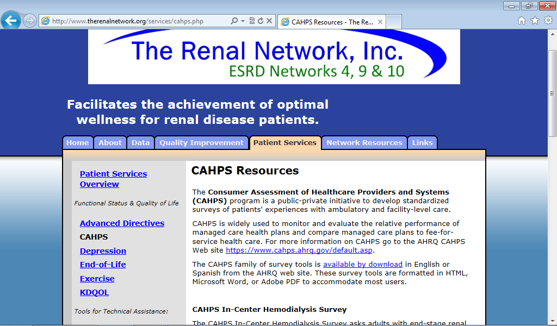

Slide 33
CAHPS In-Center Hemodialysis Survey (In the last 3 months …)
How often did
  your kidney doctors listen carefully to you?
  your kidney doctors explain things in a way that was easy to understand?
  your kidney doctors show respect for what you had to say?
  your kidney doctors spend enough time with you?
  you feel your kidney doctors really cared about you as a person?
Reporting Measures for the CAHPS® In-Center Hemodialysis Survey. Agency for Healthcare Research and Quality, Rockville, MD. Updated Dec 2007. https://www.cahps.ahrq.gov/cahpskit/files/509_ICH_Reporting_Measures.htm

Slide 34
Helpfulness of Provider’s use of Computers during a visit (2 items)
During your visits in the last 12 months, was this provider’s use of a computer or handheld device helpful to you?
  No 4%
  Yes, somewhat 20%
  Yes, definitely 76%
During your visits in the last 12 months, did this provider’s use of a computer or handheld device make it harder or easier for you to talk with him or her?
  Harder 3%
  Not harder or easier 53%
  Easier 44%

Slide 35
Getting Timely Answers to Medical
Questions by e-mail (2 items)
In the last 12 months, when you e-mailed this provider’s office, how often did you get an answer to your medical question as soon as you needed?
  Never/Sometimes 6%
  Usually 14%
  Always 80%
In the last 12 months, when you e-mailed this provider’s office, how often were all of the questions in your e-mail answered?
  Never/Sometimes 5%
  Usually 12%
  Always 83%

Slide 36
Helpfulness of Provider’s Website in Giving You Information about Your Care and Tests (4 items)
In the last 12 months, how often was it easy to find these lab or other test results on the website?
  Never/Sometimes 3%
  Usually 14%
  Always 83%
In the last 12 months, how often were these lab or other test results put on the website as soon as you needed them?
  Never/Sometimes 2%
  Usually 18%
  Always 80%

Slide 37
Helpfulness of Provider’s Website in Giving You Information about Your Care and Tests (4 items continued)
In the last 12 months, how often were these lab or other test results presented in a way that was easy to understand?
  Never/Sometimes 10%
  Usually 25%
  Always 65%
In the last 12 months, how often were the visit notes easy to understand?
  Never/Sometimes 2%
  Usually 19%
  Always 79%

Slide 38
Item-Scale Correlations (n = 4,715)
Items | Helpfulness of provider’s use of computers | Getting answers to e-mailed questions | Helpful-ness of Website | Access to care | Communi-cation with doctor | Office Staff | Shared Decision Making
Helpful to you | 0.37 | 0.27 | 0.32 | 0.27 | 0.42 | 0.23 | 0.23
Easier to talk | 0.37 | 0.18 | 0.21 | 0.17 | 0.28 | 0.14 | 02.0
Get answers to email as soon as needed | 0.23 | 0.71 | 0.40 | 0.58 | 0.48 | 0.31 | 0.23
All emailed questions answered | 0.27 | 0.71 | 0.42 | 0.54 | 0.53 | 0.28 | 0.26
Easy to find lab/test results on website | 0.21 | 0.32 | 0.55 | 0.32 | 0.32 | 0.29 | 0.16
Lab/test results on web soon as needed | 0.23 | 0.34 | 0.60 | 0.40 | 0.36 | 0.34 | 0.19
Lab/test results easy to understand | 0.26 | 0.30 | 0.56 | 0.39 | 0.38 | 0.32 | 0.21
Visit notes easy to understand | 0.27 | 0.41 | 0.50 | 0.47 | 0.53 | 0.38 | 0.23
Alpha | 0.54 | 0.83 | 0.75 | 0.85 | 0.92 | 0.85 | 0.47

Slide 39
Associations of Composites with Global Rating of Doctor (R² = 0.43)
Composite | StandardizedBeta | P-value
Access to care | 0.044 | 0.060
Communication | 0.557 | <0.001
Office Staff | 0.032 | 0.124
Shared decisions | 0.016 | 0.440
Helpfulness of provider’s use of computers | 0.081 | <0.001
Helpfulness of website | 0.047 | 0.023
Getting timely answers to e-mailed questions | 0.034 | 0.131

Slide 40


Thank you!

