Slide 1
Software Alternatives for
IRT Analyses
Ron D. Hays
September 27, 2017
HealthMeasures User Conference
Track D: Driving the Science
10:00-10:20 am
Prentice Women’s Hospital Conference Center
250 E. Superior Street, Chicago, Illinois

Slide 2
8-item Acting with Awareness Scale
FFMQ_5. When I do things, my mind wanders off and I’m easily distracted.
FFMQ_8. I don’t pay attention to what I’m doing because I’m daydreaming, worrying, or otherwise distracted.
FFMQ_13. I am easily distracted.
FFMQ_18. I find it difficult to stay focused on what’s happening in the present.
FFMQ_23. It seems I am “running on automatic” without much awareness of what I’m doing.
FFMQ_28. I rush through activities without being really attentive to them.
FFMQ_34. I do jobs or tasks automatically without being aware of what I’m doing.
FFMQ_38. I find myself doing things without paying attention.
1. Very often or always true/2. Often true/ 3. Sometimes true/
4. Rarely true/ 5. Never or very rarely true

Slide 3
Amanda Shallcross
Sample (n = 240)
75% Female
56% White, 31% Black, 8% Hispanic
Mean age = 36 (range: 19-71)
70% college education
Acting with Awareness Scale
  Possible range: 8-40
  Observed range: 9-40
  Mean = 24, SD = 6
http://self-compassion.org/wp-content/uploads/publications/FFMQ.SCS.FactprStructure.pdf

Slide 4
SAS Code (1)
PROC IRT DATA=TEMP PLOTS=ALL rorder=internal;
VAR
FFMQ_5 FFMQ_8 FFMQ_13 FFMQ_18 FFMQ_23 FFMQ_28 FFMQ_34 FFMQ_38;
TITLE "ACT5";
RUN;
http://support.sas.com/documentation/cdl/en/statug/67523/HTML/default/viewer.htm#statug_irt_syntax01.htm

Slide 5
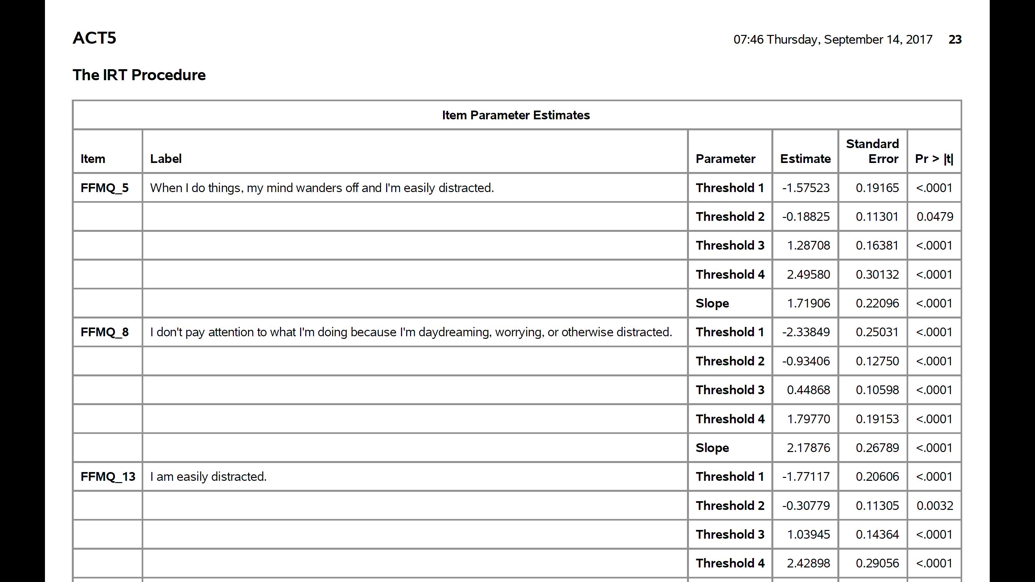
Very often or always true/Often true/Sometimes true/Rarely true/Never or very rarely true

Slide 6
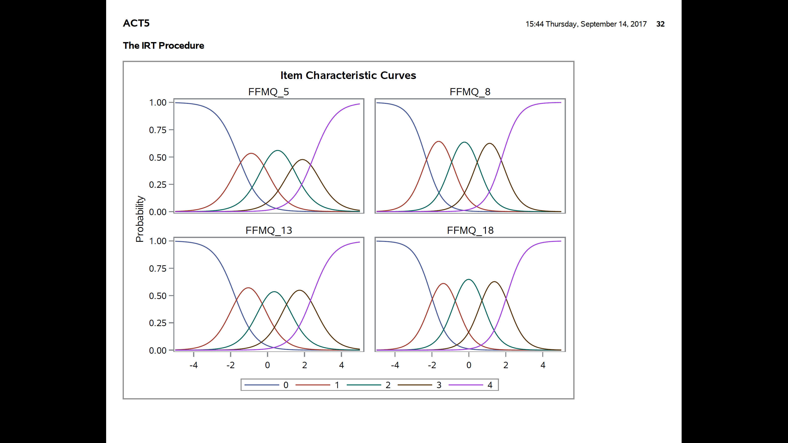
Very often or always true/Often true/Sometimes true/Rarely true/Never or very rarely true

Slide 7
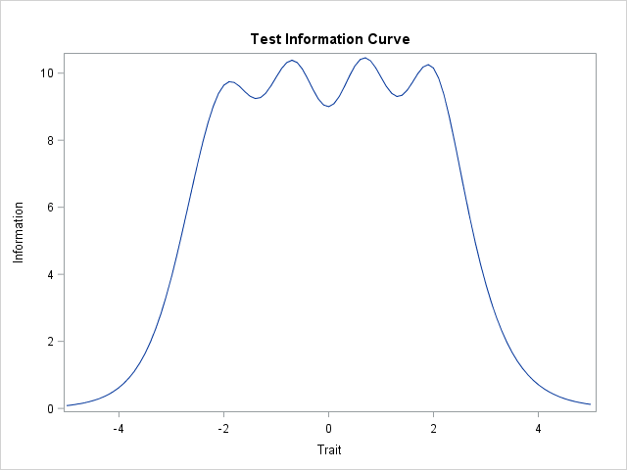
Reliability = (Info – 1) / Info

Slide 8
SAS Code (2)
PROC IRT DATA=TEMP OUT=THETA8 rorder=internal SCOREMETHOD=EAP PLOTS=ICC (XVIEWMAX=3 XVIEWMIN=-3);
VAR
FFMQ_5 FFMQ_8 FFMQ_13 FFMQ_18 FFMQ_23 FFMQ_28 FFMQ_34 FFMQ_38;
TITLE "ACT5";
RUN;

Slide 9
STATA Code (do file)
clear
set more off
cap log close
log using c:\RCMAR\irt_grm,text replace
use c:\RCMAR\temp
irt grm ffmq_5 ffmq_8 ffmq_13 ffmq_18 ffmq_23 ffmq_28 ffmq_34 ffmq_38
irtgraph icc ffmq_5, xlabel(-4 -3 -2 -1 0 1 2 3 4, grid) subtitle("FFMQ_5: when I do things my mind wanders off and I'm easily distracted") saving("ffmq_5.gph", replace)
graph export ffmq_5.pdf, replace
irtgraph tcc, thetalines(-3 -2 -1 0 1 2 3) saving("tcc.gph",replace)
graph export tcc.pdf, replace

Slide 10
Very often or always true/Often true/Sometimes true/Rarely true/Never or very rarely true

Slide 12
EQSIRT Code
/TITLE
Acting with Awareness
/SPECIFICATIONS
DATA = ‘temp.dss';
VARIABLES = 8;
CASES = 240;
USE = 'ID’-’FFMQ_38';
/MODEL
GRM = ‘FFMQ_5’-’FFMQ38';
PARAMETER = 2PL;
ESTIMATION = MML;
FACTOR = 1;
PLOTFILE = 'grm_8_irtplot.dss';
/TECHNICAL
ITERATIONS = 100;
OPTIMIZATION = opt1;
QUADRATURE = (4.0,15);
OUTPUT = TEXT;
/PRINT
/END

Slide 13
IRTPRO Code (1)
Project:
Name = act5;
Data:
File = .\temp.ssig;
Analysis:
Name = act5;
Mode = Calibration;
Title: act5
Comments:
Estimation:
Method = BAEM;
E-Step = 500, 1e-005;
SE = S-EM;
M-Step = 50, 1e-006;
Quadrature = 49, 6;
SEM = 0.001;
SS = 1e-005;
Saves:
PRM, IRT
Scoring:
Mean = 0;
SD = 1;

Slide 14
IRTPRO Code (2)
Miscellaneous:
Decimal = 2;
Processors = 8;
Print CTLD, P-Nums, Diagnostic;
Min Exp = 1;
Groups:
Group :
Dimension = 1;
Items = ffmq_5, ffmq_8, ffmq_13, ffmq_18, ffmq_23, ffmq_28, ffmq_34, ffmq_38;
Codes(ffmq_5) = 1(0), 2(1), 3(2), 4(3), 5(4);
Codes(ffmq_8) = 1(0), 2(1), 3(2), 4(3), 5(4);
Codes(ffmq_13) = 1(0), 2(1), 3(2), 4(3), 5(4);
Codes(ffmq_18) = 1(0), 2(1), 3(2), 4(3), 5(4);
Codes(ffmq_23) = 1(0), 2(1), 3(2), 4(3), 5(4);
Codes(ffmq_28) = 1(0), 2(1), 3(2), 4(3), 5(4);
Codes(ffmq_34) = 1(0), 2(1), 3(2), 4(3), 5(4);
Codes(ffmq_38) = 1(0), 2(1), 3(2), 4(3), 5(4);
Model(ffmq_5) = Graded;
Model(ffmq_8) = Graded;
Model(ffmq_13) = Graded;
Model(ffmq_18) = Graded;
Model(ffmq_23) = Graded;
Model(ffmq_28) = Graded;
Model(ffmq_34) = Graded;
Model(ffmq_38) = Graded;
Mean = 0.0;
Covariance = 1.0;
Constraints:

Slide 15
R code
library(mirt)
library(latticeExtra)
(8 items imported into “temp” and brought into RSE)
RSE<-temp[,1:8]
nitems <- 8
itemtype <- rep('graded',nitems)
RSEGRM <- mirt(RSE, 1, itemtype=itemtype)
param <- coef(RSEGRM, IRTpars=TRUE)
RSEGRMpar <- do.call(rbind,param[1:nitems])
print(RSEGRMpar,digits=4)
plot(RSEGRM) # test response curve
plot(RSEGRM, type="infoSE")
plot(RSEGRM, type="infotrace")

Slide 16

flexMIRT code
See Pattern_scoring_example.pdf
  http://gim.med.ucla.edu/FacultyPages/Hays/IRT/

Slide 17
Multidimensional IRT
Parameter recovery with simulation found high level of estimation accuracy for
  IRTPRO2.1, EQSIRT 1.0, flexMIRT 2.0, and Mplus 7.1
Differences in user interface
  e.g., IRTPRO and EQSIRT point-and-click
EQSIRT 1.0
  MCEM and MCMC estimation failed to finish
  Program often stopped running without displaying any error messages
  Took longest time to run
  Error message in dialog boxed not helpful
Han, K. T., & Paek, I. (2014). A review of commercial software packages for multidimensional IRT modeling. Applied Psychological Measurement, 38 (6), 486-498.

Slide 18

Funding for HealthMeasures was provided by the National Institutes of Health grant U2C CA186878.
Powerpoint file available at:
http://gim.med.ucla.edu/FacultyPages/Hays/present/

