Slide 1
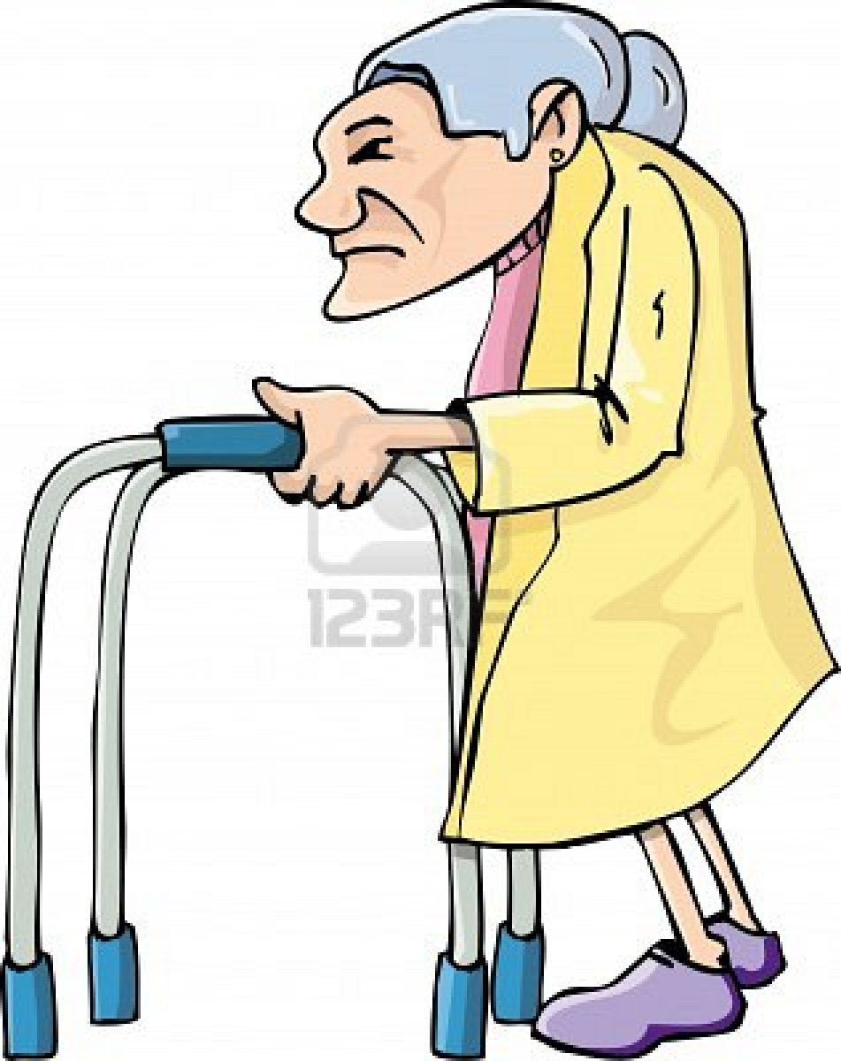
Ron D. Hays, Ph.D.
Joshua S. Malett, Sarah Gaillot, and Marc N. Elliott
Physical Functioning Among Medicare Beneficiaries
International Society for Quality of Life Studies
October 16, 2015 (4-5:30pm)
Family: Health, Aging, Finances
Renaissance Hotel, Phoenix, AZ (Salon 5)

Slide 2
Physical Functioning
Ability to conduct a variety of activities ranging from self-care to running
One of strongest predictors of
  Hospitalizations, institutionalization, and mortality
This study examines physical functioning items administered in 2010 Consumer Assessment of Healthcare Providers and Systems (CAHPS®) Medicare Survey

Slide 3

Sample
n = 366,701 Medicare managed care and FFS beneficiaries
58% female
57% high school education or less
14% 18-64; 48% 65-74, 29% 75-84, 9% 85+

Slide 4
Because of a health or physical problem are you unable to do or have any difficulty doing the following activities?
Walking?
Getting in our out of chairs?
Bathing?
Dressing?
Using the toilet?
Eating?
  I am unable to do this activity
  Yes, I have difficulty
  No, I do not have difficulty

Slide 6
Range of Inter-item Correlations
r = 0.84
Bathing & Dressing
r = 0.51 Eating and Walking
Coefficient alpha = 0.92

Slide 7
Categorical Confirmatory Factor Analysis Loadings
Physical Functioning | Loading
Walking | 0.93
Chairs | 0.95
Bathing | 0.96
Dressing | 0.98
Toileting | 0.97
Eating | 0.94

Slide 8
Item Parameters
(Graded Response Model)
Physical Functioning | Threshold Unable to do | Threshold Have difficulty | Discrimination
Walking | -1.86 | -0.55 | 4.63
Chairs | -1.91 | -0.81 | 5.65
Bathing | -1.72 | -1.02 | 6.34
Dressing | -1.78 | -1.10 | 8.23
Toileting | -1.87 | -1.27 | 7.23
Eating | -1.98 | -1.53 | 4.87

Slide 11
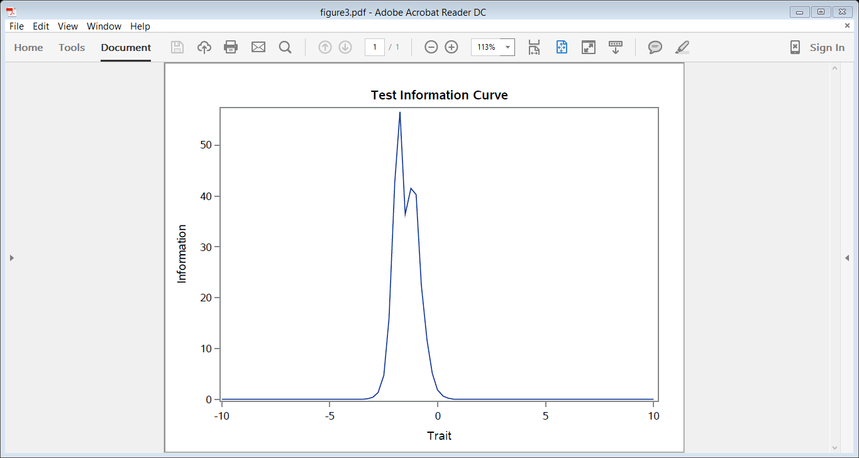
Rel = (Info – 1) / Info
Reliability = 0.95
Reliability = 0.90

Slide 12
Physical Function Scale Correlations
r = 0.39 (self-rated general health)
r = -0.23 (number of chronic conditions)

Slide 13
Summary
The 6 physical functioning items target relatively easy activities
Items representing higher levels of physical functioning are needed for the majority of Medicare beneficiaries.
  Lifting or carrying groceries
  Doing chores like vacuuming or yard work
  Running a short distance

Slide 14
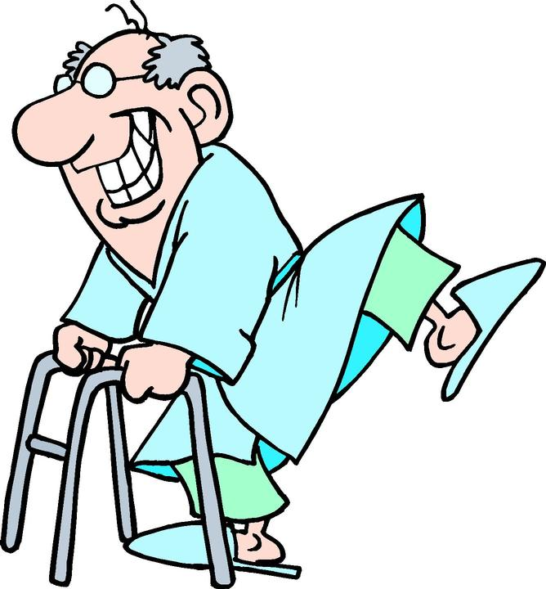
Acknowledgements
CMS contract HHSM-500-2005-000281
Thank you. (drhays@ucla.edu)

