Slide 1
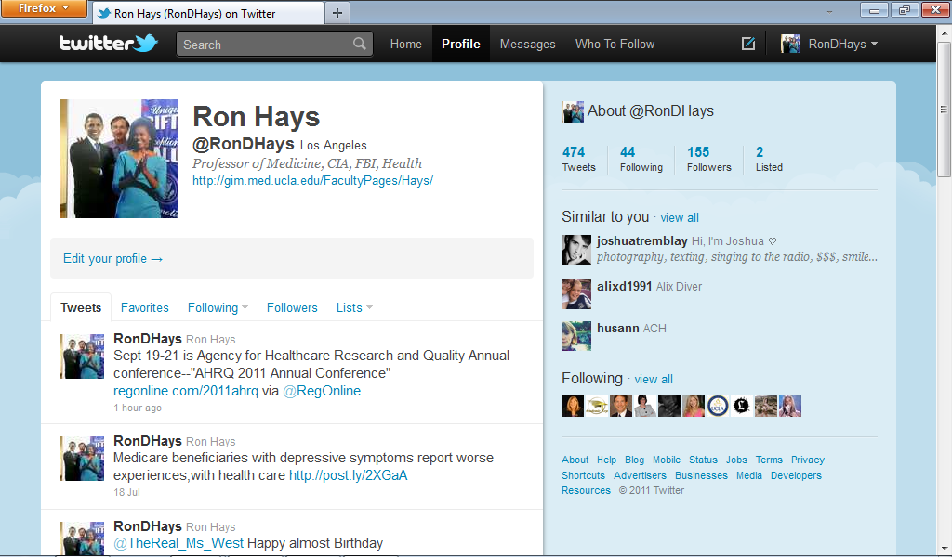
Ron D. Hays http://gim.med.ucla.edu/FacultyPages/Hays/
August 5, 2011 (12:16-12:24pm)
6 minutes presentation + 3 minutes questions

Slide 2



Some things I like

Slide 3



Some things I don’t

Slide 4
Current Positions
UCLA
  Professor, UCLA Department of Medicine
  Professor, UCLA School of Public Health, Department of Health Services
RAND
  Senior Social Policy Analyst RAND
  Pardee RAND Graduate School Faculty, Step VI.

Slide 5
Teaching
HS214: Measurement of Effectiveness and Outcomes in Health Care
HS249 F: Quality of Care
HS 265: Challenges in Clinical Health Services Research
K30 and GCRC mini-courses

Slide 6
Editorial Service
Journal of General Internal Medicine, Special methodology panel, 2011
Quality of Life Research
  Editor-in-Chief, 2005-2009
  Associate Editor, 1991-2001
Clinical Therapeutics, Editorial advisory board, 2002-2009
Medical Care , Deputy editor, 1997-2002

Slide 7
Research Areas
Patient-reported outcomes
  Health-related quality of life
  Patient evaluations of care
Health-related behaviors
  Alcohol, drug use, smoking, exercise, adherence

Slide 8
Example of Research Projects
Medical Outcomes Study
Project ALERT
Consumer Assessment of Healthcare Providers and Systems (CAHPS®)
Patient-Reported Outcomes Information Measurement System (PROMIS®)

Slide 9
