Slide 1

Ron D. Hays (drhays@ucla.edu)
August 9, 2013 (12:00-12:07pm)
Powerpoint file posted at: http://gim.med.ucla.edu/FacultyPages/Hays/

Slide 2
Current Positions
UCLA Department of Medicine
UCLA Department of Health Services
RAND, Senior Social Policy Analyst
Pardee RAND Graduate School Faculty

Slide 3
PROs
Patient-Reported Outcomes
Patient evaluations of care
Health-related quality of life

Slide 4
Consumer Assessment of Healthcare Providers and Systems (CAHPS®)
Quigley, D. D., Martino, S. C., Brown, J. A., & Hays, R.D. (2013). Evaluating the content of the communication items in the CAHPS® Clinician and Group Survey and supplemental items with what high-performing physicians say they do. Patient.

Slide 5
Patient-Reported Outcomes Information
Measurement System (PROMIS®)
Hays, R. D., Spritzer, K. L., Amtmann, D., Lai, J-S., DeWitt, E. M., Rothrock, N., DeWalt, D. A., Riley, W. T., Fries, J. F., & Krishnan, E. (2013, epub). Upper extremity and mobility subdomains from the Patient-Reported Outcomes Measurement Information System (PROMIS®) adult physical functioning item bank. Archives of Physical Medicine and Rehabilitation. NIHMS504151

Slide 6

Health-Related Behavior
Positive
  Exercise
  Medication adherence
Negative
  Alcohol use
  Drug use
  Smoking

Slide 7
Behavior and HRQOL
Hays, R. D., Smith, A. W., Reeve, B. B., Spritzer, K. L., Marcus, S. E., & Clauser, S. B. (2008). Cigarette smoking and health-related quality of life in Medicare beneficiaries. Health Care Financing Review, 29 (4), 57-68.

Slide 8
Teaching
HS214: Measurement of Effectiveness and Outcomes in Health Care
HS216: Making the Business Case for Quality
HS249 F: Quality of Care
HS 265: Challenges in Clinical Health Services Research

Slide 9
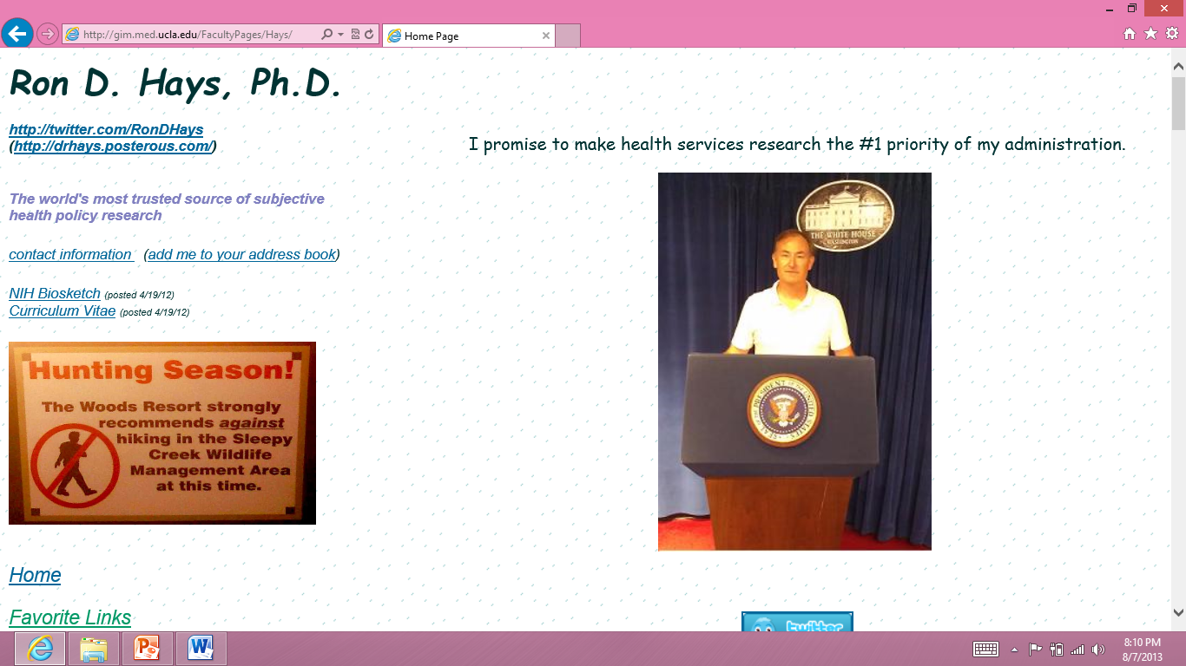
Thank you

