Slide 1

Ron D. Hays (drhays@ucla.edu)
August 7, 2015 (12:24-12:32pm)
Powerpoint file posted at: http://gim.med.ucla.edu/FacultyPages/Hays/
Health
Services
Research

Slide 2
Current Positions
UCLA Department of Medicine
UCLA Department of Health Services
RAND, Adjunct Researcher
  Pardee RAND Graduate School Faculty
NCI Consultant
FDA Staff Fellow/Medical Officer

Slide 3
PROs
Patient-Reported Outcomes
Patient evaluations of care
Health-related quality of life

Slide 4
Consumer Assessment of Healthcare Providers and Systems (CAHPS®)
Hays, R. D., Berman, L. J., Kanter, M. H., Hugh, M., Oglesby, R. R., Kim, C. Y., Cui, M., & Brown, J. (2014). Evaluating the psychometric properties of the CAHPS patient-centered medical home survey. Clinical Therapeutics, 36 (5), 689-696.
Price, R. A. Elliott, M.N., Cleary, P.D., Zaslavsky, A. M., & Hays, R. D. (2015). Should health care providers be accountable for patients’ care experiences? Journal of General Internal Medicine, 30, 253-256.

Slide 5
Patient-Reported Outcomes Information
Measurement System (PROMIS®)
Hays, R. D., Spritzer, K. L., Thompson, W. W., & Cella, D. (2015 epub). U.S. general population estimate for “excellent” to “poor” self-rated health item. Journal of General Internal Medicine.
Schalet, B. D., Rothrock, N. E., Hays, R. D., Kazis, L. E., Cook, K. F., Rutsohn, J. P., & Cella, D. (2015). Linking physical and mental health summary scores from the Veterans RAND 12-item health survey (VR-12) to the PROMIS global health scale. Journal of General Internal Medicine.

Slide 6

Health-Related Behavior
Positive
  Exercise
  Medication adherence
Negative
  Alcohol use
  Drug use
  Smoking

Slide 7
Behavior and HRQOL
Hays, R. D., Smith, A. W., Reeve, B. B., Spritzer, K. L., Marcus, S. E., & Clauser, S. B. (2008). Cigarette smoking and health-related quality of life in Medicare beneficiaries. Health Care Financing Review, 29 (4), 57-68.
Drake, C., Hays, R. D., Morlock, R., Wang, F., Shikiar, R., Frank, L., Downey, R., & Roth, T. (2014). Development and evaluation of a measure to assess restorative sleep. Journal of Clinical Sleep Medicine, 10, 733-741.
Fung, C. H., Martin, J.L., Hays, R. D., Rodriguez, J. C., Igodan, U., Jouldjian, S., Dzierzewski, J. M., Kramer, B. J., Josephson, K., & Alessi, C. (2015 epub). Development of the usability of sleep apnea equipment—positive airway pressure (USE-PAP) questionnaire. Sleep Medicine.

Slide 8
Teaching
HPM 214: Measurement of Effectiveness and Outcomes in Health Care
HPM 216: Making the Business Case for Quality
HPM 249F: Quality of Care
HS 265: Challenges in Clinical Health Services Research
M218: Questionnaire Design and Administration

Slide 9
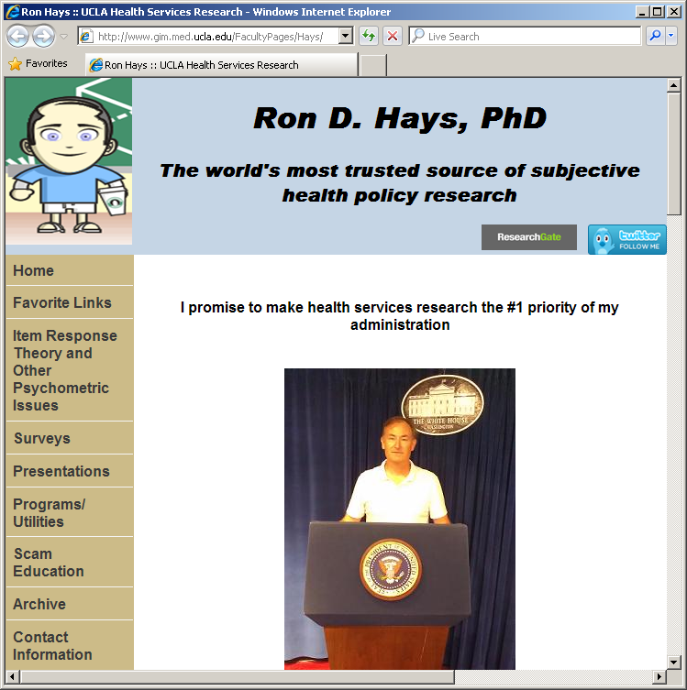
Thank you

