Slide 1
Ron D. Hays (drhays@ucla.edu) August 19, 2016 Powerpoint file posted at: http://gim.med.ucla.edu/FacultyPages/Hays/
Health
Services
Research

Slide 2
Current Positions
UCLA Department of Medicine
UCLA Department of Health Services
RAND, Adjunct Researcher
Pardee RAND Graduate School Faculty
NCI Consultant
FDA Consultant
Formerly Staff Fellow/Medical Officer

Slide 3
PROs
Patient-Reported Outcomes
Patient evaluations of care
Health-related quality of life

Slide 4
Consumer Assessment of Healthcare Providers and Systems (CAHPS®)
Hays, R. D., Chawla, N., Kent, E. E., & Arora, N. K. (epub 2016). Measurement equivalence of the Consumer Assessment of Healthcare Providers and Systems (CAHPS®) Medicare Survey Items between Non-Hispanic Whites and Asians. Quality of Life Research.
Martino, S. C., Elliott. M. N., Hambarsoomain, K., Weech-Maldonado, R., Gaillot, S., Haffer, S. C., & Hays, R. D. (2016). Racial/ethnic disparities in Medicare beneficiaries’ care coordination experiences. Medical Care., 54 (8), 765-771.

Slide 5
Patient-Reported Outcomes Information Measurement System (PROMIS®)
Hays, R. D., Spritzer, K. L., Thompson, W. W., & Cella, D. (2015). U.S. general population estimate for “excellent” to “poor” self-rated health item. Journal of General Internal Medicine. 30 (10), 1511-6.
Hays, R. D., Revicki, D. A., Feeny, D., Fayers, P., Spritzer, K. L., & Cella, D. (2016 epub). Using linear equating to MAP PROMIS global health items and the PROMIS-29 V. 2 Profile measure to the Health Utilities Index—Mark 3. Pharmacoeconomics.

Slide 6
Health-Related Behavior
Positive
Exercise
Medication adherence
Negative
Alcohol use
Drug use
Smoking

Slide 7
Behavior
Hays, R. D., Smith, A. W., Reeve, B. B., Spritzer, K. L., Marcus, S. E., & Clauser, S. B. (2008). Cigarette smoking and health-related quality of life in Medicare beneficiaries. Health Care Financing Review, 29 (4), 57-68.
Fung, C. H., Martin, J.L., Hays, R. D., et al. (2015). Development of the usability of sleep apnea equipment—positive airway pressure (USE-PAP) questionnaire. Sleep Medicine. 16(5), 645-51.
Fongwa, M. N., Nandy, K., Yang, Q., & Hays, R. D. (2015). The Facilitators of and barriers to Adherence to Hypertension Treatment Scale (FATS). Journal of Cardiovascular Nursing, 30, 484-490.

Slide 8
Teaching
HPM 214: Measurement of Effectiveness and Outcomes in Health Care
HPM 216: Making the Business Case for Quality
HS 265: Challenges in Clinical Health Services Research
M218: Questionnaire Design and Administration

Slide 9
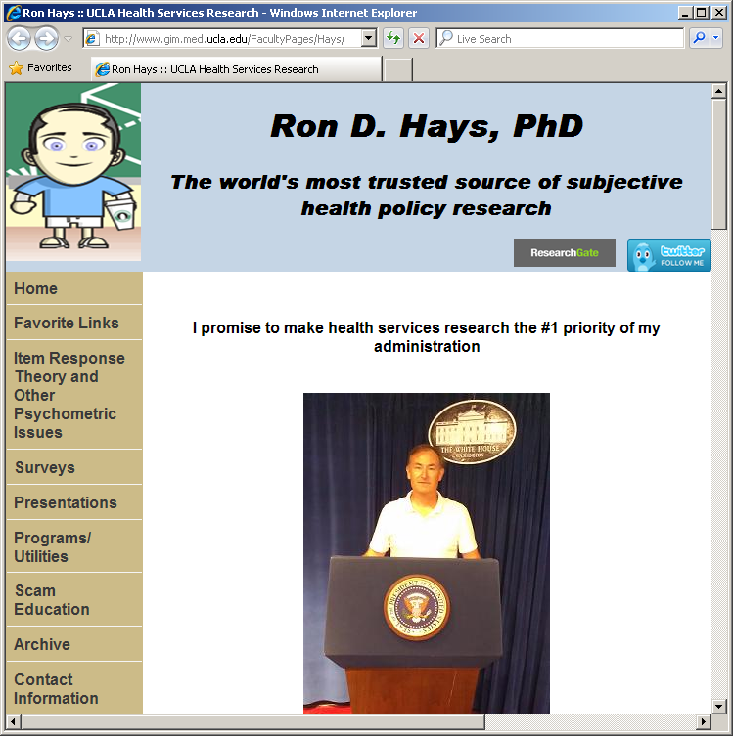
Thank you

