Slide 1

Ron D. Hays (drhays@ucla.edu)
July 28, 2017
Powerpoint file posted at: http://gim.med.ucla.edu/FacultyPages/Hays/
Health
Services
Research

Slide 2
Background
Social psychologist
Affiliations
  UCLA Department of Medicine
  UCLA Department of Health Services
  RAND, Adjunct Researcher
Teaching
  HPM 214: Measurement of Effectiveness and Outcomes in Health Care
  HPM 216: Making the Business Case for Quality
  M218: Questionnaire Design and Administration

Slide 3
Patient-Reported Outcomes
Patient experiences with care
Health-related quality of life

Slide 4

Health-Related Behavior
Positive
  Exercise
  Medication adherence
Negative
  Alcohol use
  Drug use
  Smoking

Slide 5
Patient Experiences with Care
Setodji, C. M., Quigley, D. D., Elliott, M. N., Burkhart, Q., Hochman, M. E., Chen, A. Y., & Hays, R. D. (2017 epub). Patient experiences with care differ with chronic care management in a federally qualified community health center. Population Health Management.
Hays, R. D., Chawla, N., Kent, E. E., & Arora, N. K. (2017). Measurement equivalence of the Consumer Assessment of Healthcare Providers and Systems (CAHPS®) Medicare Survey Items between Non-Hispanic Whites and Asians. Quality of Life Research, 26, 311-318.
Martino, S. C., Elliott. M. N., Hambarsoomain, K., Weech-Maldonado, R., Gaillot, S., Haffer, S. C., & Hays, R. D. (2016). Racial/ethnic disparities in Medicare beneficiaries’ care coordination experiences. Medical Care., 54 (8), 765-771.

Slide 6
Health-Related Quality of Life
Palimaru, A., & Hays, R. D. (2017). Associations of health-related quality of life with overall quality of life in the Patient-Reported Outcomes Measurement Information System (PROMIS®) Project. Applied Research in Quality of Life, 12, 241-250.
Hays, R. D., Tarver, M. E., Spritzer, K. L., Reise, S., Hilmantel, G., Hofmeister, E. M., Hanmel, K., May, J., Ferris, F., & Eydelman, M. (2017). Psychometric properties of a questionnaire assessing patient-reported outcomes with LASIK (PROWL). JAMA Ophthalmology., 135 (1), 3-12.
Paz, S., Spritzer, K. L., Reise, S. P., & Hays, R. D. (2017). Differential item functioning of the Patient-Reported Outcomes Measurement Information System (PROMIS) Pain Interference Item Bank by Language (Spanish vs. English). Quality of Life Research, 26, 1451-1462.

Slide 7
Health-Related Behavior
Fung, C. H., Martin, J. L., Hays, R. D., Patterson, E. S., Aysola, R., Coi, N., Mitchell, M. N., Truong, C., Dzierzewki, J. M., Jouldjian, S., Song, Y., Rodriquez, J. C., Josephson, K., & Alessi, C. (2017). The patient-reported usability of positive airway pressure equipment is associated with adherence in older adults. Sleep, 40 (3).
Fongwa, M. N., Nandy, K., Yang, Q., & Hays, R. D. (2015). The Facilitators of and barriers to Adherence to Hypertension Treatment Scale (FATS). Journal of Cardiovascular Nursing, 30, 484-490.
Hays, R. D., Smith, A. W., Reeve, B. B., Spritzer, K. L., Marcus, S. E., & Clauser, S. B. (2008). Cigarette smoking and health-related quality of life in Medicare beneficiaries. Health Care Financing Review, 29 (4), 57-68.

Slide 8
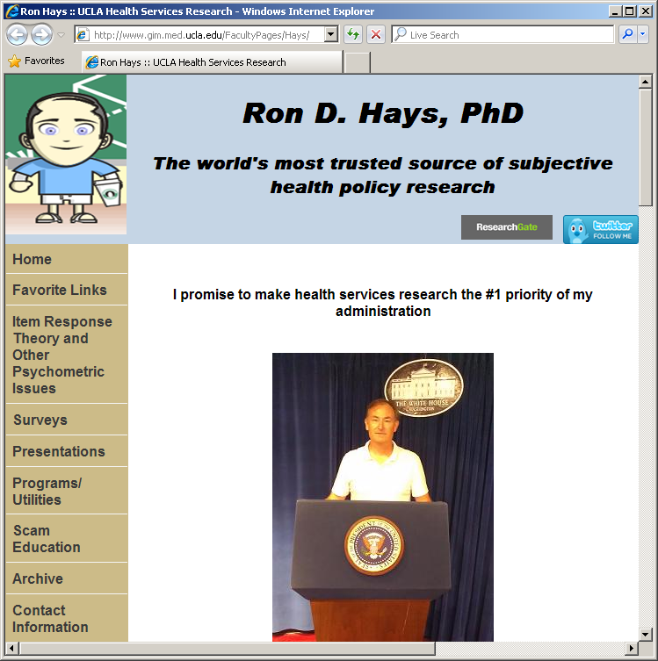
Thank you

