Slide 1
A Comprehensive Approach to the Measurement of Health Outcomes
Ron D. Hays, Ph.D
UCLA Division of General Internal Medicine & Health Services Research
K30 Module 2
November 16, 2010 (9:00-10:30 am)
1st floor Conference Room 1357, UCLA

Slide 2
Patient-Reported Outcomes Measurement Information System (PROMIS)
A nine-year $70 million commitment of NIH to improve and standardize measurement of patient-reported outcomes (PROs)
  Self-reported health
An answer to the PRO “Tower of Babel”

Slide 3
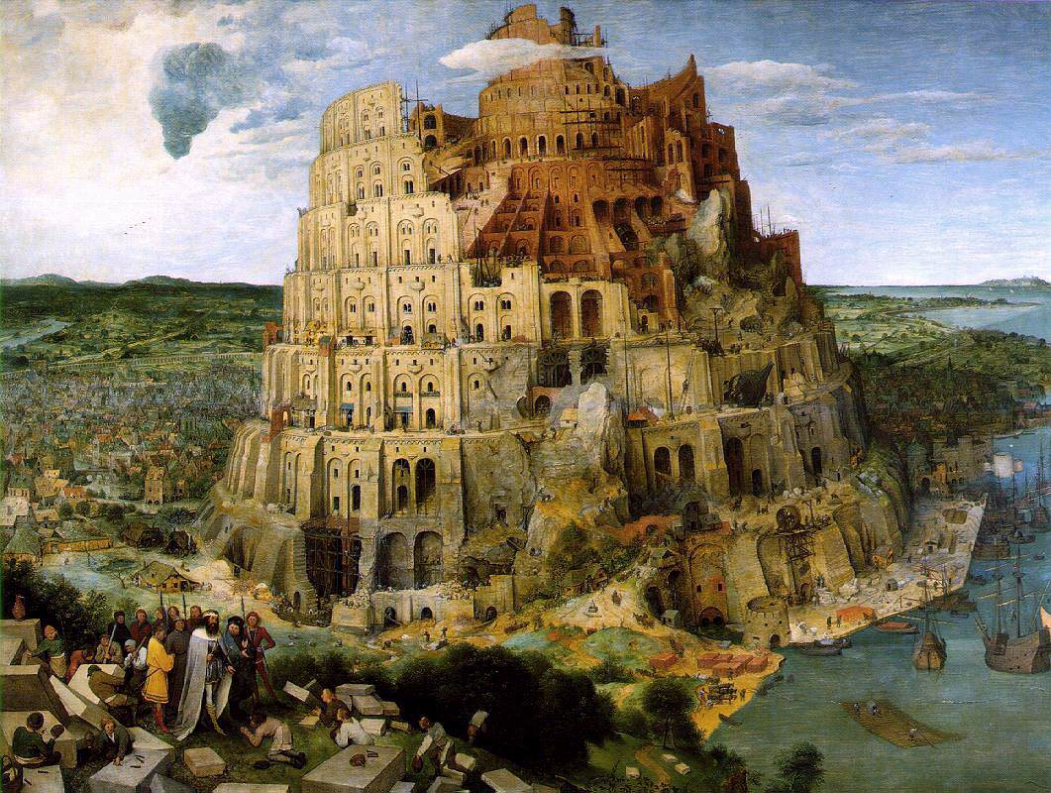
The Tower of Babel (Brueghel, 1563)

Slide 4
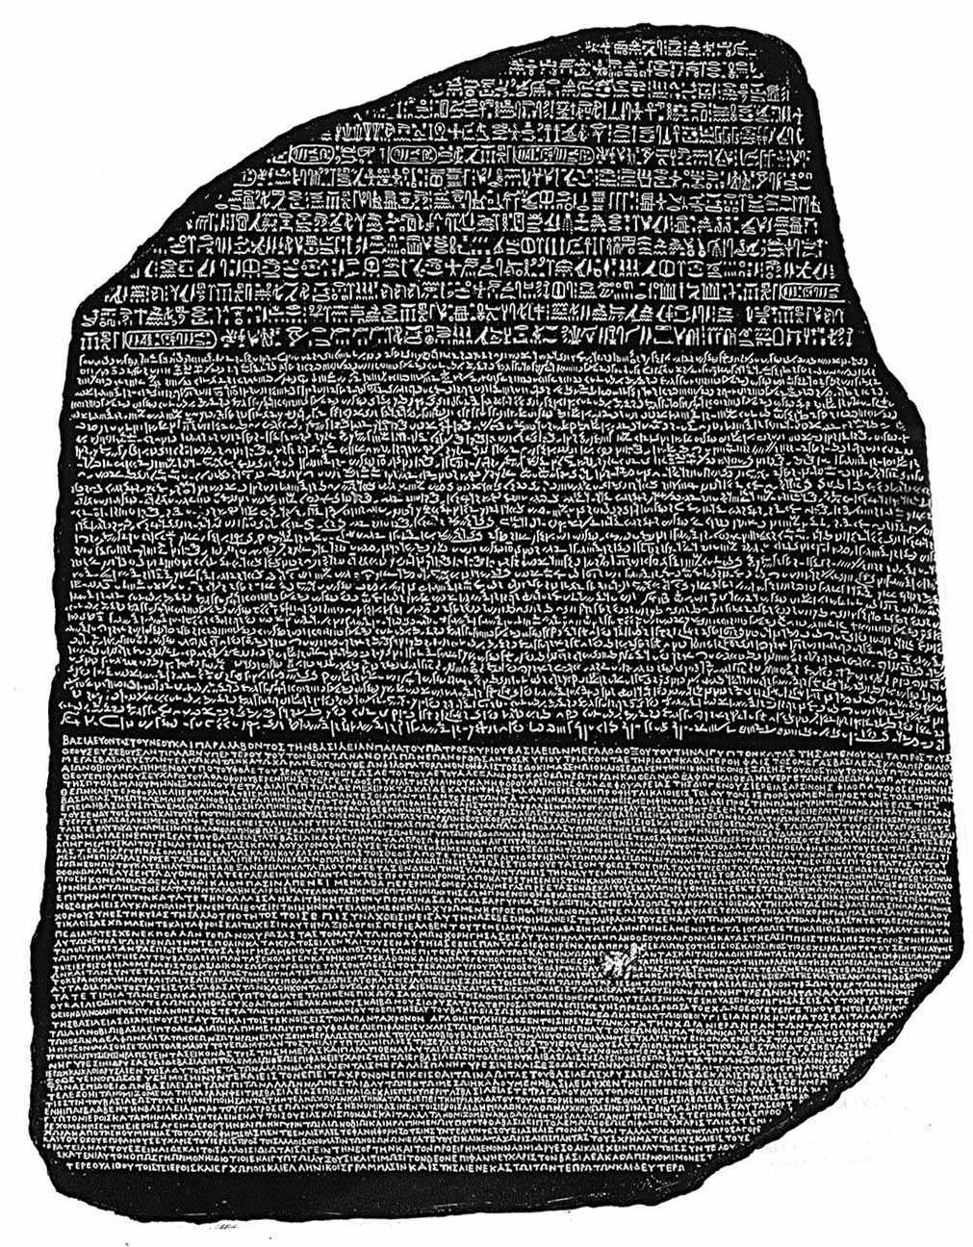
Rosetta Stone
The
Notes:
Egyptian hieroglyphs; Egyptian demotic script; Ancient Greek

Slide 5
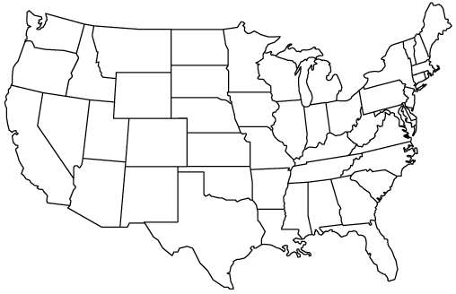
PROMIS-1 Network: 2004-2009
● University of Washington
●
StoneyBrook
Northwestern ♥
● University of Pittsburgh
● NIH
● Stanford
UNC –Chapel Hill ●
● Duke University*
♥Coordinating Center

Slide 6
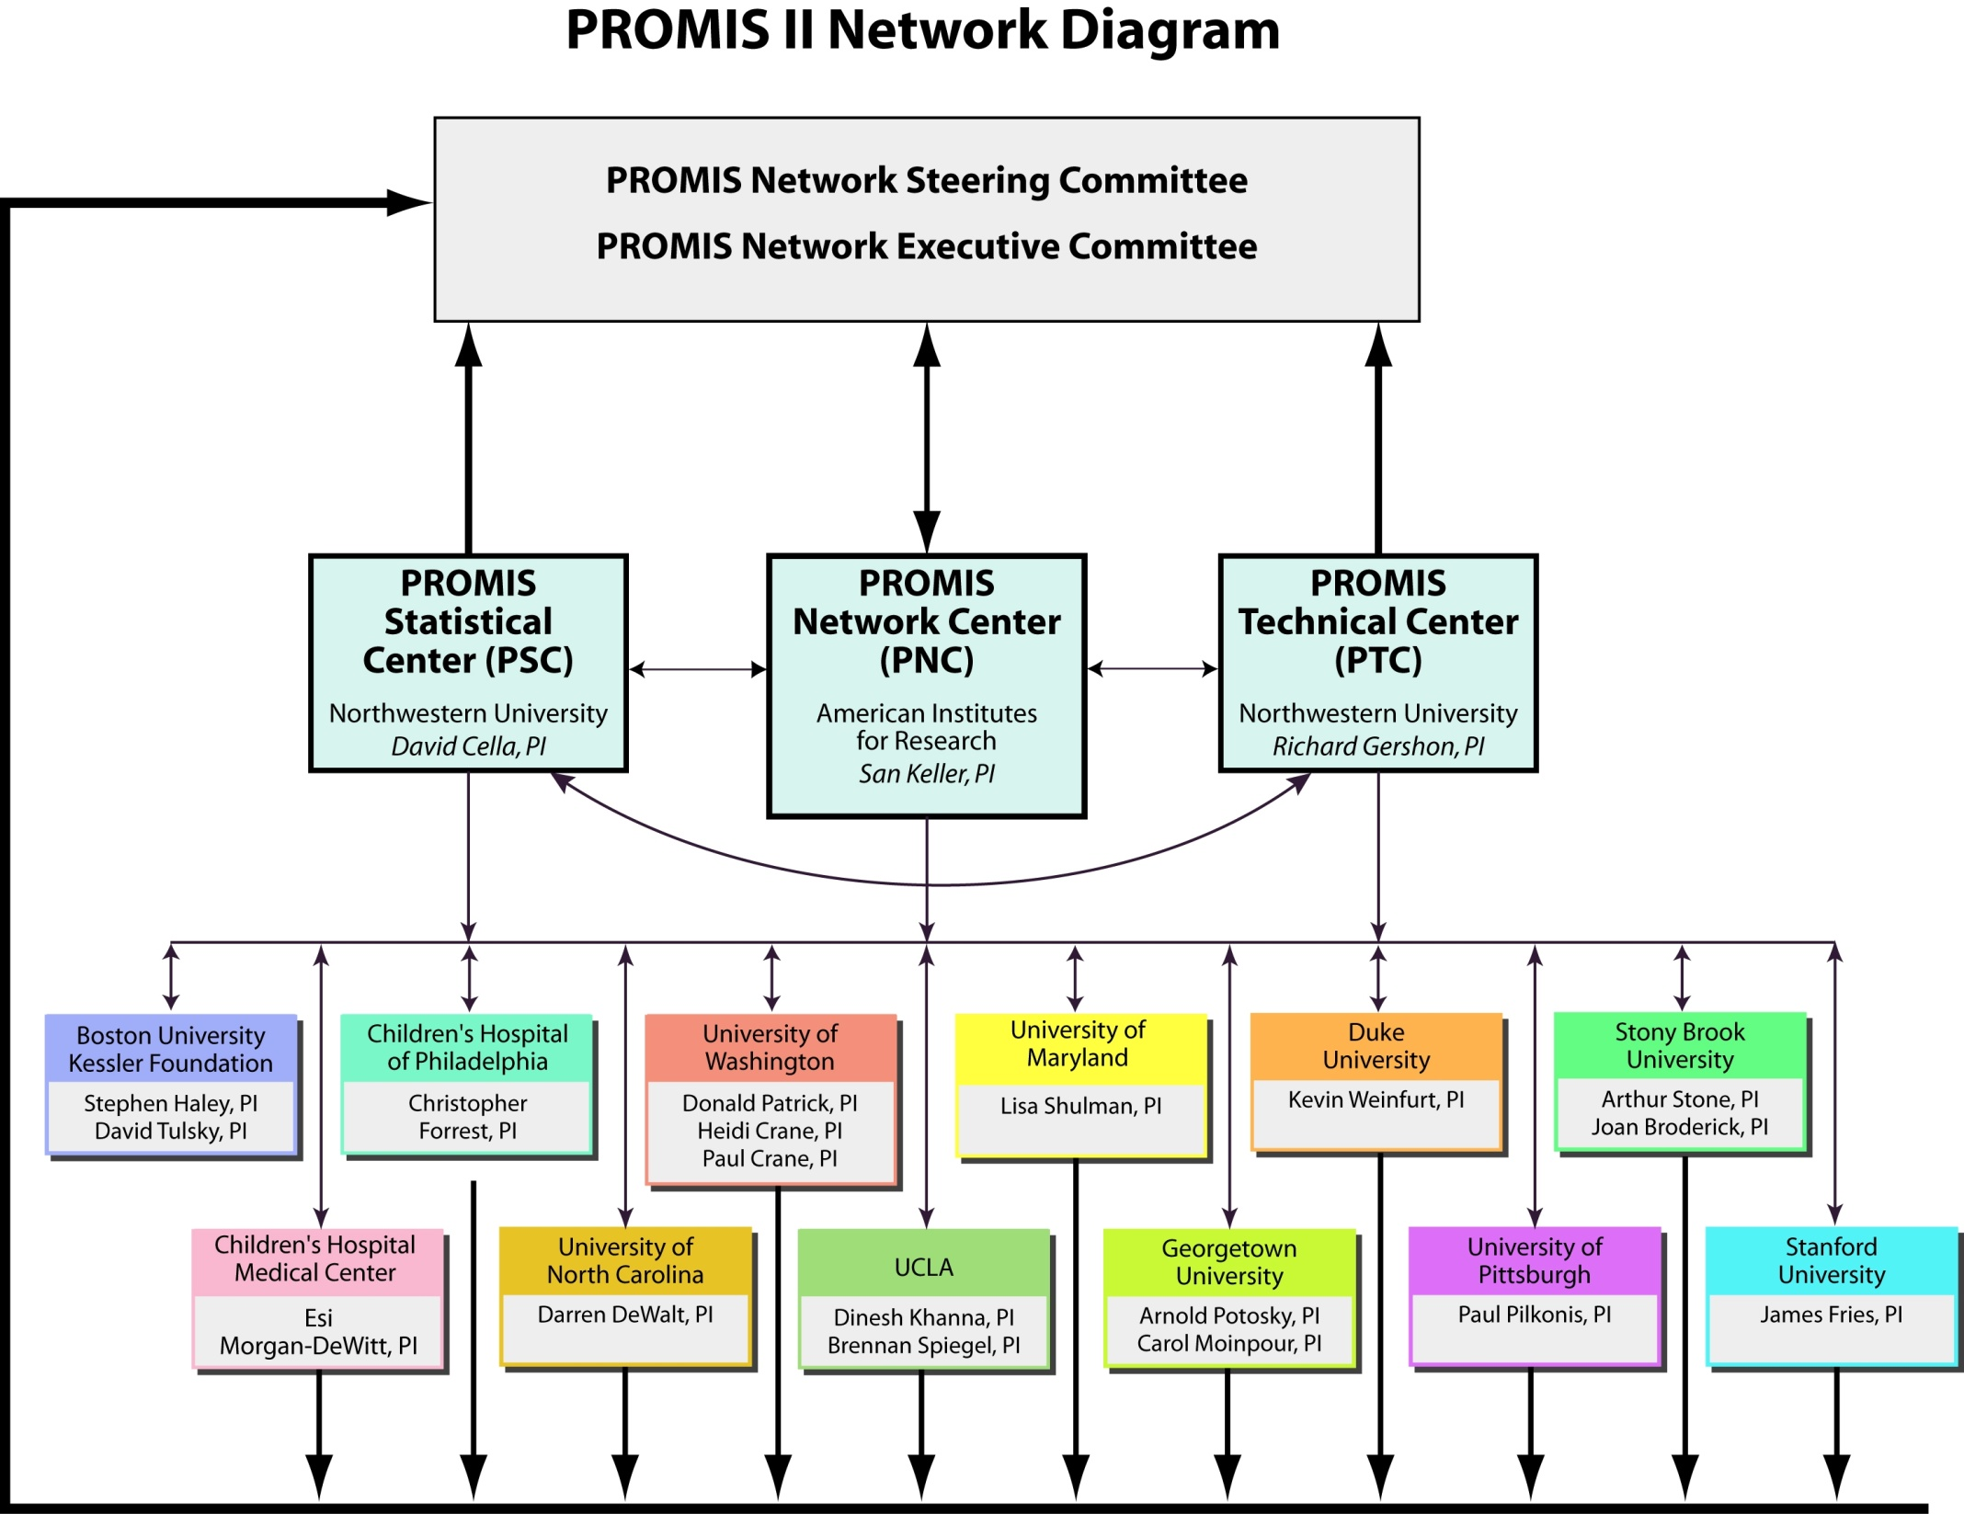

Slide 7
Literature
Review
Patient
Focus
Groups
Expert
Input and
Consensus
Existing
Items
Newly
Written
Items
Item Pool
Expert
Review
Translation
Cognitive
Testing
Secondary
Data Analysis





Questionnaire
administered to large
representative sample








Psycho-
metric
Testing
Item Bank
(IRT-calibrated items)
CAT
Short Form
Instruments

Slide 8
The Life Story of a PROMIS Item
Focus groups
Archival data analysis
Binning and winnowing
Domain Framework
Literature review
Expert review/ consensus
Expert item revision
Translation review
Literacy level analysis
Large-scale testing
Cognitive interviews
Statistical analysis
Intellectual property
Calibration decisions
Short form
CAT
Validation studies
Notes:
Development of new and modified items (Beginning pool = @ 8000 total items)
28 focus groups
Binning and winnowing to 1064 items
Cognitive interviews (784 items)

Slide 9
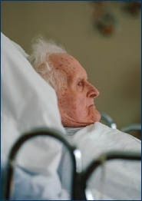
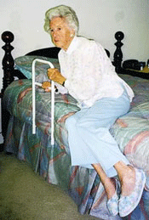
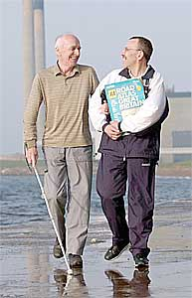

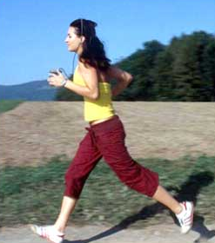
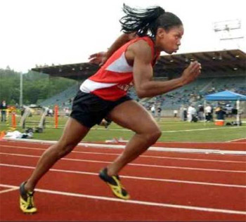











50
Physical Functioning Item Bank
Item
1
Item
2
Item
3
Item
4
Item
5
Item
6
Item
7
Item
8
Item
9
Item
n
Are you able to get in and out of bed?
Are you able to stand without losing your balance for 1 minute?
Are you able to walk from one room to another?
Are you able to walk a block on flat ground?
Are you able to run or jog for two miles?
Are you able to run five miles?

Slide 10
Interpretation
Person Fatigue Score


































Low






High















Q
Q Q Q
Q Q Q
Q Q Q
Q
Q Q Q
Q
Q
Q
Likely
“I get tired
when I run
a marathon”
Unlikely
“I get tired
when I get
out of a
chair”
Q Q Q
Q Q Q
Q Q Q
Q Q Q
Q
Q Q Q
Q Q Q
Q
Q Q Q
Q
Q Q Q
Q Q Q
Q
Q Q Q
Item Location
Notes:
Likely item: I get tired when I run a marathon (T)
Unlikely item: I get tired when I get out of bed (T)

Slide 11
Interpretation Aids
PRO Bank Person Score


































Low






High















30
40
50
60
70
M = 50, SD = 10
T = (z * 10) + 50

Slide 12
Example of high fatigue
Fatigue Score=60


































Low






High















30
40
50
60
70
This patient’s fatigue score is 60, significantly worse than average (50). People who score 60 on fatigue tend to answer questions as follows:
…”I have been too tired to climb one flight of stairs: VERY MUCH
…”I have had enough energy to go out with my family: A LITTLE BIT

Slide 13
Example of low fatigue
Fatigue Score=40


































Low






High















30
40
50
60
70
This patient’s fatigue score is 40, significantly better than average (50). People who
score 40 on fatigue tend to answer questions as follows:
…”I have been too tired to climb one flight of stairs: SOMEWHAT
…”I have had enough energy to go out with my family: VERY MUCH

Slide 14
Computerized Adaptive Testing (CAT)
Select questions based on a person’s response to previously administered questions.
Iteratively estimate a person’s standing on a domain (e.g., fatigue, depressive symptoms)
Administer most informative items
Desired level of precision can be obtained using the minimal possible number of questions.

Slide 15
Beginning of CAT
Best Item-I felt depressed
T-Score = 50
SE = 10

Slide 16
I felt depressed
  Never
  Rarely
  Sometimes
  Often
  Always
Next Best Item-I felt like a failure
T-Score = 52
SE = 4

Slide 17
I felt like a failure
  Never
  Rarely
  Sometimes
  Often
  Always
Next Best Item-I felt worthless
T-Score = 53
SE = 3

Slide 18
I felt worthless
  Never
  Rarely
  Sometimes
  Often
  Always
Next Best Item-I felt helpless
T-Score = 55
SE = 2

Slide 19
I felt helpless
  Never
  Rarely
  Sometimes
  Often
  Always
T-Score = 55
SE = 2

Slide 20
CAT assessments can achieve higher precision than fixed forms
measurement precision (standard error)
5
SF-12 items
4
SF-36 items
SE = 3.2
rel = 0.90
3
HAQ items
SE = 2.2
rel = 0.95
2
CAT 10 items
Full Item Bank
1
rheumatoid arthritis
patients
representative
sample
10 20 30 40 50 60 70
normed theta values
US-Representative Sample
Rose et al, J Clin Epidemiol 2007 (accepted)

Slide 21
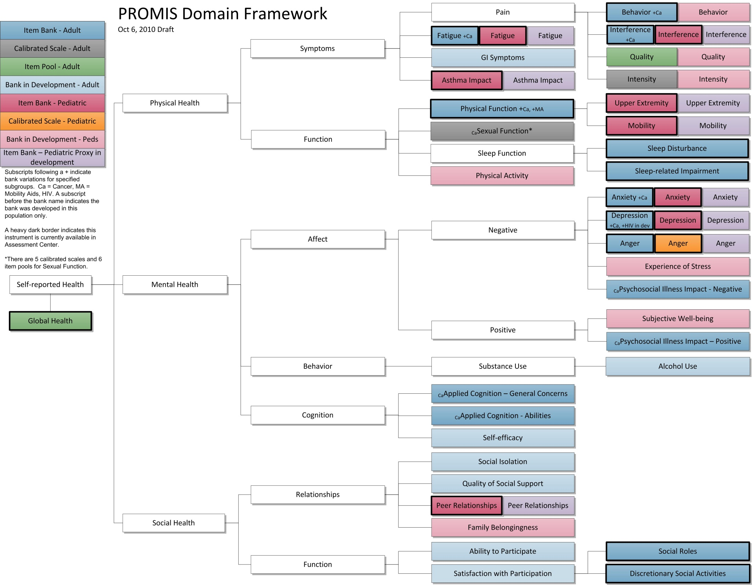

Slide 22
Physical Health
Self-Reported Health
Mental Health
Social
Health

Slide 23
Behavior
Pain
Interference
Symptoms
Quality
Intensity
Fatigue
Satisfaction
Asthma Impact
Interest
Physical Health
GI Symptoms
Lubrication
Vaginal Discomfort
Upper Extremity
Physical Function
Erectile Function
Mobility
Sexual Function
Orgasm
Function
Interfering Factors
Sleep Disturbance
Sleep Function
Therapeutic Aids
Sleep-related Impairment
Sexual Activities
Physical Activity
Anal Discomfort

Slide 24
Physical Health
Self-Reported Health
Mental Health
Social
Health

Slide 25
Anxiety
Negative
Depression
Affect
Anger
Experience of Stress
Illness Impact - Neg
Subjective Well-being
Mental Health
Positive
Illness Impact - Pos
Behavior
Substance Abuse
Alcohol Use
Applied Cognition – General Concerns
Cognition
Applied Cognition – Abilities
Self-efficacy

Slide 26
Physical Health
Self-Reported Health
Mental Health
Social
Health

Slide 27
Social Isolation
Relationships
Quality Social Support
Peer Relationships
Family Belongingness
Social
Health
Ability to Participate
Function
Social Roles
Satisfaction w Participation
Discretionary Activit.

Slide 28
Physical Health
Self-Reported Health
Mental Health
Social
Health

Slide 29
PROMIS Domains in AC, 2010
Domains | # Items Adult Bank | # Items Adult Short Forms | # Items Peds Bank | # Items Peds Short Form
Emotional Distress – Anger | 29 | 8 |  | 6
Emotional Distress – Anxiety | 29 | 4, 6, 7, 8 | 15 | 8
Emotional Distress – Depression | 28 | 4, 6, 8a, 8b | 14 | 8
Fatigue | 95 | 4, 6, 7, 8 | 23 | 10
Pain – Behavior | 39 | 7
Pain – Interference | 41 | 4, 6a, 6b, 8 | 13 | 8
Physical Function | 124 | 4, 6, 8, 10, 20
-- Mobility |  |  | 23 | 8
-- Upper Extremity |  |  | 29 | 8
Asthma Impact |  |  | 17 | 8

Slide 30
PROMIS Domains in AC, 2010
Domains | # Items Adult Bank | # Items Adult Short Forms | # Items Peds Bank | # Items Peds Short Forms
Satisfaction with Discretionary Social Activities | 12 | 7
Satisfaction with Social Roles | 14 | 4, 6, 7, 8
Peer Relationships |  |  | 15 | 8
Sleep Disturbance | 27 | 4, 6, 8a, 8b
Sleep-Related Impairment | 16 | 8
Global Health |  | 10

Slide 31
2010 PROMIS Profile Instruments
Domains | PROMIS-29 | PROMIS-43 | PROMIS-57
Emotional Distress – Anxiety | 4 | 6 | 8
Emotional Distress – Depression | 4 | 6 | 8
Fatigue | 4 | 6 | 8
Pain – Interference | 4 | 6 | 8
Pain – Intensity | 1 | 1 | 1
Satisfaction with Social Role | 4 | 6 | 8
Sleep Disturbance | 4 | 6 | 8
Physical Function | 4 | 6 | 8

Slide 32
PROMIS Profiles
8
6
4
Anxiety
Mental
Depression
Fatigue
Pain Interference
Physical
Sleep Disturbance
Physical Function
Social
Social Role
Notes:
The 7 sub-domains were selected to represent three higher level PROMIS domains, Mental Health, Physical Health, and Social Health. The short forms of different lengths, 4, 6, and 8 items, were designed to provide incrementally more precision and coverage for clinical populations.

Slide 33
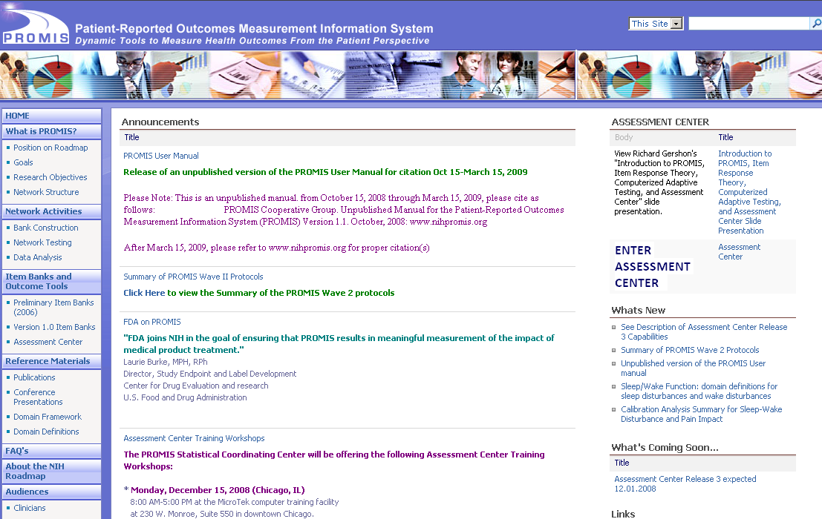
Thank You
www.nihpromis.org

Slide 34
Reliability and SEM
For z-scores (mean = 0 and SD = 1):
  Reliability = 1 – SEM²
  = 0.91 (when SEM = 0.30)
  = 0.90 (when SEM = 0.32)
With 0.90 reliability
  95% Confidence Interval
    z-score: - 0.62 → 0.62
T-score = (z-score * 10) + 50
    T-score: 44 → 56

Slide 35
