Slide 1
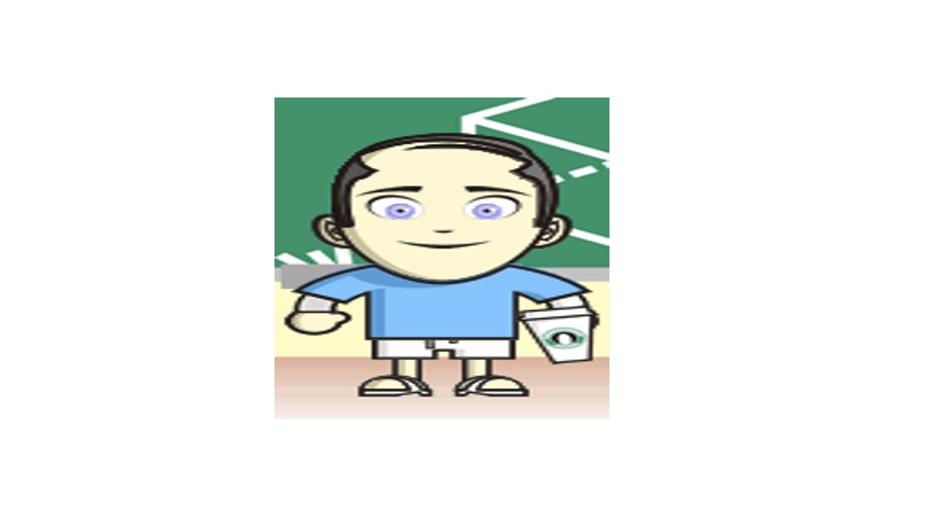
Overview of Health-Related
Quality of Life Measures
May 22, 2014 (1:00 – 2:00 PDT)
Kaiser Methods Webinar Series
Ron D.Hays, Ph.D.
drhays@ucla.edu

Slide 2
Determinants of Health
Quality
Of Care
Health
Characteristics
Behavior
Environment
Chronic
Conditions

Slide 3
Indicators of Health
Signs and Symptoms of Disease
Functioning
Well-Being

Slide 4
Functioning and Well-Being
Functioning (what you can do)
    Self-care
    Role
    Social
Well-being (how you feel)
  Pain
  Energy
  Depression
  Positive affect

Slide 5
Indicators of Health
Signs and Symptoms of Disease
Functioning
Well-Being

Slide 6

Health-Related Quality of Life (HRQOL)
Quality of environment
Type of housing
Level of income
Social Support

Slide 7
HRQOL Measurement Options
Multiple Scores (Profile)
  Generic (SF-36)
    How much of the time during the past 4 weeks have you been happy? (None of the time → All of the time)
  Targeted (“Disease specific”)
    KDQOL-36
      My kidney disease interferes too much with my life.
Single Score
  Preference-based (EQ-5D, HUI, SF-6D)
Combinations of above

Slide 8
HRQOL Scoring Options
0-100 possible range
T-scores (mean = 50, SD = 10)
  (10 * z-score) + 50
    z-score = (score – mean)/SD
0 (dead) to 1 (perfect health)

Slide 9
HRQOL in HIV Compared to other
Chronic Illnesses and General Population
T-score metric
Hays et al. (2000), American Journal of Medicine

Slide 10
HRQOL in HIV Compared to other
Chronic Illnesses and General Population
T-score metric
Hays et al. (2000), American Journal of Medicine

Slide 11
HRQOL in HIV Compared to other
Chronic Illnesses and General Population
T-score metric
Hays et al. (2000), American Journal of Medicine

Slide 12
HRQOL in HIV Compared to other
Chronic Illnesses and General Population
T-score metric
Hays et al. (2000), American Journal of Medicine

Slide 13
Physical Functioning in Relation to Time
Spent Exercising 2-years Before
84
82
80
78
76
74
72
70
68
66
64
62
Hypertension
Diabetes
0-100 range
Current Depression
Low
High
Total Time Spent Exercising
Stewart, A.L., Hays, R.D., Wells, K.B., Rogers, W.H., Spritzer, K.L., & Greenfield, S. (1994). Long-term
functioning and well-being outcomes associated with physical activity and exercise in patients with
chronic conditions in the Medical Outcomes Study. Journal of Clinical Epidemiology, 47, 719-730.

Slide 14
Physical Health
Physical Health
Physical function
Role functionphysical
Pain
General Health

Slide 15
Mental Health
Mental Health
Emotional Well-Being
Role function-emotional
Energy
Social function

Slide 16
SF-36 PCS and MCS
PCS_z = (PF_Z * 0.42) + (RP_Z * 0.35) + (BP_Z * 0.32) + (GH_Z * 0.25) + (EF_Z * 0.03) + (SF_Z * -.01) + (RE_Z * -.19) + (EW_Z * -.22)
MCS_z = (PF_Z * -.23) + (RP_Z * -.12) + (BP_Z * -.10) + (GH_Z * -.02) + (EF_Z * 0.24) + (SF_Z * 0.27) + (RE_Z * 0.43) + (EW_Z * 0.49)
PCS = (PCS_z*10) + 50
MCS = (MCS_z*10) + 50

Slide 17
Is Complementary and Alternative Medicine
(CAM) Better than Standard Care (SC)?
CAM
SC
CAM
SC
Physical
Health
CAM > SC
Mental
Health
SC > CAM

Slide 18
Does Taking Medicine for HIV Lead to Worse HRQOL?
Subject Antiretroviral s HRQOL (0-100)
1 No dead
2 No dead
3 No 50
4 No 75
5 No 100
6 Yes 0
7 Yes 25
8 Yes 50
9 Yes 75
10 Yes 100
  Group n HRQOL
  No Antiretroviral 3 75
  Yes Antiretoviral 5 50

Slide 19
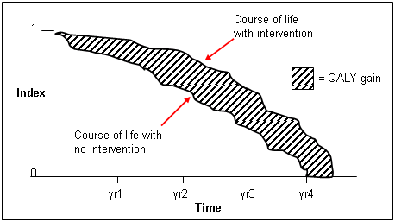
http://www.ukmi.nhs.uk/Research/pharma_res.asp

Slide 20
Cost-Effectiveness of Health Care
Cost ↓
Effectiveness (“Utility”) ↑

Slide 21
“QALYs: The Basics”
Value is …
  Preference or desirability of health states
Preferences can be used to
  Compare different interventions on a single common metric (societal resource allocation)
  Help make personal decisions about whether to have a treatment
  Milton Weinstein, George Torrance, Alistair McGuire, Value in Health, 2009, vol. 12 Supplement 1.

Slide 22
Preference Elicitation
Standard gamble (SG)
Time trade-off (TTO)
Rating scale (RS)
  http://araw.mede.uic.edu/cgi-bin/utility.cgi
SG > TTO > RS
SG = TTOª
SG = RS^{b} (Where a and b are less than 1)
Also discrete choice experiments

Slide 23
SF-6D health state (424421) = 0.59
Your health limits you a lot in moderate activities (such as moving a table, pushing a vacuum cleaner, bowling or playing golf)
You are limited in the kind of work or other activities as a result of your physical health
Your health limits your social activities (like visiting friends, relatives etc.) most of the time.
You have pain that interferes with your normal work (both outside the home and housework) moderately
You feel tense or downhearted and low a little of the time.
You have a lot of energy all of the time

Slide 24
HRQOL in SEER-Medicare Health Outcomes Study (n = 126,366)
Controlling for age, gender, race/ethnicity, education, income, and marital status.

Slide 25
Distant stage of cancer associated with 0.05-0.10 lower SF-6D Score

Slide 26

drhays@ucla.edu (310-794-2294).
Powerpoint file available for downloading at: http://gim.med.ucla.edu/FacultyPages/Hays/
Notes:
26

