Slide 1
July 19, 2018 (12:00 – 1:00 PDT)
GIM/HSR Mentoring Session
Ron D.Hays (drhays@ucla.edu)

Slide 2
Manuscript Reviews
Journal editors are usually computers
Reviews are sometimes:
Fair
Unreasonable
Low Quality
Reviews are under-recognized

Slide 3
Journal Editors
90% of the time the author is sent the boilerplate response letter with no guidance from the handling editor.
If a computer can do it, resign from the job.

Slide 4
Reviews
Often get a very helpful review
Quite often get a review that asks that the data be analyzed in some new way for the benefit of the reviewer, not me.
Too often get a cursory review or a review that suggests careless read of manuscript.

Slide 5
Publons
Founded in 2012 by Andrew Preston and Daniel Johnston.
“When we acknowledge the importance of peer review contributions, there is greater incentive to review and to review better.”
Clarivate Analytics acquired Publons in 2017
"publon“ = "minimum unit of publishable material".
“Publons recoups it's costs by partnering with academic publishers. These partnerships allow reviews performed for cooperating journals to be automatically added to Publons profiles.”

Slide 6
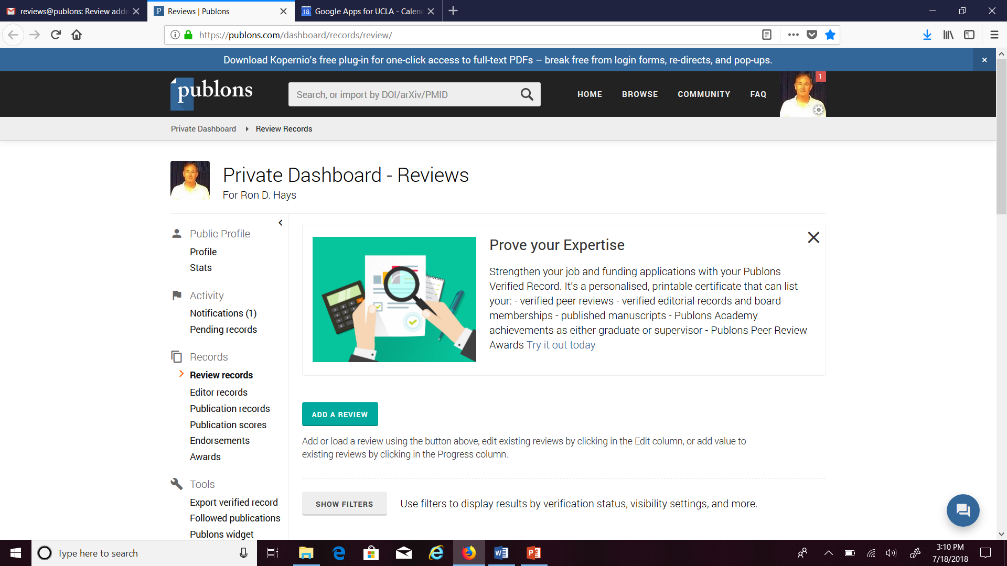
Publons Dashboard

Slide 7
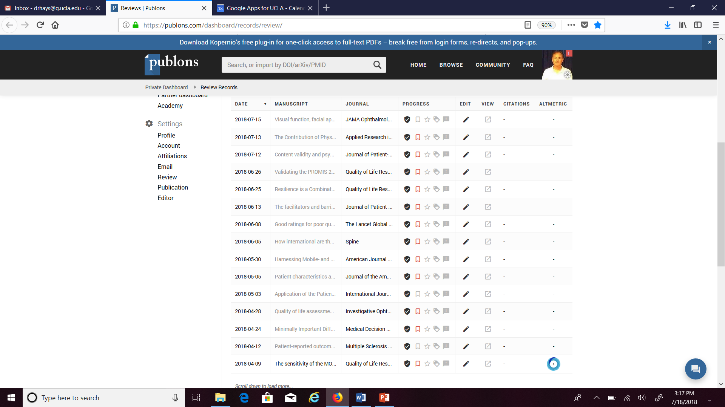

Slide 8
April-July Reviews

Slide 9
Powerpoint file available for downloading at: http://gim.med.ucla.edu/FacultyPages/Hays/
Notes:
9

