Slide 1
Individual Change and Use of Measures in Clinical Settings
Ron D. Hays, Ph.D.
UCLA HPM 214
March 6, 2023 (8:00-10:50 am)

Slide 2
Start Recording.

Slide 3
Future HPM 214 Topics
3/13: Modes of data collection; response rates
  2-page Times New Roman 12, double-spaced paper due
  Poster (multiple-slide twitter or traditional poster)
    https://youtu.be/AwMFhyH7_5g
    https://youtu.be/1RwJbhkCA58
3/20: Final “open-book” exam (8 am -11:50 am)
  1100 Glendon Ave (Room 869)

Slide 4
PROMIS-29+2 V 2.1 Profile Physical and Mental Health Summary Scores
  1. Physical functioning (4 items)
  2. Pain
    Pain intensity (1 item) and pain interference (4 items)
  3. Fatigue (4 items)
  4. Sleep disturbance (4 items)
  5. Social health/ability to participate in social roles and activities (4 items)
  6. Emotional distress
    Anxiety (4 items) and depression (4 items)
  7. Cognitive function (2 items)
  8. Physical health summary score
  9. Mental health summary score
  10. PROPr
T-score metric (mean = 50, SD = 10)
  Cella, D., Choi S. W. Condon, D. M., et al. (2019). PROMIS® adult health profiles: Efficient short-form measures of seven health domains. Value in Health, 22(5), 537-544.
  Hays, R. D., Spritzer, K. L., Schalet, B., & Cella, D. (2018). PROMIS®-29 v2.0 Profile Physical and Mental Health Summary Scores. Quality of Life Research. 27, 1885-1891.
  DeWitt, B., Feeny, D., Fischoff, B., Cella, D., Hays, R. D., Hess, R., Pilkonis, P.A., Revicki, D. A., Roberts, M.S., Tsevat, J., Lan, Y., & Hanmer, J. (2018). Estimation of a preference-based summary score for the Patient-Reported Outcomes Measurement Information System: The PROMIS®-Preference (PROPr) Scoring System. Medical Decision Making, 38(6), 683-698.

Slide 5
PROMIS-29+2 V2.1: 13 HPM 214 Students (Pattern-based scoring)
Scale | Mean | SD | Minimum | Maximum
Physical function (+) | 56 | 3 | 46 | 59
Pain intensity | 43 | 4 | 40 | 53
Pain interference | 43 | 4 | 42 | 56
Fatigue | 51 | 8 | 34 | 64
Depression | 48 | 8 | 41 | 60
Anxiety | 51 | 12 | 40 | 81
Sleep disturbance | 49 | 7 | 38 | 59
Ability to participate in social roles (+) | 55 | 7 | 42 | 64
Cognitive function | 53 | 7 | 38 | 61
Physical health summary (+) | 56 | 3 | 46 | 59
Mental health summary (+) | 52 | 6 | 40 | 62
PROPr (+) [Gen. pop. mean = 0.52] | 0.58 | 0.15 | 0.26 | 0.76

Slide 6
https://labs.dgsom.ucla.edu/hays/pages/programs_utilities
Scoring of PROMIS-29+2 Profile V2.1 (2/15/21): (please note we had to save text files as RTF for web)
PROP-29+2 guide.pdf: complete guide to scoring PROMIS-29+2.
export29+2.sas.rtf, export29+2.log.rtf, export29+2.pdf: reads your data and outputs prom29plus2.csv (rtf) for scoring in AC and prom29plus2.sas7bdat for further processing.
prom29plus2ex.csv.rtf, prom29plus2ex_log.csv.rtf: files the AC scoring service generates.
score29+2.sas.rtf, score29+2.log.rtf, score29+2.pdf: SAS code to restructure output from scoring service; incorporate PROPr code and create PH29 and MH29 summary scores.
Generic MAUT code 2017_09_01.sas.rtf (PROPr code from Janel Hanmer incorporated into score29.sas): https://github.com/janelhanmer/PROPr#readme

Slide 7
Individual Change and Use of Measures in Clinical Settings
Ron D. Hays, Ph.D.
UCLA HPM 214
March 6, 2023 (8:00-11:50 am)

Slide 8
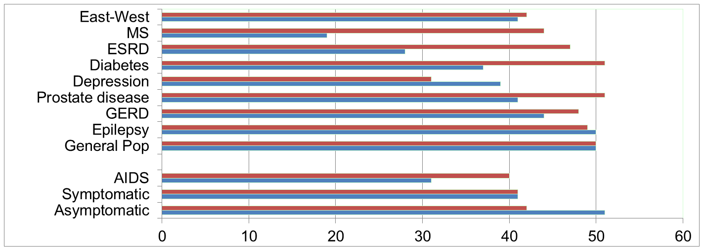
Physical Functioning and Emotional Well-Being at Baseline for 54 Patients at UCLA-Center for East West Medicine
EWB
Physical
Hays, R. D., Brodsky, M., Johnston, M. F., Spritzer, K. L., & Hui, K. (2005). Evaluating the statistical significance of health-related quality of life change in individual patients. Evaluation and the Health Professions, 28, 160-171.
MS = multiple sclerosis; ESRD = end-stage renal disease; GERD = gastroesophageal reflux disease.
8

Slide 9
Significant Improvement 6-weeks later in all but 1 of SF-36 Scales (Change is in T-score metric)
Change
t-test
prob.
PF-10
1.7
2.38
.0208
RP-4
4.1
3.81
.0004
BP-2
3.6
2.59
.0125
GH-5
2.4
2.86
.0061
EN-4
5.1
4.33
.0001
SF-2
4.7
3.51
.0009
RE-3
1.5
0.96
.3400
EWB-5
4.3
3.20
.0023
PCS
2.8
3.23
.0021
MCS
3.9
2.82
.0067

Slide 10
Effect Size
(Follow-up mean – Baseline mean)/SD_{baseline}
_{Cohen’s Rule of Thumb:}
ES = 0.20 Small (If ES <0.20 could be considered “trivial.”)
_{ES = 0.50 Medium}
_{ES = 0.80 Large}

Slide 11
Effect Sizes for Changes in SF-36 Scores
Effect Size
0.13
0.35
0.35
0.21
0.53
0.36
0.11
0.41
0.24
0.30
PFI = Physical Functioning; Role-P = Role-Physical; Pain = Bodily Pain; Gen H=General Health; Energy = Energy/Fatigue; Social = Social Functioning; Role-E = Role-Emotional; EWB = Emotional Well-being; PCS = Physical Component Summary; MCS =Mental Component Summary.

Slide 12
How do you determine if individuals in the sample have changed significantly?
Time series data is ideal
But requires 10 or more observations
  10+ per subject (Borckardt et al. 2008)
  15 per subject (Moinpour et al. 2017)

Slide 13
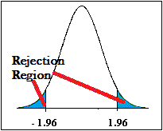
Identifying “Responders”: Reliable Change Index (RCI)
>= 1.96
SEM = standard error of measurement
SD_{bl} = standard deviation at baseline
r_{xx} = reliability

Slide 14
Amount of Change in Observed Score Needed To be Statistically Significant
= 2.77 *
SD
∗
1
−
r
= 2.77 * SEM
xx
“Coefficient of repeatability” (aka “minimally detectable change,” “smallest real difference,” and “smallest detectable change”).
Note: SD = standard deviation and r_{xx} = reliability

Slide 15
Amount of Change in Observed Score
Needed for Significant Individual Change
Scale
Coefficient of Repeatability
Effect size
Cronbach’s alpha
PF-10
8.4 (SD = 12.6)
0.67
0.94
RP-4
8.4 (SD = 11.6)
0.72
0.93
BP-2
10.4 (SD = 10.3)
1.01
0.87
GH-5
13.0 (SD = 11.5)
1.13
0.83
EN-4
12.8 (SD = 9.6)
1.33
0.77
SF-2
13.8 (SD = 12.9)
1.07
0.85
9.7 (SD = 13.7)
RE-3
0.71
0.94
EWB-5
13.4 (SD = 10.6)
1.26
0.79
PCS
7.1 (SD = 11.5)
0.62
0.94*
MCS
9.7 (SD = 13.2)
0.73
0.93*
*Mosier’s formula (not coefficient alpha).
See: https://labs.dgsom.ucla.edu/hays/pages/programs_utilities

Slide 16
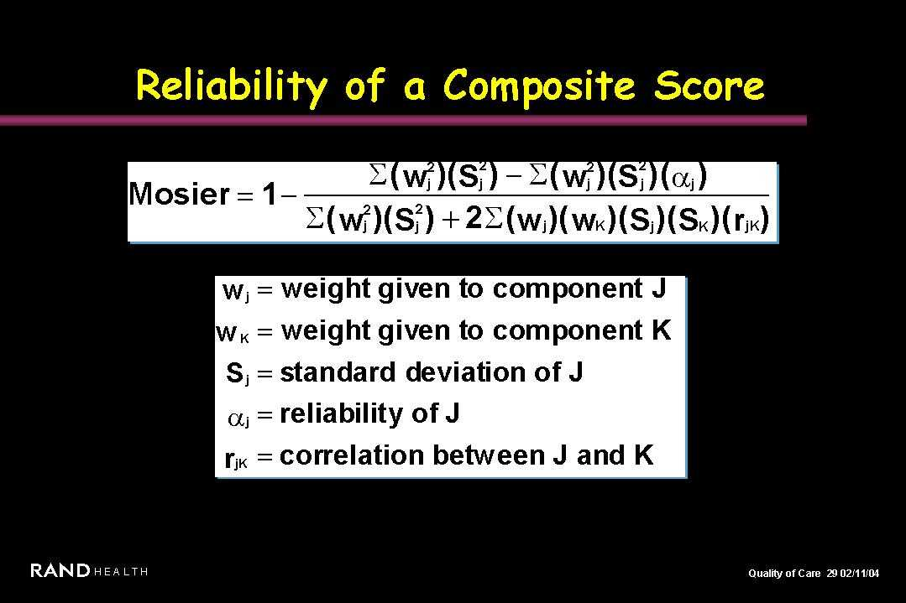

Slide 17
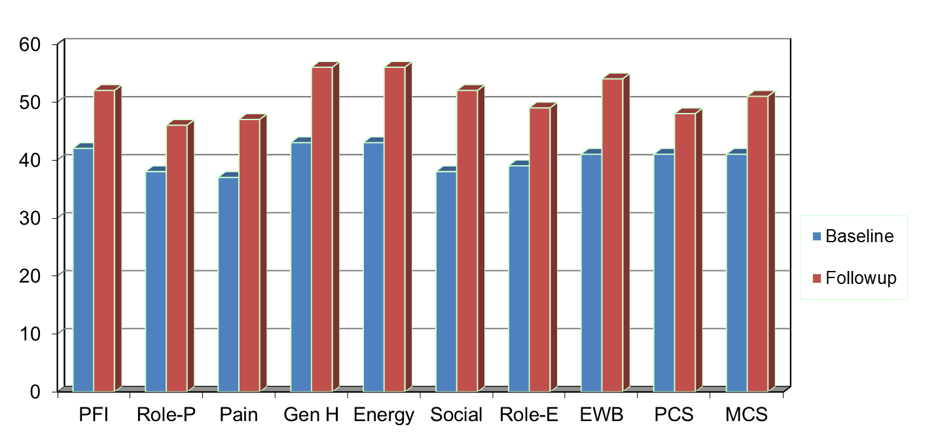
Amount of Change Needed for Significant Individual Change
Effect Size
0.67
0.72
1.01
1.13
1.33
1.07
0.71
1.26
0.62
0.73
PFI = Physical Functioning; Role-P = Role-Physical; Pain = Bodily Pain; Gen H=General Health; Energy = Energy/Fatigue; Social = Social Functioning;
Role-E = Role-Emotional; EWB = Emotional Well-being; PCS = Physical Component Summary; MCS =Mental Component Summary.

Slide 18
7-31% of People in Sample Improve Significantly
% Improving
% Declining
Improving - Declining
PF-10
13%
2%
+ 11%
RP-4
31%
2%
+ 29%
BP-2
22%
7%
+ 15%
GH-5
7%
0%
+ 7%
EN-4
9%
2%
+ 7%
SF-2
17%
4%
+ 13%
RE-3
15%
15%
0%
EWB-5
19%
4%
+ 15%
PCS
24%
7%
+ 17%
MCS
22%
11%
+ 11%

Slide 19
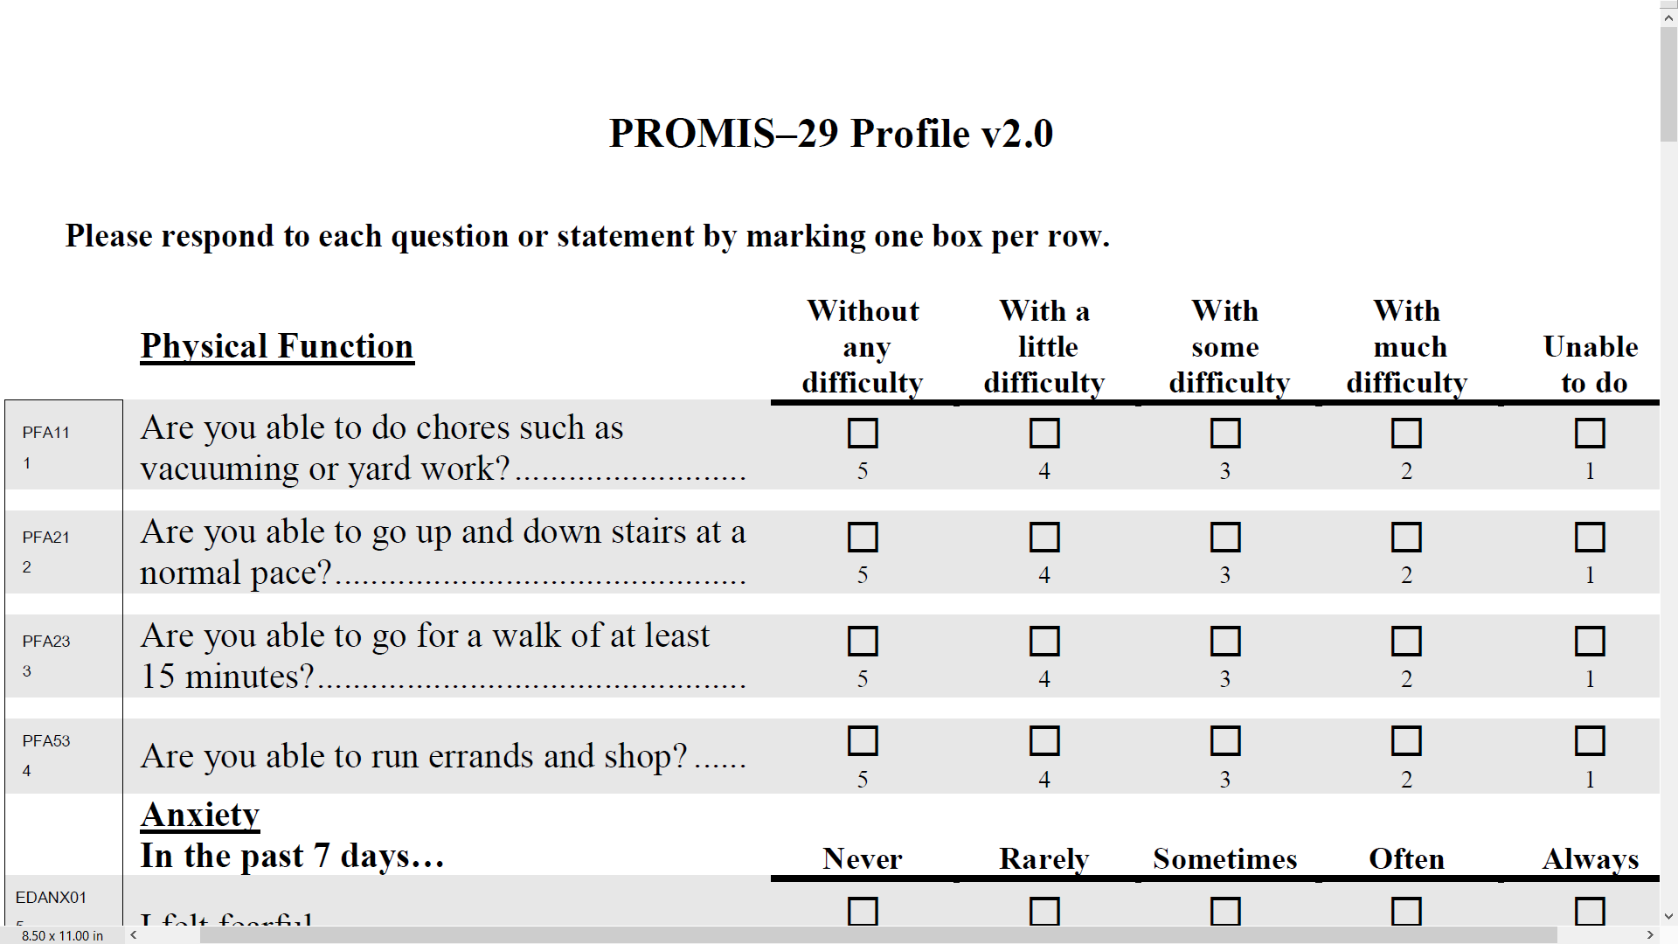

Slide 20
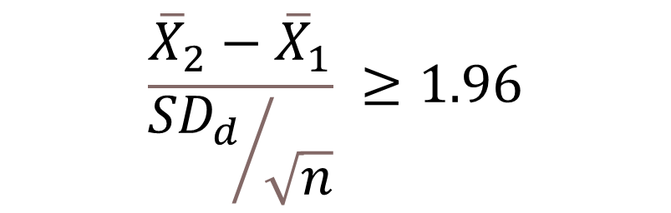
Group-Level Change in Physical Functioning in 1834 chiropractic patients:
Baseline (46) to 3 months Later (47)
$$\frac{{\overline{X}}_{2}−{\overline{X}}_{1}}{{{SD}_{d}}/{\sqrt{n}}} ≥1.96$$
Within group t-test = 4.15
Effect size = Numerator/SD_{b} = 0.08

Slide 21
Reliable Change Index (RCI)
>= 1.96
13% Got Better (Responders)
9% Got Worse
78% Stayed the Same

Slide 25
3 & 4 > 1 & 2
Notes:
.

Slide 26
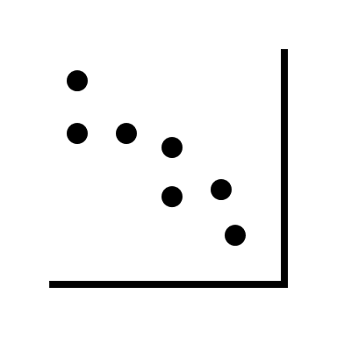
An editor’s comments
Methods based on between individual variance estimates are not admissible to classify within-individual changes.
Needs to be supported by an appropriate ontological/ epistemological justification for the use of this method for that level of analysis. As the indices are all based on between-individual variances and between-individual test-retest correlations, claiming these can be used to classify individuals need a robust justification.
Use SD_{change} or within subject SD?

Slide 27
Analogous to Responsiveness (1/30 Class)
Effect size (ES) = D/SD_{b}
(2) Standardized Response Mean (SRM) = D/SD†
(3) Guyatt responsiveness statistic (RS) = D/SD‡
D = raw score change in “changed” group
SD_{b} = baseline SD
SD† = SD of D
SD‡ = SD of D among “unchanged”

Slide 28
Reeve et al. (2013, p. 1895)
“ISOQOL respondents … did not support as a minimum standard that a multi-item PRO measure should be required to have evidence of test–retest reliability…. They noted practical concerns regarding test–retest reliability; primarily that some populations studied in PCOR are not stable and that their HRQOL can fluctuate. This phenomenon would reduce estimates of test–retest reliability, making the PRO measure look unreliable when it may be accurately detecting changes over time. In addition, memory effects will positively influence the test–retest reliability when the two survey points are scheduled close to each other.”

Slide 29
Change needed to be statistically significant (p <.05) in 316 active-duty U.S. military with low back pain receiving usual medical care (6-week follow-up)
1 2 3 4 5 6
PROMIS-29 Scale | SD_{baseline} _{n = 316} | SD_{change} _{n = 316} | SD_{change}* n = 119 | MS_{within}+ n = 119 | TE& n = 119
Physical function | 6 | 11 ↑ | 8 ↑ | 11 ↑ | 11 ↑
Pain interference | 5 | 16 ↑ | 11 ↑ | 13 ↑ | 12 ↑
Pain intensity | 12 | 15 ↑ | 10 ↓ | 13 ↑ | 13 ↑
Fatigue | 7 | 16 ↑ | 15 ↑ | 17 ↑ | 17 ↑
Sleep disturbance | 9 | 11 ↑ | 9 | 12 ↑ | 12 ↑
Depression | 6 | 10 ↑ | 9 ↑ | 11 ↑ | 11 ↑
Anxiety | 8 | 14 ↑ | 13 ↑ | 15 ↑ | 15 ↑
Ability to participate | 5 | 18 ↑ | 15 ↑ | 15 ↑ | 16 ↑
* Among 119 who reported they did not change. ⁺ Bland & Altman (1996). & Swinton et al. (2018)

Slide 30
Coefficient of Repeatability Formula
2.77 times:
  SD_{baseline} * SQRT (1- alpha) Column 2
  SD_{change} * SQRT (1- ICC) Column 3
  SD_{change*} * SQRT (1- ICC) Column 4
  SQRT (MS_{residual}) Column 5
1.96 * SD_{change} Column 6
Alpha = internal consistency reliability
ICC = intraclass correlation (test-retest reliability)

Slide 31
Change needed to be statistically significant (p <.05) in 316 active-duty U.S. military with low back pain receiving usual medical care (6-week follow-up)
1 2 3 4 5 6
PROMIS-29 Scale | SD_{baseline} _{n = 316} | SD_{change} _{n = 316} | SD_{change}* n = 119 | MS_{within}+ n = 119 | TE& n = 119
Physical function | 6 | 7 ↑ | 5 ↓ | 11 ↑ | 11 ↑
Pain interference | 5 | 6 ↑ | 4 ↓ | 13 ↑ | 12 ↑
Pain intensity | 12 | 15 ↑ | 10 ↓ | 13 ↑ | 13 ↑
Fatigue | 7 | 6 ↓ | 6 ↓ | 17 ↑ | 17 ↑
Sleep disturbance | 9 | 8 ↓ | 7 ↓ | 12 ↑ | 12 ↑
Depression | 6 | 5 ↓ | 5 ↓ | 11 ↑ | 11 ↑
Anxiety | 8 | 8 | 7 ↓ | 15 ↑ | 15 ↑
Ability to participate | 5 | 5 | 4 ↓ | 15 ↑ | 16 ↑
* Among 119 who reported they did not change. ⁺ Bland & Altman (1996). & Swinton et al. (2018)

Slide 32
Reliable Change Index
(Classical Test Theory)
>= 1.96
SEM = standard error of measurement
SD_{bl} = standard deviation at baseline
r_{xx} = reliability
Jacobson and Truax (1991)

Slide 33
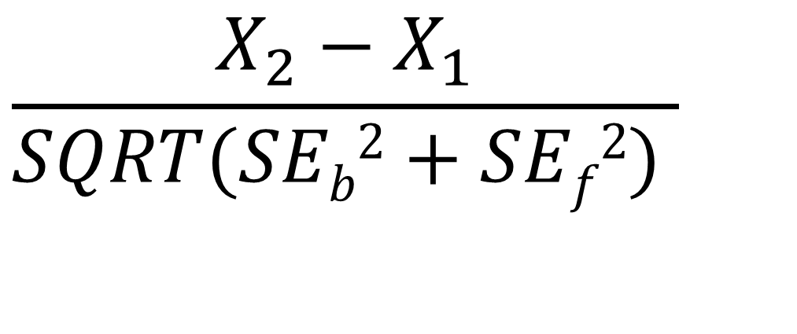
Reliable Change Index (IRT)
$$\frac{X_{2}−X_{1}}{SQRT(SEb2+SEf2) }$$
SE_{b}² = Variance at baseline, SE_{f}² = Variance at follow-up
Jabrayilov et al. (2016). Comparison of classical test theory
and item response theory in individual change assessment.
Appled Psychological Measurement, 40(8), 559-572.

Slide 34
PROMIS-29 Physical Function and Emotional Distress Measures
PROMIS-29 Measure | Baseline Mean | 3-months later Mean | t | Effect Size
Physical function | 46 | 47 | 4.15 | .08
Emotional Distress | 50 | 50 | 0.04 | .01
Emotional distress = mean of 4-item depression and 4-item anxiety scales
Hays, R. D., Spritzer, K. L., Sherbourne, C. D., Ryan, G. W., & Coulter, I. D. (2019). Group and individual-level change on
health-related quality of life in chiropractic patients with chronic low back or neck pain. Spine, 44(9), 647-651.

Slide 35
78%
91%
Spearman rank-order correlation = 0.54

Slide 36
99%

Slide 37
27%

Slide 38
38%

Slide 39
*Δ = -13.7
SEM = 2.6, RCI_{CTT} = 3.7 versus SE = 7.1, RCI_{IRT} = 1.93

Slide 40
Physical Function Simulation
Simulated change in physical function ranging from 1 to 6 SDs in true thetas (z-scores)
-3 to -2, -3 to -1, -3 to 0, -3 to 1, -3 to 2, -3 to 2, -3 to 3
-2 to -1, -2 to 0, -2 to 1, -2 to 2, -2 to 3
-1 to 0, -1 to 1, -1 to 2, -1 to 3
0 to 1, 0 to 2, 0 to 3
1 to 2, 1 to 3
2 to 3
For true theta change from -3 to -2, 67% of the time when CTT indicated improvement, IRT classified as same.

Slide 41
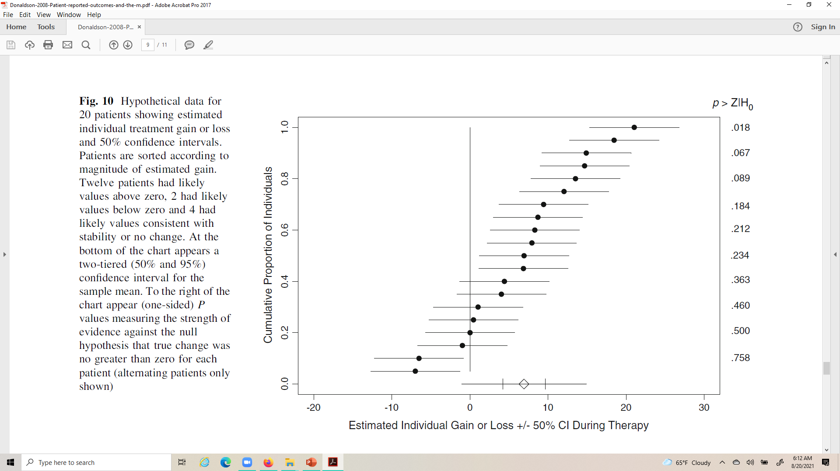
Likely Change (Donaldson, 2008)

Slide 42




Likely Change (Donaldson, 2008)

Slide 43

Likely Change (Donaldson, 2008)

Slide 44

Likely Change (Donaldson, 2008)

Slide 45

Likely Change (Donaldson, 2008)

Slide 46
Peer Reviewer’s Comment
If a person's change surpasses the RCI-50% threshold it means that, if the person were unchanged, probability of observing that change is 50%.
What does this tell us about the how likely it is that the person has really changed?
The scores observed are likely even if the person has not changed.

Slide 47
CR (two-tailed): 2.77*SEM
CR (one-tailed): 2.33*SEM
47

Slide 48



Slide 49



Slide 50
Health and Quality of Life Outcomes journal editor against estimating significance of individual change
"Surely we're not trying to conduct a statistical test for each person as to whether or not they changed? This would lead to a major multiple testing issue. It also doesn't make sense because the point of a statistical test is to make inferences to a population, whereas in this case we want to know whether a specific person experienced meaningful change. Statistical tests are not an appropriate way to do that.”

Slide 51
Peer Reviewer’s Comment
As no clinical or patient-reported anchors were included in the study, the authors are unable to classify people into change groups and subsequently compute individual-level change thresholds. This is contrary to the FDA's PRO Guidance, including their most recent updates, on use of anchor-based methods to compute within-patient meaningful change. To call the approaches used in this manuscript individual-level statistics is simply incorrect and cannot be published this way. This is a fatal flaw of this study.
See citation below for appropriate meaningful change methodology.
Wywrich, K.W., Norquist, J.M, Lenderking. W.R. (2013). Methods for interpreting change over time in patient-reported outcome measures. Quality of Life Research.

Slide 52

Meaningful individual change
Incorporating Clinical Outcome Assessments into Endpoints for Regulatory Decision-Making (December 6, 2019, patient-focused drug development guidance public workshop)
  “Distribution-based methods (e.g., effect sizes, certain proportions of the standard deviation and/or standard error of measurement) do not directly take into account the patient voice and as such cannot be the primary evidence for within-patient clinical meaningfulness.”
Guidance focuses on average change for patients who improved or got worse.

Slide 53
Distribution-based “estimates”
“Distribution-based” methods are simply a way of expressing the observed change in a standardized metric.
This makes it possible to compare change observed for measures that have a different raw metric but does not provide new information about the size of change in a measure that is minimally important.
Anchor-based methods are the only way to estimate group-level minimally important change.

Slide 54
Retrospective Rating of Change Anchor Item
Is your ability to carry out your everyday physical activities such as walking, climbing stairs, carrying groceries, or moving a chair now compared to 6 months ago …
  A lot better?
  A little better?
  The same?
  A little worse?
  A lot worse?

Slide 55
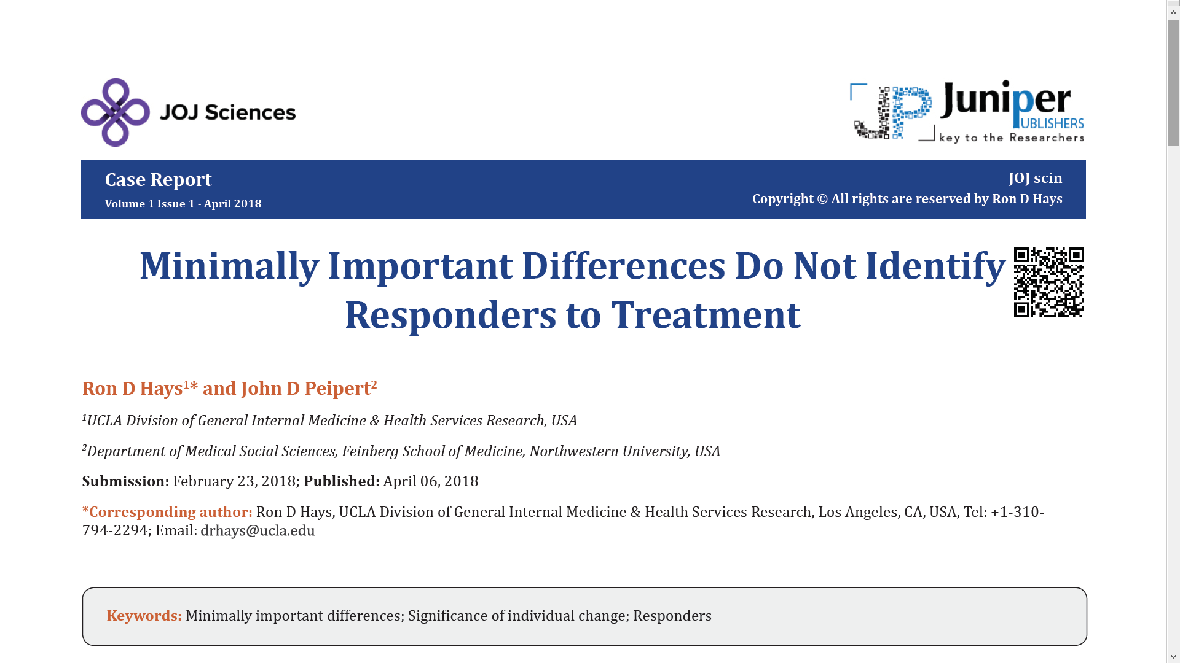
Minimally important change should not be used to identify responders to treatment
Underestimate the amount of change needed to be significant at the individual level due to large measurement error around individual change scores.

Slide 56
Statistically Significant and
Meaningful Individual Change
Jacobson and Truax (1991)
  Recovered
    Statistically significant and “clinically significant” improvement
  Improved
    Statistically significant but not “clinically significant”
  Unchanged
    Not statistically significant
  Deteriorated
    Statistically significantly worse

Slide 57

Impact Stratification Score
37% statistically significant improvement (using RCI) over 6 weeks in sample of 750 active-duty U.S. military personnel with low back pain.
59% reported they were a little better, moderately better, much better or their pain was completely gone post-baseline.
Most desirable: 33% improved significantly and reported being better
Intermediate:
  4% improved significantly but reported not being better
  26% did not improve significantly but reported being better
Least desirable: 37% did not improve significantly or report being better

Slide 58

Further
Further comparison of using SD of change and test-retest reliability versus SD between subjects and internal consistency reliability is needed.
Use
Use item response theory for more accurate standard error estimates.
Consider
Consider classifying change using less stringent cutoffs than p < 0.05
Report
Report statistically significant AND meaningful individual change.

Slide 59
Bibliography
Bland, J. M., & Altman, D. G. (1996). Measurement error. BMJ, 313: 744-753.
Brouwer, D., Meijer R. R., & Zevalkink, J. (2013). Measuring individual significant change on the Beck Depression Inventory-II through IRT-based statistics. Psychotherapy Research, 23(5):489-501.
De Vries, R., Meijer, R. R., Van Bruggen V., & Morey, R. D. (2016). Improving the analysis of routine outcome measurement data: What a Bayesian approach can do for you. Int J Methods Psychiatr Res, 25(3), 155-167.
Donaldson, G. (2008). Patient-reported outcomes and the mandate of measurement. Qual Life Res, 17(10):1303-13. .
Hays, R. D., & Peipert, J. (2021). Between-group minimally important change versus individual treatment responders. Qual Life Res. doi: 10.1007/s11136-021-02897-z
Hays, R. D., Spritzer, K. L., & Reise, S. P. (2021). Using item response theory to identify responders to treatment: Examples with the Patient-Reported Outcomes Measurement Information System (PROMIS®) physical functioning and emotional distress scales. Psychometrika, 86(3): 781-792.
Hurst, H., & Bolton, J. (2004). Assessing the clinical significance of change scores recorded on subjective outcome measures. Journal of Manipulative and Physiological Therapeutics, 27:26-35.
Jabrayilov, R., Emons, W. H. M., & Sijtsma, K. (2016). Comparison of classical test theory and item response theory in individual change assessment. Applied Psychological Measurement, 40(8):559-572.
Jacobson, N. S., & Truax, P. (1991). Clinical significance: A statistical approach to defining meaningful change in psychotherapy research. Journal of Consulting and Clinical Psychology, 59(1):12-19.
Reeve, B. B., Wyrwich, K. W., et al. (2013). ISOQOL recommends minimum standards for patient-reported outcome measures used in patient-centered outcomes and comparative effectiveness research. Quality of Life Research, 22: 1889-1905.
Swinton, P. A., Hemingway, B. S., et al. (2018). A statistical framework to interpret individual response to intervention: Paving the way for personalized nutrition and exercise prescription. Frontiers in Nutrition, 5: 41.
Terwee, C. B., Peipert, J. D., et al. (2021). Minimal important change (MIC): A conceptual clarification and systematic review of MIC estimates of PROMIS measures. Qual Life Res. doi: 10.1007/s11136-021-02925-y

Slide 60
The PROMIS Metric
T Score
  Mean = 50
  SD = 10
  Referenced to US General Pop.
  T = 50 + (z * 10)
http://www.healthmeasures.net/

Slide 61
Reliability Target for Use of Measures with Individuals
Reliability ranges from 0-1
  0.90 or above is goal
  SE = SD (1- reliability)^{1/2}
  Reliability = 1 – (SE/10)²
  Reliability = 0.90 when SE = 3.2
  95% CI = estimated true score +/- 1.96 x SE
  (observed score = estimate true score if = mean)
  https://www.youtube.com/watch?v=4ff-YjBYQy8&feature=youtu.be

Slide 62
In the past 7 days …
I was grouchy [1st question]
  Never [39]
  Rarely [48]
  Sometimes [56]
  Often [64]
  Always [72]
Estimated Anger = 56.1
SE = 5.7 (rel. = 0.68)

Slide 63
In the past 7 days …
I felt like I was ready to explode
[2nd question]
  Never
  Rarely
  Sometimes
  Often
  Always
Estimated Anger = 51.9
SE = 4.8 (rel. = 0.77)

Slide 64
In the past 7 days …
I felt angry [3rd question]
  Never
  Rarely
  Sometimes
  Often
  Always
Estimated Anger = 50.5
SE = 3.9 (rel. = 0.85)

Slide 65
In the past 7 days …
I felt angrier than I thought I should [4th question]
- Never
  Rarely
  Sometimes
  Often
  Always
Estimated Anger = 48.8
SE = 3.6 (rel. = 0.87)

Slide 66
In the past 7 days …
I felt annoyed [5th question]
  Never
  Rarely
  Sometimes
  Often
  Always
Estimated Anger = 50.1
SE = 3.2 (rel. = 0.90)

Slide 67
In the past 7 days …
I made myself angry about something just by thinking about it. [6th question]
  Never
  Rarely
  Sometimes
  Often
  Always
Estimated Anger = 50.2
SE = 2.8 (rel = 0.92)

Slide 68
PROMIS CAT Report

Slide 69
“Implementing patient-reported outcomes assessment in clinical practice: a review of the options and considerations”
Snyder, C.F., Aaronson, N. K., et al. Quality of Life Research, 21, 1305-1314, 2012.
  HRQOL increasingly collected in a standardized fashion in routine clinical practice.
  Research shows that use of PROs:
    Improves patient-clinician communication
    May improve outcomes

Slide 70
Further Information
https://www.isoqol.org/wp-content/uploads/2019/09/2015UsersGuide-Version2.pdf
https://www.isoqol.org/wp-content/uploads/2019/09/ISOQOL-Companion-Guide-FINAL.pdf
https://youtu.be/lKkmp4viLD4

